Slide 1

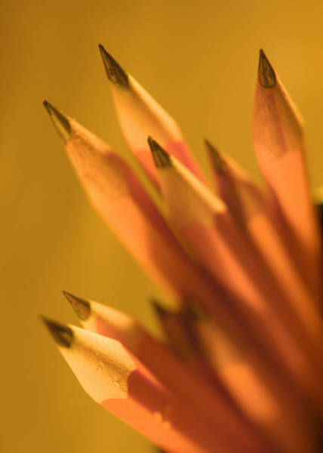

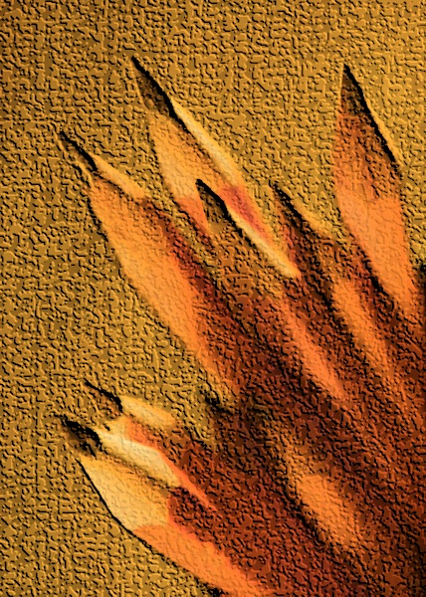
Other optional logos
The title for your poster goes here
Put your name and other authors of your paper or poster here
Put your affiliation and affiliation for other authors here
Poster Recommendations:
Section Title
This poster template is set at 36 x 48 in, which is the recommended size for the Interdisciplinary Research Symposium.
This template is only a suggestion for poster formatting. We encourage you to use this file to start your work and then modify it substantially.
Here are some suggestions:
Write as little text as possible. Most visitors will browse through posters, but not read through the entire text.
Use bullet points whenever they help convey your idea.
Recommendations for formatting:
Use font Arial 28 or larger for the text.
Use font Arial 60 or larger for your section titles.
Avoid using unusual fonts as there might be compatibility problems when printing your poster.
Do not justify your text, as it is harder to read from afar.
If you like, you can use boxes like this to separate your sections and to improve the flow of your poster.
Figure 1. We recommend that you use the highest quality images available. Avoid images downloaded from the internet.
Section Title
Section Title
Your text goes here. Your text goes here. Your text goes here. Your text goes here. Your text goes here.
Your text goes here. Your text goes here. Your text goes here. Your text goes here. Your text goes here. Your text goes here. Your text goes here. Your text goes here. Your text goes here. Your text goes here. Your text goes here
. Your text goes here. Your text goes here. Your text goes here. Your text goes here. Your text goes here. Your text goes here. Your text goes here. Your text goes here. Your text goes here.
Poster template for Virginia Tech’s First Interdisciplinary Research Symposium, Nov 4th 2011. Graduate Life Center, Virginia Tech.
This poster template is available at http://www.idrsociety.org/
Use arrows or other graphics to draw attention to key elements of your presentation.
Acknowledgements:
This is where you thank all the funding sources and other non-coauthored support you may have received for your work (usually with institutional logos).
Figure 2. It is not absolutely necessary to label or number all of your figures.
Figure 3. Venn diagrams are a great way to explain the integration of different disciplines into your work.

