Slide 1
Musiplectics Computational Assessment of the Complexity of Music Scores
Ethan Holder
Advisor: Eli Tilevich (CS)
Committee Members: Amy Gillick (Music) and R. Ben Knapp (ICAT)

Slide 2
Contents
Insights
Overview
Example
Proof of Concept
Contributions
Questions?

Slide 3


Insights
Musicians can agree that notes in different registers pose different difficulties on wind instruments, although they may not agree on the magnitude of the difference.
[1]
?

Slide 4

Insights
Notes on string and percussion instruments do not suffer as large a difference, but intervals between those notes impose varying difficulties analogously.
?

Slide 5
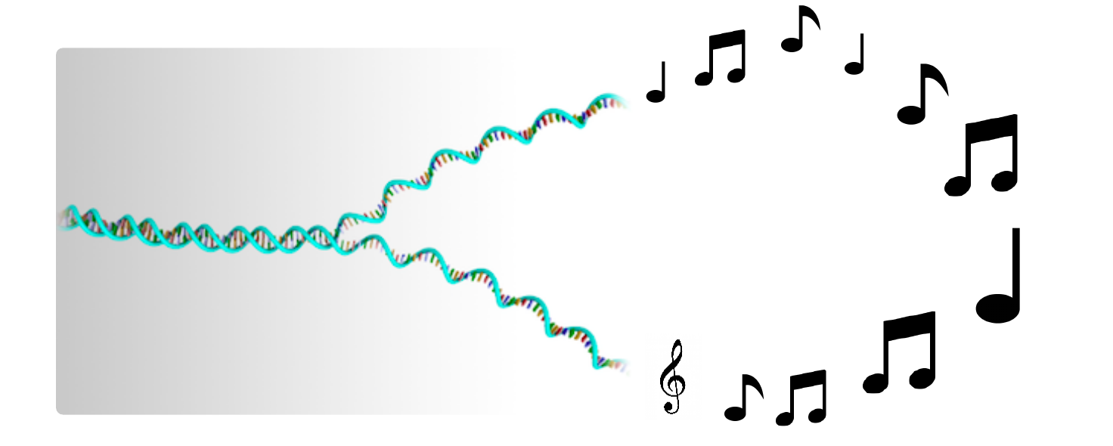
Insights
Computing offers us the capability to build upon these insights by relaxing the cognitive load required to measure them.
We can “decipher the music genome” through computing.
[2]
Notes:
Mention bioinformatics

Slide 6
Insights
Educators, performers, professionals, composers, publishers, students, and more can leverage this technology to simplify their work.

Slide 7
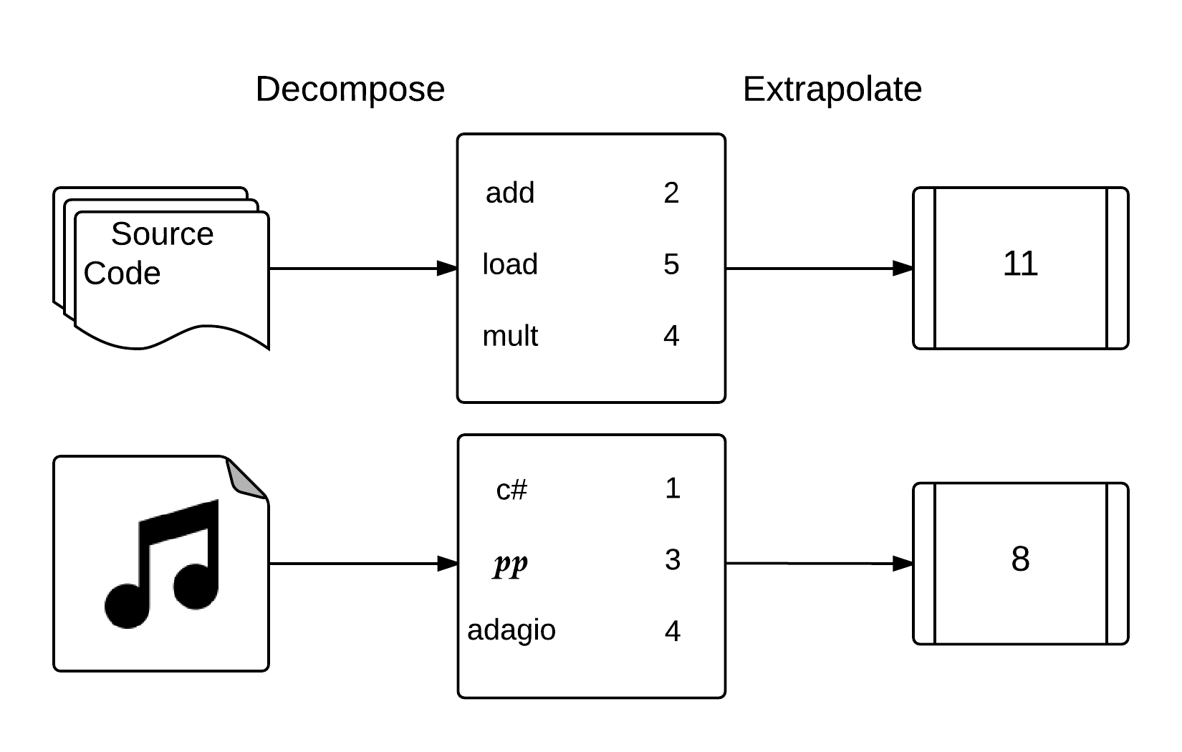
Overview
Musiplectics-a systematic and objective approach to computational assessment of the complexity of a music score for any instrument.
Decompose a piece into its musical elements and extrapolate complexity measurements from their weights.
Leverage experts to determine weights for individual musical elements on each instrument.

Slide 8
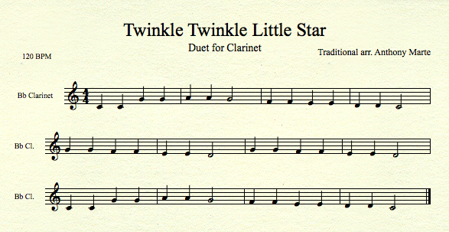
Example

Slide 9
Example
Notes
C4 C4 G4 G4 A4 A4 G4 F4 F4 E4 E4 D4 D4 C4
G4 G4 F4 F4 E4 E4 D4 G4 G4 F4 F4 E4 E4 D4
C4 C4 G4 G4 A4 A4 G4 F4 F4 E4 E4 D4 D4 C4

Slide 10
Example
Note Weights
1 1 1 1 2 2 1 1 1 1 1 1 1 1
1 1 1 1 1 1 1 1 1 1 1 1 1 1
1 1 1 1 2 2 1 1 1 1 1 1 1 1

Slide 11
Example
Note Weights with Articulations Multiplier
1 1 1 1 2 2 1 1 1 1 1 1 1 1
1 1 1 1 1 1 1 1 1 1 1 1 1 1
1 1 1 1 2 2 1 1 1 1 1 1 1 1
Notes:
No articulations so multiplied by 1

Slide 12
Example
Note Weights with Articulations and Dynamics Multipliers
1.5 1.5 1.5 1.5 3 3 1.5 1.5 1.5 1.5 1.5 1.5 1.5 1.5
1.5 1.5 1.5 1.5 1.5 1.5 1.5 1.5 1.5 1.5 1.5 1.5 1.5 1.5
1.5 1.5 1.5 1.5 3 3 1.5 1.5 1.5 1.5 1.5 1.5 1.5 1.5
Notes:
No dynamics so multiplied by 1.5 default

Slide 13
Example
Note Weights with Articulations, Dynamics, and Key Signature Multipliers
1.5 1.5 1.5 1.5 3 3 1.5 1.5 1.5 1.5 1.5 1.5 1.5 1.5
1.5 1.5 1.5 1.5 1.5 1.5 1.5 1.5 1.5 1.5 1.5 1.5 1.5 1.5
1.5 1.5 1.5 1.5 3 3 1.5 1.5 1.5 1.5 1.5 1.5 1.5 1.5
= 24
= 21
= 24
________
69
Notes:
Key of C so multiplier is 1

Slide 14
Example
Intervals
1 5 1 2 1 2 2 1 2 1 2 1 2
5 1 2 1 2 1 2 4 1 2 1 2 1 2
2 1 5 1 2 1 2 2 1 2 1 2 1 2

Slide 15
Example
Interval Weights
1 5 1 8 1 8 2 1 2 1 2 1 2
5 1 2 1 2 1 2 4 1 2 1 2 1 2
2 1 5 1 8 1 8 2 1 2 1 2 1 2

Slide 16
Example
Interval Weights with Articulations Multiplier
1 5 1 8 1 8 2 1 2 1 2 1 2
5 1 2 1 2 1 2 4 1 2 1 2 1 2
2 1 5 1 8 1 8 2 1 2 1 2 1 2

Slide 17
Example
Interval Weights with Articulations and Dynamics Multipliers
1.5 7.5 1.5 12 1.5 12 3 1.5 3 1.5 3 1.5 3
7.5 1.5 3 1.5 3 1.5 3 6 1.5 3 1.5 3 1.5 3
3 1.5 7.5 1.5 12 1.5 12 3 1.5 3 1.5 3 1.5 3

Slide 18
Example
Interval Weights with Articulations, Dynamics, and Key Signature Multipliers
1.5 7.5 1.5 12 1.5 12 3 1.5 3 1.5 3 1.5 3
7.5 1.5 3 1.5 3 1.5 3 6 1.5 3 1.5 3 1.5 3
3 1.5 7.5 1.5 12 1.5 12 3 1.5 3 1.5 3 1.5 3
= 52.5
= 40.5
= 55.5
________
148.5

Slide 19
Example
Note Duration Multiplier (Total Notes / Total Beats) * (Beats Per Minute / Sec Per Min)
1.75 = (42 / 48) * (120 / 60)
Total Notes
42
Total
Beats
48

Slide 20
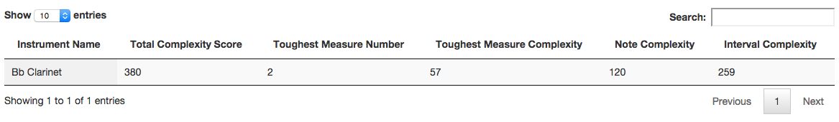
Example
Note Total = Note Weights * All Multipliers = 69 * 1.75 = 120.75
Interval Total = Interval Weights * All Multipliers = 148.5 * 1.75 = 259.875
Total Score = Note Total + Interval Total = 120.75 + 259.875 = 380.625

Slide 21
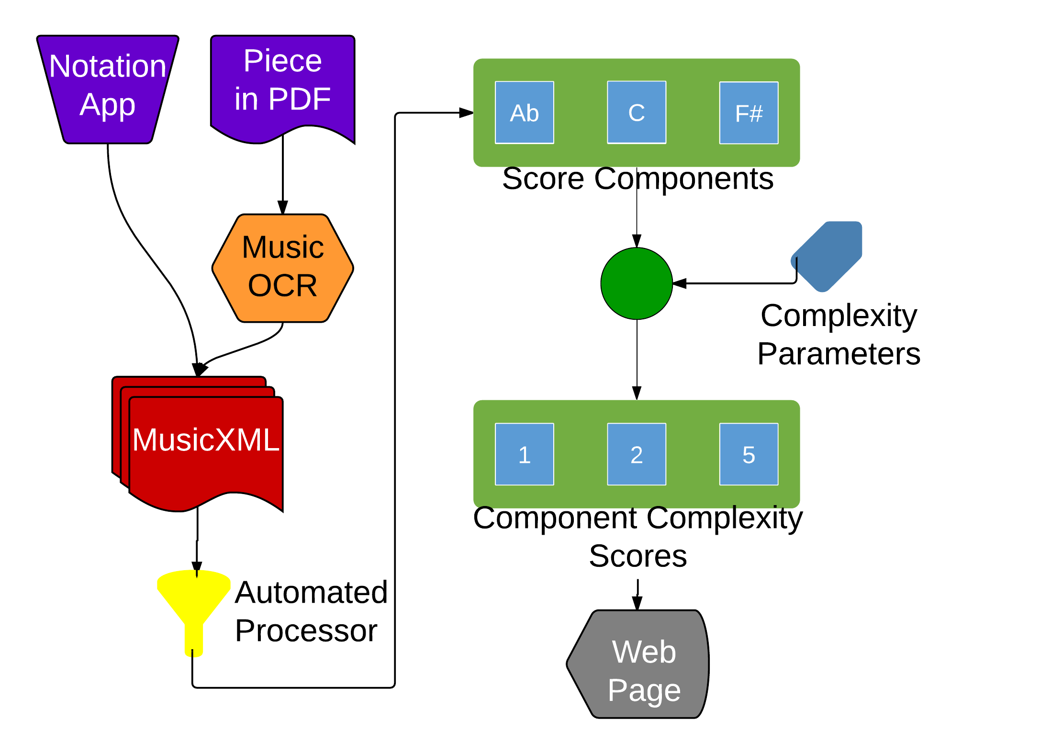
Proof of Concept
Accepts MusicXML files as input (via notation software or OCR conversion).
Tokenizes important musical elements for scoring (notes, intervals, dynamics, articulations, durations, and key signatures).
Weights tokens based on specified complexity parameters.
Aggregates and visualizes score data for consumption.
http://mickey.cs.vt.edu/

Slide 22
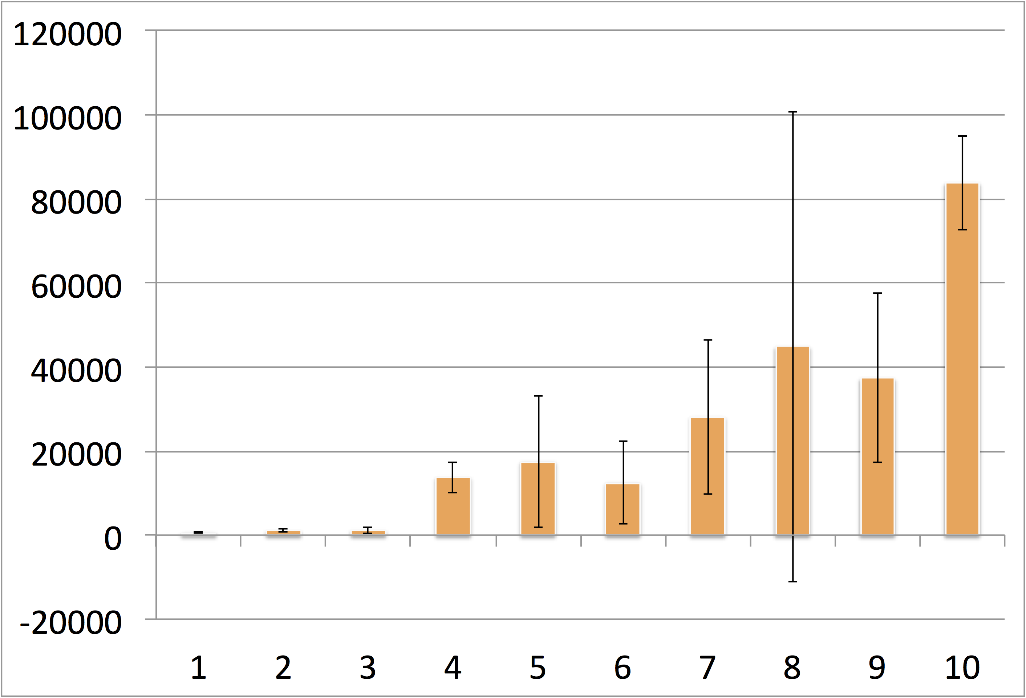
Contributions
Our complexity scores largely agree with subjective grades (Royal Conservatory instructional syllabus) of publicly available music pieces for B♭ Clarinet.
The website automates a meticulous, manual process and provides more consistent results on a ubiquitous platform.
Also a proof of concept for future instruments.
We submitted our results so far to ONWARD’15 for publication.

Slide 23
Questions
?

Slide 24
Images
http://www.goodfuneralguide.co.uk/wordpress/wp-content/uploads/2013/04/two-cartoon-men-yelling.jpg
http://www.zsgenetics.com/wp-content/uploads/2013/01/dna-split-504x482.png

Slide 25
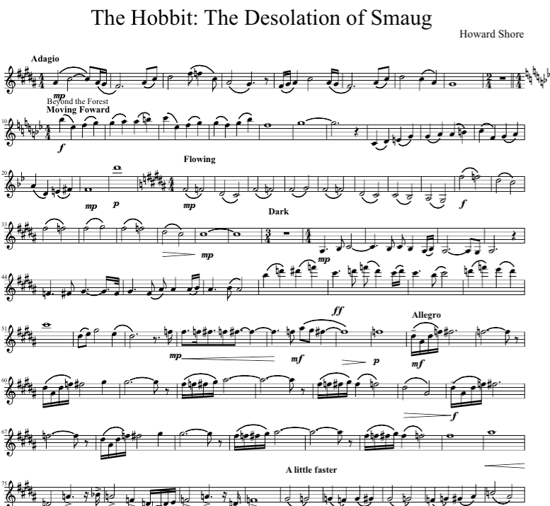
User Questions and Needs
How difficult is this piece of music?
What makes this piece of music more or less difficult than others?
What portion of this piece is the most difficult?
Why?

Slide 26
Problem
Educators and performers need answers to those questions at a glance before they decide to purchase or practice a piece.
There is currently no objective process for answering these questions.
Determining the answers for your own playing level is a tedious, error prone process.

Slide 27
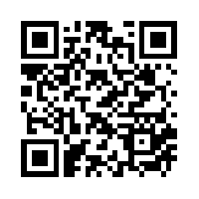
Solution
Give educators and performers an objective means to quickly determine the complexity of a piece of music relative to their own level of play.
http://mickey.cs.vt.edu/
https://github.com/xwsxethan/MusicScoring

Slide 28
Future Work
Expanding instrument complexity parameters.
Presenting at ICAT day in the Moss Arts Center.
Leveraging other research to expand the toolchain.
Music OCR, MIDI conversion
Surveying experts for baseline complexity parameters.
Integrating with existing music libraries.
IMSLP.org, National Library
Adding reference pieces to relate complexity scores to well known works.
Measuring physiological signals to determine mental complexity.

