Slide 1
Musiplectics Computational Assessment of the Complexity of Music Scores
Ethan Holder
Advisor: Eli Tilevich (CS)
Committee Members: Amy Gillick (Music) and R. Ben Knapp (ICAT)

Slide 2
Contents
Insights
Overview
Example
Proof of Concept
Findings
Contributions
Questions?

Slide 3


Insights
Musicians can agree that notes in different registers pose different difficulties on wind instruments, although they may not agree on the magnitude of the difference.
[1]
?

Slide 4

Insights
Notes on string and percussion instruments do not suffer as large a difference, but intervals between those notes impose varying difficulties analogously.
?

Slide 5
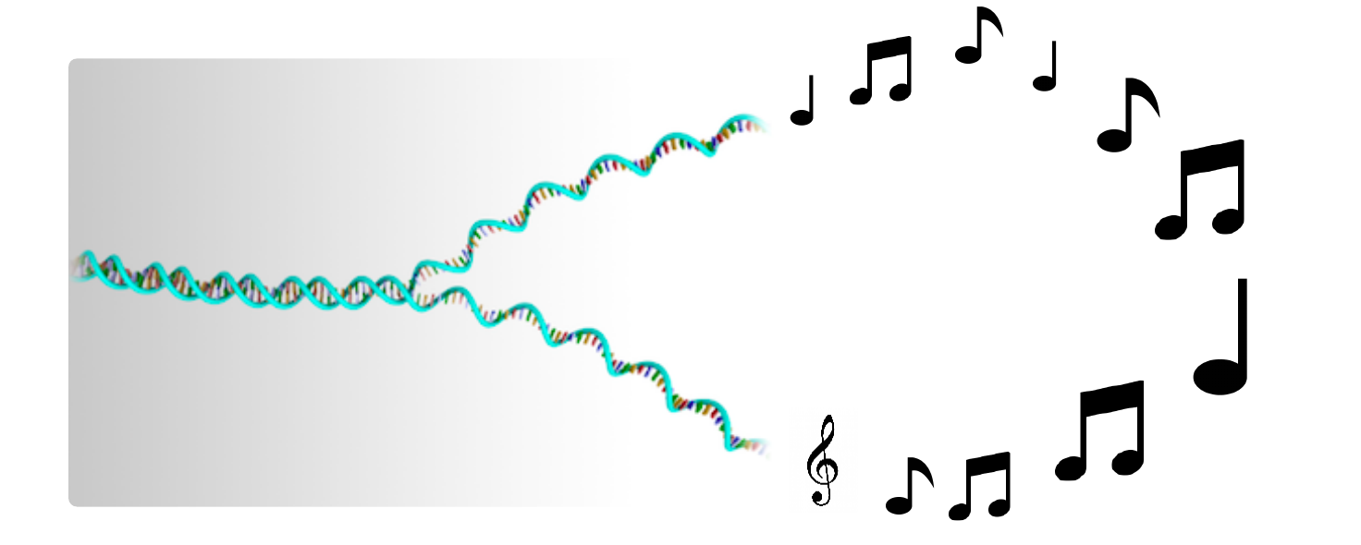
Insights
Computing offers us the capability to build upon these insights by relaxing the cognitive load required to measure them.
We can “decipher the music genome” through computing.
[2]
Notes:
Mention bioinformatics
http://www.zsgenetics.com/sample-preparation/#!prettyPhoto

Slide 6
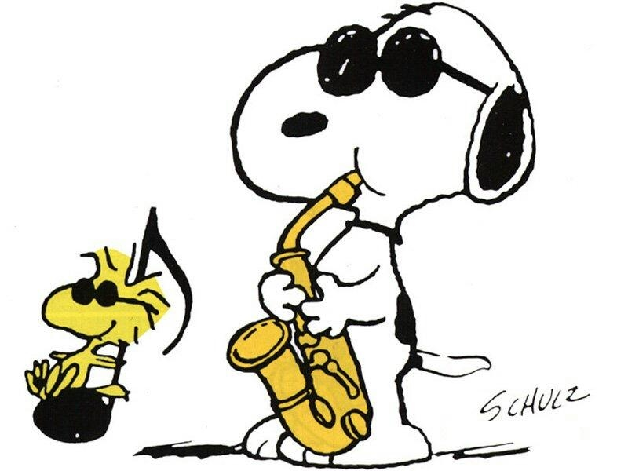
Insights
Educators, performers, professionals, composers, publishers, students, and more can leverage this technology to simplify their work.
[3]

Slide 7
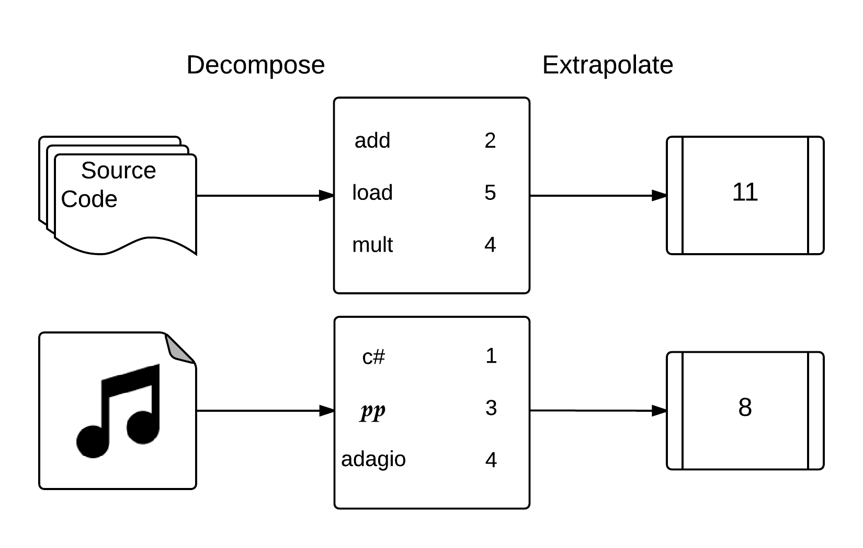
Overview
Musiplectics-a systematic and objective approach to computational assessment of the complexity of a music score for any instrument.
Decompose a piece into its musical elements and extrapolate complexity measurements from their weights.

Slide 8
Overview
Complexity parameters
“What” (i.e., is being played)
Individual notes
Intervals
“How” (i.e., how “what” components are played)
Key signature
Dynamics
Tempo/Duration
Articulation: Slurred/Separated (i.e., legato/staccato)

Slide 9
Overview
Rank each of the predefined complexity parameters.
Use default values for unranked parameters.
The “what” components get specific values.
The “how” parameters become multipliers for “what” components.

Slide 10
Overview
Leverage outside experts to determine complexity parameters for individual musical elements on each instrument.
Qualtrics Survey
Awaiting IRB Approval
Use our own parameters until we have conclusive new ones.

Slide 11
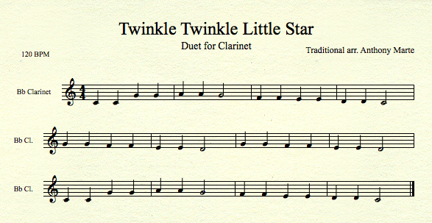
Example

Slide 12
Example
Notes
C4 C4 G4 G4 A4 A4 G4 F4 F4 E4 E4 D4 D4 C4
G4 G4 F4 F4 E4 E4 D4 G4 G4 F4 F4 E4 E4 D4
C4 C4 G4 G4 A4 A4 G4 F4 F4 E4 E4 D4 D4 C4

Slide 13
Example
Note Weights
1 1 1 1 2 2 1 1 1 1 1 1 1 1
1 1 1 1 1 1 1 1 1 1 1 1 1 1
1 1 1 1 2 2 1 1 1 1 1 1 1 1

Slide 14
Example
Note Weights with Articulations Multiplier
1 1 1 1 2 2 1 1 1 1 1 1 1 1
1 1 1 1 1 1 1 1 1 1 1 1 1 1
1 1 1 1 2 2 1 1 1 1 1 1 1 1
Notes:
No articulations so multiplied by 1

Slide 15
Example
Note Weights with Articulations and Dynamics Multipliers
1.5 1.5 1.5 1.5 3 3 1.5 1.5 1.5 1.5 1.5 1.5 1.5 1.5
1.5 1.5 1.5 1.5 1.5 1.5 1.5 1.5 1.5 1.5 1.5 1.5 1.5 1.5
1.5 1.5 1.5 1.5 3 3 1.5 1.5 1.5 1.5 1.5 1.5 1.5 1.5
Notes:
No dynamics so multiplied by 1.5 default

Slide 16
Example
Note Weights with Articulations, Dynamics, and Key Signature Multipliers
1.5 1.5 1.5 1.5 3 3 1.5 1.5 1.5 1.5 1.5 1.5 1.5 1.5
1.5 1.5 1.5 1.5 1.5 1.5 1.5 1.5 1.5 1.5 1.5 1.5 1.5 1.5
1.5 1.5 1.5 1.5 3 3 1.5 1.5 1.5 1.5 1.5 1.5 1.5 1.5
= 24
= 21
= 24
________
69
Notes:
Key of C so multiplier is 1

Slide 17
Example
Intervals
1 5 1 2 1 2 2 1 2 1 2 1 2
5 1 2 1 2 1 2 4 1 2 1 2 1 2
2 1 5 1 2 1 2 2 1 2 1 2 1 2

Slide 18
Example
Interval Weights
1 5 1 8 1 8 2 1 2 1 2 1 2
5 1 2 1 2 1 2 4 1 2 1 2 1 2
2 1 5 1 8 1 8 2 1 2 1 2 1 2

Slide 19
Example
Interval Weights with Articulations Multiplier
1 5 1 8 1 8 2 1 2 1 2 1 2
5 1 2 1 2 1 2 4 1 2 1 2 1 2
2 1 5 1 8 1 8 2 1 2 1 2 1 2

Slide 20
Example
Interval Weights with Articulations and Dynamics Multipliers
1.5 7.5 1.5 12 1.5 12 3 1.5 3 1.5 3 1.5 3
7.5 1.5 3 1.5 3 1.5 3 6 1.5 3 1.5 3 1.5 3
3 1.5 7.5 1.5 12 1.5 12 3 1.5 3 1.5 3 1.5 3

Slide 21
Example
Interval Weights with Articulations, Dynamics, and Key Signature Multipliers
1.5 7.5 1.5 12 1.5 12 3 1.5 3 1.5 3 1.5 3
7.5 1.5 3 1.5 3 1.5 3 6 1.5 3 1.5 3 1.5 3
3 1.5 7.5 1.5 12 1.5 12 3 1.5 3 1.5 3 1.5 3
= 52.5
= 40.5
= 55.5
________
148.5

Slide 22
Example
Note Duration Multiplier (Total Notes / Total Beats) * (Beats Per Minute / Sec Per Min)
1.75 = (42 / 48) * (120 / 60)
Total Notes
42
Total
Beats
48

Slide 23
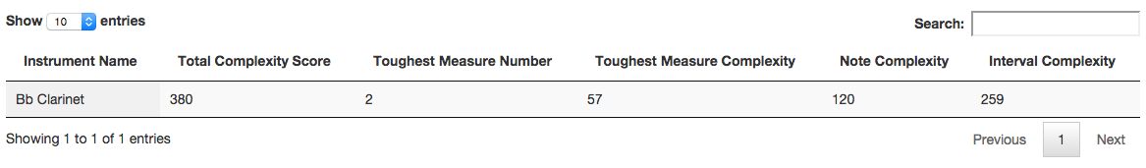
Example
Note Total = Note Weights * All Multipliers = 69 * 1.75 = 120.75
Interval Total = Interval Weights * All Multipliers = 148.5 * 1.75 = 259.875
Total Score = Note Total + Interval Total = 120.75 + 259.875 = 380.625

Slide 24
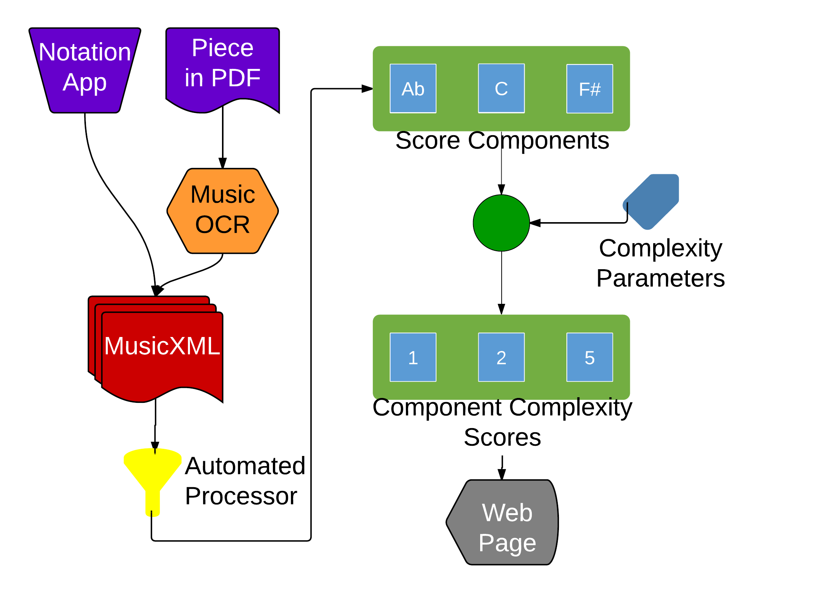
Proof of Concept
Accepts MusicXML files as input (via notation software or OCR conversion).
Tokenizes important musical elements for scoring (notes, intervals, dynamics, articulations, durations, and key signatures).
Weights tokens based on specified complexity parameters.
Aggregates and visualizes score data for consumption.

Slide 25
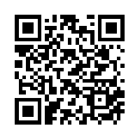
Proof of Concept
Cloud interface for generating complexity scores.
http://mickey.cs.vt.edu/

Slide 26
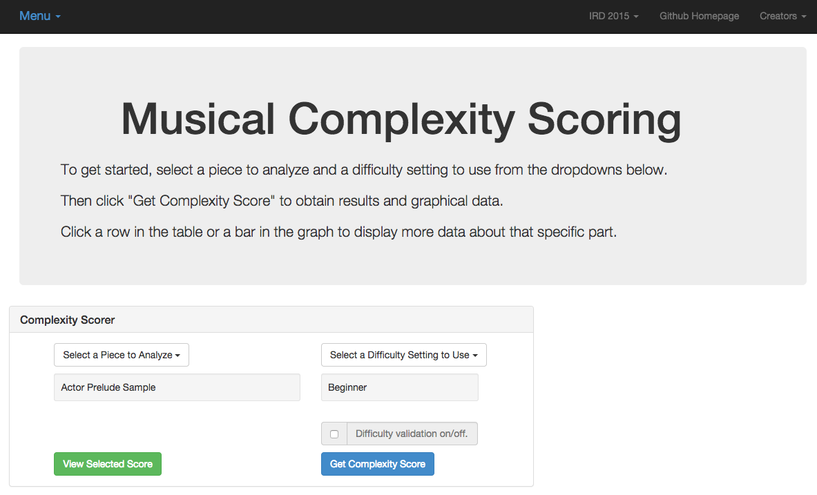
Proof of Concept

Slide 27
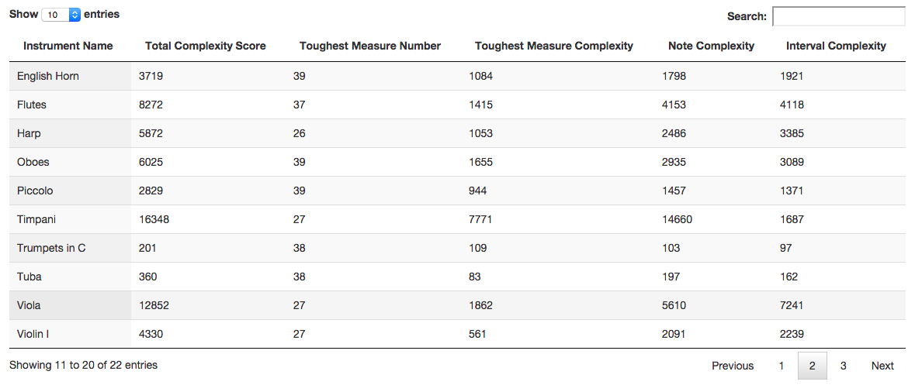
Proof of Concept

Slide 28
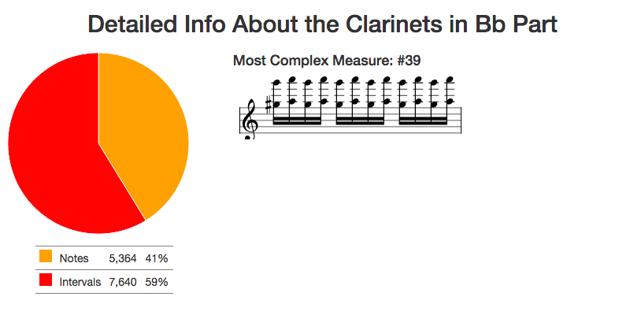
Proof of Concept

Slide 29
Findings
Experiment Setup:
Find manually scored pieces of music for Bb Clarinet from an outside source (Royal Conservatory syllabus).
Convert these manually scored pieces into MusicXML (music OCR software).
Generate complexity scores for these pieces with our system.
Compare our complexity scores to the manual scores.

Slide 30
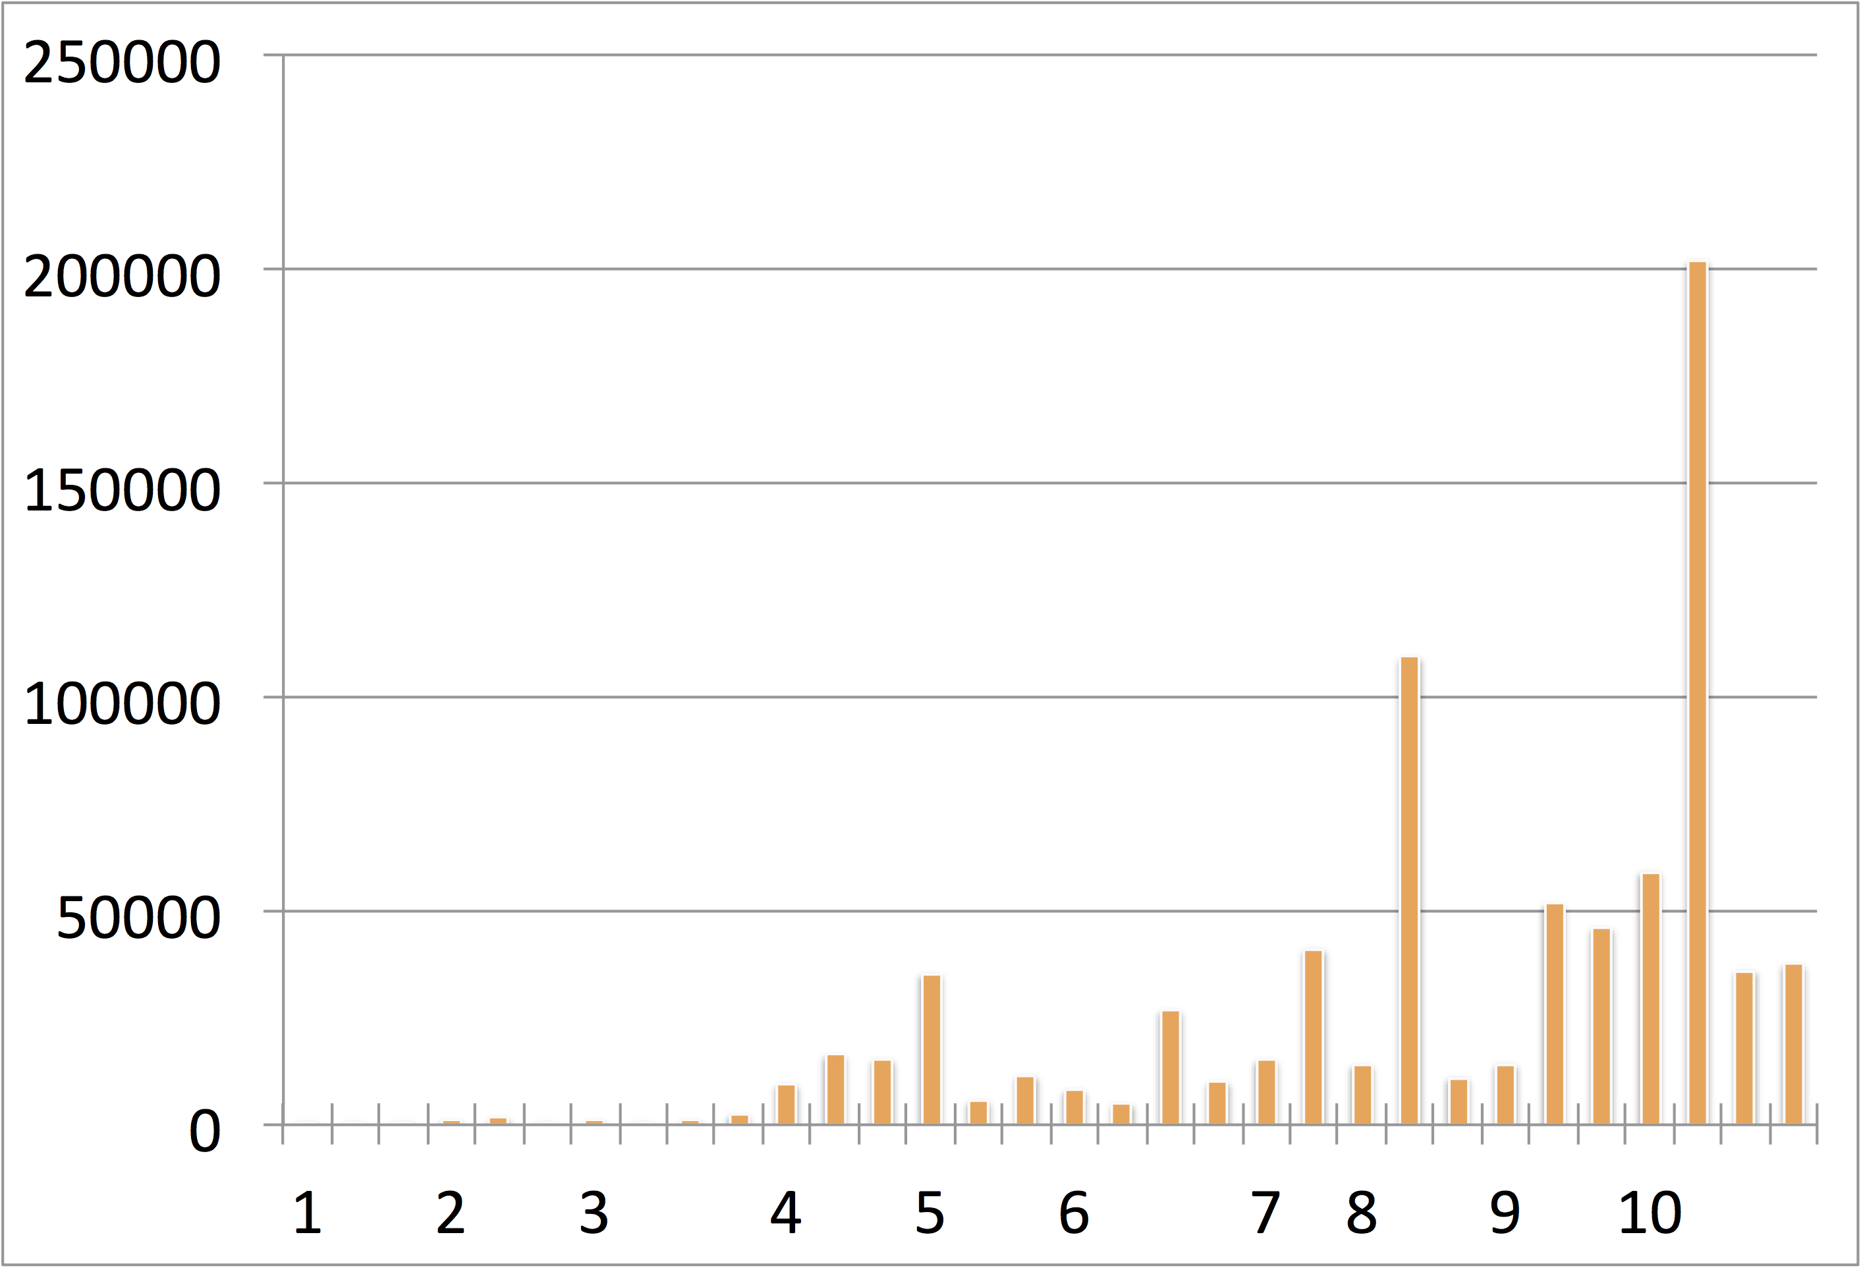
Findings
Complexity
Scores
Pieces by Manual Scores (Royal Conservatory)

Slide 31
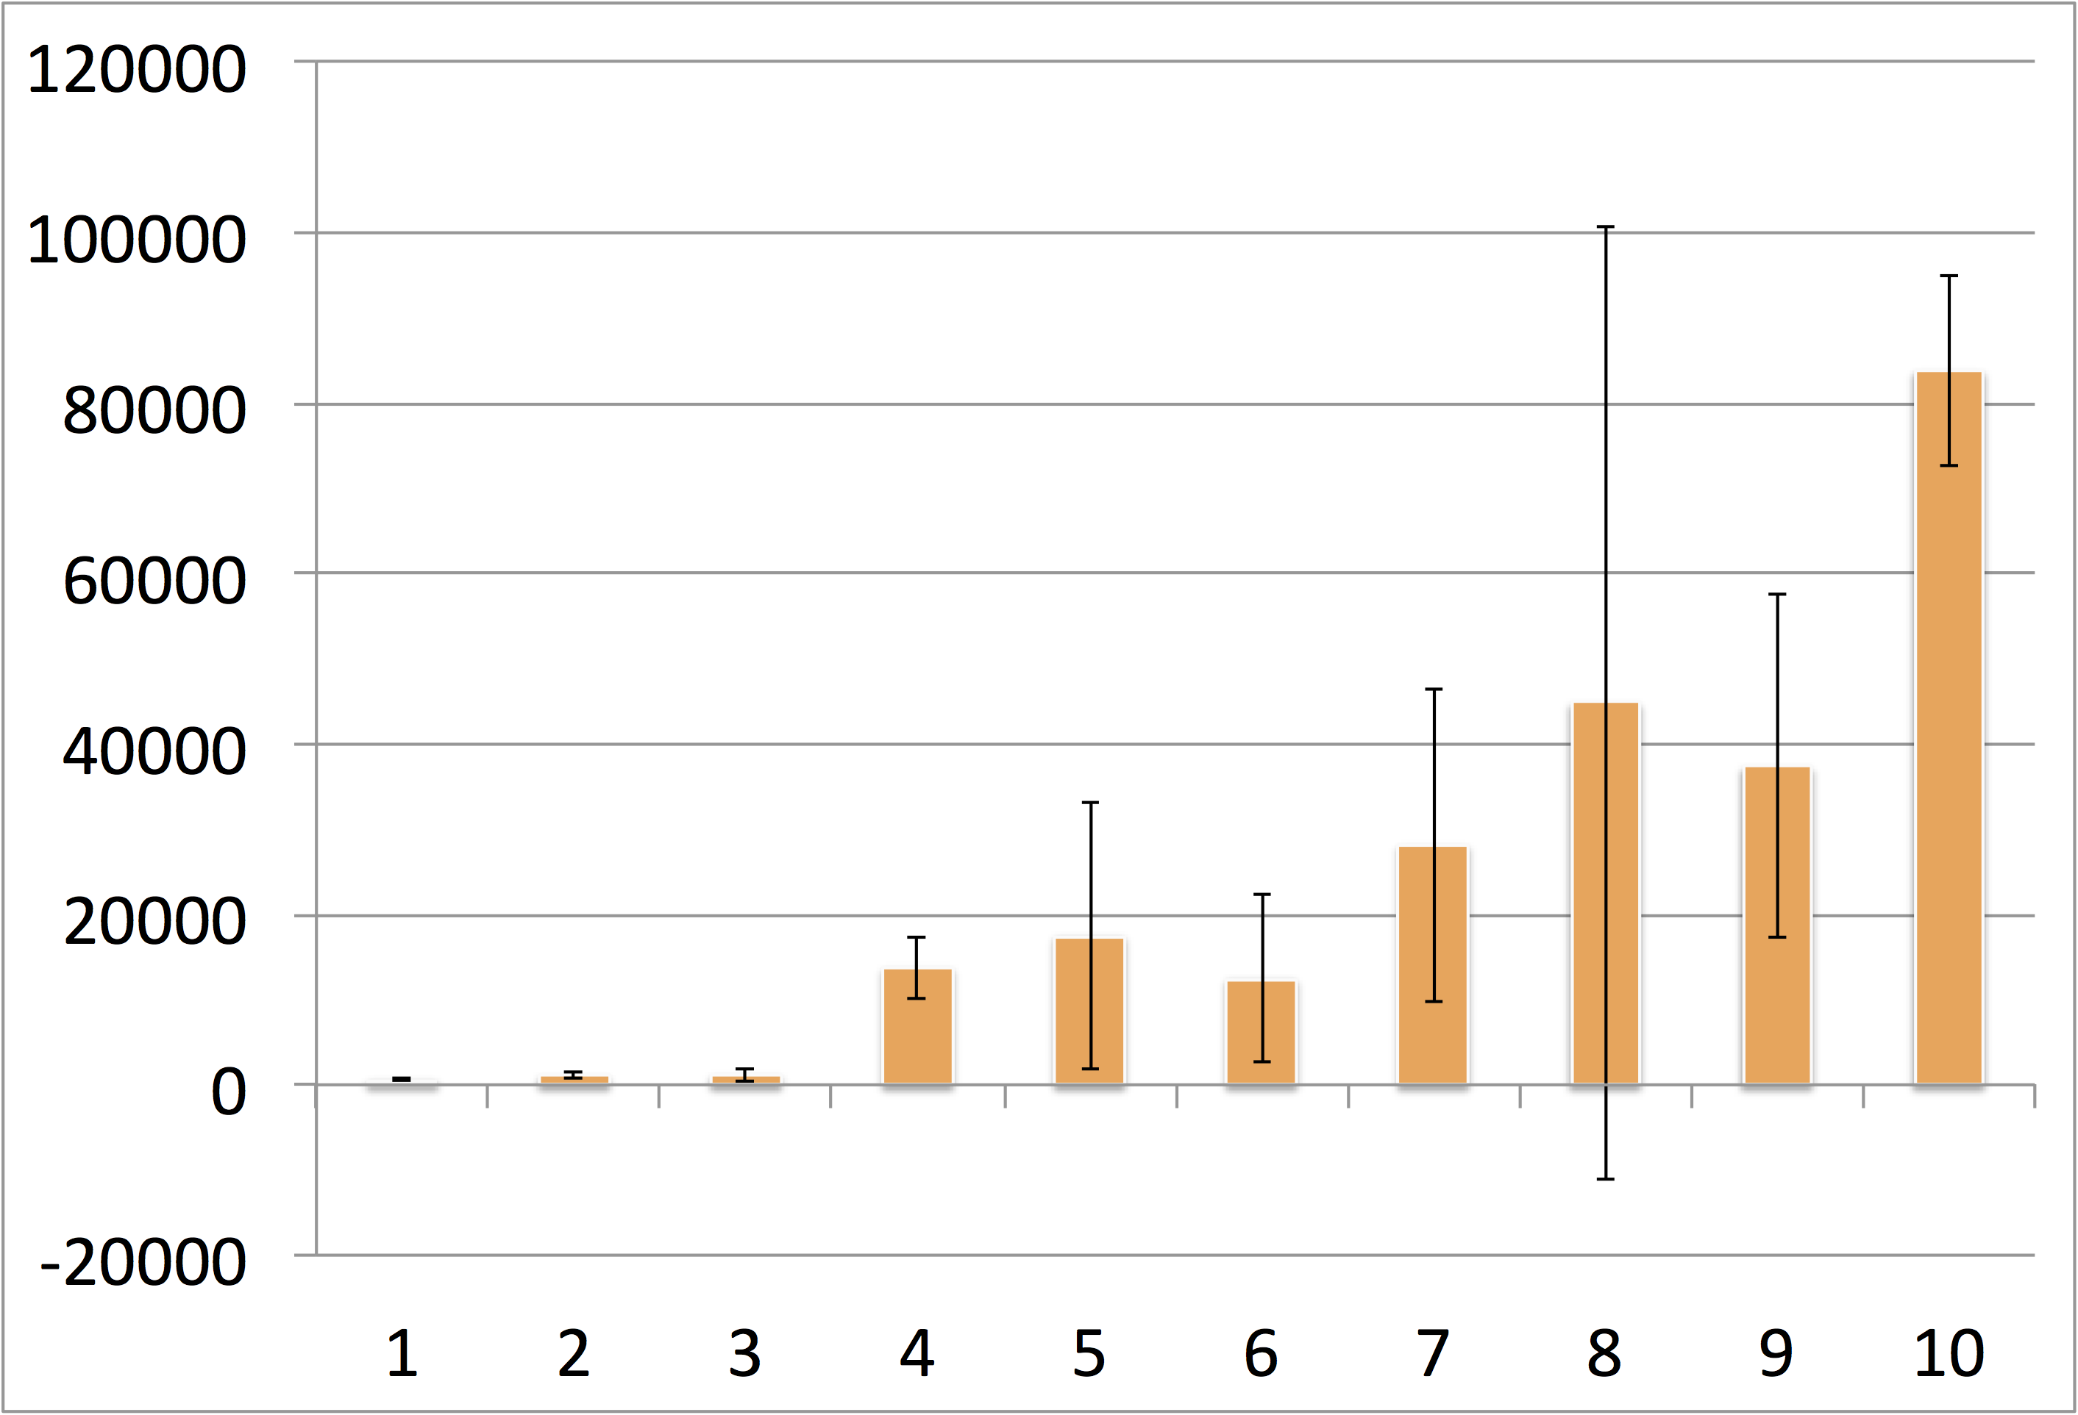
Findings
Average
Complexity
Scores
Pieces by Manual Scores (Royal Conservatory)

Slide 32
Contributions
Our complexity scores largely agree with subjective grades (Royal Conservatory instructional syllabus) of publicly available music pieces for B♭ Clarinet.
The website automates a meticulous, manual process and provides more consistent results on a ubiquitous platform.
Also a proof of concept for future instruments.
The initial results have been submitted to ONWARD’15 for publication.

Slide 33
Questions
?

Slide 34
Images
http://www.goodfuneralguide.co.uk/wordpress/wp-content/uploads/2013/04/two-cartoon-men-yelling.jpg
http://www.zsgenetics.com/wp-content/uploads/2013/01/dna-split-504x482.png
https://s-media-cache-ak0.pinimg.com/originals/49/0a/eb/490aeb9159c5b3044035cfbf7e4a19f3.jpg

Slide 35
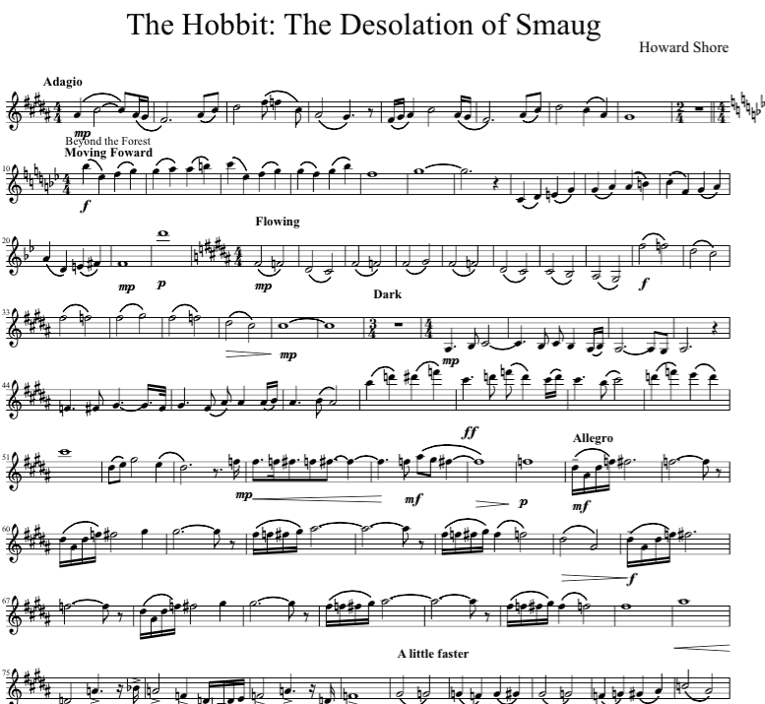
User Questions and Needs
How difficult is this piece of music?
What makes this piece of music more or less difficult than others?
What portion of this piece is the most difficult?
Why?

Slide 36
Problem
Educators and performers need answers to those questions at a glance before they decide to purchase or practice a piece.
There is currently no objective process for answering these questions.
Determining the answers for your own playing level is a tedious, error prone process.

Slide 37
Solution
Give educators and performers an objective means to quickly determine the complexity of a piece of music relative to their own level of play.
http://mickey.cs.vt.edu/
https://github.com/xwsxethan/MusicScoring

Slide 38
Future Work
Expanding instrument complexity parameters.
Presenting at ICAT day in the Moss Arts Center.
Leveraging other research to expand the toolchain.
Music OCR, MIDI conversion
Surveying experts for baseline complexity parameters.
Integrating with existing music libraries.
IMSLP.org, National Library
Adding reference pieces to relate complexity scores to well known works.
Measuring physiological signals to determine mental complexity.

Slide 39
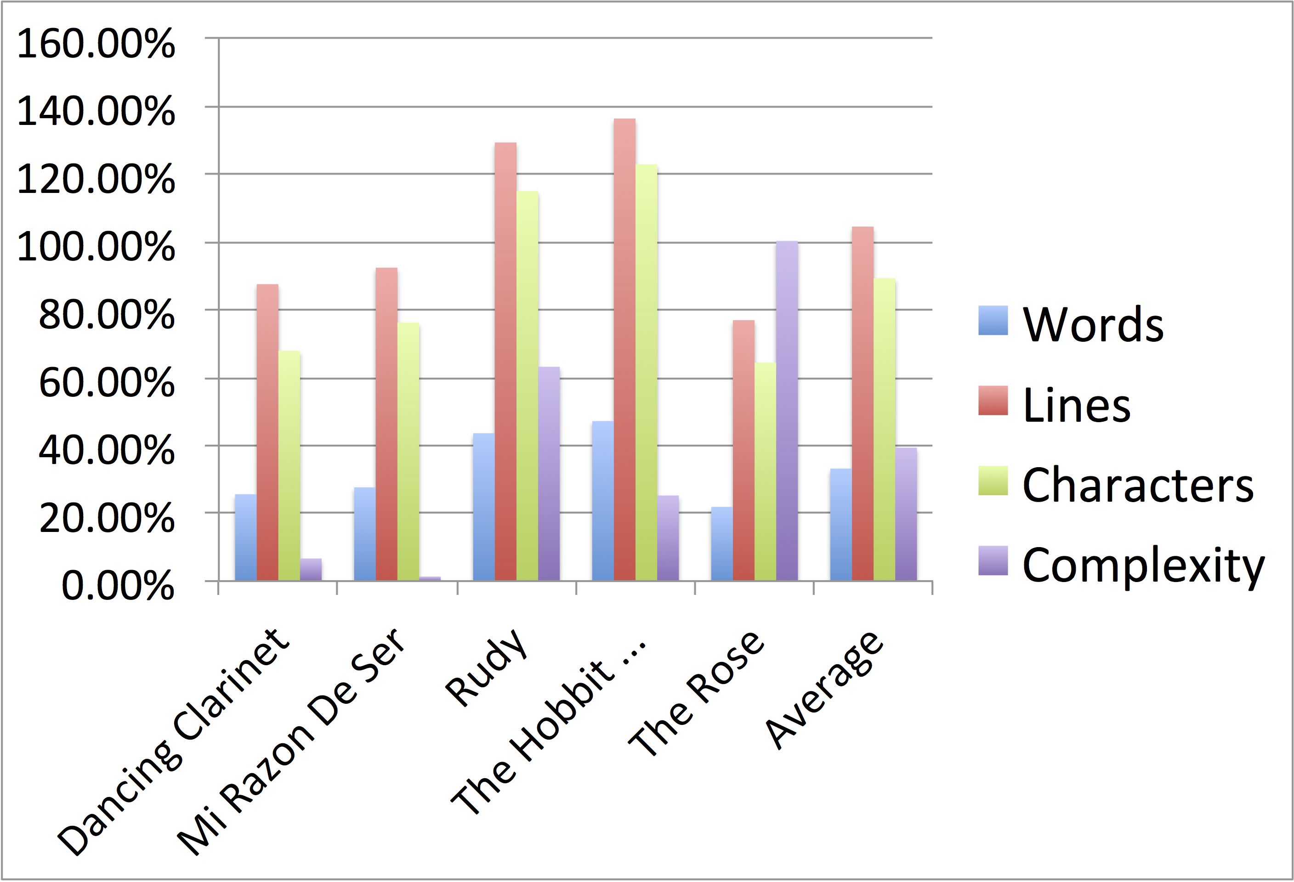
Reliability of Music OCR
Percentage
Difference
By Category
Music Pieces Converted with Music OCR (MuseScore)

