Slide 1


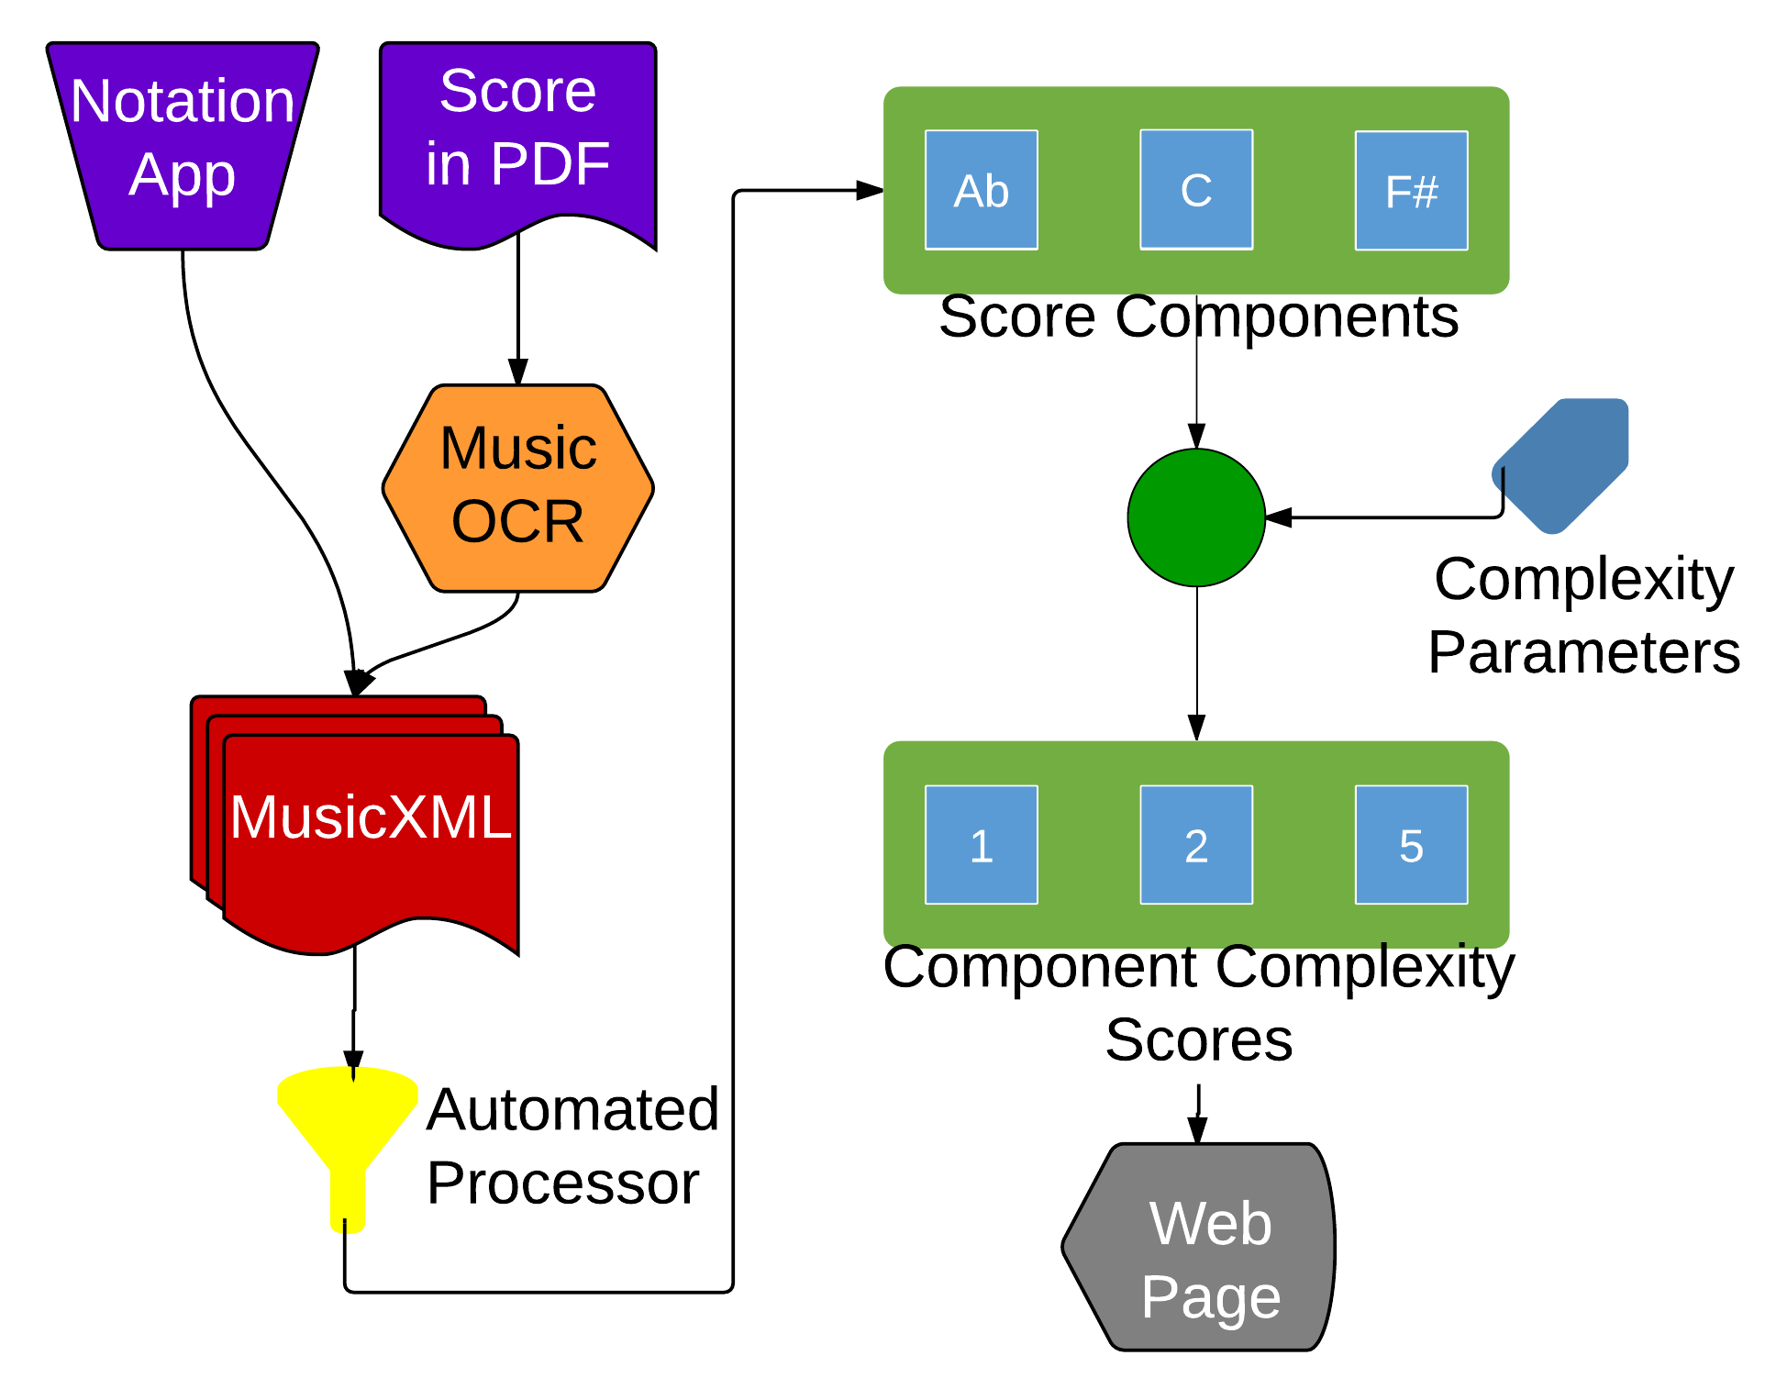
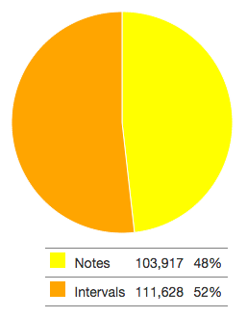
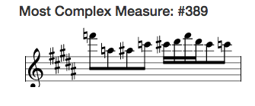
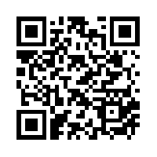
An Objective Assessment of Musical Complexity:
Translating Music Pedagogy’s Deep Insights with Novel Computing Paradigms
Author: Ethan Holder
Advisors: Dr. Eli Tilevich (CS), Dr. Amy Gillick (Music)
CS@VT
Inspiration
Problem Statement
Music educators and musicians need to accurately assess the complexity of music pieces to determine what they can best perform.
Current methods of scoring are subjective and are often inaccurate.
Users need a simple tool to quickly expose the underlying complexity of a piece automatically.
“Which piano concerto is more difficult: Rachmaninoff’s Second or Third?”
Performers, band directors, educators, and publishers would like to find out.
State of the practice---analyze music scores by hand.
“Would you rather spend your precious time on more creative pursuits?!”
Solution Approach Overview
Step 1: Gathering Information
Survey instrument experts to determine a consensus for the difficulty of certain musical elements.
Step 2: Mapping Complexity
Statically analyze the musical elements of a piece and map them to the specified difficulties in Java.
Step 3: Passing Data
Determine the final score and meta data and pass it to the web interface as JSON.
Step 4: Revealing Insights
Leverage Javascript libraries to display the final score and meta data in an easily readable form.
Exploring Complexity at Different Levels of Granularity
Overall Complexity: Notes vs. Intervals Breakdown
Practical Impact
Enable objective and accurate complexity evaluation for music educators and performers.
Automate tedious, subjective process.
Free user resources for creative tasks.
Apply music pedagogy insights to create novel computing paradigms.
Technical Details
HTML5 web-based application hosted in the cloud.
Evaluation algorithm implementing a high fidelity, bottom-up scoring heuristic.
Computing engine scalable with score length and instruments involved.
Applicability
Can analyze MusicXML for single or multi-part scores.
Limited instrument difficulty settings.
Need expert feedback to determine further difficulty settings.
Future Work
Support hand-written scores with music OCR.
Include a broader set of instruments.
Collaborate with music libraries, such as imslp.org.

