Slide 1
BAR-ILAN UNIVERSITY · FACULTY OF ENGINEERING
FinWatch
An Extensible BLE Smartwatch Platform with a Modular I²C Expansion Port
Course 83453 | Project 323 | Hardware Design Track
Omer Lazaros · Chen Leibov
Academic Supervisor: Prof. Leonid Yavitz
Project Mentor: David Freud
Github Repo: https://github.com/laserblade41/FinProj
September 2026
Project 323
1
Notes:
עמר

Slide 2
Where We're Going
1
Background & Problem
Why a sealed wearable can't grow new capabilities
2
Objectives & Scope
What this project set out to build - and what it deliberately left out
3
The FinWatch Module Protocol
The core technical contribution, explained stand-alone
4
Implementation, Verification & Results
Hardware, firmware, and what has been tested so far
5
Challenges, Logistics & Conclusion
What went wrong, what we learned, and what's next
FinWatch · Project 323
2

Slide 3
Why Build an Extensible Wearable?
The wearable engineering squeeze
The sealed-device problem
Fixed board area and battery capacity - it has to fit on a wrist
Must sleep to save power, yet stay responsive to the user
Switching regulators sit centimetres from a sensitive 2.4 GHz radio
Small board area worsens both thermal behaviour and crosstalk
Every constraint pulls against each over, we need to ensure compatibility of all components
Once assembled and sealed, the sensor set is frozen for the product's life
A new measurement idea today means designing an entirely new watch
Open wearables (PineTime, ZSWatch) open the firmware - not the hardware
Dev kits (nRF5340-DK) are fully expandable, but not wearable
Modular-phone attempts (Project Ara) failed on connector complexity at that scale
FinWatch · Project 323
3
Notes:
חן

Slide 4
Problem Statement
There is no wearable platform where a sealed, finished device can accept new I²C hardware, at runtime, from an untrusted third party - without opening the case or modifying the watch's firmware.
No case opening
No firmware update
No prior knowledge of the module
FinWatch · Project 323
4

Slide 5
Objectives
General objective
Design, build, and verify a wearable platform that keeps real smartwatch constraints while exposing a documented, safe, self-describing expansion interface.
1
Hardware platform:
4-layer PCB: nRF5340 SoC, nPM1300 PMIC, LSM6DSOX IMU, QSPI flash, SPI touch display, pogo expansion port
2
FWMP v1:
An I²C expansion contract: electrical spec, register map, CRC-protected self-describing descriptor, host enumeration state machine
3
Zephyr firmware:
≈ 2,550 lines of C across nine subsystems implementing the watch app and the host side of FWMP
4
Fault-injection harness:
A mock transport that makes every host-side rejection path reachable without physical module hardware
5
Design-review process:
Documented hardware defects, root-cause analysis, and a pre-fabrication checklist
FinWatch · Project 323
5

Slide 6
Scope
In Scope
Out of Scope (for now)
One active module at a fixed I²C address (0x42)
Polled discovery since there is no dedicated interrupt line
Low-rate sensing, bounded by I²C bandwidth
Full validation of untrusted module-supplied data
Verification via mock backend + nRF5340-DK
Multiple concurrent modules on the bus
An interrupt-capable expansion variant
Streaming data - audio or video
Electrical over-current / ESD protection at the port
Module authentication
FinWatch · Project 323
6
Notes:
עמר

Slide 7
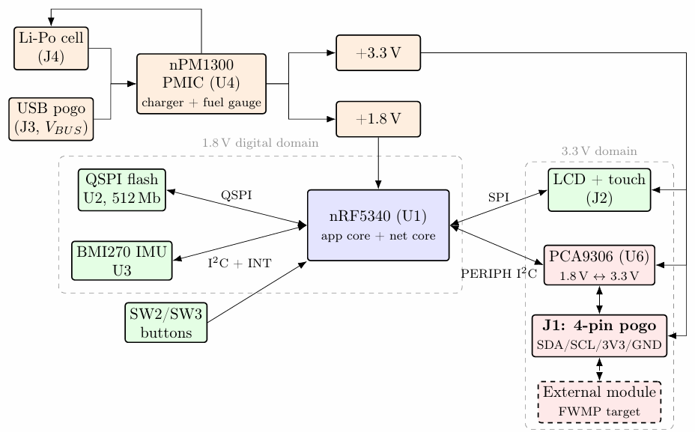
System Architecture
A bidirectional level shifter connects the SoC's 1.8 V I²C bus to the 3.3 V expansion port — this is what makes the port usable by ordinary, off-the-shelf 3.3 V hardware.
FinWatch · Project 323
7
Notes:
עמר

Slide 8
Component Selection
Every major part was chosen against explicit alternatives
Function | Chosen part | Why
SoC | nRF5340 (bare IC) | Dual-core isolates BLE timing from the app; best-in-class sleep current; owns the RF design instead of hiding it in a module
PMIC | nPM1300 | One package replaces four discretes; integrated fuel gauge; native Zephyr drivers
IMU | BMI270 | Runs off the 1.8 V rail; on-sensor pedometer / ML core can keep the MCU asleep
Level shifter | PCA9306 | Purpose-built for I²C; preserves open-drain semantics in both directions
Expansion connector | 4-pin pogo | Sealed-surface contacts; no cavity through the case; cheap on the module side
FinWatch · Project 323
8
Notes:
חן

Slide 9
The Core Contribution: FWMP
The FinWatch Module Protocol - a self-describing I²C expansion contract
Electrical contract — 4 contacts, nothing more
Logical contract — register map
Pin | Signal | Notes
1 | +3V3 | Watch → module; bounded module current
2 | SDA | Bidirectional, open-drain, pulled up on the watch
3 | SCL | Watch → module; watch is always bus controller
4 | GND | —
Offset | Meaning
0x00–0x09 | Fixed descriptor header: magic, version, length, VID/PID, capabilities
0x0A… | TLV area, then a trailing CRC-16
0x80–0x81 | STATUS / SEQ- marks if there is any new data
0x82… | INPUT report (module → watch)
0xC0… | OUTPUT report (watch → module)
Module is an I²C target at fixed address 0x42
No dedicated interrupt line, the host discovers by polling
Watch owns the pull-ups; a module must not add its own
A single two-byte STATUS/SEQ read answers whether new data exists and whether it has already been seen - keeping idle polling cheap.
FinWatch · Project 323
9
Notes:
עמר

Slide 10
Self-Description via TLV
How an unknown module tells the watch what it is
Fixed Header
magic · version · length · VID/PID · CAPS
TLV Entries
NAME · INPUT_REPORT · OUTPUT_REPORT · ICON_ID
CRC-16
protects the whole descriptor
TLV catalogue (v1)
Why this beats Qwiic / STEMMA QT
NAME: human-readable module name
INPUT_REPORT: report length + preferred poll rate
OUTPUT_REPORT: output report length
ICON_ID: index into the watch's built-in icon set
Unknown TLV types are skipped, not rejected → forward-compatible (borrowed from USB HID)
Those ecosystems standardize the connector, not discovery
A Qwiic module tells the host nothing about itself; a driver must already exist
A FinWatch module's descriptor carries name, report sizes, poll rate and icon - enough to be usable the instant it's plugged in
FinWatch · Project 323
10
Notes:
חן

Slide 11
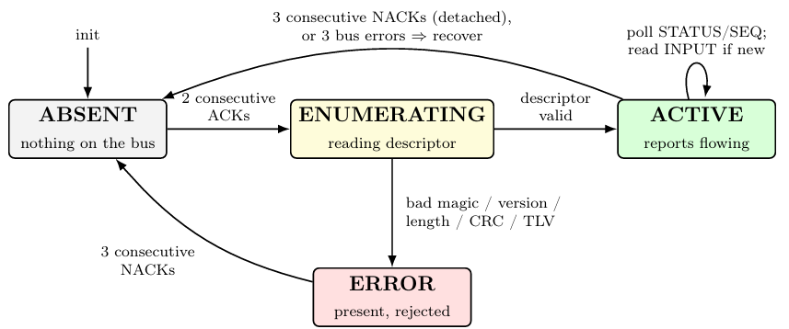
Enumeration & the Trust Boundary
Every byte a module sends is treated as untrusted, adversarial input
1
2 consecutive address ACKs → module attaches, enumeration begins
2
Descriptor validated (magic, version, length, CRC-16, TLV bounds) → ACTIVE
3
Any check fails → ERROR; not retried until the module is physically removed
4
3 consecutive NACKs, or 3 bus errors while ACTIVE ⇒ i2c_recover_bus(), back to ABSENT
FinWatch · Project 323
11
Notes:
עמר

Slide 12
Firmware & Power Design
Thread priorities (lower number = higher priority)
Adaptive polling - power vs. latency
Thread | Prio | Responsibility
Display | 7 | Renders UI, services touch
Sensor | 8 | Blocks on IMU interrupt; samples only in an active window
Update | 9 | 1 Hz watch-face refresh; battery every 10 s
Expansion | 10 (lowest) | Presence polling, enumeration, I/O reports
Regime | Interval | When
Absent | 1000 ms | No module attached
Background | 250 ms | Module attached, screen not visible
Foreground | 50 ms | User looking at the module screen
Interrupt-driven motion wake
Why lowest priority, deliberately
IMU's own wake-up detector asserts an interrupt on motion
Host sleeps until then - zero CPU time, zero timer wake-ups when idle
10 Hz step-detection sampling runs only inside a 3 s active window
Falls back to continuous polling if the interrupt fails to initialize
If a module holds the clock line indefinitely, it only ruins its own responsiveness , never the display, the sensor, or the watch face. BLE runs on a separate physical core, so a misbehaving module can never drop the radio link.
FinWatch · Project 323
12
Notes:
חן

Slide 13
Planning vs. Execution
Original plan (five contributions) against status as of today
Planned contribution | Status as of today
1. Custom hardware platform (4-layer PCB) | Revision A manufactured; power rails verified. A missing SWD header forced Revision B.
2. FWMP v1 specification | Complete: electrical spec, register map, TLV descriptor, and enumeration state machine all defined and implemented.
3. Zephyr firmware, ~2,550 LOC / 9 subsystems | Implemented and functionally verified on the nRF5340-DK, independent of the custom board.
4. Mock transport + fault-injection harness | Implemented; all six fault classes and every host-side rejection path are exercised.
5. Documented design-review process | Complete; produced directly by the Revision A SWD omission; yielded the pre-fabrication checklist.
Note: mapped from the objectives stated in the proposal / report introduction — the detailed milestone timeline follows next.
FinWatch · Project 323
13
Notes:
עמר

Slide 14
Project Timeline
Milestones against target dates, current status as of today
Mar 2026
BLE Interface & Firmware Core
May 2026
UI & Display
Jan 2025
Nordic BLE Training
Jun 2026
Reference Expansion Module
GATT services, advertising, battery notify
LVGL watch face, module screen, touch
Physical module build (Appendix C)
Two official Nordic courses + BLE course
Done
Done
Done
In progress
Done
Done
Done
Planned
Nov 2025
Board Schematic
Apr 2026
FWMP Expansion Protocol
Nov 2025 – today
PCB Fabrication: Rev A → Rev B
September 2026
Final Report
Circuit design complete
Host-side implementation + fault injection
Rev A manufactured; SWD fix applied; Rev B in hand, bring-up underway
Write-up and documentation
● Done ● In progress ● Planned
The schedule held up well overall, the main source of delay was component/part sourcing lead times (PMIC and IMU shortages, one cancelled order), not scope or design rework. Revision B is manufactured and in hand; bring-up is in progress.
FinWatch · Project 323
14
Notes:
חן

Slide 15
Verification & Results
✓
Functional verification (DK)
✓
FWMP nominal path
✓
Fault injection
✓
Revision A electrical bring-up
✓
Full firmware- display, touch, sensor, BLE, FWMP host, run on the nRF5340-DK
Devicetree abstraction let firmware development proceed in parallel with PCB fabrication
Mock “Test Dial” module: attach → descriptor read → validated → live report exchange → detach
End-to-end proof that an unknown module becomes usable with zero host-side code
Six injected fault classes: bad magic, bad version, bad CRC, oversize length, TLV overrun, bus error
Every host-side rejection path is reachable and exercised without physical hardware
Power rails (1.8 V / 3.3 V) verified on the manufactured board
Firmware loading blocked by the missing SWD header; full functional bring-up was corrected in revision B
Physical module hardware has not yet been built — fault-injection results come from the mock transport, not real bus electrics. This is named as the top item for future work in the report.
FinWatch · Project 323
15
Notes:
עמר

Slide 16
Design Challenges: The Missing Debug Header
Symptom
Root cause
Fix (Rev B)
Revision A's power rails came up correctly, but the board could not be programmed or debugged at all.
SWDIO and SWDCLK were simply never routed. A blank nRF5340 has no bootloader, so SWD is the only way in and an ERC only checks nets that exist, not ones that should.
Three signals: SWDIO, SWDCLK, and nRESET routed to 1×1 mm test pads. nRESET is included so a locked-up core can still be halted.
Component availability told the same lesson twice: a supply shortage forced a PMIC swap and a pin-compatible IMU swap. Because hardware dependencies lived in the Devicetree, the software change was confined to an overlay, not a board re-spin.
FinWatch · Project 323
16

Slide 17
Logistics
Improvements, challenges, budget and work plan
Procurement as a design constraint
Pre-fabrication checklist (derived from Rev A)
Specified PMIC and IMU were both out of stock at every distributor checked
Several suppliers would not quote single-unit student-project quantities
One order was cancelled outright, costing 14 further weeks
Availability became a primary selection criterion, not just a technical one
SWD (SWDIO, SWDCLK, nRESET) brought out to an accessible pad set
Every rail has a test point; at least one ground clip point
Every BOM part in stock from ≥ 2 distributors, second source documented
Local decoupling within a few mm of every supply pin
Antenna keepout clear on all layers; RF match is controlled-impedance
FinWatch · Project 323
17

Slide 18
How FinWatch Compares
Honest about where it's behind and precise about where it's new
Property | PineTime | ZSWatch | Dev Kits | FinWatch
Wearable form factor | Yes | Yes | No | Yes
Sensor richness / maturity | Basic | Rich, mature | Rich | Basic, prototype
Expansion without opening the case | No | No | n/a | Yes
Third-party modules, no first-party driver | No | No | No | Yes
Runtime device discovery | No | No | No | Yes
Self-describing descriptor | No | No | No | Yes
ZSWatch shares the same SoC, RTOS, PMIC and flash part, is more mature. The claim here is narrow and specific: not a better watch, but a sealed device that can use hardware its firmware has never seen.
FinWatch · Project 323
18
Notes:
חן

Slide 19
Conclusion
A sealed watch can use hardware its firmware has never seen, discovered, validated, and made usable at runtime through four contacts and a self-describing descriptor.
Recommendations, aligned to each objective
Hardware platform:
Complete Revision B bring-up and validate the RF match against the on-board antenna
FWMP protocol:
Build a physical reference module (Appendix C) to expose real electrical hot-plug behaviour
Firmware:
Move step counting fully into the IMU's embedded pedometer to cut active-window CPU time
Safety / robustness:
Add current limiting and ESD protection at the port; the trust boundary is still only logical
Scale:
Explore multi-module addressing and an interrupt-capable variant to remove idle polling cost
FinWatch · Project 323
19

Slide 20
Thank You
Questions?
Omer Lazaros · Chen Leibov
Academic Supervisor: Prof. Leonid Yavitz email: leonid.yavitz@biu.ac.il
Project Mentor: David Freud email: david.freud@mail.huj.ac.il
Course 83453 · Project 323 · Faculty of Engineering, Bar-Ilan University
20

