Slide 1
HeNe Laser Mode Sweep
The following set of 10 slides illustrate how the longitudinal modes of a typical medium power HeNe laser sweep or cycle through the neon gain curve as the laser warms up and the cavity length increases due to thermal expansion.

Slide 2
Cavity Modes and Lasing Modes
Cavity modes that fall within the region of the neon gain curve which is greater than the lasing threshold (net gain > 1) will result laser oscillation and a lasing mode with an output power approximately proportional to its amplitude compared to the lasing threshold.
These are the longitudinal modes of the laser.
The total output power of the laser is equal to the sum of all the longitudinal modes.

Slide 3
Mode Sweep
As the cavity length increases due to thermal expansion, the wavelengths of the cavity modes (and longitudinal modes) increase (moving to the left).
When a cavity mode passes the point on the left (longer wavelengths) where the gain becomes less than 1, a new mode will eventually appear on the right to replace it.

Slide 4
Polarization
Adjacent longitudinal modes in random polarized HeNe lasers are usually orthogonally polarized with respect to an orientation determined by the laser tube construction. These are denoted red and blue.
Longitudinal modes in a linearly polarized HeNe laser will all have the same polarization orientation but similar amplitudes for the same size laser.

Slide 5
Start slide show to view mode sweep.
(Left and right arrows may be used to change mode sweep speed.)

Slide 6
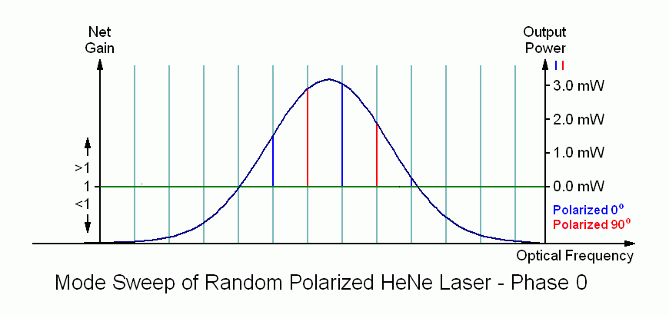

Slide 7


Slide 8


Slide 9


Slide 10
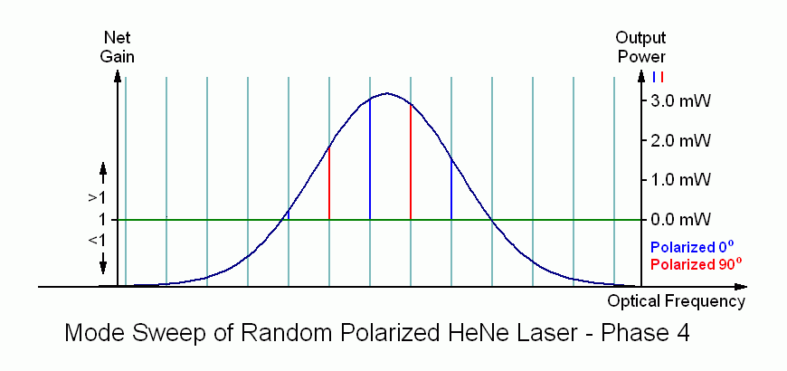

Slide 11


Slide 12


Slide 13


Slide 14


Slide 15


