Slide 1
Scalable Classification
Robert Neugebauer
David Woo

Slide 2
Scalable Classification
Introduction
High Level Comparison
SPRINT
RAINFOREST
BOAT
Summary & Future work

Slide 3
Review
Classification:
  predicts categorical class labels
  classifies data (constructs a model) based on the training set and the values (class labels) in a classifying attribute and uses it in classifying new data
Typical Applications
  credit approval
  target marketing
  medical diagnosis

Slide 4
Review: Classification – a two step process
Model construction
  describing a set of predetermined classes
Model usage: for classifying future or unknown objects
  Estimate accuracy of the model

Slide 5
Why Scalable Classification?
Classification is a well studied problem
Most of the algorithms requires all or portion of the entire dataset remain permanently in memory
Limits the suitability for mining large DBs

Slide 6
Decision Trees
age?
<=30
overcast
>40
30..40
student?
yes
credit rating?
no
yes
excellent
fair
no
yes
no
yes

Slide 7
Review: Decision Trees
Decision tree
  A flow-chart-like tree structure
  Internal node denotes a test on an attribute
  Branch represents an outcome of the test
  Leaf nodes represent class labels or class distribution

Slide 8
Why Decision Trees?
Easy for human to understand
Can be constructed relatively fast
Can easily be converted to SQL statements (for accessing the DB)
FOCUS:
Build a scalable decision-tree classifier

Slide 9
Previous work (on building classifier)
Random sampling (Catlett)
Break into subsets and use Multiple classifier (Chan & Stolfo)
Incremental Learning (Quinlan)
Paralleling decision tree (Fifield)
CART
SLIQ

Slide 10
Decision Tree Building
Growth Phase
  Recursively partitioning node until it’s “pure”
Prune Phase
  Smaller imperfect decision tree – more accurate (avoid over-fitting)
Growth phase is computationally more expensive

Slide 11
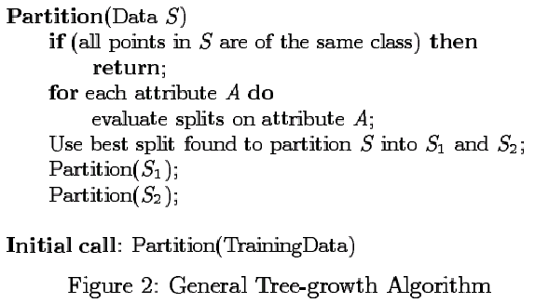
Tree Growth Algorithm

Slide 12
Major issues in Tree Building phase
How to find split points that define node tests
How to partition the data, having chosen the split point

Slide 13
Tree Building
CART
  repeated sort the data at every node to arrive at the best split attributes
SLIQ
  replaces repeated sorting by 1 time sort with separate list for each attribute.
  uses a data structure called class list (must be in memory all the time)

Slide 14
SPRINT
Use GINI index to split node
No limit on input records
Uses new data structures
  Sorted attribute list

Slide 15
SPRINT
Designed with Parallelization in mind:
  Divide the dataset among N share-nothing machines
  Categorical data: just divide it evenly
  Numerical data: use a parallel sorting algorithm to sort the data

Slide 16
RAINFOREST
Framework, not a decision classifier
Unlike Attribute List in SPRINT, it uses a new data structure: AVC-Set
Attribute-Value-Class set
Car Type | Subscription
 | Yes | No
Sedan | 6 | 1
Sports | 0 | 4
Truck | 1 | 2

Slide 17
RAINFOREST
Idea:
  Storing the whole attribute list => waste of memory.
  Only store information necessary for splitting the node
  Framework provides different algorithms for handing different main memory requirement.

Slide 18
BOAT
First algorithm that incrementally updates the tree with both insertions and deletions
Faster than RainForest (RF-Hybrid)
Sampling Approach yet guarantees accuracy
Greatly reduces the number of database reads

Slide 19
BOAT
Statistical approach called bootstrapping during the sampling phase to come up with a confidence interval
Compare all potential split points inside the interval to find the best one
A condition that signals if the split point is outside of the confidence interval

Slide 20
SPRINT - Scalable PaRallelizable INduction of decision Trees
Benefits - Fast, Scalable, no permanent in-memory data-structures, easily parallelizable
Two issues are critical for performance
1) How to find split points
2) How to partition the data

Slide 21
SPRINT - Attribute Lists
Attributes lists correspond to the training data
One attribute list per attribute of the training data.
Each Attribute list is made of tuples of the following form:
<RID>, <Attribute Value>, <Class>
Attributes lists are created for each node.
  Root node this a scan of the training data
  Child nodes from the lists of the parent node.
Each list is kept in sorted order and is maintained on disk if not enough memory.

Slide 22
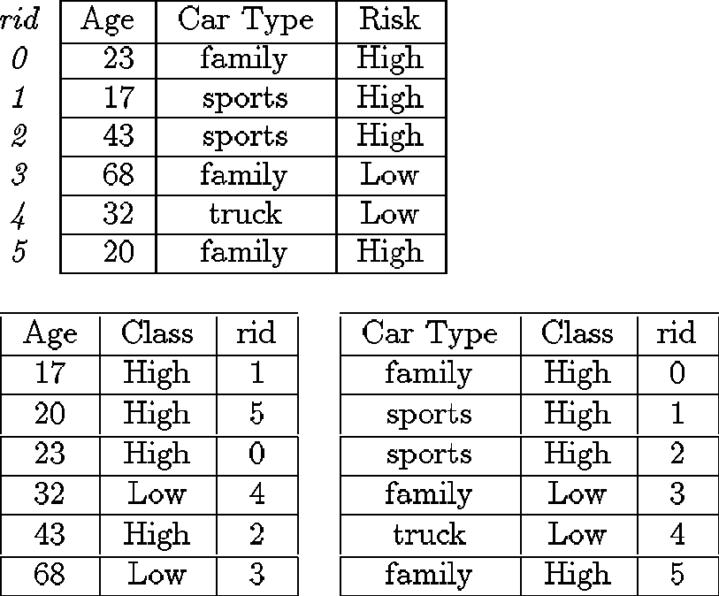
SPRINT - Attribute Lists

Slide 23
SPRINT - Histograms
Histograms capture the distribution of attribute records.
  Only required for the attribute list that is currently being processed for a split. Deallocated when finished.
For continuous attributes there are two histograms:
  C_{above} which holds the distribution of unprocessed records
  C_{below} which holds the distribution of processed records
For Categorical attributes only one histogram is required, the count matrix

Slide 24
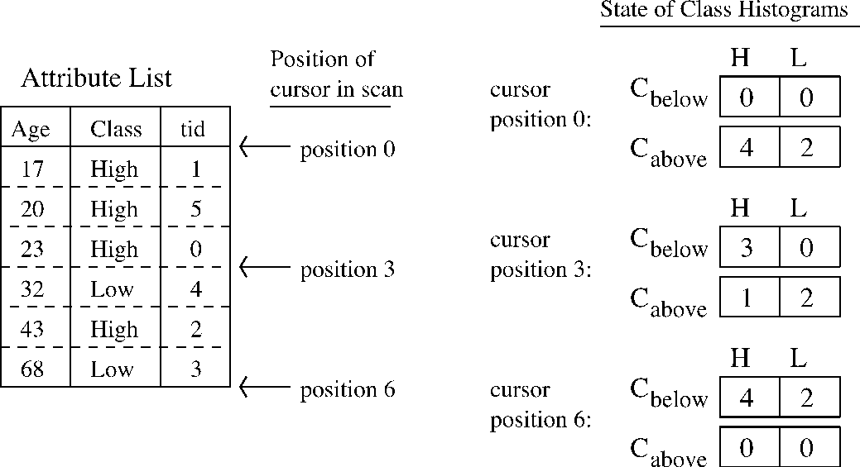
SPRINT - Histograms

Slide 25
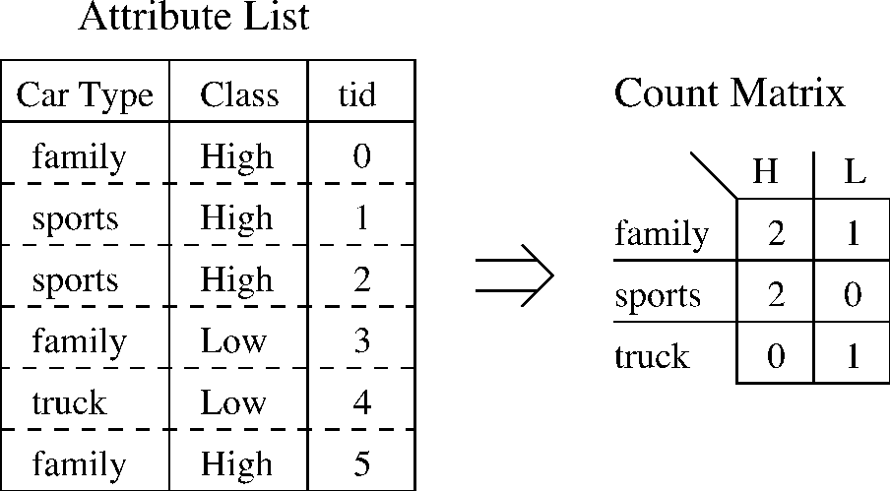
SPRINT – Count Matrix

Slide 26
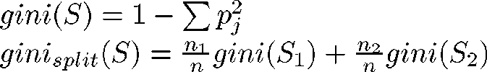
SPRINT - Determining Split Points
SPRINT uses the same split point determination method as SLIQ.
Slightly different for continuous and categorical attributes
  Use the GINI index
  Only requires the distribution values contained in the histograms above.
GINI is defined as:

Slide 27
SPRINT - Determining Split Points
Process each attribute list
  Examine Candidate Split Points
  Choose one with lowest GINI index value
Choose overall split from the attribute and split point with the lowest GINI index value.

Slide 28

SPRINT - Continuous Attribute Split Point
Algorithm looks for split function like:
  Candidate split points are the midpoint between successive data points
The C_{above} and C_{below} histograms must be initialized.
  C_{above} is initialized to class distribution for all records
  C_{below} is initialized to 0.
The actual split point is determined by calculating the GINI index for each candidate split point and choosing the one with the lowest value.

Slide 29

SPRINT - Categorical Attribute Split Point
The algorithm looks for a function like
where X is a subset of the categories for the attribute.
Count matrix is filled by scanning the attribute list and accumulating the counts

Slide 30
SPRINT - Categorical Attribute Split Point
To compute the split point we consider all subsets in the domain and choose the one with lowest GINI index.
If there are two many subsets a GREEDY algorithm is used.
The matrix is deallocated once the processing for the attribute list is finished.

Slide 31
SPRINT - Splitting a Node
Two child nodes are created with final split function
  Easily generalized to the n-ary case.
For the splitting attribute
  A scan of that list is done and for each row the split predicate determines which child it goes to.
  New lists are kept in sorted order
  At the same time a hash table of the RIDs is build.

Slide 32
SPRINT - Splitting a Node
For other attributes
  A scan of the attribute list is performed
  For each row a hash table lookup determines which child the row belongs to
  If the hash table is too large for memory, it is done in parts.
During the split the class histograms for each new attribute list on each child are built.

Slide 33
SPRINT - Parallelization
SPRINT was designed to be parallelized across a Shared Nothing Architecture.
Training data is evenly distributed across the nodes
  Build local attribute lists and Histograms
Parallel sorting algorithm is then used to sort each attribute list
Equal size contiguous chunks of each sorted attribute list are distributed to each node.

Slide 34
SPRINT - Parallelization
For processing continuous attributes
  C_{below} is initialized to the counts of other attributes
  C_{above} is initialized to the local unprocessed class distribution.
  Each node processes it local candidate split points.
For processing categorical attributes
  Coordinator node is used to aggregate the local count matrices
  Each node proceeds as before on the global count matrix.
Splitting is performed as before except using a global hash table.

Slide 35
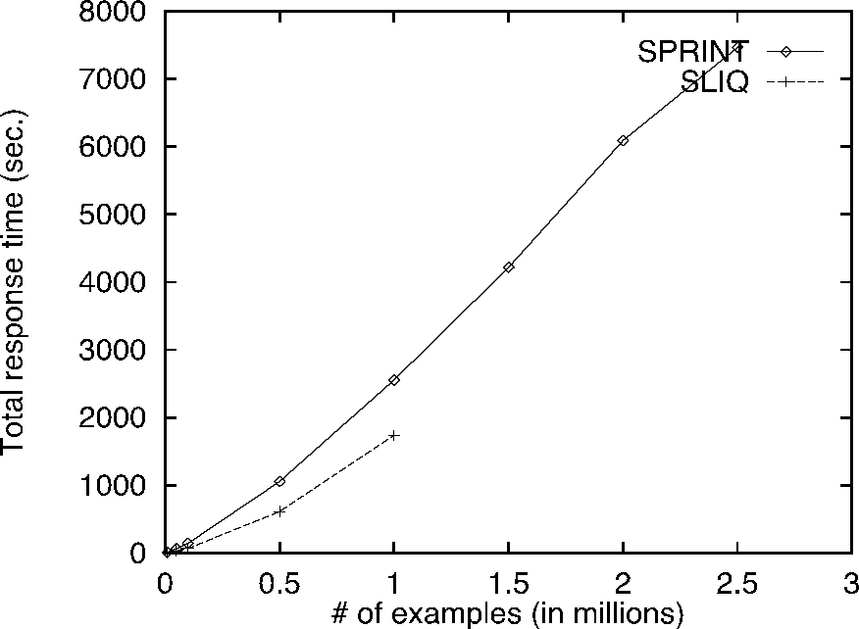
SPRINT – Serial Perf.

Slide 36
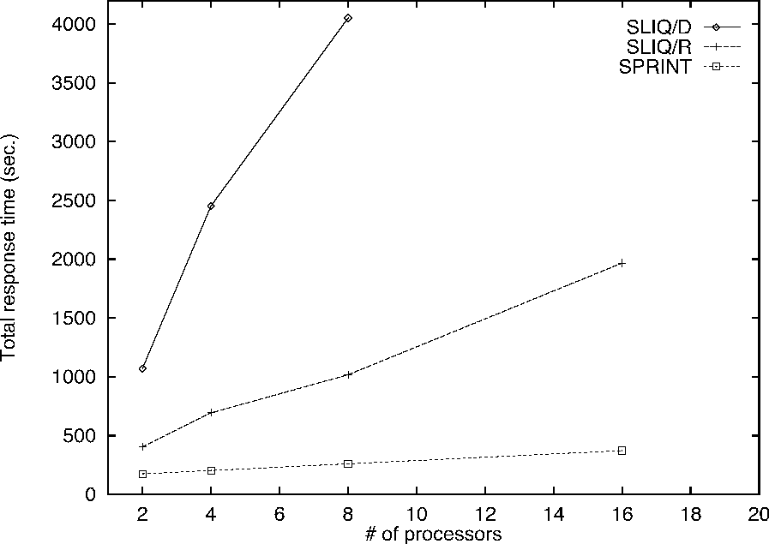
SPRINT – Parallel Perf.

Slide 37
RainForest - Overview
Framework for scaling up existing decision tree algorithms.
Key is that most algorithm access data using a common pattern.
Results in a scalable algorithm without changing the result.

Slide 38
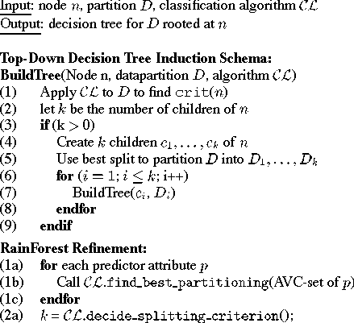
RainForest - Algorithm

Slide 39
RainForest - Algorithm
In literature, utility of an attribute is examined independently of other attributes.
Class label distribution is sufficient for determining split.

Slide 40
RainForest - AVC Set/Groups
AVC = Attribute Value Class
AVC-Set is the set of distinct values for a particular attribute the class and a count of how many tuples are in that class.
AVC-Group is the set of all AVC-Sets for a node.

Slide 41
RainForest - Steps per Node
Construct the AVC-Group - Requires scanning the tuples at that node.
Determining Splitting Predicate - Uses a generic decision tree algorithm.
Partition the data to the child nodes determined by the splitting predicate.

Slide 42
RainForest - Three Cases
AVC-Group of the root node fits in memory
Individual AVC-Sets of the root node fit in memory
No AVC-Set of the root node fits in memory.

Slide 43
RainForest - In memory
The paper presents 3 algorithms for this case, RF-Read, RF-Write & RF-Hybrid.
RF-Write & RF-Read are only presented for completeness an will only be discussed in the context of RF-Hybrid.

Slide 44
RainForest - RF-Hybrid
Use RF-Read until AVC-Groups of child nodes don’t fit in memory.
For each level where the AVC-Groups of children don’t fit in memory
  Partition child nodes into sets M & N.
    AVC-Groups for n ∈ M all fit in memory.
    AVC-Groups for n ∈ N are build on disk.
Process nodes in memory the fill memory from disk

Slide 45
RainForest - RF-Vertical
For the case when AVC-Group of root doesn’t fit in memory, each AVC-set does.
Uses local file on disk to reconstruct AVC-Sets of “large” attributes.
“Small” attributes processed like RF-Hybrid

Slide 46
RainForest - Performance
Outperforms SPRINT algorithm
Primarily due to fewer passes over data and more efficient data structures.

Slide 47
BOAT - recap
Improves in both performance and functionality
  first scalable algorithm that can maintain a decision tree incrementally when the training dataset changes dynamically.
  greatly reduces the number of database scans.
  does not write any temporary data structure on secondary storage => low run-time resource requirement.

Slide 48
BOAT Overview
Sampling phase – Bootstrapping
  in-memory sample D’ to obtain a tree T’ that is close to T with high probability
Clearing phase
  Calculate the value of the impurity function at all possible split points inside the confidence interval
A necessary condition to detect incorrect splitting criterion

Slide 49
Sampling Phase
Bootstrapping algorithm
  randomly resamples the original sample by choosing 1 value at a time and replacing the value
  some values may be drawn more than once and some not at all
  the process is repeated so that a more accurate confidence interval is created

Slide 50
Sample SubTree T’
Constructed using Bootstrap Algorithm => call this information coarse splitting criterion
Take Sample D’ which fits in Main Memory from Training Data D
construct b bootstrap trees T₁,…, T_{b} from training samples D₁,…,D_{b} obtained by sampling with replacement from D’

Slide 51
Coarse Splitting Criteria
Process the tree top down, for each node N, check if the b bootstrap splitting attribute at n at identical.
If not, delete n and its subtrees in all bootstrap trees
If the same, check if all bootstrap splitting subsets are identical. If not, delete n and its subtrees

Slide 52
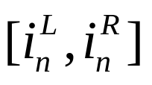
Coarse Splitting criteria
If the bootstrap splitting attribute is numerical, we obtain a confidence interval
The level of confidence can be controlled by increasing the number of bootstrap repetition

Slide 53
Coarse to Exact Splitting Criteria
If categorical attribute, coarse = exact splitting attribute. No more computation is needed.
If numerical, apply the point within the interval to the concave impurity function (e.g. GINI index), and compute the exact splitting attribute.

Slide 54
Failure Detection
To make the algorithm deterministic, need to check on the coarse split attribute is actually the final one.
Have to calculate the value of the impurity function at every x not in the confidence interval
Need to check if i’ is the global minimum without constructing all of the impurity functions in memory

Slide 55
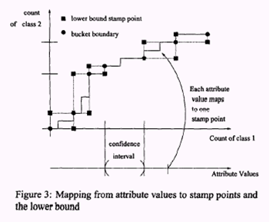
Failure Detection
Notes:
Each attribute values x uniquely determines a tuple of values => stamp points in the k-dimenional plane
Let Ni be the count of tuples in Fn with class label I
The tuple (i.e. stamp pt) uniquely determines ImpX at attribute value x
Rebuild the subtree from that node if it’s not the “best”

Slide 56
Extensions to Dynamic Environment
D be the original training db and D’ be the new data to be incorporated
Run the same tree construction algorithm
If D’ is from the same underlying probabilistic distribution, finally splitting criterion will be captured by the coarse splitting criterion.
If D’ is sufficiently different, only that part of the tree will be rebuilt.

Slide 57
Performance
Boat outperforms RAINFOREST by at least a factor of 2 as far as running time is concerned]
Comparison done against RF-Hybrid and RF-Vertical
the speedup becomes more pronounced as the size of the training database increases

Slide 58
Noise
Little impact on the running time of BOAT
Mainly affects splitting at lower levels of the tree, where the relative importance between individual predictor attributes decreases.
Most important attributes have already been used at the upper levels to partition dataset
Notes:
The effects of adding extra attributes with random values to the records in the input database. (FIG 10)
Adding attributes increases tree construction time since the additional attributes need to be processed, but doesn’t not change the final decision tree. (BOAT would never choose a NOISE as splitting attribute)
BOAT exhibits a roughly linear scaleup with the number additional attributes added.

Slide 59
Current research
Efficient Decision Tree Construction on Streaming Data (Ruoming Jin, Gagan Agrawal)
  Disk resident => continuous streams
  1 pass over entire dataset
  # of candidate split points is very large, expensive for determining best split point
  Derived approach from BOAT on interval pruning

Slide 60
Summary
Research concerned with building scalable decision tree using existing algorithms.
  Tree accuracy not evaluated in the papers.
SPRINT is scalable refinement SLIQ
Rainforest eliminates some redundancies of SPRINT
BOAT very different uses statistics and compensation to build the accurate tree.
  Compensation after is apparently faster.

