Slide 1
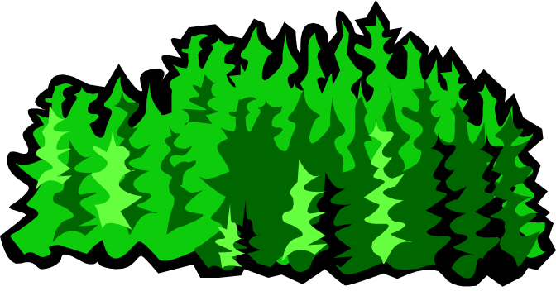
“RainForest – A Framework for Fast Decision Tree Construction of Large Datasets”
J. Gehrke, R. Ramakrishnan, V. Ganti.
ECE 594N – Data Mining
Spring 2003
Paper Presentation
Srivatsan Pallavaram
May 12, 2003

Slide 2
OUTLINE
Introduction
Background & Motivation
Rainforest Framework
Relevant Fundamentals & Jargon Used
Algorithms Proposed
Experimental Results
Conclusion

Slide 3
Introduction
Background & Motivation
Rainforest Framework
Relevant Fundamentals & Jargon Used
Algorithms Proposed
Experimental Results
Conclusion

Slide 4
DECISION TREES
Definition: A directed acyclic graph in the form of a tree which encodes the distribution of the class label in terms of predictor attributes
Advantages:
Easy to assimilate
Faster to construct
As accurate as other methods

Slide 5
CRUX OF RAINFOREST
Framework of algorithms that scale with the size of the database.
Graceful adaptation to amount of memory available.
Not limited to a specific classification algorithm.
No modification of the Result !

Slide 6
DECISION TREE (GRAPHICAL REPERSENTATION)
r
e3
e1
n3
n1
e6
e7
e2
e4
c5
c7
c1
c3
e8
e5
n2
e10
e9
c6
c2
r – Root Node
n- Internal node
c- Leaf Node
e- Edges
c4
n4
e11
e12

Slide 7
TERMINOLOGIES
Splitting Attribute – predictor attribute of an internal node.
Splitting Predicates – Set of predicates on the outgoing edges of internal node. Must be Exhaustive and Non overlapping.
Splitting Criteria – Combination of Splitting attribute and Splitting predicates associated with an internal node n – crit (n) .

Slide 8
FAMILY OF TUPLES
A "tuple" can be thought of as a set of attributes to be used as a template for matching.
The family of tuples of a root node – set of all tuples in the database
The family of tuples of an internal node – each tuple ‘t’ ε F (n) and ‘t’ ε F (p) where p is the parent node of n and q (p →n) evaluates to true. (q (p →n) is the predicate on the edge from p to n)

Slide 9
FAMILY OF TUPLES (CONT’D)
Family of tuples of a leaf node – set of tuples of the database that follow the path (W) from the root node ‘r’ to leaf node ‘c’.
Each path W corresponds to decision rule R = P →c, where P is the set of predicates along the edges in W.

Slide 10
SIZE OF DECISION TREE
Two ways to control the size of a decision tree - Bottom Up Pruning and Top-Down Pruning.
Bottom Up Pruning – Deep tree in growth phase and cut back in pruning phase
Top Down Pruning – Growth and pruning are interleaved.
Rainforest – concentrates on Growth phase due to its time consuming nature. (Irrespective of Top Down or Bottom Up Pruning )

Slide 11
SPRINT
A scalable classifier which works on large datasets with no relationship between memory and size of dataset.
Works on Minimum Description Length (MDL) principle for quality control.
Uses attribution lists to avoid sorting at each node.
It runs with minimum memory and scales to train large datasets.

Slide 12
SPRINT – Cont’d
Materializes the attribute list at each node possibly tripling the dataset size
Expensive (how? Memory wise?) to keep the attribute list sorted at each node.
Rainforest – Speeds up Sprint !!

Slide 13
Introduction
Background & Motivation
Rainforest Framework
Relevant Fundamentals & Jargon Used
Algorithms Proposed
Experimental Results
Conclusion

Slide 14
Background and Motivation
Decision Trees
The efficiency is well established for relatively small data sets.
The size of training examples is limited to main memory.
Scalability – The ability to construct a model efficiently given a large amount of data.
Notes:
For most algorithms such as ID3 c4.5 the facts are well establish….. precision, accuracy, effeciency. But this is only for relatively small data set. We can separate quality from scalability. In the Data Mining Community, Scalability is the primary focus. In this paper, the focus is on scalability, and how we can use this framework to improve on current algorithms.

Slide 15
Introduction
Background & Motivation
Rainforest Framework
Relevant Fundamentals & Jargon Used
Algorithms Proposed
Experimental Results
Conclusion

Slide 16
The Framework
Separation of scalability and quality in the construction of decision tree.
Requires minimal memory that is proportion to the dimensions of the attributes vs. the size of the data set.
A generic algorithm that instantiates with a wide range of decision tree algorithms.
Notes:
Separate the scalability aspect from the criteria in determining the quality of the tree

Slide 17
The Insight
At a node n, the utility of a predictor attribute a as a possible splitting attribute is examined independent to all other possible predictor attributes.
Only the distribution of the class label for a particular attribute is needed.
For example, to calculate information gain for any attribute, you would only need the information related to this attribute.
The key is AVC-sets (Attribute-Value Classlabel)
Notes:
Calculating the for the best splitting attribute only needs info related to that attribute. For example information gain. We only need to know the distribution of the class label over the distinct value for that attribute.

Slide 18
Introduction
Background & Motivation
Rainforest Framework
Relevant Fundamentals & Jargon Used
Algorithms Proposed
Experimental Results
Conclusion

Slide 19
AVC (Attribute-Value Classlabel)
AVC-sets
The aggregate over the distribution of the class label for each distinct value of the attribute.
(Histogram of each value of the attribute over the class label)
Size of AVC-set of a predictor attribute a at node n depends only on the number of distinct attribute values of a and the number of class labels in F(n)
AVC-group
Is the set of all possible AVC-sets at some node in the tree. (All the AVC-sets of attributes a, where a is a possible splitting attribute at a particular node n along the tree.)
Notes:
Yes this is sounds confusing. But an example will make it much clear. It is just the count of how many value v is label c1, v is label c2, v2 is label c1, etc…..

Slide 20
AVC-Example
Outlook | Play Tennis | Count
Sunny | No | 3
Overcast | Yes | 1
Overcast | No | 1
Rainy | Yes | 3
No. | Outlook | Temperature | Play Tennis
1 | Sunny | Hot | No
2 | Sunny | Mild | No
3 | Overcast | Hot | Yes
4 | Rainy | Cool | Yes
5 | Rainy | Cool | Yes
6 | Rainy | Mild | Yes
7 | Overcast | Mild | No
8 | Sunny | Hot | No
AVC-set on Attribute Outlook
Temperature | Play Tennis | Count
Hot | Yes | 1
Hot | No | 2
Mild | Yes | 1
Mild | No | 2
Cool | Yes | 2
Training Sample
AVC-set on Attribute Temperature

Slide 21
Tree Induction Schema
BuildTree (Node n, datapartition D, algorithm CL)
(1a) for each partition attribute p
(1b) Call CL.find_best_partitioning (AVC-set of p)
(1c) endfor
(2a) k = CL.decision_splitting_criteria();
(3) if ( k>0 )
(4) Create k children c₁,….., c_{n} of n
(5) Use best split to partition D into D₁,….., D_{k}
(6) for (i =1; i <=k; i++)
(7) BuildTree (c_{i} , D_{i,},CL)
(8) endfor
(9) endif
Notes:
In lines 1(a)-1(c) the total main memory required is the max size of any single AVC-set. In addition the algo CL stores…
As long as we can find an efficient way to construct the AVC-group of a node n we can scale up any classification algo CL that adheres to the generic RainForest schema.

Slide 22
S_{a} – Size of AVC-set of predictor attribute a at node n
How different is the AVC-group of root node r from the entire database/F(r)?
Depending on the amount of main memory available, 3 cases…
  The AVC-group fits in the main memory
  Each individual AVC-set of the root node fits in the main memory, but its AVC-group does not
  Not a single AVC-set of the root fits in the main memory
In RainForest algorithms the following steps are carried out for each tree node n
  AVC-group construction
  Choose splitting attribute and predicate
  Partition database D across the children nodes

Slide 23
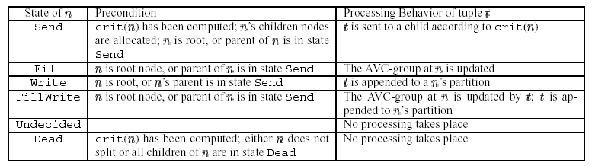
States and Processing Behavior
Notes:
The state S of a node n determines how a tuple is processed at n

Slide 24
Introduction
Background & Motivation
Rainforest Framework
Relevant Fundamentals & Jargon Used
Algorithms Proposed
Experimental Results
Conclusion

Slide 25
Algorithm: Root’s AVC-group Fits in Memory
RF-Write
  Scan the database and construct the AVC-group of r. Algorithm CL is applied and k children of r are created. An additional scan of the database is made to write each tuple t into one of the k partitions.
  Repeat this process on each partition.
RF-Read
  Scan the entire database at each level without partitioning.
RF-Hybrid
  Combines RF-write and RF-read.
  Performs RF-Read while all AVC-Group of new nodes fit in main memory, and switches to RF-Write otherwise.
Notes:
The algos presented here differ in how they utilize additional memory in the 3rd step, and how they deal with insufficient memory to hold an AVC-group in the 1st step.

Slide 26
RF-Write
Assumption: AVC-group of the root node n fits into main memory
state.r=Fill and 1 scan over D is made to construct its AVC-group
CL is called to compute crit(r) and split attribute a into k partitions
K children nodes are allocated to r and state.r=Send, state.children=Write
1 additional pass over D causes crit(r) to be applied to each tuple t read from D.
t is sent to a child c_{t} and appended to its partition as it is in the Write state
The algorithm is then applied to each partition recursively
Algo RF-Write reads the entire database twice and writes it once

Slide 27
RF-Read
Basic Idea: Always read the original database instead of writing partitions for the children nodes
state.r=Fill, 1 scan over D (database) is made and crit(r) is computed and k children nodes are created. If there is enough memory to hold all AVC-groups then 1 more scan of D is made to construct the AVC-groups of all children simultaneously. No need to write out partitions
state.r=Send, state.c_{i}=Fill from Undecided
Now, CL is applied to the in-memory AVC-group of each child node c_{i} to decide crit(c_{i}). If c_{i} splits then state.c_{i}=Send else state.c_{i}=Dead
Therefore, 2 levels ONLY 2 scans of the database
So, why even consider RF-write or RF-Hybrid???
Insufficiency of Memory at some point to hold AVC-groups of all new nodes
Solution: Divide and Rule!!!
Notes:
Since at some point all AVC-groups will not fit into the main memory…

Slide 28
RF-Hybrid
Why do we even need this???
RF-Hybrid=RF-Read until level L with N nodes is reached such that memory becomes insufficient to hold all AVC-groups
Then RF-Hybrid=RF-Write. At this point D is partitioned into m partitions after making 1 scan over it. The algorithm then recurses over each node n belonging to N to complete the subtree rooted at n.
Improvement: Concurrent Construction…
After the switch is made to RF-Write, during the partitioning pass, we do not make use of the main memory. Each tuple is read, processed by the tree and written to a partition. No new information concerning the structure of the tree is made during this pass.
Exploit the observation!!!
Choosing M – knapsack problem…

Slide 29
Algorithm – AVC-group does not fit.
RF-Vertical
  Separate AVC-groups into two sets.
    P_{-large} { AVC-groups where no two sets can fit in memory}
    P_{-small} { AVC-groups that can fit in memory}
  Process P_{-large} each AVC-set at a time.
  Process P_{-small} in memory
Note: The assumption is that each individual AVC-set will fit in memory.

Slide 30
RF-Vertical
AVC-group of root node r does not fit in main memory but each individual AVC-set of r fits.
P_{large} {a1…av}, P_{smal} {av+1..am}, class label – attribute c
Temporary file Z for predictor attributes in P_{large}
1 scan over D produces AVC-groups for attributes in P_{smal}. CL is applied.
But splitting criterion cannot be applied until AVC-sets of P_{large} have been examined. Therefore, for every predictor attribute in P_{large} we make one scan over Z .
Construct the AVC-set for the attribute and call the procedure CL.find_best_partitioning on the AVC-set.
After all v attributes have been examined, call CL.decide_splitting_criterion to compute the final splitting criterion for the node.

Slide 31
Introduction
Background & Motivation
Rainforest Framework
Relevant Fundamentals & Jargon Used
Algorithms Proposed
Experimental Results
Conclusion

Slide 32
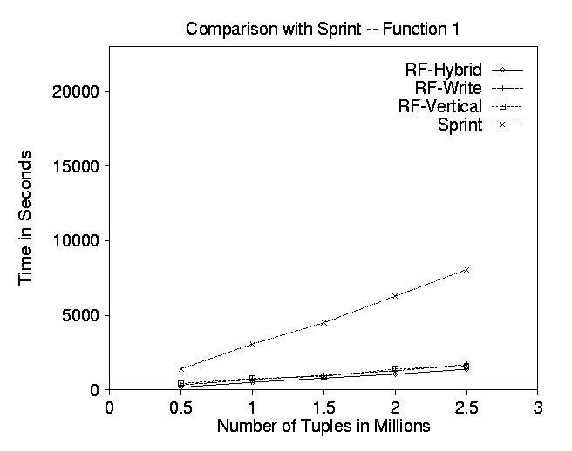
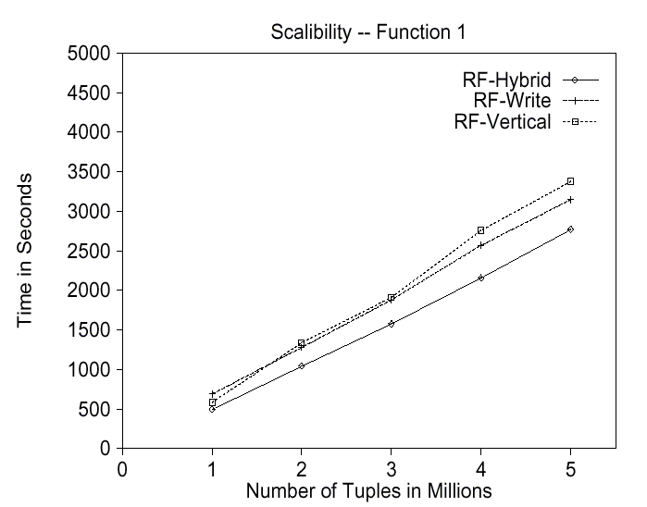
Comparison with SPRINT
Notes:
2.1 milion tuples only 17 MB. Linear to the number of examples….. Same as sprint. But much faster

Slide 33
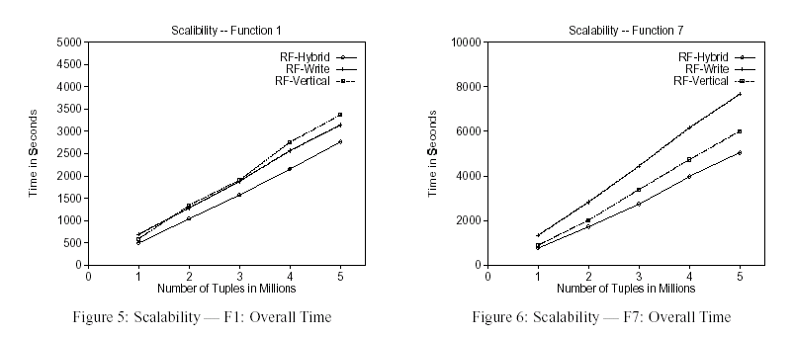
Scalability

Slide 34
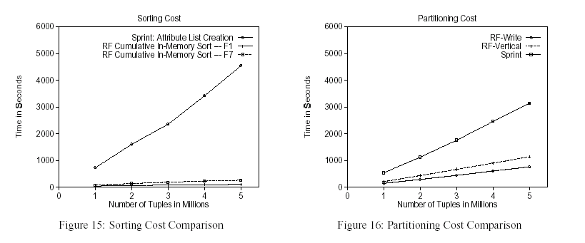
Sorting & Partitioning Costs

Slide 35
Introduction
Background & Motivation
Rainforest Framework
Relevant Fundamentals & Jargon Used
Algorithms Proposed
Experimental Results
Conclusion

Slide 36
Conclusion
Separation of scalability and quality.
Showed significant improvement in scalability performance.
A framework that can be applied to most decision tree algorithm.
Dependent on main memory and size of AVC-group.

Slide 37

Thank You

