Slide 1
Knowledge share on rxjs
by Andrey Lukyanenko

Slide 2
ReactiveX family
Java: RxJava
JavaScript: RxJS
C#: Rx.NET
C#(Unity): UniRx
Scala: RxScala
Clojure: RxClojure
C++: RxCpp
Lua: RxLua
Ruby: Rx.rb
Python: RxPY
Go: RxGo
Groovy: RxGroovy
JRuby: RxJRuby
Kotlin: RxKotlin
Swift: RxSwift
PHP: RxPHP
Elixir: reaxive
Dart: RxDart

Slide 3
Observables

Slide 4
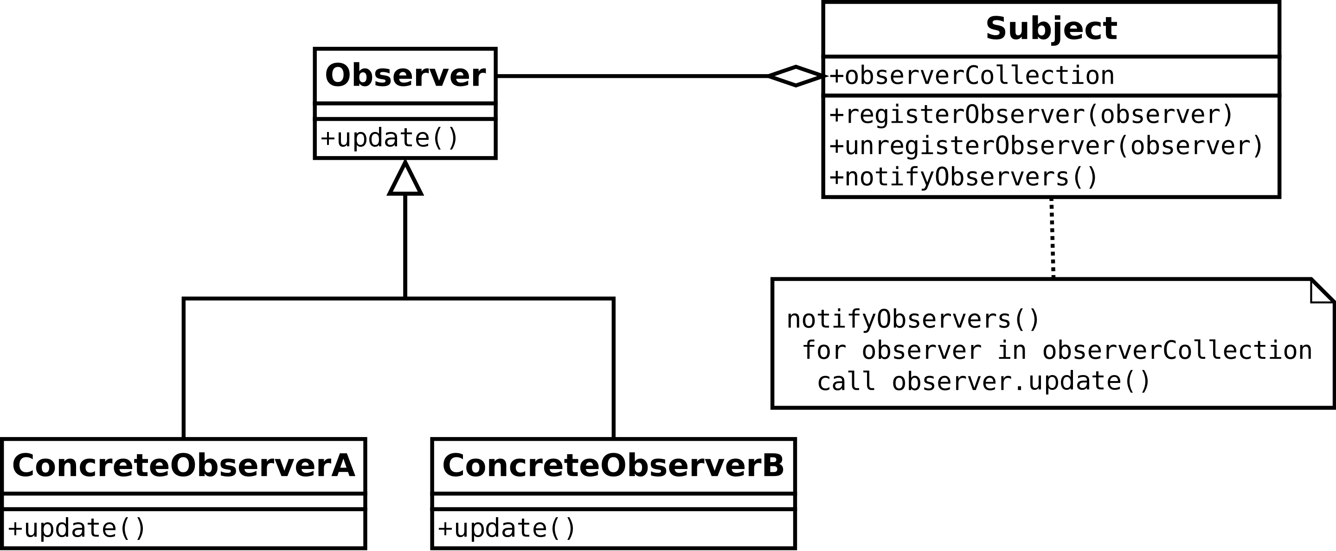
Observer pattern
Classical pattern
Well described in Gang of Four (GoF) book
May be each of us implemented it at least once

Slide 5
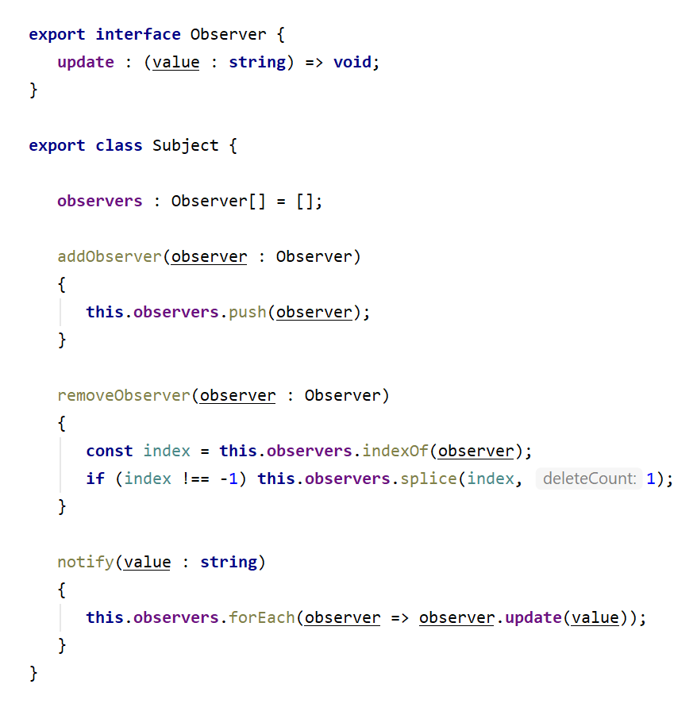
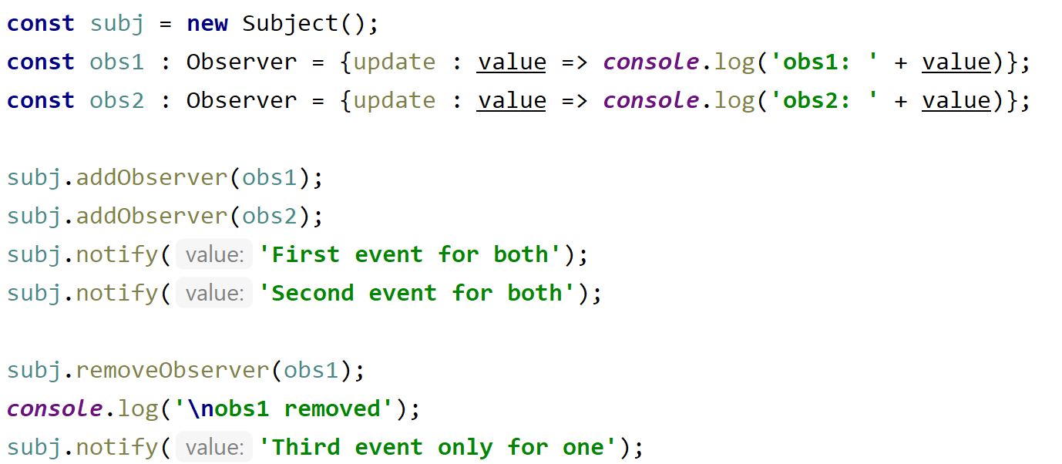
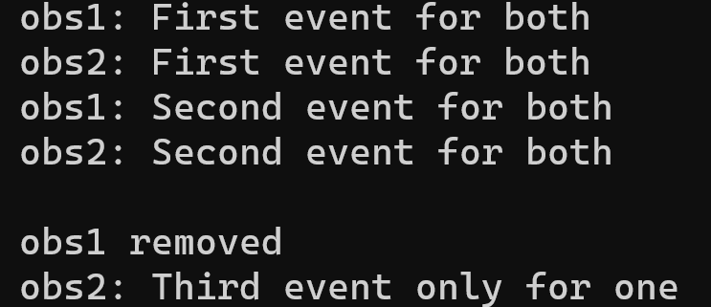
Observer pattern
Design:
Usage:

Slide 6
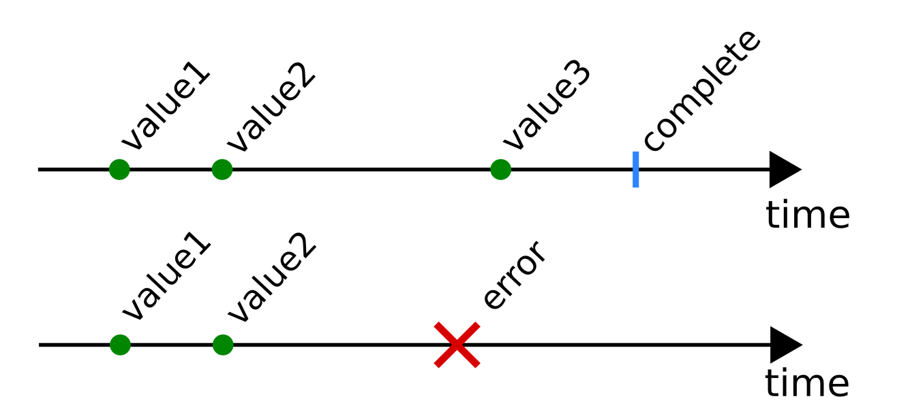
rxjs observer pattern
rxjs observer has 3 callback function instead one
  next(value) – value notification
    update in observer pattern
  error(message) – error notification
  complete() – observable is finalized notification
Observable, is an array of events

Slide 7
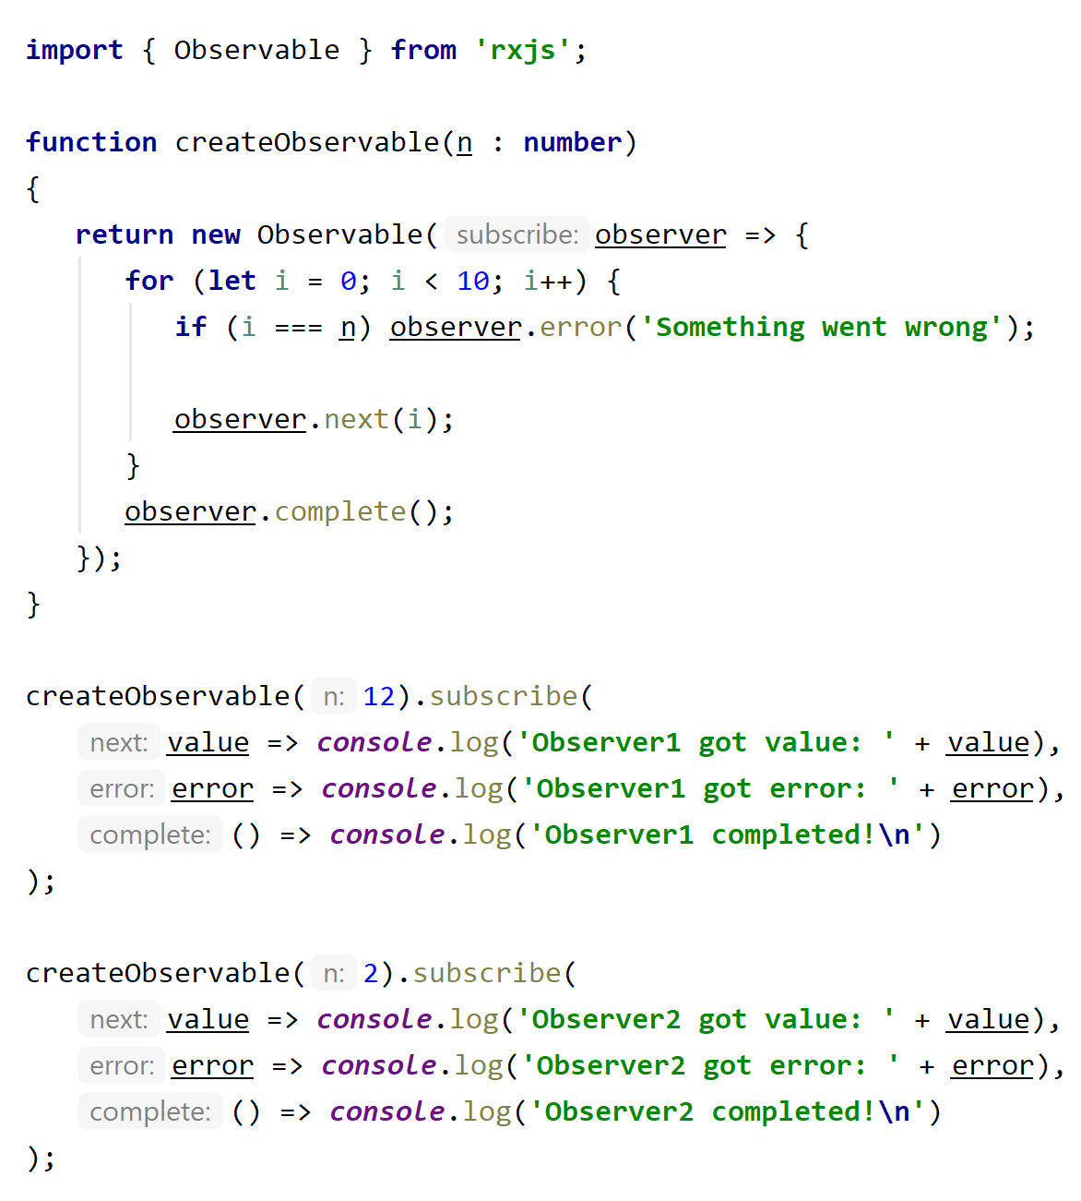
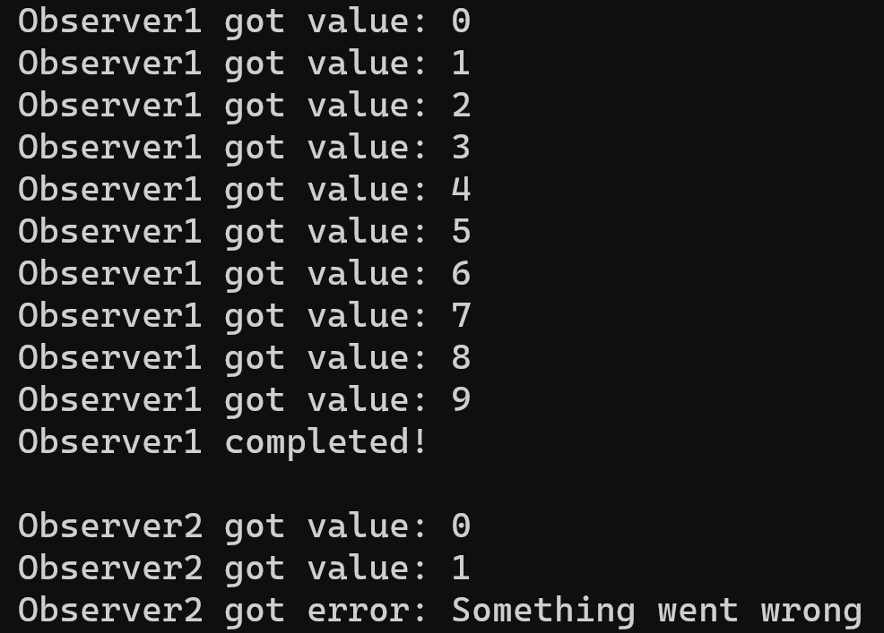
Creating observable

Slide 8
Promise vs Observable
Promises
Single value
Eager executed
Always async
Observables
Multiple values
Lazy executed
Can be sync/async
Streams open to modifications
Hot / cold

Slide 9
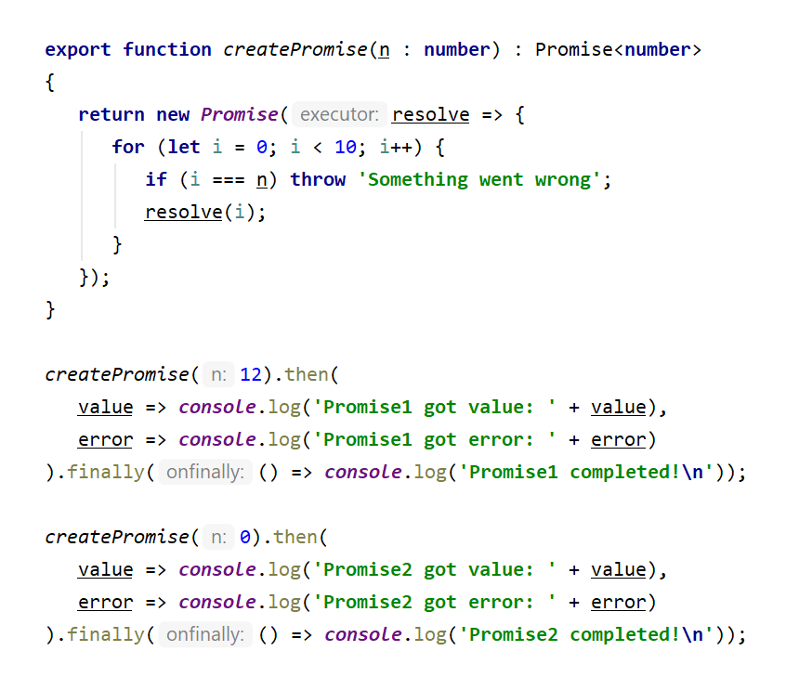
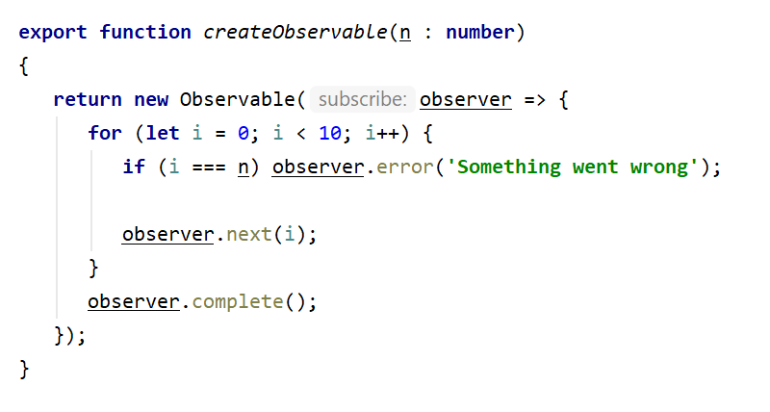
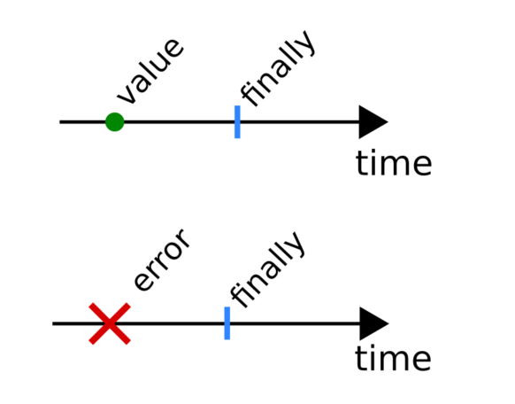
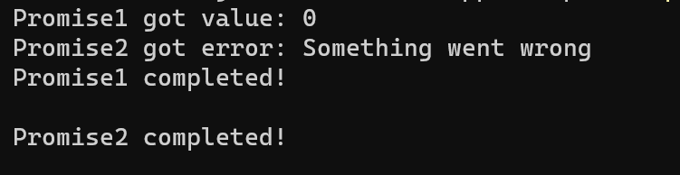
Single vs Multiple values
Compare to observable:

Slide 10
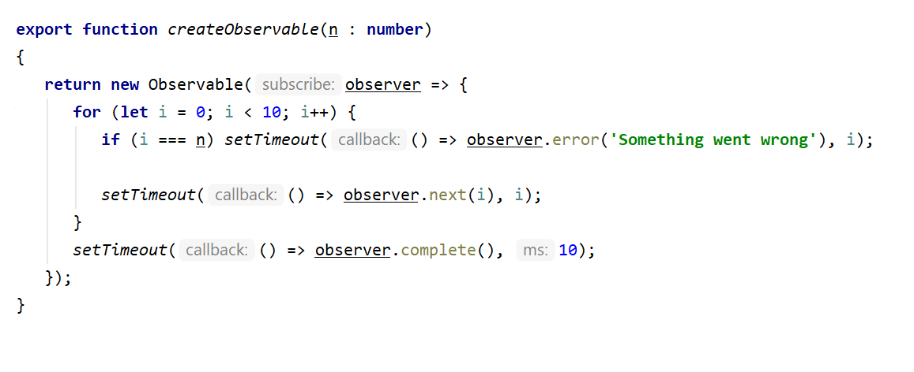
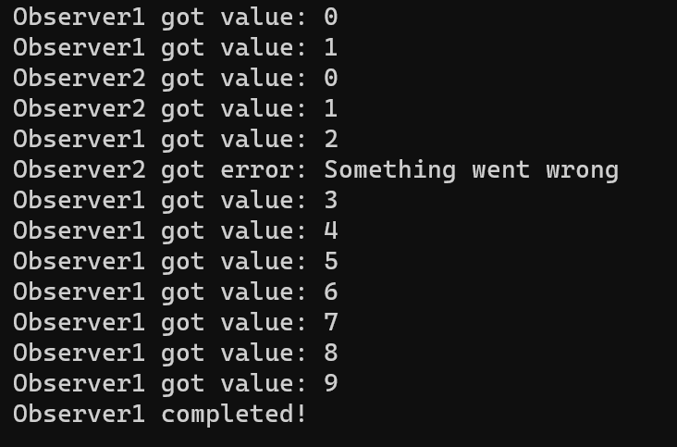
Sync / Async
Sync:
Async:

Slide 11
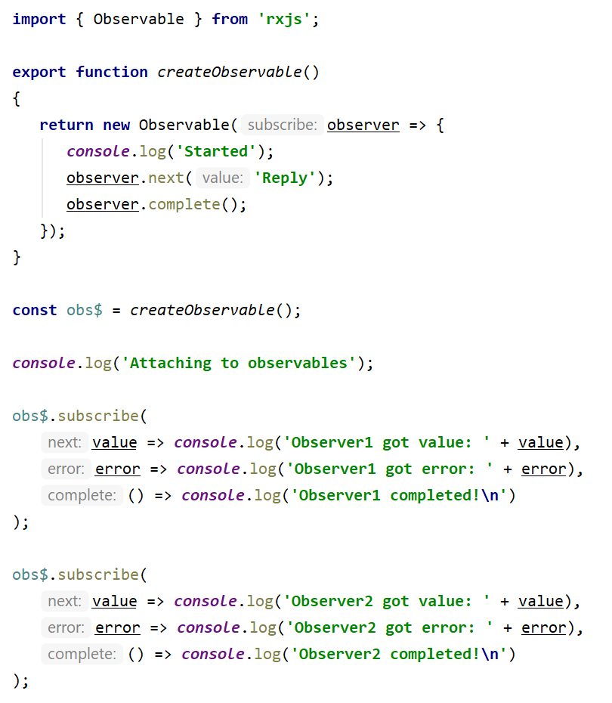
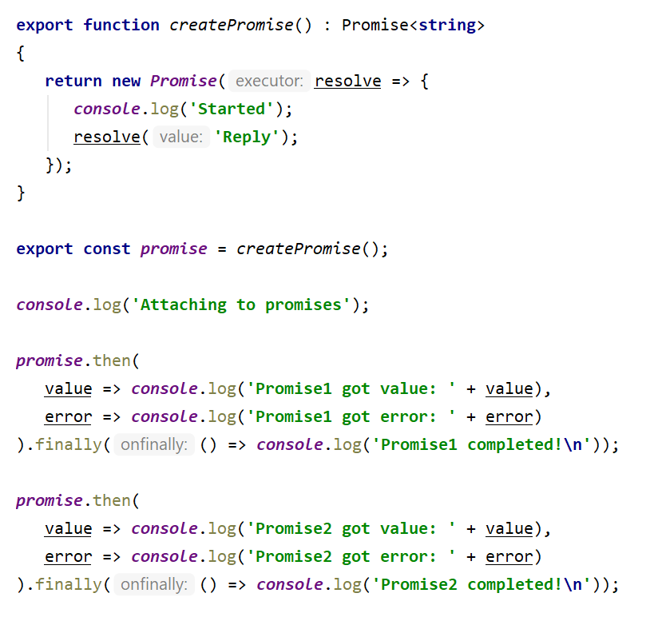
Lazy vs Eager execution

Slide 12
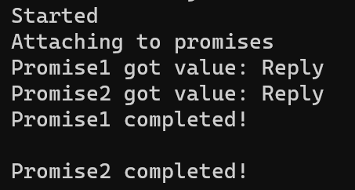
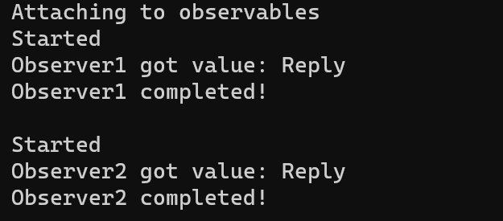
Lazy vs Eager execution

Slide 13
Operators

Slide 14
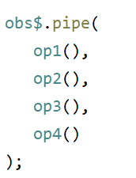
Operators
“Think of RxJS as Lodash for events” (c) rxjs.dev
Operators – are pure function on observables.
With observable obs$, and operators op1(), op2(), op3(), op4(), we can:
  op1()(obs$)
  op2()(op1()(obs$))
  op4()(op3()(op2()(op1()(obs$))))
But we can simplify with pipe():

Slide 15
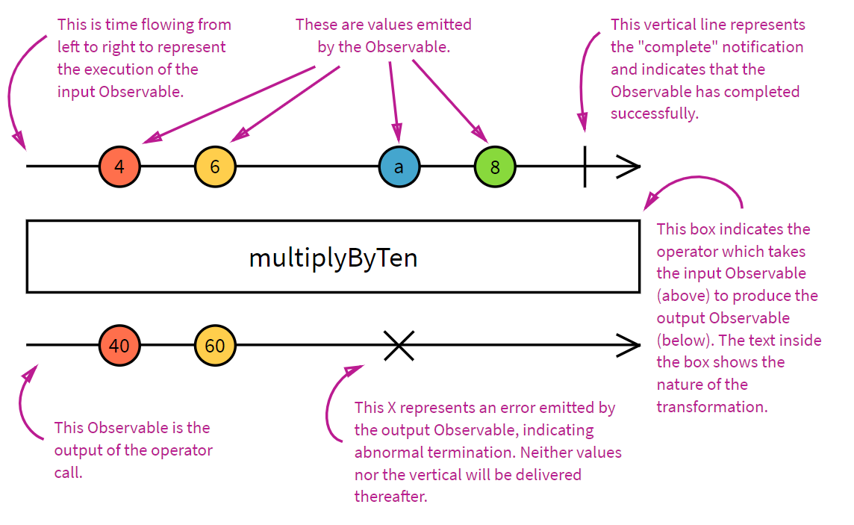
Marble diagram

Slide 16
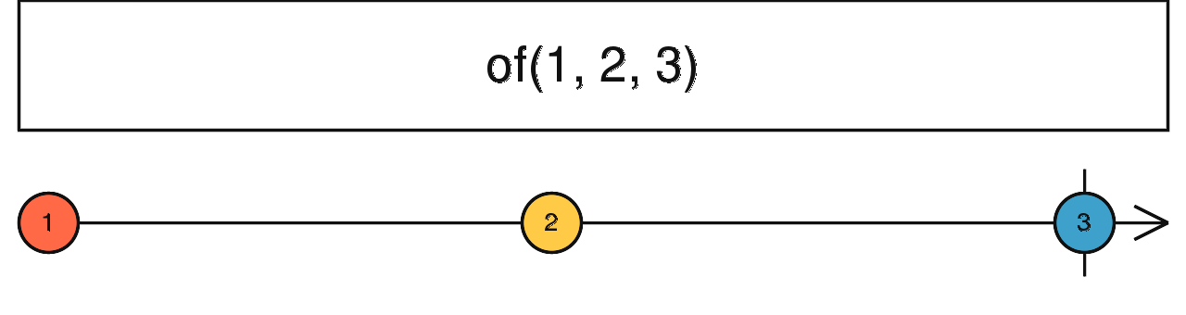
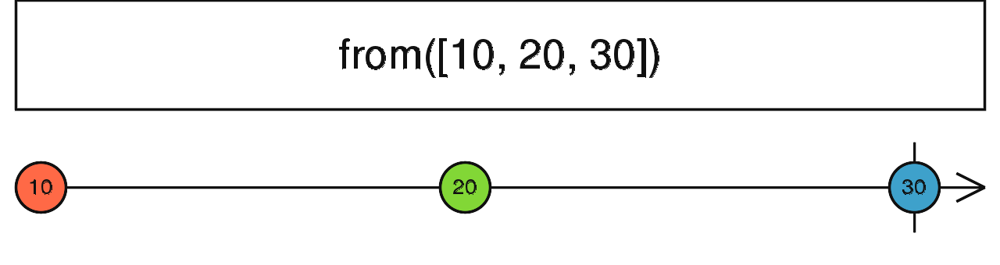
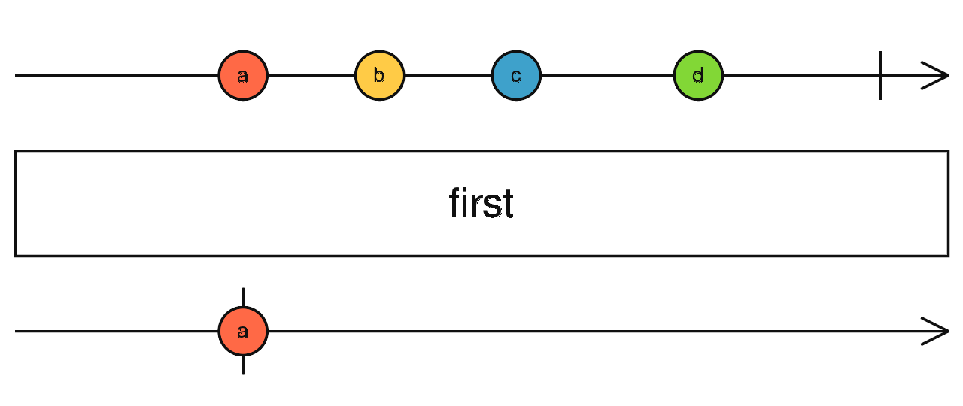
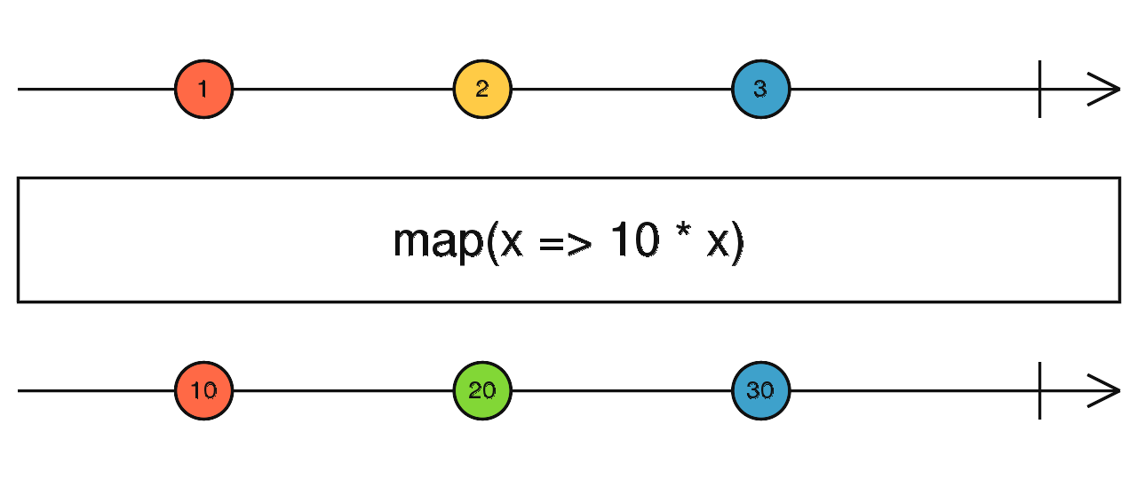
Basic operators
of
  returns observable from value
  values, comma separated emits different values,
  Note difference: of(1, 2, 3) vs of([1, 2, 3])
from: produce observables from
  Promise
  Array
first
  takes first value from observables and complete it
tap
  perform some function over observable value, without modification to stream
map
  maps emited values to new ones

Slide 17
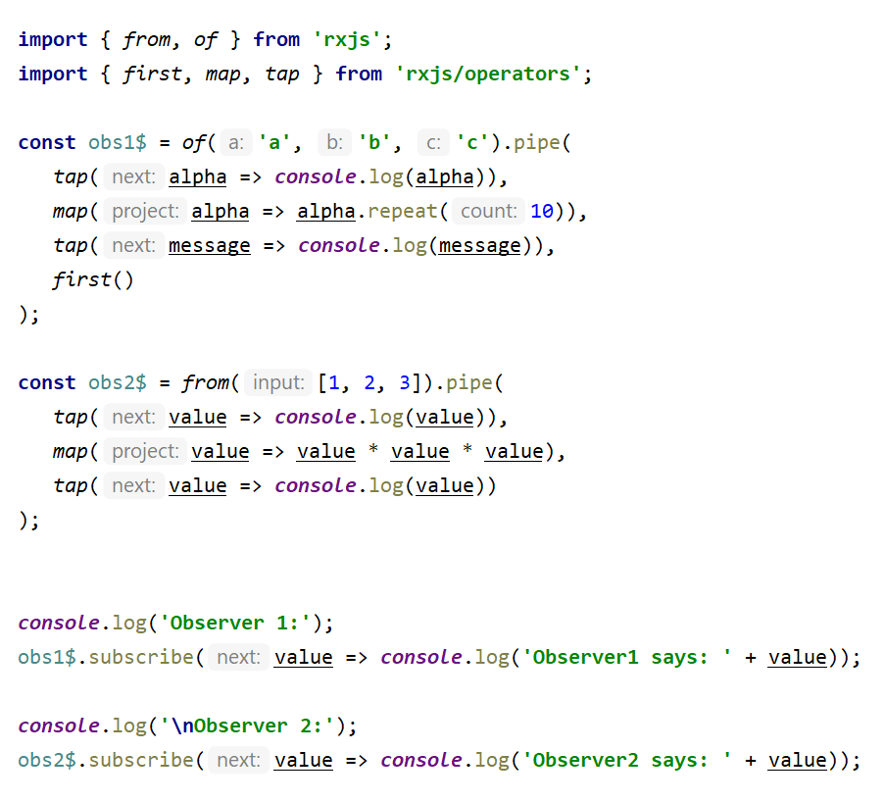
Basic operators

Slide 18
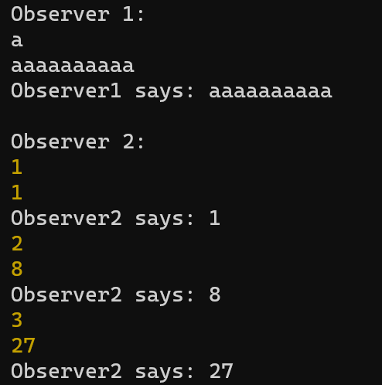
Basic operators

Slide 19
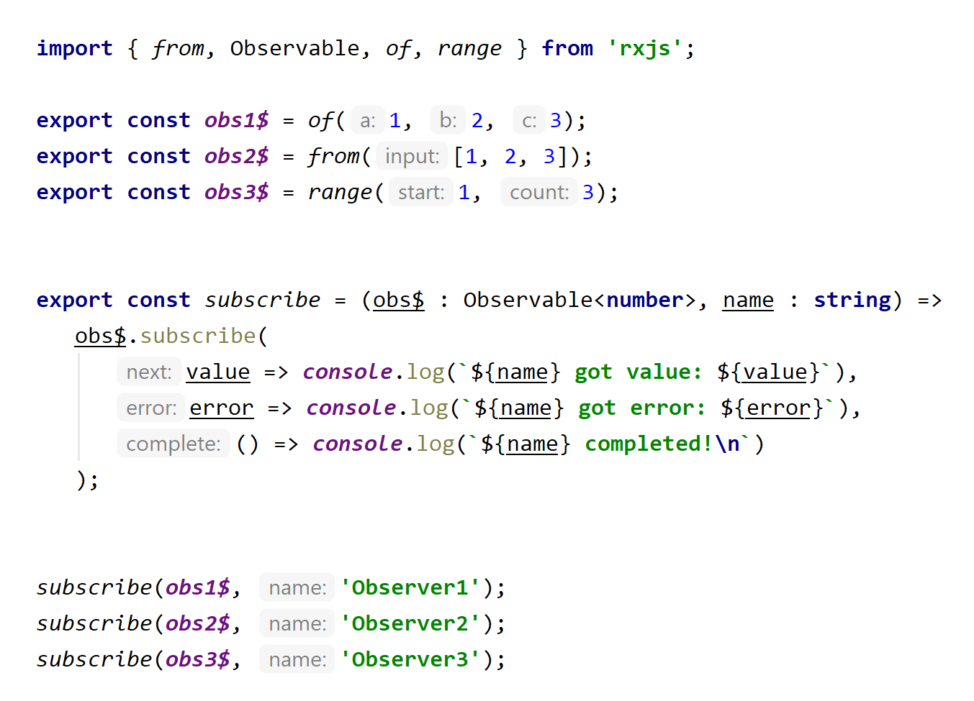
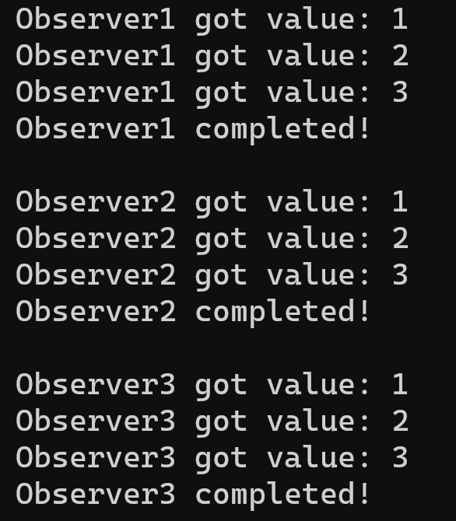
Simplifying creation

Slide 20
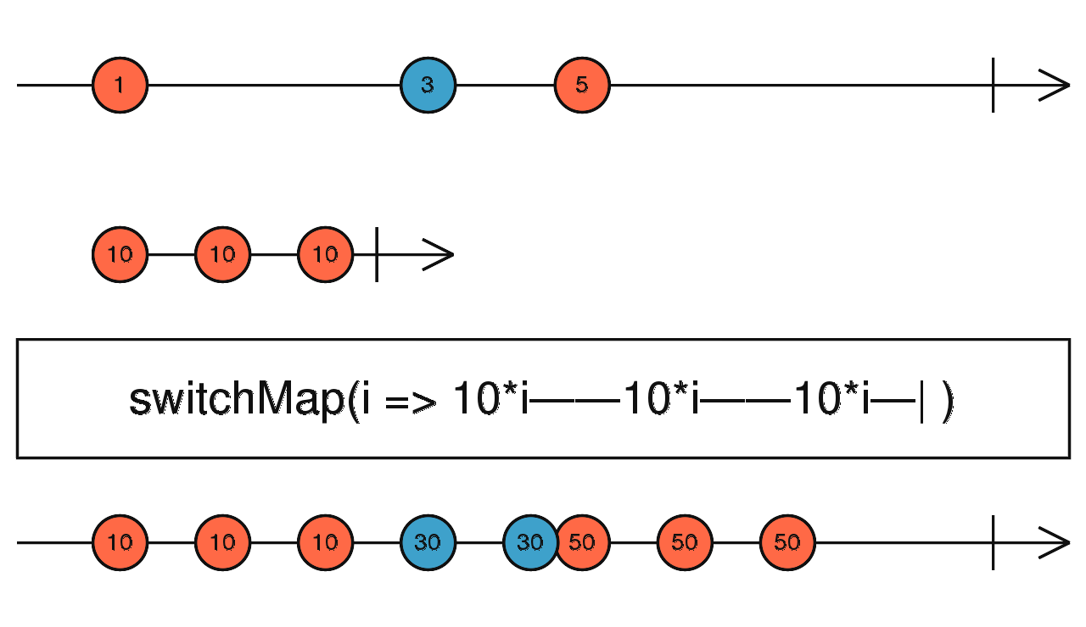
switchMap
Previously we have seen some
  Creation operators (of, from, range, etc)
  Filtering operators (first)
  Utility operators (tap)
  Simple transformation operators (map)
None of them was complex, but there are plenty of complex operators
  First on the way is SwitchMap

Slide 21
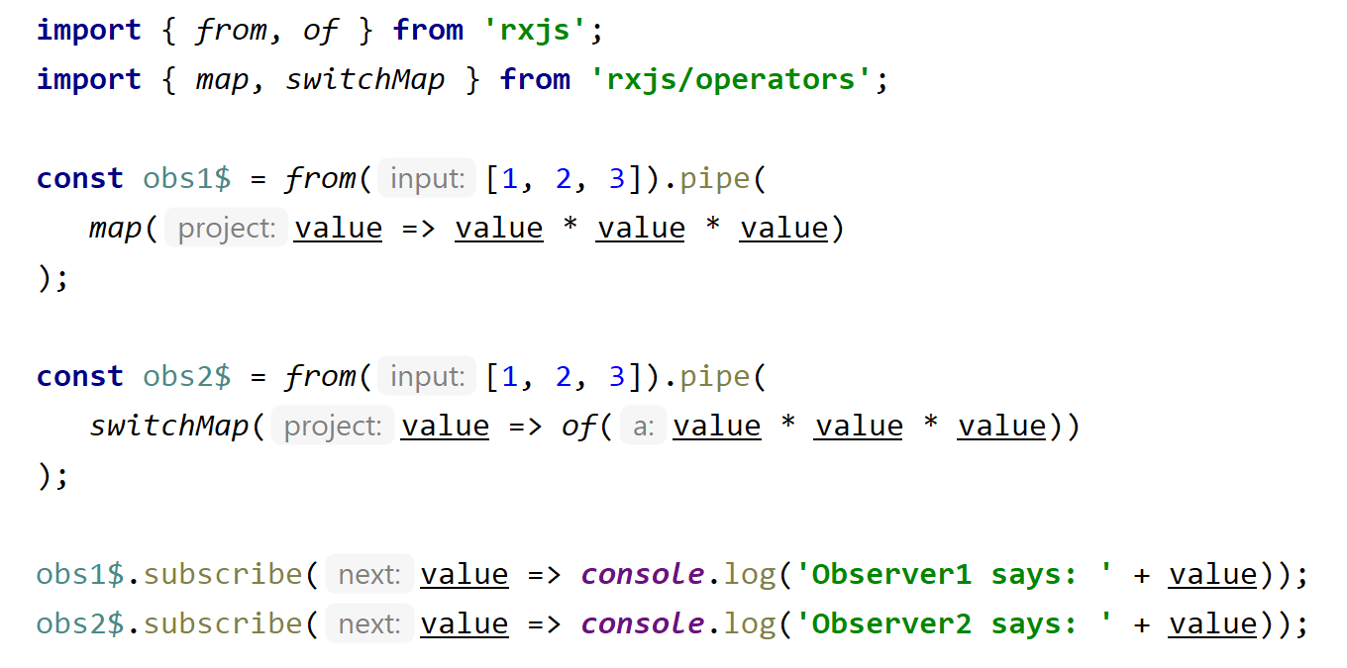
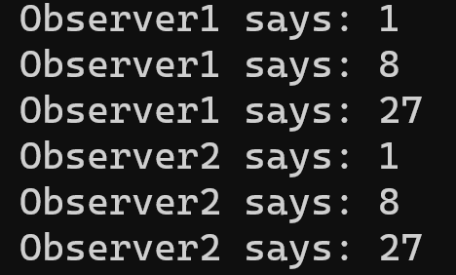
switchMap

Slide 22
Error / catchError / throwError
If error is met observable switches to error stream
Normal operators on the stream omitted
CatchError can return observable on main stream
If error goes to subscriber (observer) the observable becomes closed
There is example...
https://medium.com/sodalabs/rxjava-handling-errors-like-a-pro-8e403dd2126a

Slide 23
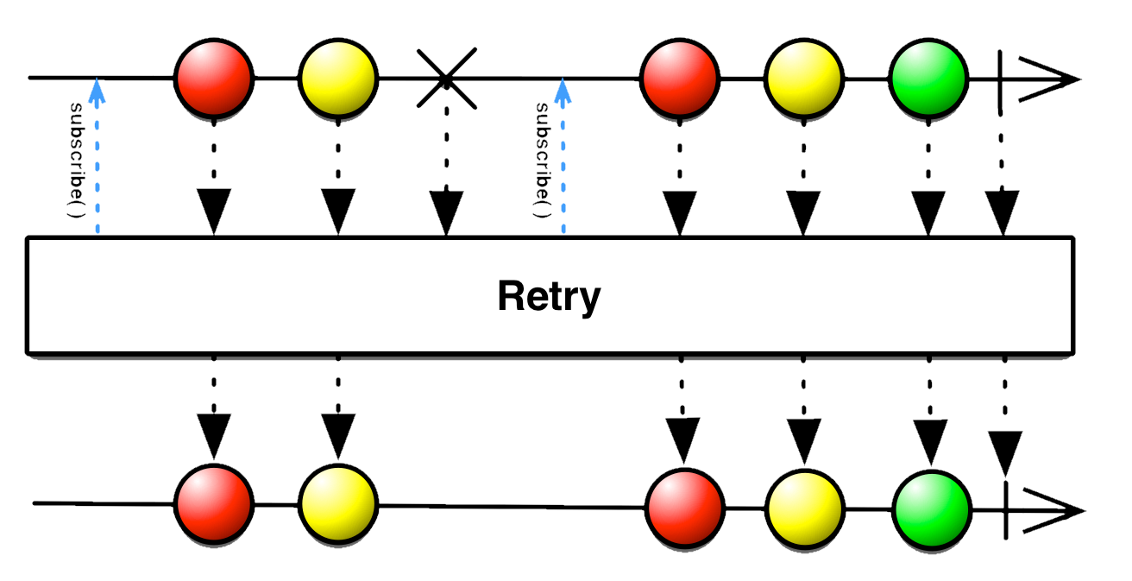
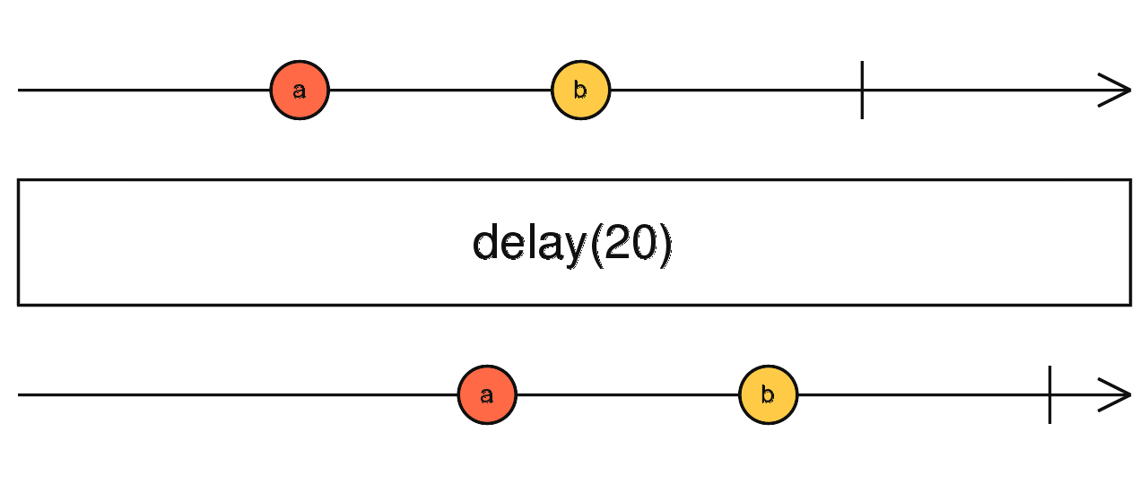
retry / delay / retryWhen
retry
  attempts to retry observable on error
delay
retryWhen – example of very confusing definition:
  Returns an Observable that mirrors the source Observable with the exception of an error. If the source Observable calls error, this method will emit the Throwable that caused the error to the Observable returned from notifier. If that Observable calls complete or error then this method will call complete or error on the child subscription. Otherwise this method will resubscribe to the source Observable.
  better read: https://medium.com/angular-in-depth/retry-failed-http-requests-in-angular-f5959d486294

Slide 24
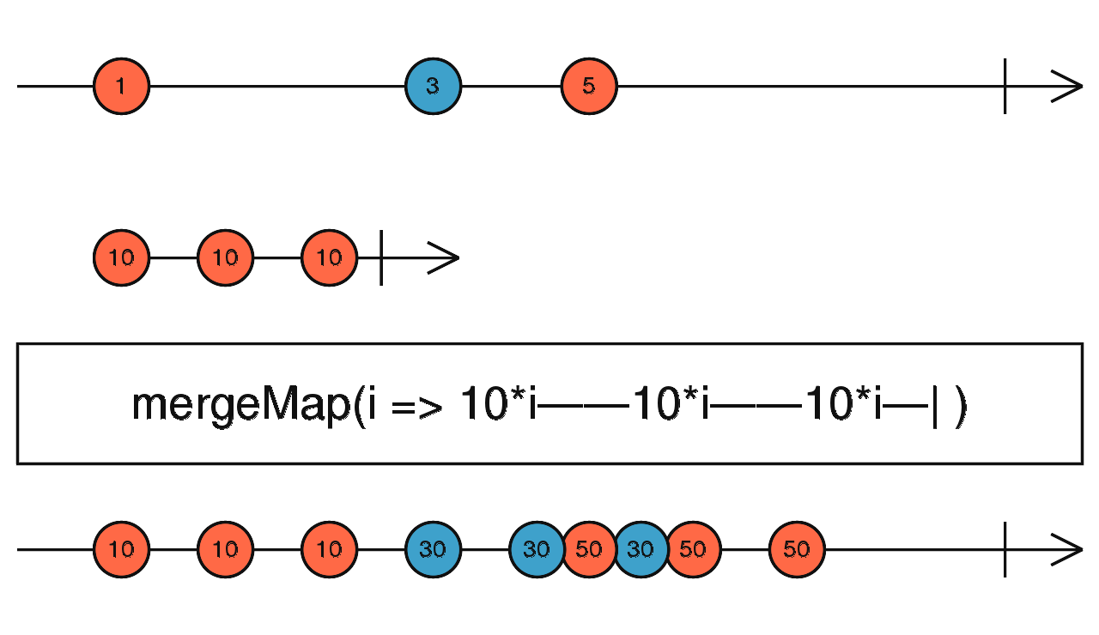
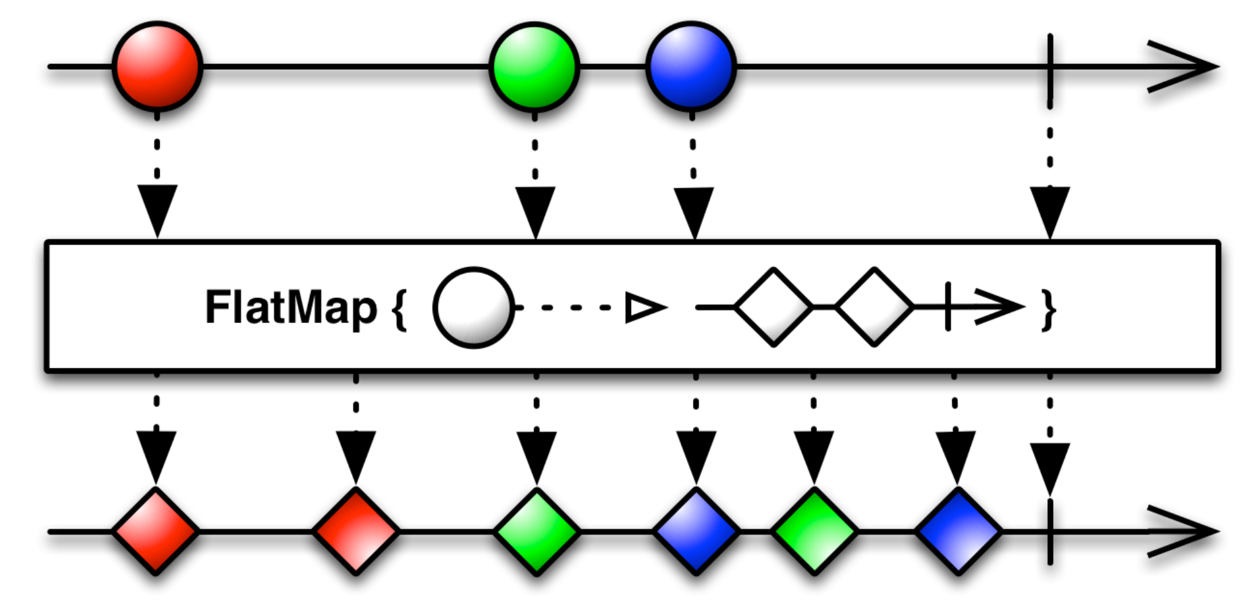
SwitchMap vs FlatMap (mergeMap)

Slide 25
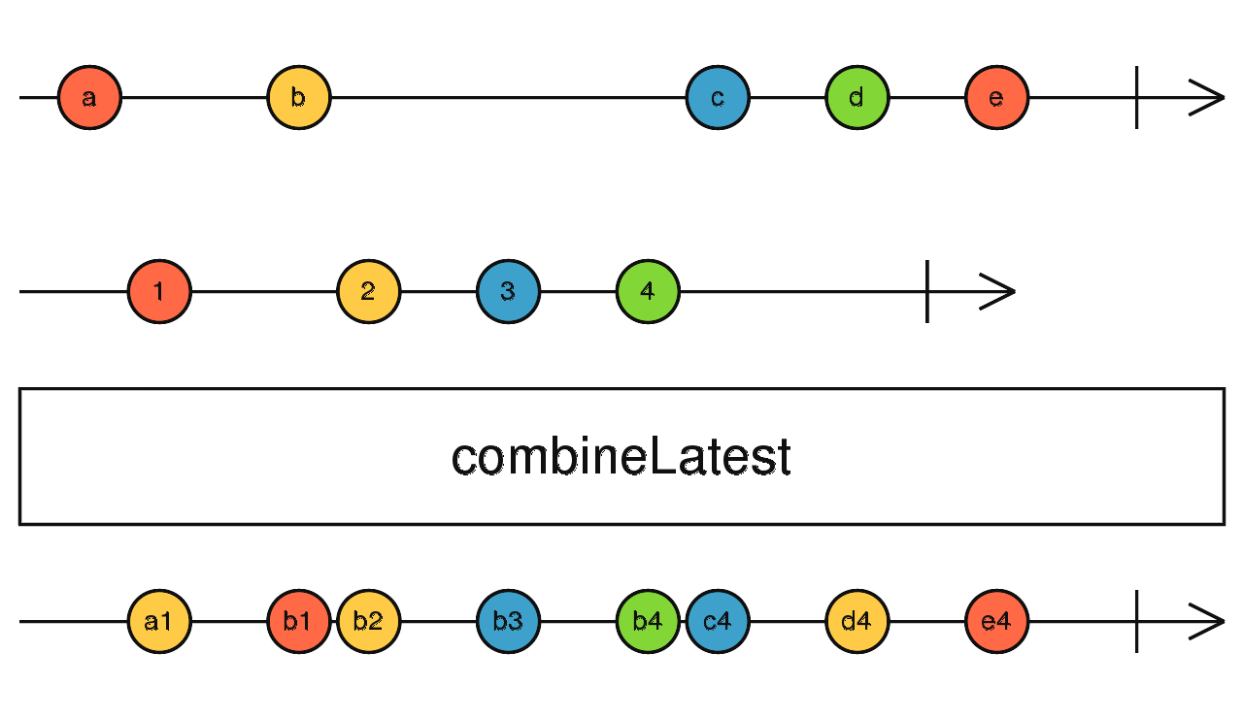
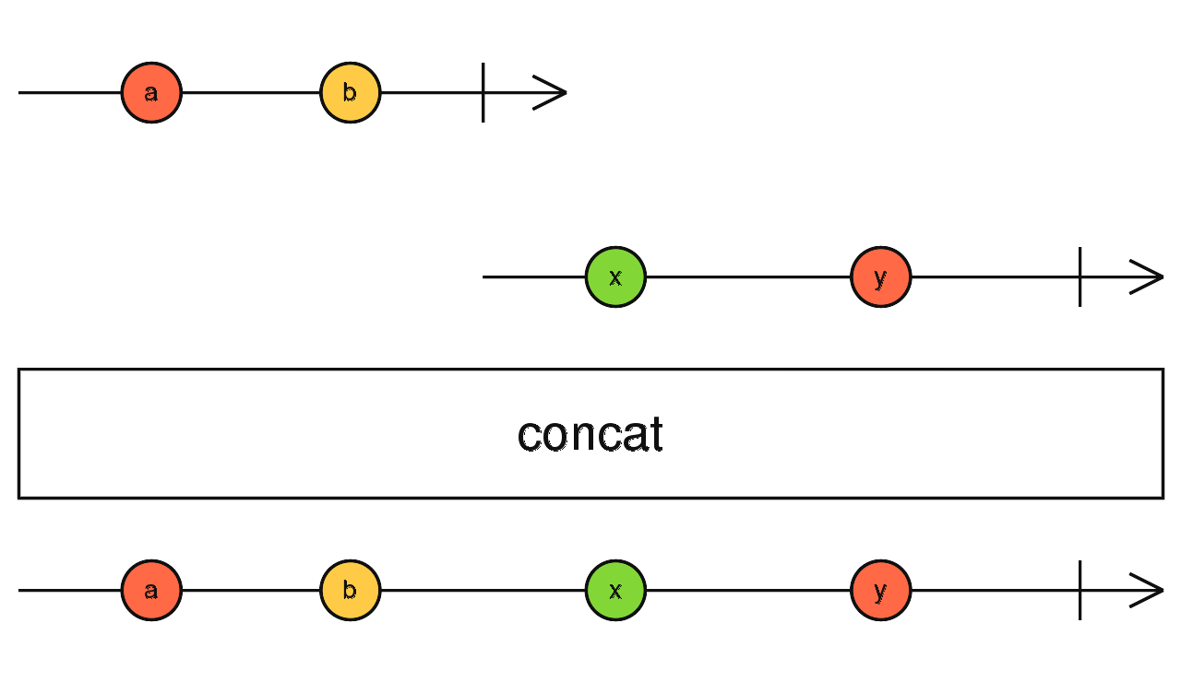
CombineLatest and concat

Slide 26
Subject

Slide 27
Subject
I lied a little bit …
      … when I mentioned observer pattern.

Slide 28
Observer pattern
Design:
Usage:

Slide 29
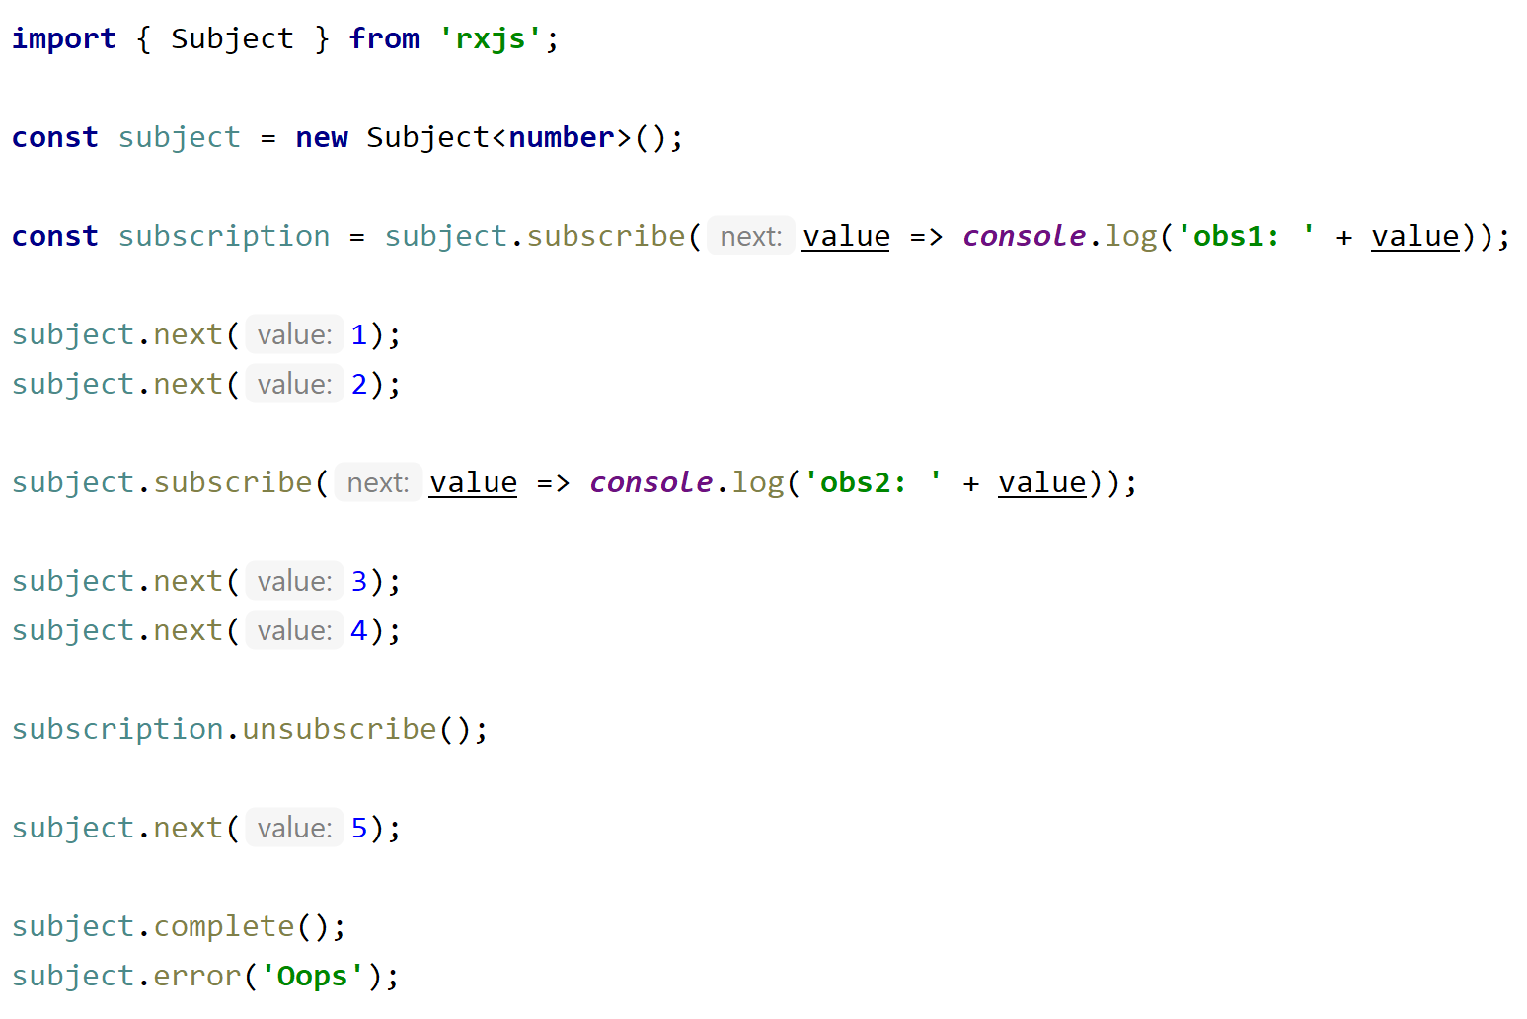
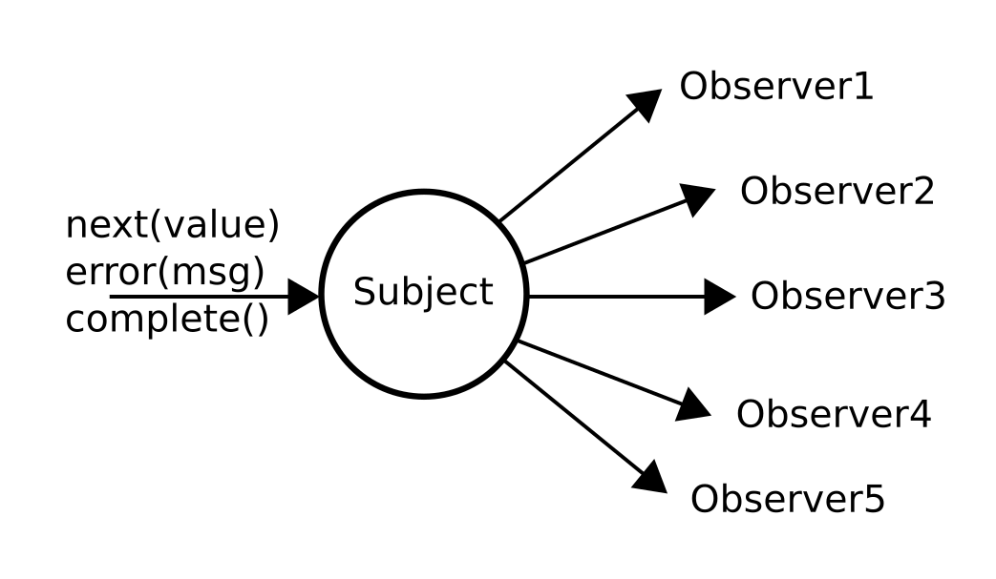
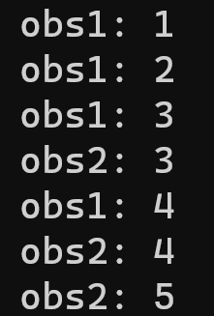
Subject
Subject
  Acts as Observable
  Acts as Observer

Slide 30
Subject
Rxjs has following types of Subjects:
Subject
  normal subject
BehaviorSubject
  stores latest value
  has “hidden” problem: cannot distinguish initial from stored latest value
ReplaySubject
  records multiple values
    const subject = new ReplaySubject(3);
  can have time frame
    const subject = new ReplaySubject(100, 500 /* windowTime */);
AsyncSubject

Slide 31
Pros / Cons
Cons:
No cons for me, but generally...
Time to study
Many operators
Careful memory management
  in some cases memory leak
Naming inconsistency
Big change from rxjs5 to rxjs6
Pros:
Easy to control
  Control of logic not construct helping operations
Easy to extend
Many operators
Lazy execution
Error handling

Slide 32
Thank You

Slide 33
Backup slides

Slide 34
SwitchMap vs FlatMap (mergeMap)

Slide 35
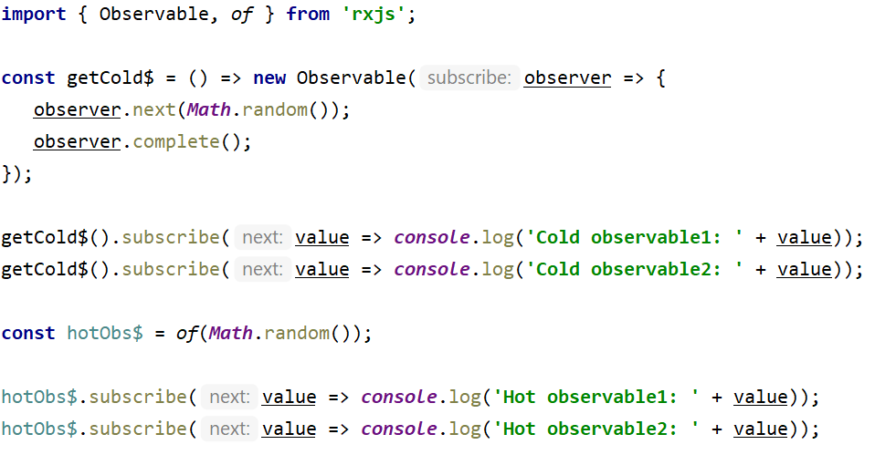
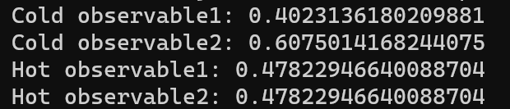
Hot / cold observables
Cold observables, which produce value from observable.
Hot observable which produces value outside.
  Hot observable can be shared
https://medium.com/@luukgruijs/understanding-hot-vs-cold-observables-62d04cf92e03

Slide 36
Memory leakage
const subscription = obs$.subscribe();
subscription.unsubscribe();

Slide 37
Old usage
Previously (before rxjs6) operators were chained:
  obs$.op1().op2().op3().op4()
  Some Internet code still shows examples like that
  You can still write this style with `rxjs-compat` module.
It was decided to switch to “more” pure functions and now all operations are not chainable, instead pipe is used

Slide 38
What is not covered
Scheduler
Marble testing
Full list of operators
  List: https://rxjs.dev/guide/operators
  Tool: https://rxjs.dev/operator-decision-tree

