Slide 1
CS501 – Artificial Intelligence, Fall 2007
“TwixTalicious”
THANH DANG LANFRANCO MUZI ALEXANDER ROSS
Portland State University, November 26th, 2007

Slide 2
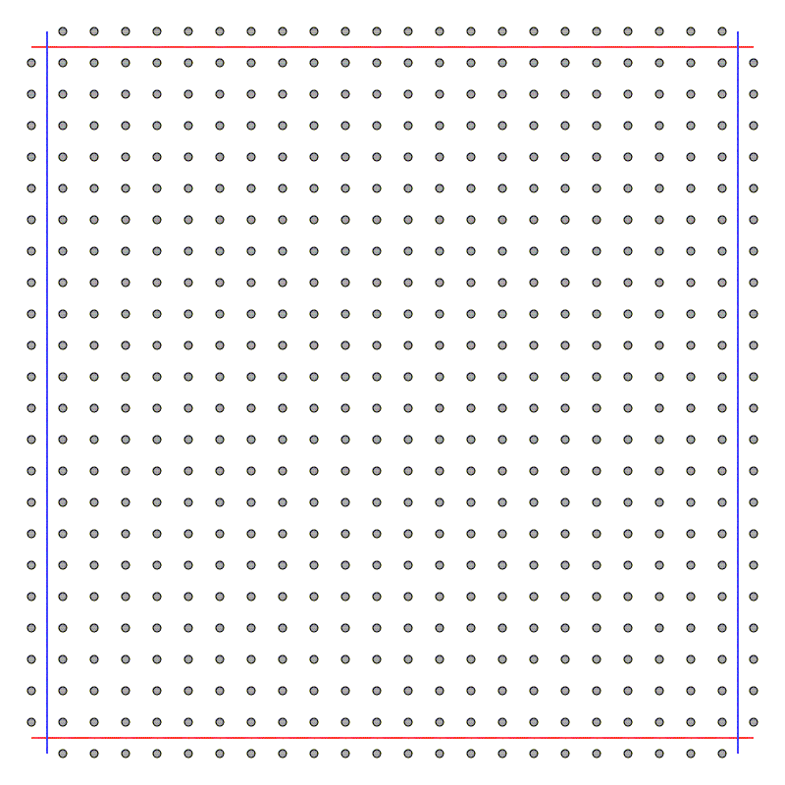
TwixT
Two players (Red and Blue) on 24×24 grid of nodes

Slide 3
TwixT – rules of the game
Topmost and bottommost rows reserved for Red
Leftmost and rightmost rows reserved for Blue
At each move, player claims a node
Two nodes owned by one player may be connected if they are a knight’s move apart
Goal: connect your reserved rows of the board with a path of connected nodes

Slide 4
Sample game

Slide 5
Sample game

Slide 6
Sample game

Slide 7
Sample game

Slide 8
Sample game

Slide 9
Sample game

Slide 10
Sample game

Slide 11
Sample game
Blue
Wins!

Slide 12
Our task
Write a program that improves its playing strategy by learning as it plays.
Compare its performance with that of a player based on a fixed heuristic

Slide 13
What we did
Adapted preexisting Python classes (A. Ross) to represent the game of TwixT
Built web server to play the game (code for rendering game, managing game state)
The computer players

Slide 14
The computer players
Non-learning player (fixed heuristic)
Learning players:
    Perceptron-based
    2-layer Neural Network-based
Based on a value function defined as a weighted summation of a number of features (more later)

Slide 15
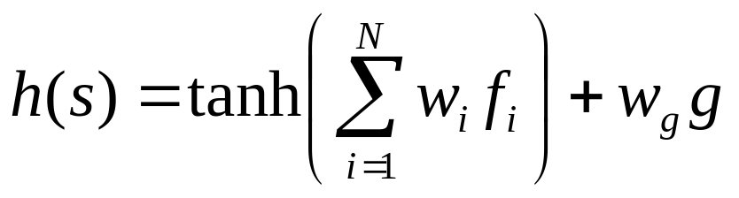
The value function
s = state of the board
f_{i} = value of feature i
w_{i} = weight of feature i
g = “General criterion”
Samuel, A. L., 1959. Some studies in machine learning using the game of checkers. IBM Journal of Research and Development 3 (3), 210-229

Slide 16
Features
Defined by us
Some have obvious “meaning” in terms of proceeding towards goal (general goal). High value = advantage in game
The meaning of others is unclear (helpful when others close to zero?)

Slide 17
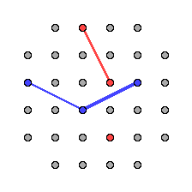
Features – f₁
Let:
P be a player
s = side of the board.
f₁ (P) = (total length of bridges owned by P)/ s²

Slide 18
Features – f₂, f₃, f₄
Let:
P’ be P’s opponent
f₂ (P) = f₁ (P) – f₁ (P’)
f₃ (P) = distance covered by projections of P’s bridges along the direction of the opponent’s edges
f₄ (P) = 1 – f₃ (P’)

Slide 19
Features – f₅, f₆, f₇
Let:
Ncm = number of potentially connectable nodes
Ncn = number of connected nodes
f₅ (P) = Ncm(P)/Ncn(P)
f₆ (P) = +∞ if winning move for P, 0 o/w
f₇ (P) = -∞ if winning move for P’, 0 o/w

Slide 20
Features - g
g (P) = f₃ (P) - f₃ (P’)
It is always assumed that it is to the player’s advantage to be “ahead” of opponent

Slide 21
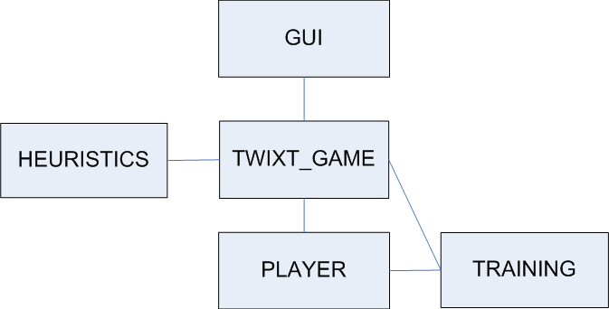
System Architecture

Slide 22
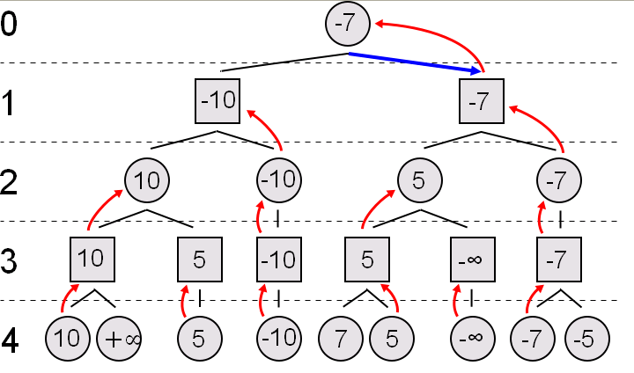
Learning Techniques (1)
MiniMax Search
2 Level Search
Source: http://upload.wikimedia.org/wikipedia/commons/6/6f/Minimax.svg

Slide 23
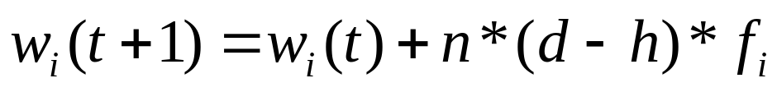
Learning Techniques (2)
Neural Network
Game score
Weights update
Weight for dominant criterion is fixed

Slide 24
Training Process
Random fixed weights vs. dominant criterion
Learning perceptron vs. dominant criterion
Random fixed weights vs. Learning Percep.

Slide 25
Results
Random fixed weights vs. dominant criterion
50 generations
Random Fixed weights | Dominant criterion | draw
50 | 0 | 0

Slide 26
Results
Learning perceptron vs. dominant criterion
50 generations
Learning Perceptron | Dominant criterion | draw
43 | 0 | 7

Slide 27
Results
Random fixed weights vs. Learning Percep.
50 generations
Random fixed weights | Learning Perceptron | draw
50 | 0 | 0

Slide 28
Results
Our testing shows that there is a strong bias for the first player.
Likely a result of the very small board size we trained on (6x6). First player is guaranteed a win by playing a certain strategy.
Even by placing the learning player in the second position, could not achieve a win for player 2.

Slide 29
Results
Depth of search was limited to 2 states. This was purely limited by available horsepower.
  This limits the sophistication play rather severely and also favors player 1.
Another problem is that we likely need more features.

Slide 30
Conclusion
We have a lot of room for improvement.
Improve code efficiency to increase search depth and board size.
Or possibly purchase new supercomputer.
Add (and test) new features.

Slide 31
TwixT – rules of the game 3
Players take turns placing pegs on the board (to claim a node), one peg per turn.
May not place peg on the rows belonging to opponent
May link one or more pairs of pegs on the board which are all your own colour.
The first player to make a continuous chain of linked pieces connecting their two sides wins.

