Slide 1
CS501 – Artificial Intelligence, Fall 2007
“TwixTalicious”
THANH DANG LANFRANCO MUZI ALEXANDER ROSS
Portland State University, November 26th, 2007

Slide 2
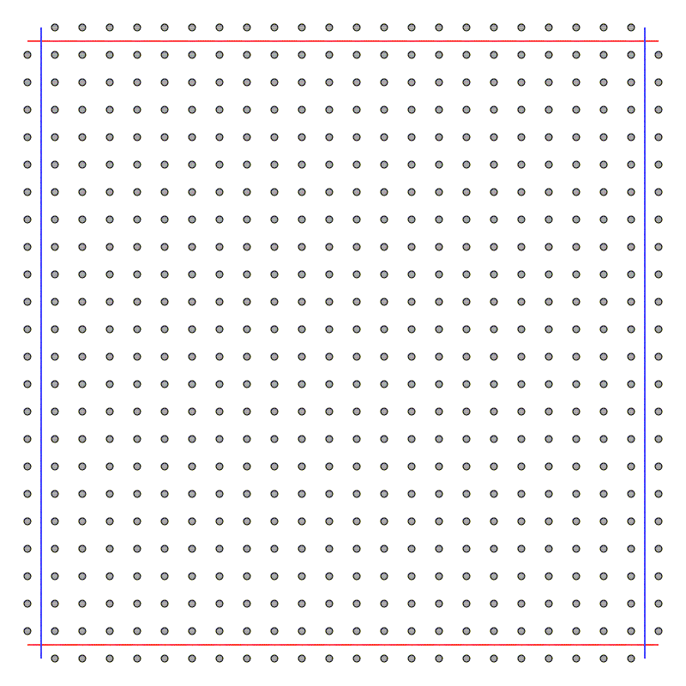
TwixT – rules of the game 1
Two players (Red and Blue) on 24×24 grid of nodes

Slide 3
TwixT – rules of the game 2
Topmost and bottommost rows belong to Red
Leftmost and rightmost rows belong to Blue

Slide 4
TwixT – rules of the game 3
Players take turns placing pegs on the board (to claim a node), one peg per turn.
May not place peg on the rows belonging to opponent
May link one or more pairs of pegs on the board which are all your own colour.
The first player to make a continuous chain of linked pieces connecting their two sides wins.

Slide 5
Sample game

Slide 6
Our task
Write a program that learns to play against a player based on a fixed heuristic

Slide 7
What we did
Adapted preexisting Python classes (A. Ross) to represent the game of TwixT
Built web server to play the game (code for rendering game, managing game state)
The computer players

Slide 8
The computer players
Non-learning player (fixed heuristic)
Learning players:
    Perceptron-based
    2-layer Neural Network-based
Based on a value function defined as a weighted summation of a number of features

Slide 9
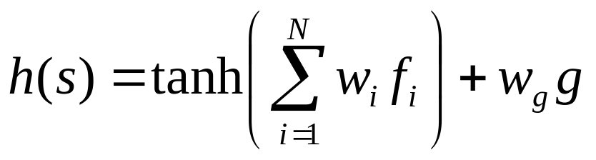
The value function
s = state of the board
f_{i} = value of feature i
w_{i} = weight of feature i
g = “General criterion”

Slide 10
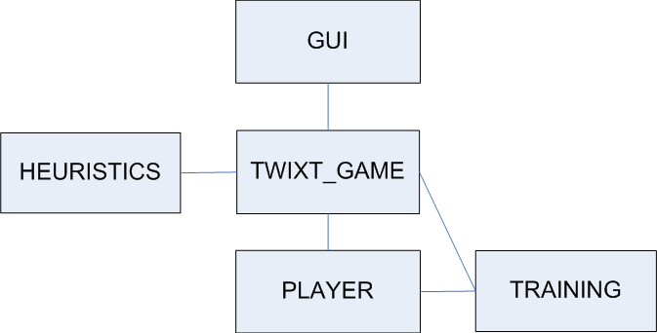
System Architecture
November 26, 2007October 29, 2007

Slide 11
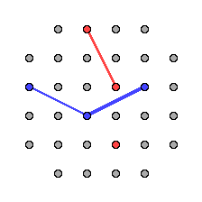
Heuristics Evaluation
Total: 11 Heuristics (only list some here)
Heuristic 3: Longest connected bridge
Heuristic 4: Vertical distance
Heuristic 5: Horizontal distance
Heuristic 8: Number of extendable nodes
Dominant criterion:
November 26, 2007October 29, 2007

Slide 12
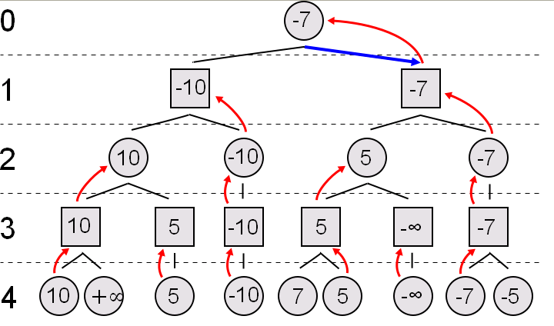
Learning Techniques (1)
MiniMax Search
2 Level Search
Source: http://upload.wikimedia.org/wikipedia/commons/6/6f/Minimax.svg
November 26, 2007October 29, 2007

Slide 13
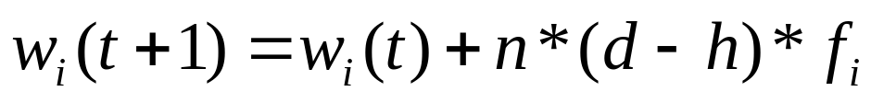
Learning Techniques (2)
Neural Network
Game score
Weights update
Weights for loosing/winning heuristics are fixed
November 26, 2007October 29, 2007

Slide 14
Training Process
Random Static Perceptron vs. function g
Learning perceptron vs. function g
Random Static Percep. vs. Learning Percep.
Learner/Learner
November 26, 2007October 29, 2007

Slide 15
References - I

