Slide 1
STEM EDUCATION & OUTREACH
CELL DIVISION GONE WRONG
Lesson 1
The Normal Cell Cycle
Teacher Facilitation Slides — In-Class Activities
Time: 50–60 min • Format: After students complete the digital lesson • Bloom's: Remember & Understand

Slide 2
OVERVIEW
What students will master today
🎯 LEARNING OBJECTIVES
📋 TODAY'S FLOW
1.
Hook & Recall (5 min)
By the end of this lesson, students will be able to:
Quick check on prior viewing
Name & describe the four phases of the cell cycle (G1, S, G2, M)
List the six stages of mitosis using the PMAT mnemonic
Explain what cytokinesis is and how it differs in animals vs. plants
Identify the three major checkpoints and what each verifies
Describe the multi-hit hypothesis for cancer development
2.
Phases & Vocabulary (10 min)
Card sort + key terms
3.
Six Stages of Mitosis (10 min)
Walk through PMAT together
4.
Decision-Gate Checkpoints (15 min)
Activity: 'Pass or Fail?'
5.
Cancer & Multi-Hit (10 min)
Discussion + Figure 5.1
6.
Exit Ticket (5 min)
Check for understanding
Cell Division Gone Wrong • Lesson 1: The Normal Cell Cycle
2 / 18

Slide 3
HOOK
Here's the question…
"How does your body know
when to make new cells?"
60 sec.: Turn and talk with your partner.
Cell Division Gone Wrong • Lesson 1: The Normal Cell Cycle
3 / 18
Notes:
💡 Teacher Prompt (3 min): Have students turn-and-talk for 60 seconds. Then call on 2–3 pairs. Don't correct yet — just collect ideas. The lesson will give them the answer (checkpoints). Use this to surface prior knowledge and misconceptions.

Slide 4
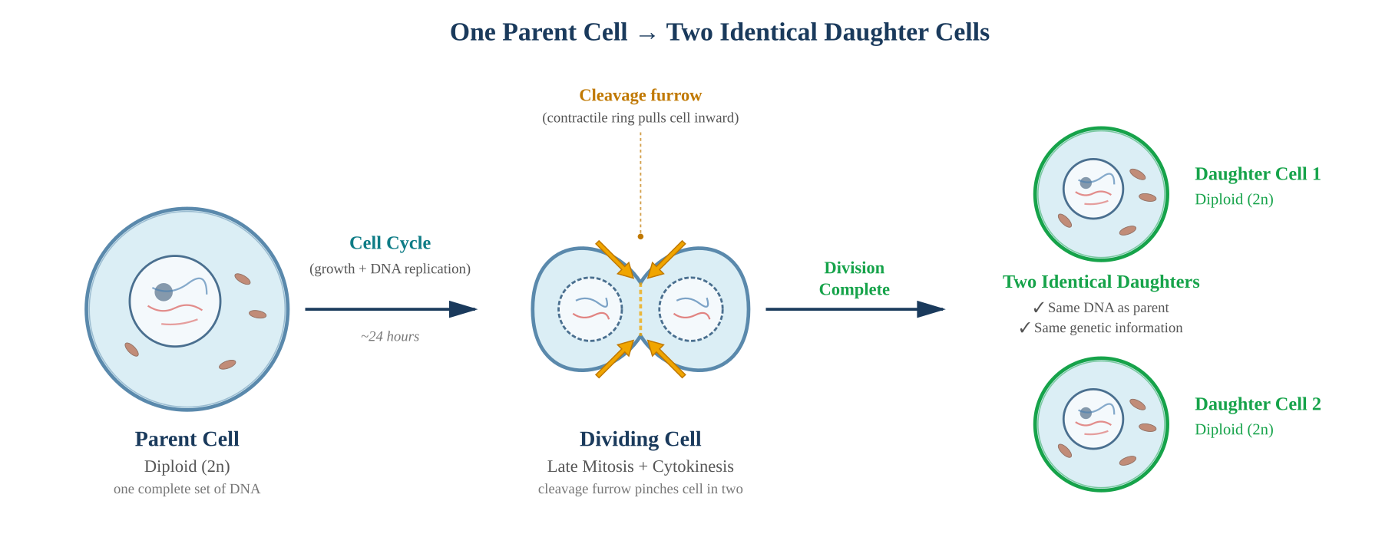
SECTION 1 RECAP
Figure 1.1 — Why Cell Division Matters
🔑 Key Takeaways for Discussion
• Both daughter cells are identical (diploid, 2n) — same DNA, same genes. This is mitosis, not meiosis.
• The cleavage furrow (dashed gold line) is pinched inward by the contractile ring (gold arrows).
• Division takes ~24 hours. Errors get passed to both daughters — quality control matters.
Cell Division Gone Wrong • Lesson 1: The Normal Cell Cycle
4 / 18

Slide 5
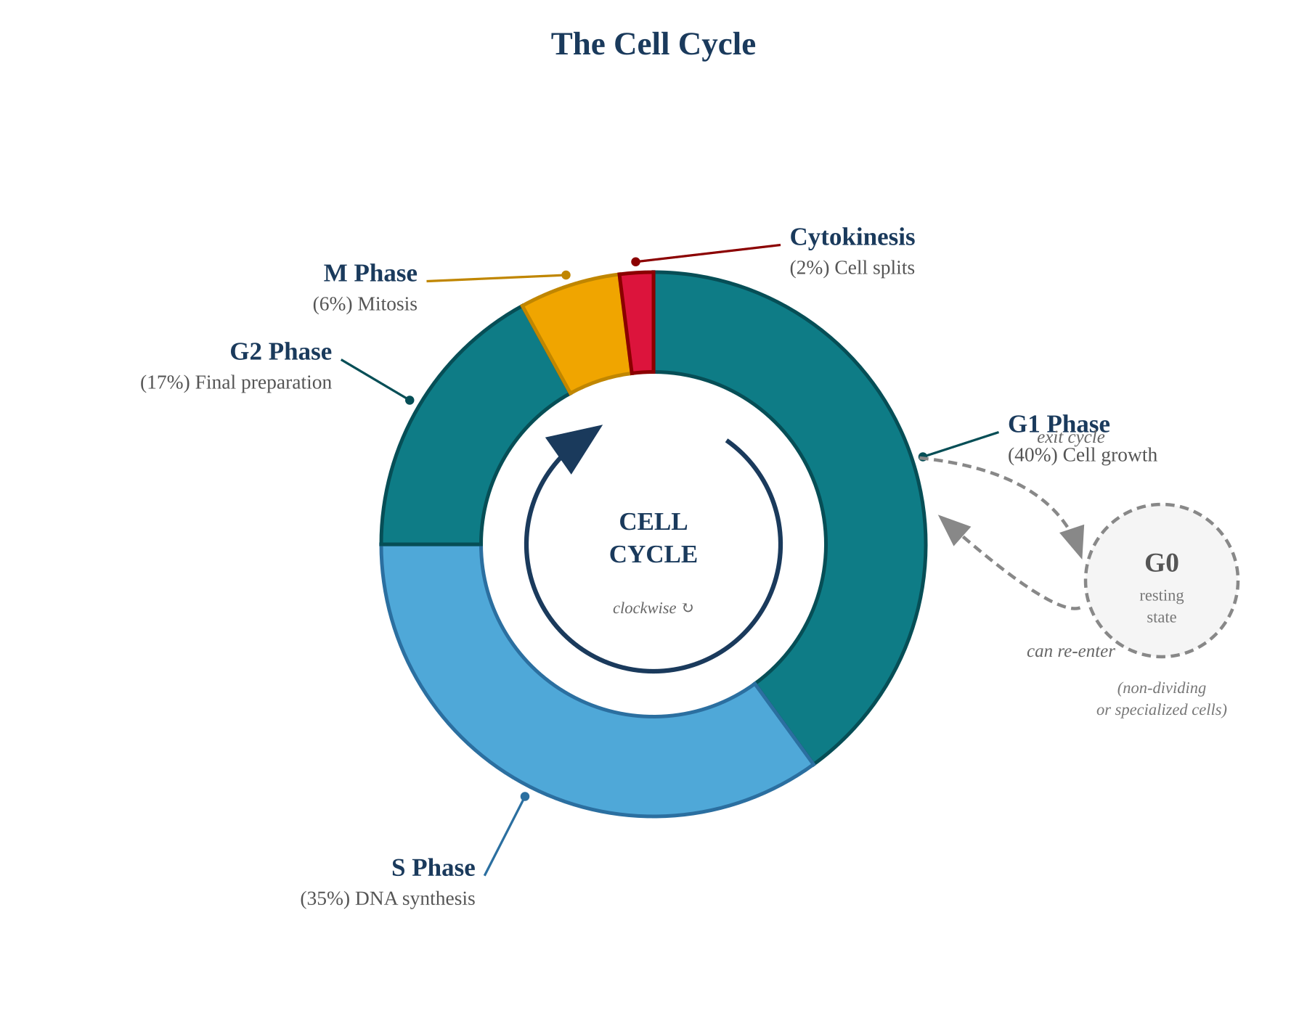
SECTION 2 RECAP
Figure 2.1 — The Cell Cycle: Four Phases + G0
Cycle progresses CLOCKWISE:
G1
Growth Phase 1
Cell grows & does its job
S
Synthesis
DNA is copied — every chromosome doubled
G2
Growth Phase 2
Final prep: check DNA, make division proteins
M
Mitosis
Chromosomes separate; nucleus divides
✕
Cytokinesis
Cell physically splits in two
G0 (resting): Cells can exit to G0. Many nerve & muscle cells stay there permanently.
Cell Division Gone Wrong • Lesson 1: The Normal Cell Cycle
5 / 18

Slide 6
ACTIVITY (8 MIN)
Vocabulary Round-Robin
HOW TO RUN IT
THE 9 KEY TERMS
Quick partner activity using the 9 vocabulary terms from the lesson's Key Structures card.
Chromosome
Sister chromatids
Centromere
Partner A picks a term
Partner B explains it in their own words
Partner A confirms or coaches
Switch roles, pick a new term
Repeat until all 9 terms covered (~5 min)
Kinetochore
Spindle fibers
Centrosome / Centrioles
Nuclear envelope
Cleavage furrow
Contractile ring
Cell Division Gone Wrong • Lesson 1: The Normal Cell Cycle
6 / 18

Slide 7
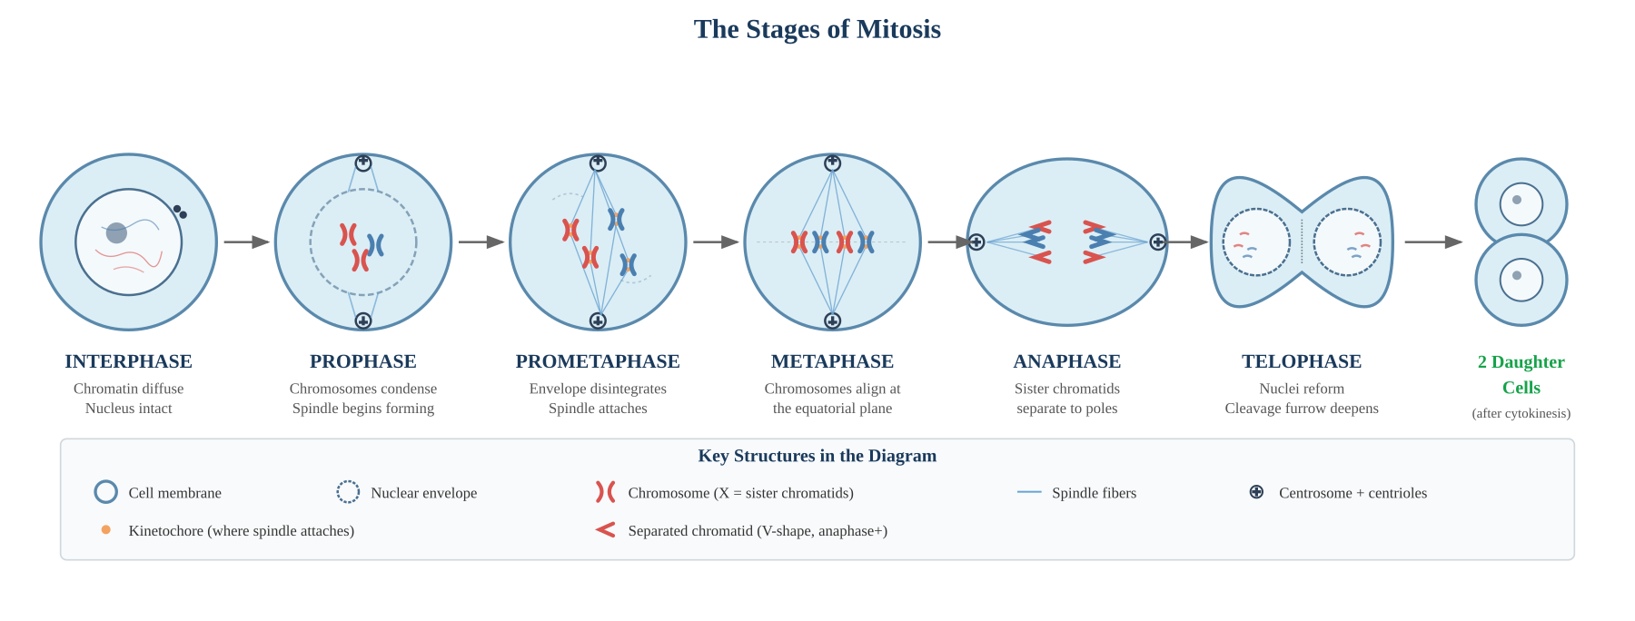
SECTION 4 RECAP
Figure 2.2 — The Stages of Mitosis
PMAT = Prophase → Metaphase → Anaphase → Telophase
📺 REPLAY OPTION: Show Video 1.3 (Amoeba Sisters PMAT, 7:55) if students need a refresher — pair with Figure 2.2 above.
Cell Division Gone Wrong • Lesson 1: The Normal Cell Cycle
7 / 18

Slide 8
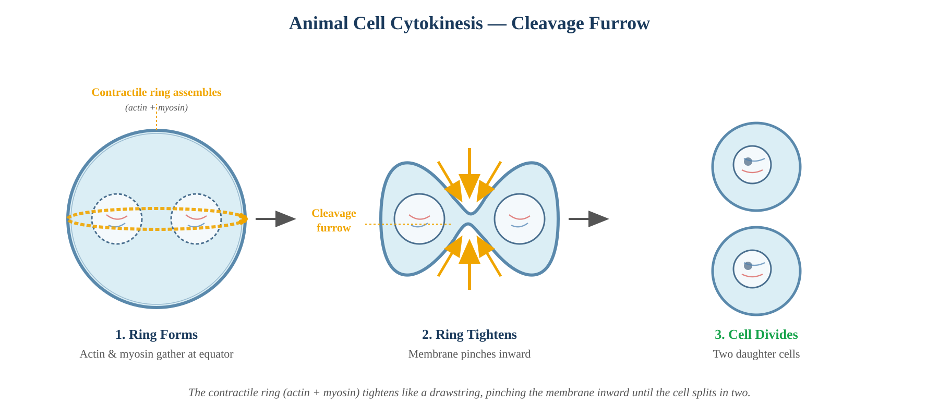
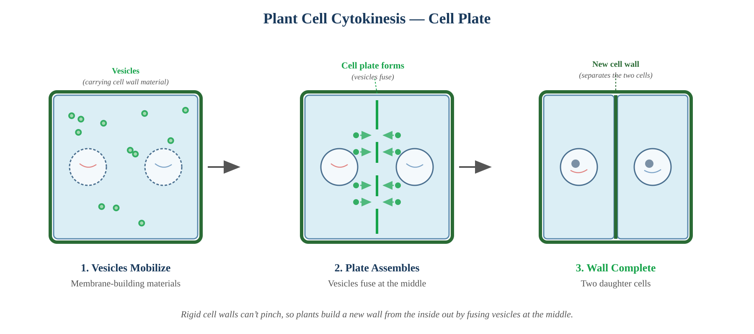
SECTION 5 RECAP
Cytokinesis: Splitting the Cell
🐾 ANIMAL CELLS — Cleavage Furrow
🌿 PLANT CELLS — Cell Plate
Contractile ring forms at the equator (actin + myosin)
Ring tightens like a drawstring — pinches inward
Membrane splits into two daughter cells
Rigid cell walls can't pinch — too stiff!
Vesicles carry wall materials to the center and fuse
New cell wall builds from the inside out
📺 Watch Video 1.4 — actual sea urchin embryo cytokinesis (real microscopy footage)
Cell Division Gone Wrong • Lesson 1: The Normal Cell Cycle
8 / 18

Slide 9
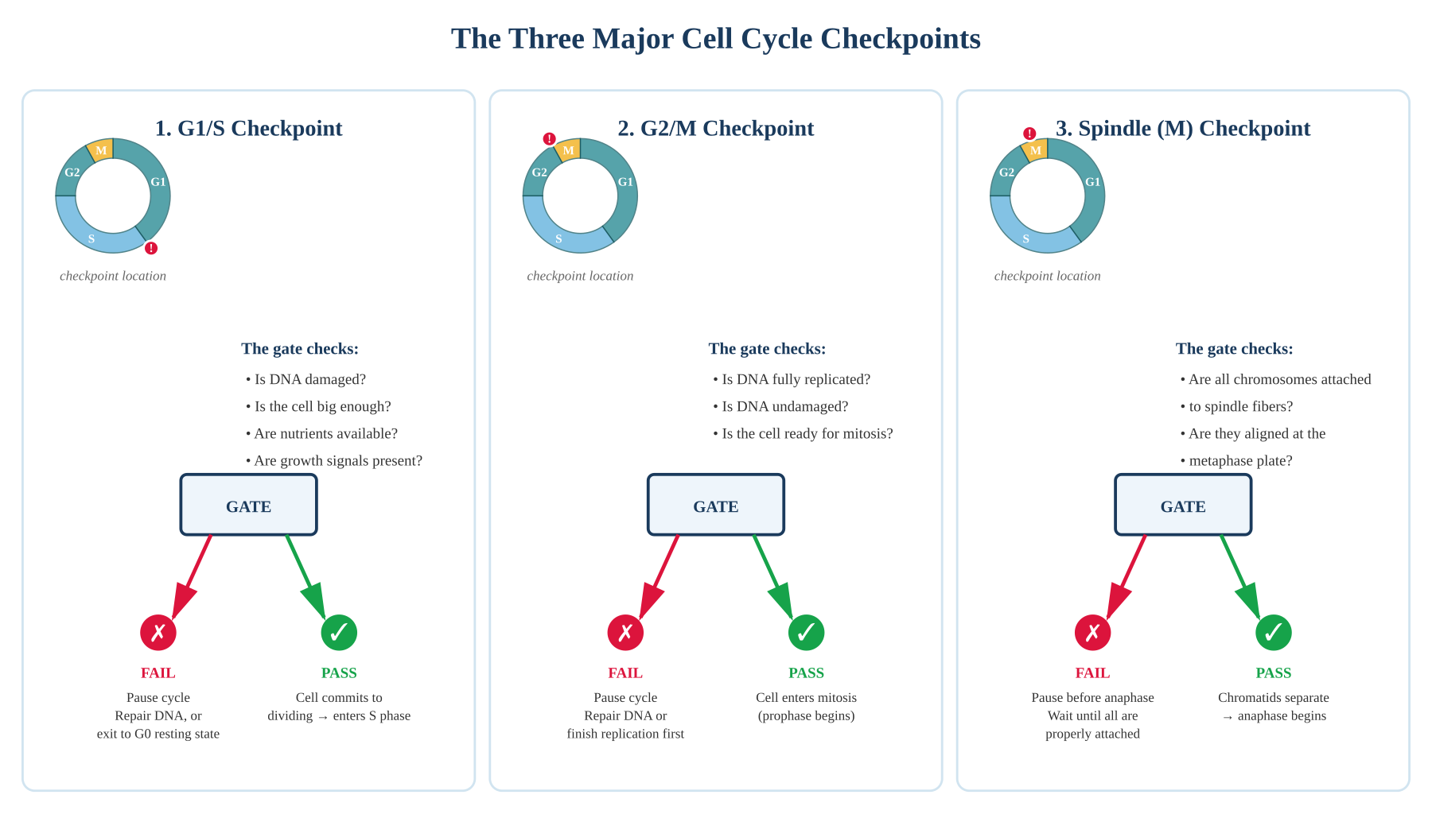
SECTION 6 RECAP
Figure 3.1 — The Three Checkpoint Gates
Cell Division Gone Wrong • Lesson 1: The Normal Cell Cycle
9 / 18
Notes:
🎯 Point students to each gate: the location in the cycle (mini wheel), what it checks, and what happens if it PASSES ✓ vs FAILS ✗.

Slide 10
ACTIVITY (12 MIN)
PASS or FAIL? — Checkpoint Decisions
How it works: Read each scenario aloud. Students hold up GREEN (PASS) or RED (FAIL) cards (or thumbs up/down). Then ask one student to explain WHY?
1
G1/S
FAIL
2
G2/M
PASS
DNA was damaged by UV light from a sunburn.
All DNA was successfully replicated; no damage detected.
→ DNA must be repaired before S phase.
→ Cell can enter mitosis safely.
3
Spindle (M)
FAIL
4
G1/S
PASS
One chromosome's kinetochore isn't attached to a spindle fiber.
Cell is healthy, has nutrients, and growth signals are present.
→ Anaphase paused — would split chromosomes wrong otherwise.
→ Cell commits to dividing — enters S phase.
Cell Division Gone Wrong • Lesson 1: The Normal Cell Cycle
10 / 18

Slide 11
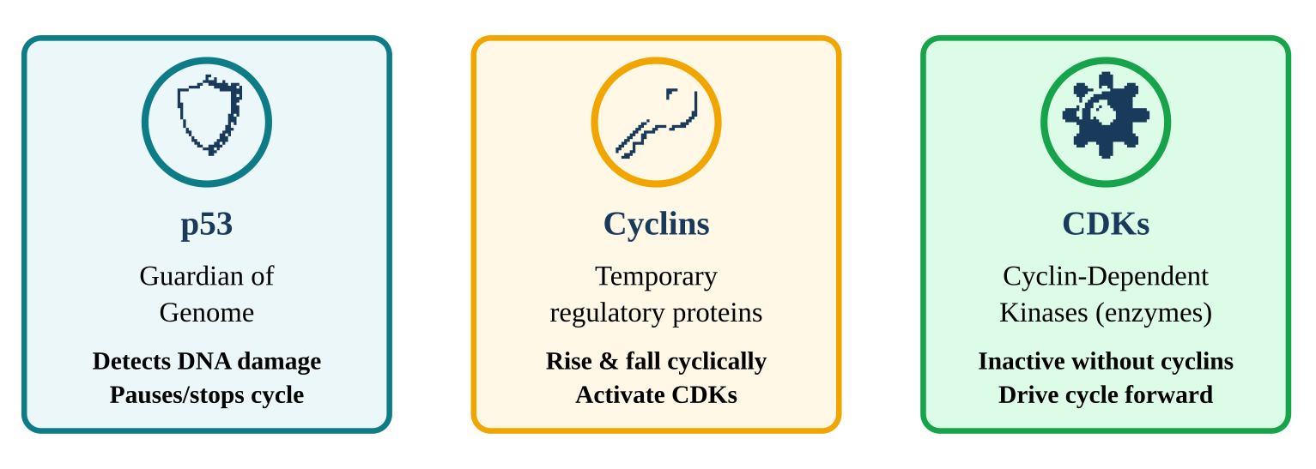
SECTION 7 RECAP
Figure 4.1 — The Molecular Gatekeepers
Nicknames to help students remember:
p53
Cyclins
CDKs
Mad2
"The Guardian"
"The Keys"
"The Engines"
"Brake Pedal"
Detects DNA damage. Can trigger apoptosis.
Activate CDKs at specific times.
Inactive alone; powerful when paired.
Holds anaphase back (spindle checkpoint).
Cell Division Gone Wrong • Lesson 1: The Normal Cell Cycle
11 / 18

Slide 12
DISCUSSION
"If your cells have all this quality control,
why does anyone get cancer?"
Hint 1
Hint 2
Hint 3
Checkpoints are good — but not perfect.
Mutations accumulate over years and decades.
When MULTIPLE checkpoints fail, no backup remains.
Cell Division Gone Wrong • Lesson 1: The Normal Cell Cycle
12 / 18
Notes:
💡 Next slide walks through Figure 5.1 — the multi-hit hypothesis.

Slide 13
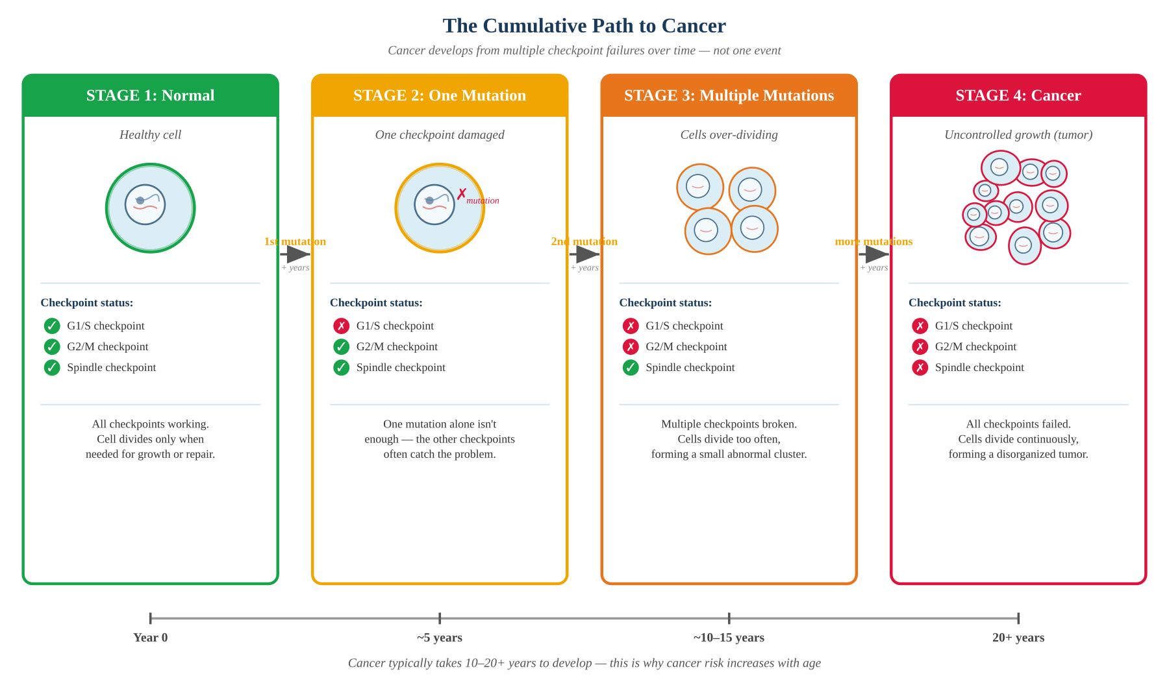
SECTION 8 RECAP
Figure 5.1 — The Multi-Hit Hypothesis
🔑 Big idea: Cancer typically takes 10–20+ years to develop because mutations must accumulate. This is why cancer risk increases with age.
Cell Division Gone Wrong • Lesson 1: The Normal Cell Cycle
13 / 18

Slide 14
WRAP-UP (5 MIN)
Exit Ticket
1
Name the four phases of the cell cycle in order, and describe what happens in each in ONE sentence.
2
What does the G1/S checkpoint check for? What happens if a cell FAILS this checkpoint?
3
Why does cancer typically take 10–20+ years to develop? Use the term "multi-hit hypothesis" in your answer.
Cell Division Gone Wrong • Lesson 1: The Normal Cell Cycle
14 / 18

Slide 15
LOOKING AHEAD
Bridge to Lesson 2
LESSON 1 (today)
LESSON 2 (next)
WHAT happens & WHY
HOW it actually works
What are the phases?
What do checkpoints check?
Why does the cell need this?
What is cancer (high level)?
How exactly does p53 sense damage?
How do cyclin-CDK pairs act as a clock?
Which mutations cause which cancers?
How do treatments target this system?
Cell Division Gone Wrong • Lesson 1: The Normal Cell Cycle
15/ 18

Slide 16
TEACHER NOTES
Watch for These Misconceptions
❌ "Interphase is rest time."
✅ Interphase is the BUSIEST phase — cells grow, copy DNA, prepare proteins.
❌ "DNA copying happens instantly."
✅ S phase takes hours. The cell copies ~3 billion base pairs with high accuracy.
❌ "One mutation = cancer."
✅ Cancer requires MULTIPLE checkpoint failures. Backups usually catch single mutations.
❌ "Mitosis = cell division (the whole thing)."
✅ Mitosis = nuclear division. Cytokinesis splits the cell. Both are needed.
Cell Division Gone Wrong • Lesson 1: The Normal Cell Cycle
16 / 18
Notes:
Hide slide from live facilitation.

Slide 17
TEACHER NOTES
Differentiation: Meet Every Student
🪜 IF STUDENTS NEED MORE SUPPORT
🚀 IF STUDENTS FINISH EARLY
Pre-teach key vocabulary visually before the lesson
Pair with a stronger partner for the round-robin
Re-show Video 1.3 (Amoeba Sisters Mitosis) at half speed
Provide phase cards to physically arrange in order
Use the lesson's Quick Reference table — skip the long stage descriptions
Focus on the gate metaphor — defer molecular detail to Lesson 2
Name a body cell that stays in G0 forever — and explain why
If the spindle checkpoint didn't exist, what would happen?
Create your own checkpoint analogy (other than security gates)
Why might children's cells divide more frequently than adults'?
Research how chemotherapy targets the cell cycle
Read about Henrietta Lacks & HeLa cells (cells that never stop)
Cell Division Gone Wrong • Lesson 1: The Normal Cell Cycle
17 / 18
Notes:
Hide slide from live facilitation.

Slide 18
Thank you for facilitating!
Cell Division Gone Wrong • Lesson 1: The Normal Cell Cycle
📁 LESSON 1 MATERIALS
• Student Lesson: Student_Lesson_TheNormalCellCycle.html
• Guided Notes: lesson1-guided-notes.html
• Card Sort Activity: lesson1-card-sort.html
• Facilitation Guide: Teacher_Facilitation_Guide_Lesson1.docx
Finding cures. Saving children. — St. Jude Children's Research Hospital
Notes:
Hide slide from live facilitation.

