Slide 1

Ionic Framework
create hybrid mobile apps with the web technologies you love.
Jul 2014

Slide 2

Overview - Ionic
Ionic offers a library of mobile-optimized HTML, CSS and JS components for building highly interactive apps. Built with Sass and optimized for AngularJS.
Jul 2014
Cake Solutions Ltd.

Slide 3
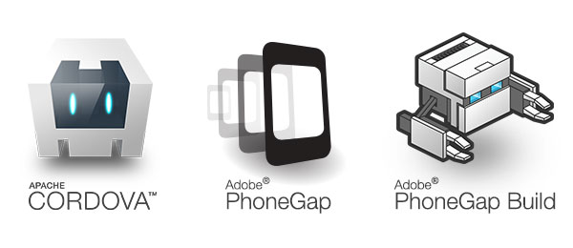
Cordova / PhoneGap
Ionic Framework is built on top of Apache Cordova, which allows you to build and package your app for the target system.
Jul 2014
Cake Solutions Ltd.

Slide 4

Ionic & Angular
A match made in heaven. Ionic utilizes AngularJS in order to create a framework most suited to develop rich and robust applications. Ionic not only looks nice, but its core architecture is for serious app development, and AngularJS ties in perfectly.
Jul 2014

Slide 5

Native Focused
Ionic realises that not every part of the app will work in the Browser, so allows for easy integration with Native code, So plugin you existing iOS or Android SDKs seamlessly
Jul 2014

Slide 6

Code Time…
Show me the code…
Jul 2014

Slide 7

Q & A Session
Jul 2014
Cake Solutions Ltd.

Slide 8
Thank You
Alex Lashford
alexl@cakesolutions.net
@alexlashford
Source code & slides are all on github
https://github.com/lashford/lightning-voting
Jul 2014

