Slide 1
Introduction to Waves
Waves are prime movers of sediment
Waves are primarily generated by wind
Waves are almost always present at the coast

Slide 2
Introduction to Waves
Waves
  Capillary (tiny waves or ripples)
  Gravity (short waves)
  Infragravity (intermediate long waves)
  Tsunami (long waves)
  Tide (long waves)

Slide 3
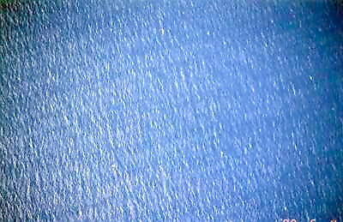
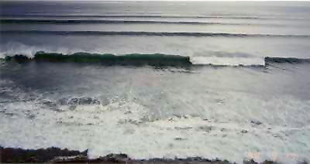
Introduction to Waves
Gravity Waves
  Seas
  Swell

Slide 4
Introduction to Waves
  REGULAR
  IRREGULAR
+
0
-
+
0
-

Slide 5
Definitions
period
(T)
length
(L)
+
amplitude
(a)
height
(H)
0
depth
(h)
-
Period is constant. Length will change with depth.

Slide 6
Linear Wave Theory
Simplifying assumptions
    Incompressible fluid
    Irrotational fluid motion (no viscosity)
    Bed is a horizontal, fixed, impermeable
    Wave amplitude is small
  Airy (or Linear) Wave Theory, 1845

Slide 7
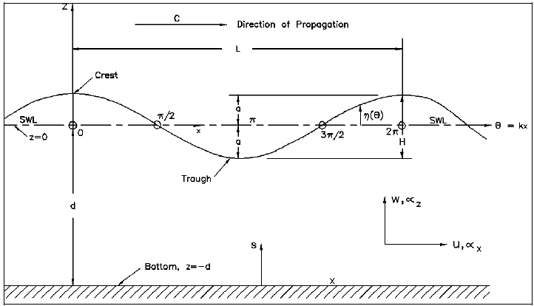
Surface Elevation
η = water surface elevation, relative to SWL
x = wave propagation direction
t = time
a = wave amplitude (H/2)
k = wave number = 2π/L (periodic in space)
σ = angular frequency = 2π/T (periodic in time)
C = wave speed (celerity) = L/T = σ/k

Slide 8
Surface Elevation
η = water surface elevation, relative to SWL
x = wave propagation direction
t = time
a = wave amplitude (H/2)
k = wave number = 2π/L (periodic in space)
σ = angular frequency = 2π/T (periodic in time)
C = wave speed (celerity) = L/T = σ/k

Slide 9
Wave Reflection
Incident wave
+
0
Reflected wave
-

Slide 10
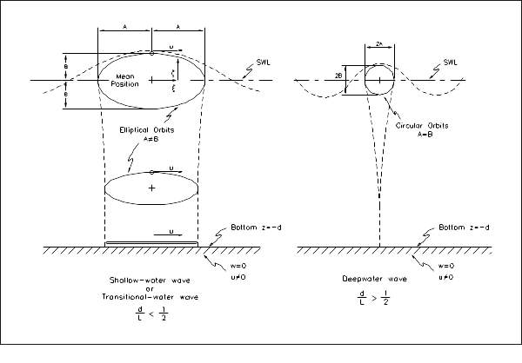
Wave Orbits
Circular orbit
decays with depth.
shallow water
h/L < 1/25
deep water
h/L > 1/2

Slide 11
Dispersion Relationship
σ² = gk tanh (kh)
(2π/T)² = g(2π/L) tanh (2πh/L)
Relates wavelength and period
T remains constant
L varies with depth (h)

Slide 12
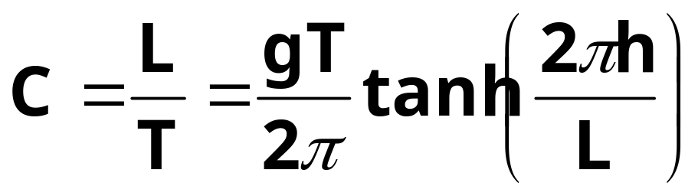
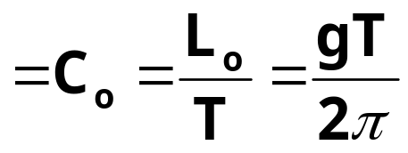
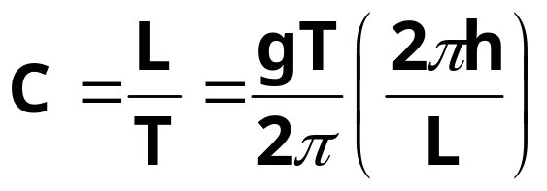
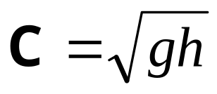
Wave Celerity
1 (deep water)
In Deepwater:
Phase velocity
In Shallow water:
Phase velocity =

Slide 13
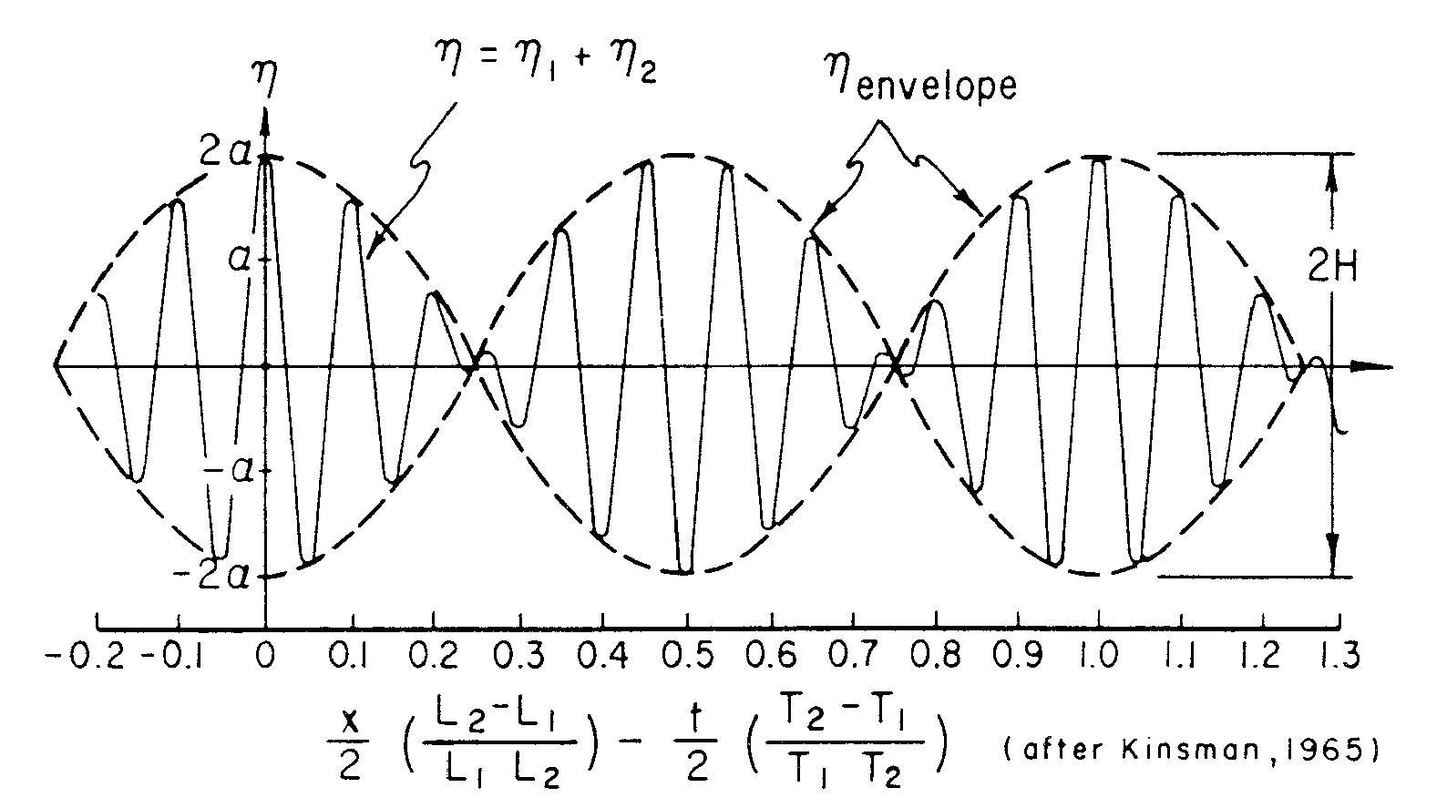
Wave Dispersion and Wave Groups

Slide 14
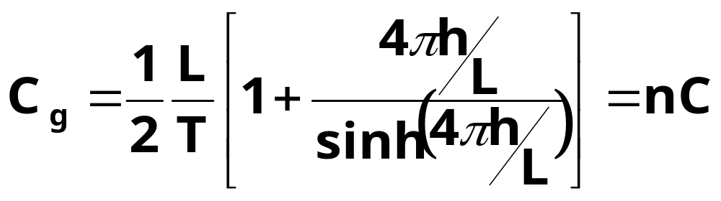
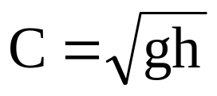
Wave Group Celerity
Wave energy propagation speed
In Deep water:
Group velocity ~ ½ x phase speed ~ ½ C_{o}
In Shallow water:
Group velocity ~ phase speed =

Slide 15
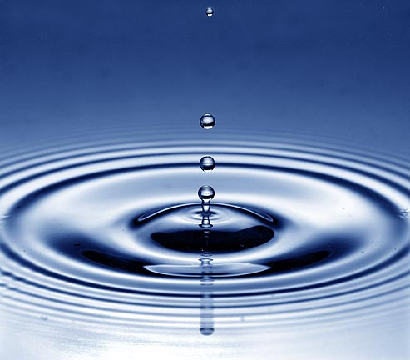

Slide 16
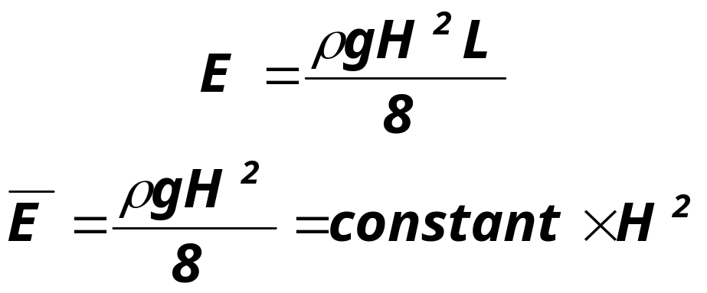
Wave Energy
The sum of kinetic energy (particle velocities)
and potential energy (crest elevation)
Wave energy is an important factor in engineering design. Because wave energy is a function of wave height squared, small changes in wave height have a large (and rapidly increasing) effect on energy.

Slide 17
Wave Energy
The sum of kinetic energy (particle velocities)
and potential energy (crest elevation)
1 m, 6 sec waves ~ 4000 watts/m of shoreline
(light 40 100-watt light bulbs)

Slide 18
Wave Transformation
Refraction
Shoaling
Diffraction
Reflection
Breaking
Wave-Current Interaction

Slide 19
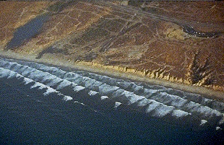
Wave Refraction

Slide 20
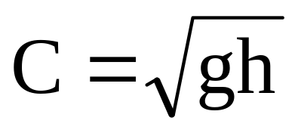
Wave Refraction

Slide 21
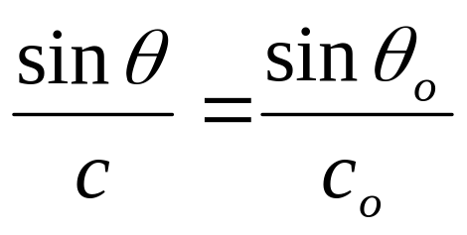
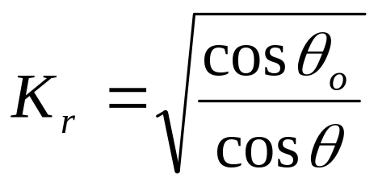
Refraction
Snell’s Law (optics):
Oblique waves on straight, parallel bottom contours
Refraction coefficient:

Slide 22
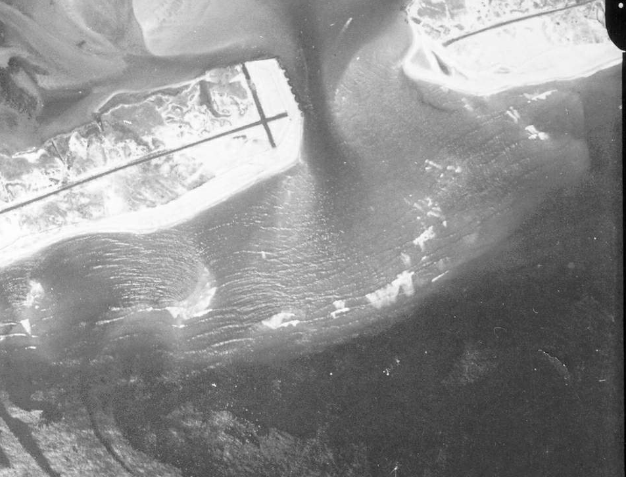
Wave Shoaling
E C_{g} = constant (constant energy flux)
Wave Height increases in shallow water

Slide 23
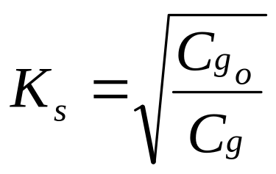
Shoaling
F = EC_{g}= constant
Change in C accounts for most of shoaling
Shoaling coefficient:

Slide 24
Wave Diffraction
Ocean
Energy gets behind breakwater.
Breakwater
Bay

Slide 25
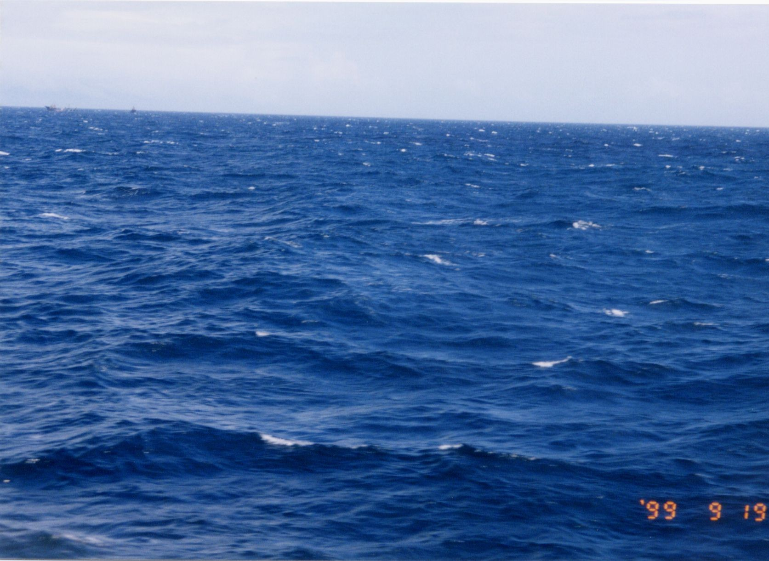
Wave Breaking

Slide 26
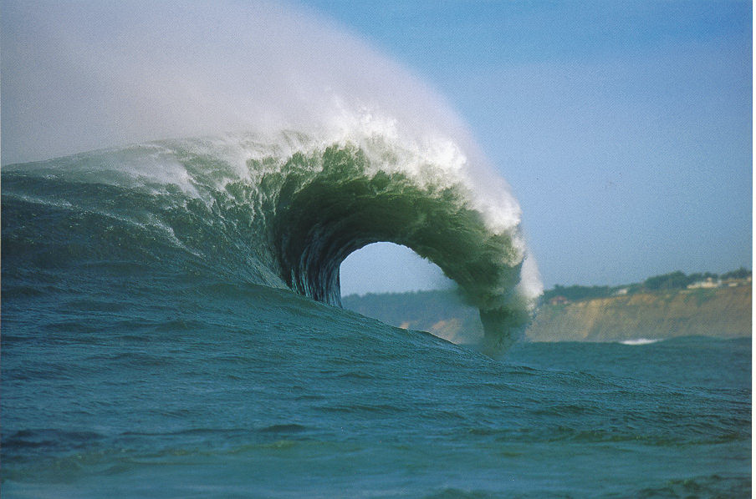
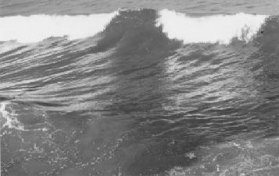
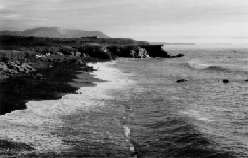
Wave Breaking
Types of Breaking Waves
  Plunging
  Spilling
  Surging

Slide 27
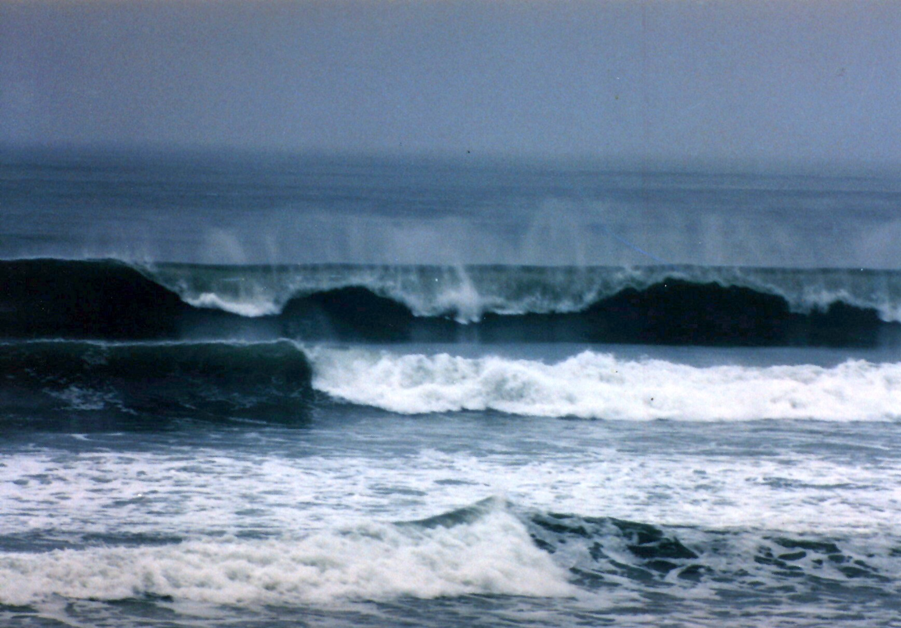
Wave Breaking
Plunging.
Spilling.

Slide 28
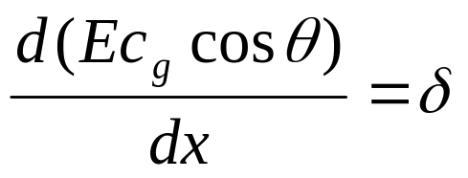
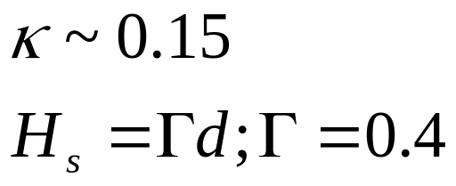
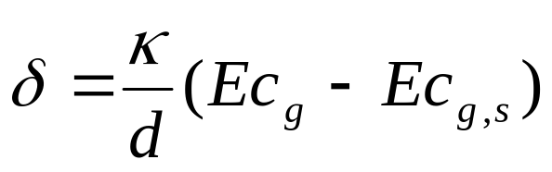
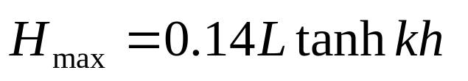
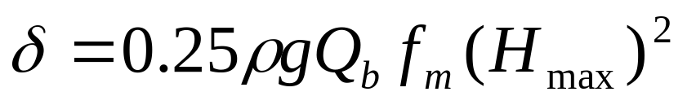
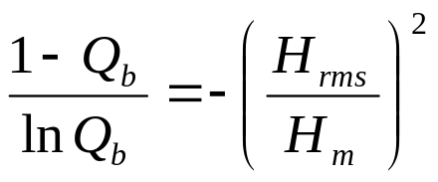
Surf Zone Wave Decay
Spilling breaking assumption:
  H = γd
Energy flux method:
  Dally, Dean & Dalrymple (1985):
  Battjes and Janssen (1978):

Slide 29
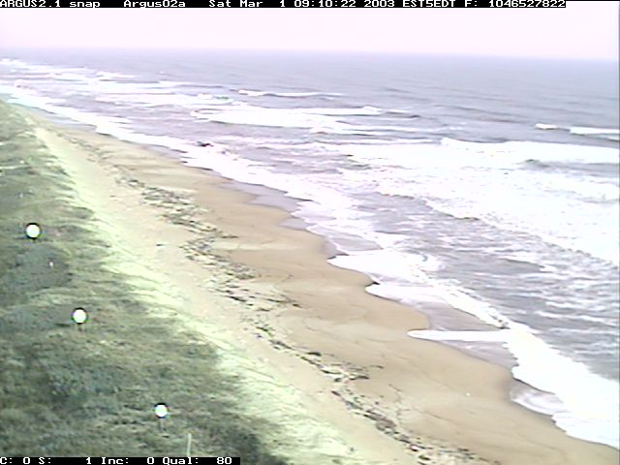
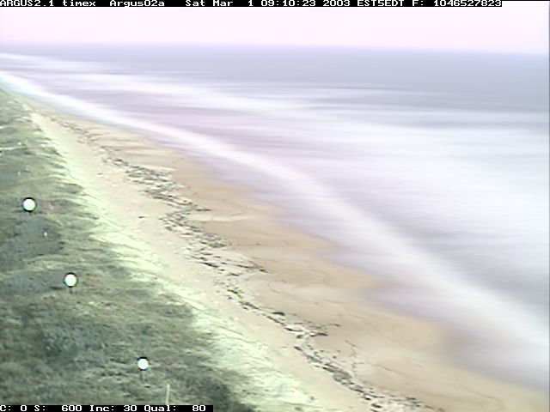
Wave Breaking
On beaches and sand bars

Slide 30

Field Research Facility

Slide 31
Summary
Linear theory is a powerful tool to understanding waves
Wave nonlinearity important for large waves and/or shallow depth
Important wave parameters
  H = Height
  T = Period
  L = Length
  C = Celerity
  C_{g} = Group Celerity
  E = Wave energy (~H²)

