Slide 1

AWS Elastic Beanstalk | Automatic Development

Slide 2
Assumptions
Assumptions…

Slide 3
Why use cloud
Lower capital expenditure and Easier maintenance and upgrades
Greater flexibility and mobility
Continuity of business and Disaster Recovery
Improved IT security
https://aws.amazon.com/premiumsupport/trustedadvisor/

Slide 4
What is Elastic Beanstalk ?
AWS Elastic Beanstalk is an orchestration service offered from Amazon Web Services for deploying infrastructure which orchestrates various AWS services, including EC2, S3, Simple Notification Service, CloudWatch, autoscaling, and Elastic Load Balancers

Slide 5
WHAT DOES AWS ELASTIC BEANSTALK COST
You pay for only the AWS resources you use

Slide 6

FAQ elastic beanstalk
https://aws.amazon.com/elasticbeanstalk/faqs/
AWS Elastic Beanstalk makes it even easier for developers to quickly deploy and manage applications in the AWS Cloud. Developers simply upload their application, and Elastic Beanstalk automatically handles the deployment details of capacity provisioning, load balancing, auto-scaling, and application health monitoring.
What are some challenges developers face ?

Slide 7
Why developers should use elastic beanstalk
Administrator access on your environment
Control everything in one place
Use any Database
Run services side by side with other EC2 instances
Ability to use Custom AMIs
Easy troubleshooting and log file rotation

Slide 8
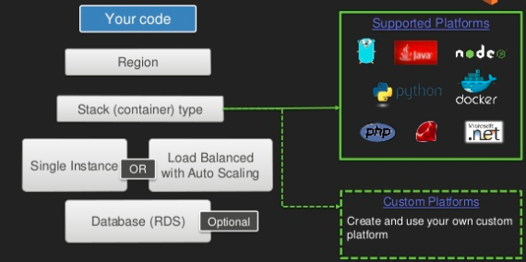
architecture

Slide 9
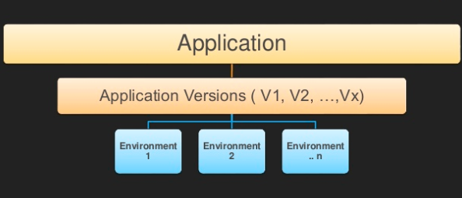
architecture

Slide 10
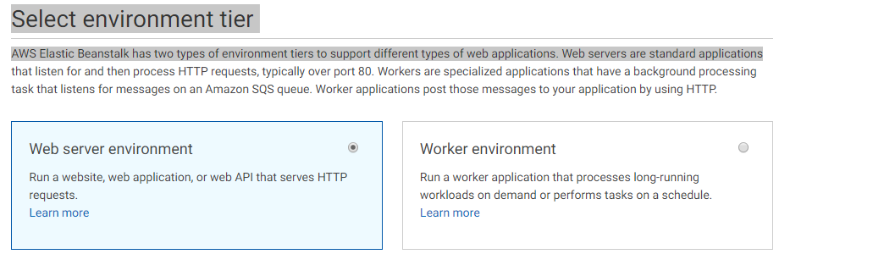
Web Vs Worker
https://docs.aws.amazon.com/elasticbeanstalk/latest/dg/using-features-managing-env-tiers.html

Slide 11
Under the hood cloudformation
Template in .json to yaml
Template is ran which creates a stack of aws resources
Whole stack can be deleted or easily re-created in another availability zone
https://aws.amazon.com/cloudformation/

Slide 12
scenario one quick deploy
Scenario one quick deploy

Slide 13
scenario two High Availability \ Custom
Scenario two High Availability \ Custom
High availability refers to systems that are durable and likely to operate continuously without failure for a long time. The term implies that parts of a system have been fully tested and, in many cases, that there are accommodations for failure in the form of redundant components.
https://docs.aws.amazon.com/quickstarts/latest/webapp/expanding-environments.html?icmpid=docs_eb_console_new#expanding-environments-rds

Slide 14
scenario three IDE Visual Studio
Scenario three IDE Visual Studio
https://aws.amazon.com/blogs/aws/aws-beanstalk-eclipse-integration/
https://docs.aws.amazon.com/elasticbeanstalk/latest/dg/create_deploy_NET.html
https://docs.aws.amazon.com/elasticbeanstalk/latest/dg/tutorials.html

Slide 15
Command line Interface
https://aws.amazon.com/getting-started/tutorials/deploy-app-command-line-elastic-beanstalk/
Use CI\CD to have a completely new environment on check in\merge
Jenkins\ other tools with command line interface
Use code deploy and set up CI\CD pipeline
https://aws.amazon.com/getting-started/projects/set-up-ci-cd-pipeline/

Slide 16
Additional resources
https://aws.amazon.com/elasticbeanstalk/

