Slide 1

AWS Elastic Beanstalk | Automatic Development

Slide 2
Assumptions
Assumptions…

Slide 3
What we will cover
Cloud benefits and what is Elastic Beanstalk

Slide 4
Why use cloud
Lower capital expenditure and Easier maintenance and upgrades
Greater flexibility and mobility
Continuity of business and Disaster Recovery
Improved IT security
https://aws.amazon.com/premiumsupport/trustedadvisor/

Slide 5
What is AWS
https://aws.amazon.com/what-is-aws/

Slide 6
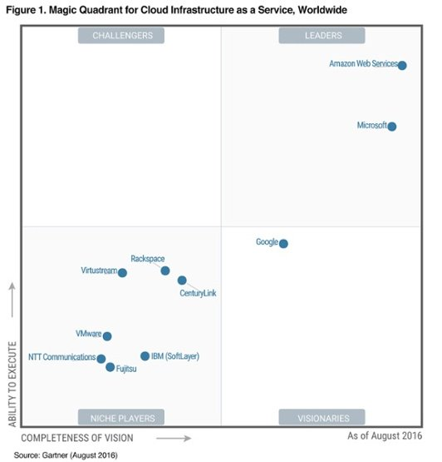
Why Use AWS
https://media.netflix.com/en/company-blog/completing-the-netflix-cloud-migration
https://aws.amazon.com/solutions/case-studies/

Slide 7
What is Elastic Beanstalk ?
AWS Elastic Beanstalk is an orchestration service offered from Amazon Web Services for deploying infrastructure which orchestrates various AWS services, including EC2, S3, Simple Notification Service, CloudWatch, autoscaling, and Elastic Load Balancers.
Elastic Beanstalk is a platform as a service such as Elastic Beanstalk provides runtime, middleware, OS, Virtualization, Servers, Storage and Network and all you have to work about is your application and your data.

Slide 8
WHAT DOES AWS ELASTIC BEANSTALK COST
You pay for only the AWS resources you use

Slide 9

FAQ elastic beanstalk
https://aws.amazon.com/elasticbeanstalk/faqs/
AWS Elastic Beanstalk makes it even easier for developers to quickly deploy and manage applications in the AWS Cloud. Developers simply upload their application, and Elastic Beanstalk automatically handles the deployment details of capacity provisioning, load balancing, auto-scaling, and application health monitoring.
What are some challenges developers face ?

Slide 10
Why developers should use elastic beanstalk
Administrator access on your environment
Control everything in one place
Quicker less complicated deployment
Run services side by side with other EC2 instances
Ability to use Custom AMIs
Easy troubleshooting and log file rotation

Slide 11
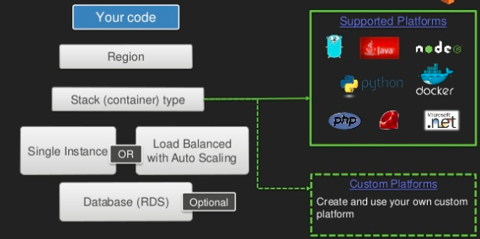
architecture

Slide 12
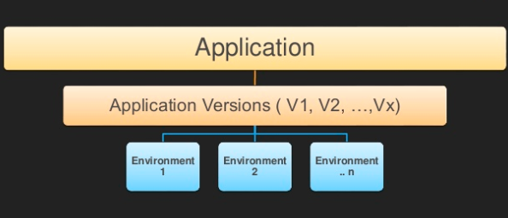
architecture

Slide 13
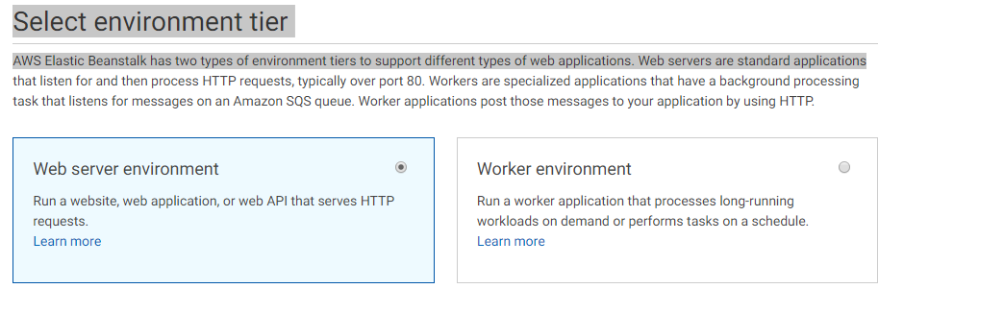
Web Vs Worker
Worker handles tasks which are time intensive or resource intensive
Worker frequently used for background tasks
Worker avoids spending too much time on single request and can make your web server more responsive
Worker and web communicate via SQS queue
https://docs.aws.amazon.com/elasticbeanstalk/latest/dg/using-features-managing-env-tiers.html

Slide 14
Environment Health
Environment is being Created\updated
Passed recent health check
Failed one or two checks
Failed three or more check

Slide 15
Under the hood cloudformation
Template in .json to yaml
Template is ran which creates a stack of aws resources
Whole stack can be deleted or easily re-created in another availability zone
https://aws.amazon.com/cloudformation/

Slide 16
Fundamental components Web Server in BeanStalk
Elastic Load Balancer – distributes load among different EC2 instances
Auto Scaling Group – increases or decreases EC2 instances
EC2 Instances
Host Manager – software which monitors health, etc.
Security Groups – Creates a default security group and allow you client to access on port 80

Slide 17
scenario one quick deploy
Scenario one quick deploy

Slide 18
scenario two High Availability \ Custom
Scenario two High Availability \ Custom
High availability refers to systems that are durable and likely to operate continuously without failure for a long time. The term implies that parts of a system have been fully tested and, in many cases, that there are accommodations for failure in the form of redundant components.
https://docs.aws.amazon.com/quickstarts/latest/webapp/expanding-environments.html?icmpid=docs_eb_console_new#expanding-environments-rds

Slide 19
scenario three IDE Visual Studio
Scenario three IDE Visual Studio
https://aws.amazon.com/blogs/aws/aws-beanstalk-eclipse-integration/
https://docs.aws.amazon.com/elasticbeanstalk/latest/dg/create_deploy_NET.html
https://docs.aws.amazon.com/elasticbeanstalk/latest/dg/tutorials.html

Slide 20
Command line Interface
https://aws.amazon.com/getting-started/tutorials/deploy-app-command-line-elastic-beanstalk/
Use CI\CD to have a completely new environment on check in\merge
Jenkins\ other tools with command line interface
Use code deploy and set up CI\CD pipeline
https://aws.amazon.com/getting-started/projects/set-up-ci-cd-pipeline/

Slide 21
Additional resources
https://aws.amazon.com/elasticbeanstalk/

