Slide 1
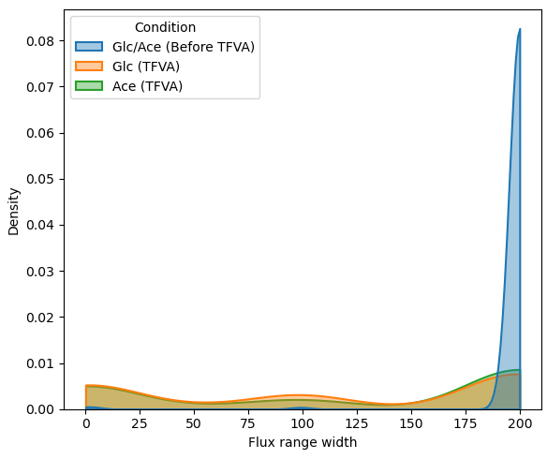
TFVA Flux space reduction
TFVA reduces feasible flux space significantly for both conditions
  Sum of flux range widths (ub – lb):
  Glc: 1.24e5 -> 7e4
  Ace: 1.24e5 -> 7.5e4

Slide 2
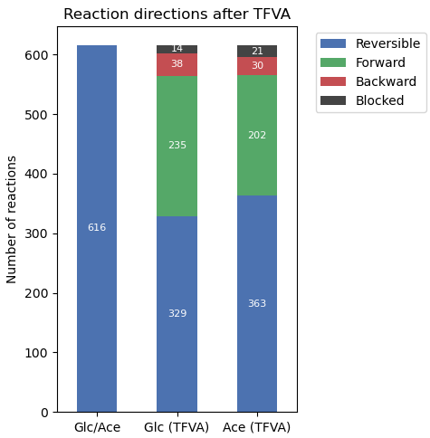
TFVA fixes reaction directions

Slide 3
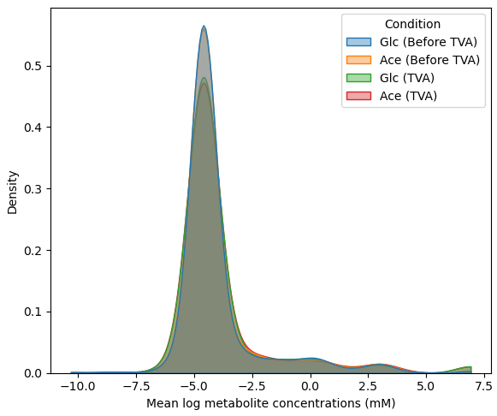
TVA met. conc. space reduction
TVA on metabolite concentrations reduces the total space slightly
  Sum of linear concentration range widths (ub – lb):
  Glc: 1106 -> 1063
  Ace: 1103 -> 1052

Slide 4
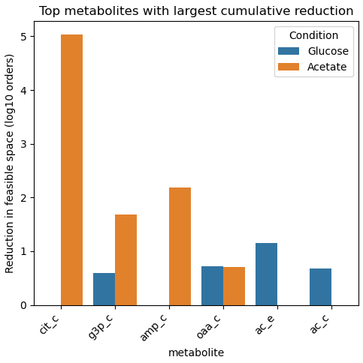
TVA met. conc. space reduction

