Slide 1

Transforming Financial Leasing with Machine Learning: Intelligent Risk Assessment and Predictive Analytics
Group ID : 25-26J-179

Slide 2

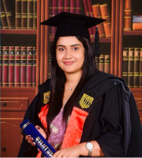




OUR TEAM
Project supervisor:
Mrs. Suryaa Kumari
Project co-supervisor:
Mrs. Dulani Jayasingha
External supervisor:
H.D Kapila Premachandra
IT22198518
Semasingha W.A.L.D(Leader)
IT22129130
Maharambage K.N
IT22087560
Weerasinghe M P
IT22583796
Erangi M G M

Slide 3
PP2 COMMENTS & ACTIONS TAKEN
Student Name | Comments | Actions Taken
Semasingha W.A.L.D | Validate data and provide proof Results show each model values, and they have a high difference and it seems impractial | Tested the system with company employees. Fine tuned the model to give accurate values. Made changes to view system easily for non technical people
Maharambage K.N | Validate data and provide proof A model comparison is done, code comprehension is average | • Strong data validation pipeline • Clear model comparison results • Improved code understanding • High accuracy stacking model • Real-time prediction system
Weerasinghe M P | Validate data and provide proof Results representation needs to be much clearer, it makes no sense Code comprehension is low | Redesigned result outputs using clear visualizations. Refactored code into modular, well-structured functions.
Erangi M G M | Validate data and provide proof Could fine-tune to enhance accuracy | Use more data for dataset Proof of Validation- Photos were taken during the system check and validation session with the company supervisor as evidence Real-World Testing Conducted

Slide 4
Intelligent Risk Assessment and Predictive Analytics
Problem in Brief
Inaccurate risk prediction Traditional methods fail to accurately predict customer default risk and financial losses.
Inefficient customer service Heavy reliance on human agents causes delays and high operational costs
Lack of integrated performance analysis Existing systems cannot effectively combine financial data and employee performance
Complex impairment and ECL estimation Calculating loan impairment and Expected Credit Loss
Design Excellence of Overall Solution
Integrated modular architecture Combines AI assistant, risk prediction, branch analysis and impairment modules into a single unified yet flexible system
Advanced machine learning design Uses ensemble models (Random Forest, XGBoost, CatBoost, stacking) for high accuracy
Real-time and scalable system Built with FastAPI and cloud-ready technologies to support real-time processing
User-centric and intelligent interaction Multi-modal AI chatbot (text, voice, image) with RAG ensures accurate

Slide 5
Impairment and Credit Loss Estimation
Predicts impairment amount & 1-year Expected Credit Loss (ECL) for leasing portfolios
Uses financial + behavioral data (arrears, payments, loan details)
Applies advanced ML models → CatBoost selected as best performer
Achieves high accuracy (R² ≈ 0.99 impairment, 0.94 ECL)
Identifies early credit deterioration using risk-driven features
Enables proactive risk management & IFRS 9 compliance
IT22307330 | H.N.S. ABAYAWARDHANA | 25-26J-167

Slide 6
DEFAULT RISK PREDICTION
Predicts customer default risk using financial and behavioral data
Calculates Probability of Default (PD) for each customer
Classifies customers into High, Medium, and Low risk levels
Detects high-risk customers early to support proactive decision-making
Uses Stacking Ensemble Model (Random Forest, XGBoost, CatBoost)
Combines multiple models to improve prediction accuracy
IT22355614 | G.G.M.U.M. HEMAWARDANA | 25-26J-167

Slide 7
Branch Performance Analysis
Analyzes and compares performance across different branches
Uses machine learning models such as Random Forest, XGBoost, and CatBoost
Processes and cleans data to ensure accurate results
Displays insights through simple dashboards and visualizations
Helps decision-making by identifying high and low performing branches
IT22355614 | G.G.M.U.M. HEMAWARDANA | 25-26J-167

Slide 8

AI-DRIVEN CONVERSATIONAL ASSISTANT FOR LEASING COMPANY CUSTOMER CARE
Provide 24/7 instant customer support answers leasing-related questions quickly
Uses RAG combined with knowledge base for accurate answers
Supports text, voice and image inputs customers can interact in different ways based on their convenience
Understands and processes queries intelligently uses advanced AI (LLMs)
Escalates to human agent when needed transfers complex or sensitive queries to a real customer care officer
IT22583796 | Erangi M G M | 25-26J-179

Slide 9
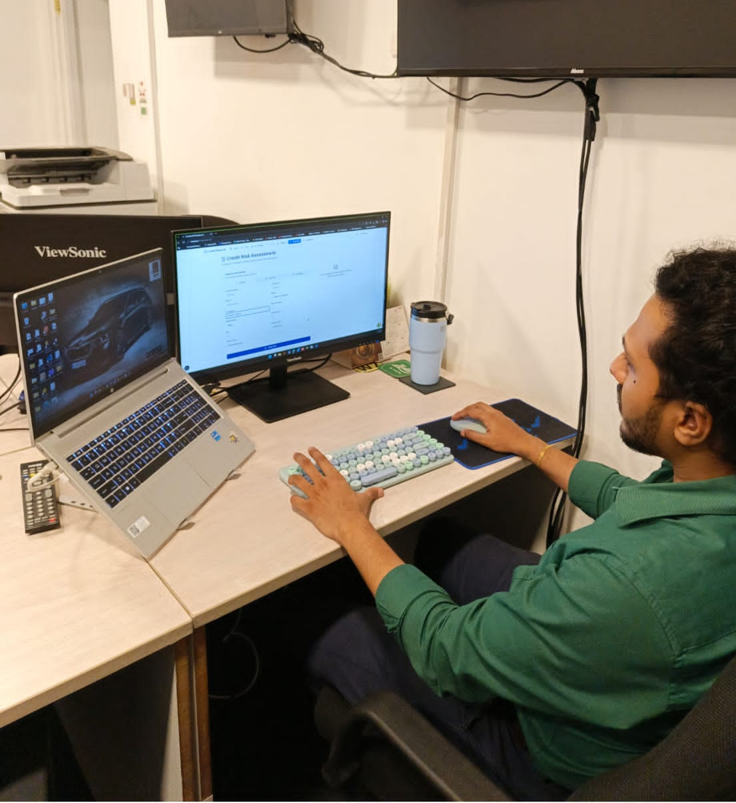
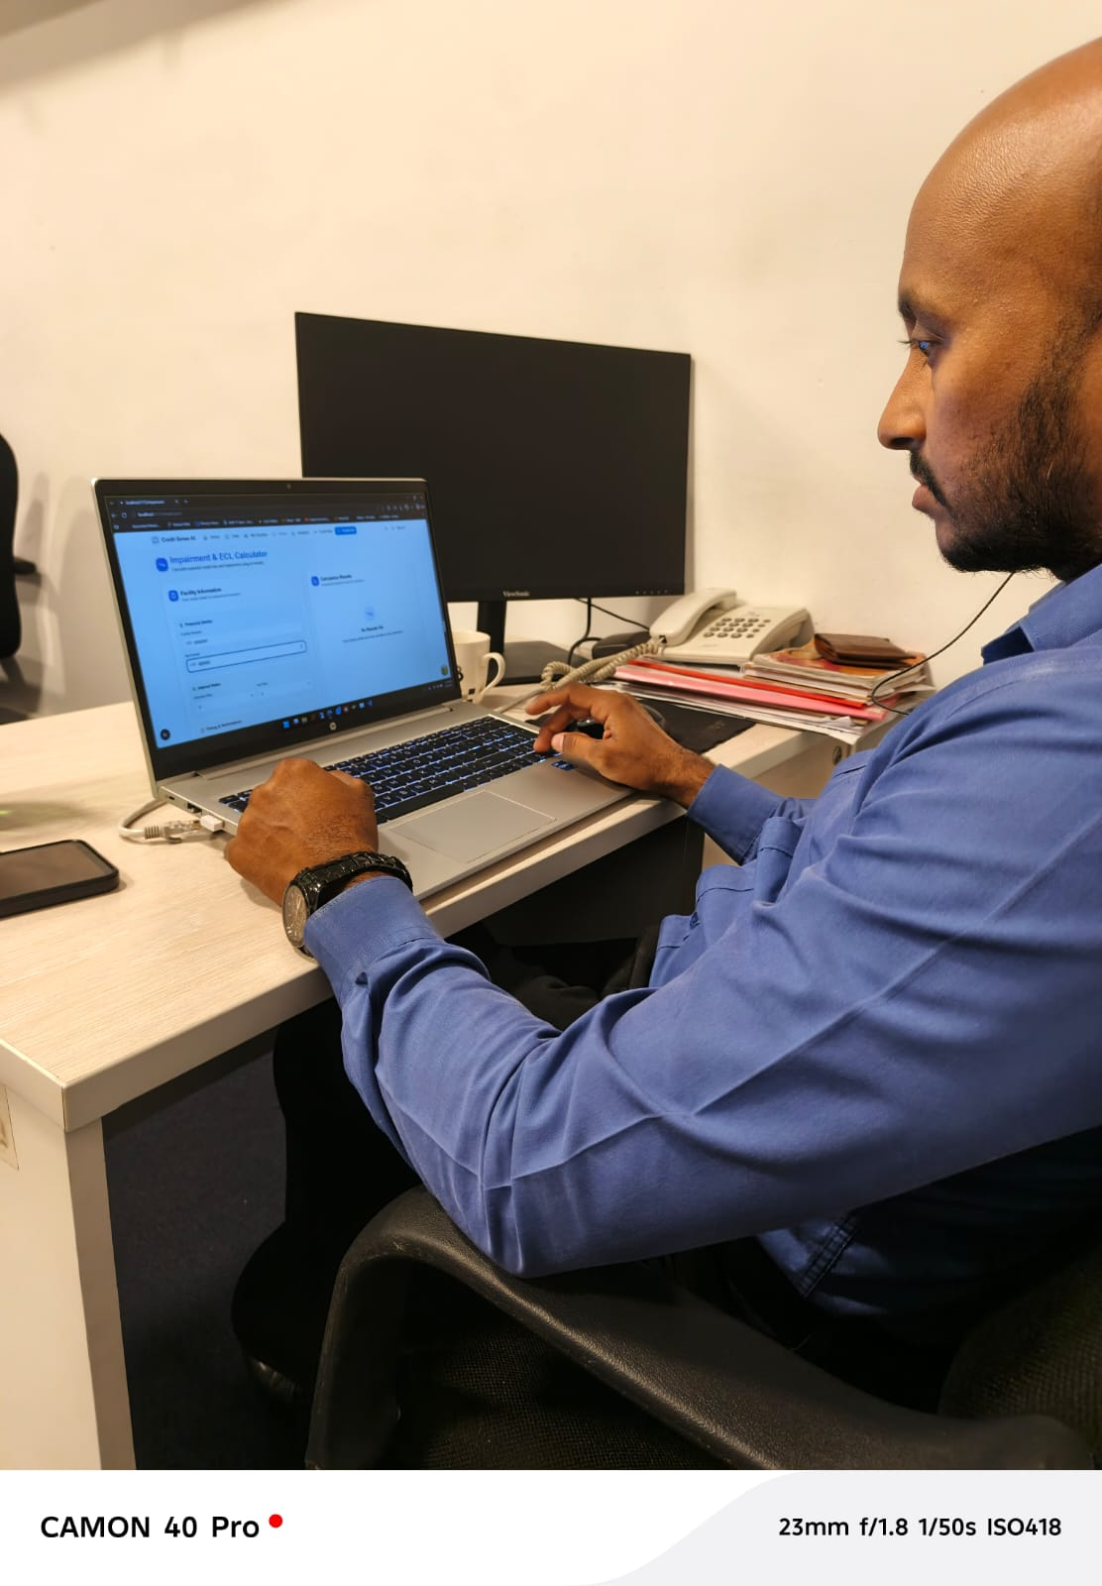
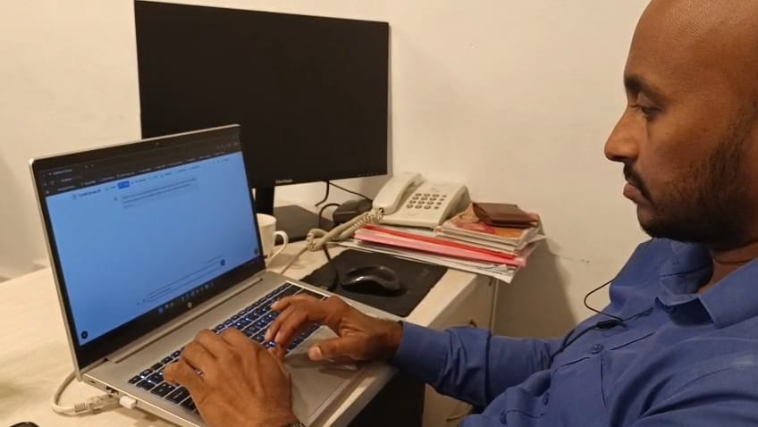
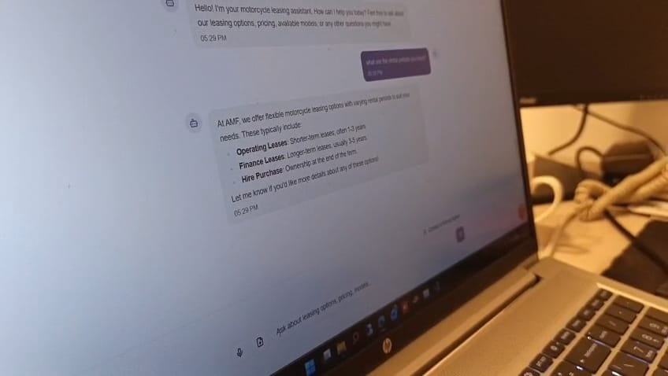
RESULTS, TESTIMONIALS & FUTURE IMPROVEMENTS
Feedback / Validation
Limitations & Future Improvements
Used data from only one company → need more data from different sources
Doesn’t consider economic changes (like inflation, market conditions)
Data is not perfectly balanced → can affect prediction accuracy
System is not real-time → can be improved with live data processing

Slide 10
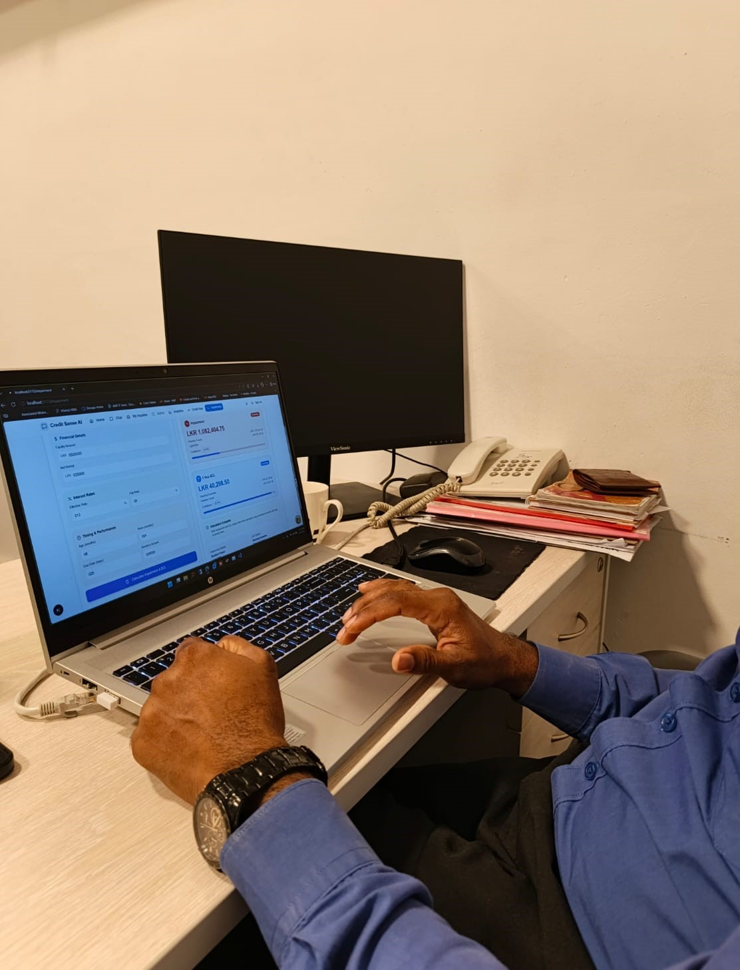
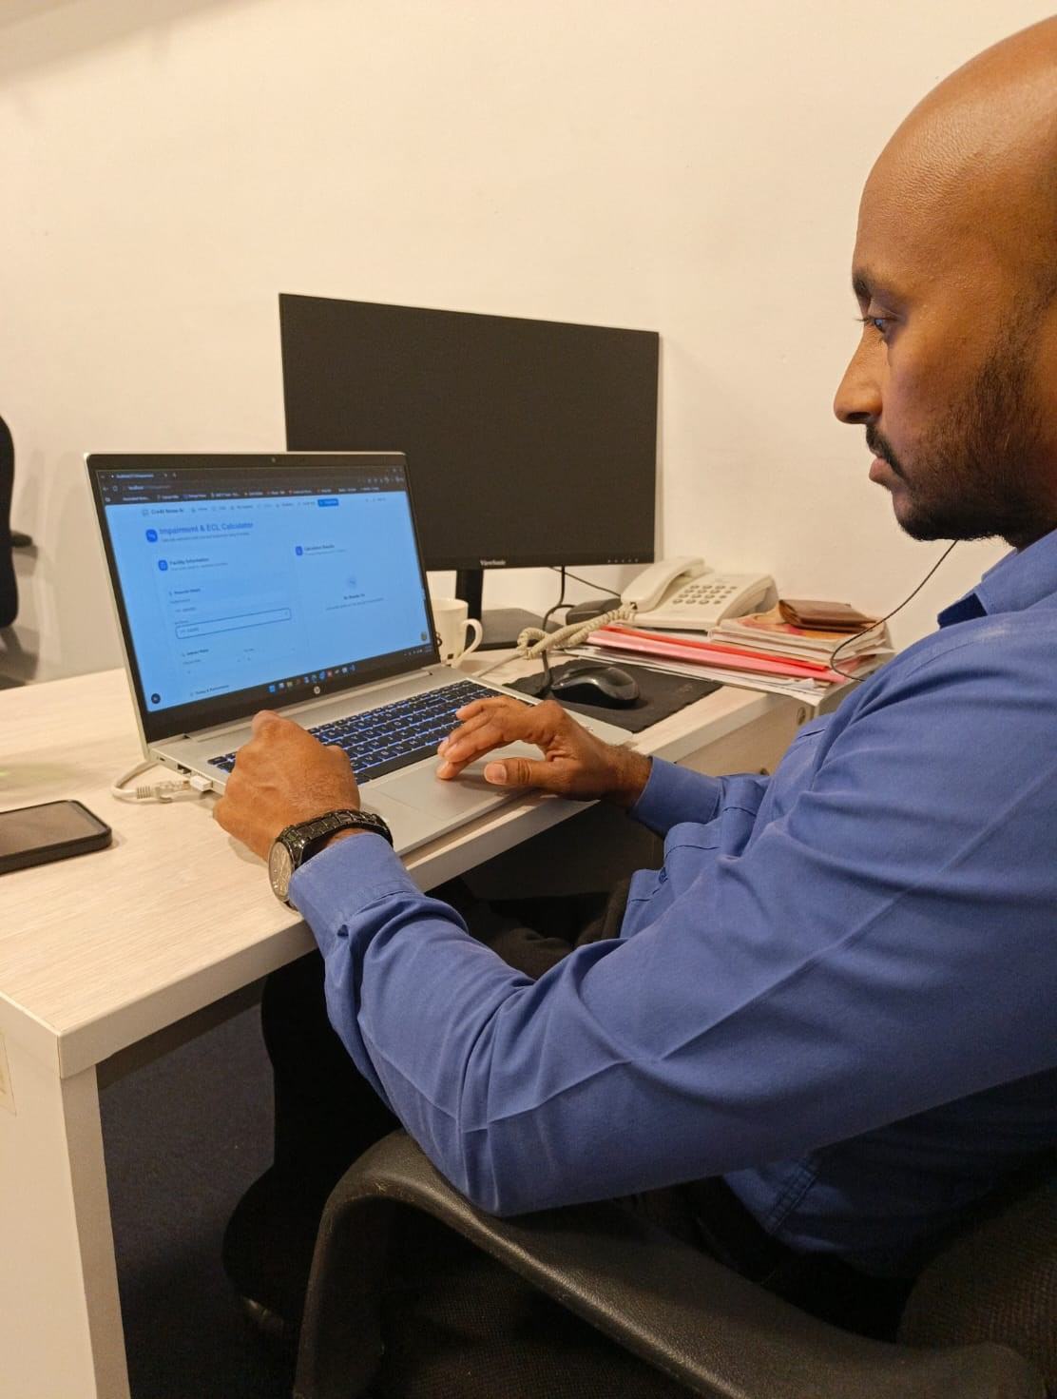
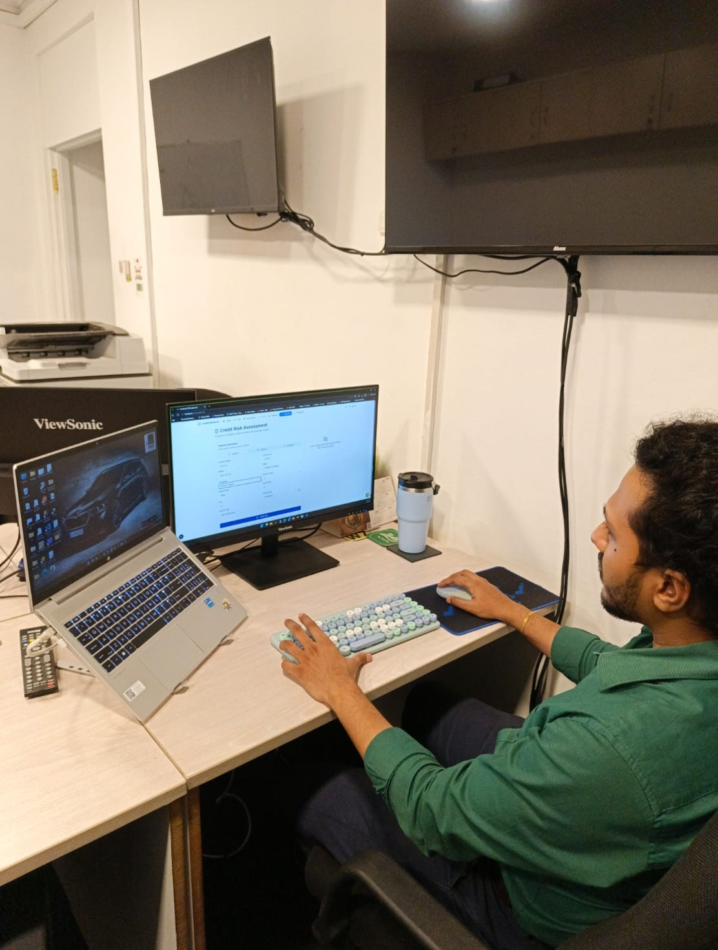

Slide 11
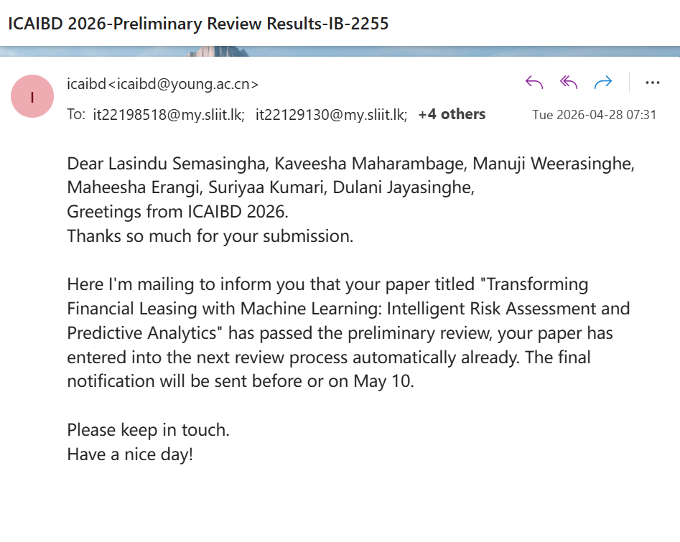
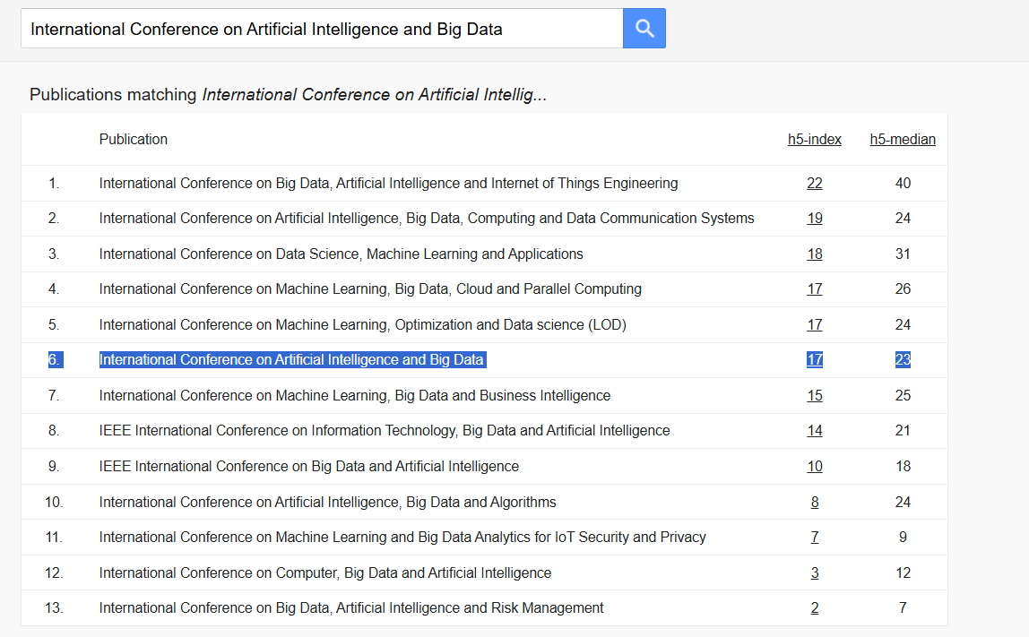
Benchmark Tests / Accuracy / F1 Score
Conference accepted and H-index = 17

Slide 12
Commercialization
Solves Real Industry Problems-Addresses key issues like loan default risk, poor customer service, and inefficient decision-making
Cost Reduction & Efficiency-Chatbot reduces human labor cost and response time
Improves Financial Performance -Default risk model helps identify high-risk customers early
Supports Decision Making - Helps in better resource allocation and branch performance improvement
User-Friendly System - Easy-to-use interface for non-technical staff

Slide 13
THANK YOU !

