Slide 1


Machine Learning Applications in Financial Leasing
25-26J-179

Slide 2




Our Team
IT22198518
Semasingha W A L D
IT22129130
Maharambage K N
IT22087560
Weerasinghe M P
IT22583796
Erangi M G M

Slide 3

Financial analysts, credit risk managers, branch managers, and operations, teams in leasing institutions.
Problem & Impact
Manual, rule-based leasing processes are slow, error-prone, and hard to scale across risk, impairment, performance, and customer operations.
Machine learning provides accurate impairment and default risk predictions from large historical datasets for faster, reliable decisions.
AI-driven analytics and automation reduce workload, improve branch insights, and boost overall efficiency.
Target Users

Slide 4

Design Excellence
Provides end-to-end ML solutions for impairment estimation, Risk prediction, branch performance analysis, and customer inquiry automation.
Combines multiple advanced models and ensemble techniques to maximize prediction accuracy and reliability.
Designed for scalability, efficiency, and integration into financial leasing operations.
Offers actionable insights and automation, supporting faster decisions and reduced operational workload.

Slide 5
IT22198518 | W.A.L.D. Semasingha
BSc (Hons) in Information Technology Specializing in Information Technology
IT22198518 | W.A.L.D. Semasingha | 25-26J-179

Slide 6

Impairment Estimation
Solution
Developed a direct data-driven impairment & ECL prediction prototype using historical leasing data.
Trained on 98,000 real financial records, ensuring robustness and real-world applicability.
Multiple advanced ML models were evaluated to identify the most accurate and stable approach.
User Requirements
High accuracy in impairment and ECL prediction → achieved using advanced ensemble learning.
Fast decision support for credit risk and provisioning.
IT22198518 | W.A.L.D. Semasingha | 25-26J-179

Slide 7
Design Excellence & Technical Contribution
Trained and evaluated six advanced models:
Random Forest, XGBoost, LightGBM, CatBoost, Gradient Boosting,
Ridge Regression (Polynomial Features)
Implemented Ensemble Stacking (Meta-Model) to combine strengths of individual learners.
Final architecture:
Gradient Boosting → Impairment prediction
Stacking Ensemble → ECL prediction
Achieved significant performance improvement over baseline single models.
User Feedbacks
The model demonstrated high predictive accuracy, particularly for impairment, improving confidence in provisioning estimates.
The solution was viewed as suitable for decision-support, early risk identification, and internal analysis.
IT22198518 | W.A.L.D. Semasingha | 25-26J-179

Slide 8
IT22129130 – Maharambage K.N
Default risk prediction
B.Sc. (Hons) Degree in Information Technology Specialization in Information Technology
IT22129130 | Maharambage K.N | 25-26J-179

Slide 9
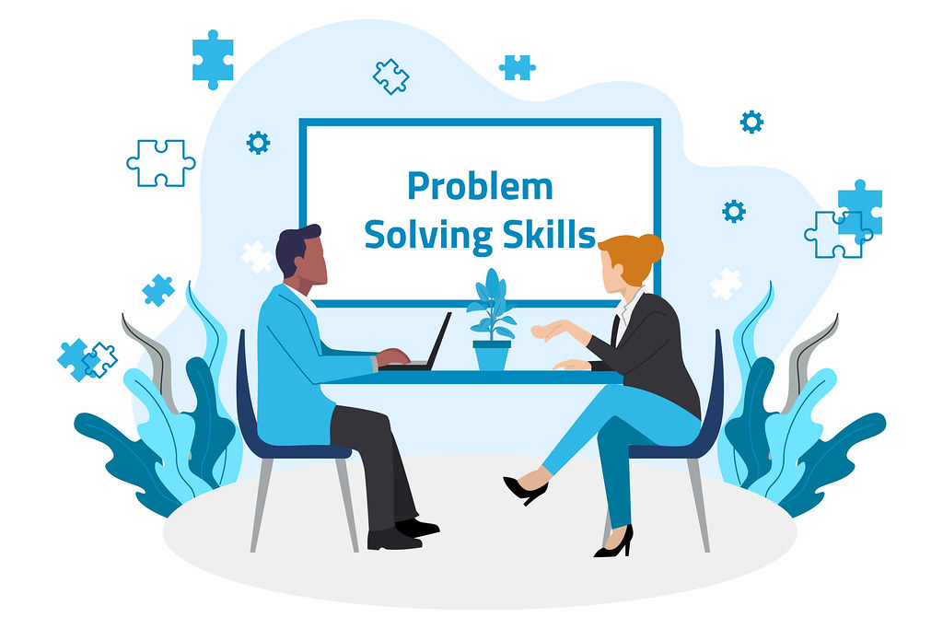
Default Risk Prediction
How the Solution Solves the Problem
Traditional rule-based credit scoring with a machine learning model.
Combines financial and behavioral data
Predicts default risk early
Provides Probability of Default (PD) score
Supports real-time decision making
User Requirements
Easy-to-use web application
Accurate default risk prediction
Real-time risk assessment
Secure access to data
Reliable system availability
IT22129130 | Maharambage K.N | 25-26J-179

Slide 10
Default Risk Prediction
Design Excellence
Simple and clean user interface
Built using multiple ML models including Random Forest, XGBoost, Decision Tree, and Logistic Regression.
Models trained on large historical leasing datasets for stronger pattern detection.
Compared performance across models to ensure high accuracy and reliability.
Selected best-performing approaches to deliver consistent default risk identification.
User Feedback
Easy to understand and use
Helpful for quick decision making
Clear explanation of risk predictions
Saves time for credit officers
Improves confidence in decisions
IT22129130 | Maharambage K.N | 25-26J-179

Slide 11
Weerasinghe m p - it22087560
Branch Performance Analysis
BSc (Hons) in Information Technology Specializing in Information Technology
IT22087560 | WEERASINGHE M P | 25-26J-179

Slide 12

Branch Performance Analysis
How the Solution Solves the Problem
Uses smart clustering + machine learning to auto-classify branch performance in real time
Replaces static reports & manual comparisons with live dashboards
Simple interface — no technical skills needed
User Requirements
Easy access on any device
Instant performance insights and alerts
Clear, actionable data for decision-making
IT22087560 | WEERASINGHE M P | 25-26J-179

Slide 13
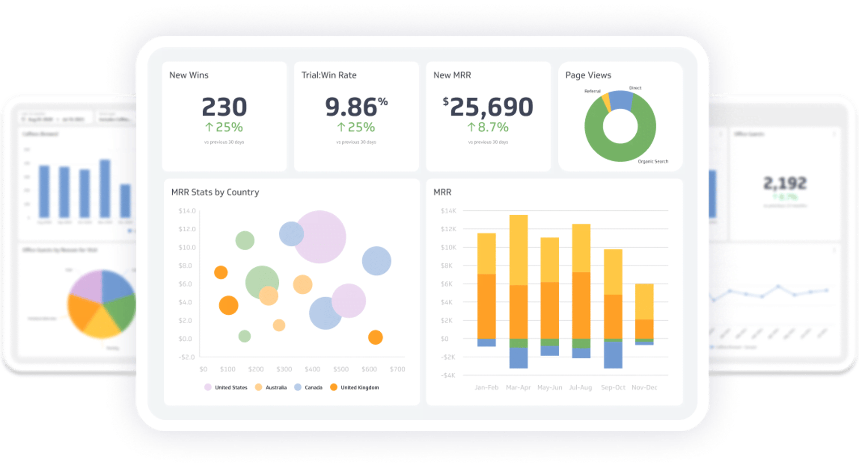
Branch Performance Analysis
Design Excellence
Integrates multiple ML models (Random Forest, XGBoost, etc.)
99.99% accuracy with 99.87% poor detection rate
Combines clustering + classification for smart insights
User Feedback
Managers say it’s easy to use and saves time
Real-time dashboards help make decisions faster
Clustering helps spot underperformers quickly
System is intuitive and replaces manual reports
IT22087560 | WEERASINGHE M P | 25-26J-179

Slide 14
IT22583796 - Erangi M G M
AI-Driven Conversational Assistant for Automated Customer Inquiries in Financial Leasing
B.Sc. (Hons) Degree in Information Technology Specialization in Information Technology
IT22583796 | Erangi M G M | 25-26J-179

Slide 15
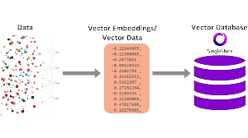

AI-Driven Conversational Assistant for Automated Customer Inquiries in Financial Leasing
How the Solution Solves the Problem
Automates customer inquiries in financial leasing
Handles text, voice, and image-based questions
Reduces dependency on human customer service staff
Prototype demonstrates real-time interaction and response
RAG agent creation (Retrieval-Augmented Generation)
User Requirements
24/7 customer support availability
Easy-to-use chat and voice interface
Natural conversation flow with history aware understanding
Secure handling of user data without human
Support for leasing questions with images

Slide 16

AI-Driven Conversational Assistant for Automated Customer Inquiries in Financial Leasing
Design Excellence
Specific AI model(LLM) for financial leasing
Multimodal interaction (Text + Voice + Image)
Intelligent knowledge base matching
Scalable and modular system design
Improves customer experience in leasing services
Contributes a practical AI solution to research
User Feedback on Prototype
Users found the chatbot easy to use
Voice interaction improved accessibility
Faster response compared to manual support
Accurate answers for common leasing inquiries
Positive feedback on overall experience
Suggestions received for future improvements

Slide 17
Market size
Market Need:
AI-driven leasing and risk analytics to reduce non-performing assets and manual processes.
Local Relevance:
Supports Sri Lanka’s leasing and finance institutions facing rising credit risk and regulatory pressure.
Trend:
Increasing demand for AI-powered automation and predictive analytics in financial services.

Slide 18

Unique in Our Solution
Comprehensive ML platform: Integrates impairment prediction, ECL estimation, branch performance analysis, and AI-driven customer support in a single solution.
Optimized for accuracy and scalability: Leverages advanced modeling techniques to deliver highly reliable predictions across all modules.
Data-driven operational intelligence: Provides insights from large-scale leasing data, enabling better-informed decisions in multiple aspects of operations.
Automation beyond predictions: Reduces manual effort in risk assessment, reporting, and customer interaction, improving overall efficiency.

Slide 19
Commercialization & Sustainability
Freemium Model:
Basic reporting and rule-based dashboards are free advanced AI features (impairment prediction, default risk scoring, branch forecasting, AI chatbot) are offered as premium services.
Enterprise Licensing:
Custom solutions for large leasing institutions with system integration, role-based access, and regulatory compliant reporting.
Ecosystem Partnerships:
Integration with core leasing systems, credit bureaus, and cloud platforms for seamless data flow and scalable analytics.
Sustainability:
Early risk detection and automation reduce non-performing leases, operational costs, and manual workload, while a tiered pricing model ensures long-term financial and operational sustainability.

Slide 20
Thank You!

