Slide 1
Machine Learning Applications in Financial Leasing
25-26J-179

Slide 2





Our Team Members
IT22198518
Semasingha W A L D
IT22129130
Maharambage K N
IT22087560
Weerasinghe M P
IT22583796
Erangi M G M

Slide 3
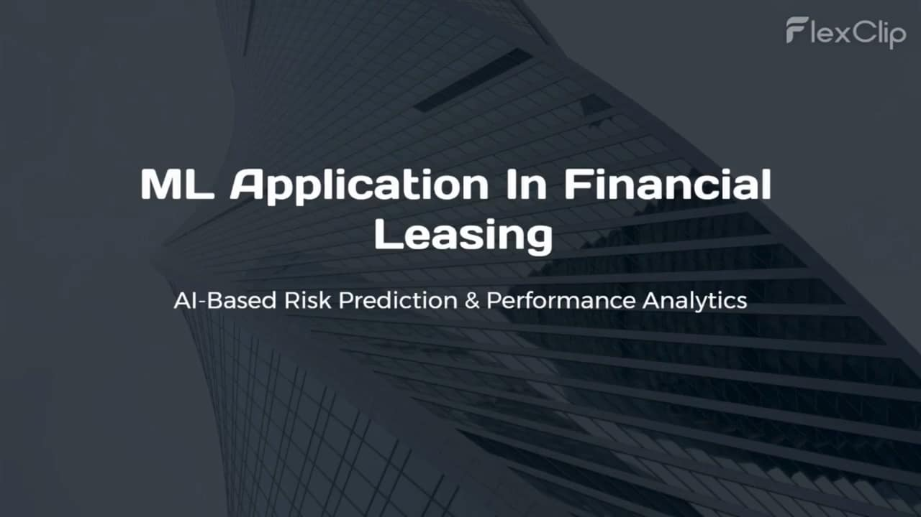

Slide 4
Problem Statement & Stakeholders
Stakeholders
Leasing Customers, Admins(Company Staff), Users
Problem & Impact
Manual, rule-based leasing processes are slow, error-prone, and hard to scale across risk, impairment, performance, and customer operations
Machine learning provides accurate impairment and default risk predictions from large historical datasets for faster, reliable decisions
AI-driven analytics and automation reduce workload, improve branch insights, and boost overall efficiency.

Slide 5
Research Gap & Objectives
Research Gap
Existing leasing systems depend on manual and rule-based processes, while current research primarily focuses on predictive models rather than integrated AI and Machine Learning solutions for risk assessment, impairment prediction, and customer cares.
Main Objectives
Impairment Estimation, Default Risk Prediction, Branch Performance Analysis, AI Chatbot for Customer Inquiries in Financial Leasing

Slide 6
Solution Overview
A comprehensive AI-powered financial leasing system that helps leasing companies improve risk management, financial analysis, and customer support. The system integrates machine learning models, predictive analytics, and an AI conversational assistant to automate decision-making and improve operational efficiency.
Non Functional Focus
Default Risk Prediction: Helps identify high-risk customers early and reduce non-performing leases
Impairment & Expected Credit Loss Prediction: Supports IFRS 9 compliance and better financial risk planning
Branch Performance Analysis: Helps management detect underperforming branches and operational risks
AI Conversational Assistant: Supports text ,voice and image interaction to improve customer service and reduce staff workload
Reliability: Secure and stable AI system for continuous financial risk monitoring
Performance: Fast real-time predictions and analytics for leasing decision support.
Usability: Simple dashboards and AI assistant for easy interaction by staff and customers.
90% Completed

Slide 7
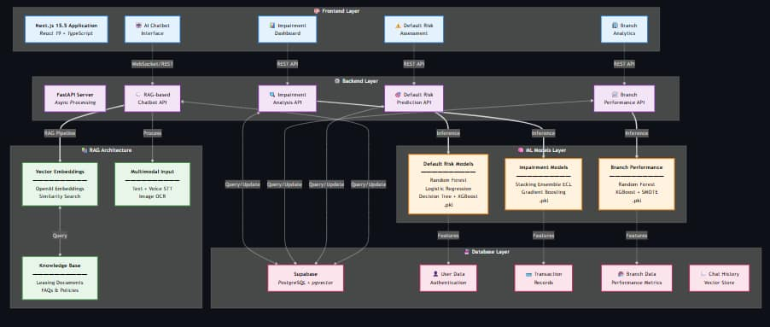
System Architecture & Integration

Slide 8
Commercialization
Target Users & Market
Financial leasing industry
Risk management teams
Finance analysts
Branch managers
Leasing customers
Value Proposition
AI-driven risk prediction helps leasing companies identify high-risk customers early
Branch performance insights support data-driven management decisions
AI conversational assistant provides instant responses to customer inquiries

Slide 9
Commercialization
Cost and Feasibility
Software development
Cloud hosting
Adoption Plan
System maintenance and updates
Data storage
Security management

Slide 10
Thank You!

