Slide 1
Predicting Loan Approval for those with limited Credit History
Home Credit Kaggle competition

Slide 2
Background - Home Credit
Currently operate in 11 countries
Mostly in North America and Asia
Goal is to provide a positive lending experience to customers who have little banking history
Offer differing loan products
Cash loans and revolving loans
92% of current applications are approved
Home Credit is currently using some statistics and machine learning
Goal is to approve all applicants who have potential to repay

Slide 3
Working with missing data
Original Size 122 X 307511
16 Categorical
106 Numeric
67 columns had missing data
Columns with more than 100K missing values were dropped
Remaining Categorical features filled NaN with ‘other’
NaN for Numeric features were filled with the column mean
Any remaining NaN values were dropped

Slide 4
Feature Engineering and Selection
”Flag” columns were grouped and summed into [’Flag_Total’]
Individual columns were dropped
Binary features were manually encoded 0 and 1 from Y/N
Remaining categorical features were encoded
One column was kept from each categorical feature
17 features remained an the end of feature selection
PCA was also applied and like models were compared as a validation technique for comparison

Slide 5
Working with unbalanced data
92 % of applicants were approved
Models learned to return approved for all predictions
Options to deal with unbalanced target
Reduce the number of approved to match those denied
Can lose some of the signal
Synthetically manufacture more of the minority class
SMOTE
These points do not exist in the real world

Slide 6
Models Evaluated
Logistic Regression
KNN Classifier
Decision Tree
Gradient Boost Classifier
Random Forest
XG Boost Classifier
SVM Classifier
Voting Classifier

Slide 7
Model Evaluation Metrics
Train / Test Split
80 % Train / 20 % Test Split
Cross Validation
K-folds = 10
Classification Accuracy
Confusion Matrix
Recall
Specificity
False Positive Rate
Precision

Slide 8
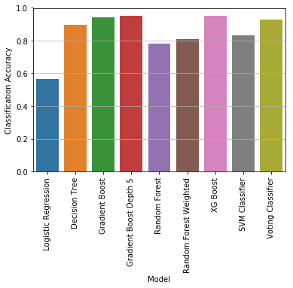
Classification Accuracy

Slide 9
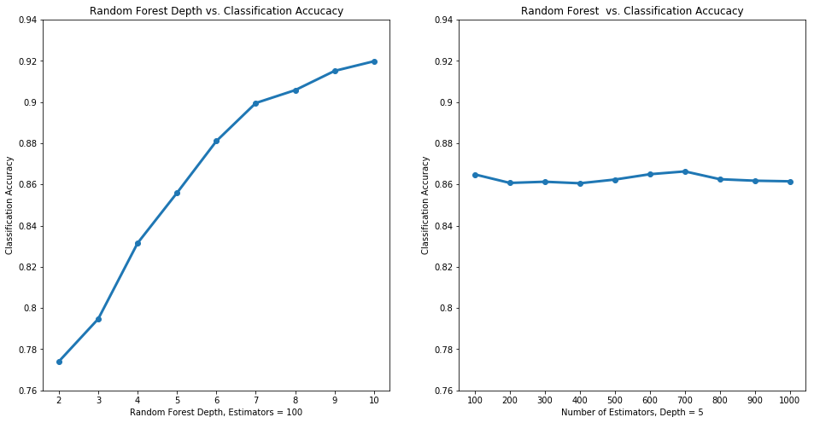
Random Forest Comparison

Slide 10
Recommended Model
Gradient Boost
Parameters
n_estimators = 500, max_depth = 5
Evaluation Metrics
Classification Accuracy: .951
Recall: .904
Specificity: .998
Precision: .906
AUC with 10 fold cross- validation mean : .969
PCA with 10 components cross-validation mean: .906

Slide 11
Additional Steps
Continued tuning of Gradient Boost
Holdout Group
Different weights for SMOTE
Modify Voting Classifier
Weighted Random Forest
Gradient Boost
Feature Validity
Countries, Regions, Gender

