Slide 1



Outgoing Asymptote
$V_{∞}(t_{f}$)
Journey boundary state
Match point
Sphere of Influence
Body
Forward and backward integration
Incoming Asymptote
$V_{∞}(t_{0}$)

Slide 2
Outgoing Conic
Forward and backward integration
Body modeled as massless point
Incoming Conic

Slide 3






Impulsive DSMs
Perturbations
$$v_{1}^{−}$$
$$v_{1}^{+}$$
$$v_{N}^{−}$$
$$v_{N}^{+}$$
Forward propagation
Backward propagation
$$m_{0}$$
$$m_{f}= m_{n}$$
Mission clock time flow

Slide 4
Low Thrust
Perturbations
Forward propagation
Backward propagation
$$m_{0}$$
$$m_{f}= m_{n}$$
Mission clock time flow

Slide 5


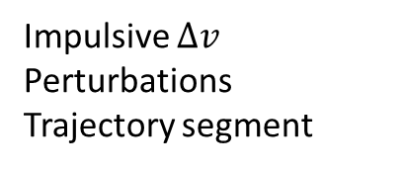
Impulsive $∆v$
Perturbations
Trajectory segment
$$∆v_{1}$$
$$∆v_{N}$$
Forward propagation
Backward propagation
$$m_{0}$$
$$m_{f}= m_{n}$$
Mission clock time flow

Slide 6
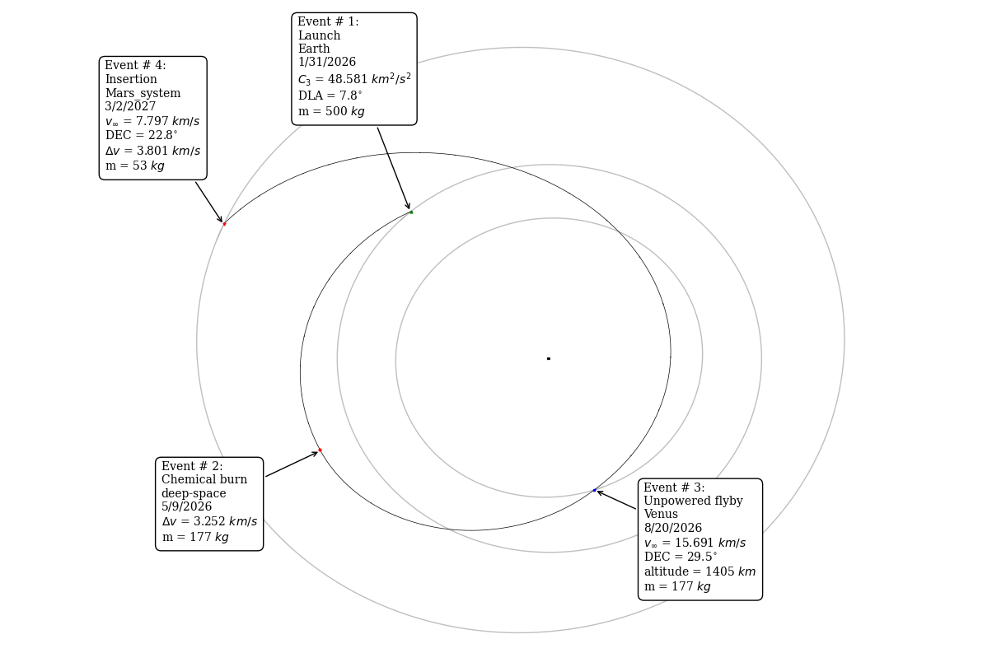
Orbit around the Sun connecting Venus and Mars

