Slide 1
Nonlinear Programming: Theory and Practice in EMTG
Noble Hatten
02/17/022

Slide 2
Contents
Theoretical structure of a nonlinear programming (NLP) problem
Solving an NLP problem
How this relates to adding a boundary constraint to EMTG
References/suggested reading

Slide 3
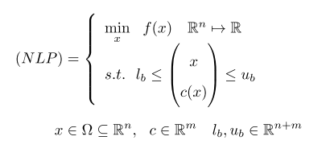
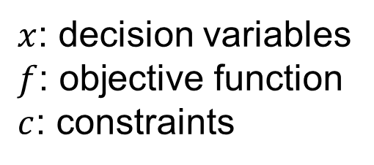
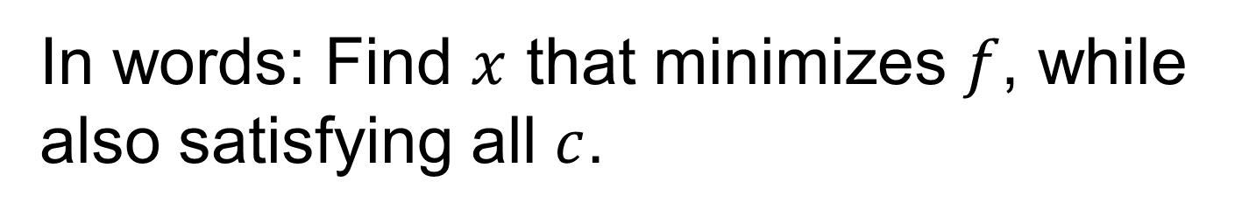
NLP Problem
$x$: decision variables
$f$: objective function
$c$: constraints
In words: Find $x$ that minimizes $f$, while also satisfying all $c$.

Slide 4

Posing an NLP Problem
What are $f$, $c$, and $x$?
How do I express $f$ and $c$ as functions of $x$?
What are my lower and upper bounds on $x$ and $c$?

Slide 5
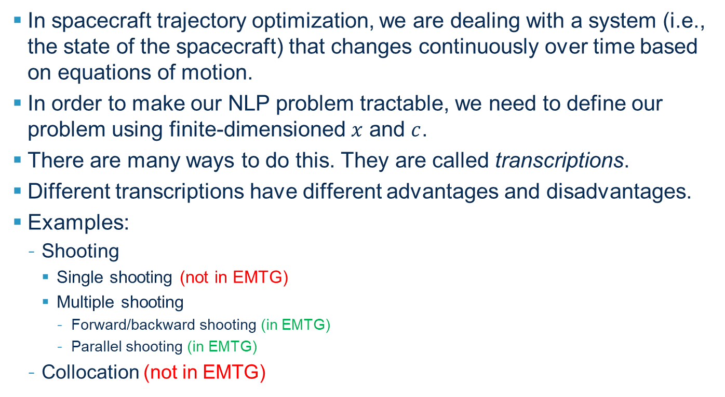
Transcriptions
In spacecraft trajectory optimization, we are dealing with a system (i.e., the state of the spacecraft) that changes continuously over time based on equations of motion.
In order to make our NLP problem tractable, we need to define our problem using finite-dimensioned $x$ and $c$.
There are many ways to do this. They are called transcriptions.
Different transcriptions have different advantages and disadvantages.
Examples:
Shooting
Single shooting (not in EMTG)
Multiple shooting
Forward/backward shooting (in EMTG)
Parallel shooting (in EMTG)
Collocation (not in EMTG)

Slide 6
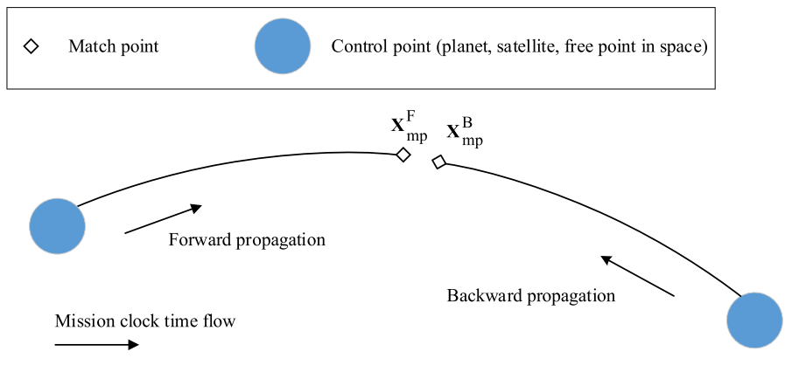
Generic Forward/Backward Shooting

Slide 7
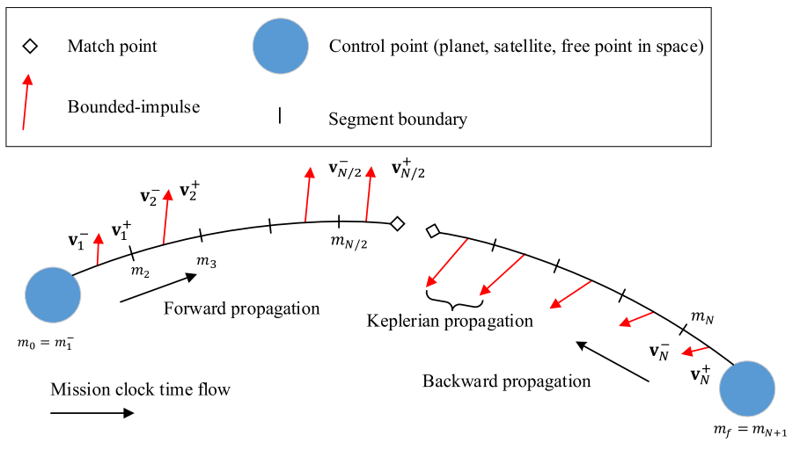
Forward/Backward Shooting: Multiple Gravity Assist Low-Thrust (MGALT) Phase

Slide 8
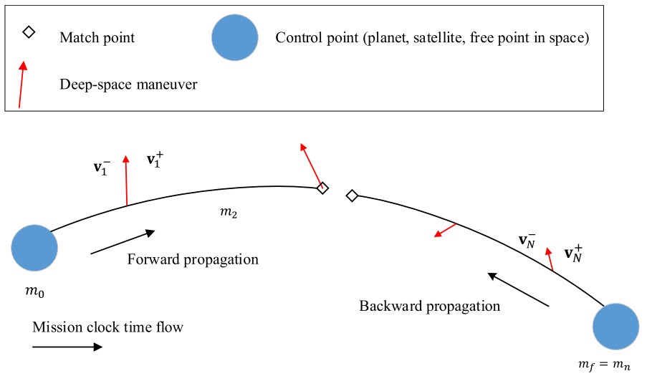
Forward/Backward Shooting: Multiple Gravity Assist n Deep Space Maneuvers (MGAnDSMs) Phase

Slide 9
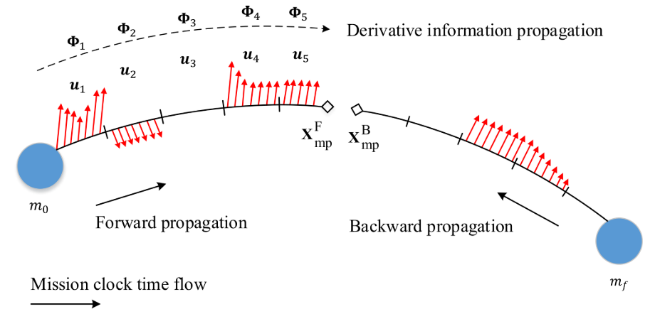
Forward/Backward Shooting: Finite Burn Low Thrust (FBLT) Phase

Slide 10
Parallel Shooting
Skip for now

Slide 11
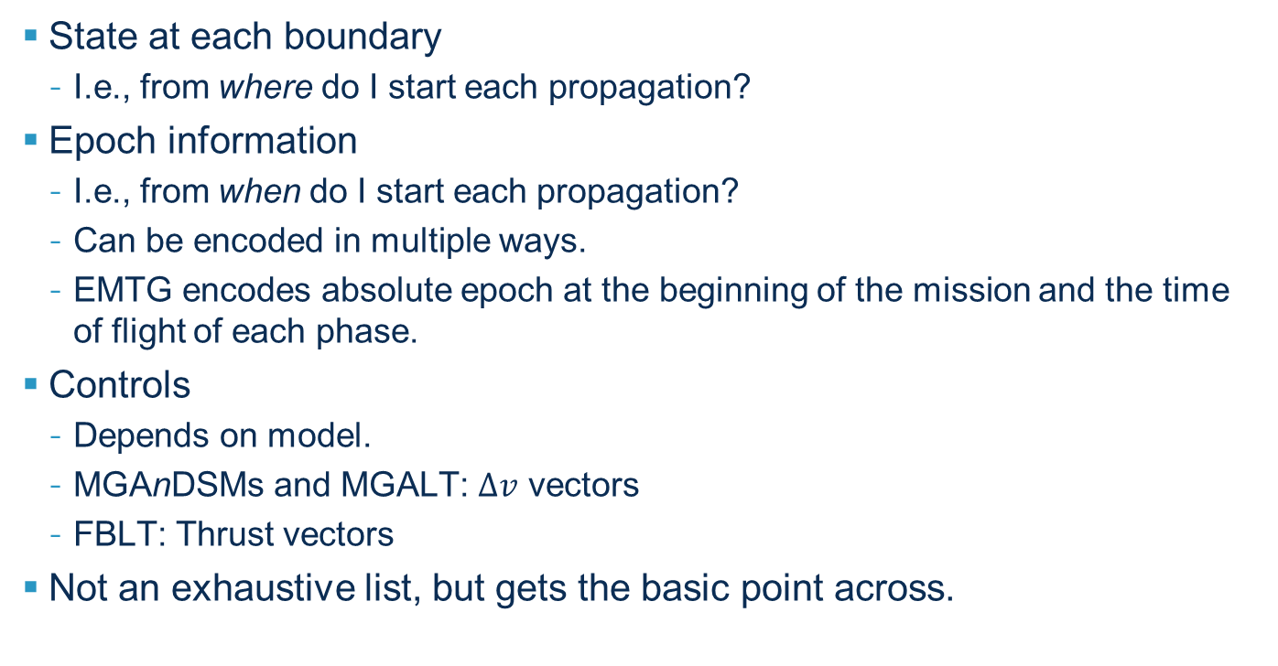
Decision Variables in Forward/Backward Multiple Shooting
State at each boundary
I.e., from where do I start each propagation?
Epoch information
I.e., from when do I start each propagation?
Can be encoded in multiple ways.
EMTG encodes absolute epoch at the beginning of the mission and the time of flight of each phase.
Controls
Depends on model.
MGAnDSMs and MGALT: $Δv$ vectors
FBLT: Thrust vectors
Not an exhaustive list, but gets the basic point across.

Slide 12
Decision Variables and Constraints in EMTG
Execute an EMTG mission.
The XFfile.csv produced by the execution contains a list the objective function, the decision variables, and the constraints, along with their values and lower/upper bounds.

Slide 13
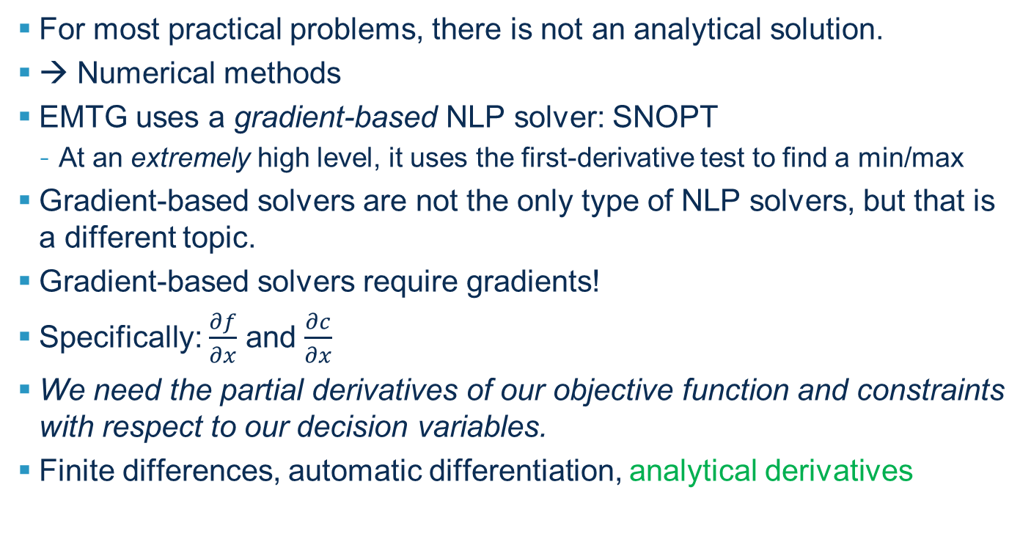
Solving an NLP Problem
For most practical problems, there is not an analytical solution.
→ Numerical methods
EMTG uses a gradient-based NLP solver: SNOPT
At an extremely high level, it uses the first-derivative test to find a min/max
Gradient-based solvers are not the only type of NLP solvers, but that is a different topic.
Gradient-based solvers require gradients!
Specifically: $\frac{∂f}{∂x}$ and $\frac{∂c}{∂x}$
We need the partial derivatives of our objective function and constraints with respect to our decision variables.
Finite differences, automatic differentiation, analytical derivatives

Slide 14
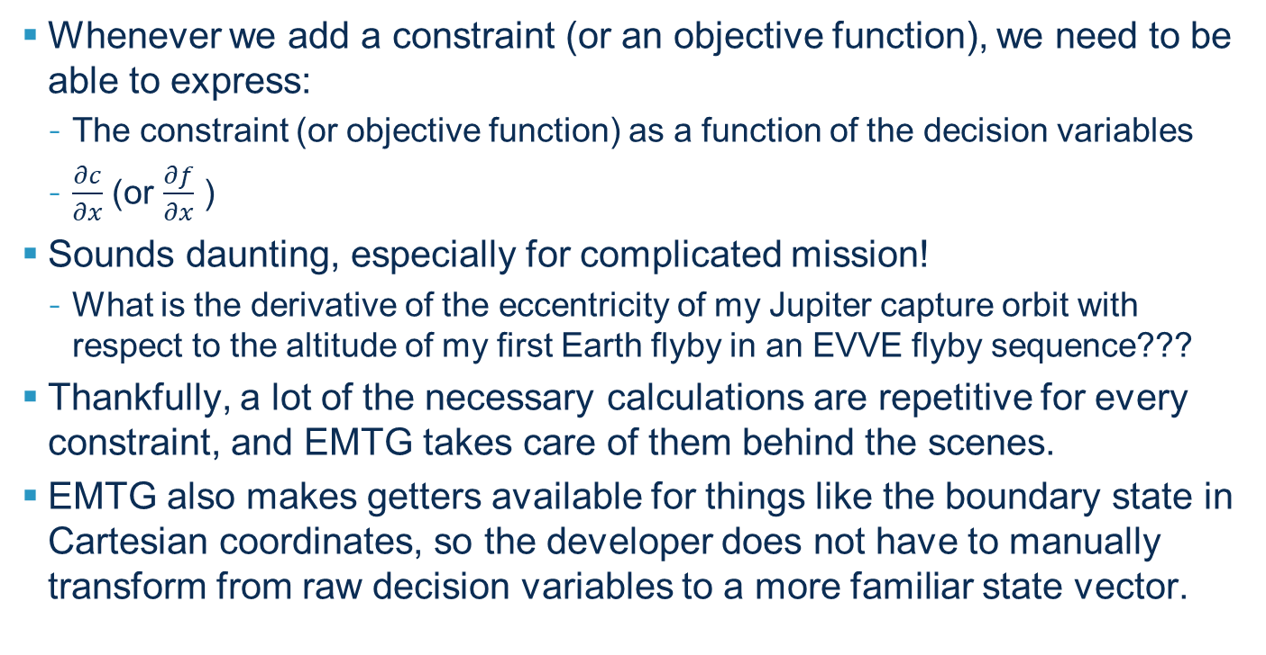
Adding a Boundary Constraint to EMTG
Whenever we add a constraint (or an objective function), we need to be able to express:
The constraint (or objective function) as a function of the decision variables
$\frac{∂c}{∂x}$ (or $\frac{∂f}{∂x}$ )
Sounds daunting, especially for complicated mission!
What is the derivative of the eccentricity of my Jupiter capture orbit with respect to the altitude of my first Earth flyby in an EVVE flyby sequence???
Thankfully, a lot of the necessary calculations are repetitive for every constraint, and EMTG takes care of them behind the scenes.
EMTG also makes getters available for things like the boundary state in Cartesian coordinates, so the developer does not have to manually transform from raw decision variables to a more familiar state vector.

Slide 15
The Developer’s Job
Express the constraint as a function of the ICRF state and epoch at the boundary at which the constraint is applied.
Express the derivatives of the constraint with respect to the ICRF state and epoch at the boundary at which the constraint is applied as functions of the ICRF state and epoch at that boundary.
Use getters to chain-rule appropriately with behind-the-scenes calculations.
Put results in appropriate containers.
(3) and (4) are not easy – I strongly urge starting from an existing boundary constraint class and editing as necessary – don’t start from scratch!!
In emtg repo / docs / constraint_scripting / EMTG_constraint_scripting.pdf, there is a more detailed “How-to” guide.

Slide 16
A “Simple” Example: Vertical Flight Path Angle
Repo / src / Mission / Journey / Phase / BoundaryEvents / SpecializedBoundaryConstraints / BoundaryVelocityVFPAconstraint.cpp/h
I chose this example because the constraint depends on position, velocity, and epoch.
I am not going to repeat everything that is already in the How-To guide.
I am going to skip most of calcbounds()

Slide 17
calcbounds(): Set the sparsity pattern
Deep breath … Go through example in EMTG_constraint_scripting.pdf.

Slide 18
process_constraint(): Calculate the constraint value
Grab behind-the-scenes info:
Math … math … math …
Put in container:

Slide 19
process_constraint(): Calculate the constraint derivatives
The math is the “simple” part – basically makes sense whether you know EMTG or not.
Calculate derivatives in BCF frame, use chain rule to get into ICRF
For epoch derivatives – how does the orientation of the BCF frame change w/r/t/ ICRF if the epoch changes?

Slide 20
process_constraint(): Chain Rule to Decision Variables
The brain-breaking part!
See instructions in EMTG_constraint_scripting.pdf.
In particular, this is broken into 3 parts:
Derivatives with respect to the boundary state
Derivatives with respect to time variables that affect the boundary state (i.e., implicit time derivatives)
See next slide
Explicit time derivatives

Slide 21
process_constraint(): Implicit Time Derivatives
This is where things like derivatives w/r/t/ times of flight are taken care of.
EMTG makes it easy.
These derivatives are exactly the same as the state derivatives except for the last step of the chain rule – which you just grab using a different EMTG getter.
See How-To and examples.

Slide 22
Checking Derivatives of Constraints in EMTG
EMTG variables of type “doubleType” are hooked up to an automatic differentiation package called GSAD.
By default, GSAD is turned OFF because it makes EMTG slow.
However, the EMTG mission_testbed project allows a user to run a mission in TrialX mode with GSAD turned ON.
Further, mission_testbed produces csv files (analogous to XFfile.csv) that compare analytical derivatives of constraints with their AD counterparts in order to test the accuracy of the analytical derivatives.
I’ll add more details on this later.

Slide 23
References/Suggested Reading
Number-one resource for theory is Donald Ellison’s PhD dissertation
Robust Preliminary Design for Multiple Gravity Assist Spacecraft Trajectories, University of Illinois at Urbana-Champaign, 2018.
EMTG constraint scripting documentation has a “How to” guide.
Emtg repo/docs/constraint_scripting/EMTG_constraint_scripting.pdf

