Slide 1
Traditional Approach
A depends on B
Adamant Approach
A and B depend on C
A
f()
B
A
B
C
f()

Slide 2
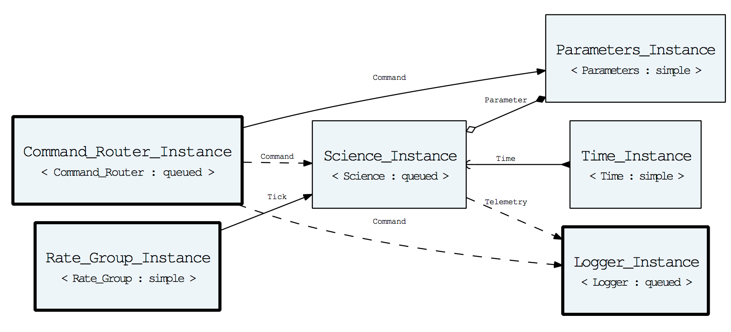
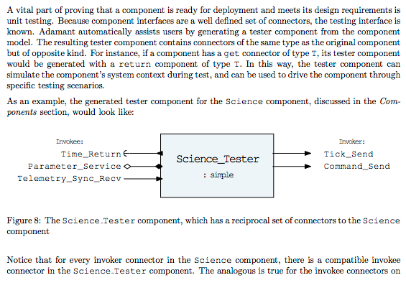
Structural Source Code (Ada)
Unit Test Harness (Ada)
Text-based Models
(YAML files)
Ground System Interface
Generators (Python)
Design Diagrams
Latex & HTML Documentation

Slide 3
Architecture Layer Diagram
Legend
Software Documentation System
User Defined
Assembly Documentation
Generated
A Docs
B Docs
C Docs
Provided
Software Testing System
Assembly Ground System Interface
Software Modeling System
A Unit Tests
B Unit Tests
C Unit Tests
Assembly Model
A Model
A Harness
B Harness
C Harness
B Model
C Model
Software Embedded System
Assembly Structure & Initialization
Component Integration
A Behavior
B Behavior
C Behavior
Component Behavior
A Structure
B Structure
C Structure
Component Structure
Framework’s Small Core
Common Objects
Runtime System
Priority Preemptive Scheduling
Notes:
The following is the Adamant architecture laid out for an assembly consisting of 3 components.

Slide 4
Component Class Layout
The following is a class diagram for a component called “science” using probably-incorrect UML
Code Source
Class Hierarchy
Contents
Framework
component
Core framework code
Generated
component-science
Structural code ie. Connectors, abstract connector/command handlers, queues, etc.
Hand coded
component-science-implementation
Behavioral code implementing abstract handlers ie. What does the component do when it receives command or when a connector is invoked?

Slide 5
Code Source
Package Hierarchy
Contents
Framework
Provided
Component
“framework core package”
Core Code: Framework definitions
Model
Generated
Component.Example_Component
“generated base package”
Structural Code: Connectors, queues, abstract subprograms
Component.Example_Component.Implementation
“hand-coded implementation package”
Behavioral Code: User defined implementation of abstract subprograms
Hand-coded
Legend:
Framework Package
Component Autocoded Package
Component Hand-coded Package

Slide 6
Unit Testing Package Hierarchy
Component
“framework core package”
Component.Example_Component
“generated base package”
Component.Example_Component_Reciprocal
“generated reciprocal base package”
Component.Example_Component.Implementation
“hand-coded implementation package”
includes
Component.Example_Component.Implementation.Tester
“implementation tester package”
Legend:
includes
Framework Package
Example_Component_Tests
“generated unit test base package”
Component Autocoded Package
Component Hand-coded Package
Tester Component Autocoded Package
Tester Component Hand-coded Package
Example_Component_Tests.Implementation
“hand-coded implementation unit test package”
Unit Test Autocoded Package
Unit Test Hand-coded Package
Test
“generated unit test main”
includes
Example_Component_Tests.Implementation.Suite
“generated unit test suite package”

Slide 7
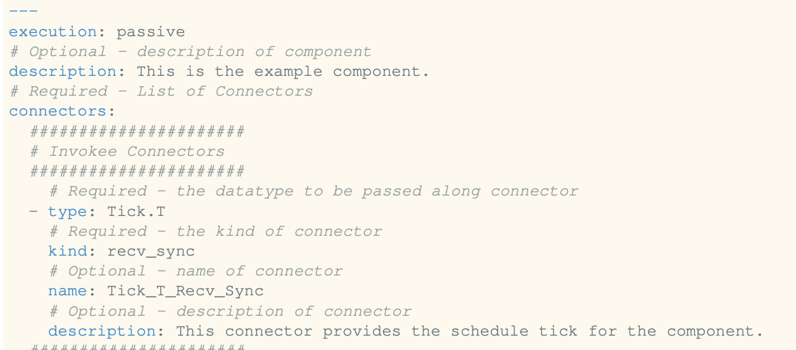
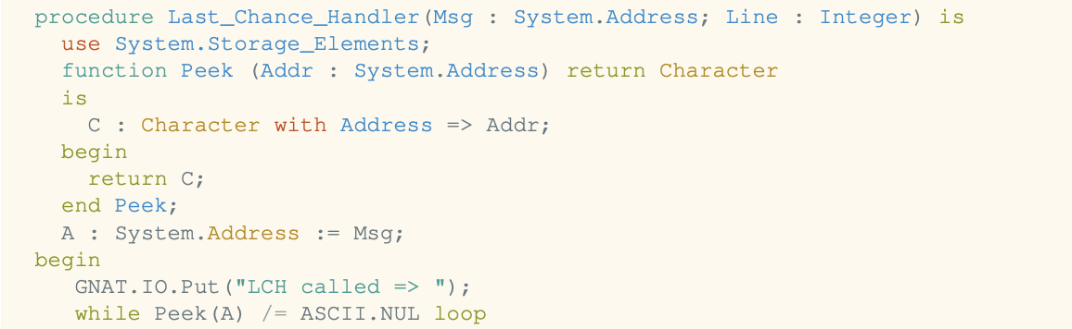
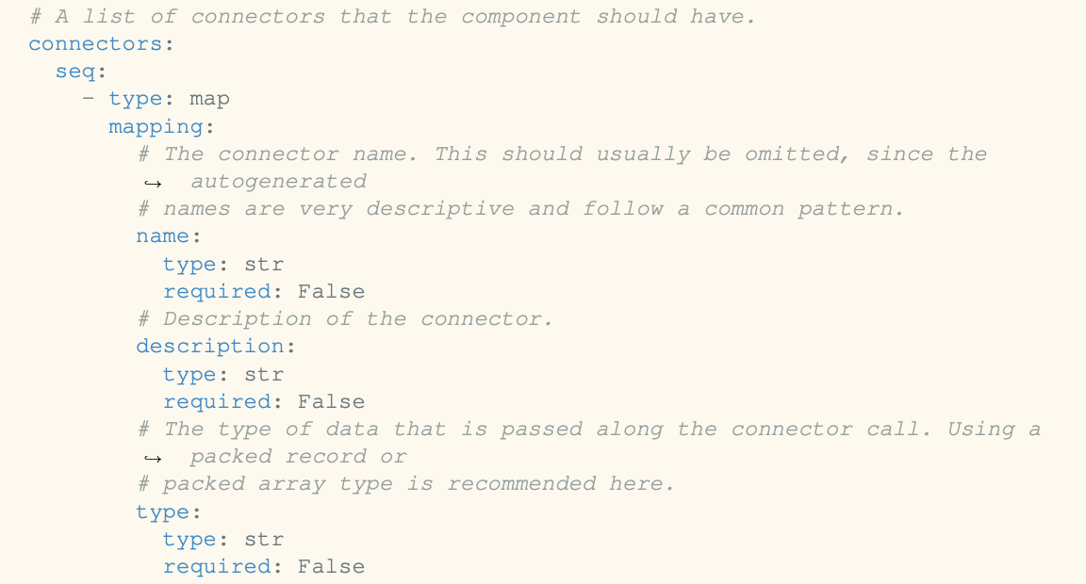
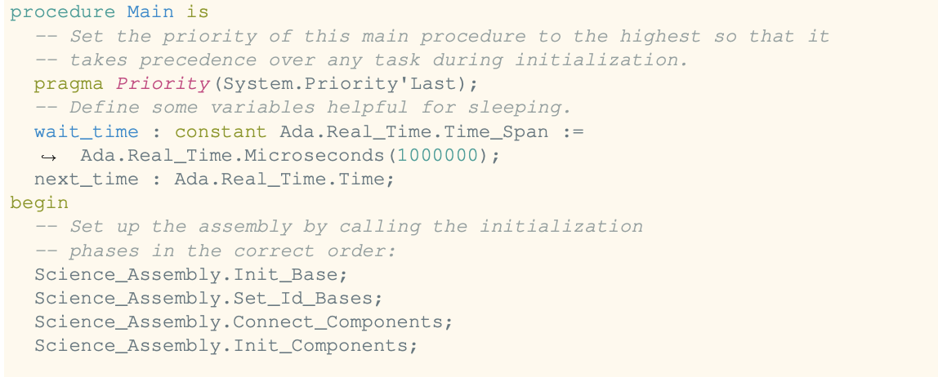
YAML Model
Output Product
Generator System
./example.type.yaml
gen/generators/type.py
./build/src/example.adb
1. load
Generator (Python)
5. write
2. validate
3. ingest,
check,
calculate
4. render
gen/schemas/type.yaml
gen/templates/type/name.adb
Model Class
(Python)
File Type Legend:
user model
generator system
generated output
gen/models/type.py
Pykwalify Schema
Jinja2 Template

