Slide 1

GDD Apprenticeship
Python day 1
03-03-22

Slide 2
Schedule
Introduction to Python
Exercise notebooks
Break
Exercise notebooks continued
Lunch
Python project structure
Break
Mini challenges exercise

Slide 3
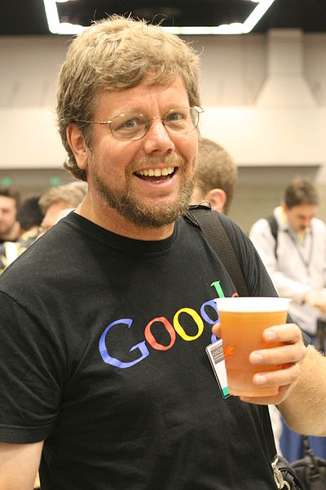
What is Python?
“Python is an experiment in how much freedom program-mers need. Too much freedom and nobody can read another's code; too little and expressive-ness is endangered.”
- Guido van Rossum

Slide 4
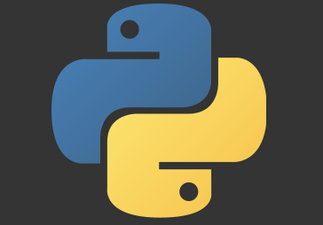
What is Python?
Python is a high-level, general-purpose, multi-paradigm programming language
Released in 1991 by Guido van Rossum at the Centrum Wiskunde & Informatica in Amsterdam
Successor to the ABC programming language, which is a successor to BASIC, Pascal and AWK

Slide 5
Features
Dynamically Typed
Strongly Typed
Object Oriented
Functional

Slide 6
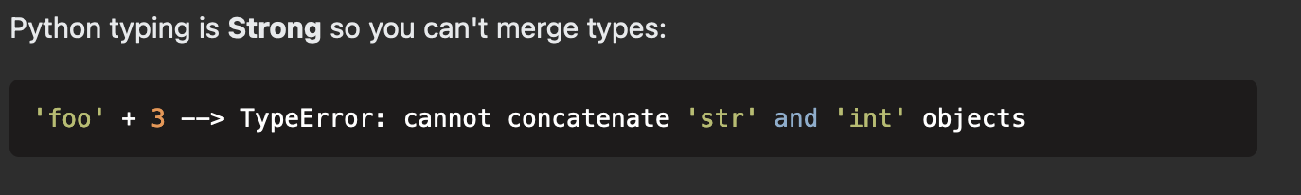
Dynamically typed
“Dynamic typing means that runtime objects (values) have a type, as opposed to static typing where variables have a type.”

Slide 7
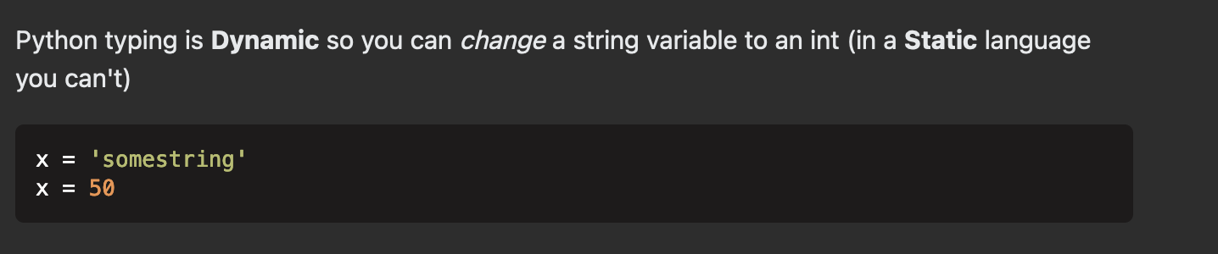
Strongly typed
“Strong typing means that the type of a value doesn't change in unexpected ways.
A string containing only digits doesn't magically become a number, as may happen in Perl. Every change of type requires an explicit conversion.”

Slide 8
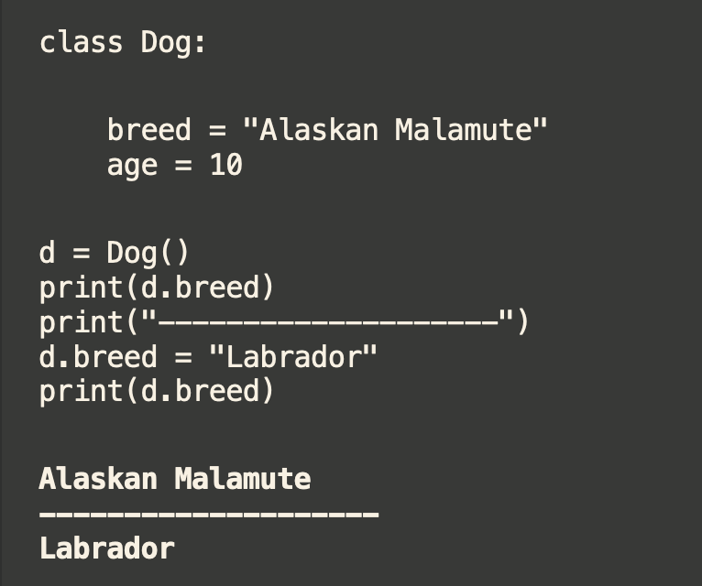
Object Oriented Programming
“Object Oriented Programming is method of computer programming that involves using 'objects'. An object is essentially a piece of code that lets you create many similar pieces of code without actually re-writing the code each time.”

Slide 9
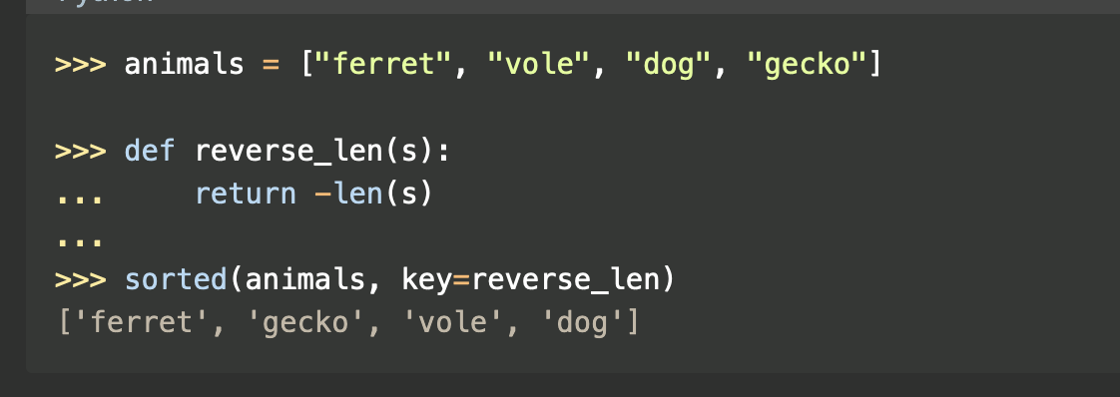
Functional programming
“Functional programming is a programming paradigm in which the primary method of computation is evaluation of pure functions”

Slide 11
Fin
Questions?

