Slide 1
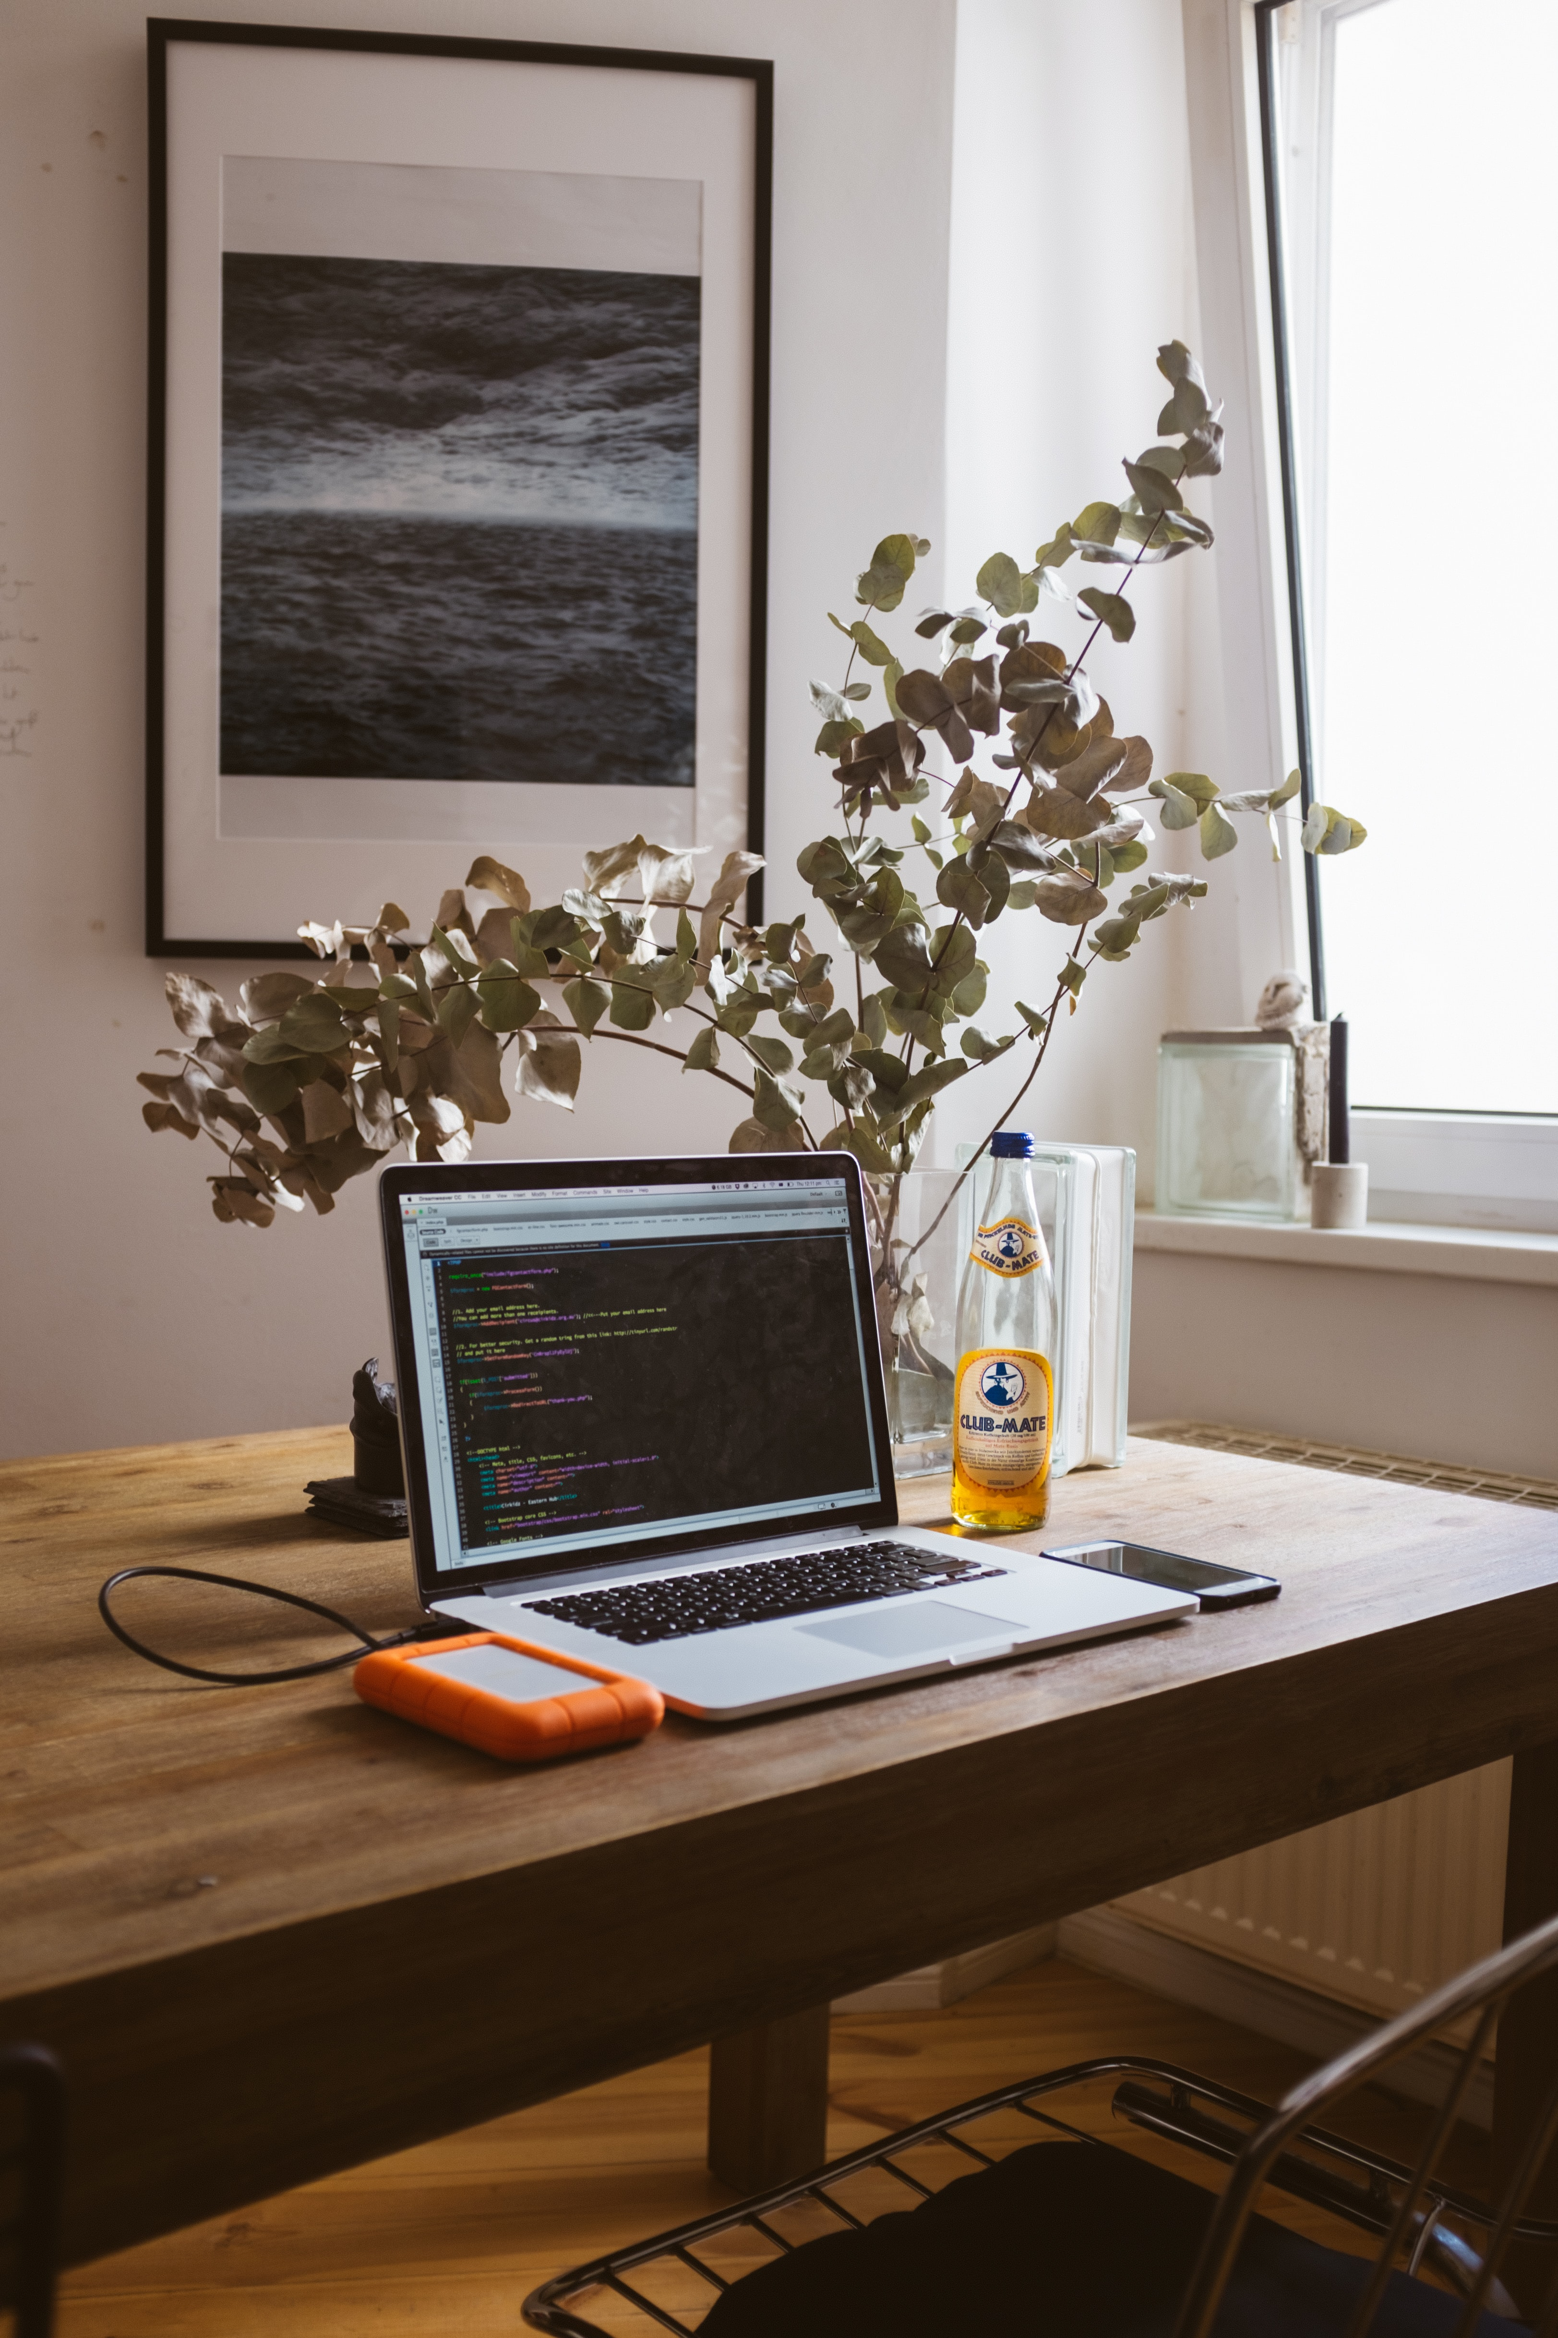
DNA Art
Sankt Hans Hospital
Lasse Folkersen

Slide 2
Background – problem/situation definition
The human genome consists of 3.15 billion base pairs. It is one of the most defining things about ourselves.
I challenge participants to make unique art pieces based on our underlying DNA sequence.
Copenhagen Bioinformatics Hackathon 2020 – April 24 - 26

Slide 3
Challenge
Teams choosing this challenge are expected to creatively use cutting-edge methods, such as generative adversarial networks (GANs), to make art based on human DNA.
Success is evaluated by the same metric as modern art: it has to catch the attention of the viewers!
Copenhagen Bioinformatics Hackathon 2020 – April 24 - 26

Slide 4
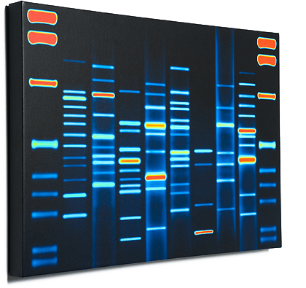
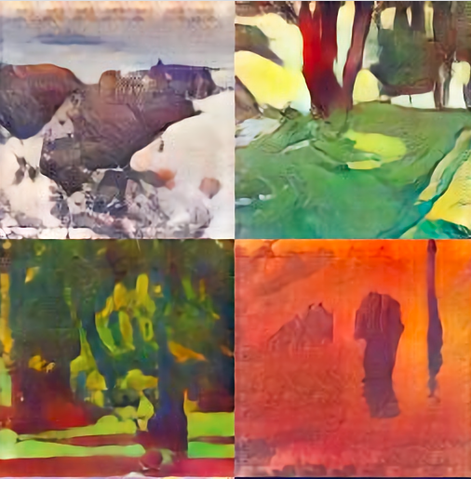
Examples of existing (similar) solutions
This restriction fragment southern blot sells for 500 €
It is based on 1990 DNA-technology
These landscape paintings were made by a computer.
It is based on GAN technology. They don’t use DNA.
Copenhagen Bioinformatics Hackathon 2020 – April 24 - 26

Slide 5
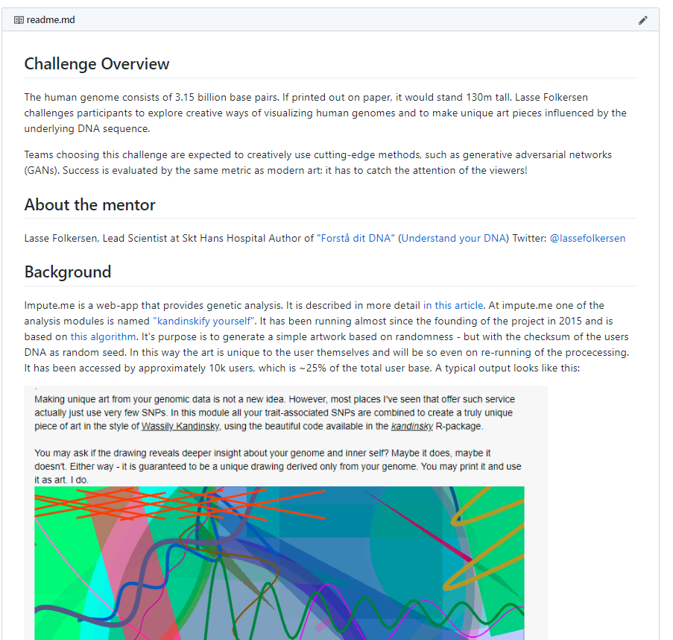
Details, suggestions and guidance
https://github.com/lassefolkersen/hackaton_art
Copenhagen Bioinformatics Hackathon 2020 – April 24 - 26 --- https://github.com/lassefolkersen/hackaton_art

Slide 6
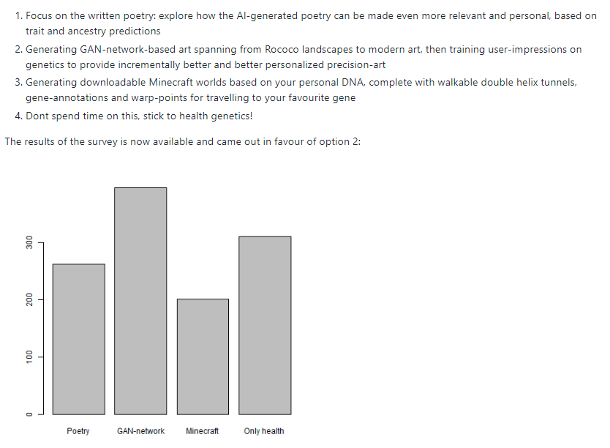
Details, suggestions and guidance
https://github.com/lassefolkersen/hackaton_art
Copenhagen Bioinformatics Hackathon 2020 – April 24 - 26 --- https://github.com/lassefolkersen/hackaton_art

Slide 7
Output requirements
Overall goal: A prototype DNA-based art generator
Three work packages are suggested. They are optional suggestions!
WP 1 implement automatic generation of pictures using GAN-approaches together with DNA- information input
WP 2 train the outputting generator based on user-feedback (“like” or “not like”), using DNA-based variables as training data
WP 3 showcase running algorithm using the provided test DNA-samples
But!! The sole criteria for evaluating success of this project is : ability to catch interest of viewers.
Copenhagen Bioinformatics Hackathon 2020 – April 24 - 26 --- https://github.com/lassefolkersen/hackaton_art

Slide 8
Resources available
Hardware SSH-based access to an AWS cloud computer of the g3s.xlarge size
Standard software: Ubuntu (18.04), with R (3.4.4) and python (2.7.17), CUDA Toolkit (10.2, for GPU usage).
Genomics data: Genomic data from 51 example-genomes are available in standard impute-me format
Art repository data: two sets are pre-loaded on the instances: one with 200k aligned portrait images and one with 10k landscape art images
Custom software: Each instance has a working copy of the impute.me software running (for WP3)
Copenhagen Bioinformatics Hackathon 2020 – April 24 - 26 --- https://github.com/lassefolkersen/hackaton_art

