Slide 1


Container Orchestration with Docker Swarm

Slide 2

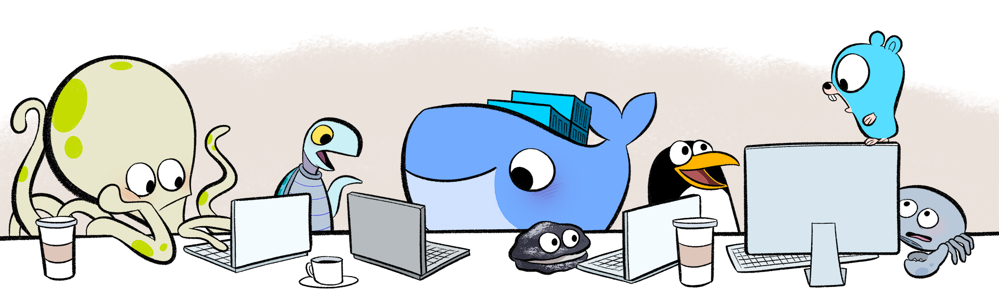
About me
Frederik Mogensen
Software Pilot at Trifork
Focus on Docker, orchestration and ci/cd

Slide 3
Running N containers on M machines ?

Slide 4


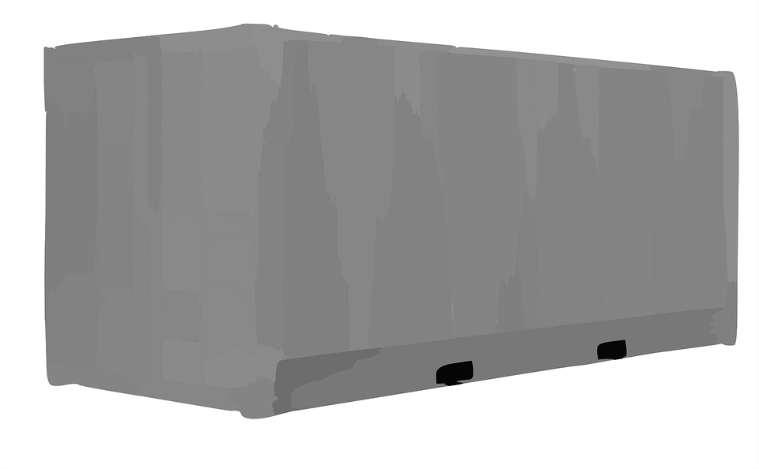
Independent Docker hosts
Deployment on M machines ?
Updating N containers ?
Scheduling N on M ?
Possible solutions
Chef
Puppet
Ansible

Slide 5
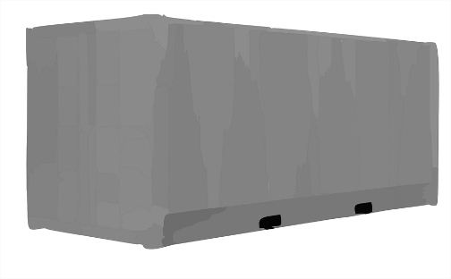
Containers manually allocated on multiple nodes
Non-linear resources usage
No service discovery, hardcoded configurations
Manual reaction to failures
Possible solutions
Manually monitor nodes and reschedule containers
Maintain list of services on nodes
Notes:
Consul
Eureka

Slide 6


Storage for containers
Store on node?
Manually integrate to network storage

Slide 7
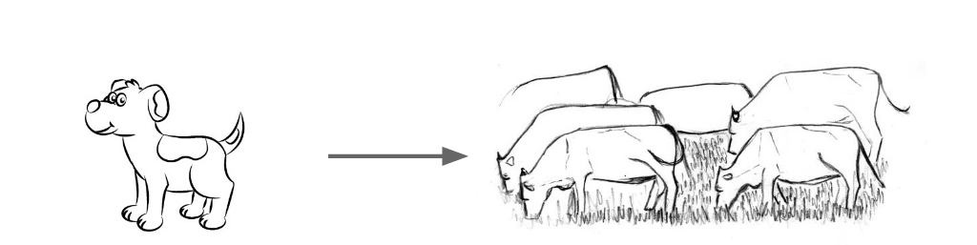
Pets VS Cattle
Unique systems that can never be down.
Build and managed manually.
“Hand fed”
” When one of them gets sick, you shoot 'em in the head and replace 'em with a new one.”
https://www.slideshare.net/zhurbilo/artem-zhurbilo-some-ways-to-set-up-the-server-highload-strategy-meetup

Slide 8
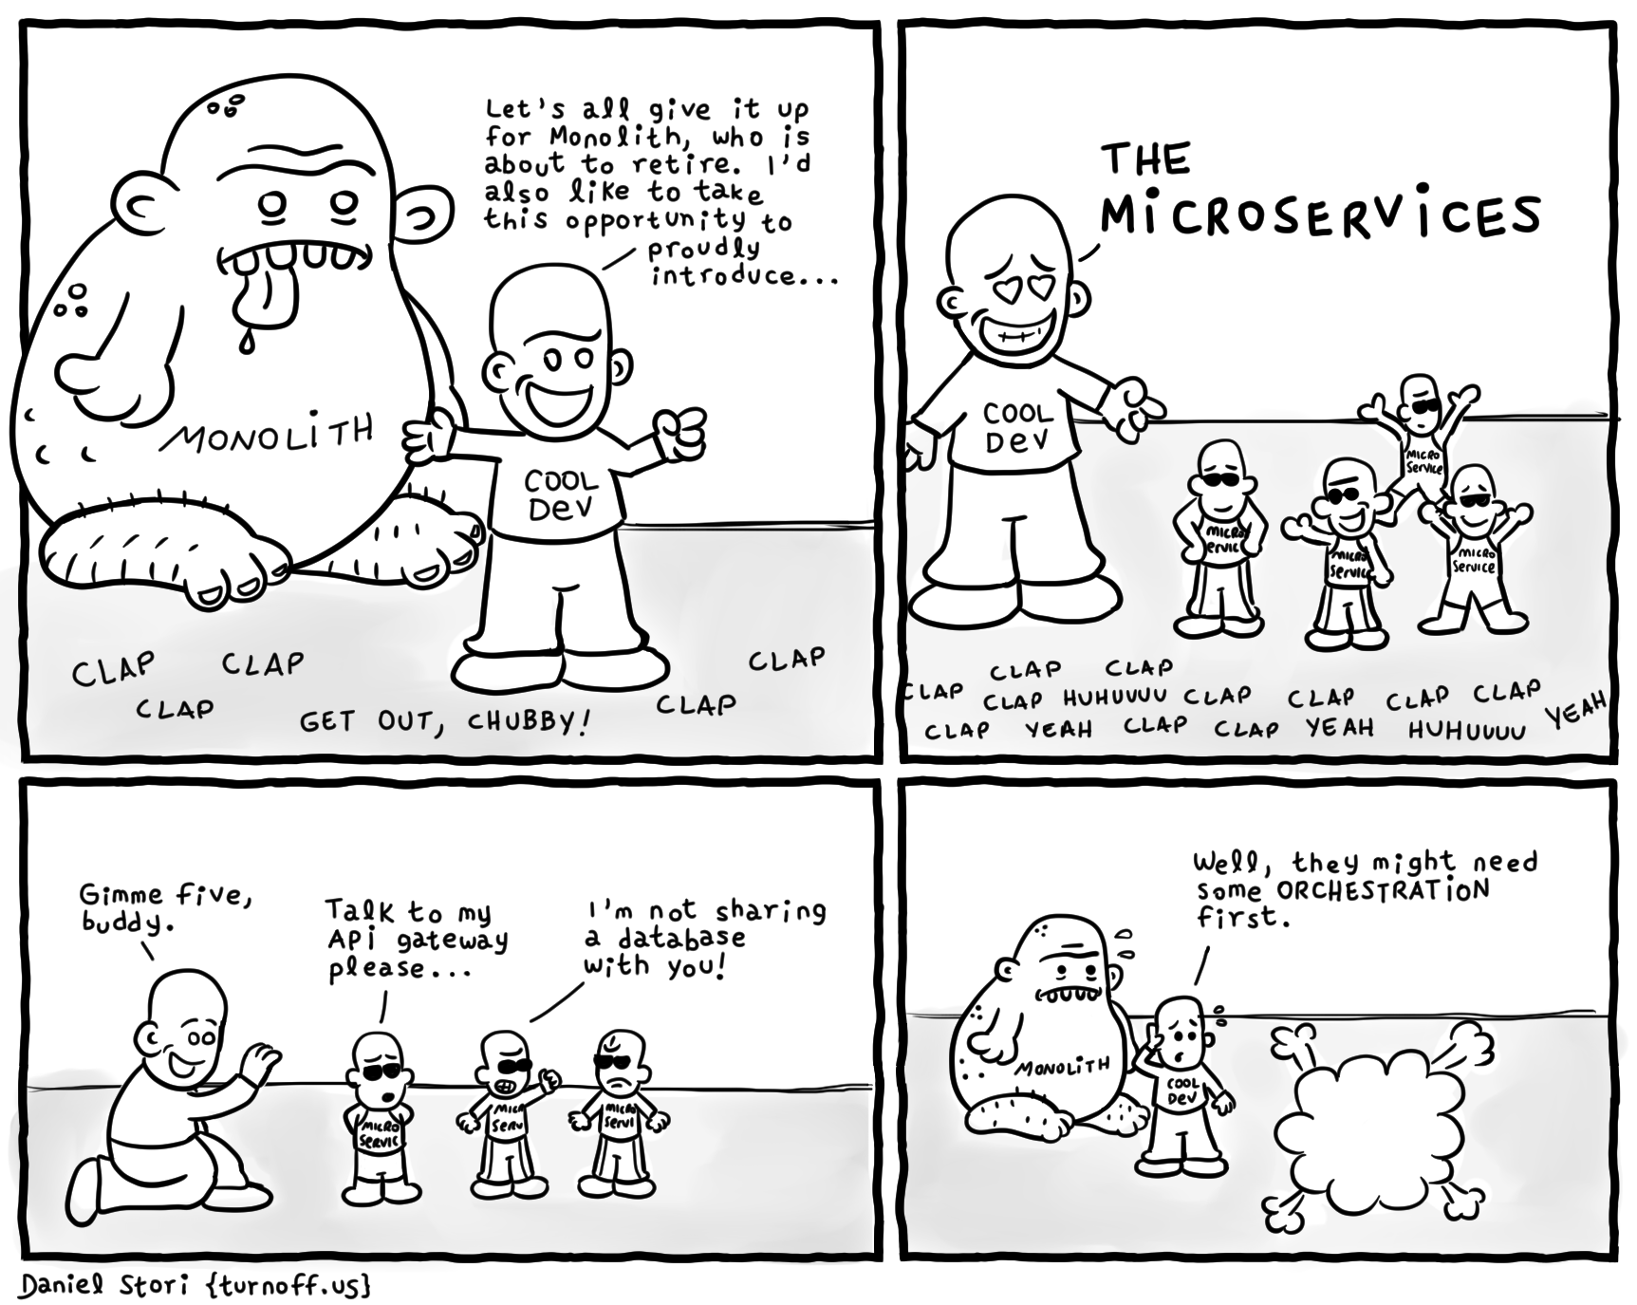
The Monolith Retirement
http://turnoff.us/geek/monolith-retirement/

Slide 9
Orchestration

Slide 10

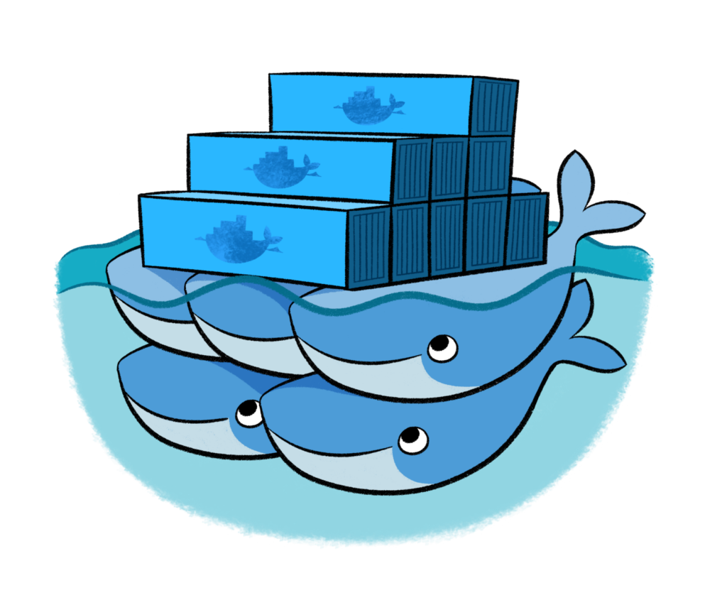

What is Container Orchestration?
Cluster management
Scaling
Service discovery
Load balancing
Networking
Security
Rolling updates
Storage
Configuration
Secrets
...

Slide 11
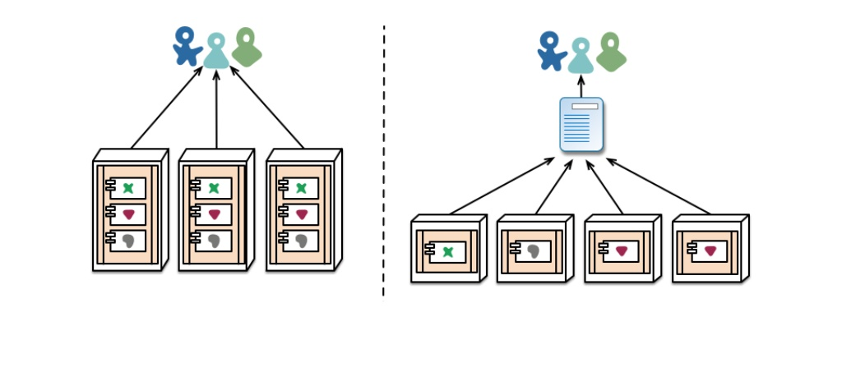
Scaling Services
Declare the number of services you want to run
Scale up or down
Orchestrator automatically adapts to desired state.
https://martinfowler.com/articles/microservices.html

Slide 12
Service Discovery
Allow for services in the cluster to locate other services
DNS
API
Load balancing
Running containers
Not dead containers
https://martinfowler.com/articles/microservices.html

Slide 13
Load Balancing
Expose services to external users
Distribution of workloads across multiple computing resources
Optimize resource usage
Maximize throughput
Avoid overload of any single resource
Increase reliability and availability through redundancy

Slide 14
Docker Swarm

Slide 15
Core consepts
Swarm
Node
Service
Tasks
Secrets

Slide 16
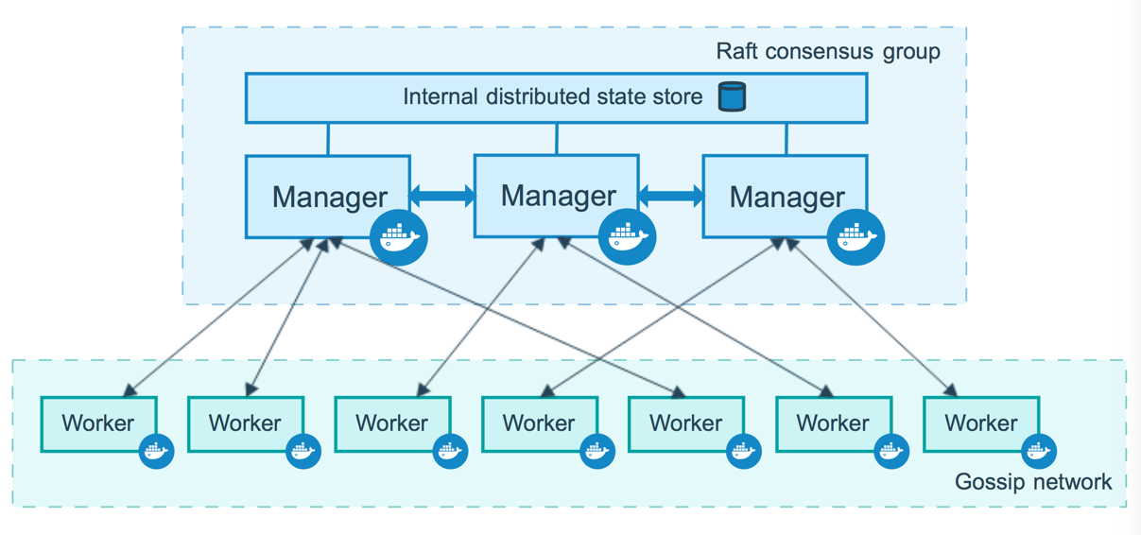
How nodes work
https://docs.docker.com/engine/swarm
Notes:
Manager nodes
Maintaining cluster state
Scheduling services
Serving swarm mode HTTP API endpoints
Worker nodes
Sole purpose is to execute containers.
By default, all managers are also workers
Raft group
All events for recreating the cluster
Encrypted by default
Majority or quorum of (N/2)+1
5 noted -> max 2 down

Slide 17
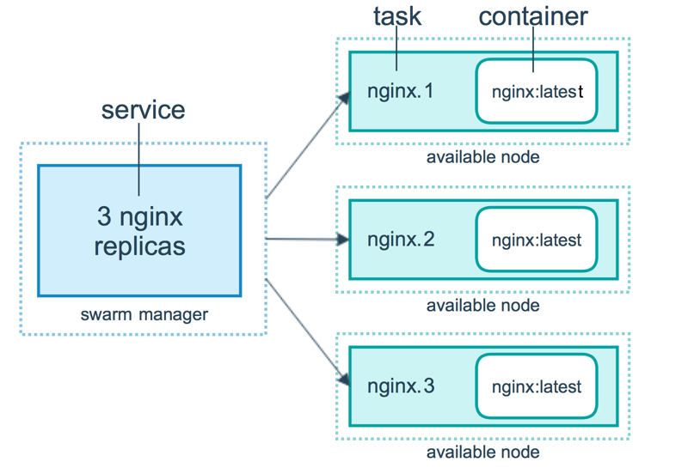
How services work
In a services we specify
Image
Exposing external ports
Overlay network for connecting to other services
CPU and memory limits and reservations
Update policy
Number of replicas
https://docs.docker.com/engine/swarm

Slide 18
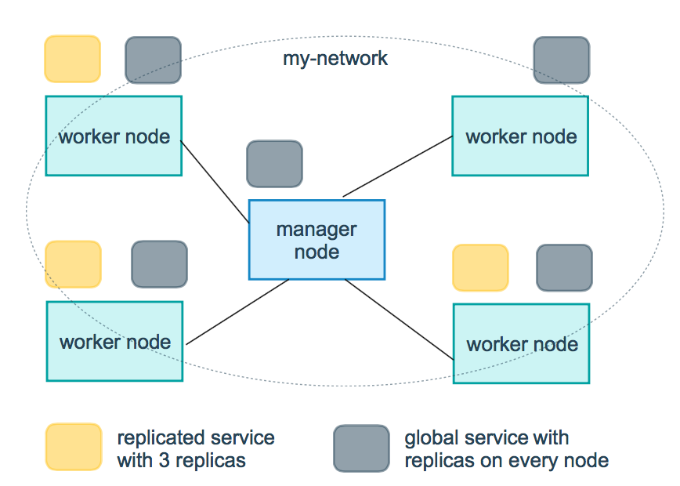
How services work
Replicated
Specify the number of identical tasks you want
Global services
Service that runs one task on every node
https://docs.docker.com/engine/swarm

Slide 19
Configuration
Environment variables
web:
environment:
- DEBUG
Environment files
web:
env_file:
- web-variables.env

Slide 20
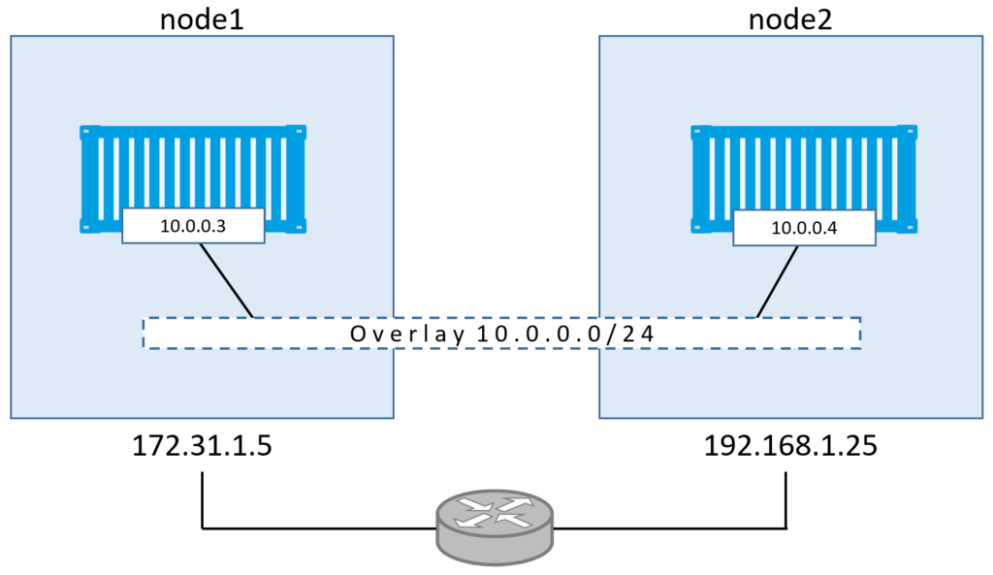
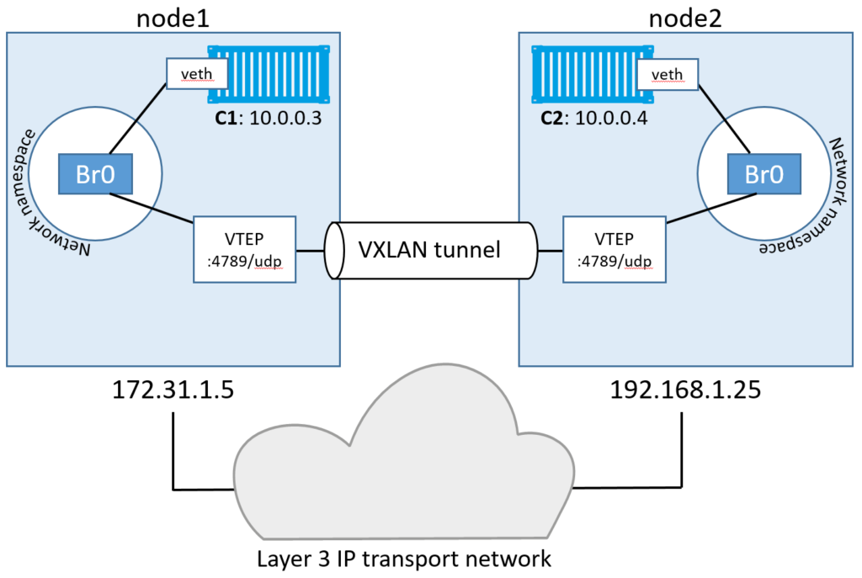
Networks
Develope-editon
Network-guy-edition
http://blog.nigelpoulton.com/demystifying-docker-overlay-networking/

Slide 21
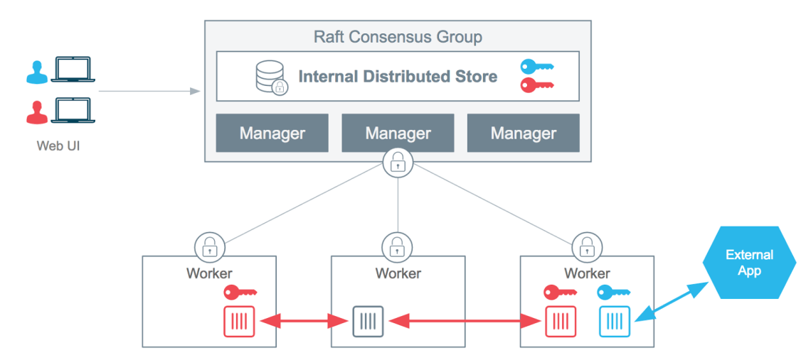
Secrets
$ echo "This is a secret" | docker secret create my_secret –
$ docker service create --name redis --secret my_secret redis:alpine
$ docker exec $(docker ps --filter name=redis -q) cat /run/secrets/my_secret
This is a secret
https://blog.docker.com/2017/02/docker-secrets-management/
Notes:
In Docker, a secret is
any blob of data
password
SSH private key
TLS Certificate
any other piece of data that is sensitive

Slide 22
Docker Swarm Cheat Sheet
Swarm
$ docker swarm init --advertise-addr $IP/$NET_INTERFACE
$ docker swarm join --token SWMTKN-1-49n… $MANAGER_IP:2377
$ docker swarm leave
Node
$ docker node ls
$ docker node update --availability drain $NODE_ID
$ docker node update --availability active $NODE_ID
$ docker node promote $NODE_ID

Slide 23
Docker Swarm Cheat Sheet
Services
$ docker service create --name=$SERVICE_ID $IMAGE
$ docker service rm $SERVICE_ID
$ docker service ls
Stacks
$ docker stack deploy --compose-file myComposeFile.yml $NAME
$ docker stack ls
$ docker stack ps
$ docker stack rm

Slide 24
Food, Beer, and Exercises

Slide 25
Exercises
https://tiny.cc/docker-swarm-meetup
https://docs.docker.com/engine/swarm/swarm-tutorial/
https://docs.docker.com/engine/swarm

Slide 26
