Slide 1
Thesis defense
Simulating multi-wavelength observations from low-resolution spectrographs
Lasse L. S. Berthelsen
Supervisor: Hans Kjeldsen
Co-supervisor: Victoria Antoci
22/1-2020
Aarhus University

Slide 2
Outline
Motivation
  Exoplanetary atmospheres
Simulation
  Step-by-step walkthrough
Using the simulator
Future work

Slide 3
Motivation
Search for alien life
Biosignatures and indicators
  Water, CO₂, oxygen
Atmospheres

Slide 4
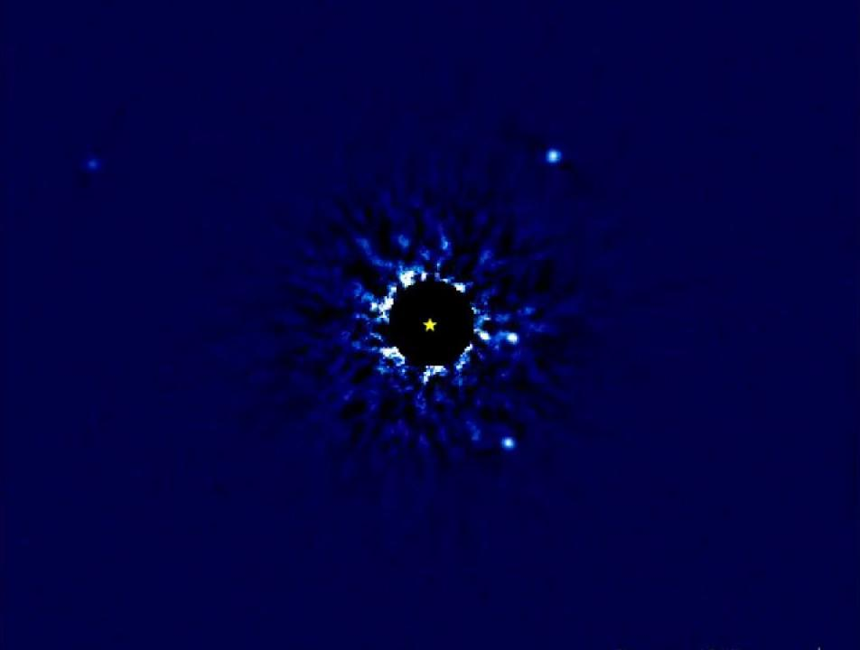
Exoplanetary atmospheres
How to detect them:
Direct imaging
Transit method
W.M. Keck observatory, J. Wang, C. Marois
Notes:
Direct imaging of exoplanets and their atmospheres is tremendously hard, as the planet is often extremely faint compared to the host star. In this case HR8799, the planetary brightness is 10e-5 times that of the star (12 magnitudes difference)
Detection method: Angular Differential Imaging (ADI)

Slide 5
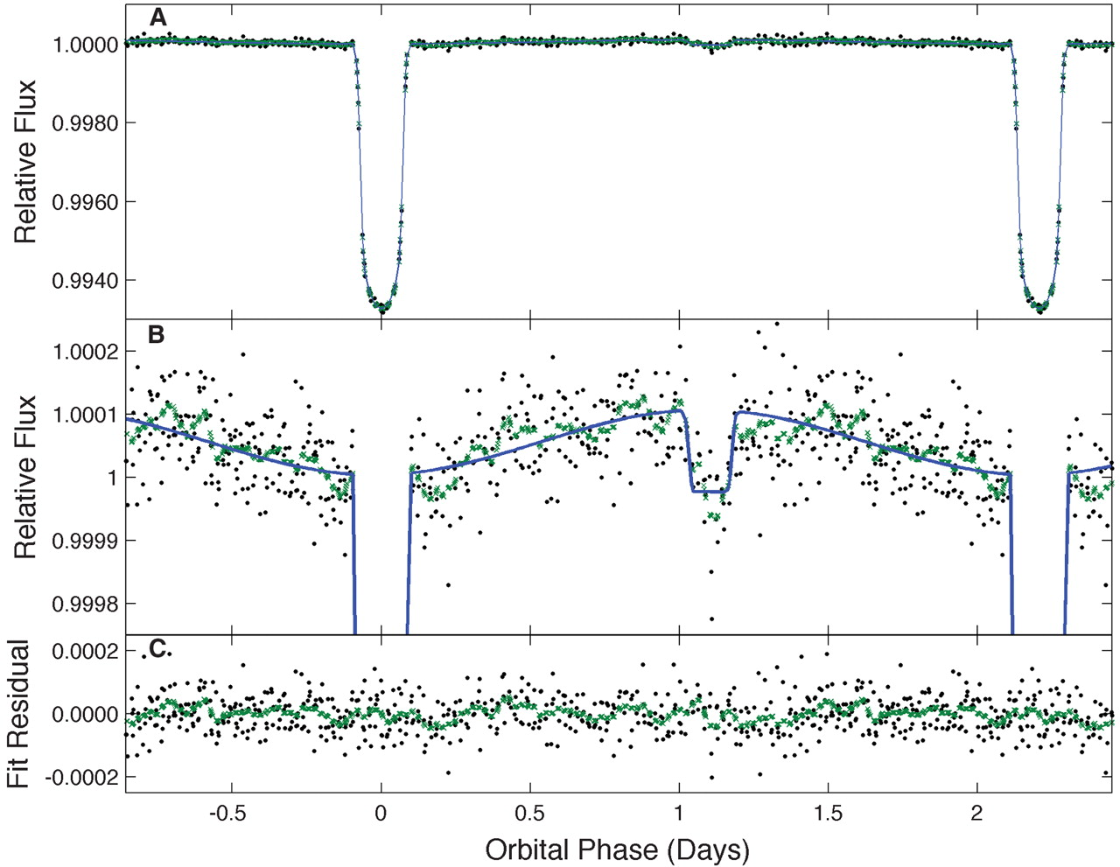
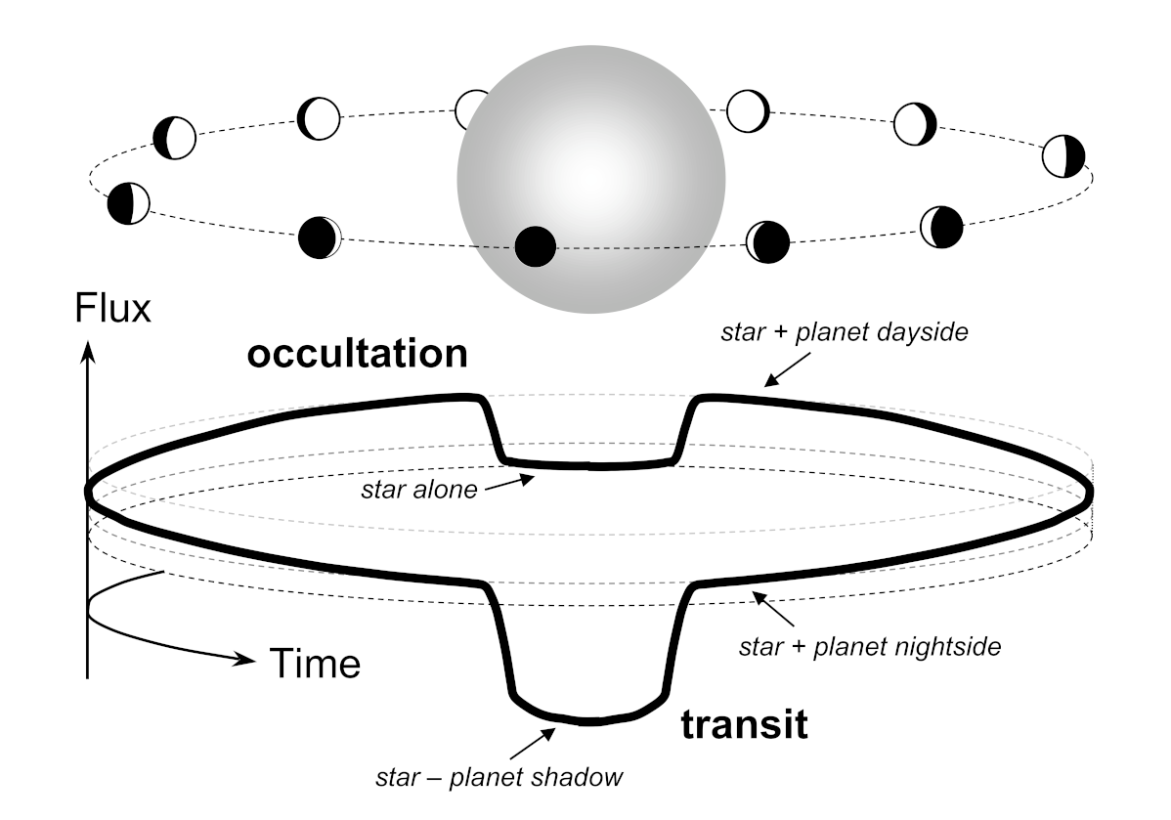
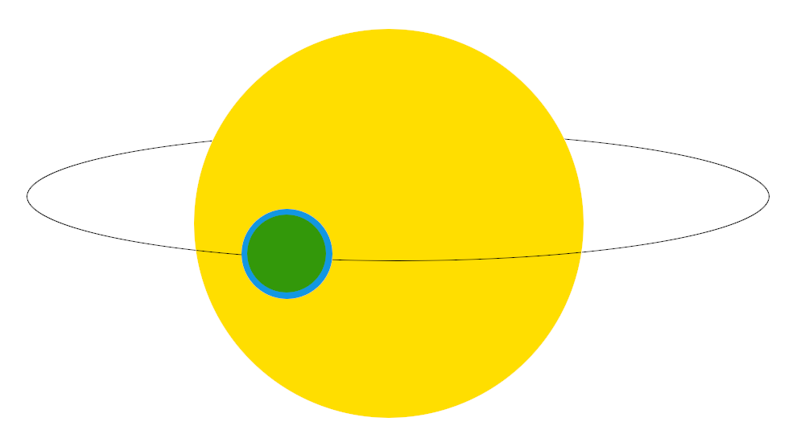
Transit method
Borucki et al. 2009
Winn 2014
Notes:
Photometry of HAT-P-7. Black dots are measurements, green are 0.1-day moving averages.

Slide 6
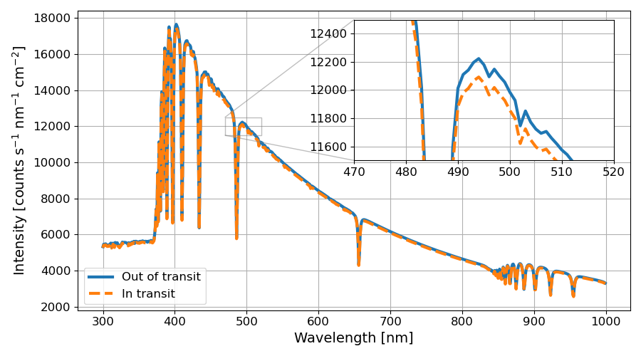
Transit method + spectroscopy
Fig. 8.1

Slide 7
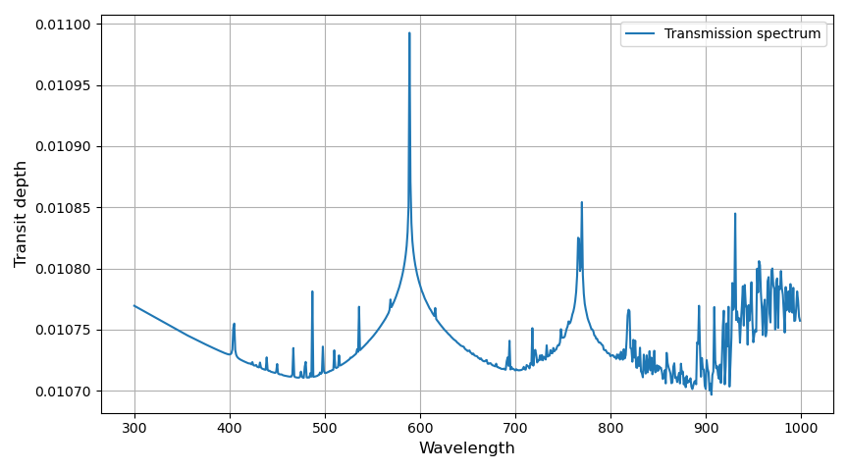
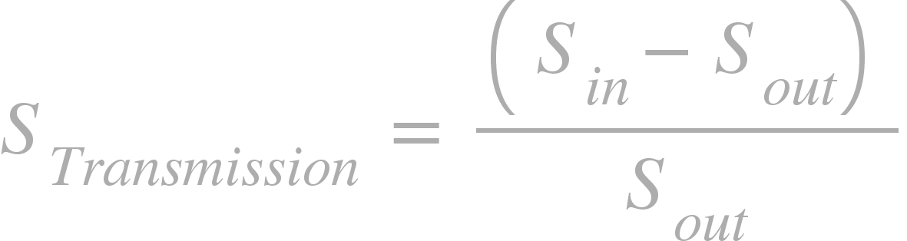
Transit method + spectroscopy
Transmission spectrum:
Notes:
Spectral features: @589 nm = Sodium doublet. @769 nm = Potassium (K), maybe?

Slide 8
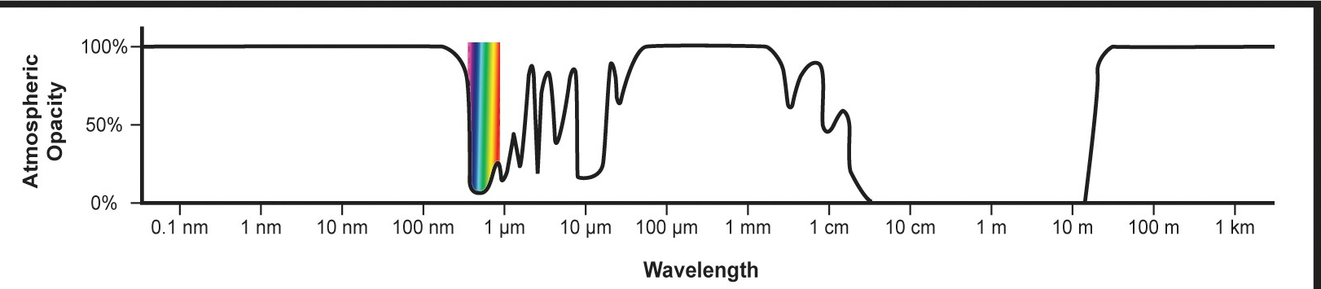
Another atmosphere...
Notes:
Low values = transparent. High values = not transparent

Slide 9
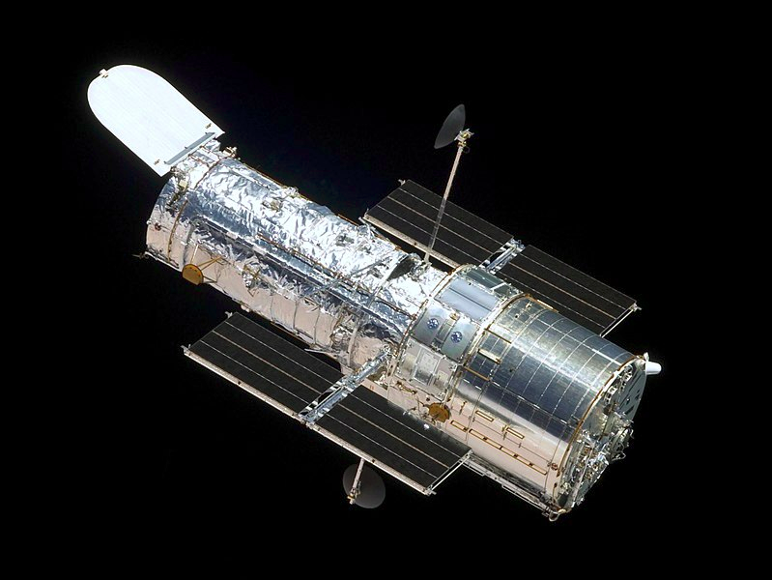
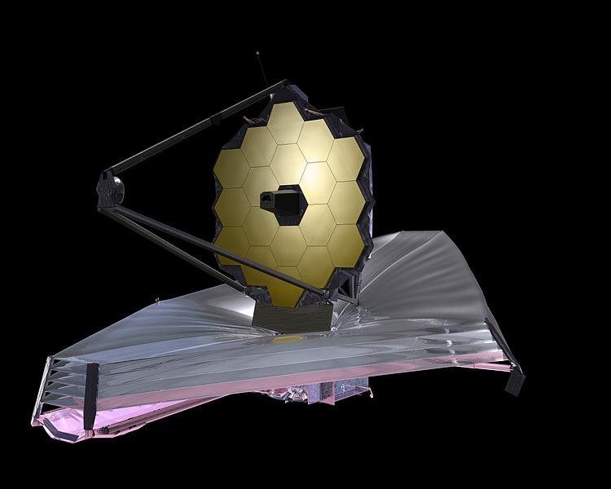
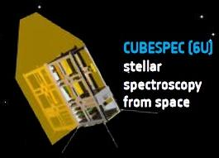
Satellite-based spectroscopy
NASA
NASA
ESA
Notes:
Hubble, JWST, CUBESPEC (Raskin et al. 2018)
Why make the simulator? A: Sending stuff into space is expensive, and we better make sure that the system we intend to use is capable of making the desired observations -> this is why simulations are smart, so we can evaluate this prior to launch.

Slide 10

Simulator
HIDRA: Hyperspectral Instrument Data Resemblance Algorithm
  Modular simulator for low-resolution spectroscopy
  Written in Python
1 nm spectral resolution
Notes:
This is what the project landed on in the end: simulating the observations, in order to evaluate quality, etc.

Slide 11
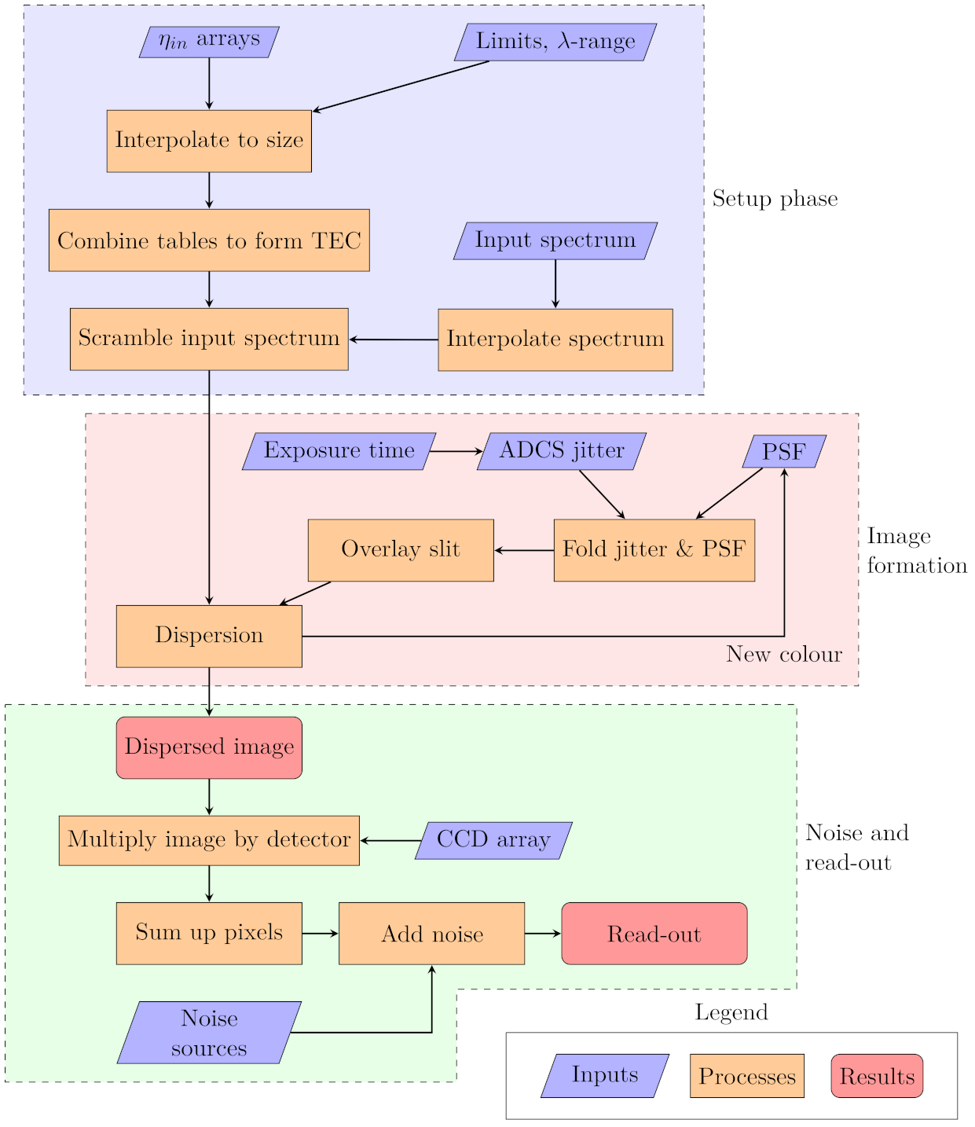
Fig. 6.1

Slide 12

Inputs
Input spectra
  In and out of transit
Spectral throughput, η_{in}
  CCD QE, spectral response of optics, etc.
Pixel size, plate scale, etc.
Tab. 8.1

Slide 13
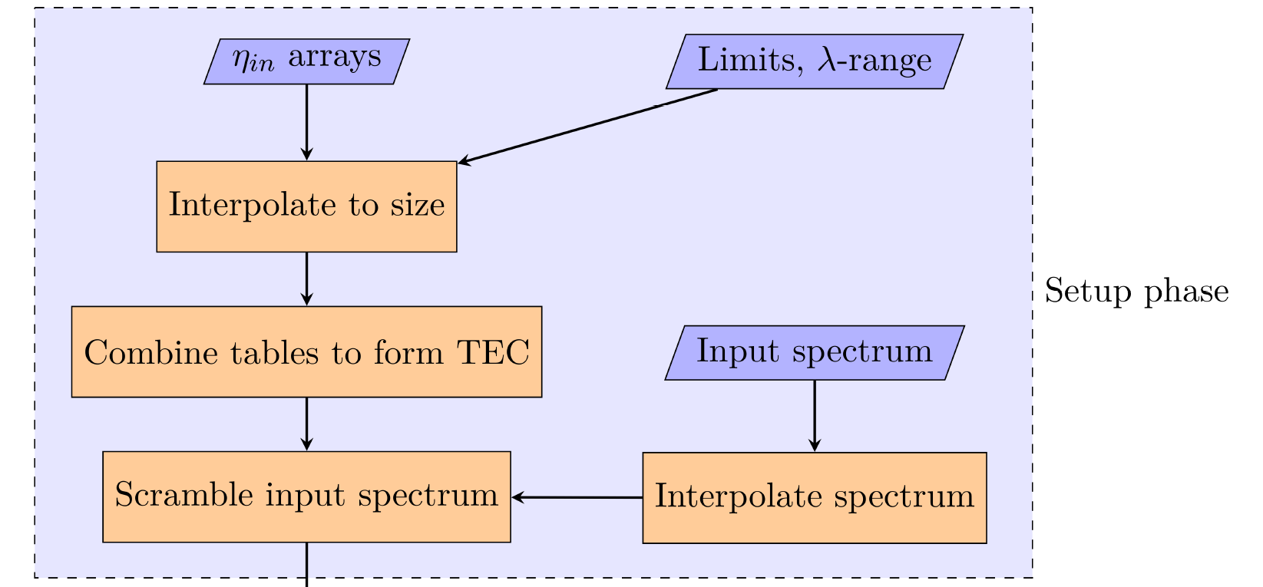
Step 1: Setup and interpolate

Slide 14
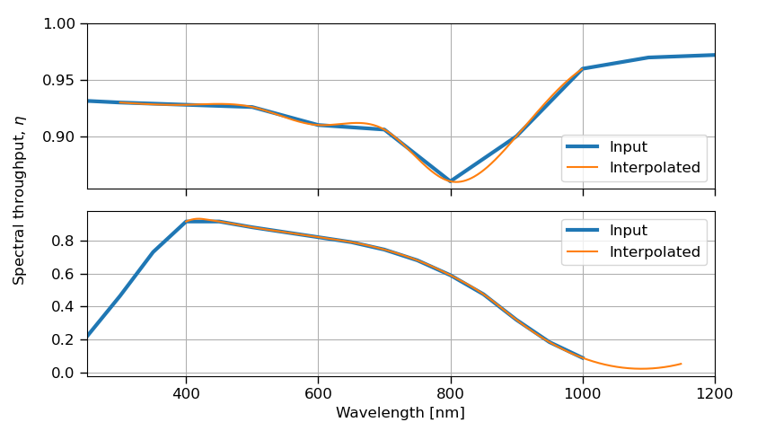
Step 1: Setup and interpolate
Fig. 7.1

Slide 15
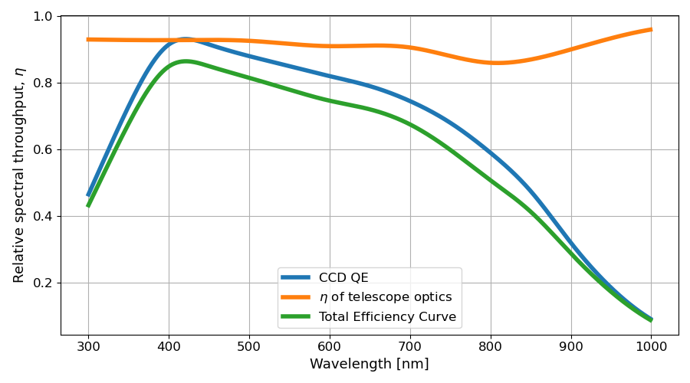
Step 1: Setup and interpolate
Fig. 8.2

Slide 16
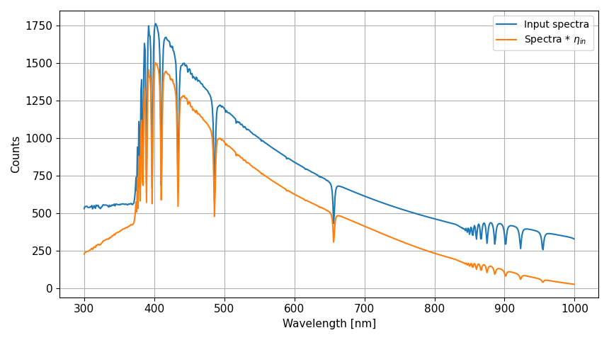
Step 1: Setup and interpolate

Slide 17
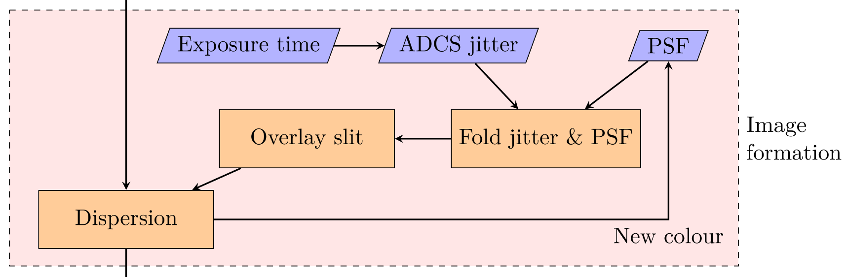
Step 2: Image formation

Slide 18
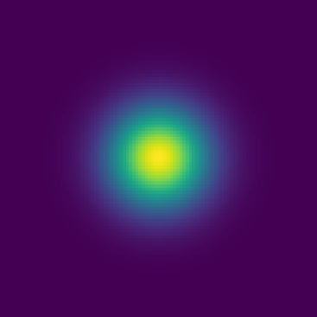
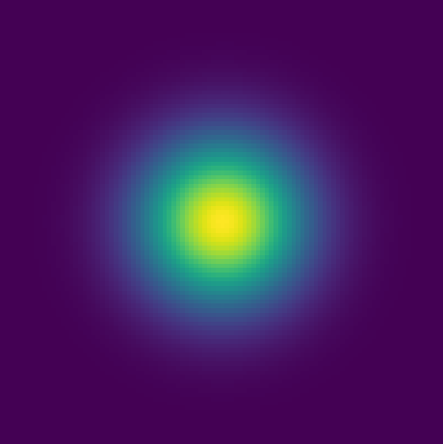
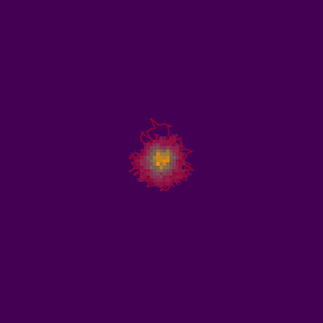
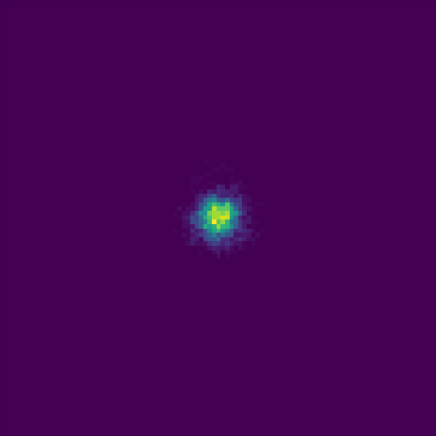
PSF & Jitter
Point Spread Function Spacecraft jitter / seeing
Convolution
Notes:
Convolution: Essentially the same as multiplying the Fourier transforms of the two images, and reverting back to “real space” (pixel-space in this case)

Slide 19
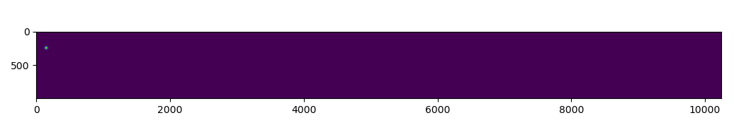
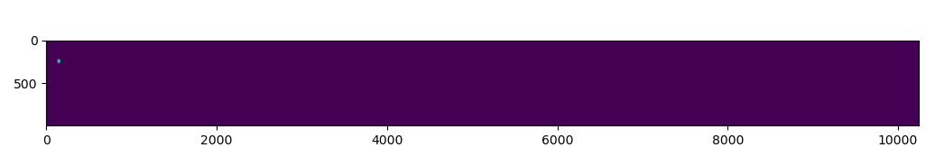
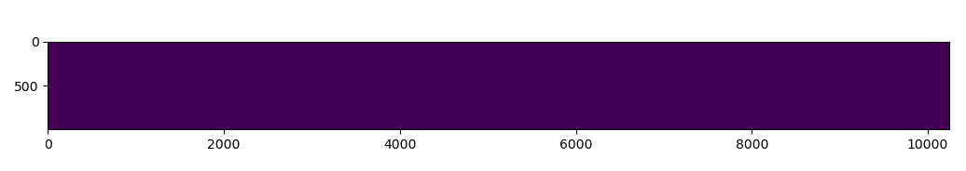
Step 2: Image formation
Notes:
REMEMBER: Spectrum is multiplied onto the PSF @ each color-step, otherwise spectrum is not included at all

Slide 20
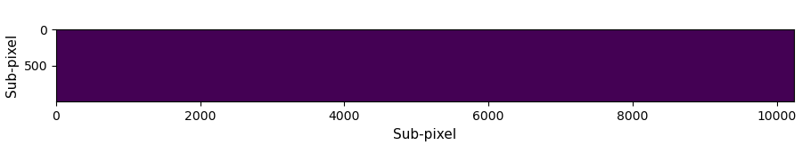


Step 2: Image formation
Notes:
REMEMBER: Spectrum is multiplied onto the PSF @ each color-step, otherwise spectrum is not included at all

Slide 21
PSF & Jitter
Point Spread Function - Next color Spacecraft jitter / seeing
Convolution

Slide 22
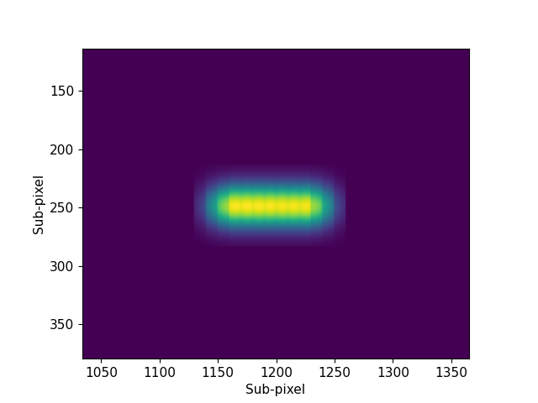
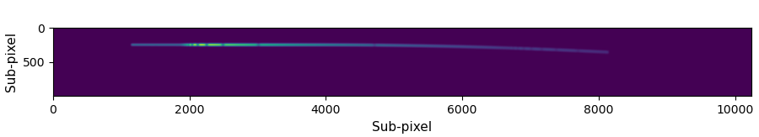
Step 2: Image formation

Slide 23
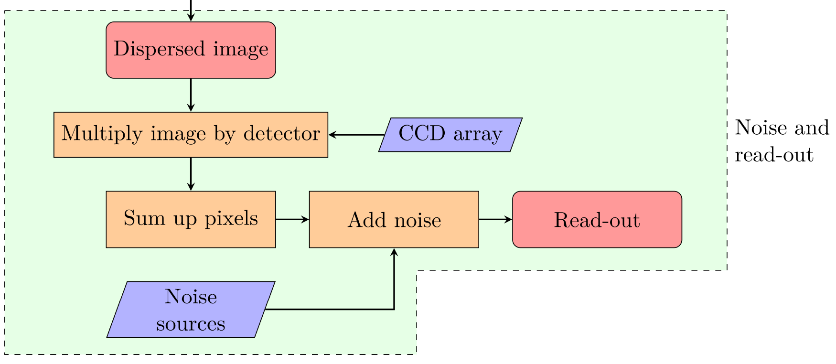
Step 3: Noise and read-out

Slide 24
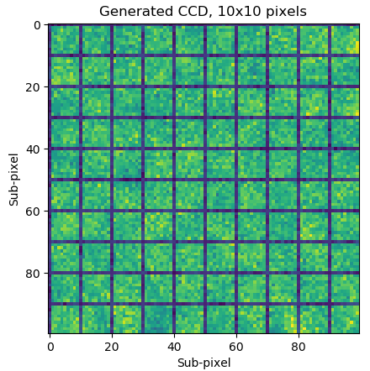
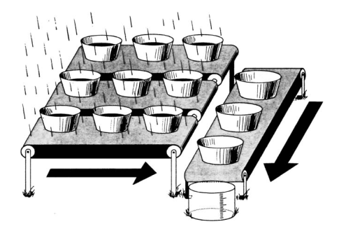
Multiply by CCD
Janesick & Blouke 1987
Fig. 6.7
Notes:
Reminder: Sub-pixels are not physical in nature, it is just something introduced to help with computations. In real life, the CCD is made up of silicon, that might have “defects” in the pixels.

Slide 25
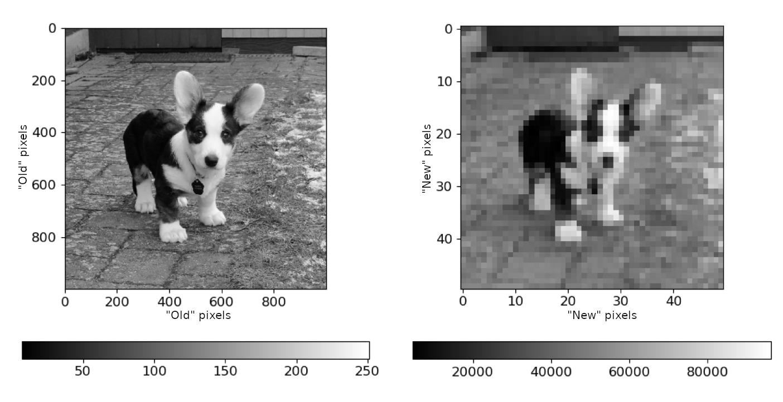
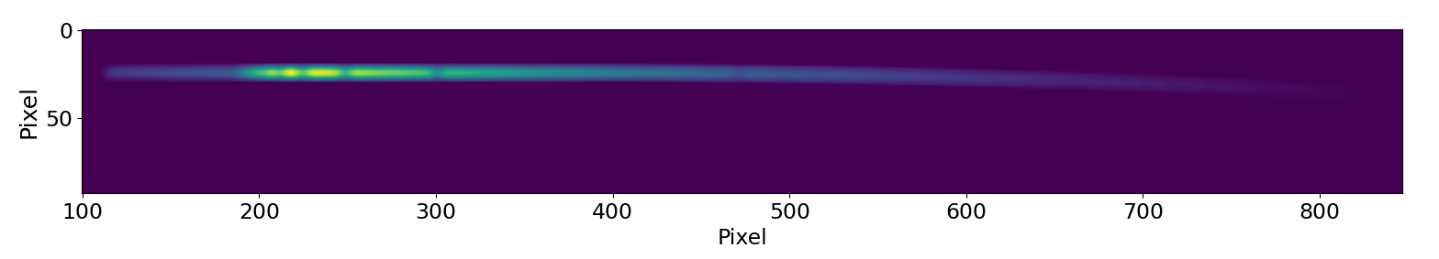
Sum up pixels
Fig. 8.3
Fig. 7.5

Slide 26
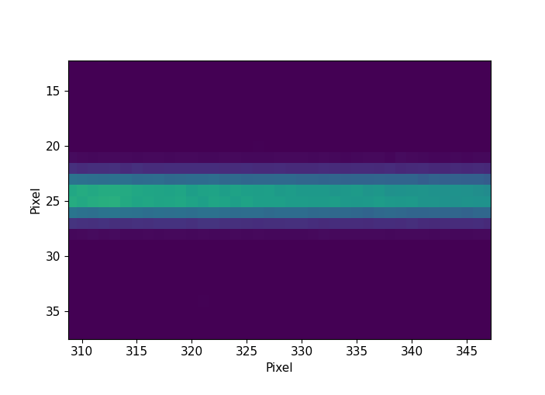
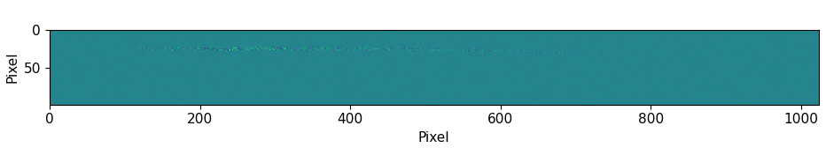

Adding noise

Slide 27
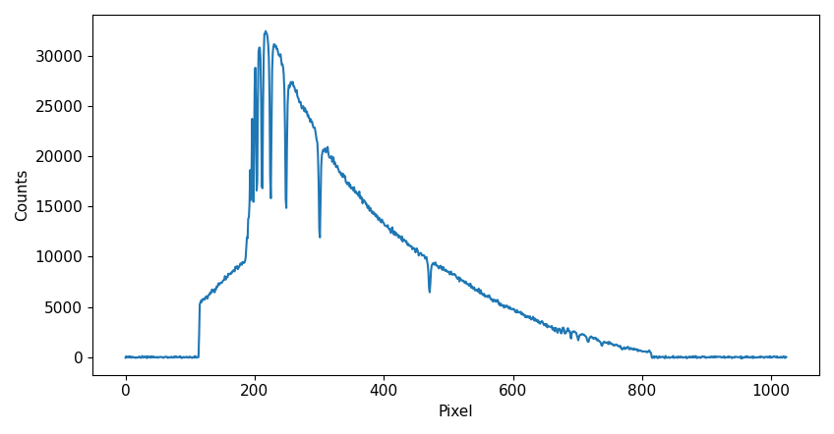
Read-out

Slide 28
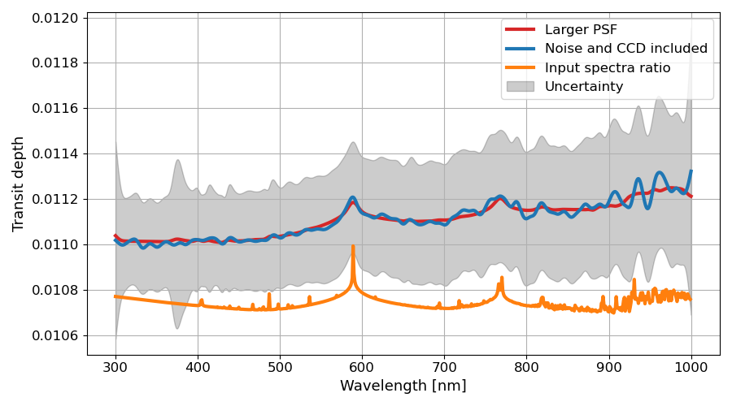
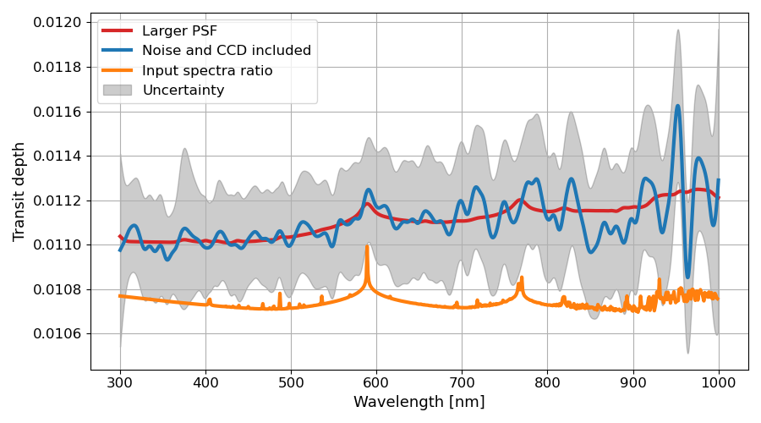
Results
Fig. 8.11
Fig. 8.12
Notes:
Uncertainties are absolute, and can thus not be used to evaluate the individual spectral features, only the global position of the spectrum. However, it might still be possible to determine the presence of clouds and hazes in the atmosphere (Rayleigh scattering)

Slide 29
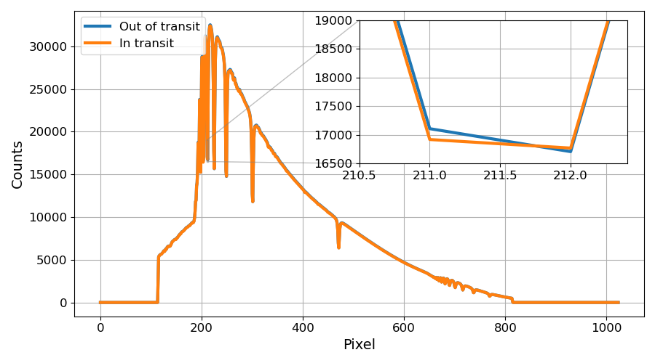
Using the simulator - misalignment
Fig. 8.5

Slide 30
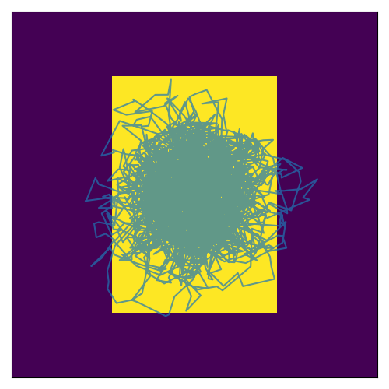
Using the simulator - jitter

Slide 31
Future improvements
Faster run-time
Higher spectral resolution
Secondary light sources / background stars
Improved format checking during setup

Slide 32
Conclusion
Goals of this thesis:
  Create a simulator for low-resolution spectroscopy
    Tests were conducted
Realistic input values were used to conduct a “real-life test”
  Jitter is a major obstacle!
Future improvements
  Faster, more robust, and with higher spectral resolution

