Slide 1
Digital Signal Processing Spectral Estimation Techniques II
Prof. Aldebaro Klautau Federal University of Pará (UFPA)
www.lasse.ufpa.br & www.ppgee.ufpa.br

Slide 2
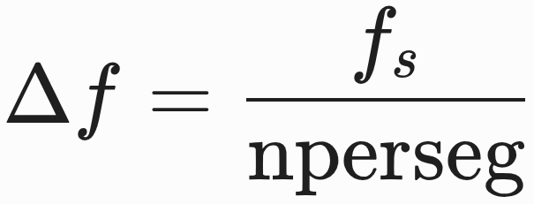
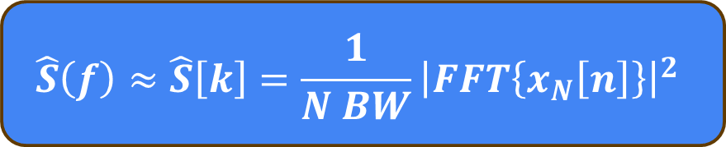
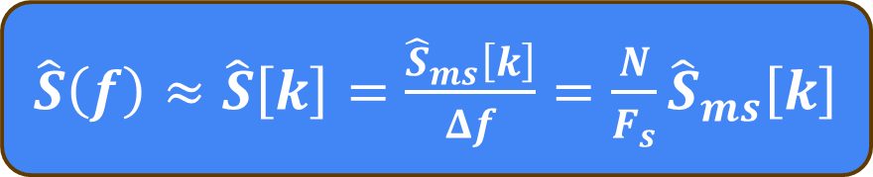
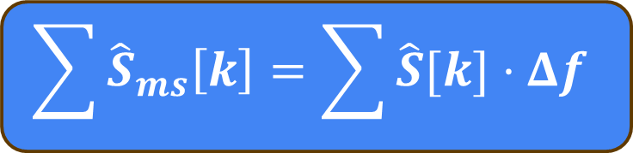
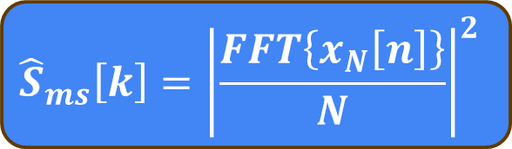

Periodogram
Spectral Estimation Techniques
MS spectrum $S_{ms}[k]$ unit is Watts
$${\hat{S}}_{ms}\left[k\right]={\left|\frac{FFT\left\{x_{N}\left[n\right]\right\}}{N}\right|}^{2}$$
We want the density in watts per hertz
Frequency bin width:
$$\sum{{\hat{S}}_{ms}\left[k\right]}=\sum{\hat{S}[k]⋅Δf}$$
$\hat{S}\left(f\right)≈\hat{S}\left[k\right]=$ $\frac{{\hat{S}}_{ms}\left[k\right]}{Δf}$ $=\frac{N}{F_{s}}{\hat{S}}_{ms}\left[k\right]$
W
W/hz
hz
Periodogram definition
Since the periodogram does not learn parameters, it is a non-parametric estimator
$$\hat{S}\left(f\right)≈\hat{S}\left[k\right]=\frac{1}{N BW}{\left|FFT\left\{x_{N}\left[n\right]\right\}\right|}^{2}$$

Slide 3
Welch: averages of periodograms
Spectral Estimation Techniques
One periodogram is one estimate/measurement of $S\left(f\right)$ of a random process
One estimate
Multiple combined
estimates
Welch’s improves variance by averaging the power over shorter windows, sacrificing frequency resolution

Slide 4
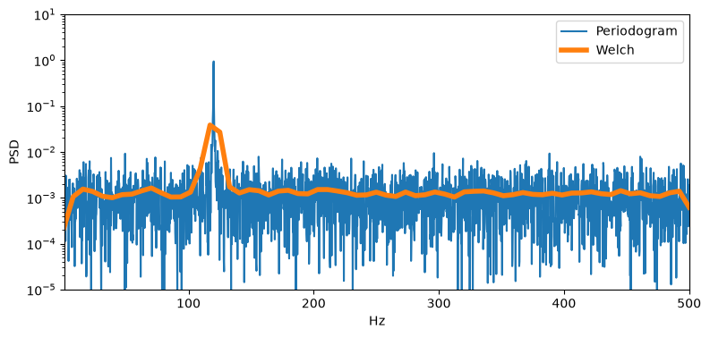
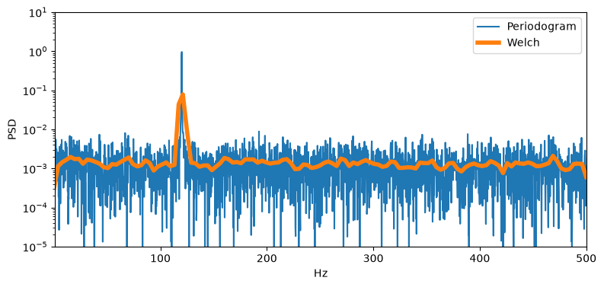
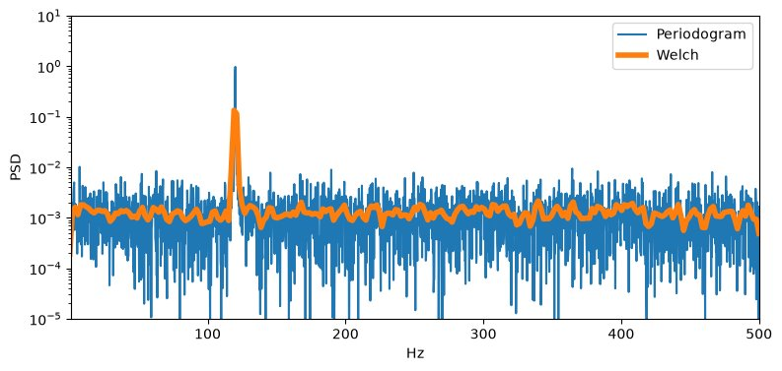
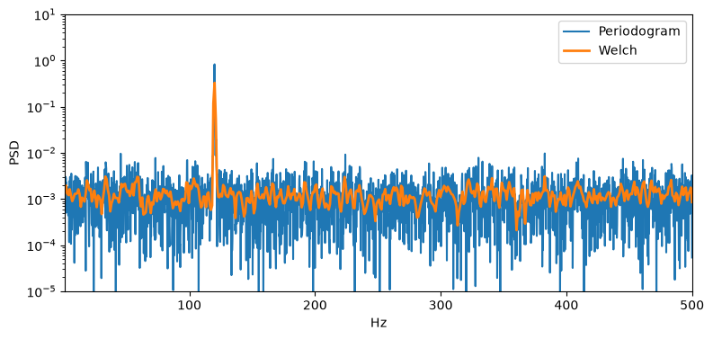
Spectral Estimation Techniques
4
Frequency bin width:
nperseg = 128
nperseg = 256
nperseg = 1024
nperseg = 512
nperseg = 1024

Slide 5
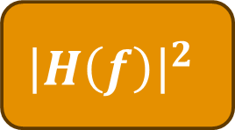
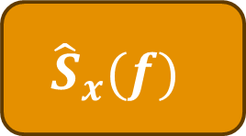
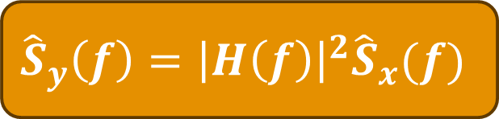
Filtering white noise shapes the noise spectrum like the filter
Spectral Estimation Techniques
5
$${\hat{S}}_{x}(f)$$
$${\left|H\left(f\right)\right|}^{2}$$
$${\hat{S}}_{y}\left(f\right)={\left|H\left(f\right)\right|}^{2}{\hat{S}}_{x}(f)$$
White noise
Colored noise

Slide 6
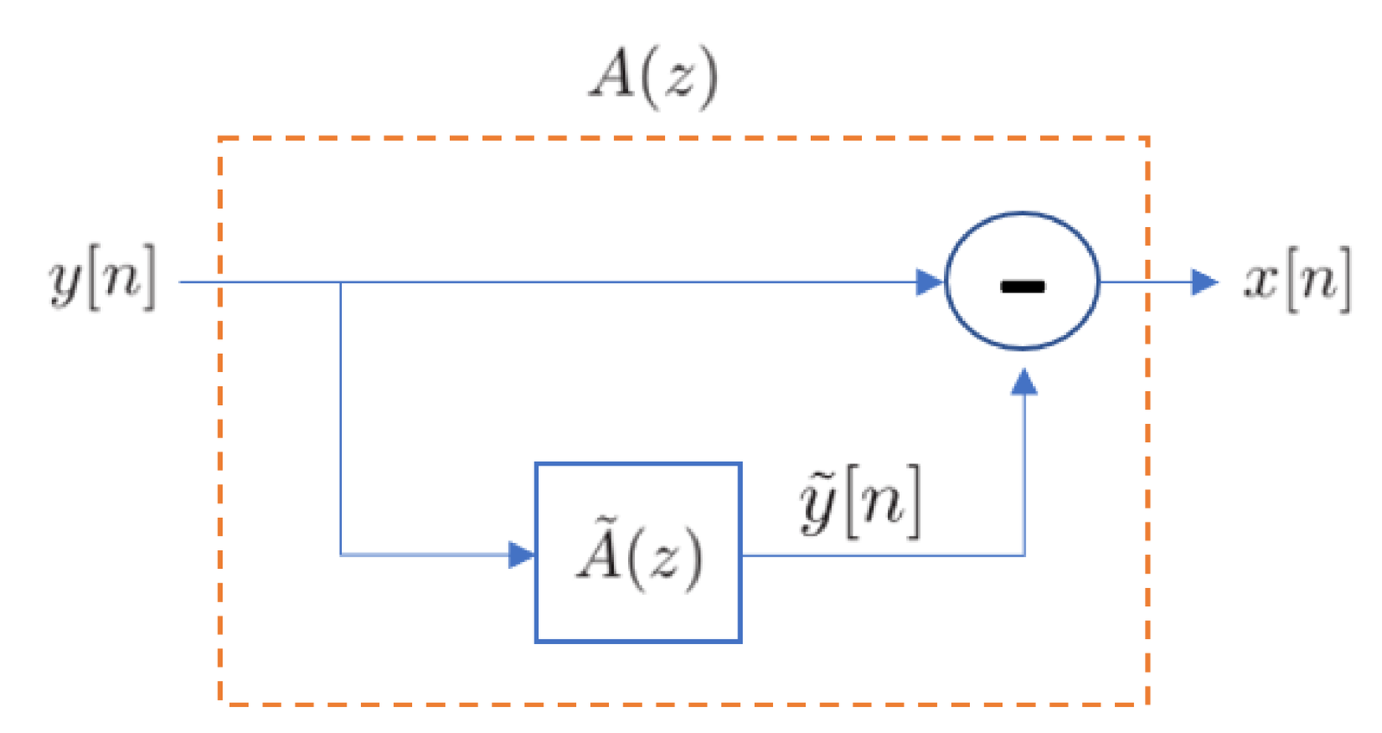

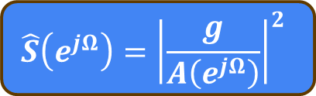


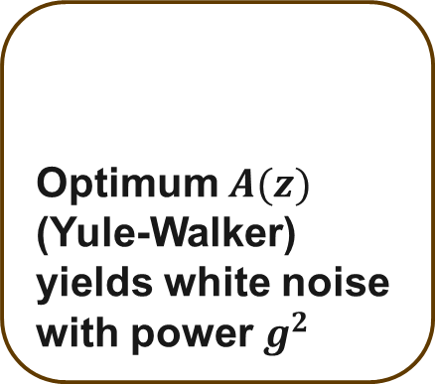

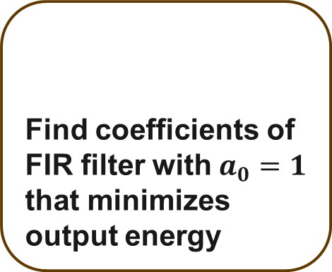


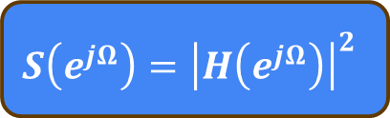
Autoregressive (AR) Modeling
Spectral Estimation Techniques
6
Model assumption:
$H(z)$ is all-poles
Collected signal
Find coefficients of FIR filter with$a_{0}=1$ that minimizes output energy
Optimum $A(z)$ (Yule-Walker) yields white noise with power $g^{2}$
White Noise
$$H(z)$$
Colored noise
$$A(z)$$
White Noise
$$\tilde{x}[n]$$
$$x[n]$$
$$y[n]$$
$$S\left(e^{jΩ}\right)={\left|H\left(e^{jΩ}\right)\right|}^{2}$$
Prediction filter
$$\hat{S}\left(e^{jΩ}\right)={\left|\frac{g}{A\left(e^{jΩ}\right)}\right|}^{2}$$
AR model is widely used in speech coding to mimic voice spectrum

Slide 7
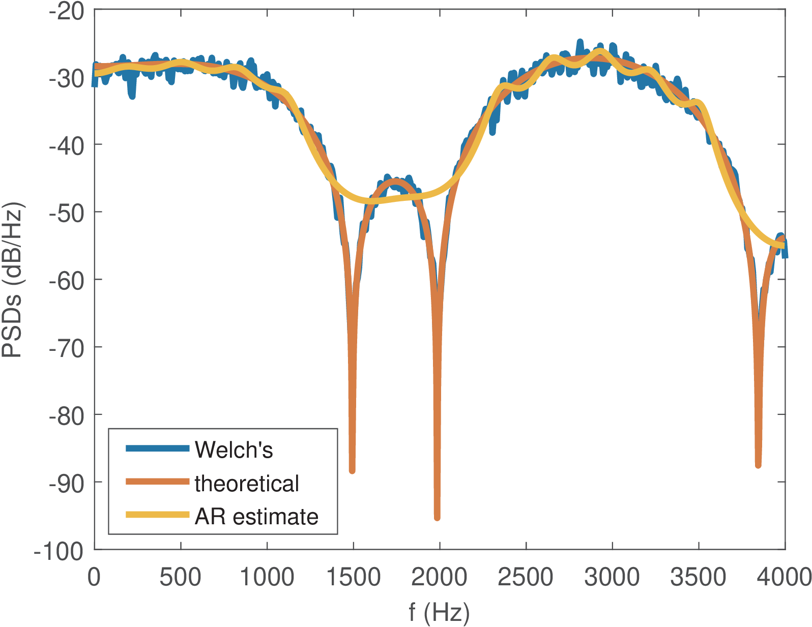
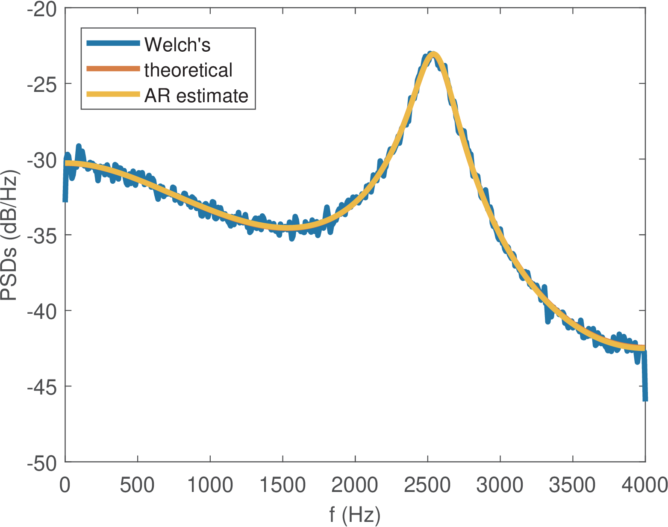
Spectral Estimation Techniques
7
Satisfying the assumptions of the AR model
Not satisfying the assumptions of the AR model (system has zeros)
Far fewer coefficients compared to Welch’s method
Poles cannot create zeros, so AR model performs poorly near notches

Slide 8
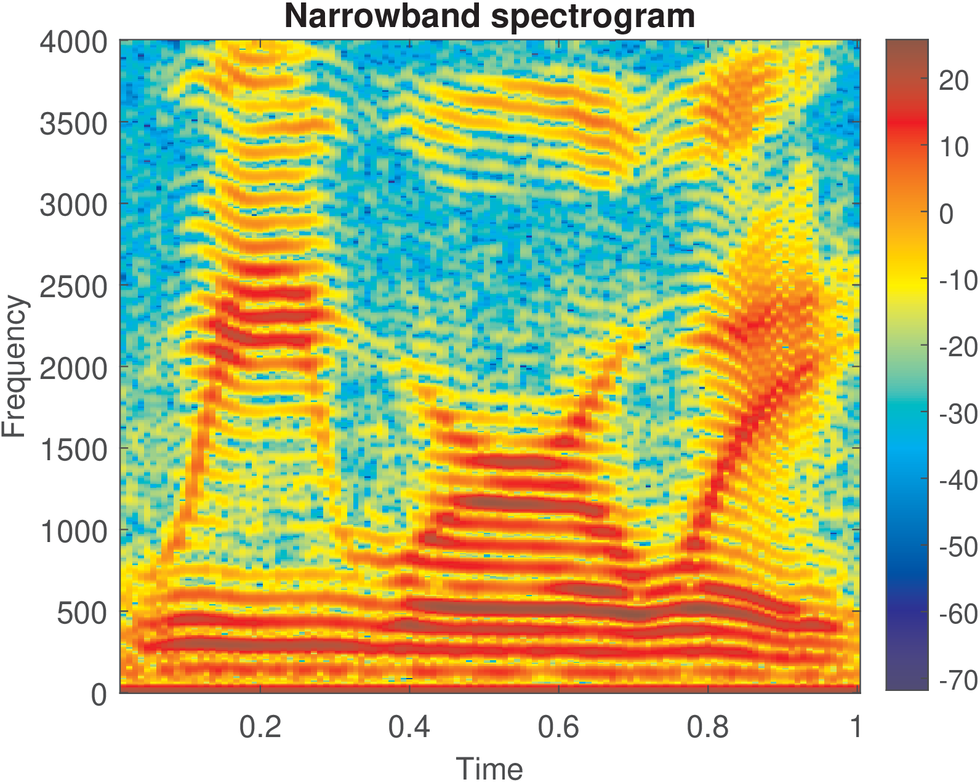
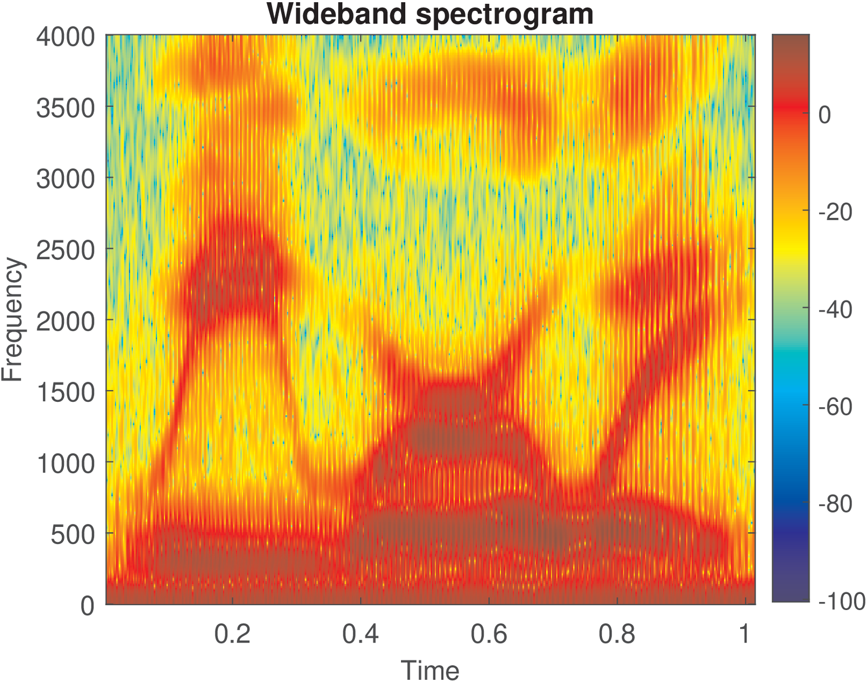
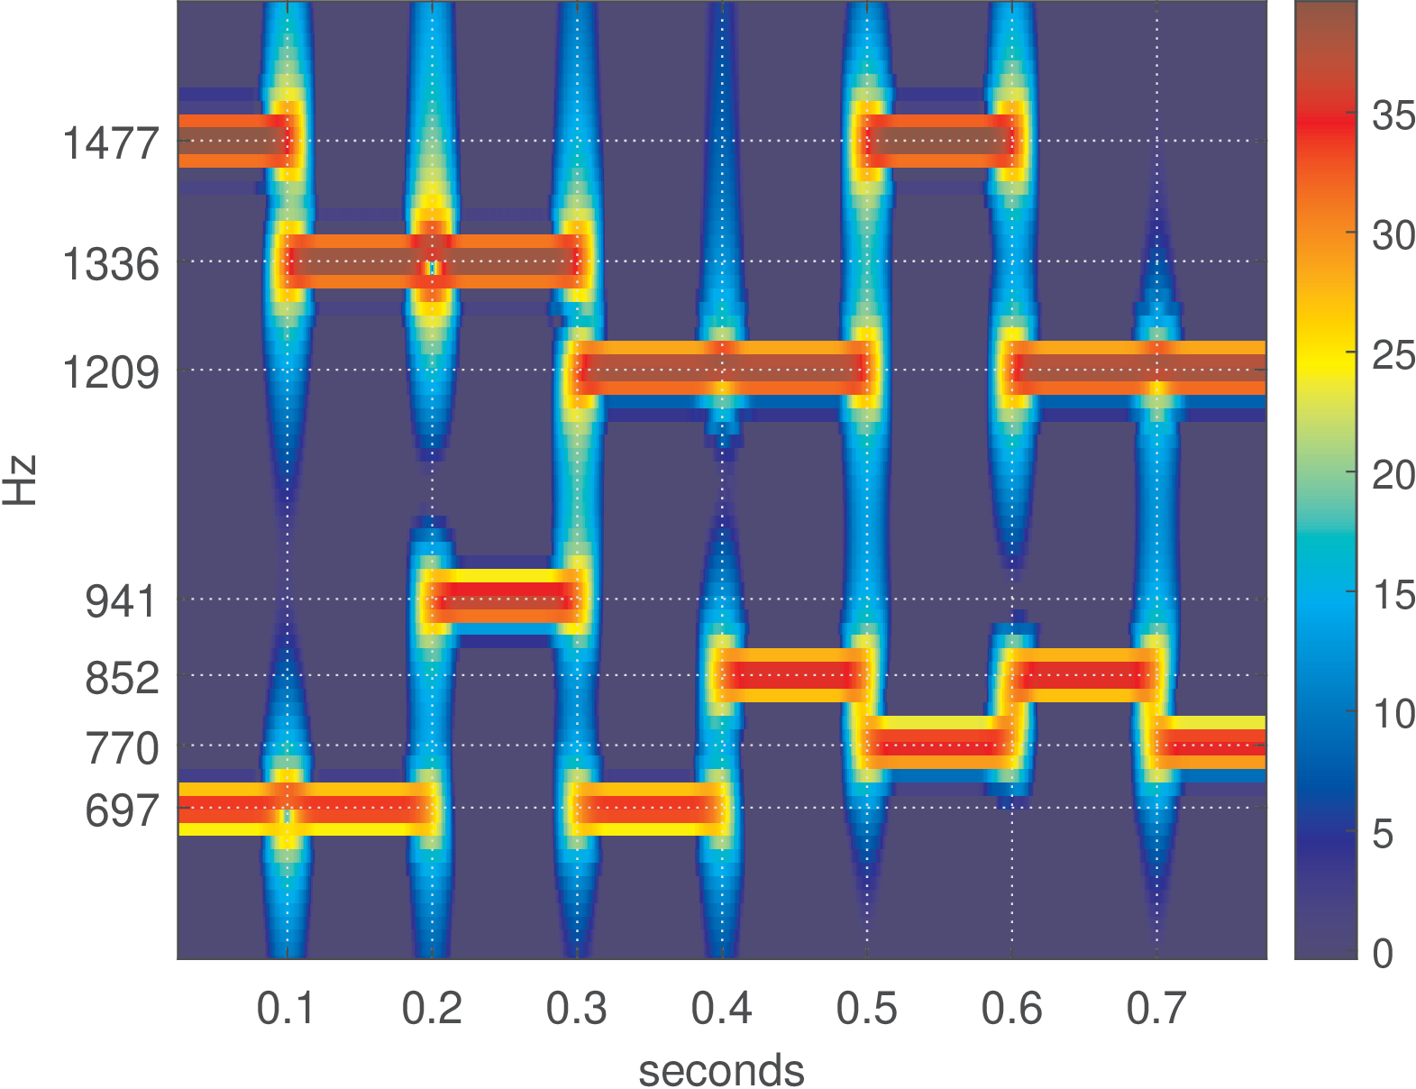
Spectrogram
Spectral Estimation Techniques
8
Nonstationary processes have time-varying spectrum
Spectrograms take multiple windows but do not combine them like Welch’s method
Speech
Speech
Piano

Slide 9
Thank you!
Prof. Aldebaro Klautau. Federal University of Pará (UFPA)
www.lasse.ufpa.br & www.ppgee.ufpa.br

