Slide 1
Digital Signal Processing Analog and Digital Systems
Prof. Aldebaro Klautau Federal University of Pará (UFPA)
www.lasse.ufpa.br & www.ppgee.ufpa.br

Slide 2
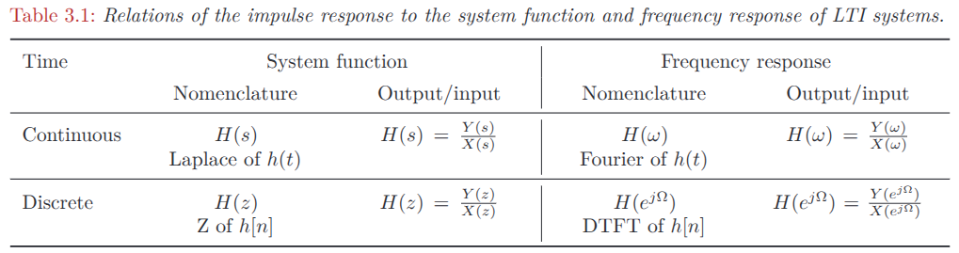
Signals vs Systems
Contrasting Signals and Systems

Slide 3
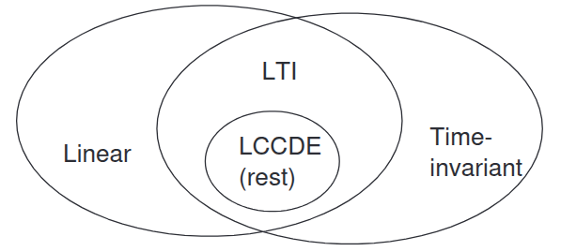
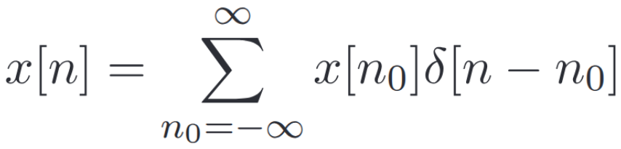
Linear Systems
Linear Time-Invariant Systems
In Linear systems, the linear combination of inputs lead to the same linear combination of their respective outputs
x[n] is a sum of scaled shifted impulses
LTI - Linear and Time-Invariant Systems
LCCDE – Linear Constant-Coefficient difference equations
Using linearity, we obtain that the response to such a signal is the sum of the responses to each scaled shifted impulse
We will focus on LTI systems

Slide 4
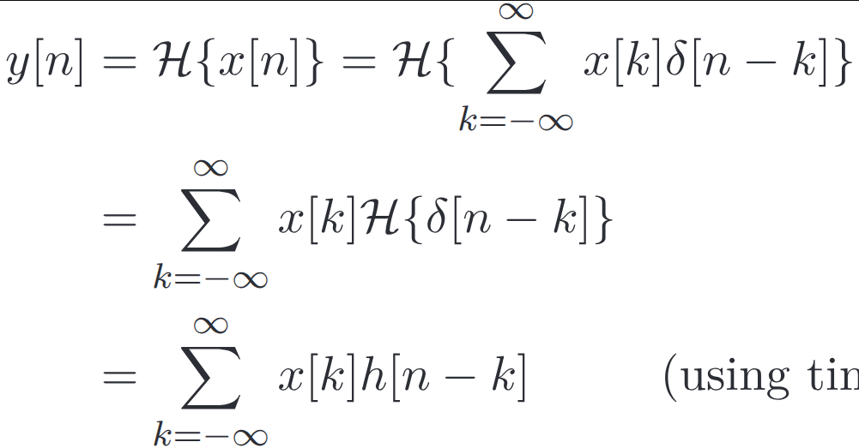
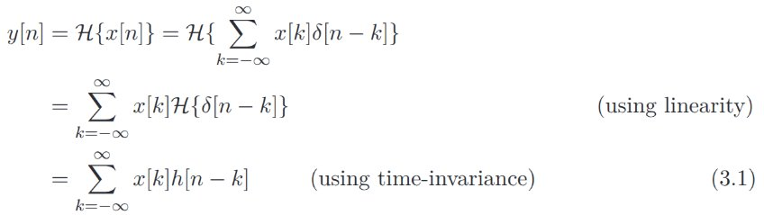
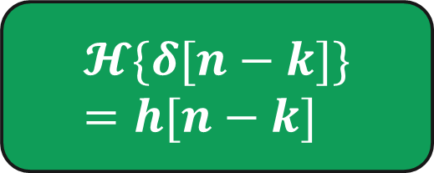
Time-Invariant Systems
Linear Time-Invariant Systems
By time-invariance, the response to any signal $x[n−k]$ will be $y[n−k]$
If a system is also linear, we only need the response to a single impulse
$$𝓗\{δ[n−k]\}=h[n−k]$$

Slide 5
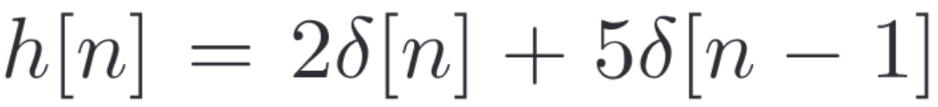

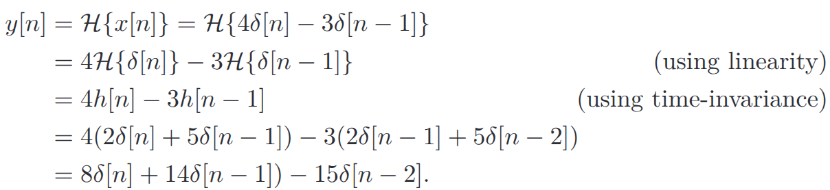
LTI system impulse response example
Linear Time-Invariant Systems
Assume the impulse response of an LTI system:
Now, for the input signal below:
We have:

Slide 6

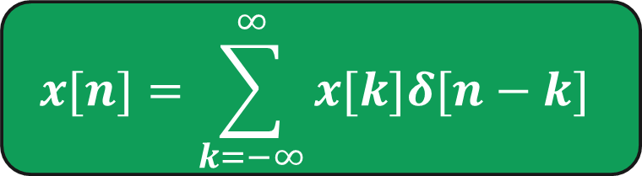

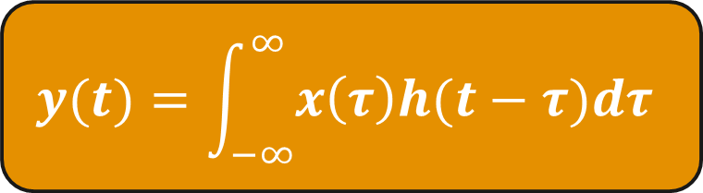
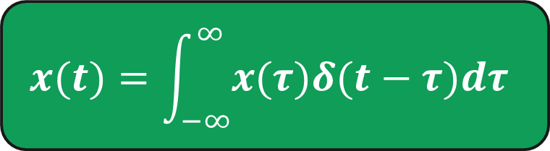
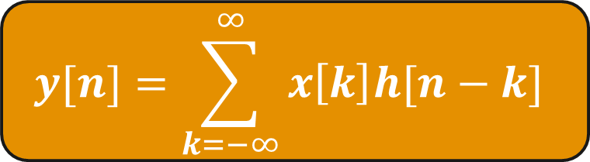
The convolution operator as the core of LTI Systems
Linear Time-Invariant Systems
$$y[n]=x[n]∗h[n]$$
$$y(t)=x(t)∗h(t)$$
Convolution Formal Expression
$$x[n]=\sum_{k=−∞}^{∞}{x[k]δ[n−k]}$$
$$y[n]=\sum_{k=−∞}^{∞}{x\left[k\right]h[n−k]}$$
Continuous
Convolution
$$x(t)=\int_{−∞}^{∞}{x(τ)δ(t−τ)dτ}$$
$$y(t)=\int_{−∞}^{∞}{x\left(τ\right)h(t−τ)dτ}$$

Slide 7

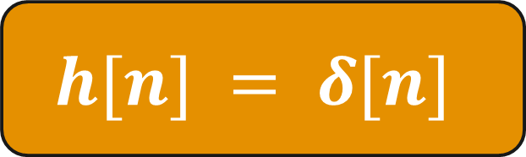
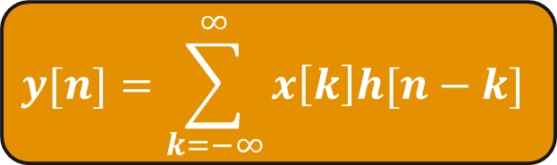
Graphical example of convolution (impulse) - example 1/3
Linear Time-Invariant Systems
$$x[n]$$
$$h[n] = δ[n]$$
$$y[n]=\sum_{k=−∞}^{∞}{x\left[k\right]h[n−k]}$$

Slide 8
Graphical example of convolution (rectangular) - example 2/3
Linear Time-Invariant Systems

Slide 9
Graphical example of convolution (edge detector) - example 3/3
Linear Time-Invariant Systems

Slide 10
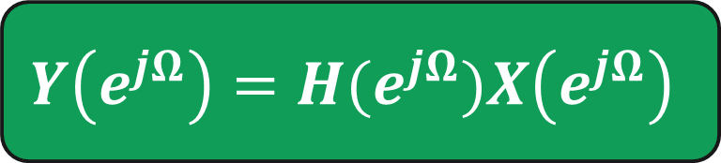
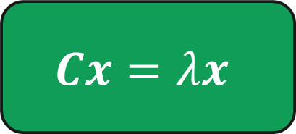






Convolution in time domain is a multiplication in frequency domain
Linear Time-Invariant Systems
$$Cx=λx$$
For linear operators C, we have eigenvectors and eigenvalues
The LTI system is linear, and it has eigenfunctions
$$X\left(e^{jΩ}\right)$$
$$𝓗$$
$$Y\left(e^{jΩ}\right)=H(e^{jΩ})X\left(e^{jΩ}\right)$$
$$x[n]=e^{jγn}$$
$$𝓗$$
$$y\left[n\right]=ηe^{jγn}$$
$$=\left|η\right|e^{jγn+∠η}$$
In general:
$$x_{1}\left[n\right]∗x_{2}\left[n\right]⇔X_{1}\left(z\right)X_{2}\left(z\right)$$

Slide 11
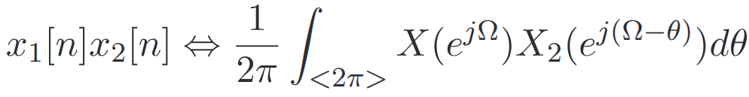
Convolution in time domain is a multiplication in frequency domain
Linear Time-Invariant Systems
Continuous-time
Discrete-time

Slide 12
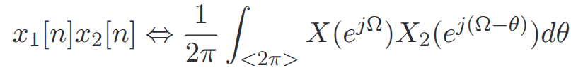
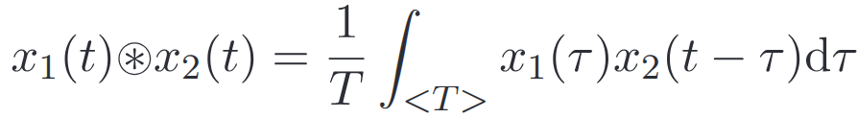

(Circular) Convolution using DTFTs and inverse DTFT
Linear Time-Invariant Systems
This property allows
us to write the above formula as the one below:

Slide 13
Circular and fast convolution using FFT
Linear Time-Invariant Systems
Suppose $x_{1}[n]$ has support 4 and $x_{2}[n]$ has support 3
FFT size = 4, pad with zeroes for x2
1 | 2 | 3 | 4
1 | 0 | -1 | 0
0 | -1 | 0 | 1
0 | -1 | 0 | 1
0 | -1 | 0 | 1
0 | -1 | 0 | 1
0 | -1 | 0 | 1
0 | -1 | 0 | 1
0 | -1 | 0 | 1
0 | -1 | 0 | 1
-2 | -2 | 2 | 2

Slide 14
Circular and fast convolution using FFT
Linear Time-Invariant Systems
$x_{1}[n]$ has support 4 and $x_{2}[n]$ has support 3
FFT size = 6, pad with zeroes for x1 and x2
1 | 2 | 3 | 4 | 0 | 0
1 | 0 | -1 | 0 | 0 | 0
0 | 0 | 0 | -1 | 0 | 1
0 | 0 | 0 | -1 | 0 | 1
0 | 0 | 0 | -1 | 0 | 1
0 | 0 | 0 | -1 | 0 | 1
0 | 0 | 0 | -1 | 0 | 1
0 | 0 | 0 | -1 | 0 | 1
0 | 0 | 0 | -1 | 0 | 1
0 | 0 | 0 | -1 | 0 | 1
0 | 0 | 0 | -1 | 0 | 1
0 | 0 | 0 | -1 | 0 | 1
0 | 0 | 0 | -1 | 0 | 1
0 | 0 | 0 | -1 | 0 | 1
1 | 2 | 2 | 2 | -3 | -4

Slide 15
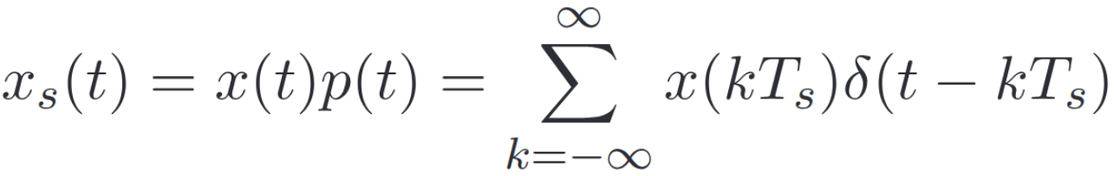


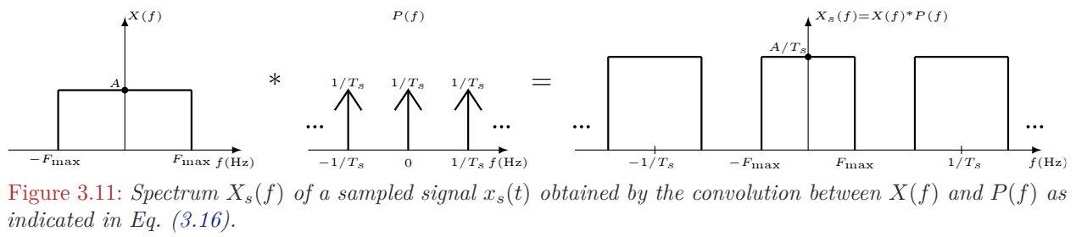
Sampling Theorem
Advanced: Sampling and Signal Reconstruction Revisited

Slide 16
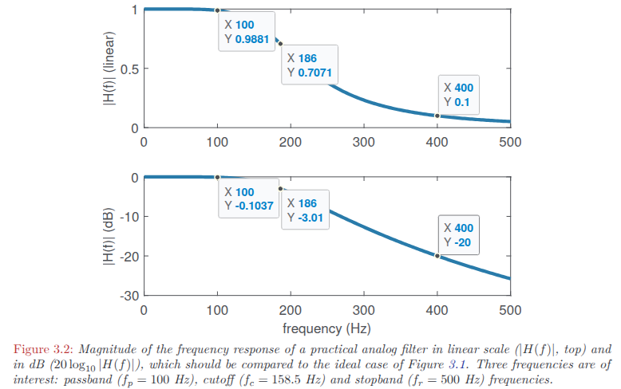
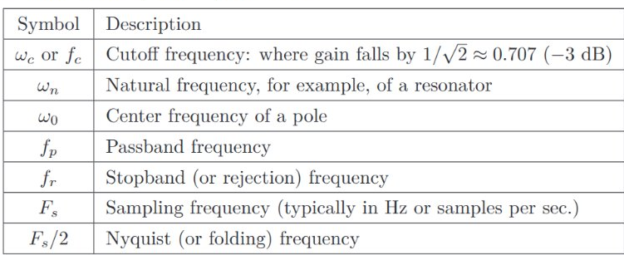
Discussion on Filters
A Quick Discussion About Filters

Slide 17
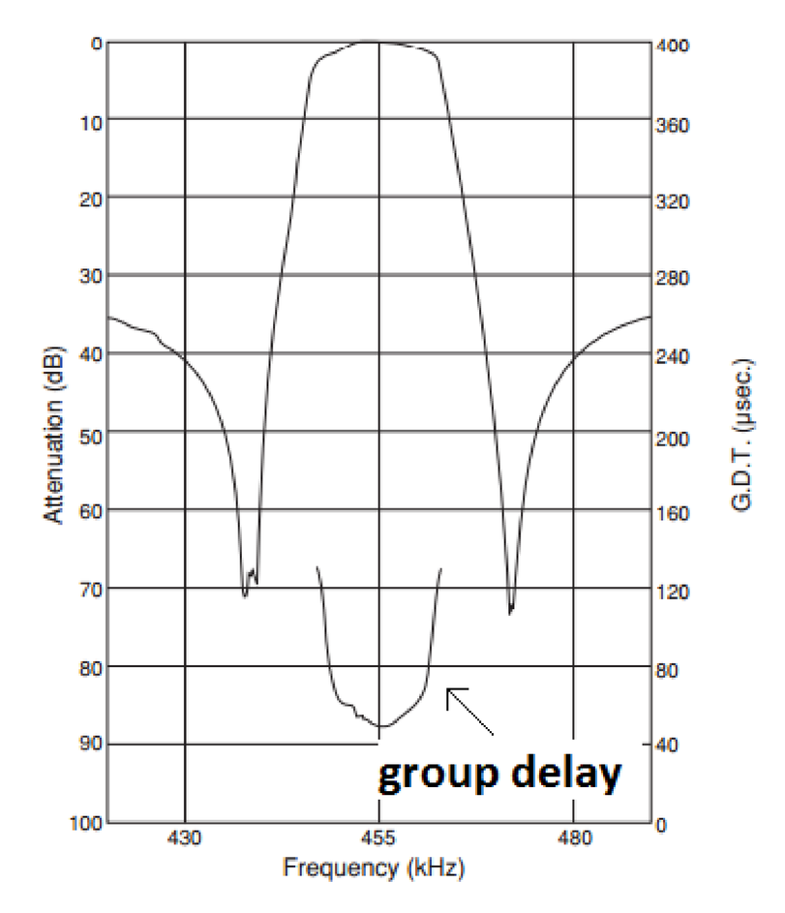
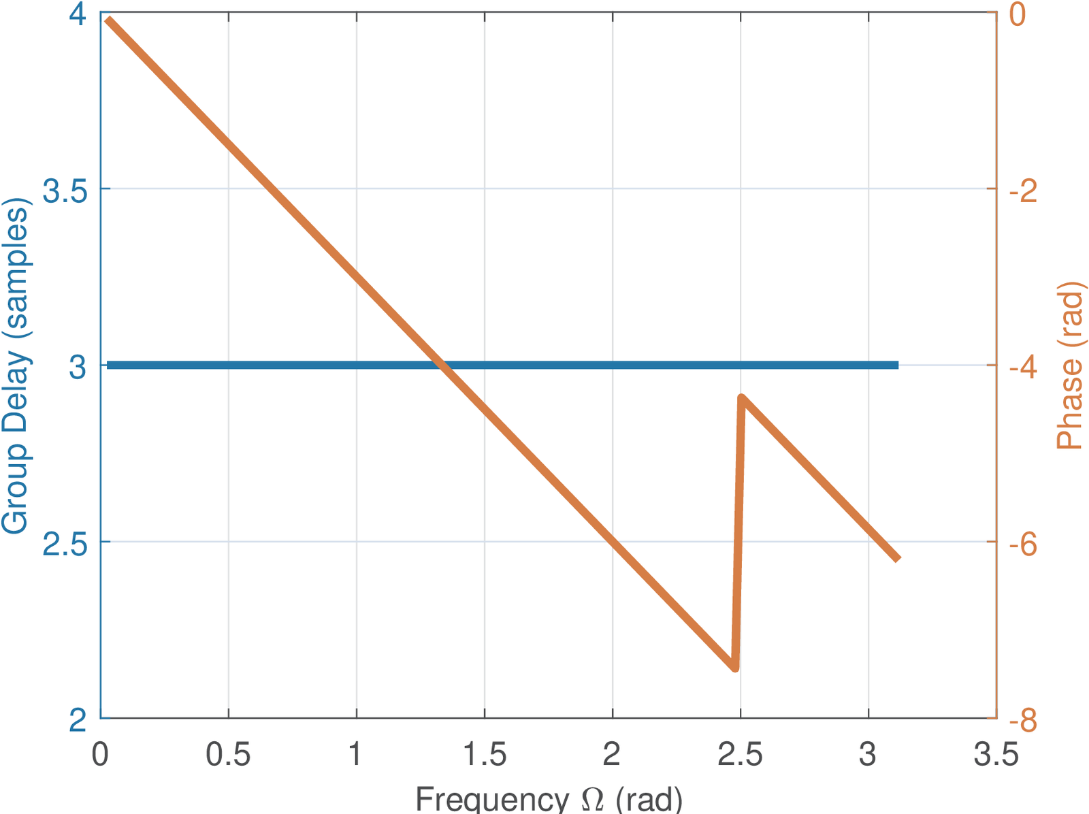
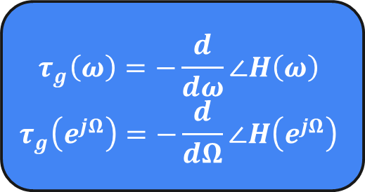
Linear Phase Filters
Importance of Linear Phase (or Constant Group Delay)
The response delay to a complex exponential is the derivative of the phase of the frequency response to that exponential
$$τ_{g}\left(ω\right)=−\frac{d}{dω}∠H\left(ω\right)$$
$$τ_{g}\left(e^{jΩ}\right)=−\frac{d}{dΩ}∠H\left(e^{jΩ}\right)$$
A symmetric FIR filter has constant group delay
Analog filters may get close to but can’t achieve linear phase

Slide 18
Thank you!
Prof. Aldebaro Klautau. Federal University of Pará (UFPA)
www.lasse.ufpa.br & www.ppgee.ufpa.br

