Slide 1
Digital Signal Processing Laplace and Z Transforms
Prof. Aldebaro Klautau. Federal University of Pará (UFPA)
www.lasse.ufpa.br & www.ppgee.ufpa.br

Slide 2

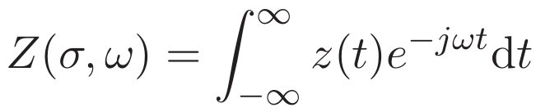
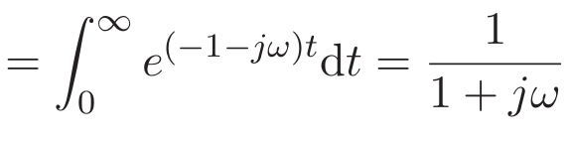
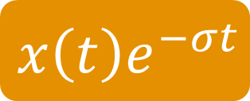
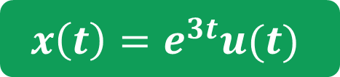

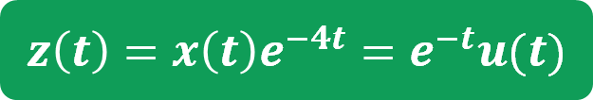
Motivation to Laplace transform
Laplace and Z Transforms
Not every signal has representation via Fourier analysis
Integral does not converge
No Fourier transform
This can be circumvented by a trick which is pre-multiplying the input signal $x(t)$ by an exponential $e^{−σt}$ obtaining $x\left(t\right)e^{−σt}$
Example:
2) Use the pre-multiplication trick
3) Apply FT on the new signal
1) Take the signal x(t)
$$z\left(t\right)=x\left(t\right)e^{−4t}=e^{−t}u(t)$$
$$x\left(t\right)=e^{3t}u(t)$$
$$x\left(t\right)e^{−σt}$$
this trick!

Slide 3
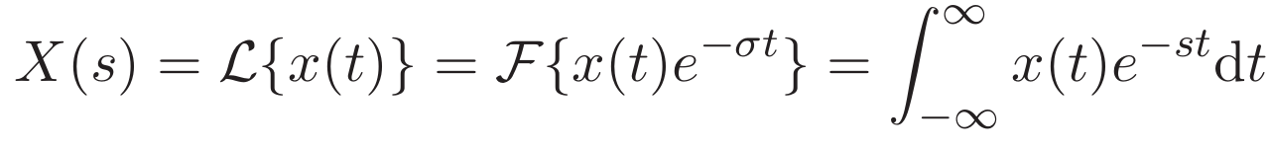

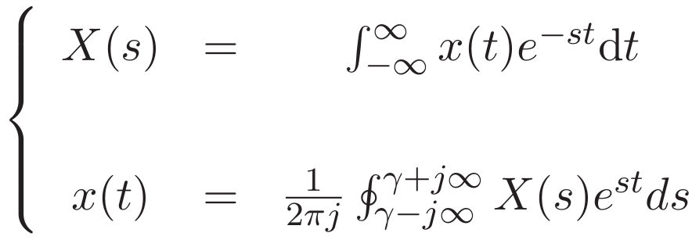
The Laplace transform equations
Laplace and Z Transforms
Where
Transform
Inverse-transform
Laplace transform = Fourier transform multiplied by the exponential $e^{−σt}$

Slide 4

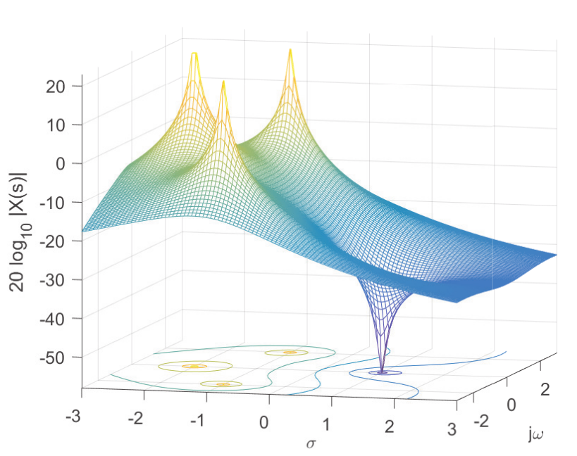
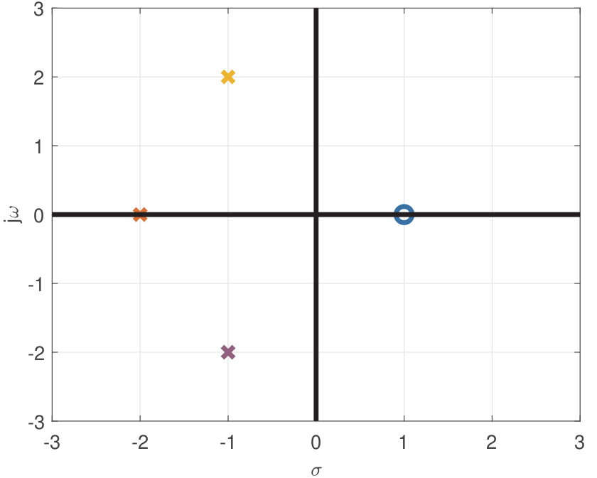
Laplace and Z Transforms
Zeros and poles

Slide 5
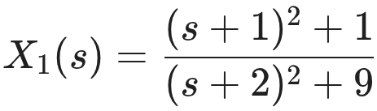
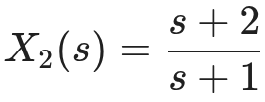
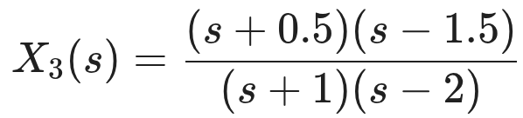
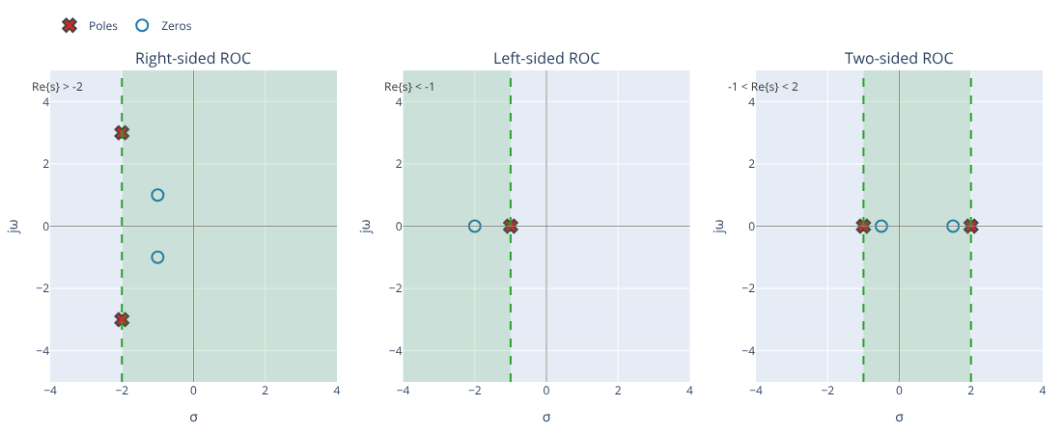
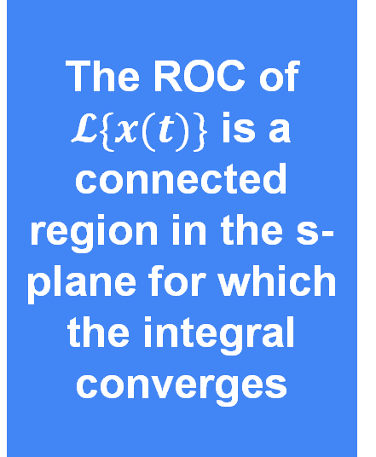
Region of Convergence (ROC)
Laplace and Z Transforms
The ROC of $𝓛\{x(t)\}$ is a connected region in the s-plane for which the integral converges
Pay attention: For the original x(t) to have a FT, ROC must include the jω axis

Slide 6
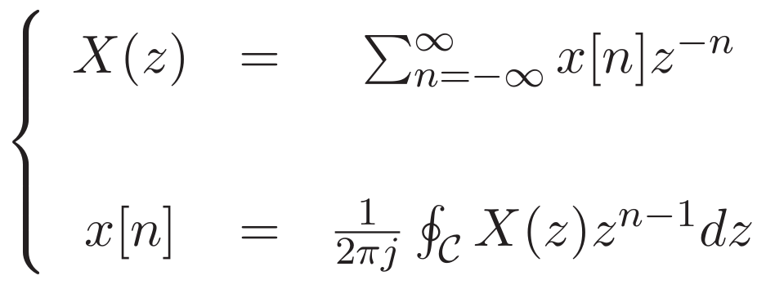
Z transform
Laplace and Z Transforms
Is the counterpart of the Laplace transform for discrete-time signals
Transform
Inverse-transform
C is a counterclockwise closed path encircling the origin and is entirely in the region of convergence (ROC)
The contour (or path) C must encircle all poles of X(z)

Slide 7
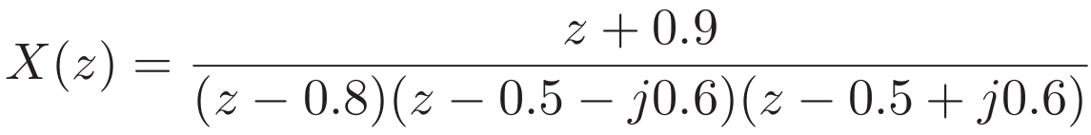
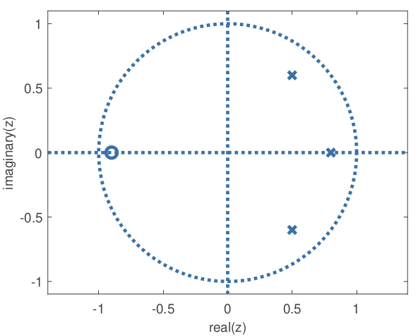
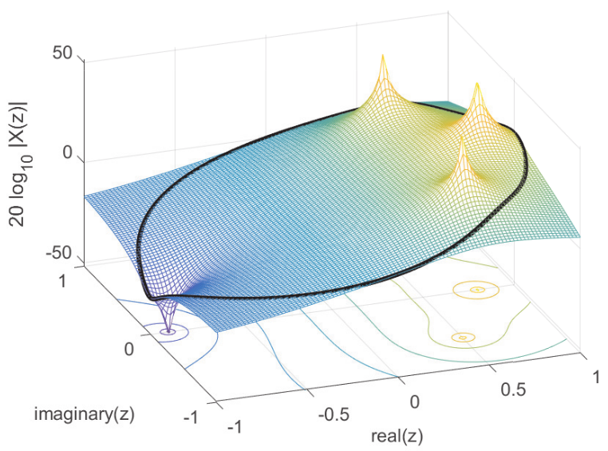
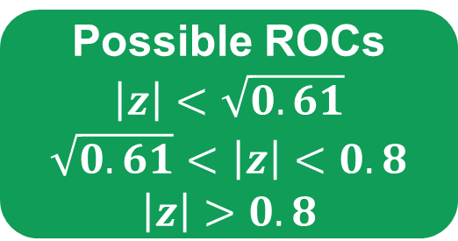
ROC
Laplace and Z Transforms
ROC cannot be inferred from the expression alone, you still need information from x[n].
Possible ROCs
$$\left|z\right|<\sqrt{0.61}$$
$$\sqrt{0.61}<\left|z\right|<0.8$$
$$\left|z\right|>0.8$$
Pay attention: For the original x[n] to have a DTFT, ROC must include the unit circle

Slide 8

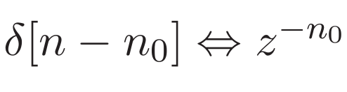



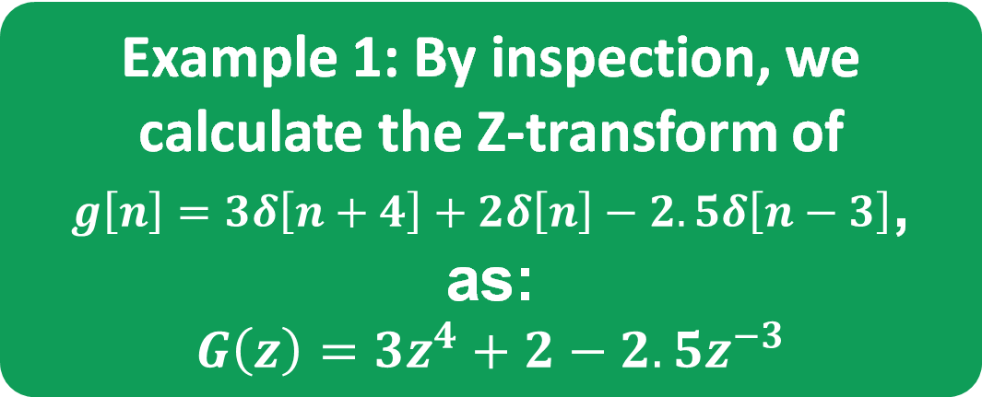
Some Z transform Properties
Laplace and Z Transforms
Example 1: By inspection, we calculate the Z-transform of
$g\left[n\right]=3δ\left[n+4\right]+2δ\left[n\right]−2.5δ\left[n−3\right]$, as:
$$G\left(z\right)=3z^{4}+2−2.5z^{−3}$$
Do not forget the ROC!
Terms after $n=0$ need $\left|z\right|≠0$
Terms before $n=0$ need $\left|z\right|≠∞$
ROC: $0<\left|z\right|<∞$

Slide 9
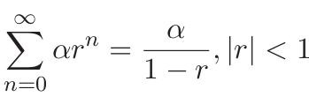
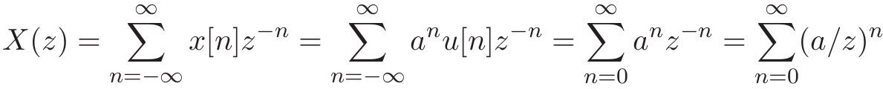

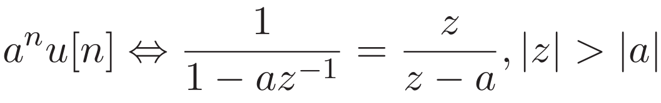


Z transform of an exponential
Laplace and Z Transforms
In cases x[n] is a left or right-sided exponential, we can use the geometric series
Example 2: the Z transform of x[n] = a^{n}u[n] is obtained as follows
The same expression is used for a left-sided exponential $x\left[n\right]=−a^{n}u\left[−n−1\right]$ with $\left|z\right|<\left|a\right|$

Slide 10
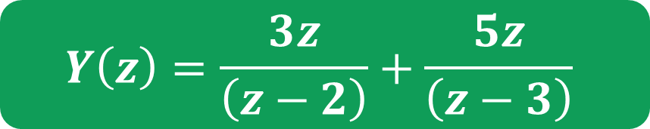

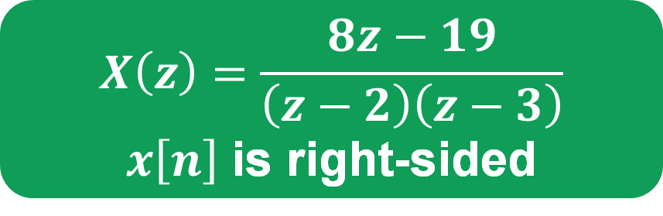
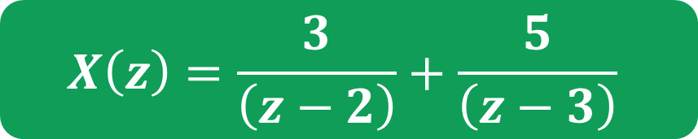
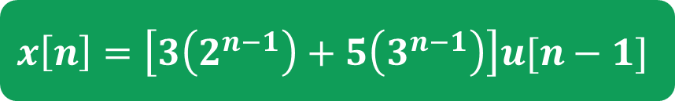
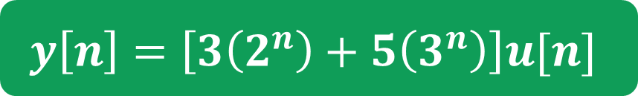

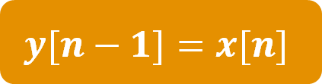
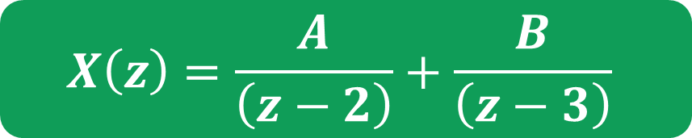

Inverse Z-transform via partial fractions
Laplace and Z Transforms
$$X\left(z\right)=\frac{8z−19}{\left(z−2\right)\left(z−3\right)}$$
$x\left[n\right]$ is right-sided
We want to force the the appearance of terms like
$$\frac{z}{z−a}$$
$$X\left(z\right)=\frac{A}{\left(z−2\right)}+\frac{B}{\left(z−3\right)}$$
$$Y\left(z\right)=zX(z)$$
$$y[n−1]=x[n]$$
$$Az+Bz=8z$$
$$−3A−2B=−19$$
$$Y\left(z\right)=\frac{3z}{\left(z−2\right)}+\frac{5z}{\left(z−3\right)}$$
$$A = 3, B=5$$
$$y\left[n\right]=\left[3\left(2^{n}\right)+5\left(3^{n}\right)\right]u[n]$$
$$X\left(z\right)=\frac{3}{\left(z−2\right)}+\frac{5}{\left(z−3\right)}$$
$$x\left[n\right]=\left[3\left(2^{n−1}\right)+5\left(3^{n−1}\right)\right]u[n−1]$$

Slide 11
Thank you!
Prof. Aldebaro Klautau. Federal University of Pará (UFPA)
www.lasse.ufpa.br & www.ppgee.ufpa.br

