Slide 1
Digital Signal Processing Digital Filters
Prof. Aldebaro Klautau Federal University of Pará (UFPA)
www.lasse.ufpa.br & www.ppgee.ufpa.br

Slide 2
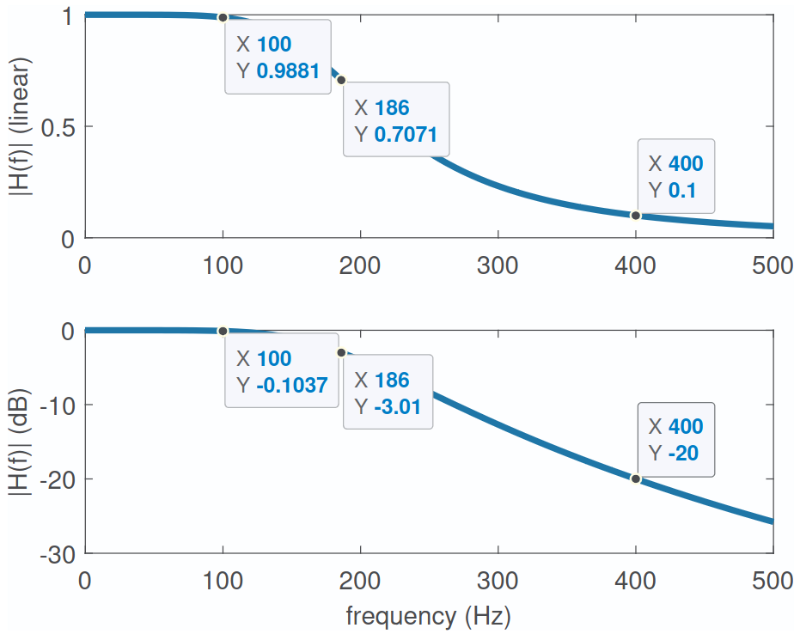
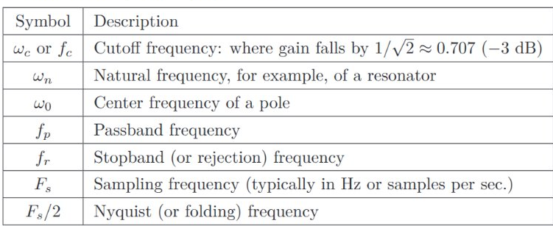
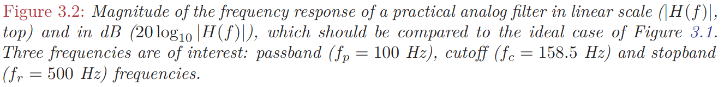
Discussion on Filters
A Quick Discussion About Filters

Slide 3
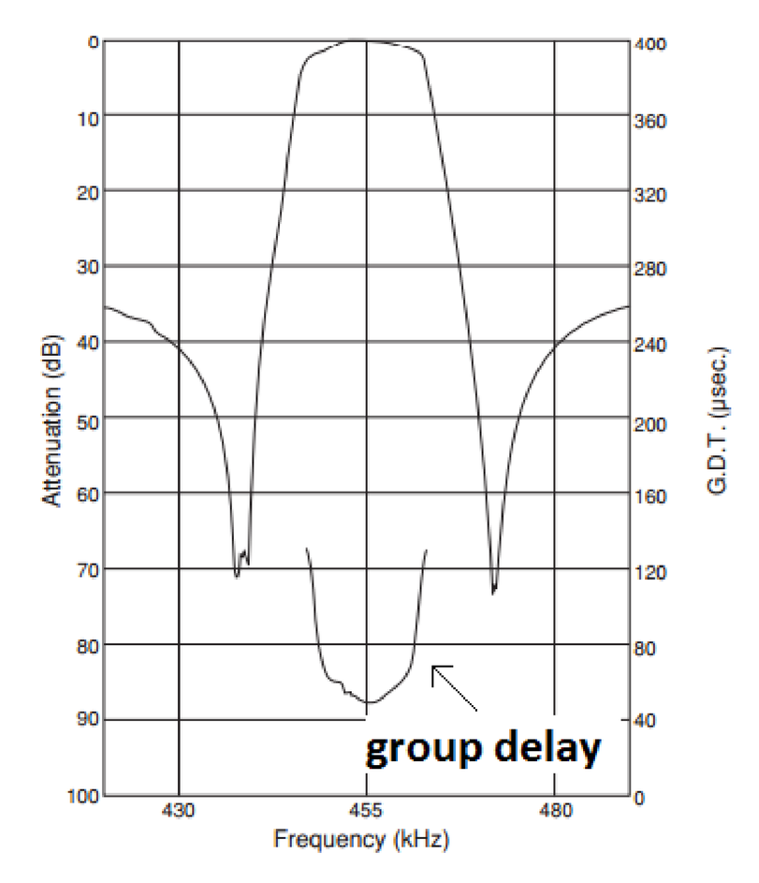
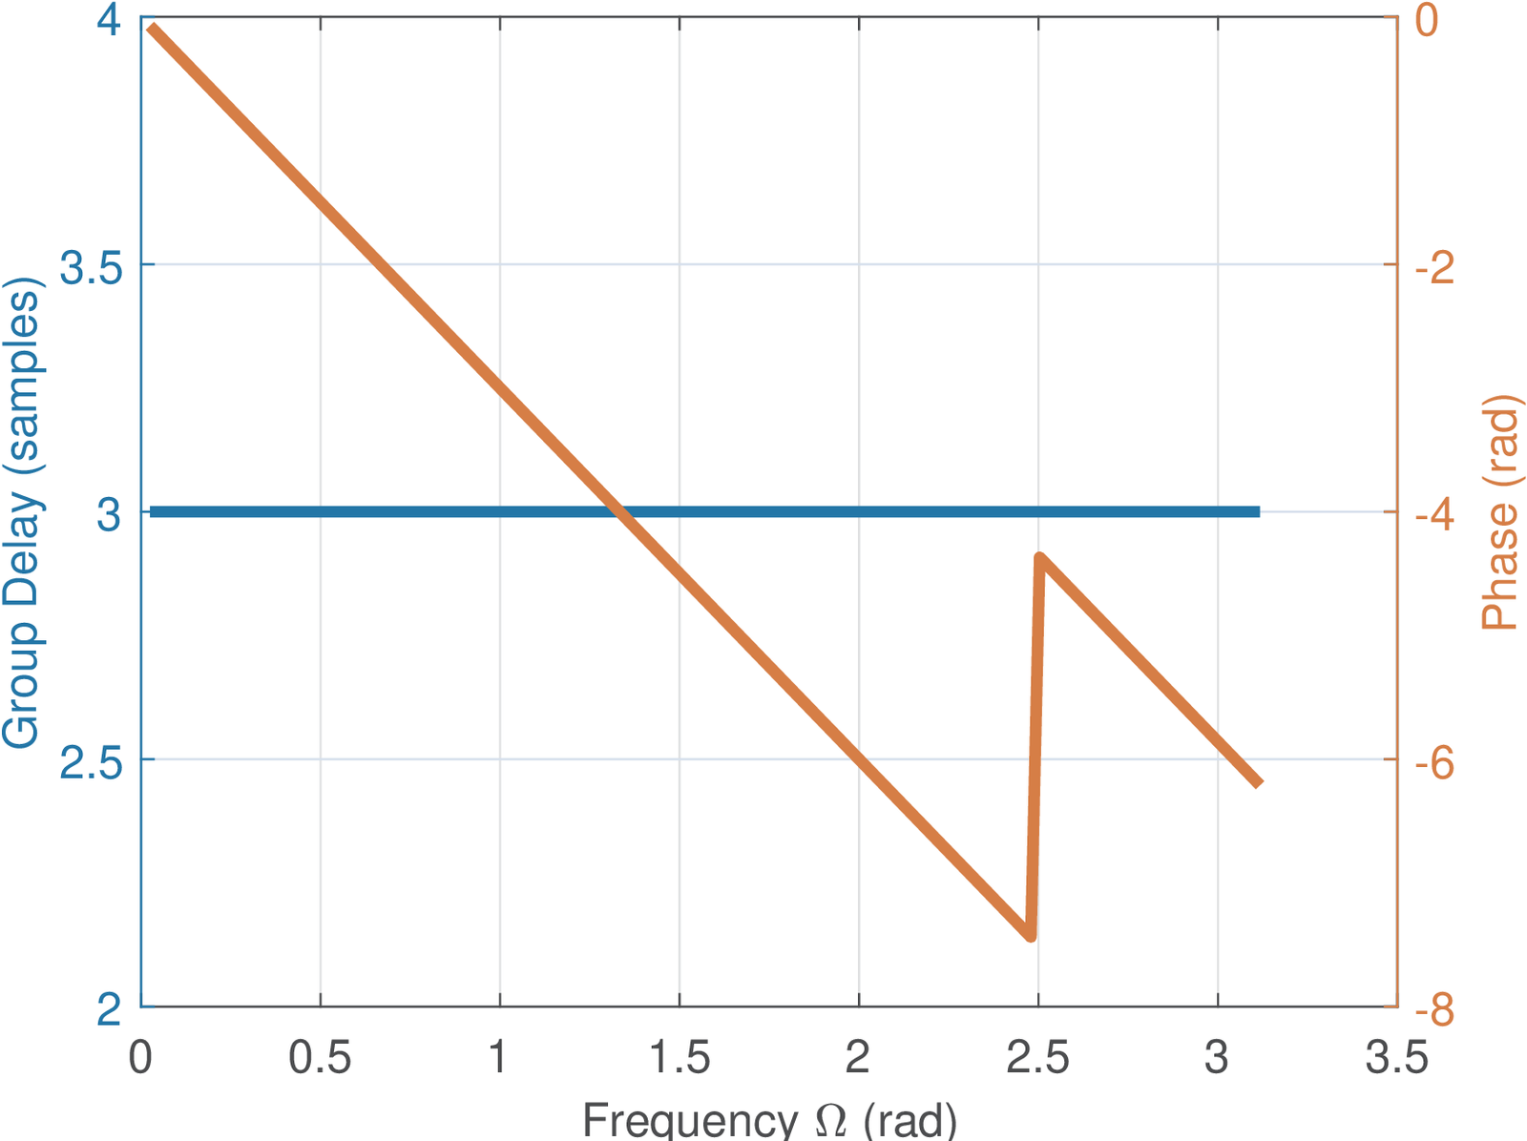
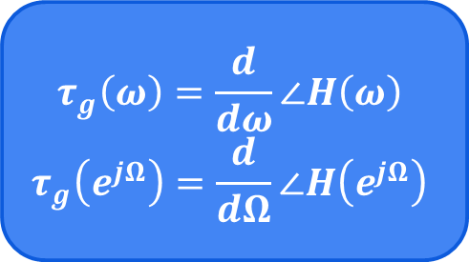
Linear Phase Filters
Importance of Linear Phase (or Constant Group Delay)
The response delay to a complex exponential is the derivative of the phase of the frequency response to that exponential
$$τ_{g}\left(ω\right)=\frac{d}{dω}∠H\left(ω\right)$$
$$τ_{g}\left(e^{jΩ}\right)=\frac{d}{dΩ}∠H\left(e^{jΩ}\right)$$
A symmetric FIR filter has constant group delay
Analog filters may get close to but can’t achieve linear phase

Slide 4

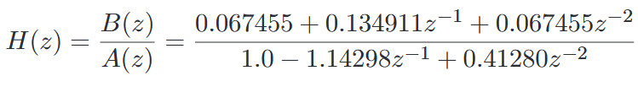
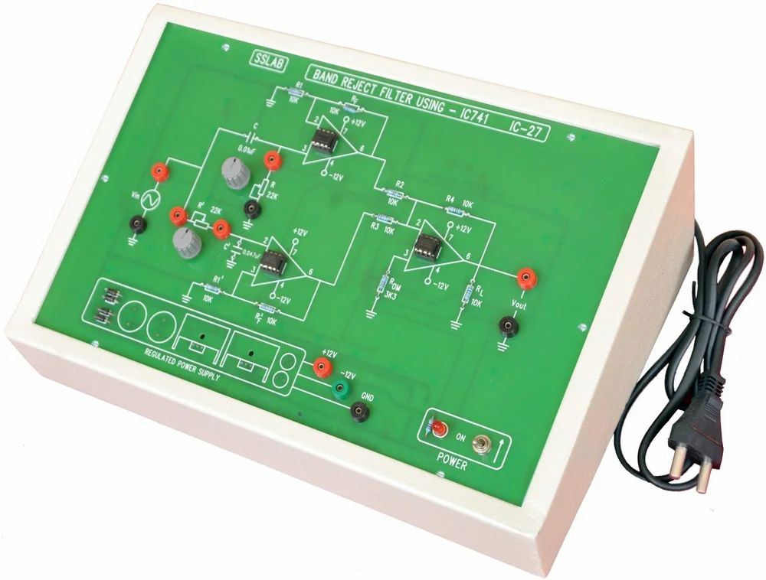
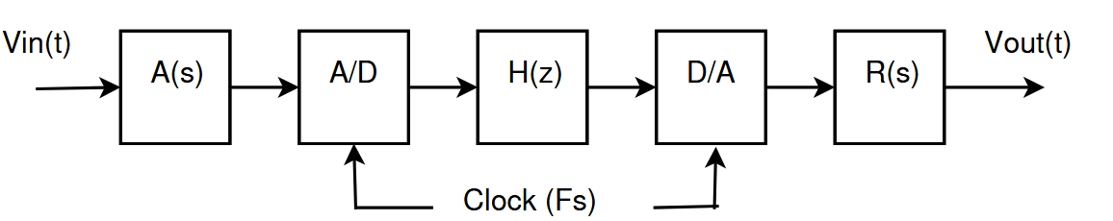
Analog x Digital Filters
Introduction to Digital Filters
Analog prototypes can be converted into digital filters. In Matlab:
Analog filters can be built using discrete components such as resistor, capacitors, inductors and op-amps or using ICs
Classical Filter Families:
Butterworth, Chebyshev, Bessel and Cauer (or elliptic)
If H(z) is a rational functional, it can be implemented using a LCCDE (Linear Constant-Coefficient Difference Equation)
Digital filters extra steps:
Anti-aliasing
Reconstruction

Slide 5
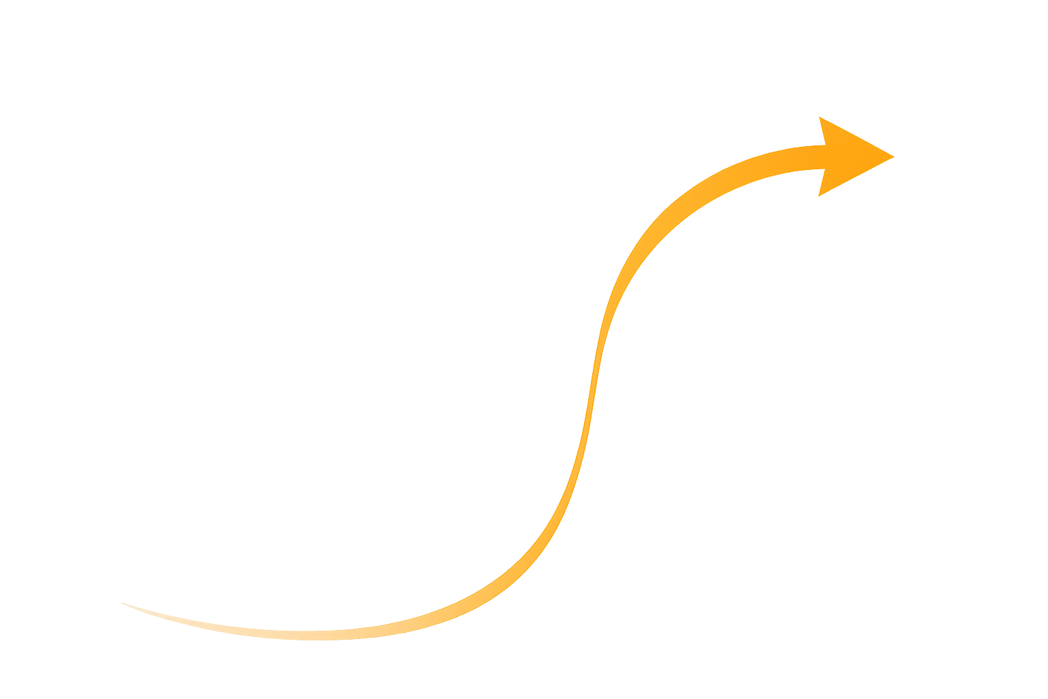
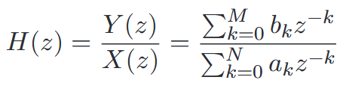
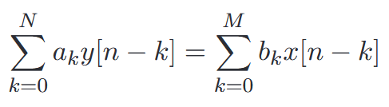
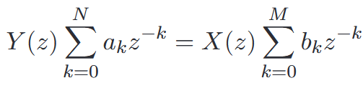
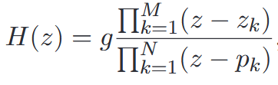
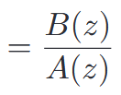
LCCDE digital filters
Introduction to Digital Filters
If a system has the output and input signals related by a LCCDE such as:
The result transfer function is:
Using algebra we can reach the final equation:
Taking the Z-transform:

Slide 6


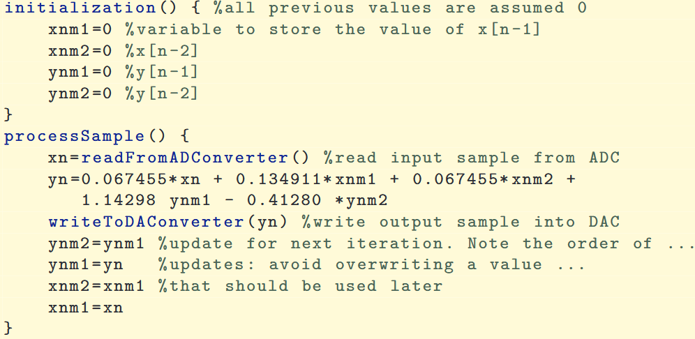




Example: Obtaining the difference equation and implementing a digital filter
Introduction to Digital Filters
Taking the inverse Z-transform, the difference equation is:

Slide 7
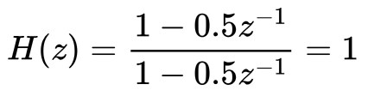
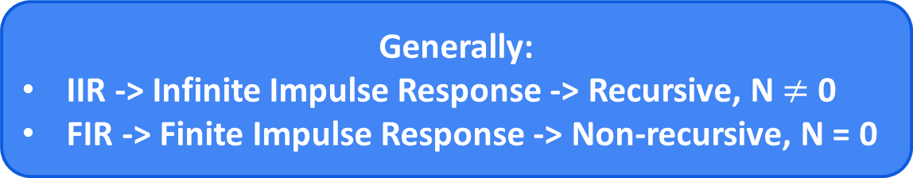
FIR, IIR, AR, MA and ARMA systems
Introduction to Digital Filters
Impulse Response Duration
Recursiveness
Generally:
IIR -> Infinite Impulse Response -> Recursive, N $≠$ 0
FIR -> Finite Impulse Response -> Non-recursive, N = 0
But, for example, you can create a recursive FIR using cancellation of poles and zeros
MA -> Moving-average -> non-recursive FIR
AR -> Autoregressive -> special recursive IIR -> H(z) = g/A(z)
ARMA -> Autoregressive-moving-average -> Generic -> H(z) = B(z)/A(z)

Slide 8
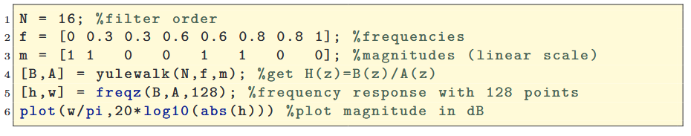
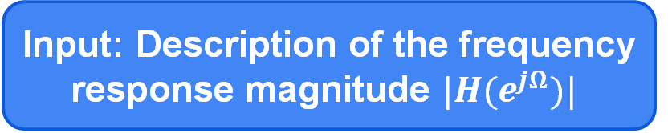
IIR Filter Design
IIR Filter Design
IIR -> Infinite Impulse Response
Direct
Indirect
Many well-established algorithms for analog filters H(s)
Yule-Walker
H(z)
H(s)
H(z)
Input: Description of the frequency response magnitude $|H(e^{jΩ})|$
Three Steps:
Convert the filter specification from discrete to continuous-time
Design the continuous-time H(s)
Convert H(s) into H(z)

Slide 9
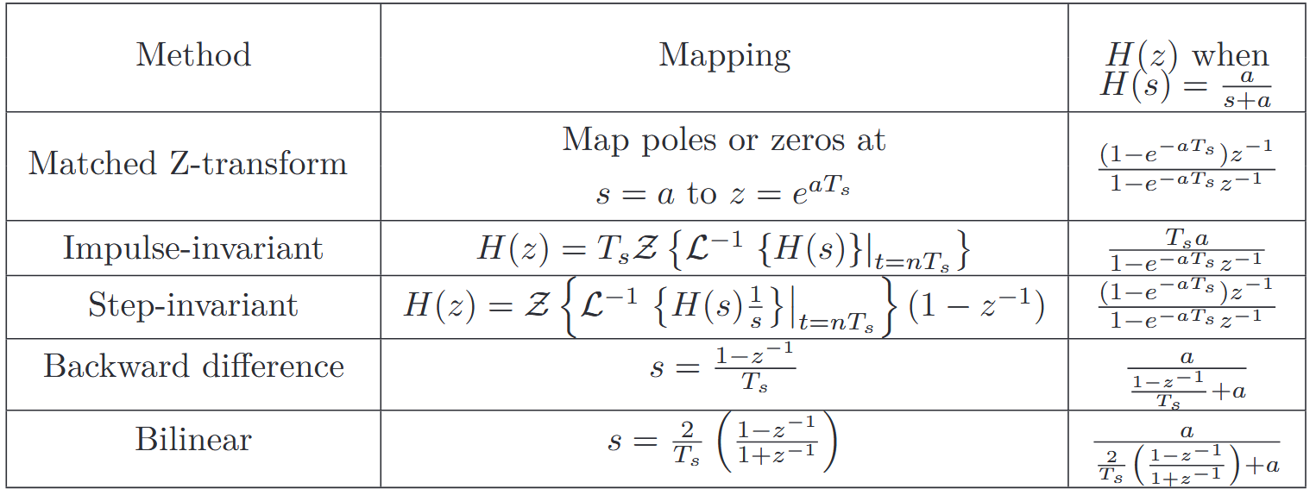
Methods to convert continuous into discrete-time system functions
IIR Filter Design

Slide 10
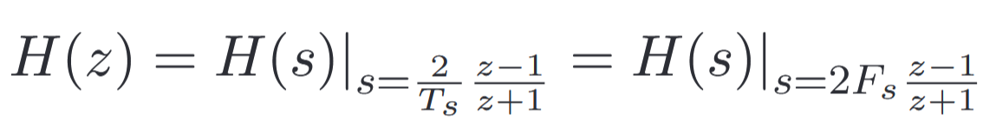
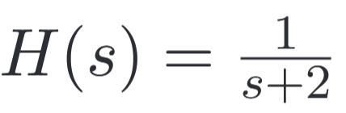
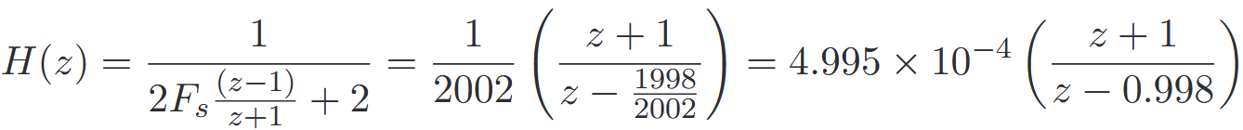
Bilinear Transformation: Definition and Properties
Bilinear Transformation
Most popular approach to design conventional (low, high, pass) IIR filters
It is not a common "Transform" such as Fourier, Z or Laplace
It is a simple transformation from H(s) in continuous-time to H(z) in discrete-time
Example:

Slide 11
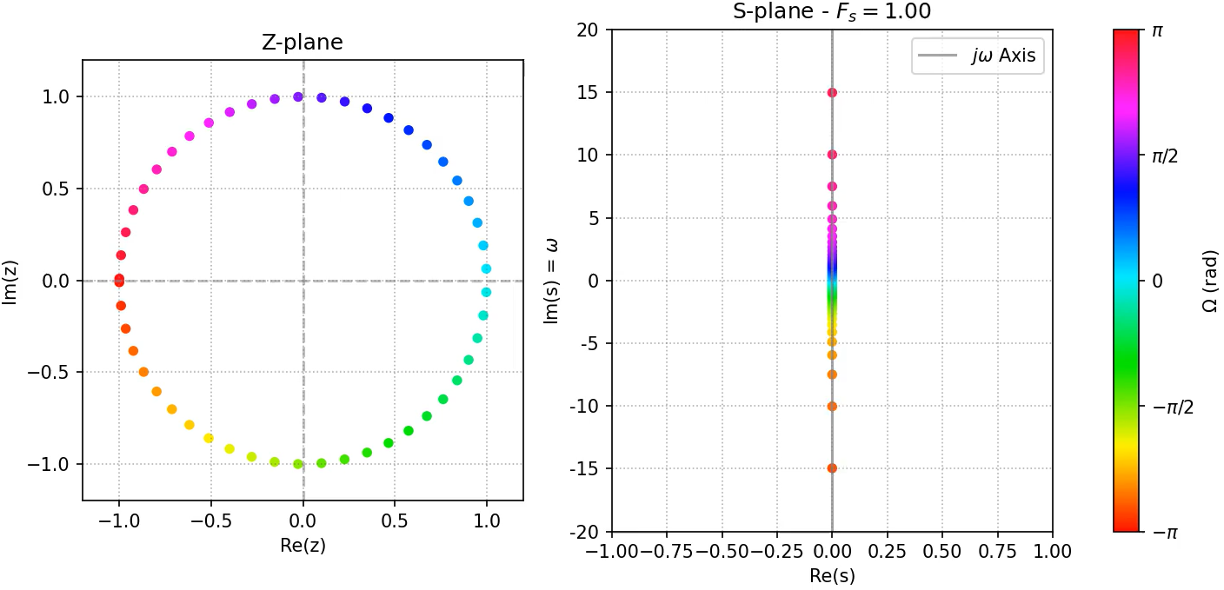

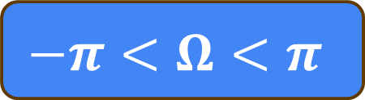
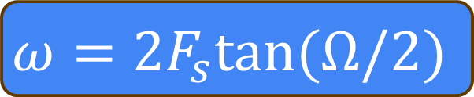
Mapping the Z-plane DTFT into the S-plane FT via Bilinear Transform
Bilinear Transformation
$$ω=2F_{s}tan(Ω/2)$$
$$−π<Ω<π$$
$$−∞<ω<∞$$
Not linear!
Frequency is “warped”

Slide 12
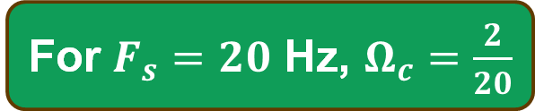

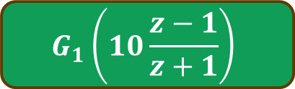
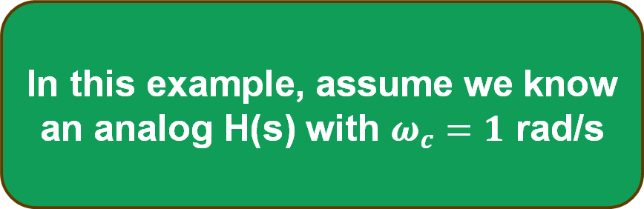
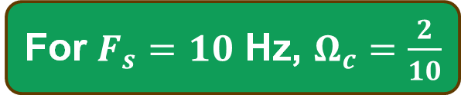

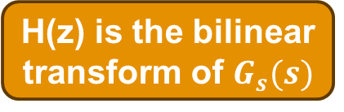
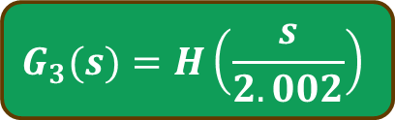
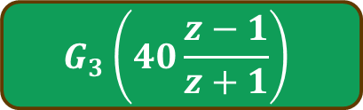


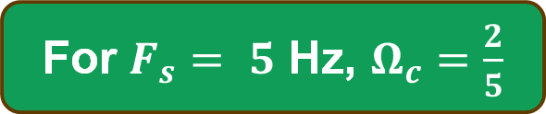
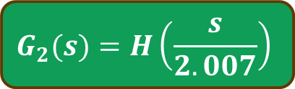

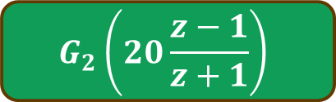
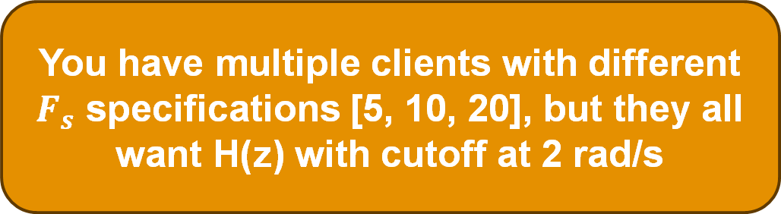
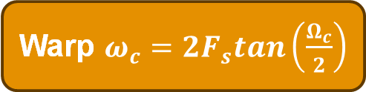
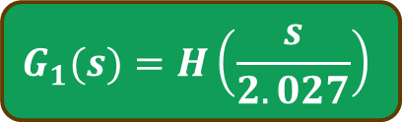
Since bilinear warps, we pre-warp
System Design with Bilinear Transformation
In this example, assume we know an analog H(s) with $ω_{c}=1$ rad/s
You have multiple clients with different $F_{s}$ specifications [5, 10, 20], but they all want H(z) with cutoff at 2 rad/s
Find $Ω_{c}$requirement
Warp $ω_{c}=2F_{s}tan\left(\frac{Ω_{c}}{2}\right)$
Design $G_{s}(s)$
H(z) is the bilinear transform of $G_{s}(s)$
For $F_{s}= 5$ Hz, $Ω_{c}=\frac{2}{5}$
$$ω_{c}≈2.027$$
$$G_{1}(s)=H\left(\frac{s}{2.027}\right)$$
$$G_{1}\left(10\frac{z−1}{z+1}\right)$$
For $F_{s}=10$ Hz, $Ω_{c}=\frac{2}{10}$
$$ω_{c}≈2.007$$
$$G_{2}(s)=H\left(\frac{s}{2.007}\right)$$
$$G_{2}\left(20\frac{z−1}{z+1}\right)$$
For $F_{s}=20$ Hz, $Ω_{c}=\frac{2}{20}$
$$ω_{c}≈2.002$$
$$G_{3}(s)=H\left(\frac{s}{2.002}\right)$$
$$G_{3}\left(40\frac{z−1}{z+1}\right)$$

Slide 13
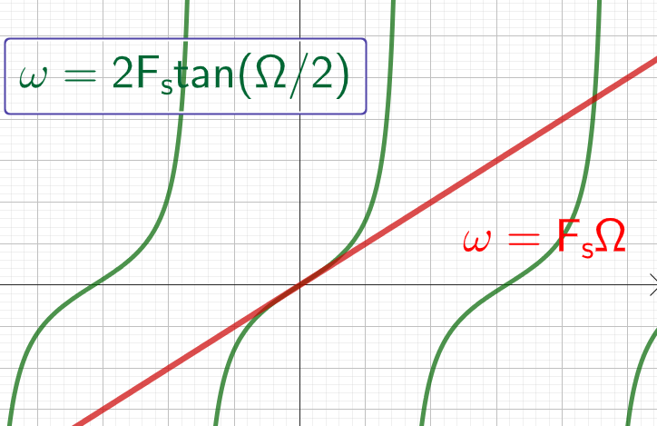
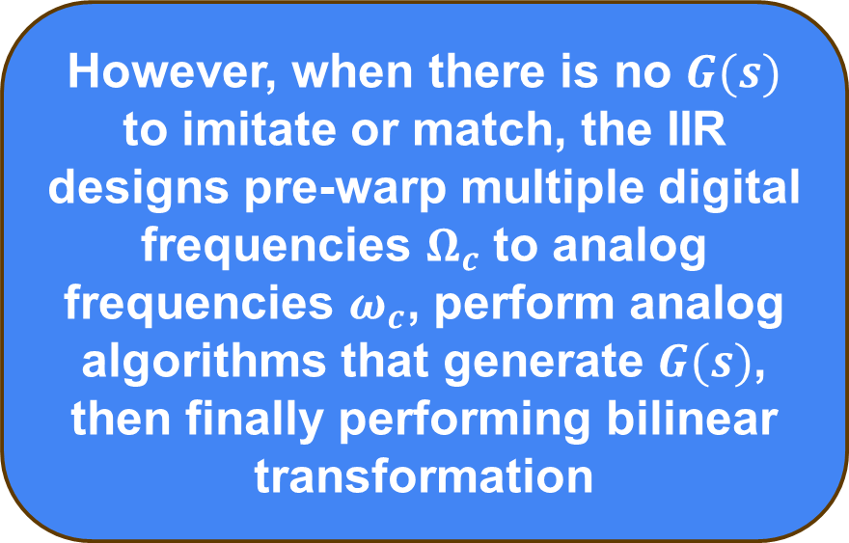
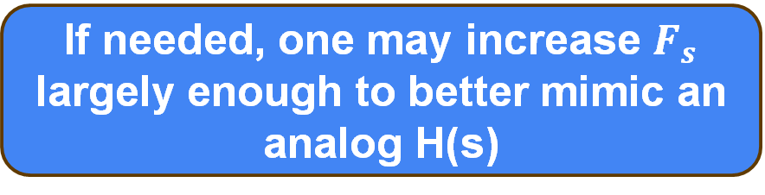

Considerations about the Bilinear Transform
System Design with Bilinear Transformation
Warping is not linear but is close to linear near $Ω=0$
You can only match a single Frequency with pre-warping
However, when there is no $G(s)$ to imitate or match, the IIR designs pre-warp multiple digital frequencies $Ω_{c}$ to analog frequencies $ω_{c}$, perform analog algorithms that generate $G(s)$, then finally performing bilinear transformation
If needed, one may increase $F_{s}$ largely enough to better mimic an analog H(s)

Slide 14
Thank you!
Prof. Aldebaro Klautau. Federal University of Pará (UFPA)
www.lasse.ufpa.br & www.ppgee.ufpa.br

