Slide 1
An efficient mapreduce cube algorithm for varied data distributions
Written by Tova Milo & Eyal Altshuler
Proposed by Maabout Sofian
Lassouani sofiane & ouadi steward

Slide 2
What is a data cube ?
Company turnover per : year, activity or branch
Beer sales in different countries over the years
Same name in different departments of FRANCE over the years
Dimension: period or department
Measure: sum, enumerate

Slide 3
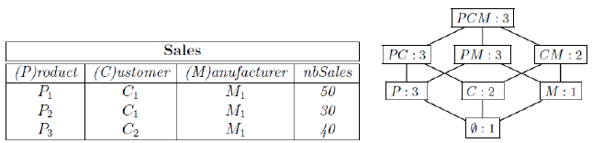
CONCRETE EXAMPLE
Exponential number of cuboids
Fig-1 : Data Cube Calculation
Source : https://www.researchgate.net/profile/Eve_Garnaud/publications

Slide 4
What is a data cube used for ?
Compute turnover per branch over the 5 last years
5 branches, 2 million lines per branch a year → 50 million lines
A lot of work !
People having the same name in different countries over the years
Name, born date, country, sexe, infoYear
5 billion lines
A lot of work !

Slide 5
What is a data cube used for ?
Data cube for example 1 and 2
Data cube → time saver
Time is money. Data cube → money saver

Slide 6
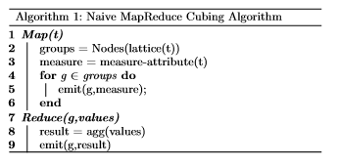
NaIve mapreduce cubing algorithm
Map/Reduce
Map
<Key, Value>
Reduce
<Key, {Values…}>
Fig-2 : Naive MapReduce Cubing Algorithm
Source : An Efﬁcient MapReduce Cube Algorithm for Varied Data Distributions

Slide 7
Naive algorithm limits
Memory is not sufficient
I/O between main-memory and disk
Load Balancing
Network Trafﬁc

Slide 8
COnclusion
Schedule computation and partition data efficiently → SP-CUBE algorithm
THE SP-CUBE ALGORITHM :
Computation → RAM
Two MapReduce jobs
SP-Sketch
Reduce network traffic
Assign the calculation of each c-group to its least unbiased descendant
EXPERIMENTS :
SP-CUBE ALORITHM VS (Apache Pig Cube & Apache Hive Cube)

