Slide 1
SYSC 3100 System Analysis and Design
Constraints and Contracts
The Object Constraint Language

Slide 2
Textbook Reading
Chapter 13 of the recommended text
Read through (some of the material is not covered in the slides)
Write down questions related to material covered in the book and ask them at the beginning of class or during office hours
Look at solved problems and review questions

Slide 3
Constraints: Motivations
Constraints on UML model elements: conditions that must be true about some aspect of the system
Example: In the CarMatch system, an individual may not have more than 10 agreements for car sharing
Precise constraints make the analysis and design more precise and rigorous
Complement the UML graphical notation by associating properties with model elements (e.g., methods, classes, transitions)
Help verification and validation of models
The focus here is on a specific use of constraints: Contracts

Slide 4
Contracts - Definitions
Goals: Specify operations so that caller/client and callee/server operations share the same assumptions
A contract specifies constraints that the caller must meet before using the class as well as the constraints that are ensured by the callee when used.
Three types of constraints involved in contracts: Invariant (class), Precondition, Postcondition (operations)
Contracts should be specified, for all known operations

Slide 5
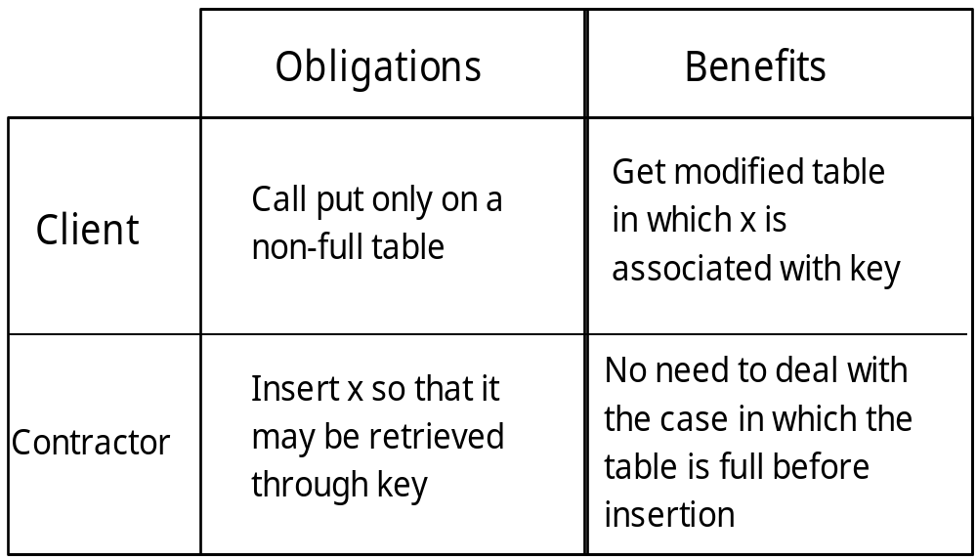
Design by Contract
Contractor :: put (element: T, key: STRING)
-- insert element x with given key
Notes:
Table state (full, not full) describes the “system” state required here to perform the operation
The resulting state after executing put() is to have an additional element in the table, a position in the table determined by its key

Slide 6
Operation Pre and Post Conditions
  Pre-condition: What must be true before executing an operation
  Post-condition: Assuming the pre-condition is true, what should be true about the system state and the changes that occurred after the execution of the operation
  These conditions have to be written as logical (Boolean) expressions
  Thus, system operations are treated as a black box. Nothing is said about operations’ intermediate states and algorithmic details
Before
After
Precondition
(what must be true before)
Postcondition
(change that has occurred)

Slide 7
Specifying Contracts
  Specify the requirements of system operation in terms of inputs and system state (Pre-condition)
  Specify the effects of system operations in terms of state changes and output (Post-condition)
  The state of the system is represented by the state of objects and the relationships between them
  A system operation may
    create a new instance of a class or delete an existing one
    change an attribute value of an existing object
    add or delete links between objects
    send an event/message to an object
Notes:
Template to help define contracts

Slide 8
Class Invariant
Condition that must always be met by all instances of a class
CarMatch system: a car sharer must be aged 21 years or older, journeys must be 2 miles or over.
Described using a Boolean expression that evaluates to true if the invariant is met
Invariants must be true all the time, except during the execution of an operation where the invariant can be temporarily violated.
If the pre- and post-conditions are satisfied, then the class invariant must be preserved by an operation
A violated invariant suggests an illegal system state

Slide 9
Usage of Contracts
Analysis/Design: Understand and document clearly operations’ intent and purpose
Coding: Guide programmer to an appropriate implementation (i.e. method)
System robustness: Check invariants and pre-conditions at run time before the execution of operations, possibly raise exceptions and display error messages. Post-conditions can also be checked after the completion of operations.
Testing: Verify that the method does what was originally intended

Slide 10
Object Constraint Language (OCL)
Formal, mathematical language
Inspired by the work on formal specification methods
Part of UML from the start, version 1.1
Motivation: UML diagrams are not precise enough for a precise and unambiguous specification
Not a programming language but a typed, declarative language
Uses: invariants, pre/post conditions, guards, etc…
OCL contains set operators and logic connectives.
Notes:
The official doc is on the course web page

Slide 11
The requirements of OCL
1. The OCL must enable us to express constraints on UML models.
2. The OCL must be a precise and unambiguous language that can be easily read by designers, developers and testers.
3. The OCL must be a declarative language, its expressions can have no side-effects.
4. OCL must be a typed language so that OCL expressions can be type checked for correctness.

Slide 12
Stereotyped Constraints
Constraints in OCL are commonly applied to state the properties of a class and its operations
This cannot be represented graphically in UML, e.g., use note boxes
Stereotypes: <<invariant>>, <<precondition>>, <<postcondition>>
Can also be documented separately from the diagrams

Slide 13
General form of OCL Expressions
package name
package <packagePath>
context <contextualInstanceName>:<modelElement> expression context
<expressionType><expressionName>:
<expressionBody>
<expressionType><expressionName>:
<expressionBody>
...
endpackage
The package context is optional
The expression context is mandatory
One or more expressions.
expression
expression

Slide 14
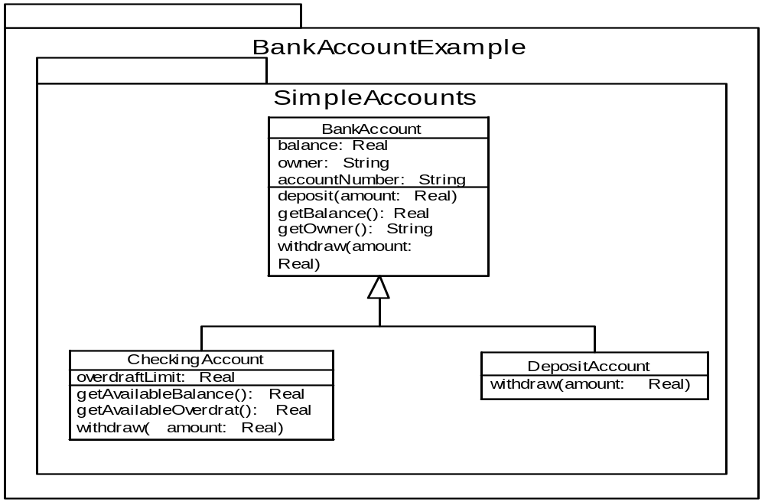
Package context and pathname
Package example – Bank Account

Slide 15
Package context and pathname
If the package context is not specified, the name space for the expression defaults to the whole model.
If OCL expression is attached directly to a model element, the namespace for the expression defaults to the owing package of the element.
For example, in the Bank Account package, you could specify the package context as:
  package BankAccountExample::SimpleAccounts
  ...
  endpackage
There is no need to use package context if the elements in your UML model have unique names. You can refer to each element by name.
However, if elements in different packages have the same name, you may have to refer to the element using full pathnames e.g.
  BankAccountExample::SimpleAccounts:BankAccount

Slide 16
Expression Elements
The ability to specify which model element is being constrained. This is known as the context of the constraint.
Example contexts: operation (pre/post condition), class (class invariant)
The ability to navigate through a model to identify other objects which may be relevant to the constraint being defined. This is done by means of navigation expressions.
The ability to make assertions about the relationships between the context object and any objects retrieved by means of navigation expressions. These assertions are similar to the Boolean expressions used in programming languages

Slide 17
Expression Context
Every OCL constraint has a context, the element that is being constrained (operation, class)
A constraint can be written in a textual form (data dictionary) or attached to model elements
Keyword context in bold type as well as constraint stereotypes
The keyword self in the textual form of the constraint simply refers to the instance of the context class (not always needed but aid readability)
SavingsAccount
Context SavingsAccount inv:
self.balance > 0 and self.balance < 25000
balance
Notes:
The element being constrained is often a class (class invariant)
Constraints can also be shown as notes attached to the appropriate model element
Example specifies that in all instances of the saving account class, at all times, the value stored in the balance attribute must be greater than 0 and less that $ 25000. This constraint is an example of a class invariant.
Self not useful here but make it easier to read
Notation clearly chosen to resemble the notation used in Java or C++ for accessing features of classes

Slide 18
Types in OCL
  Predefined types (and operations)
    Basic types - Integer, Real, String and Boolean
    Collection types – Collection, Set, OrderedSet, Bag, Sequence
  Meta types (advanced)
    OclAny – the supertype of all types in OCL and the associated UML model;

Slide 19
Types in OCL cont.
In OCL type system, all of the classifiers in the associated UML model become types in OCL. This means that OCL expression can refer directly to classifiers in the model. This makes OCL work as a constraint language.
In OCL every type is a subtype of OclAny.
The most unusual OclAny operation is allInstances(). This is a class scope operation – it applies directly to class, rather than to any specific instance and it returns the Set of all instances of that class.

Slide 20
Boolean Expressions
a | b | a = b | a <> b | a and b | a or b | a xor b | a implies b
true | true | true | false | true | true | false | true
true | false | false | true | false | true | true | false
false | true | false | true | false | true | true | true
false | false | true | false | false | false | false | true
The Boolean type has two values, true and false. It has a set of operations that return Boolean values (as shown above).
There is also a unary not operator – if the value of a is true then the value of not a is false.
Boolean expressions are often used in if…then…else expressions:
If <booleanExpression> then <oclExpression1> else <oclExpression2> endif

Slide 21
Navigation Expressions
Navigation is the process whereby you follow links from a source object to one or more target objects.
Navigation is possibly the most complex and difficult area of OCL.
OCL navigation expressions can refer to any of the following:
  Classifiers;
  Attributes
  Association ends;
  Query operations (these are operations that have the property isQuery set to true).

Slide 22
Example: Personnel System CD
1
Department
*
staff
1
*
Person
employee
employer
payrollNo
Company
0..1
1
1
name
age() : Integer
manager
0..1
*
*
Contract
*
1
Grade
startDate
salary
Notes:
This is an example we will refer to in this section.
Note the association class, the qualifier (employees are accessed by a unique payroll number)
Information that might be maintained by a personnel dept in some large company
Source: M. Priestley, Practical Object-Oriented Design with UML, 2000

Slide 23
Traversing Associations
One provides the names of the associations that are to be traversed
Use role names opposite to the context object or class name if no role name and no ambiguity
Dot notation:
Department Company
self.staff self.Department
No difference between composition, aggregation and associations as far as navigation expressions are concerned
Can traverse several associations in one expression
Notes:
If two associations, the class name cannot be used (ambiguity), suitable role names have to be added

Slide 24
Operations and Attributes in OCL Expressions
OCL provides basic types and model types
Basic types come with a set of defined operations
Model types have attributes and operations defined on them, in the class diagram
context Person inv:
self.age()
self.Contract.Grade.salary
Collections of attribute values can be obtained:
context Department inv:
self.staff.name
Notes:
Basic: Integer, Real, String, Boolean
Model types have attributes and operations
Operations written after an expression designating an object of the model type, separated by a dot

Slide 25
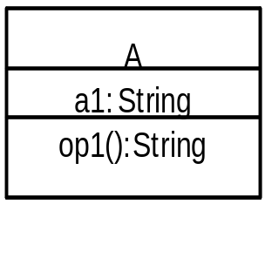
Navigation within the contextual instance
Example model | Navigation Expression | Semantics
 | self | The contextual instance – an instance of A
 | self.a1 a1 | The value of attribute a1 of the contextual instance
 | self.op1() Op1() | The result of op1() called on the contextual instance. The operation op1() must be query operation

Slide 26
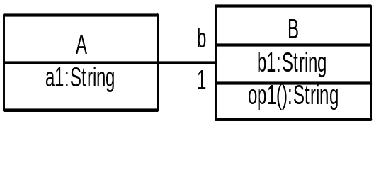
Navigation across associations
Example model | Navigation expressions (A is the expression context)
 | Expression | Value
 | self | The contextual instance – an instance of A
 | self.b | An object of type B
 | self.b.b1 | The value of attribute B::b1 on B instance
 | self.b.op1() | The result of operation B::op1() called on B instance

Slide 27
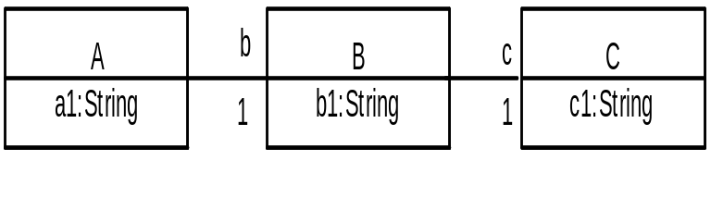
Navigation across multiple associations
Example model | Navigation expressions
 | Expression | Value
 | self | The contextual instance – an instance of A
 | self.b | An object type B
 | self.b.b1 | The value of attribute B::b1
 | self.b.c | An object of type C
 | self.b.c.c1 | The value of attribute C::c1
context

Slide 28
Collections
Navigation expressions may yield more than one object (when associations are not one-to-one)
In this case, it is said to return a collection
The properties of collections play important roles in constraints, e.g., cardinality
Collections can be: sets, bags, ordered sets, ordered bags (sequences)

Slide 29
Navigating Associations
Account
1
0..*
Transaction
self.Transaction returns a collection of transactions
Book
borrower
*
Member
self.borrower returns a collection of members

Slide 30
Types of Collections
Bag: can contain duplicate items
Set: cannot contain duplicate items
OrderedSet: elements of a set are ordered, cannot contain duplicate items (navigating {ordered} )
Sequences: ordered bags (navigating {ordered} )
OCL provides operation to convert bags to sets (asSet)
Whenever more than one association with a multiplicity greater than one is traversed, the collection returned is by default a bag
context Department inv:
staff.Contract.Grade
Notes:
Bags and sets make a big difference
Rule applies to example here -> bag
Here several instances of grade objects
If we want to sum up salaries -> need bag
If we want to know what are the represented grades in dept -> set

Slide 31
Examples
Set{4,7,2,9}
Bag{3,5,4,6,8,3,5,2,5}
Sequence{2,3,3,5,7,7,8,9,9}
Set{‘orange’, ‘apple’,’banana’}
OrderedSet {‘apple’,’banana’, ‘orange’}

Slide 32
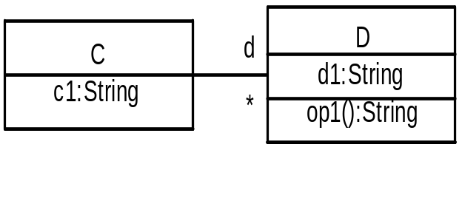
Collections Navigation Templates
Example Model | Navigation expressions
 | Expression | Value
 | self | The contextual instance – an instance of C
 | self.d | A Set(D) of objects of type D
 | self.d.d1 | A Bag(String) of the values of attribute D::d1 - shorthand for self.d -> collect(d1)
 | self.d.op1() | A Bag(String) of the results of operation D::op1() – shorthand for self.d -> collect(op1())
context

Slide 33
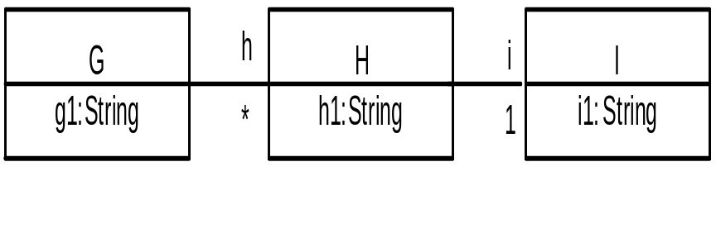
Collections Navigation Templates
Example model | Navigation expressions
 | Expression | Value
 | self | The contextual instance – an instance of G
 | self.h | A Set(H) of objects of type H
 | self.h.h1 | A Bag(String) of values of attribute H::h1
 | self.h.i | A Bag(I) of objects of type I
 | self.h.i.i1 | A Bag(String) of values of attribute I::i1
context

Slide 34
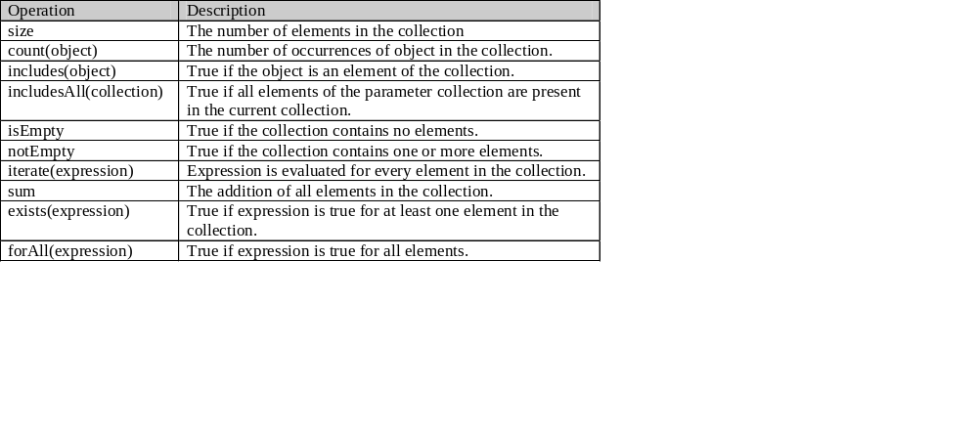
Some Operations on Collections

Slide 35
Collection hierarchy
Collection
size
includes
count
includesall
isEmpty
Set
Bag
Sequence
union, intersection
=, -, including, excluding
Count …
union, intersection
…
asSet
first
last
at(int)
append
prepend …
Notes:
Shows collection types, general operations, and some of the specific operations defined on each type
Some operations on different types have the same name but different semantics (check official doc)

Slide 36
Operations on Collections
A number of predefined operations on all types
‘ ->’ symbol for collection operation being applied
E.g., sum, size
context Department inv:
staff.Contract.Grade.salary->sum()
context Department inv:
staff.Contract.Grade->asSet()->size()
Notes:
asSet converts a bag to a set

Slide 37
From Bag to Set
Customer
Account
Transaction
context Customer inv:
self.Account produces a set of Accounts
context Customer inv:
self.Account.Transaction produces a bag of transactions
If we want to use this as a set we have to do the following
self.Account.Transaction -> asSet()
Notes:
Assumptions: Transactions may involve two or more accounts

Slide 38
Traversing Qualified Associations
Provide additional capacity for locating individual objects
context Company inv:
self.employee[314159]
context Company inv:
self.employee[314159].manager

Slide 39
Association Classes
Can navigate from instance of association class to objects at the ends of association
context Grade inv:
self.Contract.employee
context Person inv:
self.Contract.Grade
Notes:
Set of all employees of a particular grade
The grade of a particular employee

Slide 40
Subset Selection
Sometimes necessary to consider only a subset of objects returned
context Company inv:
self.employee->select(p:Person | p.Contract.Grade.salary > 50000)
Operation “select” applies a Boolean expression to each object and return objects for which the expression is true
Declaration of local variable: Context for navigation
Subset can be used for further navigation
context Company inv:
employee->select(p:Person |
p.Contract.Grade.salary > 50000).manager
Notes:
Local variable often unnecessary as the type of the objects can be worked out from the first part of the expression

Slide 41
select, reject
Account
Transaction
context Account inv:
self.Transactions -> select( value > 500 )
context Account inv:
self.Transactions -> reject( not(value > 500 ))

Slide 42
collect
Takes a navigation expression as argument and returns a bag consisting of the values of the expression for each object in the original collection
context Department inv:
self.staff->collect(p:Person | p.age())
Expression can perform additional calculations
context Company inv:
self.Contract.Grade->collect(g:Grade | salary*1.1)
->sum()
Notes:
Ages of all employees in dept
Company’s salary bill after applying a 10% pay rise
Here local variables are not necessary and could be omitted.

Slide 43
includes, includesAll
pilot
Flight
Person
crew
1..*
0..*
flightAttendant
context Flight inv:
self.crew -> includes(self.pilot )
context Flight inv:
self.crew -> includesAll(self.flightAttendants)

Slide 44
Basic Constraints
Combine OCL navigation expressions and Boolean operators
Simplest form: relational operators (e.g., =, <>)
context Person inv:
self.employer = self.Department.Company
Constraints that apply to collections
context Company inv:
self.employee->select(p:Person|p.age() < 18)->isEmpty()
context Person inv:
self.employer.Grade->includes(self.contract.grade)
context Department inv:
self.Company.employee->includesAll(self.staff)
Notes:
isEmpty or size = 0

Slide 45
Examples of Basic Constraints
Customer
name: String
title: String
age: Integer
isMale: Boolean
context Person
inv: title = if isMale then ‘Mr.’ else ‘Ms.’ endif
inv: age >= 18 and age < 66
inv: name.size < 100
Notes:
Note if then else construct in OCL
Self keyword omitted here (allowed)

Slide 46
Combining Constraints
Constraints can be combined using Boolean operators and, or, xor, and not
Boolean operator for implication: implies
context Person inv:
self.age() > 50 implies self.Contract.Grade.salary >
25000
Notes:
Every employee over the age of 50 must receive a salary of at least 25K

Slide 47
Iterative Constraints (1/2)
Apply a Boolean expression to every element in a collection and return a Boolean value
forAll returns true if the specified Boolean expression is true for every member of the collection
context Company inv:
self.Grade->forAll(g:Grade | not g.contract
->isEmpty())
Notes:
There is at least one employee appointed at every grade in the company

Slide 48
Iterative Constraints (2/2)
Operator exists which returns true if the Boolean expression is true for at least one element in collection
context Department inv:
staff->exists(e:Person | e.manager->isEmpty())
When a constraint has to systematically compare the values of different instances of a class
context Grade inv:
Grade.allInstances->forAll(g : Grade |
g <> self implies g.salary <> self.salary)
Iteration through the collection formed by applying allInstances
Notes:
Every dept has a head, I.e., an employee has no manager

Slide 49
Shorthand
Constraints on classes apply to all instances of a class, i.e., no need of forAll
context Grade inv:
salary > 20000
No need for
context Grade inv:
Grade.allInstances->forAll(g:grade | g.salary >20000)

Slide 50
Postconditions
Notational problem: attribute names denote current value of attribute
We need to compare attribute values before and after operations are executed
Notation @pre is used
context SavingsAccount::withdraw(amt)
pre: amt < balance
post: balance = balance@pre - amt
Notes:
Here is an example of postcondition
Pre and post conditions can be included in a note box attached to their respective operations. However, it tends to clutter the diagram. Here is a way to document, in a textual form, pre and post conditions, as well as invariants
“pre” and “post” labels are used
This is the format you should use when documenting operations and classes in the data dictionary

Slide 51
Producing and Using Constraints
Throughout Analysis and Design
Determining pre-conditions and post-conditions (in natural language) on use cases
Determining invariants on classes in the analysis model
Translating use-case constraints to constraints on operations
Translating pre-conditions, post-conditions and invariants to code assertions in the implementation

Slide 52
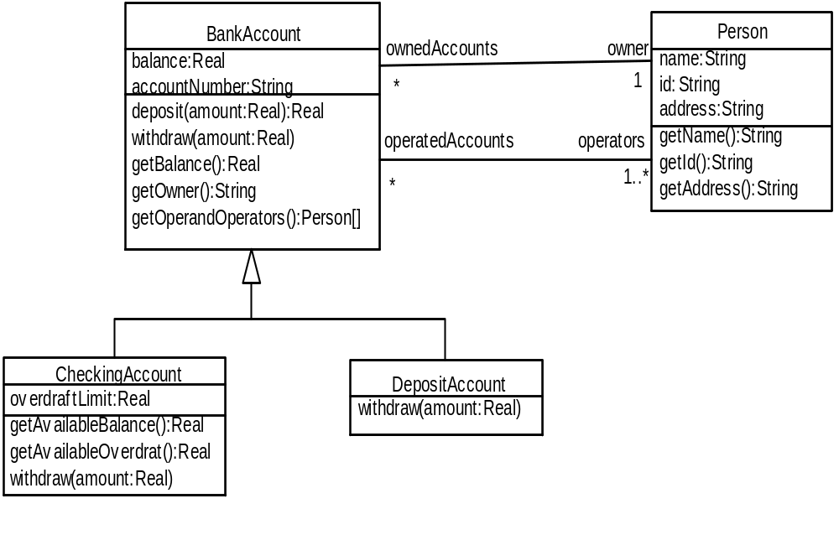
Example: BankAccount

Slide 53
Example: BankAccount – inv:
An invariant is something that must be true for all instances of its context classifier. There are four business rules about CheckingAccounts and DepositAccounts.
No Account shall be overdrawn by more than $1000.00.
We can express this first rule as an invariant on the BankAccount class because it must be true for all instances of BankAccount.
context BankAccount
inv balanceValue:
self.balance >= (-1000.0)
/* A bank account shall have a balance > -1000.0 */
This invariant is inherited by the two subclasses, CheckingAccount and DepositAccount. These subclasses can strengthen this invariant but can never weaken it. This is to preserve the substitutability principle.

Slide 54
Example: BankAccount – inv: cont.
CheckingAccounts have an overdraft facility. The account shall not be overdrawn to an amount greater than its overdraft limit.
We can express rules 1 and 2 as invariants on the CheckingAccount class:
context CheckingAccount
inv balanceValue:
self.balance >= (-overdraftLimit)
inv maximumOverdraftLimit:
self.overdraftLimit <= 1000.0
See how the CheckingAccount subclass has strengthened the BankAccount::balance class invariant by overriding it.

Slide 55
Example: BankAccount – inv: cont..
DepositAccounts shall never be overdrawn.
We can express this rule as follows:
context DepositAccount
inv balanceValue:
self.balance >= 0.0 /* Have a balance of zero or more */
This also is a strengthening of BankAccount::balance class invariant.
Each accountNumber shall be unique.
This constraint is expressed as an invariant on the BankAccount class.
context BankAccount
inv uniqueAccountNumber:
BankAccount.allInstances->
isUnique( account | account.accountNumber)

Slide 56
Example: BankAccount – inv: cont…
We can see that each BankAccount has exactly one owner and one or more operators. The owner is the Person who owns the account, and the operators are those People who have the right to withdraw money and access the account details. There is a business constraint that the owner must also be an operator. We can capture this constraint as follows:
context BankAccount
inv ownerIsOperator:
self.operators->includes( self.owner)
We can also write the following constraint on Person
context Person
inv ownedAccountsSubsetOfOperatedAccounts:
self.operatedAccounts->includesAll(self.ownedAccounts)

Slide 57
Example: BankAccount – pre:, post:, and @pre
Preconditions and postconditions apply to operations. Their contextual instance is an instance of the classifier to which the operations belong.
  Preconditions state things that must be true before an operation executes.
  Postconditions state things that must be true after an operation executes.
Consider the deposit() operation that both CheckingAccount and DepositAccount inherit from BankAccount. There are two business rules.
The amount to be deposited shall be greater than zero.
After the operation executes, the amount shall have been added to the balance.

Slide 58
Example: BankAccount – pre:, post:, and @pre - cont.
These rules can be expressed concisely and accurately in preconditions and postconditions on the BankAccount::deposit() operation as follows:
context BankAccount::deposit( amount: Real): Real
pre amountToDepositGreaterThanZero:
amount > 0
post depositSucceeded:
self.balance = self.balance@pre + amount
Notice the use of the @pre keyword. This keyword can be used only within postconditions. The expression balance@pre refers to the value of balance before the operation executes.

Slide 59
Example: BankAccount – pre:, post:, and @pre - cont.
For completeness, here are the constraints on the BankAccount::withdraw() operation
context BankAccount::withdraw(amount: Real)
pre amountToWithdrawGreaterThanZero:
amount > 0 and amount < balance + 1000.0
post withdrawalSucceeded:
self.balance@pre – amount
When an operation is redefined by a subclass (withdraw in CheckingAccount or DepositAccount), it gets the preconditions and postconditions of the operation it redefines. It can only change these conditions as follows:
  The redefined operation may only weaken the precondition.
  The redefined operation may only strengthen the postcondition.
This way, substitutability principle is preserved.
Notes:
Define contracts in the two subclasses of BankAccount

Slide 60
Another Contract Example

Slide 61
Library Class Diagram
Book
isbn : String
author : String
title : String
+book
1
1
Library
date : Date
name
+copy
0..*
0..*
borrowCopy(uid: Integer, cid: Integer)
+library
+stock
Copy
renewCopy(uid: Integer, cid: Integer)
copyId : Integer
returnCopy(uid: Integer, cid: Integer)
1
0..*
register(name: String)
0..*
removeUser(uid: Integer)
addCopy(cid: Integer)
deleteCopy(cid: Integer)
+library
1
1
LoanCopy
ReferenceCopy
loanType : String
0..*
+user
0..*
User
OnLoan
userid : Integer
+user
+issued
return : Date
OnShelf
name : String
onhold : Boolean = FALSE
address : String
renewed : Integer
copylimit : Integer = 5
1
1
0..*
numberofcopy : Integer
0..*
renewlimit : Integer = 5
Notes:
System class diagram here, at the end of analysis (we used Rational Rose 2000)

Slide 62
borrowCopy Precondition
context Library::borrowCopy(uid, cid)
pre :
self.user->exists(user : User | user.userid = uid and not user.numberofcopy = user.limit )
and
self.OnShelf->exists(onshelf : OnShelf | onshelf.copyid = cid)
Notes:
Such conditions can be put in a note box attached to the operation – not done here for the sake of legibility
cid and uid are input parameters of borrowCopy

Slide 63
borrowCopy Postcondition
context Library::borrowCopy(uid, cid)
post :
not self.OnShelf->exists(onshelf : OnSelf | onshelf.copyId = cid)
and
self.OnLoan->exists(onloan : OnLoan | onloan.copyId = cid)
and
self.user->exists(user : User | user.userid = uid
and user.numberofcopy = user.numberofcopy@pre + 1
and user.OnLoan->exists(onloan : Onloan | onloan.copyId = cid ))
Notes:
All state changes are precisely defined, in terms of the class diagram elements

Slide 64
Advantages of Contracts
Better documentation
  Improved precision, e.g., meaning of operations
  Helps check the completeness of model, e.g., class diagram
Communication without misunderstanding
Better testability: we know precisely the effect of operations
Should be used each time a new class or a new operation is defined, during Analysis or design
Notes:
e.g., The semantics of operations is precisely defined

Slide 65
Source of Contracts
Pre/Post conditions of use cases translate into pre/post conditions of operations, class invariants
Class invariants are determined by characterizing the legal state of instances for that class.
CarMatch system, Use case: Register car Sharer (p 264)
Pre-condition includes: car sharer must not be already registered, car sharer must not have been disqualified from membership in the past
RCSControl class implements the Register car sharer use case
RCSControl will likely have a register() operation

Slide 66
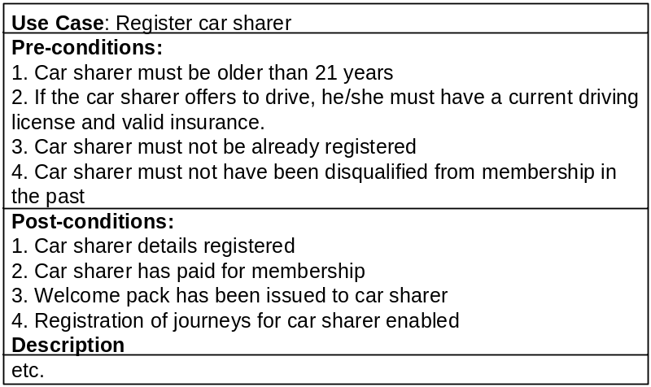
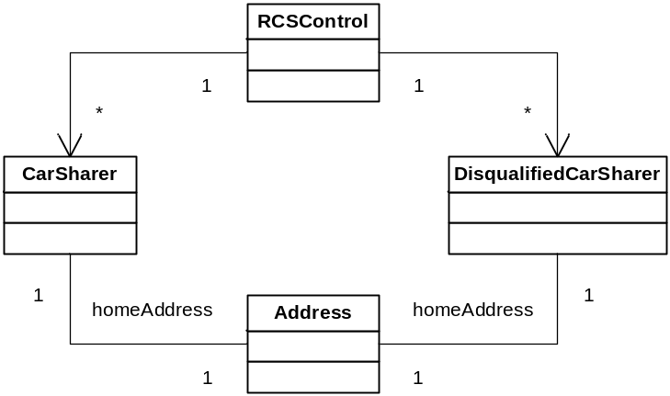
Register Car Sharer Use Case

Slide 67
Pre-condition
context RCSControl::register(fName,lName, address)
pre:
self.CarSharer->forall(c | c.firstName <> fName and c.lastName <> lName and c.homeAddress <> address)
and
self.DisqualifiedCarSharer-> forall(d | d.firstName <> fName and d.lastName <> lName and d.homeAddress <> address )
Class diagram p 293, note navigability arrows from control class to entity classes ( 1 to *)
Note the use of parameters in the pre-condition
“and” is optional and could have been omitted

Slide 68
Using Enumerations
Customer
<<enumeration>>
Gender
gender: Gender
name: String
title: String
dateOfBirth: Date
male
female
context Customer
inv : gender = Gender::male
implies title = ‘Mr.‘

Slide 69
Other Uses of Constraints
Guard conditions on statecharts’ transitions
Path conditions in sequence diagrams
Generation of test oracles
In general, OCL constraints helps make the use of UML diagrams more precise and rigorous
Notes:
NFR example: real-time deadline between two messages

Slide 70
Guard Conditions

Slide 71
Guards in State Transition Diagrams
A transition can have an event, a guard, and an action
Guard: Determines whether or not a transition is enabled
It can be expressed in OCL – more rigorous
The guard is expressed in terms of
  The parameters of the event
  Attributes and links of the object specified
Notes:
The guard is a precondition on the transition
Events often correspond to (remote) operation calls or signals in RT systems
The state transition diagram tells us when these events/calls are permitted (based on guard+ state)
From a state you can derive the effects of an event
Guards can then be translated in operation precondition and the state change can be translated into an operation postcondition

Slide 72
State Transitions
  The guard expression specifies what must be true for a transition to occur
  Expressed in terms of trigger event parameters, state variables and operations
  The value of a condition essentially represents a state of the system.
start [transmission= neutral]
Engine Off
Engine On
Notes:
Transition takes place when the guard is true and the event occurs
Example: transmission is an attribute of class Engine. Start is a signal.
Format: eventName [guard condition] / operation (arguments)

Slide 73
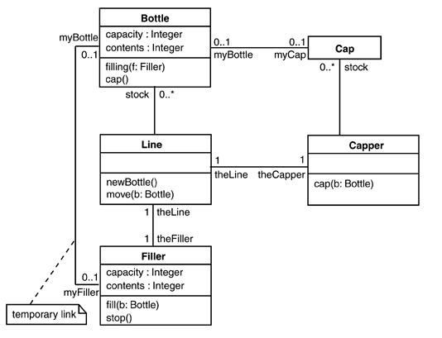
Example: Class diagram Bottle filling system
Notes:
Two events are defined here: fill(amount:Integer), cap()
fill is an operation – the fill operation will not perform in state filled
The state can be modeled as an enumeration attribute (we will see later a better way)

Slide 74
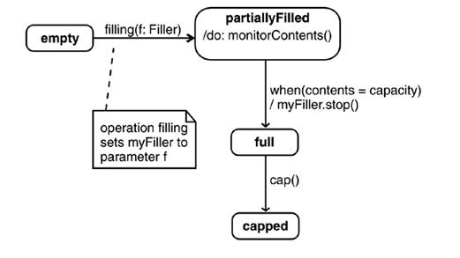
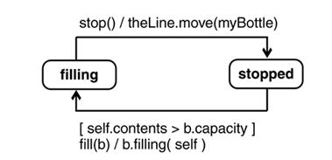
Statecharts
Bottle statechart
Filler statechart

Slide 75
Change Events
One or more attributes or associations change
Expression change from false to true
Different from guard condition
Format: when(OCL expression)
For example, in the state transition diagram of the Bottle class, a change event is attached to the transition from state partiallyFilled to state full.
Different semantics … no externally generated event is needed
Notes:
Different from guard condition: a guard condition is evaluated once when its event fires
If the guard condition is false, the transition does not occur and the event is “lost”
If we substitute cap with the when expression in the bottle example, the semantics have changed: no cap event needs to be generated by an object (cap() invoked) – the when event takes place as soon as the when condition is fulfilled

Slide 76
Restrictions on States of Bottle Class (State Invariants)
context Bottle
inv: self.oclInState(full))
implies contents = capacity
and myCap->isEmpty()
inv: self.oclInState(empty)
implies contents = 0
inv: self.oclInState(capped)
implies contents = capacity and
myCap->notEmpty()
inv: self.oclInState(partiallyFilled)
implies myFiller->notEmpty()

Slide 77
Class Invariant
context Bottle inv:
self.oclInState(full) =
(contents = capacity) and myCap->isEmpty()
self.oclInState(empty) = (contents = 0)
self.oclInState(capped) =
(contents = capacity) and myCap>notEmpty()
self.oclInState(partiallyFilled) =
myFiller->notEmpty()
Notes:
And implicit

Slide 78
Class Invariant II
context Bottle inv:
self.oclInState(full) and contents = capacity
xor
self.oclInState(empty) and contents = 0
xor
self.oclInState(capped) and myCap->notEmpty()
xor
self.oclInState(partiallyFilled) and myFiller->notEmpty()

Slide 79
Textbook Solved Problems

Slide 80
Sell Policy Use Case
SPControl class ( <<control>> ) that implements operations to gather insurance details, create a new policy, create a new payment schedule
Before getting insurance details, otherwise it would be a waste of time, one needs to check that the future policy holder is registered as a car sharer and paid their membership (first use case precondition).
context SPControl::gatherInsuranceDetails(lastname, firtname): carSharer
pre: Carsharer.allInstances
->select(c | c.lastname = lastname and c.firstname = firstname)
.membership.balance >= 0
Note: the operation returns the CarSharer instance corresponding to the first and last names in input. This will be used by createPolicy()

Slide 81
Sell Policy Use Case II
Another use case pre-condition states that two policies must not be in force at the same time for a given car sharer
Note Date is not a basic type here and provides operations such as before()
context SPControl::createPolicy(startDate, renewalDate, carSharer): Policy
pre:
carSharer.Policy
->forall(p | p.startDate.before(startDate)
implies p.renewalDate.before(startDate))
Note: carSharer is the applicant seeking an insurance policy, which was the return value of gatherInsuranceDetails()

Slide 82
Sell Policy Use Case III
Another use case pre-condition states that the first payment schedule must be made before cover is granted
context SPCControl::createPaymentSchedule(startDate, regularDate,amount,frequency, policy)
pre:
startDate.before(policy.startDate)
Note: the policy parameter was returned from createPolicy()

Slide 83
Sell Policy Use Case IV
The last use case pre-condition also results into class invariants.
context Carsharer inv:
self.Policy->forall(p1,p2| p1<>p2 and p1.startDate.before(p2.startDate) implies p1.renewalDate.before(p2.startDate))
context Policy inv:
startDate.before(renewalDate)

Slide 84
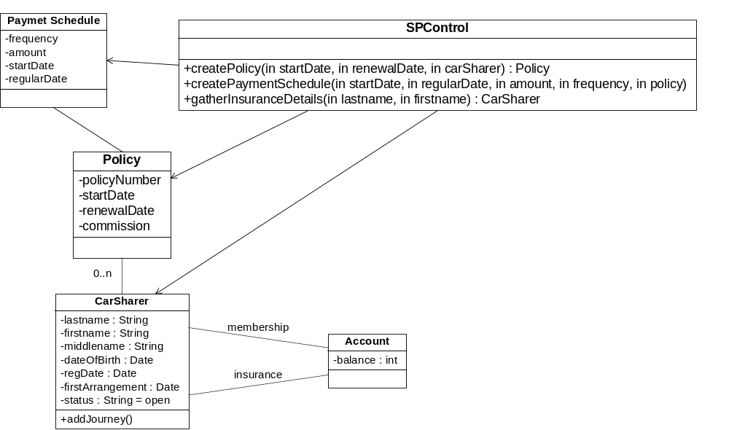
Sell Policy class diagram
Notes:
“0..n” in textbook should be “*”

Slide 85
Match car sharer use case
They must be at least one driver and at least two people in an agreement
MCSControl class ( <<control>> ) with operations to choose sharers for a particular journey and then create a sharing agreement
context MCSControl::chooseSharers(journey): Set(CarSharer)
Post: result->exists(x|x.canDrive)
and result->size()>=2
context MCSControl::createArrangement(agreementDate, startDate, finishDate, sharers)
Pre: sharers->exists(x|x.canDrive)
and sharers->size()>=2
context SharingAgreement inv:
self.CarSharer->exists(x|x.canDrive)
and self.sharer->size()>=2

Slide 86
Match car sharers class diagram
MCSControl
+createArrangement(agreementDate, startDate, finishDate, sharers)
+chooseSharers(in Journey) : Set(CarSharer)
CarSharer
-lastname : String
SharingAgreement
-firstname : String
-agreementDate : Date
agreement
sharer
-middlename : String
-startDate : Date
-dateOfBirth : Date
-finishDate : Date
0..n
2..5
-regDate : Date
-firstArrangement : Date
-status : String = open
-canDrive : Boolean
+addJourney()

