Slide 1

Department of Electronics and Communication Engineering
PROJECT MEMBERS
ARIVUDAI NAMBI .A - 830116106004
SURIYA. M - 830116106036
DHARANEESHWARAN. B - 830116106701
RAM PRAKASH. J - 830116106706
PROJECT GUIDE
Dr. T.S.MURUGESH
ASP/ECE/GCES

Slide 2
IoT BASED SMART SURVEILLANCE ROBOT FOR MILITARY APPLICATIONS

Slide 3
INTRODUCTION
Objective - To propose an Internet-of-Things based Robot
The robot is fitted with sensors like PIR, bomb detector, and ESP8266 module for providing real-time environmental monitoring.

Slide 4
EXISTING MODEL
Data Transmission takes place via zigbee or bluetooth
Existing models consist only of either bomb detection or person detection during mishaps.

Slide 5
PROBLEM STATEMENT
Unable to carry out surveillance from long range.
Live Monitoring

Slide 6
PROPOSED SYSTEM
We have proposed an robot with metal detection, person detection by using node MCU with some other modules.
Cloud based surveillance.

Slide 7
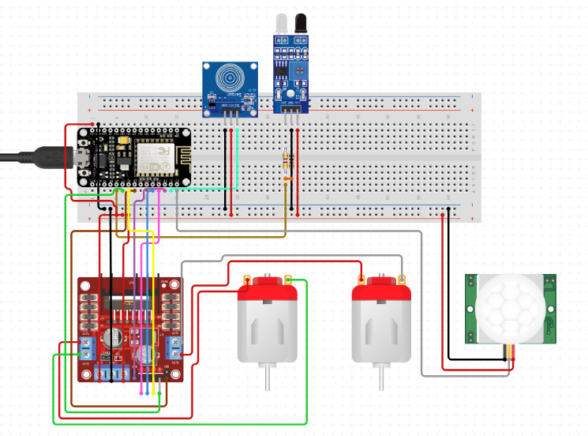

Slide 8
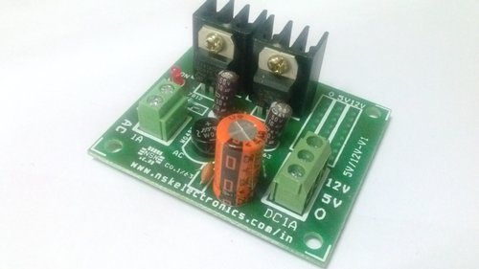
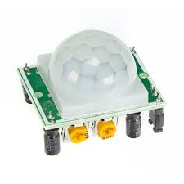
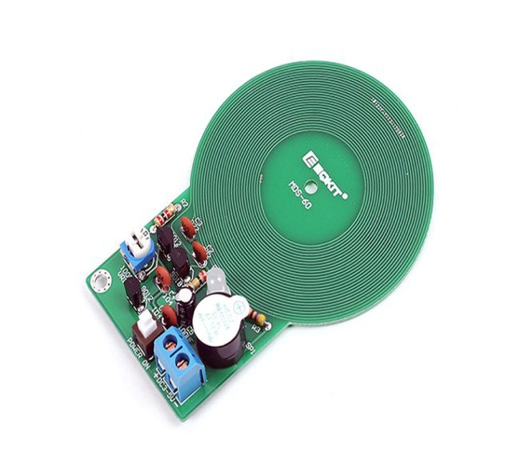
HARDWARE
Power supply
PIR
Metal detector

Slide 9



SOFTWARE

Slide 10
Development and implementation of smart IOT device quickly and easily...
It is used to read, store and visualize sensor data and control hardware remotely.

Slide 11
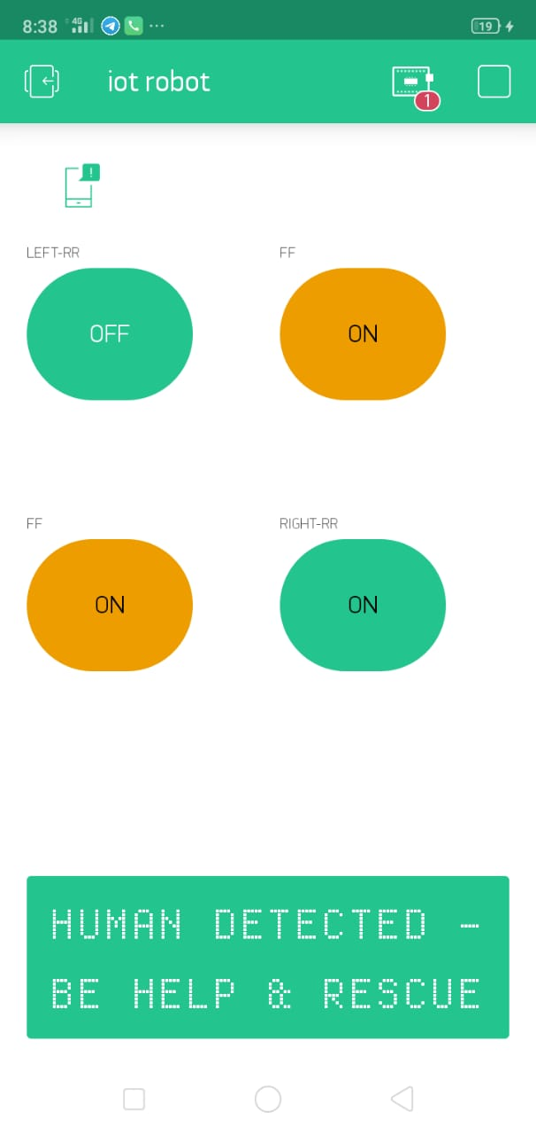
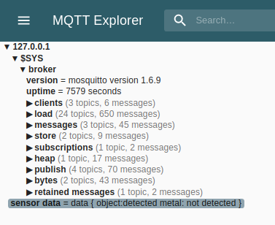
APP PREVIEW

Slide 12
CONCLUSION
In this project, the framework for making a robot for surveillance purpose is proposed. It overcomes the problem of limited range surveillance by using the concept of IOT.
We can control the robot with the help of laptop/mobile manually.
Automatic monitoring can also be done.

Slide 13
REFERENCES
Coal Mine Robot for Detection of Hazardous Gas - S. D. Mitragotri, A. R. Karwankar - 2016.
Hazardous Gas & Mine Detecting Robot - Sharath Sethu Raghavan, Jasim M, Aqib Saman K , Jisnu Thomas – 2015
Hazardous gas detecting method applied in coal mine detection robot - Niu Zhigang, Wang Lu - 2011.
Hazardous gas detecting rescue robot in coal mines - T S Kumar Reddy, G Bala Siva Krishna - 2014
Embedded Control System Design for Coal Mine Detect and, Rescue Robot - Zhu Jianguo Gao Junyao, Li Kejie, Lin Wei, Bi Shengjun – 2014.

