Slide 1
Website Design
Eng Shimaa mohamed

Slide 2
CSS stands for Cascading Style Sheets
CSS describes how HTML elements are to be displayed on screen, paper, or in other media
CSS

Slide 3
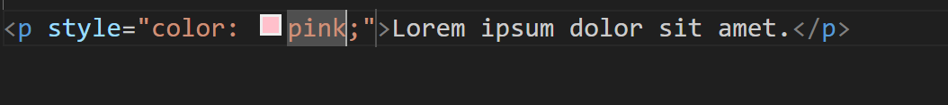
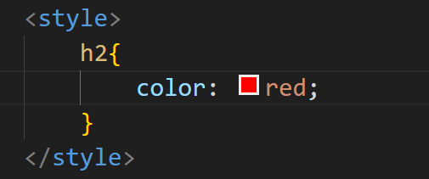
Using CSS
CSS can be added to HTML documents in 3 ways:
Inline - by using the style attribute inside HTML elements
Internal - by using a <style> element in the <head> section
External - by using a <link> element to link to an external CSS file

Slide 4
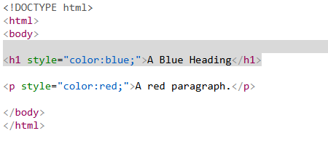
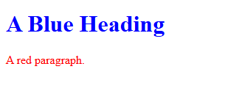
inline CSS
An inline CSS is used to apply a unique style to a single HTML element.
An inline CSS uses the style attribute of an HTML element.
The following example sets the text color of the <h1> element to blue, and the text color of the <p> element to red:

Slide 5
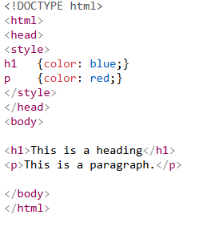
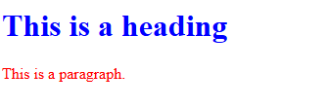
Internal CSS
An internal CSS is used to define a style for a single HTML page.
An internal CSS is defined in the <head> section of an HTML page, within a <style> element.
The following example sets the text color of ALL the <h1> elements (on that page) to blue, and the text color of ALL the <p> elements to red. In addition, the page will be displayed with a "powderblue" background color:

Slide 6
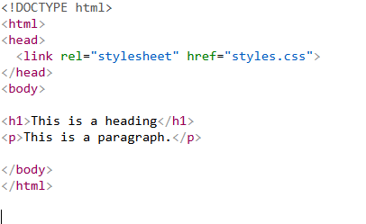
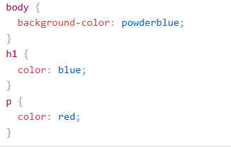
External CSS
An external style sheet is used to define the style for many HTML pages.
To use an external style sheet, add a link to it in the <head> section of each HTML page:

Slide 7
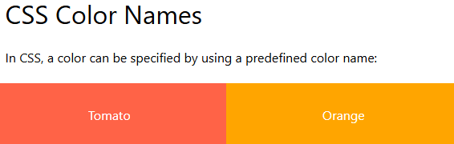
CSS Colors
In CSS, colors are specified by using a predefined color name, or with a RGB, HEX.

Slide 8
CSS RGB Colors
RGB Value
An RGB color value represents RED, GREEN, and BLUE light sources.
In CSS, a color can be specified as an RGB value, using this formula:
Rgb (red, green, blue)
Each parameter (red, green, and blue) defines the intensity of the color between 0 and 255.
For example, rgb (255, 0, 0) is displayed as red.
To display black, set all color parameters to 0, like this: rgb(0, 0, 0).
To display white, set all color parameters to 255, like this: rgb(255, 255, 255).

Slide 9
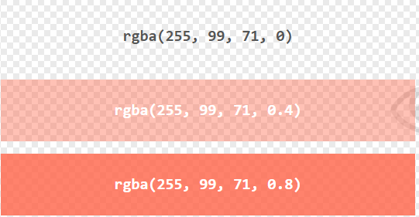
CSS RGBA Colors
RGBA Value
RGBA color values are an extension of RGB color values with an alpha channel - which specifies the opacity for a color.
An RGBA color value is specified with:
rgba(red, green, blue, alpha)

Slide 10
CSS HEX Colors
HEX Value
A hexadecimal color is specified with: #RRGGBB.
In CSS, a color can be specified using a hexadecimal value in the form:
#rrggbb
Where rr (red), gg (green) and bb (blue) are hexadecimal values between 00 and ff (same as decimal 0-255).
For example, #ff0000 is displayed as red, because red is set to its highest value (ff) and the others are set to the lowest value (00).
To display black, set all values to 00, like this: #000000.
To display white, set all values to ff, like this: #ffffff.

Slide 11


Div & span
Definition and Usage
The <div> tag defines a division or a section in an HTML document.
The <div> tag is used as a container for HTML elements - which is then styled with CSS
The <span> tag is an inline container used to mark up a part of a text,
<div> → block-level → for sections/containers.
<span> → inline → for styling small parts of text or content

Slide 12
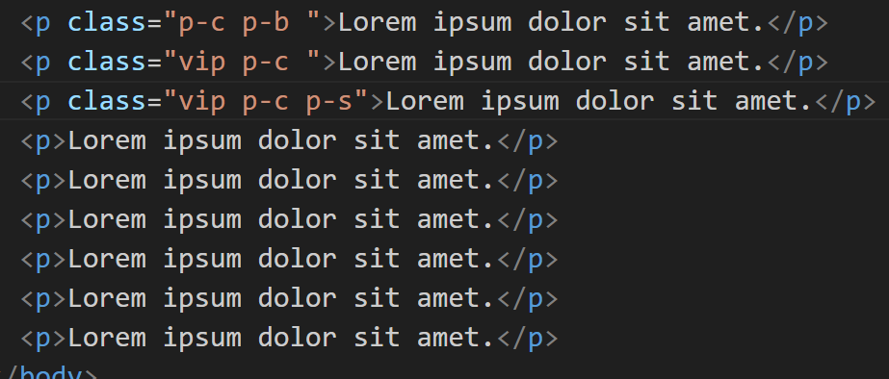
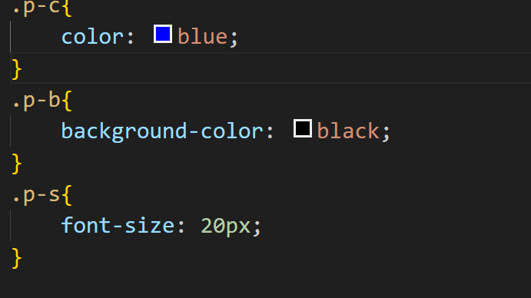
Class & id
The HTML class attribute is used to specify a class for an HTML element.
Multiple HTML elements can share the same class
The id attribute specifies a unique id for an HTML element.

Slide 13
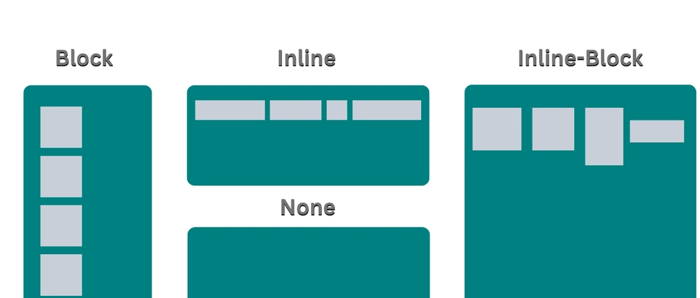
Css Display

Slide 14
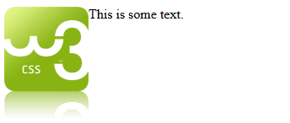
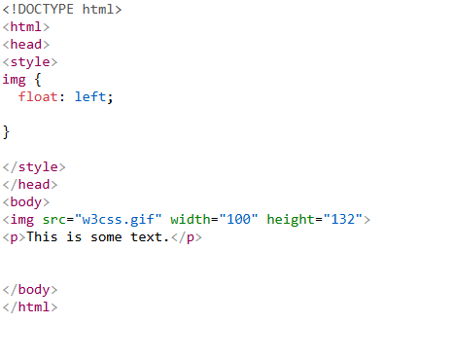
Css Float
Elements next to a floating element will wrap around it

Slide 15
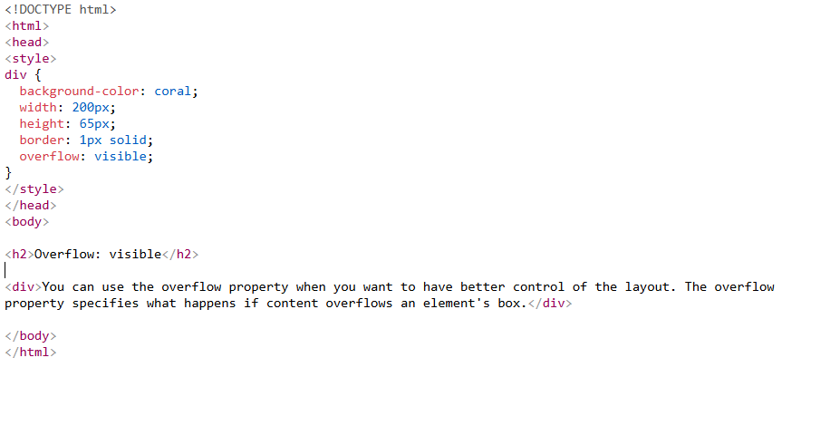
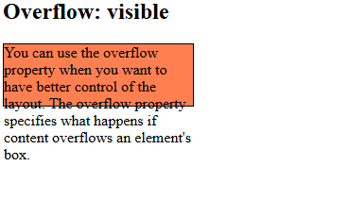
overflow
CSS overflow property controls what happens to content that is too big to fit into an area.
visible → extra content remains visible outside the element.

Slide 16
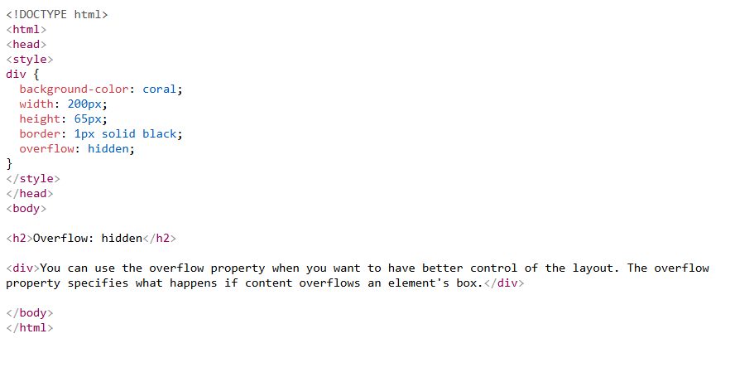
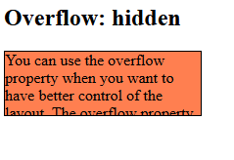
CSS overflow: hidden
hidden → extra content is cut off

Slide 17
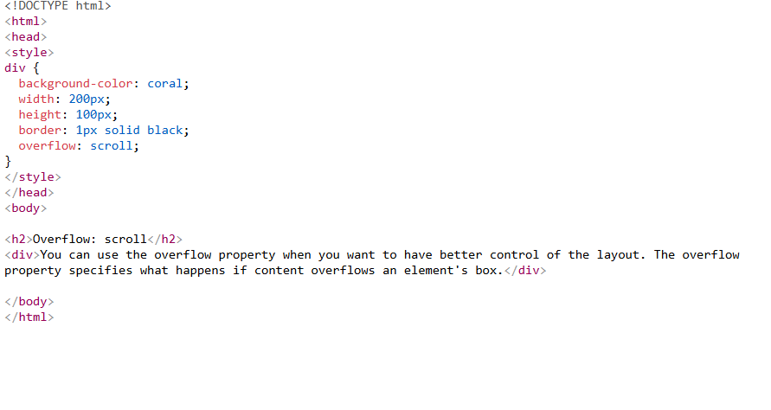
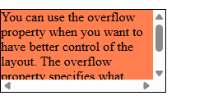
CSS overflow: scroll
scroll → extra content can be seen using a scrollbar.

Slide 18

CSS Box Model
Box model → Every element in CSS is a box made of: content, padding, border, and margin.

Slide 19
CSS Text
CSS Text Alignment
The text-align property is used to set the horizontal alignment of a text.
This property can have one of the following values:
left - Aligns the text to the left
right - Aligns the text to the right
center - Centers the text

Slide 20
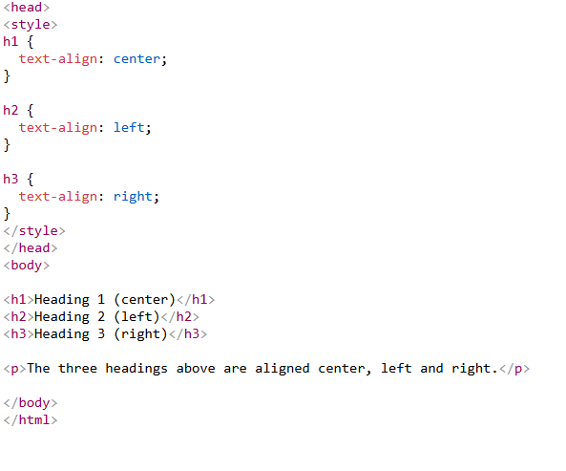
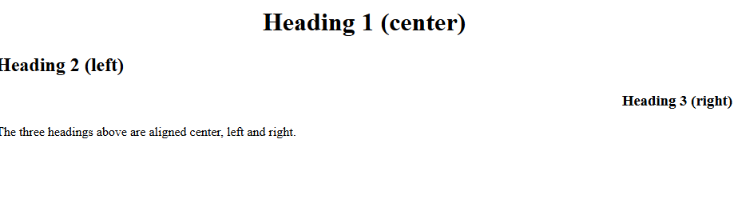
CSS Text Alignment

Slide 21
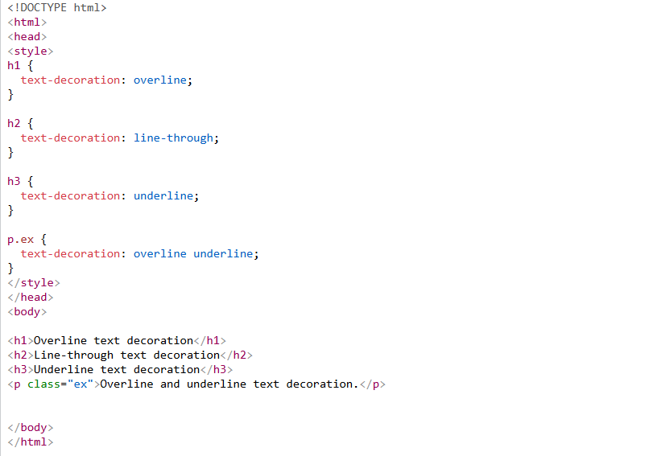
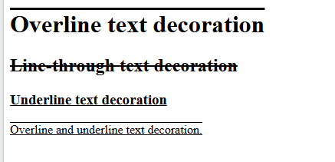
CSS Text Decoration
The CSS text-decoration property is used to control the appearance of decorative lines on text

Slide 22
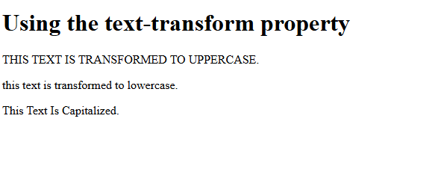
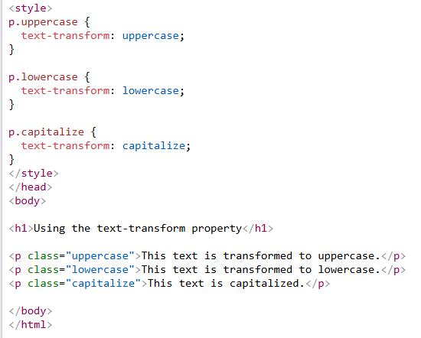
CSS Text Transformation
capitalize - Transforms the first character of each word to uppercase
uppercase - Transforms all characters to uppercase
lowercase - Transforms all characters to lowercas

Slide 23
CSS Text Spacing
CSS has several properties to control text spacing.
In this chapter you will learn about the following properties:
text-indent
letter-spacing
line-height
word-spacing

Slide 24

Task

Slide 25

Task

