Slide 1
Breast Cancer Wisconsin Visualization
Sara Goldoni
Federica Savini
Lavinia Fabrello

Slide 2
Project Purpose
Analyze Breast Cancer Wisconsin Data Set present on sklearn
The data set consists in
Number of Instances: 569
Number of Attributes: 30 numeric, predictive attributes and the class
class:
WDBC-Malignant
WDBC-Benign
Missing Attribute Values: None
Class Distribution:
212 - Malignant,
357 - Benign
Creator: Dr. William H. Wolberg, W. Nick Street, Olvi L. Mangasarian
Donor: Nick Street
Date: November, 1995

Slide 3
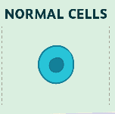
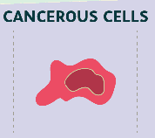
What we know from literature
Under a microscope, normal cells and cancer cells may look quite different. In contrast to normal cells, cancer cells often exhibit much more variability in cell size—some are larger than normal and some are smaller than normal.
In addition, cancer cells often have an abnormal shape, both of the cell, and of the nucleus (the “brain” of the cell.) The nucleus appears both larger and darker than normal cells.
The reason for the darkness is that the nucleus of cancer cells contains excess DNA. Up close, cancer cells often have an abnormal number of chromosomes that are arranged in a disorganized fashion
Nucleus that are larger and darker
than normal

Slide 4
Data Set Description
Features are computed from a digitized image of a fine needle aspirate (FNA) of a breast mass. They describe characteristics of the cell nuclei present in the image.
radius (mean of distances from center to points on the perimeter)
texture (standard deviation of gray-scale values)
perimeter
area
smoothness (local variation in radius lengths)
compactness (perimeter^2 / area - 1.0)
concavity (severity of concave portions of the contour)
concave points (number of concave portions of the contour)
symmetry
fractal dimension (“coastline approximation” - 1)
Some attribute (radius, perimeter, area,…) are easy to understand. What about the others?

Slide 5
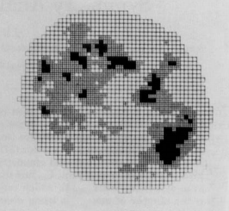
Understanding attributes (1/2)
concavity (severity of concave portions of the contour): the ratio between concave zone/perimeter represents concavity
Symmetry: Is a measure of how evenly a particular chromatin component is distributed over the twodimensional projection of the nuclear image

Slide 6
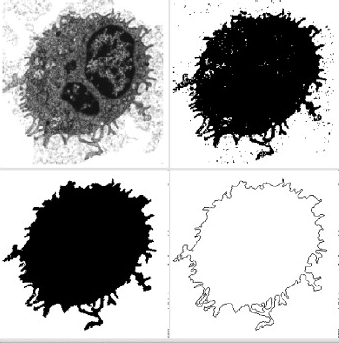
Understanding attributes (2/2)
The fractal dimension of a system is a characteristic number associated to the geometric self-similarity pattern presented in the image structure

Slide 7
How data set is composed
The mean, standard error, and “worst” or largest (mean of the three worst/largest values) of these features were computed for each image, resulting in 30 featues.
Let’s see what standard error represents

Slide 8
Standard error
The standard error (SE)is a measures of spread. The higher the number, the more spread out analyzed data is.
SE is used to estimate the efficiency, accuracy, and consistency of a sample. In other words, it measures how precisely a sampling distribution represents a population.

Slide 9
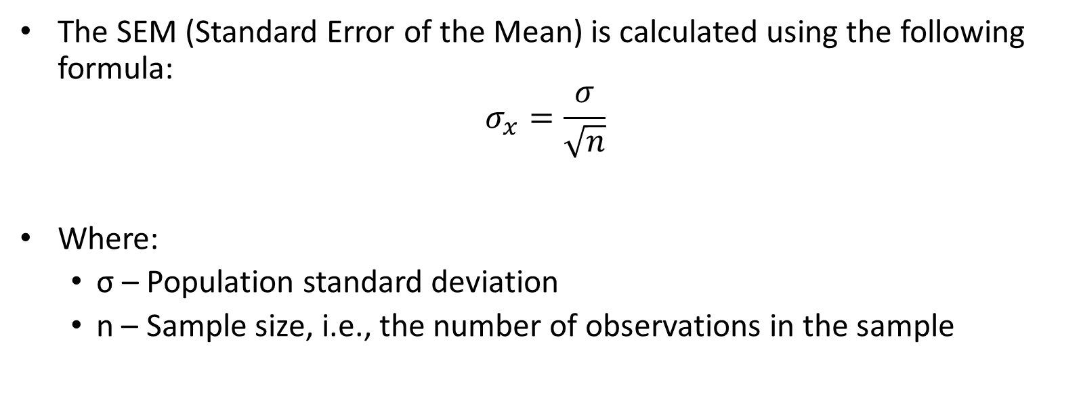
Just one formula, we promise…
The SEM (Standard Error of the Mean) is calculated using the following formula:
$$σ_{x}=\frac{σ}{\sqrt{n}}$$
Where:
σ – Population standard deviation
n – Sample size, i.e., the number of observations in the sample

Slide 10
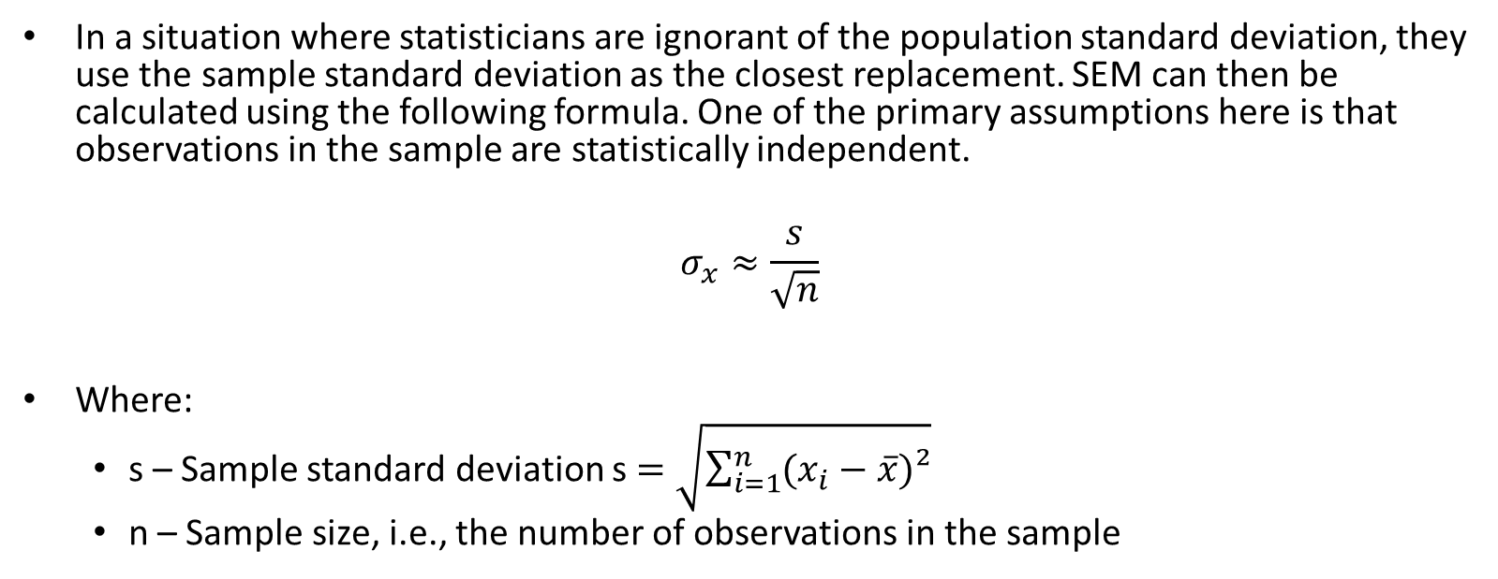
Ok, two formulas…
In a situation where statisticians are ignorant of the population standard deviation, they use the sample standard deviation as the closest replacement. SEM can then be calculated using the following formula. One of the primary assumptions here is that observations in the sample are statistically independent.
$$σ_{x}≈\frac{s}{\sqrt{n}}$$
Where:
s – Sample standard deviation s $=\sqrt{\sum_{i=1}^{n}{(x_{i}−\overline{x})²}}$
n – Sample size, i.e., the number of observations in the sample

Slide 11
References
sklearn data set
Cancer Cells vs. Normal Cells: How Are They Different?
(Lynne Eldridge)
Symmetry Analysis of Cell Nuclei
(J.P. Panno)
Computational cancer cells identification by fractal dimension analysis
(C. Timbo, A.R da Rosa, M. Goncalves, B. Duarte)
Wikipedia

