Slide 1
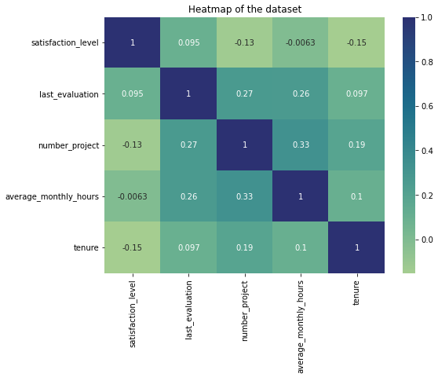
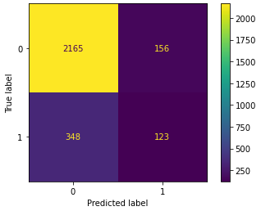
Salifort Motors
Employee Retention Project
Salifort Motors seeks to improve employee retention and answer the following question:
What’s likely to make the employee leave the company?
Since the target variable is categorical, a logistic regression model was selected to predict employee attrition.
Because the outcome variable is categorical, logistic regression was chosen as an appropriate modeling approach for this analysis.
Heatmap above highlights moderate positive correlations between number_project and average_monthly_hours, as well as weaker relationships among last_evaluation, tenure, and workload-related variables.
The model predicts employee attrition and highlights the factors that most strongly influence an employee’s likelihood of leaving, supporting data-driven retention decisions by HR.
In the confusion matrix above, the model correctly predicts the majority of employees who stay, while showing moderate performance in identifying employees who leave, indicating reasonable but improvable classification performance.
Cap the number of projects that employees can work on.
Consider promoting employees who have been with the company for at least four years, or conduct further investigation about why four-year tenured employees are so dissatisfied.
Either reward employees for working longer hours, or don't require them to do so.
If employees aren't familiar with the company's overtime pay policies, inform them about this. If the expectations around workload and time off aren't explicit, make them clear.
Hold company-wide and within-team discussions to understand and address the company work culture, across the board and in specific contexts.
High evaluation scores should not be reserved for employees who work 200+ hours per month. Consider a proportionate scale for rewarding employees who contribute more/put in more effort.

