Slide 1
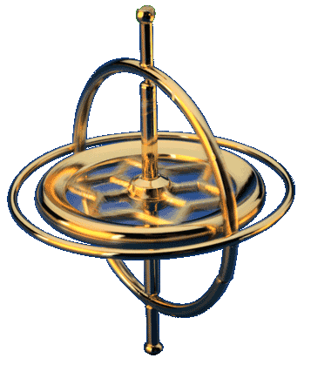

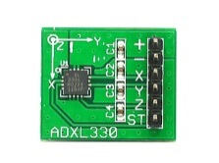
Render
Position
Orientation
Fusion + Correction
Math
Image processing
Math
Math
Accelerometer
Gyroscope

