Slide 1
제목을 입력
Man in the mirror
Who am I to be blind pretending not to see their needs A summer's disregard a broken bottle top and a one man's soul they follow each other on the wind ya know 'cause they got nowhere to go that's why I want you to know I'm starting with the man in the mirror. I'm asking him to change his ways and no message could have been any clearer

Slide 2
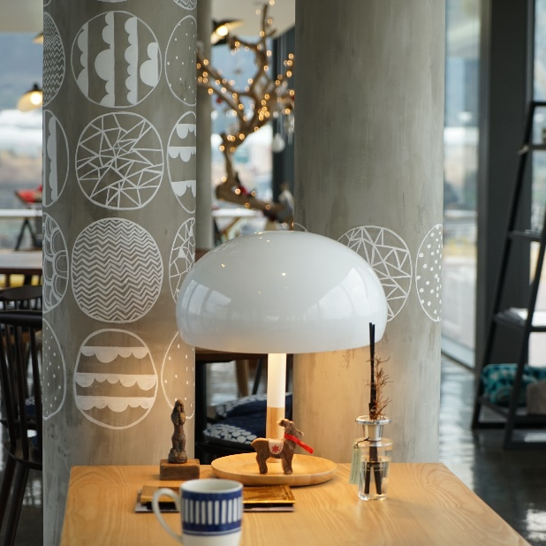
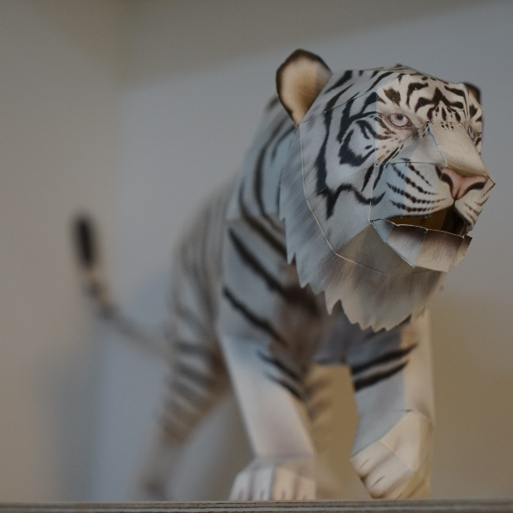
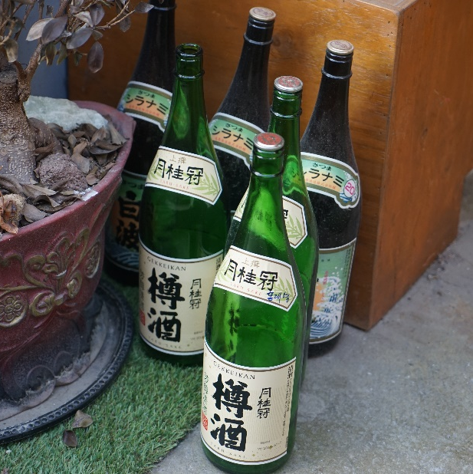
제목을 입력
Picture’s Name
Picture’s Name
Picture’s Name

Slide 3
제목을 입력
Chart type
Chart type
Chart type
Insert your text
Insert your text
Insert your text

Slide 4
제목을 입력
Man in the mirror
Who am I to be blind pretending not to see their needs A summer's disregard a broken bottle top and a one man's soul they follow each other on the wind ya know 'cause they got nowhere to go that's why I want you to know I'm starting with the man in the mirror. I'm asking him to change his ways and no message could have been any clearer

Slide 5
제목을 입력

