Slide 1
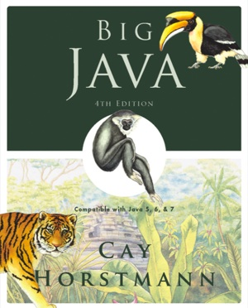
Chapter 5 – Decisions
Big Java by Cay Horstmann
Copyright © 2009 by John Wiley & Sons. All rights reserved.

Slide 2
Chapter Goals
To be able to implement decisions using if statements
To understand how to group statements into blocks
To learn how to compare integers, floating-point numbers, strings, and objects
To recognize the correct ordering of decisions in multiple branches
To program conditions using Boolean operators and variables
To be able to program loops with the while and for statements
To avoid infinite loops and off-by-one errors
To be able to use common loop algorithms
Big Java by Cay Horstmann
Copyright © 2009 by John Wiley & Sons. All rights reserved.

Slide 3
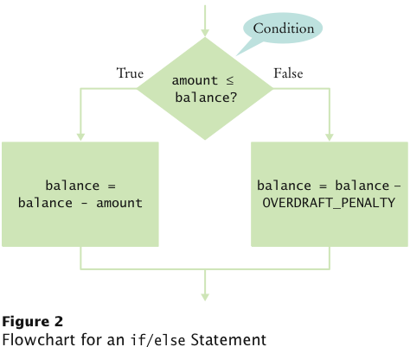
The if/else Statement
if (amount <= balance)
balance = balance – amount;
else
balance = balance – OVERDRAFT_PENALTY
Big Java by Cay Horstmann
Copyright © 2009 by John Wiley & Sons. All rights reserved.

Slide 4
Statement Types
Simple statement:
balance = balance - amount;
Compound statement:
if (balance >= amount) balance = balance - amount;
Block statement:
{
double newBalance = balance - amount;
balance = newBalance;
}
Big Java by Cay Horstmann
Copyright © 2009 by John Wiley & Sons. All rights reserved.

Slide 5
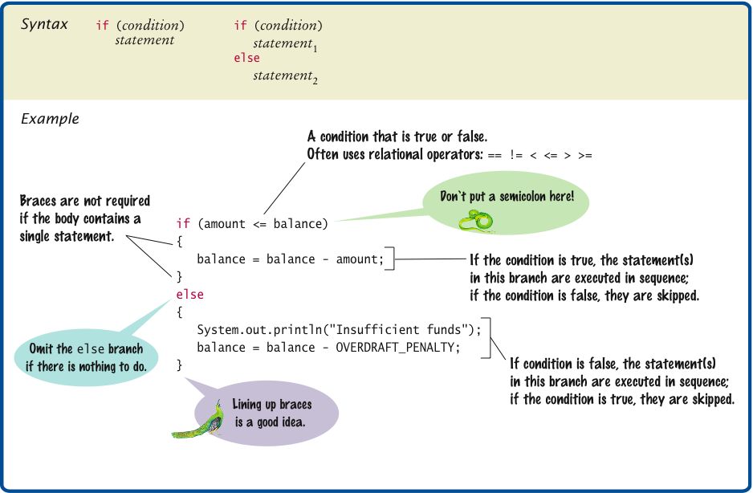
Syntax 5.1 The if Statement
Big Java by Cay Horstmann
Copyright © 2009 by John Wiley & Sons. All rights reserved.

Slide 6
Comparing Values: Relational Operators
Relational operators compare values
Java | Math Notation | Description
> | > | Greater than
>= | ≥ | Greater than or equal
< | < | Less than
<= | ≤ | Less than or equal
== | = | Equal
!= | ≠ | Not equal
Big Java by Cay Horstmann
Copyright © 2009 by John Wiley & Sons. All rights reserved.

Slide 7
Comparing Values: Relational Operators
The == denotes equality testing:
  a = 5; // Assign 5 to a
  if (a == 5) ... // Test whether a equals 5
Relational operators have lower precedence than arithmetic operators:
  amount + fee <= balance
Big Java by Cay Horstmann
Copyright © 2009 by John Wiley & Sons. All rights reserved.

Slide 8
Comparing Floating-Point Numbers
To avoid roundoff errors, don’t use == to compare floating-point numbers
To compare floating-point numbers test whether they are close enough: |x - y| ≤ ε
final double EPSILON = 1E-14;
if (Math.abs(x - y) <= EPSILON)
// x is approximately equal to y
ε is a small number such as 10⁻¹⁴
Big Java by Cay Horstmann
Copyright © 2009 by John Wiley & Sons. All rights reserved.

Slide 9
Comparing Strings
To test whether two strings are equal to each other, use equals method:
  if (string1.equals(string2)) . . .
Don’t use == for strings!
  if (string1 == string2) // Not useful
== tests identity, equals tests equal contents
Case insensitive test:
if (string1.equalsIgnoreCase(string2))
Big Java by Cay Horstmann
Copyright © 2009 by John Wiley & Sons. All rights reserved.

Slide 10
Comparing Strings
string1.compareTo(string2) < 0 means:
  string1 comes before string2 in the dictionary
string1.compareTo(string2) > 0 means:
  string1 comes after string2
string1.compareTo(string2) == 0 means:
  string1 equals string2
"car" comes before "cargo"
All uppercase letters come before lowercase:
  "Hello" comes before "car"
Big Java by Cay Horstmann
Copyright © 2009 by John Wiley & Sons. All rights reserved.

Slide 11
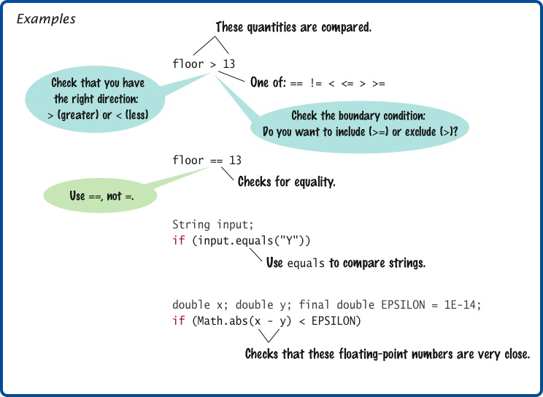
Syntax 5.2 Comparisons
Big Java by Cay Horstmann
Copyright © 2009 by John Wiley & Sons. All rights reserved.

Slide 12
Comparing Objects
== tests for identity, equals for identical content
Rectangle box1 = new Rectangle(5, 10, 20, 30);
Rectangle box2 = box1;
Rectangle box3 = new Rectangle(5, 10, 20, 30);
box1 != box3, but box1.equals(box3)
box1 == box2
Caveat: equals must be defined for the class
Big Java by Cay Horstmann
Copyright © 2009 by John Wiley & Sons. All rights reserved.

Slide 13
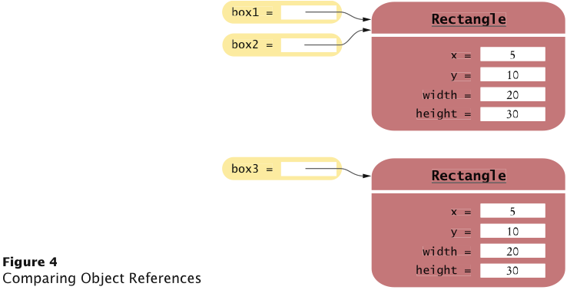
Object Comparison
Big Java by Cay Horstmann
Copyright © 2009 by John Wiley & Sons. All rights reserved.

Slide 14
Testing for null
null reference refers to no object:
String middleInitial = null; // Not set
if ( ... )
middleInitial = middleName.substring(0, 1);
Can be used in tests:
if (middleInitial == null)
System.out.println(firstName + " " + lastName);
else
System.out.println(firstName + " " + middleInitial +
". " + lastName);
Use ==, not equals, to test for null
null is not the same as the empty string ""
Big Java by Cay Horstmann
Copyright © 2009 by John Wiley & Sons. All rights reserved.

Slide 15
Self Check 5.4
Which of the following comparisons are syntactically incorrect? Which of them are syntactically correct, but logically questionable?
String a = "1";
String b = "one";
double x = 1;
double y = 3 * (1.0 / 3);
  a == "1"
  a == null
  a.equals("")
  a == b
  a == x
  x == y
  x - y == null
  x.equals(y)
Answer: Syntactically incorrect: e, g, h. Logically questionable: a, d, f.

Slide 16
Multiple Alternatives: Sequences of Comparisons
if (condition₁)
statement₁;
else if (condition₂)
statement₂;
...
else
statement₄;
The first matching condition is executed
Order matters:
if (richter >= 0) // always passes
r = "Generally not felt by people";
else if (richter >= 3.5) // not tested
r = "Felt by many people, no destruction";
...
Big Java by Cay Horstmann
Copyright © 2009 by John Wiley & Sons. All rights reserved.

Slide 17
Multiple Alternatives: Sequences of Comparisons
Don’t omit else:
if (richter >= 8.0)
r = "Most structures fall";
if (richter >= 7.0) // omitted else--ERROR
r = "Many buildings destroyed";
Big Java by Cay Horstmann
Copyright © 2009 by John Wiley & Sons. All rights reserved.

Slide 18
ch05/quake/Earthquake.java
1 /**
2 A class that describes the effects of an earthquake.
3 */
4 public class Earthquake
5 {
6 private double richter;
7
8 /**
9 Constructs an Earthquake object.
10 @param magnitude the magnitude on the Richter scale
11 */
12 public Earthquake(double magnitude)
13 {
14 richter = magnitude;
15 }
16
Continued
Big Java by Cay Horstmann
Copyright © 2009 by John Wiley & Sons. All rights reserved.

Slide 19
ch05/quake/Earthquake.java (cont.)
17 /**
18 Gets a description of the effect of the earthquake.
19 @return the description of the effect
20 */
21 public String getDescription()
22 {
23 String r;
24 if (richter >= 8.0)
25 r = "Most structures fall";
26 else if (richter >= 7.0)
27 r = "Many buildings destroyed";
28 else if (richter >= 6.0)
29 r = "Many buildings considerably damaged, some collapse";
30 else if (richter >= 4.5)
31 r = "Damage to poorly constructed buildings";
32 else if (richter >= 3.5)
33 r = "Felt by many people, no destruction";
34 else if (richter >= 0)
35 r = "Generally not felt by people";
36 else
37 r = "Negative numbers are not valid";
38 return r;
39 }
40 }
Big Java by Cay Horstmann
Copyright © 2009 by John Wiley & Sons. All rights reserved.

Slide 20
ch05/quake/EarthquakeRunner.java
1 import java.util.Scanner;
2
3 /**
4 This program prints a description of an earthquake of a given magnitude.
5 */
6 public class EarthquakeRunner
7 {
8 public static void main(String[] args)
9 {
10 Scanner in = new Scanner(System.in);
11
12 System.out.print("Enter a magnitude on the Richter scale: ");
13 double magnitude = in.nextDouble();
14 Earthquake quake = new Earthquake(magnitude);
15 System.out.println(quake.getDescription());
16 }
17 }
Program Run:
  Enter a magnitude on the Richter scale: 7.1
  Many buildings destroyed
Big Java by Cay Horstmann
Copyright © 2009 by John Wiley & Sons. All rights reserved.

Slide 21
Multiple Alternatives: Nested Branches
Branch inside another branch:
if (condition₁)
{
if (condition_{1a})
statement_{1a};
else
statement_{1b};
}
else
statement₂;
Big Java by Cay Horstmann
Copyright © 2009 by John Wiley & Sons. All rights reserved.

Slide 22
Tax Schedule
If your filing status is Single |  | If your filing status is Married
Tax Bracket | Percentage | Tax Bracket | Percentage
$0 ... $32,000 | 10% | 0 ... $64,000 | 10%
Amount over $32,000 | 25% | Amount over $64,000 | 25%
Big Java by Cay Horstmann
Copyright © 2009 by John Wiley & Sons. All rights reserved.

Slide 23
Nested Branches
Compute taxes due, given filing status and income figure:
  branch on the filing status
  for each filing status, branch on income level
The two-level decision process is reflected in two levels of if statements
We say that the income test is nested inside the test for filing status
Big Java by Cay Horstmann
Copyright © 2009 by John Wiley & Sons. All rights reserved.

Slide 24
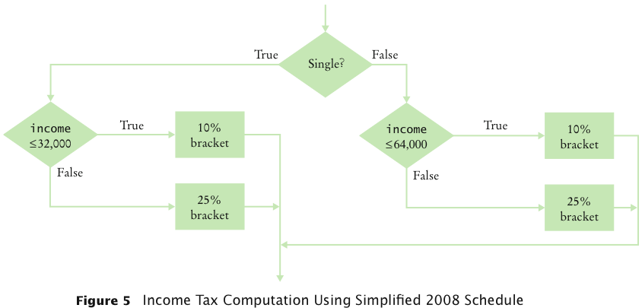
Nested Branches
Big Java by Cay Horstmann
Copyright © 2009 by John Wiley & Sons. All rights reserved.

Slide 25
ch05/tax/TaxReturn.java
1 /**
2 A tax return of a taxpayer in 2008.
3 */
4 public class TaxReturn
5 {
6 public static final int SINGLE = 1;
7 public static final int MARRIED = 2;
8
9 private static final double RATE1 = 0.10;
10 private static final double RATE2 = 0.25;
11 private static final double RATE1_SINGLE_LIMIT = 32000;
12 private static final double RATE1_MARRIED_LIMIT = 64000;
13
14 private double income;
15 private int status;
16
Continued
Big Java by Cay Horstmann
Copyright © 2009 by John Wiley & Sons. All rights reserved.

Slide 26
ch05/tax/TaxReturn.java (cont.)
17 /**
18 Constructs a TaxReturn object for a given income and
19 marital status.
20 @param anIncome the taxpayer income
21 @param aStatus either SINGLE or MARRIED
22 */
23 public TaxReturn(double anIncome, int aStatus)
24 {
25 income = anIncome;
26 status = aStatus;
27 }
28
29 public double getTax()
30 {
31 double tax1 = 0;
32 double tax2 = 0;
33
Continued
Big Java by Cay Horstmann
Copyright © 2009 by John Wiley & Sons. All rights reserved.

Slide 27
ch05/tax/TaxReturn.java (cont.)
34 if (status == SINGLE)
35 {
36 if (income <= RATE1_SINGLE_LIMIT)
37 {
38 tax1 = RATE1 * income;
39 }
40 else
41 {
42 tax1 = RATE1 * RATE1_SINGLE_LIMIT;
43 tax2 = RATE2 * (income - RATE1_SINGLE_LIMIT);
44 }
45 }
46 else
47 {
48 if (income <= RATE1_MARRIED_LIMIT)
49 {
50 tax1 = RATE1 * income;
51 }
52 else
53 {
54 tax1 = RATE1 * RATE1_MARRIED_LIMIT;
55 tax2 = RATE2 * (income - RATE1_MARRIED_LIMIT);
56 }
57 }
58
59 return tax1 + tax2;
60 }
61 }
Big Java by Cay Horstmann
Copyright © 2009 by John Wiley & Sons. All rights reserved.

Slide 28
ch05/tax/TaxCalculator.java
1 import java.util.Scanner;
2
3 /**
4 This program calculates a simple tax return.
5 */
6 public class TaxCalculator
7 {
8 public static void main(String[] args)
9 {
10 Scanner in = new Scanner(System.in);
11
12 System.out.print("Please enter your income: ");
13 double income = in.nextDouble();
14
15 System.out.print("Are you married? (Y/N) ");
16 String input = in.next();
17 int status;
18 if (input.equalsIgnoreCase("Y"))
19 status = TaxReturn.MARRIED;
20 else
21 status = TaxReturn.SINGLE;
22 TaxReturn aTaxReturn = new TaxReturn(income, status);
23
24 System.out.println("Tax: "
25 + aTaxReturn.getTax());
26 }
27 }
Continued
Big Java by Cay Horstmann
Copyright © 2009 by John Wiley & Sons. All rights reserved.

Slide 29
ch05/tax/TaxCalculator.java (cont.)
Program Run:
  Please enter your income: 50000
  Are you married? (Y/N) N
  Tax: 11211.5
Big Java by Cay Horstmann
Copyright © 2009 by John Wiley & Sons. All rights reserved.

Slide 30
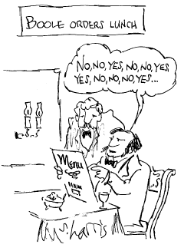
Using Boolean Expressions: The boolean Type
George Boole (1815-1864): pioneer in the study of logic
value of expression amount < 1000 is true or false
boolean type: one of these 2 truth values
Big Java by Cay Horstmann
Copyright © 2009 by John Wiley & Sons. All rights reserved.

Slide 31
Using Boolean Expressions: Predicate Method
A predicate method returns a boolean value:
public boolean isOverdrawn()
{
return balance < 0;
}
Use in conditions:
if (harrysChecking.isOverdrawn())
Useful predicate methods in Character class:
isDigit
isLetter
isUpperCase
isLowerCase
Big Java by Cay Horstmann
Copyright © 2009 by John Wiley & Sons. All rights reserved.

Slide 32
Using Boolean Expressions: Predicate Method
if (Character.isUpperCase(ch)) ...
Useful predicate methods in Scanner class: hasNextInt() and hasNextDouble():
if (in.hasNextInt()) n = in.nextInt();
Big Java by Cay Horstmann
Copyright © 2009 by John Wiley & Sons. All rights reserved.

Slide 33
Using Boolean Expressions: The Boolean Operators
&& and
|| or
! not
if (0 < amount && amount < 1000) . . .
if (input.equals("S") || input.equals("M")) . . .
if (!input.equals("S")) . . .
Big Java by Cay Horstmann
Copyright © 2009 by John Wiley & Sons. All rights reserved.

Slide 34
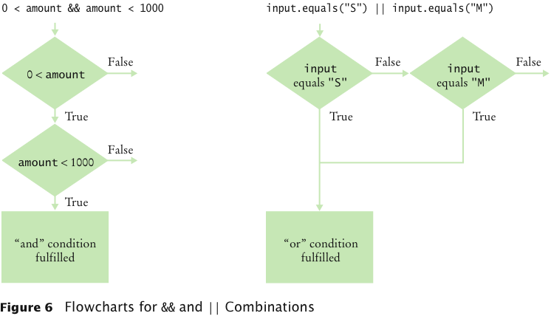
&& and || Operators
Big Java by Cay Horstmann
Copyright © 2009 by John Wiley & Sons. All rights reserved.

Slide 35
Truth Tables
A | B | A && B
true | true | true
true | false | false
false | Any | false
A | B | A || B
true | Any | true
false | true | true
false | false | false
A | !A
true | false
false | true
Big Java by Cay Horstmann
Copyright © 2009 by John Wiley & Sons. All rights reserved.

Slide 36
Using Boolean Variables
private boolean married;
Set to truth value:
married = input.equals("M");
Use in conditions:
if (married) ... else ...
if (!married) ...
Also called flag
It is considered gauche to write a test such as
if (married == true) ... // Don't
Just use the simpler test
if (married) ...
Big Java by Cay Horstmann
Copyright © 2009 by John Wiley & Sons. All rights reserved.

Slide 37
Self Check 5.8
Rewrite the following expression, avoiding the comparison with false:
if (character.isDigit(ch) == false) ...
Answer: if (!Character.isDigit(ch)) ...

Slide 38
while Loops
A while statement executes a block of code repeatedly
A condition controls how often the loop is executed
while (condition)
statement
Most commonly, the statement is a block statement (set of statements delimited by { })
Big Java by Cay Horstmann
Copyright © 2009 by John Wiley & Sons. All rights reserved.

Slide 39
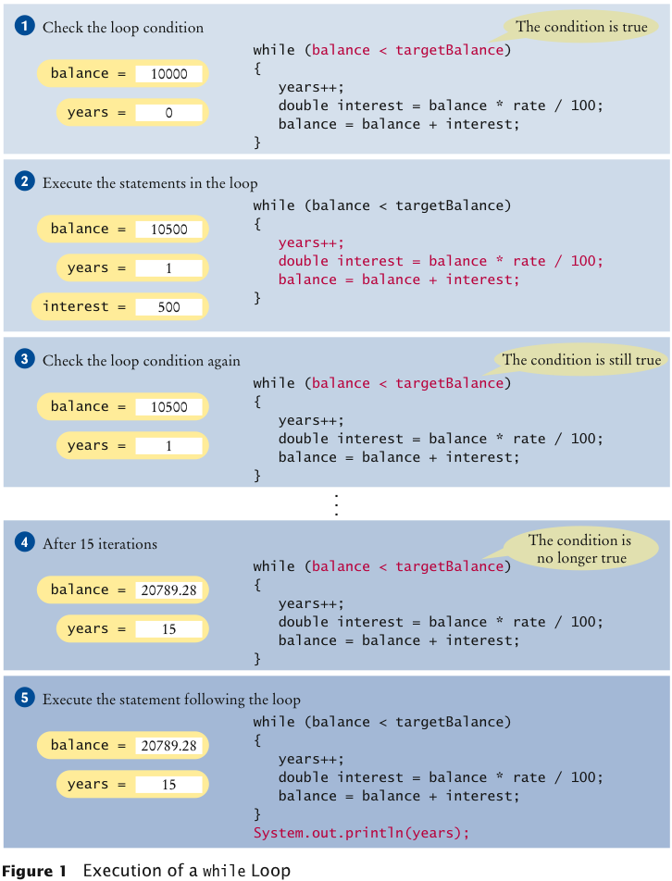
Execution of a while Loop
Big Java by Cay Horstmann
Copyright © 2009 by John Wiley & Sons. All rights reserved.

Slide 40
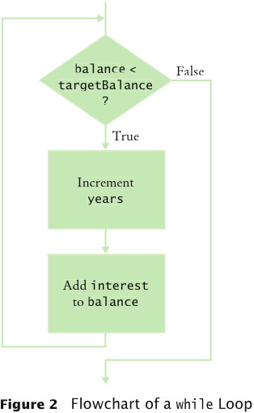
while Loop Flowchart
Big Java by Cay Horstmann
Copyright © 2009 by John Wiley & Sons. All rights reserved.

Slide 41
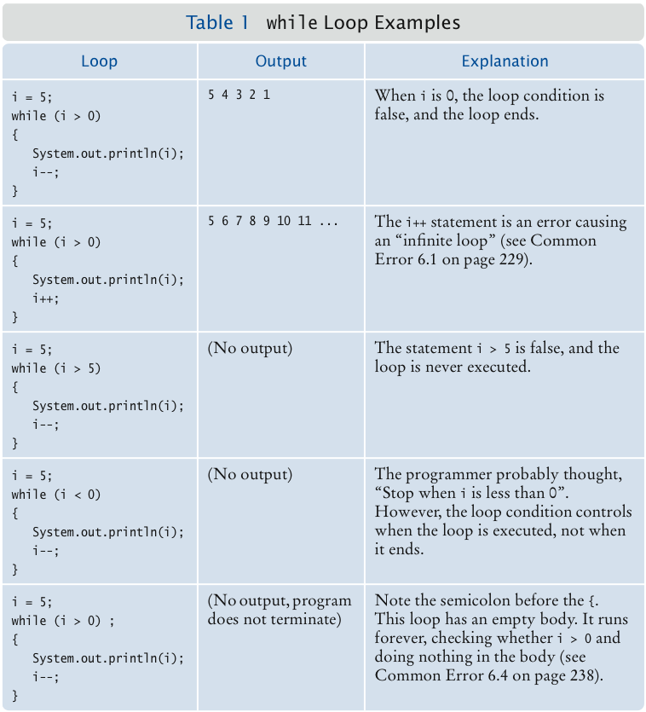
while Loop Examples
Big Java by Cay Horstmann
Copyright © 2009 by John Wiley & Sons. All rights reserved.

Slide 42
Self Check 6.1
How often is the following statement in the loop executed?
  while (false) statement;
Answer: Never.
Big Java by Cay Horstmann
Copyright © 2009 by John Wiley & Sons. All rights reserved.

Slide 43
Common Error: Infinite Loops
Example:
  int years = 0;
  while (years < 20)
  {
  double interest = balance * rate / 100;
  balance = balance + interest;
  }
Loop runs forever — must kill program
Big Java by Cay Horstmann
Copyright © 2009 by John Wiley & Sons. All rights reserved.

Slide 44
Common Error: Infinite Loops
Example:
  int years = 20;
  while (years > 0)
  {
  years++; // Oops, should have been years--
  double interest = balance * rate / 100;
  balance = balance + interest;
  }
Loop runs forever — must kill program
Big Java by Cay Horstmann
Copyright © 2009 by John Wiley & Sons. All rights reserved.

Slide 45
Common Error: Off-by-One Errors
Off-by-one error: a loop executes one too few, or one too many, times
Example:
  int years = 0;
  while (balance < 2 * initialBalance)
  {
  years++;
  double interest = balance * rate / 100;
  balance = balance + interest;
  }
  System.out.println("The investment reached the target after " + years + " years.");
Should years start at 0 or 1?
Should the test be < or <=?
Big Java by Cay Horstmann
Copyright © 2009 by John Wiley & Sons. All rights reserved.

Slide 46
for Loops
Example:
  for (int i = 1; i <= n; i++)
  {
  double interest = balance * rate / 100;
  balance = balance + interest;
  }
Use a for loop when a variable runs from a starting value to an ending value with a constant increment or decrement
Big Java by Cay Horstmann
Copyright © 2009 by John Wiley & Sons. All rights reserved.

Slide 47
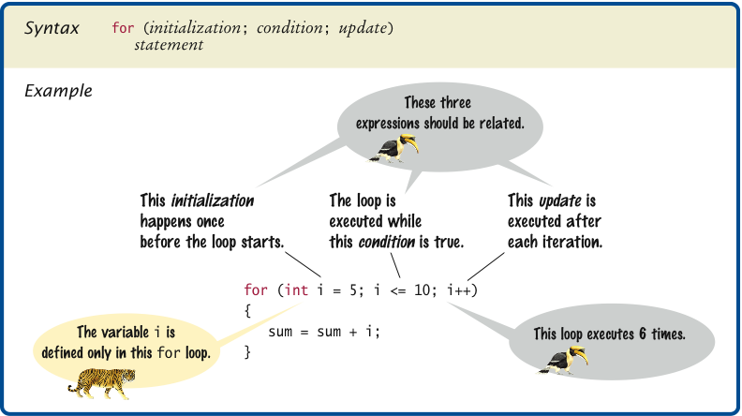
Syntax 6.2 The for Statement
Big Java by Cay Horstmann
Copyright © 2009 by John Wiley & Sons. All rights reserved.

Slide 48
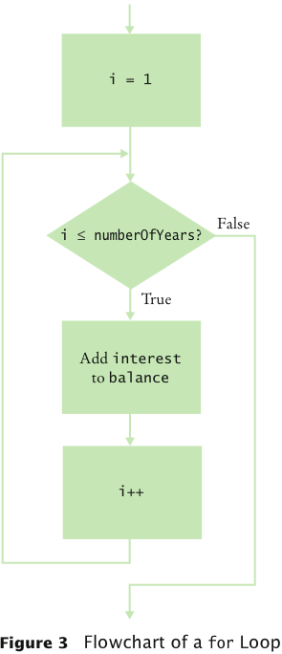
for Loop Flowchart
Big Java by Cay Horstmann
Copyright © 2009 by John Wiley & Sons. All rights reserved.

Slide 49
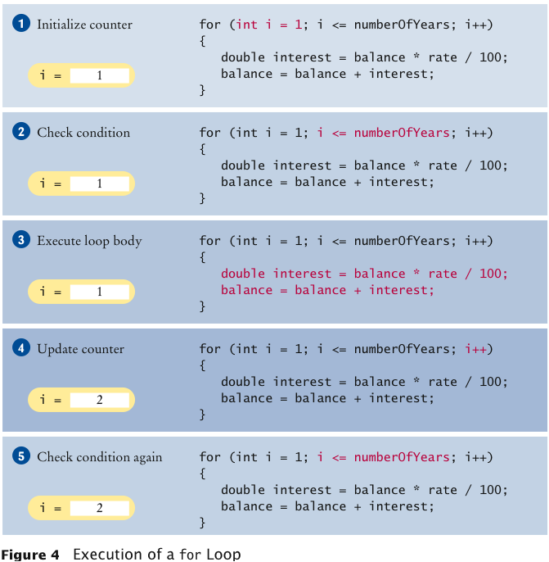
Execution of a for Loop
Big Java by Cay Horstmann
Copyright © 2009 by John Wiley & Sons. All rights reserved.

Slide 50
Self Check 6.3
Rewrite the for loop in the waitYears method as a while loop.
Answer:
  int i = 1;
  while (i <= n)
  {
  double interest = balance * rate / 100;
  balance = balance + interest;
  i++;
  }
Big Java by Cay Horstmann
Copyright © 2009 by John Wiley & Sons. All rights reserved.

Slide 51
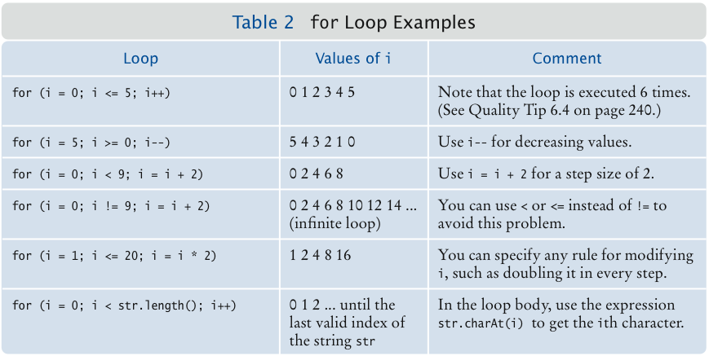
for Loop Examples
Big Java by Cay Horstmann
Copyright © 2009 by John Wiley & Sons. All rights reserved.

Slide 52
Common Errors: Semicolons
A missing semicolon:
  for (years = 1;
  (balance = balance + balance * rate / 100) < targetBalance;
  years++)
  System.out.println(years);
A semicolon that shouldn’t be there:
  sum = 0;
  for (i = 1; i <= 10; i++);
  sum = sum + i;
  System.out.println(sum);
Big Java by Cay Horstmann
Copyright © 2009 by John Wiley & Sons. All rights reserved.

Slide 53
Common Loop Algorithm: Computing a Total
Example — keep a running total: a variable to which you add each input value:
  double total = 0;
  while (in.hasNextDouble())
  {
  double input = in.nextDouble();
  total = total + input;
  }
Big Java by Cay Horstmann
Copyright © 2009 by John Wiley & Sons. All rights reserved.

Slide 54
Common Loop Algorithm: Counting Matches
Example — count how many uppercase letters are in a string:
  int upperCaseLetters = 0;
  for (int i = 0; i < str.length(); i++)
  {
  char ch = str.charAt(i);
  if (Character.isUpperCase(ch))
  {
  upperCaseLetters++;
  }
  }
Big Java by Cay Horstmann
Copyright © 2009 by John Wiley & Sons. All rights reserved.

Slide 55
Common Loop Algorithm: Finding the First Match
Example — find the first lowercase letter in a string:
  boolean found = false;
  char ch = '?';
  int position = 0;
  while (!found && position < str.length())
  {
  ch = str.charAt(position);
  if (Character.isLowerCase(ch)) { found = true; }
  else { position++; }
  }
Big Java by Cay Horstmann
Copyright © 2009 by John Wiley & Sons. All rights reserved.

Slide 56
Common Loop Algorithm: Prompting Until a Match is Found
Example — Keep asking the user to enter a positive value < 100 until the user provides a correct input:
  boolean valid = false;
  double input;
  while (!valid)
  {
  System.out.print("Please enter a positive value < 100: ");
  input = in.nextDouble();
  if (0 < input && input < 100) { valid = true; }
  else { System.out.println("Invalid input."); }
  }
Big Java by Cay Horstmann
Copyright © 2009 by John Wiley & Sons. All rights reserved.

Slide 57
Common Loop Algorithm: Comparing Adjacent Values
Example — check whether a sequence of inputs contains adjacent duplicates such as 1 7 2 9 9 4 9:
  double input = in.nextDouble();
  while (in.hasNextDouble())
  {
  double previous = input;
  input = in.nextDouble();
  if (input == previous) { System.out.println("Duplicate input"); }
  }
Big Java by Cay Horstmann
Copyright © 2009 by John Wiley & Sons. All rights reserved.

Slide 58
Loop and a Half
Sometimes termination condition of a loop can only be evaluated in the middle of the loop
Then, introduce a boolean variable to control the loop:
  boolean done = false;
  while (!done)
  {
  Print prompt
  String input = read input;
  if (end of input indicated)
  done = true;
  else
  {
  Process input
  }
  }
Big Java by Cay Horstmann
Copyright © 2009 by John Wiley & Sons. All rights reserved.

Slide 59
ch06/dataset/DataAnalyzer.java
1 import java.util.Scanner;
2
3 /**
4 This program computes the average and maximum of a set
5 of input values.
6 */
7 public class DataAnalyzer
8 {
9 public static void main(String[] args)
10 {
11 Scanner in = new Scanner(System.in);
12 DataSet data = new DataSet();
13
14 boolean done = false;
15 while (!done)
16 {
17 System.out.print("Enter value, Q to quit: ");
18 String input = in.next();
19 if (input.equalsIgnoreCase("Q"))
20 done = true;
21 else
22 {
23 double x = Double.parseDouble(input);
24 data.add(x);
25 }
26 }
27
Continued
Big Java by Cay Horstmann
Copyright © 2009 by John Wiley & Sons. All rights reserved.

Slide 60
ch06/dataset/DataAnalyzer.java (cont.)
28 System.out.println("Average = " + data.getAverage());
29 System.out.println("Maximum = " + data.getMaximum());
30 }
31 }
Big Java by Cay Horstmann
Copyright © 2009 by John Wiley & Sons. All rights reserved.

Slide 61
ch06/dataset/DataSet.java
1 /**
2 Computes information about a set of data values.
3 */
4 public class DataSet
5 {
6 private double sum;
7 private double maximum;
8 private int count;
9
10 /**
11 Constructs an empty data set.
12 */
13 public DataSet()
14 {
15 sum = 0;
16 count = 0;
17 maximum = 0;
18 }
19
Continued
Big Java by Cay Horstmann
Copyright © 2009 by John Wiley & Sons. All rights reserved.

Slide 62
ch06/dataset/DataSet.java (cont.)
20 /**
21 Adds a data value to the data set
22 @param x a data value
23 */
24 public void add(double x)
25 {
26 sum = sum + x;
27 if (count == 0 || maximum < x) maximum = x;
28 count++;
29 }
30
31 /**
32 Gets the average of the added data.
33 @return the average or 0 if no data has been added
34 */
35 public double getAverage()
36 {
37 if (count == 0) return 0;
38 else return sum / count;
39 }
40
Continued
Big Java by Cay Horstmann
Copyright © 2009 by John Wiley & Sons. All rights reserved.

Slide 63
ch06/dataset/DataSet.java (cont.)
41 /**
42 Gets the largest of the added data.
43 @return the maximum or 0 if no data has been added
44 */
45 public double getMaximum()
46 {
47 return maximum;
48 }
49 }
Program Run:
  Enter value, Q to quit: 10
  Enter value, Q to quit: 0
  Enter value, Q to quit: -1
  Enter value, Q to quit: Q
  Average = 3.0
  Maximum = 10.0
Big Java by Cay Horstmann
Copyright © 2009 by John Wiley & Sons. All rights reserved.

