Slide 1
Arrays
(Chapter 2)

Slide 2
Abstract Data Types and the C++ Classes
An explicit mechanism to support the distinction between specification and implementation
The C++ class consists of:
  (1) A class name: (e.g., Rectangle)
  (2) Data members: data (e.g., xLow, yLow, height, width)
  (3) Member functions: operations (e.g., GetHeight(), GetWidth())
  (4) Levels of program access: members and member functions
    public: can be accessed anywhere
    private: within its class, friend classes and functions
    protected: within its class, subclasses, and firends

Slide 3
Data Abstraction and Encapsulation in C++
Data members declared as private or protected
  Data encapsulation; information hiding
Member functions
  Access the data members.
  public member functions: invoked externally
  private and protected: accessed through public member functions
  Member function definition
    Can be separated from the class definition; implementation independent (see Programs 2.1 and 2.2, pp. 75-76)
  Member functions defined inside the class definition
    Processed as inline functions

Slide 4
Declaring Class Objects and Invoking Member Functions
Class objects: declared and created as variables in C
Access or invocation of the members of an object
  Dot operator (.): direct component selection
  Arrow operator (->): indirect selection through a pointer
// In a source file main.cpp
#include <iostream>
#include "Rectangle.h“
main() {
Rectangle r, s; // r and s are objects of class Rectangle
Rectangle *t = &s; // t is a pointer to class object s
.
.
// use . to access members of the class objects.
// use → to access members of class object through pointers.
if (r.GetHeight()*r.GetWidth() > tGetHeight() * tGetWidth())
cout << " r ";
else cout << " s ";
cout << "has the greater area" << endl;
}

Slide 5
Constructors (1/2)
Special member functions of a class
Constructors
  Initialize the data members of an object
  Automatically executed when an object is created
  Declared as a public function of the class
  The name of a constructor must be identical to the name of the corresponding class
Rectangle::Rectangle(int x, int y, int h, int w)
{
xLow = x; yLow = y;
height = h; width = w;
}

Slide 6
Constructors (2/2)
Initialization using a constructor function
Sophisticated definition of a constructor
  Also serves as a default constructor
  An efficient way
Rectangle r(1,3,6,6);
Rectangle *s = new Rectangle(0,0,3,4);
Rectangle t; // compile time error  default constructor
Rectangle::Rectangle (int x = 0, int y = 0, int h = 0, int w = 0)
: xLow(x), yLow(y), height(h), width(w)
{ }

Slide 7
Destructors
Destructors
  Automatically invoked when a class object goes out of scope or is deleted
  Must be declared as public
  Identical to the class name with a tilde (~) attached
  No return value; no arguments
  If a data member is a pointer to some other object,
    The space allocated to the pointer is returned.
    The designated object itself is not returned.
    → A destructor which explicitly frees the allocated memory space should be defined.

Slide 8
Operator Overloading (1/3)
An operator for specific data type could be implemented in C++.
  Operator overloading for used-defined data types
  Form of a class member function or an ordinary function
  The function prototype must adhere to the specifications for the particular operator.
  (e.g.) operator ==
    Check for equality between two int’s
    Check for equality between two float’s
    Check for equality between two Rectangle’s
      Operator overloading
      The same object
      The same location and size

Slide 9
Operator Overloading (2/3)
Overloading of operator == for class Rectangle
this: represents a pointer to the particular class that invoked it.
*this: class object itself
Comparing procedure
  If two operands are the same object, then true (this == &s);
  Else if each corresponding data member has the same value, then true;
  Else false.
bool Rectangle::operator==(const Rectangle & s ){
if (this == &s) return true;
if ((xLow == s.xLow) && (yLow == s.yLow)
&& (height == s.height) && (width==s.width) return true;
else return false;
}

Slide 10
Operator Overloading (3/3)
Overloading of operator << for class Rectangle
Accesses the private members of Rectangle
  Must be a friend function of the class (if defined as a global function)
Output of cout << r
  Position is: 1 3
  Height is: 6
  Width is: 6
ostream& operator << (ostream& os, Rectangle& r)
{
os << "Position is: “ << r.xLow << " ";
os << r.yLow < endl;
os << "Height is: “ << r.height << endl;
os << "Width is: "r.width << endl;
return os;
}

Slide 11
Miscellaneous Topics
struct in C++
  Default level of access: public
  (cf. private in class)
  Generalization of the struct in C
  (Member functions could also be defined.)
union
  Reserves storage for the largest data member
  An efficient way of using memory
static class data member
  Global variable for a class: only one copy resides.
  Shared among all the class objects
  Should be defined outside the class definition

Slide 12
ADTs and C++ Classes
One significant difference between ADTs and C++ classes
  Some operators in C++ do not exist as member functions of the class
  →In general, they are declared as normal C++ functions outside the class
  (should be friends of the corresponding class)

Slide 13
The Array as an Abstract Data Type
A consecutive set of memory locations: implementation-oriented
A set of pairs <index, value>
    index -> value: correspondence or mapping
    the same data type
C++ arrays
  The index starts at 0
  C++ does not check an array index.
  e.g., float floatArray[n];
  the ith element: floatArray[i] , *(floatArray+i)
Abstract data type GeneralArray (see ADT 2.2, p. 85)
  GeneralArray(int j, RangeList list, float initValue=defaultValue)
  Retrieve(index)
  Store(index, item)

Slide 14
The Polynomial Abstract Data Type
Ordered (or linear) lists
  examples
    Days of the week: (Sun, Mon, Tue, Wed, …, Sat)
    Values in a deck of cards: (Ace, 2, 3, 4, 5, 6, 7, 8, 9, 10, Jack, Queen, King)
    Floors of a building: (basement, lobby, mezzanine, first, second)
    Years the US fought in WW II: (1941, 1942, 1943, 1944, 1945)
    Years Switzerland fought in WW II: ()
  List: (a₀, a₁, ... , a_{n-1})
  Empty list : ()

Slide 15
Ordered (Linear) Lists
  Operations on lists
    Find length, n, of the list
    Read the list from left (right) to right (left)
    Retrieve the ith element, 0 ≤ i < n
    Store a new value into the ith position, 0 ≤ i < n
    Insert a new element at the position i, 0 ≤ i < n
    Delete the element at position i, 0 ≤ i < n
  Ordered list implementation
    Utilizing arrays
    Index i → a_{i}, 0 ≤ i < n
    ... i, i+1, ...
    ... a_{i}, a_{i+1}, ...
    Sequential mapping
    Drawbacks: overhead incurred for operations 5 ans 6

Slide 16
Polynomials
a(x)=3x²+2x-4, b(x)=x⁸-10x⁵-3x³+1
  Coefficients: 3, 2, -4
  Exponents: 2, 1, 0
  Variables: x
Degree: the largest exponent from the nonzero terms
Sum and product of polynomials
  a(x) + b(x) = ∑(a_{i} + b_{i})x^{i}
  a(x) · b(x) = ∑(a_{i}x^{i} · ∑(b_{j}x^{j}))

Slide 17
Polynomial Representation
Arrange the terms in decreasing order of exponent
Representation 1: define the private data members of Polynomial
  a(x) would be represented as (n ≤ MaxDegree),
  a.coef[i] is the coefficient of x^{n-i}의 each coefficient is stored in order of decreasing exponents.
  Many operations for polynomials become simple.
private:
int degree; //degree ≤ MaxDegree
float coef [MaxDegree + 1]; // coefficient array
a.degree = n
a.coef[i] = an-i, 0 ≤ i ≤ n

Slide 18
Polynomial Representation
Representation 2:
  The constructor for polynomials
  Inefficient use of memory when the polynomials are sparse (i.e., contain many zero terms)
  e.g., x¹⁰⁰⁰+1
  → 999 entries in coef are zero.
  → Representation 3
private:
int degree;
float *coef;
Polynomial::Polynomial(int d){
degree=d;
coef=new float[degree+1];
}

Slide 19
Polynomial Representation
Representation 3:
The private data members of Polynomial
class Polynomial; // forward declaration
class Term{
friend Polynomial;
private:
float coef; // coefficient
int exp; // exponent };
private:
Term *termArray; // array of nonzero terms
int capacity; // size of termArray
int terms; // number of nonzero terms

Slide 20
Polynomial Addition
A C++ function for c=a+b
Function Add (Program 2.8, p. 91): adds a(x) (*this) and b(x) term by term to produce c(x)
  Assume that the default constructor for Polynomial initializes capacity and terms to 1 and 0, respectively, and termArray to an array with 1 position
The basic loop consists of merging the terms of the two polynomials, depending on the exponent comparison result.

Slide 21
void Polynomial::NewTerm(const float the Coeff, const int theExp)
// Add a new term to the end of termArray
if (terms==capacity)
{// double capacity of termArray
capacity *= 2;
term *temp = new term [capacity]; // new array
copy(termArray, termArray + terms, temp);
delete [ ] termArray; // deallocate old memory
termArray = temp; }
termArray[terms].coef = theCoef;
termArray[terms++].exp = theExp;}
Analysis of Add :
  In terms of number of nonzero terms in a and b
  Total run time: O(m+n)
  Array doubling contributes at most a constant multiplicative factor to the run time.

Slide 22
An Alternative Polynomial Representation
Representation of two polynomials A(x)=2x¹⁰⁰⁰+1, B(x)=x⁴+10x³+3x²+1
Any polynomial a with n nonzero terms has a.start and a.finish s.t. a.finish = a.start + n – 1.
  If a has no nonzero terms,
    a.finish = a.start – 1.
a.start
a.finish
b.start
b.finish
free
coef
2
1
1
10
3
1
exp
1000
0
4
3
2
0
0
1
2
3
4
5
6

Slide 23
Sparse Matrices
a[m][n]
  m × n matrix a
    m: the number of rows
    n: the number of columns
    m × n: the number of elements
  Sparse matrix (ADT 2.4, p. 97)
    the number of nonzero elements / the total number of elements << small
    → reduce both the space and time requirements by storing only the nonzero elements
  Matrix operations
    Creation
    Transpose
    Addition
    Multiplication

Slide 24
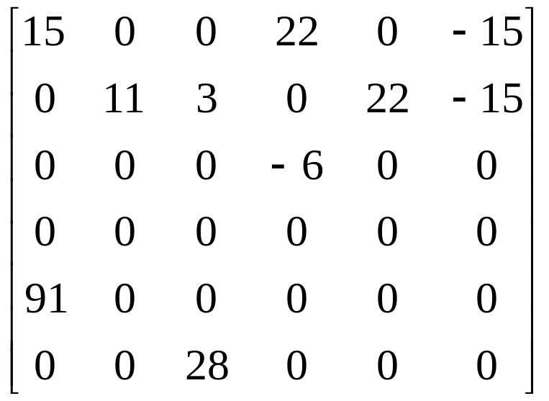
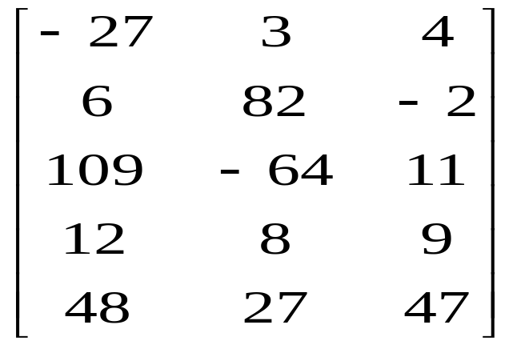
Two Matrices
0
1
2
3
4
5
0
1
2
0
0
1
1
2
2
3
3
4
4
5
(a)
(b)

Slide 25
Sparse Matrix Representation (1/2)
Representation
  An element is uniquely recognizable by the triple <row, col, value>.
  These triples are stored row by row.
  Column indices are in increasing order.
  We must know the numbers of rows and columns as well as the number of nonzero elements in the matrix.
C++ representation
class SparseMatrix; // forward declaration
class MatrixTerm {
friend class SparseMatrix
private:
int row, col, value;
};

Slide 26
Sparse Matrix Representation (2/2)
In class SparseMatrix
  rows: the number of rows
  cols: the number of columns
  terms: the number of nonzero terms
  capacity: the size of smArray
private:
int rows, cols, terms, capacity;
MatrixTerm *smArray;

Slide 27
Sparse Matrix and Its Transpose Stored as Triples
row
col
value
row
col
value
smArray
[0]
0
0
15
smArray
[0]
0
0
15
[1]
0
3
22
[1]
0
4
91
[2]
0
5
-15
[2]
1
1
11
[3]
1
1
11
[3]
2
1
3
[4]
1
2
3
[4]
2
5
28
[5]
2
3
-6
[5]
3
0
22
[6]
4
0
91
[6]
3
2
-6
[7]
5
2
28
[7]
5
0
-15
(a)
(b)

Slide 28
Matrix Transposition (1/3)
The triple (i, j, value) in the original matrix should be positioned as (j, i, value) in its transposed version.
  e.g.,
  (0, 0, 15)  (0, 0, 15)
  (0, 3, 22)  (3, 0, 22)
  (0, 5, -15)  (5, 0, -15)
  (1, 1, 11)  (1, 1, 11)
  We do not know where to put (j, i, value) until all other elements that precede it have been processed.
Algorithm
  for (all elements in column j)
  store (i, j, value) of the original matrix as (j, i, value) of the transpose

Slide 29
Matrix Transposition (2/3)
Analysis of Transpose
  Total running time: O(terms • cols)
  In addition to the space for *this and b, this function requires only a constant amount of space, i.e., space for c, i, currentB.
Using simple two dimensional arrays
  An algorithm with O(rows⋅cols) time complexity is available as follows.
for (int j = 0; j < columns; j++)
for (int i = 0; i < rows; i++)
b[j][i] = a[i][j];

Slide 30
Matrix Transposition (3/3)
A faster version with a little more space: FastTranspose
  Determine the number of elements in each column of *this
  Determine the number of elements in each row of b
  The starting point in b of each of its row is easily obtained
  Move the elements of *this one by one into the corresponding positions in b
    ROW_SIZE ROW_START
    [0] 3 0
    [1] 2 3
    [2] 1 5
    [3] 0 6
    [4] 1 6
    [5] 1 7
    ↑ ↑
    # of terms starting position
    in b's row (a's col) of b's row
  Time complexity: O(cols+terms)

Slide 31
Matrix Multiplication (1/2)
a(m × n) × b(n × p)
the product matric d(m × p)
Multiplication of two sparse matrices represented as ordered lists
  Compute the elements of d by rows
  Pick a row of a and find all elements in column j of b
  Transpose b
  Once the elements of row i of a and column j of b have located, just do a merge operation
n
−
1
d
=
∑
a
b
0
≤
i
<
m
,
0
≤
j
<
p
ij
ik
kj
k
=
0
⎡
1
0
0
⎤
⎡
1
1
1
⎤
⎡
1
1
1
⎤
⎢
⎥
⎢
⎥
=
⎢
⎥
⎢
1
0
0
⎥
⎢
0
0
0
⎥
⎢
1
1
1
⎥
⎢
1
0
0
⎥
⎢
0
0
0
⎥
⎢
1
1
1
⎥
⎣
⎦
⎣
⎦
⎣
⎦

Slide 32
Matrix Multiplication (2/2)
Analysis of Multiply (Program 2.14, pp. 104-106)
  Time for the while loop (lines 20-52): O(b.cols•t_{r}+b.terms))
  Total time complexity:
The classical multiplication algorithm
for (int i = 0; i < a.rows; i++)
for (int j = 0; j < b.cols; j++)
{
sum = 0;
for (int k = 0; k < A.Cols; k++)
sum += (a[i][k] * b[k][j]);
c[i][j] = sum;
}

Slide 33
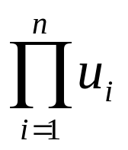
Array Representation (1/4)
For an array a[u₁][u₂], ….., [u_{n}]
The number of elements in a:
Representation order: row major order, column major order
  Row major order for a[2][3][2][2]
    Total number of elements: 2*3*2*2=24
    Storing order:
    a[0][0][0][0], a[0][0][0][1], a[0][0][1][0], a[0][0][1][1]
    a[0][1][0][0], a[0][1][0][1], a[0][1][1][0], a[0][1][1][1]
    ……
    a[1][2][0][0], a[1][2][0][1], a[1][2][1][0], a[1][2][1][1]
    Hence, 0000, 0001, …, 1210, 1211
    → lexicographic order

Slide 34
Array Representation (2/4)
Translation from a[i₁][i₂],…,[i_{n}] to the correct location in the one-dimensional array
  e.g., a[0][0][0][0] ⇒ location 0
  a[0][0][0][1] ⇒ location 1
  a[1][2][1][1] ⇒ location 23
One-dimensional array a[u₁]
  α: address of a[0]
  Address of a[i]: α +i
array element
a[0]
a[1]
...
a[i]
...
a[u₁-1]
address
α
α+1
...
α+i
...
α+u₁-1

Slide 35
Array Representation (3/4)
2-dimensional array
  α: address of a[0][0]
  Address of a[i][0] : α + i*u₂
  Address of a[i][j] : α + i*u₂ + j
col0
col1
col u₂-l
row 0
x x … x
x x … x
x x … x
x x … x
u₂
element
u₂
element
row 1
row 2
...
...
row 0
row 1
row i
row u_{i}-1
row u₁ -1
i*u₂ element
(a)
(b)

Slide 36
Array Representation (4/4)
3-dimensional array
  α: address of A[0][0][0]
  Address of A[i][0][0]: α + i
  Address of A[i][j][k]: α + iu₂u₃ + ju₃ + k
u
u
2
1
u
3

Slide 37
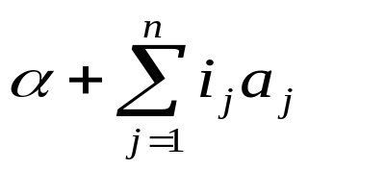
Representation of Multidimensional Arrays
i u₂u₃ elements
n-dimensional array a[u₁][u₂]…,[u_{n}]
  α: address of A[0][0],…,[0]
  Address of a[i₁][i₂][0],…,[0]: α + i₁u₂u₃ …u_{n}
  Address of a[i₁][i₂][0],…,[0]: α + i₁u₂u₃ … u_{n}+ u₃ + i₂u₂u₃ … u_{n}
  Address of a[i₁][i₂],…,[i_{n}]
...
...
A(0,u₂,u₃)
A(1,u₂,u₃)
A(1,u₂,u₃)
A(u₁-1,u₂,u₃)
n
a
=
∏
u
,
1
≤
j
<
n
where
j
k
k
=
j
+
1
a
=
1
n

Slide 38
The String Abstract Data Type
String: S = s₀, ..., s_{n-1},
  s_{i}: characters from the character set
  n = 0: null (empty) string
Operations
  Creating a new empty string, reading a string or printing it out
  String concatenation, copying a string
  Comparing strings, inserting a substring into a string
  Removing a substring from a string
  Finding a pattern in a string

Slide 39
String Pattern Matching: A Simple Algorithm
Function Find
  pat is a pattern to be searched for in s
  s.Find(pat)
    returns an index i s.t. pat matches the substring of s that begins at position i
    returns -1 if and only if pat is either empty or not a substring of s
  lengthP: the length of pat
  lengthS: the length of s
  Positions of s to the right of position lengthS – lengthP need not be considered, as there are not enough characters.
  Complexity: O(lengthPlengthS)

Slide 40
String Pattern Matching: The KMP algorithm
Given pattern:
  e.g., pat = 'a b c a b c a c a b’
String: s = s_{o} s₁ … s_{m-1}
Comparison procedure
  s = - a b ? ? ? . . . . ?
  pat = a b c a b c a c a b
  → compare the first character in pat with s_{i+2}
  s = - a b c a ? ? . . . ?
  pat = a b c a b c a c a b
  → compare s_{i+4} and the second character in p₁, i.e., b

Slide 41
String Pattern Matching: The KMP algorithm
failure function
  largest k < j s.t. p₀…p_{k} = p_{j-k} … p_{j} if such a k ≥ 0 exists
  f(j) =
  -1 otherwise.
For instance, pat = abcabcacab
  j 0 1 2 3 4 5 6 7 8 9
  pat a b c a b c a c a b
  f -1 -1 -1 0 1 2 3 -1 0 -1
Computing time of FastFind: O(lengthS)

Slide 42
Pattern Matching with Failure Functions
int String::FastFind(String pat)
{ // Determine if pat is a substring of s.
int posP = 0, posS = 0;
int LengthP = pat.Length(), LengthS = Length();
while ((posP<lengthP) && (posS<lengthS))
if (pat.str[PosP] = str[PosS]) { // character match
posP++; posS++;
}else
if (posP == 0)
posS++;
else posP = pat.f[posP-1] + 1;
if (posP<lengthP) return -1;
else return posS-lengthP;
}

