Slide 1
Basic Concepts
(Chapter 1)

Slide 2
Objectives
This course introduces the C++ programming, data structures, and their applications.
The purpose of this class is to develop problem solving skills, recognizing the benefits and liabilities of standard algorithms and data structures with respect to the efficient use of processing time and memory.

Slide 3
Why This Course Is Important?
There can be a large difference between solving a problem, and solving a problem efficiently.

Slide 4
Program
A set of instructions to be executed in a computer in order to solve some problem
A computer is a general-purpose device.
A program transforms a computer into a special purpose devices
  web browser, word processor, email, …..
A computer without programs is useless!
cf. Algorithm

Slide 5
Data Structures
How we organize data in a program
Fundamentals of computer science/engineering
Example
  Student registration databases:
  store & retrieve information
Why Data Structures?
  Efficient
  Correct

Slide 6
All data in the computer is represented as binary digits. However these bits may represent many different types of data, e.g., char and int.
Computer processors can directly manipulate basic data types such as integers and characters (primitives), but programs generally require more complex data types, e.g., strings and tables, which are organized for some logical processing task.
Data structures are defined and manipulated by systems and application software, and include strings, arrays, and file structures.

Slide 7
Virtually all data structures make use of pointers, particularly dynamic structures such as linked lists, to maintain things like the end of the list.
A pointer is a memory cell containing the address of some piece of data or structures. Programming languages such as C and C++ allow the declaration and manipulation of pointers.

Slide 8
Operating system will generally provide support for some data structures such as records.
Range of data types available depends on the operations the processor can perform, and the data types supported by the language used to write software program. The data type defines the set of possible operations.
Data structures are LOGICAL. They may be mapped to physical storage in a variety of ways.

Slide 9
Primitive Data
Structures
Simple Data
Structures
Compound Data
Structures
File
Organizations
Integer
Boolean
Character
Strings
Arrays
Records
Stacks
Queues
Lists
Sequential
Relative
Indexed
Trees
Graphs

Slide 10
System Life Cycle
Requirements
Analysis
Design
Coding
Verification

Slide 11
Requirements
Input
  the information that we are given
Output
  the results that we must produce

Slide 12
Analysis
Break the problem down into manageable pieces.
Bottom-up
  places an early emphasis on the coding fine points
  older and unstructured strategy
Top-down
  begins with the purpose that the program will serve and uses this end product to divide the program into manageable segments

Slide 13
Design
The designer approaches the system from the perspectives of
data objects that the program needs
  leads to the creation of abstract data types
operations performed on the data objects
  requires the specification of algorithms and a consideration of algorithm design strategies

Slide 14
Example of Design
Design a scheduling system for a university
  data objects: students, courses, professors
  operations
    add a course to the list of university courses
    search for the courses taught by some professors

Slide 15
Refinement and Coding
Choose representations for the data objects and write algorithms for each operation
The order is crucial
  A data object’s representation can determine the efficiency of the algorithms related to it.

Slide 16
Verification
Correctness proofs
  selecting algorithms that have been proven correct can reduce the number of errors
  what is the correctness?
Testing
  error-free program
  requires working code and sets of test data
Error removal
  The ease of error removal depends on the design and coding decisions
  well-documented and modularized programming

Slide 17
Object-Oriented Design
Algorithmic decomposition vs. object-oriented decomposition
  Process vs. object
Object-oriented programming
  Objects are the fundamental building blocks.
  Each object is an instance of some type (class).
  Classes are related to each other by inheritance relationships.

Slide 18
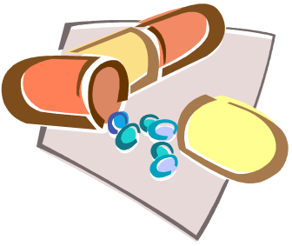
Data Abstraction and Encapsulation
Data encapsulation
  Information hiding; concealing of the implementation details of a data object
Data abstraction
  Separation between the specification of a data object and its implementation

Slide 19
Data Type
Data Type
  a collection of objects and a set of operations that act on those objects
char, int, float, double

Slide 20
Abstract Data Type (ADT)
Data type is organized in such a way that the specification of the objects and operations on them is separated from the implementation.
The specification consists of the names of every function, the type of its arguments, the type of its result, and a description of what the function does.
An implementation of an ADT is a translation into the statements of a programming language.
An implementation chooses a data structure to represent ADT.
A data structure is built up from the basic data types in the underlying PL.
see ADT 1.1 (p. 10)

Slide 21
Basics of C++
C and C++ have a lot of common features.
C++ has a number of features not associated with either data abstraction or inheritance that improve on C.
See http://www.cplusplus.com/doc/tutorial/ or http://tc.pukyung.co.kr/index.htm.

Slide 22

Program Organization in C++
  // my first program in C++
  #include <iostream>
  using namespace std;
  int main ()
  {
  cout << "Hello World!";
  return 0;
  }

Slide 23
Scopes in C++
File Scope
Namespace Scope
Local Scope
Class Scope
See scopes of the C language

Slide 24
Basic Input/Output
  cout << "Hello, " << "I am " << "a C++ statement";
  cout << "Hello, I am " << age << " years old and my zipcode is " << zipcode;
  cin >> a >> b;

Slide 25
Exceptions
Handles exceptions such as a runtime error
  // exceptions
  #include <iostream>
  using namespace std;
  int main ()
  {
  try { throw 20; }
  catch (int e) { cout << "An exception occurred. Exception Nr. " << e << endl; }
  return 0;
  }

Slide 26
Algorithms
A lot of algorithms for solving a given problem
  Sorting arrays
    Bubble sort
    Selection sort
    Insertion sort
    Quick sort
    etc.
Which one to choose for solving problems?
  According to many factors
    Hardware/software/datasets

Slide 27
Algorithm Specification
Definition: An algorithm is a finite set of instructions, that, if followed, accomplishes a particular task. In addition, all algorithms must satisfy the following criteria:
Input
Output
Definiteness
Finiteness
Effectiveness

Slide 28
Input : It has zero or more input parameters.
Output : It produces at least one output parameter.
Definiteness : Each instruction must be clear and unambiguous.
Finiteness : For every input, it executes only a finite number of instructions.
Effectiveness : Every instruction must be sufficiently basic so that a person can execute the instruction using pencil and paper (must be feasible).

Slide 29
(Ex) Selection Sort
Sorts a set of n ≥ 1 integers
  From those integers that are currently unsorted, find the smallest and place it next in the sorted list

Slide 30
  for (int i=0; i < n; i++) {
    Examine list[i] to list[n-1].
    suppose that the smallest integer is at list[min];
    Interchange list[i] and list[min];
  }

Slide 31
(Ex) Binary Search
Assume that we have n ≥ 1 distinct integers that are already sorted and stored in the array list. We must figure out if an integer searchnum is in this list. If we should return an index i, such that list[i] = searchnum. If searchnum is not present, we should return -1.

Slide 32
Initialize left and right;
while (there are more integers to check) {
    middle = (left + right) / 2;
    if (searchnum < list[middle])
    right = middle - 1;
    else if (searchnum == list[middle])
      return middle;
      else left = middle + 1;
    }

Slide 33
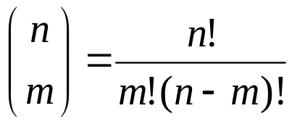
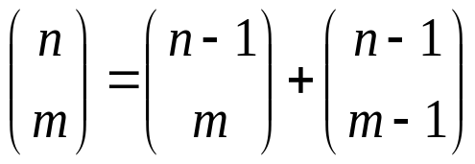
Recursive Algorithms
Direct recursion : Functions call themselves
Indirect recursion : Functions call other functions that invoke the calling function again
Express a complex process in very clear terms
  any function can be written recursively
  good when the problem is defined recursively

Slide 34
Transformation of Iterative program into recursive version
establish boundary conditions that terminate the recursive calls
implement the recursive calls so that each call brings us one step closer to a solution
(ex) Recursive implementation of binary search

Slide 35
(Ex) permutations
Given a set of n ≥ 1 elements, print out all possible permutations of this set.
  We can obtain a simple algorithm for generating permutations if we look at the set {a, b, c, d}. We can construct the set of permutations by printing:
    (1) a followed by all permutations of {b, c, d}
    (2) b followed by all permutations of {a, c, d}
    (3) c followed by all permutations of {a, b, d}
    (4) d followed by all permutations of {a, b, c}
  See Program 1.12 (p. 32)

Slide 36
Simple Criteria for Algorithms
Little code
Little time to write codes
Little time to debug

Slide 37
More Criteria for Algorithms
Fast execution
More functionality
Minimize memory space used
If there are lots of memory, then make the program as fast as possible.
If it’s critical application, make it as robust as possible.

Slide 38
Performance Analysis
Criteria
  (1) Does the program meet the original specifications of the task?
  (2) Does it work correctly?
  (3) Does the program contain documentation that shows how to use it and how it works?
  (4) Does the program effectively use functions to create logical units?
  (5) Is the program’s code readable?
  (6) Does the program efficiently use primary and secondary storage?
  (7) Is the program’s running time acceptable for the task?
Performance evaluation
  performance analysis: machine independent, complexity theory
  performance measurement: machine dependant, running times

Slide 39
Space Complexity
Space complexity
  the amount of memory that it needs to run to completion.
The space needed by a program is the sum of
  (1) Fixed space requirements
  (2) Variable space requirements
  S(P) = c + S_{P}(I)

Slide 40
Time Complexity
Time complexity
  The amount of computer time that it needs to run to completion
Program step
  a syntactically meaningful program segment whose execution time is independent of the instance characteristics.
  e.g., a = 2, a = 2*b+3*c/d-e+f/g/a/b/c

Slide 41
(Ex) Iterative Summation of a List of Numbers
float sum(float list[], int n)
{
  float tempsum = 0; count++; // for assignment
  for (int i = 0; i < n; i++) {
    count++; // for the for loop
    tempsum += list[i]; count++; // for assignment
  }
  count++; // last execution of for
  count++; // for return
  return tempsum;
}

Slide 42
Step Analysis
statement
float sum(float list[], int n)
{
  float tempsum = 0;
  int i;
  for (i = 0; i < n; i++)
    tempsum += list[i];
  return tempsum;
}
total
s/e
0
0
1
0
1
1
1
0
frequency
0
0
1
0
n+1
n
1
0
total steps
0
0
1
0
n+1
n
1
0
2n+3

Slide 43
Recursive Summation
float Rsum(float *list, const int n)
{
  count++; // for if colnditional
  if(n<=0){
  count++; // for return
    return 0;
  }
  else{
  count++; // for return
  return (Rsum(a, n-1+a[n-1]);
}

Slide 44
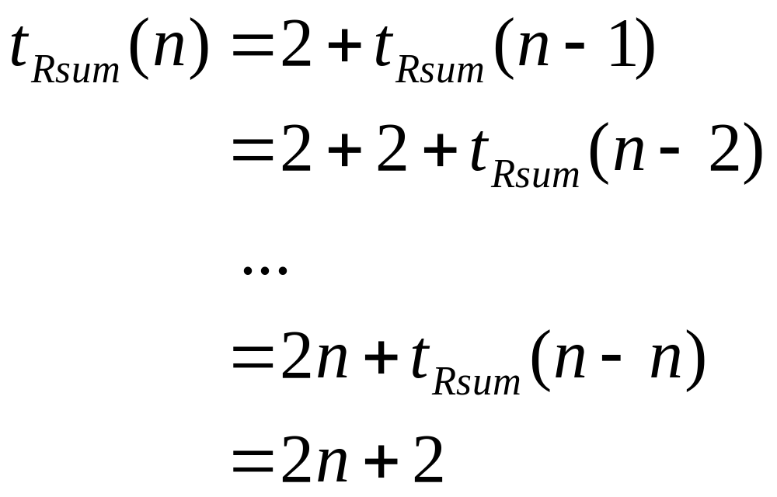
Step Analysis

Slide 45
(Ex) Matrix Addition
void add(int a[][MAX_SIZE], int b[][MAX_SIZE], int c[][MAX_SIZE], int rows, int cols)
{
    int i, j;
    for (i = 0; i < rows; i++)
        for (j = 0; j < cols; j++)
        c[i][j] = a[i][j] + b[i][j];
}

Slide 46
Step Analysis
statement
void add(int a[][MAX_SIZE] ...)
{
  int i, j;
  for (i=0; i<rows; i++)
  for(j = 0; j<cols; j++)
  c[i][j] = a[i][j] + b[i][j];
}
Total
s/e
0
0
0
1
1
1
0
frequency
0
0
0
rows+1
rows∗(cols+1)
rows∗cols
0
total steps
0
0
0
rows+1
rows∗cols+rows
rows∗cols
0
2rows∗cols+2rows+1

Slide 47
Asymptotic Notation (Ο, Ω, Θ)
Definition: [Big O]
  f(n) = O(g(n))
  iff there exist positive constants c and n₀ such that f(n) ≤ cg(n) for all n, n ≥ n₀.
  e.g., 3n + 2 = O(n) as 3n + 2 ≤ 4n for all n ≥ 2.
  10n² + 4n + 2 = O(n²) as 10n² + 4n + 2 ≤ 11n² for all n ≥ 5.
  O(1), O(log n), O(n), O(n log n), O(n²), O(n³), and O(2^{n})
  g(n) is an upper bound on the value of f(n) for all n, n ≥ n₀.

Slide 48
Definition: [Omega]
  f(n) = Ω(g(n))
  iff there exist positive constants c and n₀ such that f(n) ≥ cg(n) for all n, n ≥ n₀.
  e.g., 3n + 2 = Ω(n) as 3n + 2 ≥ 3n for all n ≥ 1.
  10n² + 4n + 2 = Ω(n²) as 10n² + 4n + 2 ≥ n² for all n ≥ 1.
  g(n) is a lower bound on f(n).

Slide 49
Definition: [Theta]
  f(n) = Θ(g(n))
  iff there exist positive constants c₁, c₂ and n₀ such that c₁g(n) ≤ f(n) ≤ c₂g(n) for all n, n ≥ n₀.
  e.g., 3n + 2 = Θ(n) as 3n ≤ 3n + 2 ≤ 4n for all n ≥ 2, so c₁ = 3, c₂ = 4, and n₀ = 2.
  10n² + 4n + 2 = Θ(n²).
  g(n) is both an upper and lower bound on f(n).

Slide 50
Computing Asymptotic Complexity
(1) Determine the asymptotic complexity of each statement and then
(2) take the maximum
(ex)
Statements
void add(int a[][MAX_SIZE] ...)
{
int i, j;
for (i=0; i<rows; I++)
for (j=0; j<cols; j++)
c[i][j] = a[i][j] + b[i][j];
}
Total
Asymptotic complexity
0
0
0
Θ(rows)
Θ(rows∗cols)
Θ(rows∗cols)
0
Θ(rows∗cols)

Slide 51
Function Values
Instance characteristic n
Time
1
log n
n
n log n
n²
n³
2^{n}
n!
Name
Constant
Logarithmic
Linear
Log linear
Quadratic
Cubic
Exponential
Factorial
1
1
0
1
0
1
1
2
1
2
1
1
2
2
4
8
4
2
4
1
2
4
8
16
64
16
24
8
1
3
8
24
64
512
256
40326
16
1
4
16
64
256
4096
65536
20922789888000
32
1
5
32
160
1024
32768
4294967296
26313 x 10³³

Slide 52
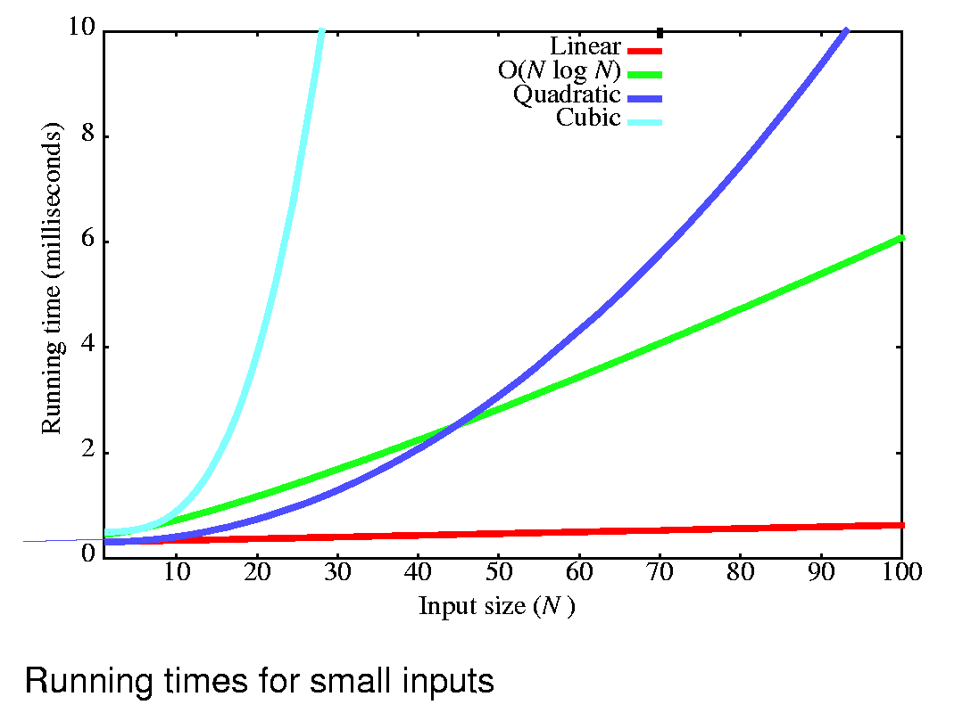

Slide 53
Performance Measurement
Actual space and time requirements of a program
  Dependent on the particular compiler and options used as well as on the specific computer on which the program is run.
  time() or clock() functions can be used.
  See Program 1.29 (p. 65)

