Slide 1
Graphs

Slide 2
The Graph Abstract Data Type (1/8)
Introduction
  The Königsberg bridge problem
  degree : # of incident edges
  Eulerian walk
g
c
C
d
A
D
C
Kneiphof
e
g
c
A
d
e
D
B
a
B
b
a
b
f
f
(a) Section of the river Pregel in Koenigsberg
(b) Euler’s graph

Slide 3
The Graph Abstract Data Type (2/8)
Definition
  Graph G :
    V : finite non-empty set of vertices
    E : set of pairs of vertices, i.e., edges
    G = (V, E)
  Undirected graphs
    The pair of vertices in any edge is unordered.
  Directed graphs
    Have directed pairs <u, v>
    (u is the tail, v is the head
    <v, u> and <u, v> are different.

Slide 4
The Graph Abstract Data Type (3/8)
  Graph examples
    V(G₁)={0,1,2,3}
    E(G₁)={(0,1),(0,2),(0,3),(1,2),(1,3),(2,3)}
    V(G₂)={0,1,2,3,4,5,6)
    E(G₂)={(0,1),(0,2),(1,3),(1,4),(2,5),(2,6)}
    V(G₃)={0,1,2}
    E(G₃)={<0,1>,<1,0>,<1,2>}
0
0
0
0
1
2
1
2
1
3
3
4
5
6
2
G₁
G₂
G₃

Slide 5
The Graph Abstract Data Type (4/8)
Restrictions on graphs
  Self edges, e.g., (v, v)
  Multiple occurrences of the same edge
0
0
0
1
0
0
1
3
0
0
2
0
2
0
Graph with a self edge
Multigraph
  Complete graph : n-vertex graph with n(n – 1)/2 edges
  If (u, v) is an edge in E(G)
    u and v are adjacent.
    (u, v) is incident on u and v.
  Subgraph of G
  : G', V(G') ⊆ V(G) and E(G') ⊆ E(G)

Slide 6
The Graph Abstract Data Type (5/8)
Path from u to v
  Sequence of vertices u, i₁, i₂, ..., i_{k}, v s.t. (u,i₁), (i₁,i₂), ..., (i_{k},v) are in E(G).
Length of path
  # of edges on it
Simple path
  A path in which all vertices except possibly the first and last are distinct
Simple directed path
Cycle
  A simple path in which the first and last vertices are the same

Slide 7
The Graph Abstract Data Type (6/8)
0
0
0
0
1
2
1
2
1
2
1
2
3
3
3
(i)
(ii)
(iii)
(iv)
G₁
Some of the subgraphs of G₁
0
0
0
0
0
0
1
1
1
1
2
2
2
2
G₃
(i)
(ii)
(iii)
(iv)
Some of the subgraphs G₃

Slide 8
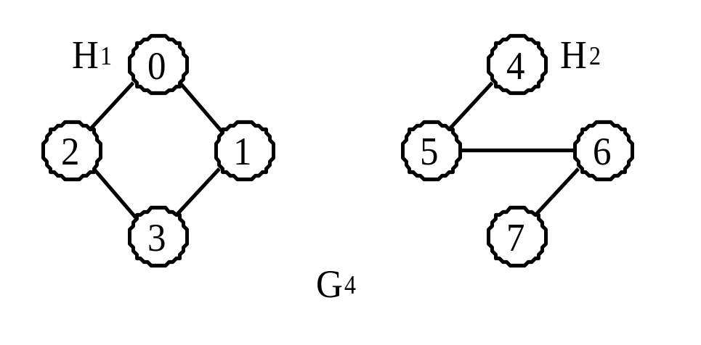
The Graph Abstract Data Type (7/8)
Connected component
: Maximal connected subgraph
Strongly connected
: For every pair of distinct vertices u and v in a directed graph V(G), there is a directed path from u to v and also from v to u.
Strongly connected component
: Maximal subgraph that is strongly connected
A graph with two connected components

Slide 9
The Graph Abstract Data Type (8/8)
0
Strongly connected components of G3
1
2
Degree : # of incident edges
In-degree of v
  # of edges for which v is the head
Out-degree of v
  # of edges for which v is the tail
# of edges
Digraph : directed graph
n-1
e =(∑d_{i})/2
i
(a graph with n vertices and e edges)

Slide 10
Graph Representations (1/2)
Adjacency matrix
  G = (V, E) : a graph with n (n≥1) vertices
  The adjacency matrix of G : two-dimensional n×n matrix
  (v_{i}, v_{j}) ∈ E(G) ⇒ a[i][j]=1
  (v_{i}, v_{j}) ∉ E(G) ⇒ a[i][j]=0
  Needed space : n² bits
0 1 2 3 4 5 6 7
0
1
2
3
4
5
6
7
0 1 1 0 0 0 0 0
1 0 0 1 0 0 0 0
1 0 0 1 0 0 0 0
0 1 1 0 0 0 0 0
0 0 0 0 0 1 0 0
0 0 0 0 1 0 1 0
0 0 0 0 0 1 0 1
0 0 0 0 0 0 1 0
0 1 2 3
0 1 1 1
1 0 1 1
1 1 0 1
1 1 1 0
0
1
2
3
0 1 2
0 1 0
1 0 1
0 0 0
0
1
2
G₁
G₃
G₄
n-1
∑a[i][j]
  For undirected graphs : the degree of a vertex i :
  For directed graphs : the row-sum is the out-degree, the col-sum the in-degree
  Some non-trivial questions on graphs : O(n²)
  For sparse graphs : O(e+n)
J=0

Slide 11
Graph Representations (2/2)
Adjacency Lists
  The n rows of an adjacency matrix are represented as n chains.
  C++ declarations
  For undirected graphs with n vertices, e edges
    An array of size n and 2e chain nodes
  Directed graphs : e list nodes
  Inverse adjacency lists
    One list for each vertex
  Chain<int> *adjList;
  LinkedGraph(const int vertice=0) ; n(vertices), e(0)
  {adjList=new Chain<int>[n];}

Slide 12
Adjacency Lists (1/3)
adjLists
data link
[0]
[1]
[2]
[3]
3
1
2
0
2
3
0
0
1
3
0
0
0
1
2
0
G₁
adjLists
[0]
[1]
[2]
1
0
2
0
0
0
G₃
adjLists
[0]
[1]
[2]
[3]
2
1
0
3
0
0
0
3
0
1
2
0
[4]
[5]
[6]
[7]
5
0
6
4
0
5
7
0
6
0
G₄
(

Slide 13
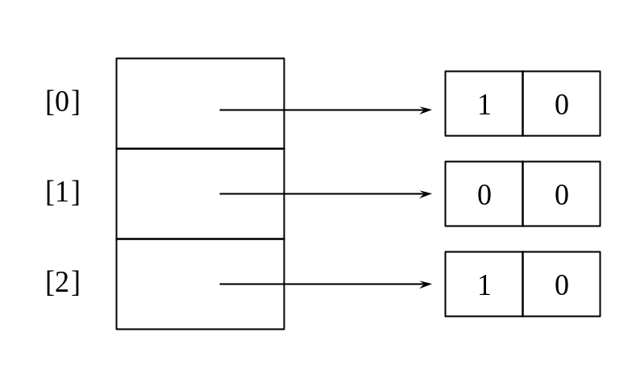
Adjacency Lists (2/3)
int nodes[n + 2*e +1];
0 1 2 3 4 5 6 7 8 9 10 11 12 13 14 15 16 17 18 19 20 21 22
Sequential representation of G₄
Inverse adjacency list for G₃

Slide 14
Adjacency Lists (3/3)
header nodes
0
1
2
0
0
1
0
0
1
1
0
0
1
2
0
0
2
0
Orthogonal list representation for G₃

Slide 15
Adjacency Multilists
(u, v) is represented by two entries
: For u and v, respectively
Adjacency multilists for G₁
m
vertex 1
vertex 2
list 1
list 2
adjNodes
[0]
N0
0
1
N1
N3
edge (0,1)
[1]
N1
0
2
N2
N3
edge (0,2)
[2]
N2
0
3
0
N4
edge (0,3)
[3]
N3
1
2
N4
N5
edge (1,2)
N4
1
3
0
N5
edge (1,3)
N5
2
3
0
0
edge (2,3)
The lists are
vertex 0: N0 -> N1 -> N2
vertex 1: N0 -> N3 -> N4
vertex 2: N1 -> N3 -> N5
vertex 3: N2 -> N4 -> N5

Slide 16
Weighted Edges
Weights assigned on edges
Adjacency matrix representation : each entry of the matrix a[i][j] contains the weight information.
Adjacency list representation : an additional field for the weight information
Network : graph with weighted edges

Slide 17
C++ Graph Classes
Graph
Matrix WDigraph
LinkedWDigraph
LinkedDigraph
MatrixWGraph
MatrixDigraph
LinkedWGraph
LinkedGraph
MatrixGraph
Possible derivation hierarchy for graph classes

Slide 18
Elementary Graph Operations
Depth-First Search, DFS
  (1) visit the starting vertex v
  (2) an unvisited vertex w adjacent to v is selected
  (3) a dfs from w is initiated
  (4) when a vertex u is reached whose adjacent vertices have all been visited, back up to the last vertex visited that has an unvisited vertex w adjacent to it and initiate a dfs from w again
  (5) the search terminates when no unvisited vertex can be reached from any of the visited vertices

Slide 19
Depth-First Search (1/2)
Example 6.1
  0, 1, 3, 7, 4, 5, 2, 6
0
1
2
3
4
5
6
7
adjLists
(
a)
[0]
[1]
[2]
[3]
[4]
[5]
[6]
[7]
1
2
0
0
3
4
0
0
5
6
0
G and its adjacency lists
1
7
0
1
7
0
2
7
0
2
7
0
3
4
5
6
0
(b)

Slide 20
Depth-First Search (2/2)
Analysis of DFS
  Time to complete search : O(e)
  Time for determining all vertices adjacent to v : O(n)
  Total time : O(n²)

Slide 21
Breadth-First Search (1/2)
Breadth-First Search
  visit the starting vertex v
  all unvisited vertices adjacent to v are visited
  unvisited vertices adjacent to these newly visited vertices are visitied
Example 6.2
  0, 1, 2, 3, 4, 5, 6, 7
0
1
2
3
4
5
6
7

Slide 22
Breadth-First Search (2/2)
Virtual void Graph::BFS(int v)
// A breadth first search of the graph is carried out beginning at vertex w.
// visited[i] is set to TRUE when v is visited. The function uses a queue.
{
visited = new bool[n]; .
fill(visited, visited+n, false);
visited[v] = true;
Queue<int> q;
q.push(v);
while(!q.IsEmpty()) {
v = *q.Front();
q.Pop();
for(all vertices w adjacent to v) // actual code uses an iterator
if(!visited[w]) {
q.Push(w);
visited[w] = TRUE;
}
} // end of while loop
delete [] visited;
}
Analysis of BFS
  Total time : O(n²)
  Adjacency list representation : O(e)

Slide 23
Connected Components
Connected component
  Repeated calls to either DFS(v) or BFS(v) where v is a vertex that has not yet been visited
Virtual void Graph::Components()
// Determine the connected components of the graph
{
// visited is assume to be declared as a bool* data member of Graph
visited = new bool[n];
fill(visited, visited+n, false);
for(i=0; i<n; i++)
if(!visited[i]) {
DFS(i); // find a component
OutputNewComponent();
}
delete [] visited;
}
Determining connected components
Analysis of Component
  Adjacency list : generation time O(n+e)
  Adjacency matrix : O(n²)

Slide 24
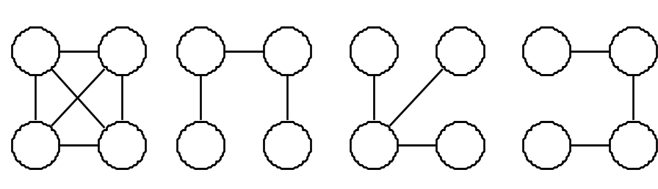
Spanning Trees (1/2)
Spanning tree : consisting solely of edges in G and including all vertices in G
  Depth-first spanning tree
  Breadth-first spanning tree
A complete graph and three of its spanning trees
0
0
1
2
1
2
3
4
5
6
3
4
5
6
7
7
(a) DFS(0) spanning tree
(b) BFS(0) spanning tree

Slide 25
Spanning Trees (2/2)
Example 6.3 [creation of circuit equations]
  obtain a spanning tree for the electrical network
  introduce the nontree edges into the spanning tree one at a time
  use the Kirchoff’s second law on the obtained cycles
Minimal subgraph of G
  V(G') = V(G) and G‘ is connected.
A spanning tree has n-1 edges.

Slide 26
Biconnected Components (1/3)
Articulation point
  Its deletion together with the removal of all of its incident edges leaves behind a graph that has at least two connected components.
Biconnected graph
  A connected graph that has no articulation points
Biconnected component
  Maximal biconnected subgraph
0
8
9
0
8
9
1
7
7
1
7
1
7
2
3
5
2
3
3
5
5
4
6
4
6
A connected graph
Its biconnected components

Slide 27
Biconnected Components (2/3)
Biconnected component of connected, undirected graph
  Depth-first spanning tree
1
3
5
0
10
8
9
9
2
6
0
8
9
4
5
4
1
7
8
1
7
1
6
3
2
7
6
3
2
3
5
2
3
5
4
4
6
1
8
7
4
6
2
7
9
10
5
0
8
9
Connected graph
Depth-first spanning tree

Slide 28
Biconnected Components (3/3)
Back edge
  Nontree edge (u, v); u is an ancestor of v or vice versa
Cross edge
  Nontree edge (not back edge)
low(w)
  low(w) = min{dfn(w), min{low(x) | x is a child of w},
  min{dfn(x) | (w, x) is a back edge}}
Vertex
0
1
2
3
4
5
6
7
8
9
dfn
5
4
3
1
2
6
7
8
10
9
low
5
1
1
1
1
6
6
6
10
9
dfn an low values for spanning tree of Fig. 6.21(b)

Slide 29
Minimum-Cost Spanning Trees
Minimum-cost spanning tree
  Spanning tree of least cost
Kruskal’s, Prim’s, Sollin’s algorithms
Greedy method
  construct an optimal solution in stages
  at each stage, the best decision possible at that time is made
  no back-tracking is allowed
Constraints on the spanning tree
  (1) use only the edges within the graph
  (2) use exactly n-1 edges
  (3) not use edges that produce a cycle

Slide 30
Kruskal’s Algorithm (1/3)
Algorithm
  Builds a minimum-cost spanning tree T by adding edges to T one at a time
  Selects the edges for inclusion in T in nondecreasing order of their cost
  An edge is added to T if it does not form a cycle with the edges that are already in T
  Since G is connected and has n > 0 vertices, exactly n-1 edges will be selected for inclusion in T

Slide 31
Kruskal’s Algorithm (2/3)
Example 6.4
0
0
28
0
0
10
1
10
1
1
10
1
14
16
5
5
5
5
6
2
24
6
2
6
2
6
2
4
25
4
4
4
18
12
12
3
22
3
3
3
(
d)
(
a)
(
b)
(
c)
0
0
0
0
10
10
10
1
10
1
1
1
14
14
5
14
5
14
16
5
16
5
16
6
6
6
2
6
2
2
2
4
25
4
4
4
12
12
12
12
22
3
22
3
3
3
(
e)
(
f)
(
g)
(
h)
Stages in Kruskal’s algorithm

Slide 32
Kruskal’s Algorithm (3/3)
T = ∅;
while ((T contains less than n – 1 edges) && (E not empty)) {
choose an edge (v, w) from E of lowest cost;
delete (v, w) from E;
if ((v, w) does not create a cycle in T) add (v, w) to T;
else discard (v,w);
}
if (T contains fewer than n – 1 edges) cout << “no spanning tree" << endl;
Kruskal’s algorithm
Theorem 6.1
  Let G be any undirected, connected graph. Kruskal’s algorithm generates a minimum-cost spanning tree.

Slide 33
Prim’s Algorithm (1/2)
Algorithm
  constructs the minimum-cost spanning tree edge by edge
  at all times during the algorithm, the set of selected edges forms a tree
  begins with a tree T contains a single vertex
  add a least cost edge (u, v) to T s.t. T U {(u, v)} is also a tree
  The above step is repeated until T contains n - 1 edges

Slide 34
Prim’s Algorithm (2/2)
0
0
0
10
1
10
1
10
1
5
5
5
6
2
6
2
6
2
25
25
4
4
4
3
3
22
3
(a)
(b)
(c)
0
0
0
10
1
10
1
10
1
16
14
16
5
5
5
6
2
6
2
6
2
25
25
25
4
4
4
12
12
12
22
3
22
3
22
3
(d)
(e)
(f)
Stages in Prim’s slgorithm

Slide 35
Sollin’s Algorithm
Algorithm
  selects several edges at each stage
  during a stage, one edge for each tree in the forest is selected
  this edge is a minimum-cost edge that has exactly one vertex in the tree
  the selected edges are added to the spanning tree being constructed
  terminates when there is only one tree at the end of a stage or when no edges remain to be selected
0
0
10
1
10
1
14
14
16
5
5
6
2
6
2
25
4
4
12
12
22
3
22
3
(a)
(b)
Stages in Sollin’s algorithm

Slide 36
Shortest Paths and Transitive Closure
Single source/all destinations : nonnegative edge costs
  Problem : determine a shortest path from v to each of the remaining vertices of G
45
0
50
1
10
2
Path
Length
1) 0, 3 10
30
2) 0, 3, 4 25
10
20
15
20
35
3) 0, 3, 4, 1 45
4) 0, 2 45
3
4
5
15
3
(a) Graph
(b) Shortest paths from 0
Graphs and shortest paths from vertex 0 to all destinations

Slide 37
Single Source/All Destinations : Nonnegative Edge Costs (1/3)
The function ShortestPath
Analysis of ShortestPath
  O(n²)
void MatrixWdigraph::ShortestPath(const int n, const int v)
// dist[j],0 ≤ j< n , is set to the length of the shortest path from v to j
// in a digraph G with n vertices and edges lengths given by length[j][j].
{
for (int i=0; i<n; i++) s[i] = false; dist[i] = length[v][i]; // initialize
s[v] = true;
dist[v] = 0;
for (i=0; i<n-2; i++) { // determine n-1 paths from vertex v
int u = Choose(n); // choose returns a value u such that:
// dist[u] = minimum dist[w], where s[w]=false
s[u] = true;
for (int w=0; w<n; w++)
if(!s[w]&&dist[u]+length[u][w]<dist[w])
dist[w] = dist[u] + length[u][w];
} // end of for(i=0; ...)
}

Slide 38
Single Source/All Destinations : Nonnegative Edge Costs (2/3)
Example 6.5
Boston
1500
4
Chicago
San Francisco
1200
3
250
1
800
2
1000
300
Denver
5
New York
1000
1400
0
1700
Los Angeles
7
900
New Orleans
1000
6
Miami
(a) Digraph
0 1 2 3 4 5 6 7
0
0
1
300
0
2
1000
800
0
3
1200
0
4
1500
0
250
5
1000
0
900
1400
6
0
1000
7
1700
0
(b) Length-adjacency matrix

Slide 39
Single Source/All Destinations : Nonnegative Edge Costs (3/3)
Iteration
Vertex selected
Distance
LA
SF
DEN
CHI
BOST
NY
MIA
NO
[0]
[1]
[2]
[3]
[4]
[5]
[6]
[7]
Initial
----
∞
∞
∞
1500
0
250
∞
∞
1
5
∞
∞
∞
1250
0
250
1150
1650
2
6
∞
∞
∞
1250
0
250
1150
1650
3
3
∞
∞
2450
1250
0
250
1150
1650
4
7
3350
∞
2450
1250
0
250
1150
1650
5
2
3350
3250
2450
1250
0
250
1150
1650
6
1
3350
3250
2450
1250
0
250
1150
1650
Action of ShortestPath on digraph of Fig. 6.27

Slide 40
Single Source/All Destinations : General Weights (1/3)
When negative edges are permitted, we should ensure that the graph have no cycles of negative length.
5
0
7
1
-5
2
Directed graph with a negative-length edge
-2
0
1
2
1
1
Directed graph with a cycle of negative length
Dynamic programming methodoogy
: Compute dist^{n-1}[u] for all u
  dist^{k}[u] = min{dist^{k-1}[u], min{dist^{k-1}[i] + length[i][u]}}
i

Slide 41
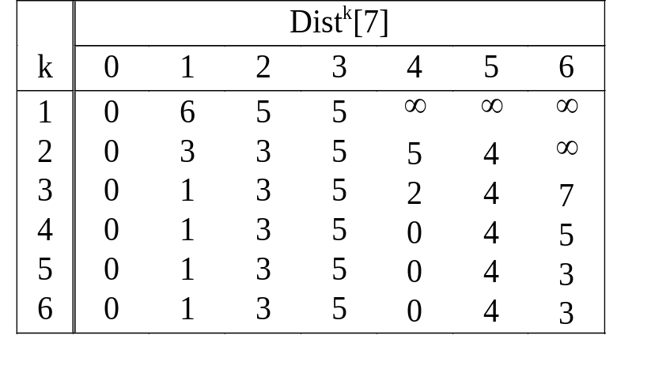
Single Source/All Destinations : General Weights (2/3)
Example 6.6
1
-1
4
6
3
-2
1
0
5
2
6
5
-2
3
5
3
-1
(
a)
A directed graph
(b) dist^{k}
Shortest paths with negative edge lengths

Slide 42
Single Source/All Destinations : General Weights (3/3)
Bellman and Ford algorithm
void MatrixWDigraph::BellmanFord(const int n, const int v)
{// Single source all destination shortest paths with negative edge lengths
for(int i=0; i<n; i++) dist[i] = length[v][i]; // initialize dist
for(int k=2; k<=n-1; k++)
for(each u such that u != v and u has a least one incoming edge)
for(each <i, u> in the graph)
if(dist[u]>dist[i]+length[i][u]) dist[u] = dist[i] + length[i][u];
}
Bellman and Ford algorithm to compute shortest paths
Analysis of BellmanFord
  Adjacency matrix O(n³), adjacency list O(ne)

Slide 43
All-Pairs Shortest Paths (1/3)
Find the shortest paths btw all pairs of vertices u and v, u ≠ v
Successively generate A⁻¹, A⁰, A¹, A², …, A^{n-1}
  The shortest path from i to j going through no vertex with index greater than k does not go through the vertex with index k, so its length is A^{k-1}[i][j]
  The shortest path goes through vertex k. The path consists of a subpath from i to k and another one from k to j. These subpaths must be the shortest paths from i to k and from k to j going through no vertex with index greater than k – 1, so their lengths are A^{k-1}[i][k] and A^{k-1}[k][j]
A^{k}[i][j] = min{A^{k-1}[i][j], A^{k-1}[i][k] + A ^{k-1}[k][j]}, k ≥ 0
A⁻¹[i][j] = length[i][j]

Slide 44
All-Pairs Shortest Paths (2/3)
void MatrixWDigraph::AllLengths(const int n)
{ // length[n][n] is the adjacency matrix of a graph with n vertices.
// a[i][j] is the length of the shortest path btw i and j.
for(int i=0; i<n; i++)
for(int j=0; j<n; j++)
a[i][j] = length[i][j]; // copy length into a
for(int k=0; k<n; k++) // for a path with highest vertex k
for(i=0; i<n; i++) // for all possible pairs
for(int j=0; j<n; j++)
if((a[i][k]+a[k][j]) < a[i][j]) a[i][j] = a[i][k] + a[k][j];
}
Analysis of AllLengths
  Total time : O(n³)

Slide 45
All-Pairs Shortest Paths (3/3)
Example 6.7
6
A
-1
0
1
2
A
0
0
1
2
0
4
1
11
2
0
0
4
11
0
0
4
11
3
1
6
0
2
1
6
0
2
2
2
3
0
2
3
7
0
(
a)
Example digraph
(
-1
0
b) A
(
c) A
A
1
0
1
2
A
2
0
1
2
0
0
4
6
0
0
4
6
1
6
0
2
1
5
0
2
2
3
7
0
2
3
7
0
(
1
2
d) A
(
e) A
Example for all-pairs shortest-paths problem

Slide 46
Transitive Closure (1/2)
Transitive closure matrix (A⁺)
  A⁺[i][j] = 1, if there is a path of length > 0 from i to j
Reflexive transitive closure (A*)
  A*[i][j] = 1, if there is a path of length 0 ≥ from i to j
0 1 2 3 4
0
0
1
0
0
0
1
0
0
1
0
0
2
0
0
0
1
0
0
1
2
3
4
3
0
0
0
0
1
4
0
0
1
0
0
(
a)
Digraph
G
(
b)
Adjacency matrix
A
0 1 2 3 4
0 1 2 3 4
0
0
1
1
1
1
0
1
1
1
1
1
1
0
0
1
1
1
1
0
1
1
1
1
2
0
0
1
1
1
2
0
0
1
1
1
3
0
0
1
1
1
3
0
0
1
1
1
4
0
0
1
1
1
4
0
0
1
1
1
(
c) A
+
(
d) A
*

Slide 47
Transitive Closure (2/2)
A⁺
  Edge <i, j> ∈ G ⇒ length[i][j] = 1,
  otherwise, length[i][j] = LARGE
  When AllLengths terminates, length[i][j] < +∞ ⇒ A⁺[i][j]=1
A* : obtained by setting all diagonal elements of A⁺ equal to 1
Total time : O(n³)

Slide 48

Activity Networks
AOV (activity-on-vertex) networks
: vertices represent tasks, edges represent precedence relations
C9
C8
C10
C11
C1
C12
C3
C7
C2
C13
C14
C4
C5
C6
C15
(a) Courses needed for a CS degree at a university
(b) AOV network representing courses as vertices and prerequisites as edges
An activity-on-vertex (AOV) network

Slide 49
AOV Networks (1/4)
Definitions
  there is a directed path from i to j : i is a predecessor of j
  <i, j> is an edge in G : i is an immediate predecessor of j
  i is a predecessor of j : j is a successor of i
  i is an immediate predecessor of j : j is an immediate successor of j
  a transitive relation ⋅ : for all triples i, j, k, i ⋅ j and j ⋅ k implies i ⋅ k
  an irreflexive relation : no element x in S, is it the case x ⋅ x
  partial order : a precedence relation that is both transitive and irreflexive
  topological order : a linear ordering of the vertices of a graph s.t. for any two vertices i and j, if i is s predecessor of j in the network, then i precedes j in the linear ordering

Slide 50
AOV Networks (2/4)
1
1
1
0
2
4
2
4
2
4
3
5
3
5
5
(a) Initial
(b) Vertex O deleted
(c) Vertex 3 deleted
1
1
4
4
4
5
(d) Vertex 2 deleted
(e) Vertex 5 deleted
(f) Vertex 1 deleted
Topological order generated : 0, 3, 2, 5, 1, 4

Slide 51
AOV Networks (3/4)
count
first
data
link
1
1
2
[0]
0
1
3
0
[1]
1
4
0
4
[2]
1
1
5
0
[3]
5
1
1
4
0
[4]
3
0
[5]
2
0
Internal representation used by topological sorting algorithm

Slide 52
AOV Networks (4/4)
Analysis of TopologicalOrder
  Asymptotic computing time : O(e+n)
void LinkedDigraph::TopologicalOrder()
{ // The n vertices of a network are listed in topological order.
int top = -1;
for(int i=0; i<n; i++) // create a linked stack of vertices with
if(count[i]==0) {count[i] = top; top = i;} // no predecessors
for(i=0; i<n; i++)
if(top==-1) throw “Network has a cycle."
int j = top; top = count[top]; // unstack a vertex
cout << j << endl;
Chain<int>::ChainIterator ji = adjLists[j]. begin();
while (ji) { // decrease the count of the successor vertices of j
count[*ji]--;
if(count[*ji]==0) { count[*ji] = top;top=*ji;} // add *ji to stack
ji++;
}
}
Topological order

Slide 53
AOE Networks (1/8)
AOE (activity on edge) networks
  Directed edges : tasks to be performed on a project
  Vertices : events
  (Events signal the completion of certain activities.)
  Activities represented by edges leaving a vertex cannot be started until the event at that vertex has occurred.

Slide 54
AOE Networks (2/8)
1
a = 6
a = 1
6
1
4
a = 2
10
a = 9
start
0
4
7
8
finish
a = 4
a = 7
2
8
a = 1
a = 4
5
11
a = 5
2
7
3
a = 4
9
3
a = 2
5
6
(a) Activity network of a hypothetical project
Event
Interpretation
0
start of project
1
completion of activity a1
4
completion of activities a4 and a5
7
completion of activities a8 and a9
8
completion of project
(b) Interpretation of some of the events in the network of (a)

Slide 55
AOE Networks (3/8)
Critical path
  A path of longest length
Earliest time e(i)
  The length of the longest path from o to i
Latest time l(i)
  An activity may start without increasing the project duration
Critical activity : all activities s.t. e(i) = l(i)
The purpose of critical-path analysis
  Identify critical activities so that resources may be concentrated on these activities in an attempt to reduce project finish time

Slide 56
AOE Networks (4/8)
The earliest and latest event times
  e(i)= ee[k]
  (ee[k] : the earliest event time)
  l(i) = le[l] – duration of activity a_{i}
  (le[l] : the latest event time)
Computing the earliest event time
  ee[j] = max { ee[i] + duration of <i, j>}
  (P(j) : set of all vertices adjacent to j)
i∈P(j)

Slide 57
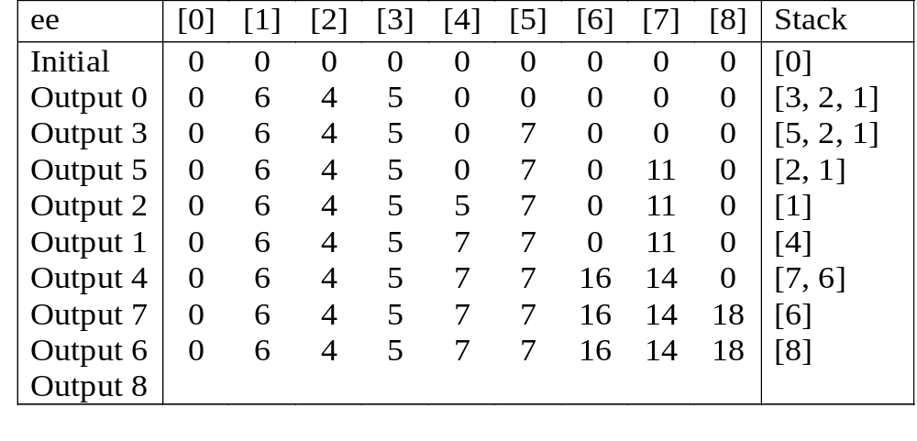
AOE Networks (5/8)
count first
vertex dur link
[0]
0
1
6
2
4
3
5
0
[1]
1
4
1
0
[2]
1
4
1
0
(a) Adjacency lists for Fig. 6.39(a)
[3]
1
5
2
0
[4]
2
6
9
7
7
0
[5]
1
7
4
0
[6]
1
8
2
0
[7]
2
8
4
0
[8]
2
0
(b) Computation of ee

Slide 58
AOE Networks (6/8)
Computing the latest event time
  le[j] = min { le[i] – duration of <j, i>}
  (S(j) is the set of j’s adjacent vertices)
i∈P(j)
le[8]=ee[8]=18
le[6]=min{le[8]-2}=16
le[7]=min{le[8]-4}=14
le[4]=min{le[6]-9, le[7]-7}=7
le[1]=min{le[4]-1}=6
le[2]=min{le[4]-1}=6
le[5]=min{le[7]-4}=10
le[3]=min{le[5]-2}=8
le[0]=min{le[1]-6, le[2]-4, le[3]-5}=0
Computation of le’s

Slide 59
AOE Networks (7/8)
early time
late time
slack
critical
activity
e
1
1
–
e
1
–
e = 0
a
0
0
0
Yes
1
a
0
2
2
No
2
a
0
3
3
No
3
a
6
6
0
Yes
4
a
4
6
2
No
5
a
5
8
3
No
6
a
7
7
0
Yes
7
a
7
7
0
Yes
8
a
7
10
3
No
9
a
16
16
0
Yes
10
a
14
14
0
Yes
11
Early, late, and criticality values

Slide 60
AOE Networks (8/8)
1
6
a₁
a₄
a₁₀
a₇
start
0
4
8
finish
a₈
a₁₁
7
Graph obtained after deleting all noncritical activities
a₅
a₁
1
4
5
a₃
a₇
a₆
0
3
a₂
a₄
2
AOE network with some nonreachable activities

