Slide 1
Hashing

Slide 2
Introduction
ADT dictionary (see ADT 5.3 in Chap. 5)
Hashing
  Static hashing
  Dynamic hashing

Slide 3
Static Hashing (1)
Hash tables (1)
  the dictionary pairs are stored in a table, ht
  the hash table is partitioned into b buckets, ht[0], … , ht[b-1]
  each bucket is capable of holding s slots
  each slot can hold one dictionary pair
  the address of a pair whose key is k is determined by a hash function
  the hash function maps keys into buckets
  h(k) : home address of k
  under ideal conditions, dictionary pairs are stored in their home buckets

Slide 4
Static Hashing (2)
Hash tables (2)
  Definition
    the key density of a hash table is n/T
    the loading density of a hash table is α = n/(sb)
    n : # of pairs in the table
    T : total # of keys
  the key density n/T is usually very small; the number of buckets b is also much less than T
  if h(k₁) = h(k₂)
    k₁ and k₂ are synonyms w.r.t. h

Slide 5
Static Hashing (3)
Hash tables (3)
  under ideal conditions, dictionary pairs are stored in their home buckets
  overflow
    the situation where the home bucket for a new dictionary pair is full at the time we wish to insert that pair into the dictionary
  collision
    when the home bucket for the new pair is not empty

Slide 6
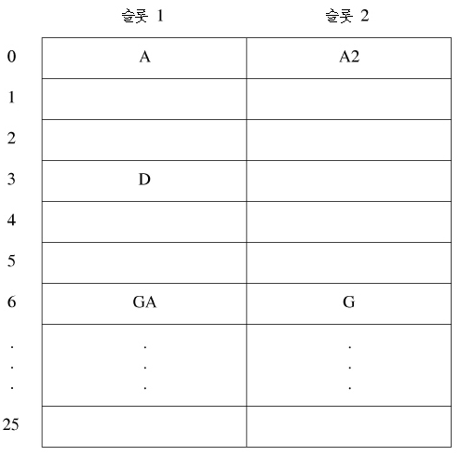
Static Hashing (4)
Hash tables (4)
  a hash table with b=26 and s=2
    n=10, α =10/52 = 0.19
    map each key into one of the numbers 0 to 25
    GA and G are synonymous
    A and A2 are synonymous
    where in the table should A1 be entered
Slot 1
Slot 2

Slide 7
Static Hashing (5)
Hash tables (5)
  when no overflows occur
    the time required to insert, delete, or search using hashing depends only on the time required to compute the hash function and the time to search one bucket
    since the bucket size s is usually small, the search within a bucket is carried by a sequential search
  hashing schemes
    use a hash function to map keys into hash-table buckets
    easy to compute; minimizes the number of collisions
    a mechanism to handle overflow is needed

Slide 8
Static Hashing (6)
Hash functions (1)
  map a key to a bucket in the hash table
  easy to compute; minimize the number of collisions
  uniform hash functions
    if a key k is chosen randomly, the probability that h(k) = i to be i/b for all buckets i
    a random key has an equal chance of hashing into any of the buckets
  several kinds of uniform hash functions are in practical use
    since, in many applications, the data type of key is not one for which arithmetic operations are defined (e.g., string), it is necessary to first convert the key into an integer (say) prior to arithmetic operations

Slide 9
Static Hashing (7)
Hash functions (2)
  division
    most widely used in practice
    assumes the key are non-negative integers
    the home bucket is determined by using the modulo (%) operator
      the key k is divided by some number D, and the remainder is used as the home bucket for k
        h(k) = k%D
        bucket address range : 0 ~(D-1)
        the hash table must have at least b = D buckets
    the choice of D has a critical impact on the number of overflows
      the degree of bias decreases as the smallest prime factor of D increases
    require D should be odd and b=D
    array doubling results in increasing the number of buckets from b to 2b+1

Slide 10
Static Hashing (8)
Hash functions (3)
  the mid-square hash function
    determines the home bucket for a key by squaring the key and then using an appropriate number of bits from the middle of the square
    the key is assumed to be an integer
    since the middle bits of the square usually depend on all bits of the key, different keys are expected to result in different hash addresses with high probability
    the number of bits to be used to obtain the bucket address depends on the table size
      if r bits are used, the range of values is 0 through 2^{r} - 1

Slide 11
Static Hashing (9)
Hash functions (4)
  the folding function
    k is partitioned into several parts, all but possibly the last being of the same length
    the partitions are added to obtain the hash address of k
    two ways of carrying out the addition
      shift folding
        all but the last partition are shifted so that the least significant bit of each lines up with the corresponding bit of the last partition
        the different partitions are added together to get h(k)
      folding at the boundaries
        the key is folded at the partition boundaries
        the digits falling into the same position are added to get h(k)

Slide 12
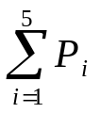
Static Hashing (10)
Hash functions (5)
  example 8.2
    k = 12320324111220, is partitioned into three-decimal-digit-long parts
      P1 = 123, P2 = 203, P3 = 241, P4 = 112, P5 = 20
      using shift folding:
        h(k) = = 123 + 203 + 241 + 112 + 20 = 699
      using folding at the boundaries:
        first, reverse P2 and P4 to obtain 302 and 211, respectively; next, the five partitions are added to obtain h(k) = 123 + 302 + 241 + 211 + 20 = 897

Slide 13
Static Hashing (11)
Hash functions (6)
  digital analysis
    useful in the case of a static file
    each key is interpreted as a number using some radix r
    that radix is used for all the keys in the table
    digits having the most skewed distributions are deleted
    enough digits are deleted so that the number of remaining digits is small enough to give an address in the range of the hash table

Slide 14
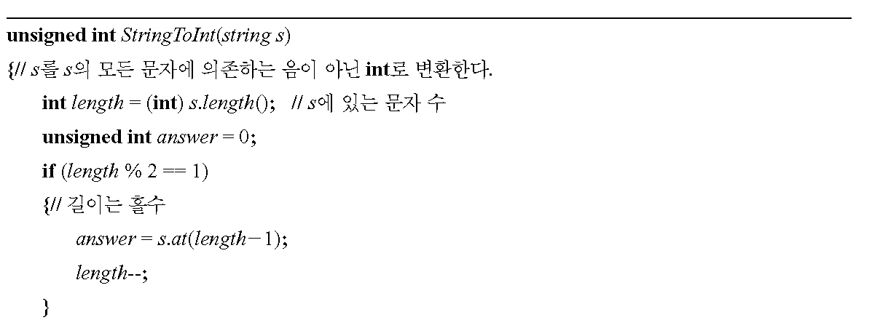
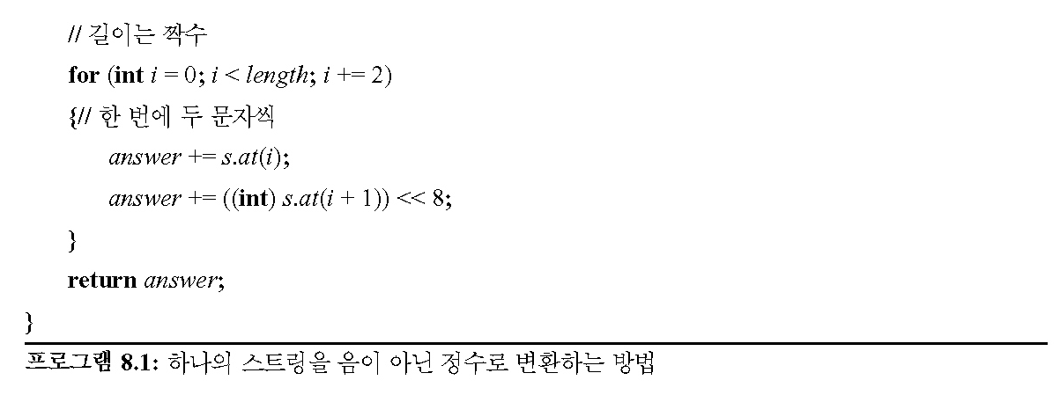
Static Hashing (12)
Hashing functions (7)
  converting keys to integers
    keys need to be converted to nonnegative integers
    need not to be converted into unique nonnegative integers
    conversion of strings
      16-bit integer

Slide 15
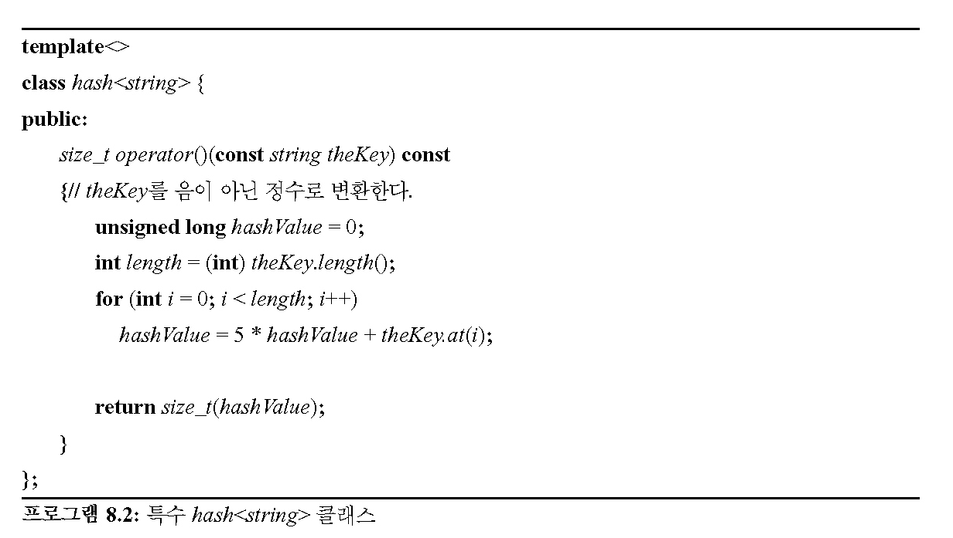
Static Hashing (13)
Hashing functions (8)
  converting keys to integers (cont’d)
    the C++ STL provides specializations of the STL template class hash<T> that transform instances of type T into a nonnegative integer of type size_t

Slide 16
Static Hashing (14) – Secure Hash Functions (1)
Hashing functions with additional properties find several applications in computer security
  (ex) message authentication
    when a message M is transmitted over an insecure channel from A to B, we want B to be confident that the received message is original and not a forgery
    use a hash function h and transmit M’s hash value h(M) using the more secure method
    weak collision resistance
      it should be difficult for a malicious user who has knowledge of M and h to determine a synonym for M

Slide 17
Static Hashing (15) – Secure Hash Functions (2)
One-way property
  for a given c, it is computationally difficult to find a k s.t. h(k) = c
Strong collision resistance
  it is computationally difficult to find a pair (x, y) s.t. h(x) = h(y)
Several cytographic hash functions
  additional features for practical use
    (1) h can be applied to a block of data of any size
    (2) h produces a fixed-length hash code
    (3) h(k) is relatively easy to compute for any given k, making both hardware and software implementations practical

Slide 18
Static Hashing (16) – Secure Hash Functions (3)
The Secure Hash Algorithm (SHA)
  developed at the National Institute of Standards and Technology (NIST)
  input : any message with maximum length less than 2⁶⁴ bits
  output : 160-bit code
Step 1 : Preprocess the message so that its length is q*512 bits for some integer q. The preprocessing may entail adding a string of zeroes to the end of the message.
Step 2 : Initialize the 160-bit output buffer OB, which comprises five 32-bit registers A, B, C, D, and E, with A=67452301, B=efcdab89, C= 98bdcfe, D=10325476, E=c3d2e1f0 (all values are hexadecimal).
Step 3 : for(int i=1; i<=q; i++){
Let B_{i} = ith block of 512 bits of the message
OB = F(OB, B_{i});
}
Step 4 : Output OB.
SHA algorithm

Slide 19
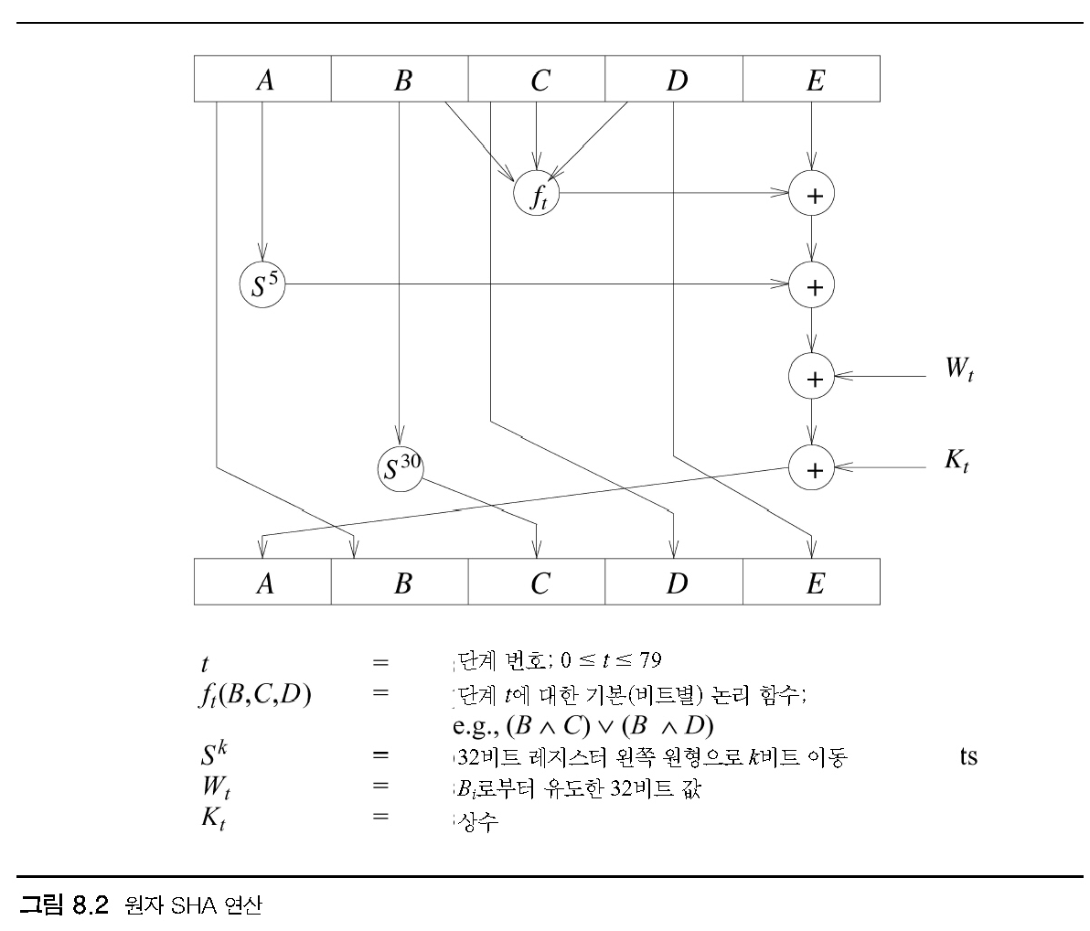
Static Hashing (17) – Secure Hash Functions (4)
step number; 0 <= t <= 79
primitive (bitwise) logical function for step t;
circular left shift of the 32-bit register by k bits
a 32-bit value derived from B_{i}
a constant
Atomic SHA operation

Slide 20
Static Hashing (18) – Overflow Handling (1)
Popular ways to handle overflows
  open addressing
    linear probing
    quadratic probing
    rehashing
    random probing
  chaining

Slide 21
Static Hashing (19) – Overflow Handling (2)
Linear probing (1)
  when inserting a new pair whose key is k
    search the hash table buckets in the order ht[h(k)+i]%b , 0<= i <= b – 1
      h : hash function, b : # of buckets
    the search terminates when we reach the first unfilled bucket and the new pair is inserted into this bucket
    in case no such bucket is found, the hash table is full and
      it is necessary increase the table size
      in practice, when the loading density exceeds a prespecified threshold, e.g., 0.75
    when we resize the hash table
      we must change the has function as well
      all dictionary entries need to be remapped into the new larger table
0
1
2
3
4
5
6
7
8
9
10
11
12
25
A
A2
A1
D
A3
A4
GA
G
ZA
E
L
.
Z
≈
≈
Hash table with linear probing
(26 buckets, one slot per bucket)

Slide 22
Static Hashing (20) – Overflow Handling (3)
Linear probing (2)
  when s=1 and linear probing is used, a hash table search for the pair with key k proceeds as follows:
    (1) compute h(k)
    (2) examine the hash table buckets in the order ht[h(k)], ht[(h(k)+1)%b], … , ht[(h(k)j)%b] until one of the following happens:
      (a) the bucket ht[(h(k)+j)%b] has a pair whose key is k; in this case, the desired pair has been found
      (b) ht[h(k)+j] is empty; k is not in the table
      (c) we return to the starting position ht[h(k)]; the table is full and k is not in the table

Slide 23
Static Hashing (21) – Overflow Handling (4)
Linear probing (3)
template <class K, class E>
pair<K,E>* LinearProbing <K,E>::Get(const K&k)
{// search the linear probing hash table ht (each bucket has exactly one slot) for k.
// if a pair with this key is found, return a pointer to this pair; otherwise, return 0.
int i = h(k); // home bucket
int j;
for(j = i; ht[k] && ht[j] → first != k;) {
j = (j+1) % b; // treat the table as circular
if(j == i) return 0; // back to start point
}
if (ht[j] → first == k) return ht[j];
return 0;
}
Linear probing

Slide 24
Static Hashing (22) – Overflow Handling (5)
Linear probing (4)
  when linear probing is used to resolve overflows
    keys tend to cluster; adjacent clusters coalesce, increasing the search time
  when linear probing is used together with a uniform hash function
    the expected average number of key comparisons to look up a key is approximately (2-α)/(2-2α), where α is the loading density
  quadratic probing
    some improvement in the growth of clusters
    in linear probing, search the buckets (h(k)+i)%b, 1≤i≤b-1, where b is the number of buckets in the table; in quadratic probing, a quadratic function of i is used as the increment:
      the search is carried out by examining buckets h(k), (h(k)+i²) % b, (h(k)-i²) % b, 0≤i≤(b-1)/2
      when b is a prime number of the form 4j+3 (j is an integer), the quadratic search described above examines every bucket in the table

Slide 25
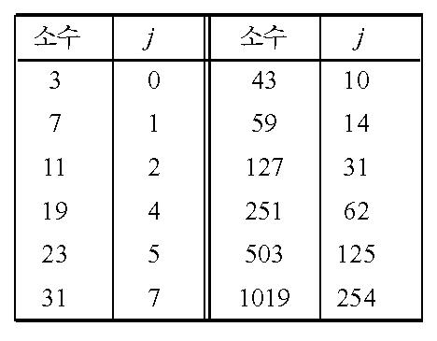
Static Hashing (23) – Overflow Handling (6)
Linear probing (5)
  another approach to retarding the growth of clusters
    rehashing
      a series of hash functions h₁, h₂, ..., h_{m}
      buckets h_{i}(k) (0≤i≤m) are examined in that order
    random probing
Prime
Prime
Some prime numbers of the form 4j+3

Slide 26
Static Hashing (24) – Overflow Handling (7)
Poor performance of linear probing and its variations
  search for a key involves comparison with keys having different hash values
Chaining
  use an array ht[0:b-1] of type ChainNode <pair <K, E>>*
  ht[i] points to the first node of the chain for bucket i
template <class K, class E>
pair<K,E>* Chaining <K,E>::Get(const K&k)
{// search the chained hash table ht for k
// if a pair with this key is found, return a pointer to this pair; otherwise, return 0
int i = h(k); // home bucket
// search the chain ht[i]
for(ChainNode <pair <K, E>>* current = ht[i]; current; current = current -> link)
if(current->data.first == k) return &current->data;
return 0;
}
Chain search

Slide 27
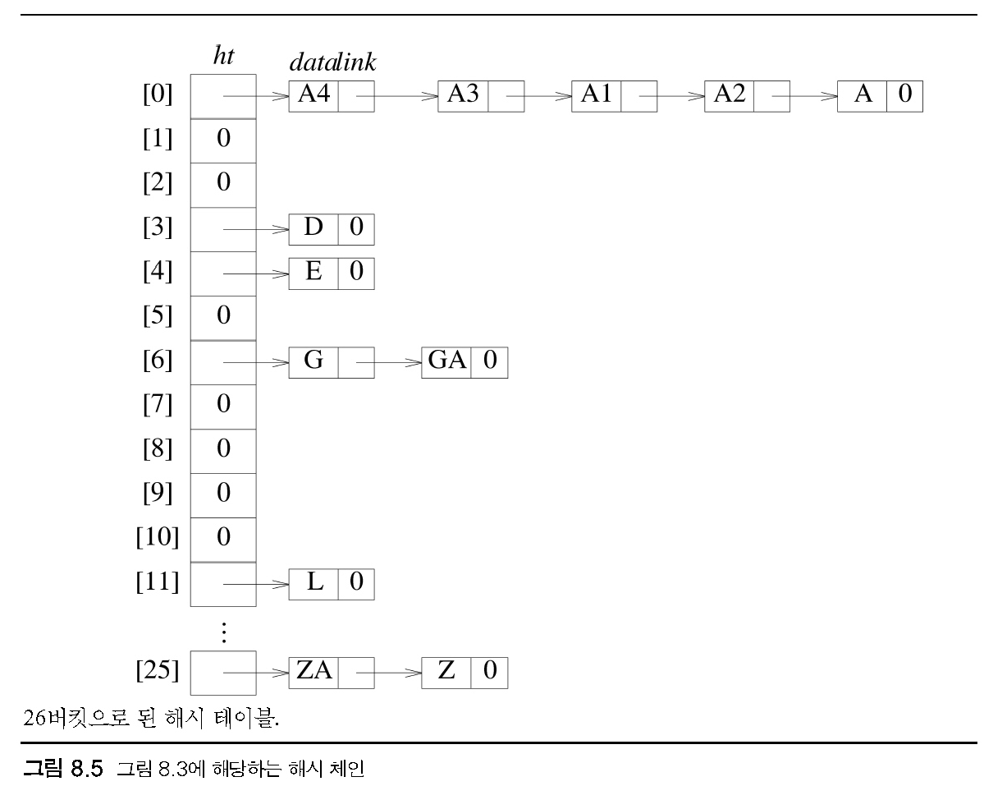
Static Hashing (25) – Overflow Handling (8)
Hash table with 26 buckets

Slide 28
Static Hashing (26) – Overflow Handling (9)
Chaining (cont’d)
  chaining with a uniform hash function
    the expected average number of key comparisons for a successful search is around 1 + α/2, where α is the loading density n/b (b = # of buckets)
  performance depends only on the method used to handle overflows
  in practice, keys are selected in a biased manner
    hence, different hash functions result in different performance
    in general, the division hash function with chaining yields best performance
  the worst-case number of comparisons needed for a successful search
    O(n)
    may be reduced to O(log n) by storing synonyms in a balanced search tree

Slide 29
Static Hashing (27) – Overflow Handling (10)
Theoretical evaluation of overflow techniques (1)
  hashing shows a very good performance compared to conventional methods such as balanced trees
  the worst-case performance can be very bad
    an insertion or a search in a hash table with n keys may take O(n) time
  probabilistic analysis for the expected performance of the chaining method
    ht[0:b-1] : a hash table with b buckets, having one slot
    h : a uniform hash function with range [0,b-1]
    n keys k₁, k₂, ...., k_{n} are entered into the hash table
      b^{n} distinct hash sequences h(k₁), h(k₂), ... , h(k_{n})
      assume that each of the above is equally likely to occur
    S_{n} : the expected number of key comparisons needed to locate a randomly chosen k_{i} (1≤i≤n)
      the average number of comparisons needed to find the jth key k_{j} j(1≤i≤n)
      and averaged over all b^{n} hash sequences
    U_{n} : the expected number of key comparisons when a search is made for a key not in the hash table

Slide 30
Static Hashing (28) – Overflow Handling (11)
Theoretical evaluation of overflow techniques (2)
  probabilistic analysis for the expected performance of the chaining method (cont’d)
    (theorem 8.1) let a = n/b be the loading density of a hash table using a uniform hash function h
    (1) for linear open addressing
      U_{n} = ½[1 + 1/(1-a)²]
      S_{n} = ½[1 + 1/(1-a)]
    (2) for rehashing, random probing, and quadratic probing
      U_{n} ≈ 1/(1-a)
      S_{n} ≈ –[1/a]log_{e}(1-a)
    (3) for chaining
      U_{n} ≈ a
      S_{n} ≈ 1 + a/2

Slide 31
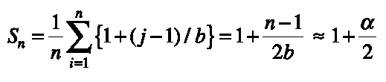
Static Hashing (29) – Overflow Handling (12)
Theoretical evaluation of overflow techniques (3)
  probabilistic analysis for the expected performance of the chaining method (cont’d)
  (proof)
    if the key k begin sought has h(k)=i, and chain i has q nodes on it
      q comparisons are needed if k is not on the chain
      j comparisons are needed if k is in the jth node (1≤j≤q)
    when the n keys are distributed uniformly over the b possible chains
      the expected number in each chain is n/b=α
      since U_{n} equals the expected number of keys on a chain, U_{n}=α
    when the ith key, k_{i} is being entered into the table, the expected number of keys on any chain is (i-1)/b
      ∴ the expected number of comparisons needed to search for k_{i} after all n keys have been entered is 1 + (i –1)/b
    Thus,

Slide 32
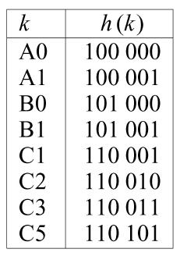
Dynamic Hashing
Motivation for dynamic hashing
  also known as extendible hashing
  reduce the rebuild time by ensuring that each rebuild changes the home bucket for the entries in only one bucket
  provide acceptable hash table performance on a per operation basis
An example hash function

Slide 33
Dynamic Hashing Using Directories (1)
Dynamic hashing using directories
  employ a directory, d, of pointers to buckets
  size of directory : depends on the number of bits of h(k) used to index into the directory
  directory depth
    the number of bits of h(k) used to index the directory
    t : directory depth, 2^{t} : size of directory
      (ex) indexing by h(k,2) → directory size = 2²=4
      indexing by h(k,5) → directory size = 2⁵=32
    number of buckets is less than or equal to directory size

Slide 34
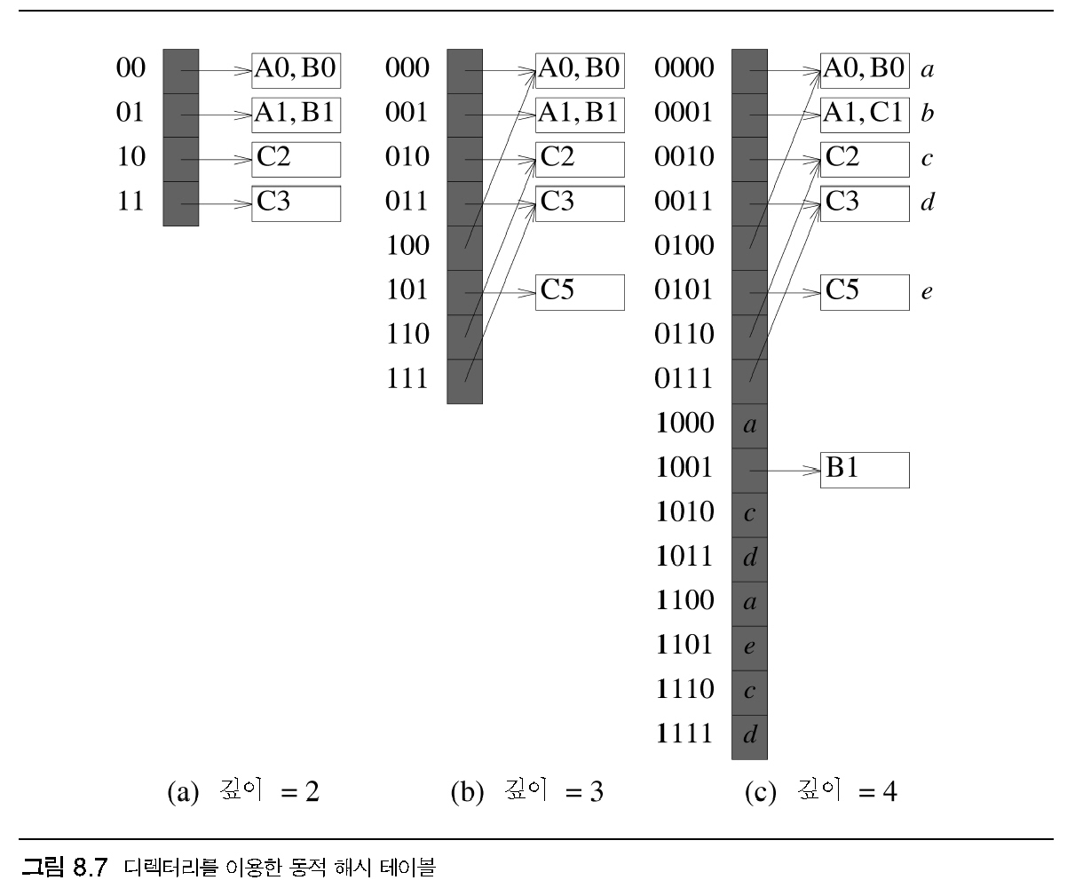
Dynamic Hashing Using Directories (2)
Dynamic hash table containing the keys A0, B0, A1, B1, C2, and C3
directory depth is two
two slots per bucket
(shaded – directory
others – buckets)
(a) depth = 2
(b) depth = 3
(c) depth = 4

Slide 35
Dynamic Hashing Using Directories (3)
Dynamic hash table containing the keys A0, B0, A1, B1, C2, and C3 (cont’d)
  to search for a key k
    merely examine the bucket pointed to by d[h(k,t)], where t is the directory depth
  to resolve overflows
    determine the least u such that h(k,u) is not the same for all keys in the overflowed bucket
    → increase the directory size but not the number of buckets
    following the resizing, split the overflowed bucket using h(k,u)
    when the current directory depth is greater than or equal to u, some of the other pointers to the split bucket also must be updated to point to the new bucket
  although dynamic hashing employs array doubling, the time for this array doubling is considerably less than that for the array doubling used in static hashing

Slide 36
Directoryless Dynamic Hahing (1)
an array, ht, of buckets is used instead of the directory
  assume that the array is as large as possible (no increasing)
  use two variables q and r (0≤q<2^{r}) to keep track of the active buckets
    only buckets 0 through 2^{r}+q-1 are active
  each active bucket is the start of a chain of buckets
  overflow bucket : the remaining buckets on a chain
  the active buckets 0 through q-1 as well as 2^{r} through 2^{r}+q-1 are indexed using h(k, r+1)
  the remaining active buckets are indexed using h(k,r)
  each dictionary pair is either in an active or an overflow bucket

Slide 37
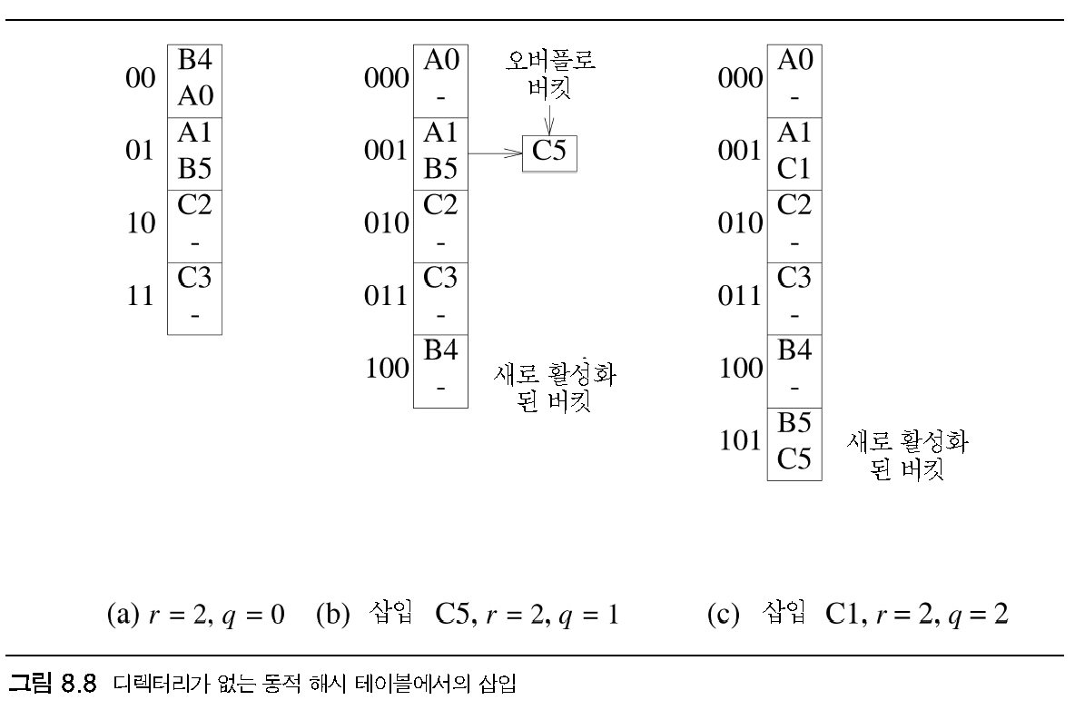
Directoryless Dynamic Hahing (2)
a directoryless hash table ht with r=2 and q=0
  the hash function is that of Fig. 8.6, the number of active buckets = 4
  each active bucket has two slots
overflow buckets
new active bucket
new active bucket
Insert
Insert

Slide 38
Bloom Filters (1)
Application – differential files (1)
  maintain an indexed file
    one index and a single key
      dense index and updates to the file are permitted
    need to keep a backup copy of the index and file
      master index, master file
      – working copy of the index file
    transaction log
      necessary for recovery from the failure
      backup copies and a log of all updates made since the backup copy were created
    process the backup copies and the transaction log to reproduce an index and file corresponding to the working copies at the time of failure
      ∴time for recovery – a function of the sizes of the backup index and file and the size of transaction log
    differential file
      when only the file is very large
      a reduction in recovery time can be obtained by keeping updated records in a separate file called the differential file

Slide 39
Bloom Filters (2)
Application – differential files (3)
  when a differential file is used, the backup file is an exact replica of the master file
  master index and differential file are relatively small
  it is feasible to backup frequently
  using a differential file as suggested does not affect the number of disk accesses needed to perform a file operation
  when both the index and the file are very large
    get around the problem by using a differential file and a differential index

Slide 40
Bloom Filters (3)
Bloom filter design
  bloom filter
    a device residing in internal memory and accepts queries of the following type: Is key k in the differential index?
  the only way to answer such queries accurately is to have a list of all keys
  does not answer queries accurately
    ‘maybe’ or ‘no’
  ‘no’
    assured that the key k is not in the differential index
  ‘maybe’
    the differential index is searched

Slide 41
Bloom Filters (4)
The probability of a filter error
  P(u) = (1-1/n)^{u}(1-(1-1/m)^{uh})^{h}
Using an approximation
  (1-1/x)^{q} ~ e^{-q/x}
For large x
  P(u) ~ e^{-u/n}(1-e^{-uh/m})^{h}
Differentiate P(u) w.r.t. h and set the result to zero
  h = (log_{e}2)m/u ~ 0.693m/u

