Slide 1
Linked Lists
Chapter 4

Slide 2
4.1 Singly Linked Lists and Chains
Sequential representation
  Data objects are stored a fixed distance apart
  Adequate for diverse tasks
  Insertion or deletion of arbitrary elements is expensive.
Linked representation
  Anywhere in memory
  Comprised of nodes
Data
Link (pointer)

Slide 3
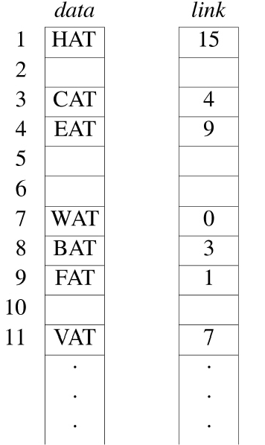
Nonsequential List Representation
first = 8
data[8] = BAT: data
link[3] = 4: address
data[link[3]] = EAT

Slide 4
Usual Way to Draw a Linked List
first
BAT
CAT
EAT
WAT
0

Slide 5
Inserting into a Linked List (1/2)
Steps for data insertion (e.g., insert GAT)
  Get a node a that is currently unused.
  Set the data field of a to GAT
  Set the link field of a to point to the node after FAT
  Set the link field of the node containing FAT to a
Need not to move any elements when performing insert operation
Additional storage for the field link

Slide 6
Inserting into a Linked List (2/2)
data
link
1
HAT
15
2
3
CAT
4
4
EAT
9
5
GAT
1
(a) Insert GAT into Data[5]
6
7
WAT
0
8
BAT
3
9
FAT
5
10
(b) Insert node GAT into list
11
VAT
7
first
BAT
CAT
EAT
FAT
HAT
x
GAT

Slide 7
Node Deletion
Find the element that immediately precedes GAT, i.e. FAT
Set link[9] to the position of HAT which is 1
first
BAT
CAT
EAT
FAT
GAT
HAT
WAT
0
Delete GAT from list

Slide 8
4.2 Representing Chains in C++
Defining a Node in C++
  Node structures for chains
class ThreeLetterNode {
private:
char data[3];
ThreeLetterNode *link;
};
class NodeA {
private:
int data1;
char data2;
float data3;
NodeA *linka;
NodeB *linkb;
} ;
class NodeB{
private:
int data;
nodeb *link;
};
data1
55
data
22
data2
‘c’
link
data3
3.14
linka
linkb
NodeA
NodeB
Illustration of NodeA and NodeB

Slide 9
Designing a Chain Class in C++ (1/5)
Design Attempt 1
  ThreeLetterNode *first;
    Variable declaration
  first→data, first→link
    Data member reference
  first→data[0], first→data[1], first→data[2]
    Data component reference
  Compile-time error
    data and link are declared as private → private members are not accessible from outside the class.
*first
first→data
first
first→data[0]
first→data[1]
first→data[2]
first→link

Slide 10
Designing a Chain Class in C++ (2/5)
Design attempt 2
  Only permit those functions that perform list manipulation operations access to the data members of ThreeLetterNode
Design attempt 3
  A class corresponding to the entire chain
  Composite of ThreeLetterNode and ThreeLetterChain
  An object of ThreeLetterChain consists of zero or more objects of ThreeLetterNode → ThreeLetterChain HAS-A ThreeLetterNode

Slide 11
Designing a Chain Class in C++ (3/5)
Definition
  A data object of type A HAS-A data object of type B if A conceptually contains B or B is a part of A.
  Make the contained class a member of the containing class
ThreeLetterChain
ThreeLetterNode
first
BAT
CAT
WAT
0
ThreeLetterChain HAS-A ThreeLetterNode

Slide 12
Designing a Chain Class in C++ (4/5)
ThreeLetterChain is defined so that it only contains the access pointer, first.
  It is impossible to know the number of ThreeLetterNodes contained in ThreeLetterChain in advance.
Declare ThreeLetterChain to be a friend of ThreeLetterNode
  Only member functions of ThreeLetterChain and ThreeLetterNode can access the private members of ThreeLetterNode.
ThreeLetterChain
ThreeLetterNode
first
BAT
CAT
WAT
0
Actual relationship between ThreeLetterChain and ThreeLetterNode

Slide 13
Designing a Chain Class in C++ (5/5)
Nested Classes
  One class is defined inside the definition of another class.
  Ensure that ThreeLetterNode objects cannot be accessed outside class ThreeLetterChain.
class ThreeLetterChain {
public:
//Chain manipulation operations
.
.
private:
class ThreeLetterNode{ //nested class
public:
char data[3];
ThreeLetterNode *link;
};
ThreeLetterNode *first;
};

Slide 14
Pointer Manipulation in C++
Node creation: new
  ThreeLetterNode* f; f = new ThreeLetterNode;
    NodeA* a; a = new NodeA;
    NodeB* b; b = new NodeB;
Node deletion: delete
  e.g., delete f; delete a; delete b;
Null pointer constant 0 (or NULL)
  A pointer points to no node
  Empty list
x
a
a
x
b
y
b
x
b
y
b
y
(a)
(b) x = y
(c) *x = *y
Effect of pointer assignments

Slide 15
Chain Manipulation Operations (1/2)
Create a two-node list
Two-node list
void Chain::Create2()
{
//create and set fields of second node
ChainNode* second = new ChainNode(20,0);
// create and set fields of first node
first = new ChainNode(10,second);
}
first
10
20
0

Slide 16
Chain Manipulation Operations (2/2)
Node insertion
Inserting into an empty and nonempty list
void Chain::Insert50(ChainNode *x)
{
if(first)
//insert after x
x→link = new ChainNode(50, x→link);
else
//insert into empty list
first = new ChainNode(50);
}
first
first
x
50
0
0
50
(a)
(b)

Slide 17
4.3 The Template Class Chain
Template definition of chains
Definition of an empty chain of integers
  Chain<int> intlist;
template <class T> class Chain; // forward declaration
template <class T>
class ChainNode {
friend class Chain<T>;
private:
T data;
ChainNode<T> *link;
};
template <class T>
class Chain {
public:
Chain() {first = 0;}; // constructor initializing first to 0
// chain manipulation operations
.
.
private:
ChainNode<T> *first;
};

Slide 18
Chain Iterators (1/2)
Iterators
  access the elements of a container class one by one
Possible operations on a container class C
  (1) Output all integers in C
  (2) Obtain the max, min, mean, median, or mode of all integers in C
  (3) Obtain the sum, product of all integers in C
  (4) Obtain all integers in C that satisfy some property P
  (5) Obtain x s.t. for some function f, f(x) is maximum
Pesudo-code
Initialization step;
for each item in C {
currentItem = current item of C;
do something with currentItem;
}
postprocessing step;
int x = std::numberic_limits<int>::min();
for each item in C {
currentItem = current item of C;
x = max(currentItem x);
}
return x;
Pseudo-code for computing maximum integers

Slide 19
Chain Iterators (2/2)
Implement operations, e.g., finding the max element as member functions of the particular container class
  Drawbacks
    All operations of Chain<T> should be preferably be independent of the type of object to which T is instantiated.
    The number of member functions of Chain<T> can become quiet large, making the class definition rather unwieldy.
    Learn how the container class is implemented
→ Iterators that provide systematic access to the elements of the object

Slide 20
C++ Iterators (1/2)
Iterator
  Pointer to an element of an objett
  Iterate through the elements of the object one by one
Using an array iterator
Possible code for STL copy function
void main()
{
int x[3] = {0,1,2};
//use a pointer y to iterate through the array x
for(int* y=x; y!=x+3;y++)
cout<<*y<<“ “;
cout << endl;
}
template <class Iterator>
void copy(Iterator start, Iterator end, Iterator to)
{//copy from [start, end) to [to, to+end-start)
while(start != end)
{*to = *start; start++; to++;}
}

Slide 21
C++ Iterators (2/2)
Five categories of C++ STL iterators
  Input
  Output
  Forward
  Bidirectional
  Random access
Supported operations
  Dereference *
  Equality ==, !=
  Read access to the elements pointed at
  Write access to the elements
  Pre- and post- increment and decrement
  Pointer arithmetic and jumps by arbitrary amounts

Slide 22
Chain Operations
Examples of the included operations in reusable classes
  Constructors (default and copy constructors)
  Destructors
  Assignment operator (operator=)
  Test-for-equality operator (operator== )
  Input and output operators for a class object (operator>>, operator<<)
A chain class
  Insertion and deletions
  last: points to the last node
  Inserting at the back of a list
template<class T>
void Chain<T>::InsertBack(const T& e){
if(first){//nonempty chain
last→link = new ChainNode<T>(e);
last = last→link;
}
else first = last = new ChainNode<T>(e);
}

Slide 23
Reusing a Class
When necessary
Scenarios where class reuse is not appropriate
  (1) When reusing a class is less efficient than directly implementing another class
  (2) When the required operations are complex and specialized

Slide 24
4.4 Circular Lists (1/3)
Circular lists
  The link field of the last node points to the first node.
  Singly-linked circular lists
A circular list
Example of a circular list
first
BAT
CAT
EAT
WAT
first
x1
x2
x3
data link

Slide 25
4.4 Circular Lists (2/3)
Inserting at the front of a circular list
  Pointing to the last node of a circular list
  Insert in O(1) time
x1
x2
x3
last
data link
template <class T>
void CircularList<T>::InsertFront(const T& e)
{//Insert the element e at the “front” of the circular
// list *this, where last points to the last node in the list.
ChainNode<T> *newNode = new ChainNode<T>(e);
if(last) { // nonempty list
newNode→link = last→link;
last→link = newNode;
}
else {// empty list
last = newNode;
newNode→link = newNode;
}
}

Slide 26
4.4 Circular Lists (3/3)
Header nodes
  Dummy node
  The empty list doesn’t need to be handled specially.
head
(a) Empty circular list
head
BAT
CAT
EAT
WAT
(b)

Slide 27
4.5 Available Space Lists (1/2)
Maintain the chain of free (or deleted) nodes
  The run-time of destructors may be reduced to O(1)
  Examine the chain when a new node is needed
  Only when this chain is empty, create a new node
Getting a node ◆ Returning a node
template <class T>
ChainNode<T>* CircularList<T>::GetNode()
{//Provide a node for use
ChainNode<T>* x;
if(av) {x =av;av=av→link;}
else x = new ChainNode<T>;
return x;
}
template <class T>
void CircularList<T>::RetNode(ChainNode<T>*& x)
{//Free the node pointed to by x
x→link=av;
av = x;
x = 0;
}

Slide 28
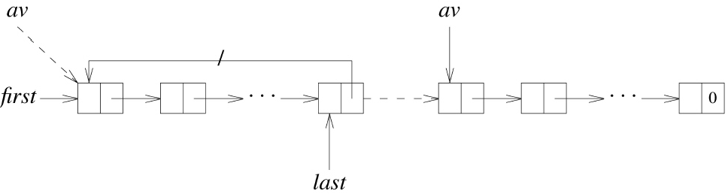
4.5 Available Space Lists (2/2)
Deleting a circular list
template <class KeyT>
void CircularList<T>::~CrivularList()
{//Delete the circular list
if(last){
ChainNode<T>* first = last→link;
last→link = av; //last node linked to av
av = first; //first node of list becomes front of av list
last = 0;
}
}
Dashed arrows indicate changes involved in deleting a circular list

Slide 29
4.6 Linked Stacks and Queues (1/2)
Linked stacks
  Facilitate insertion and deletion at the top
  top: point to the top node of the stack
  The constructor sets top to be 0 (NULL).
data link
top
0

Slide 30
4.6 Linked Stacks and Queues (2/2)
Linked queues
  Easily add a node at the rear
  Easily delete a node from the front
  front: point to the first node
  rear: point to the last node
  The constructor set both front and rear as 0.
front
rear
data link
0

Slide 31
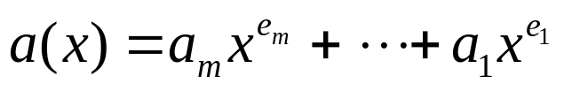
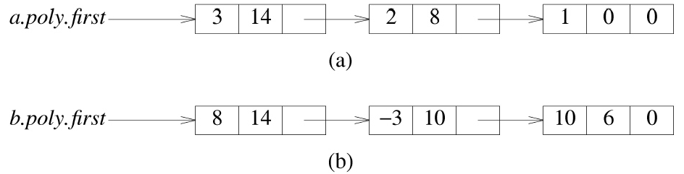
4.7 Polynomials (1/2)
Polynomial representation
  a_{i}: coefficient (nonzero)
  e_{i}: exponents (nonnegative integers)
  e_{m}>e_{m-1}> ... >e₂>e₁≥ 0
  Polynomial implemented by list
    We have Polynomial IS-IMPLEMENTED-BY List
3x¹⁴+ 2x⁸ +1
8x¹⁴ + 3x¹⁰ + 10x⁶

Slide 32
4.7 Polynomials (2/2)
Polynomial class definition
struct Term
{//All members of Term are public by default
int coef; //coefficient
int exp; //exponent
Term Set(int c, int e){coef=c; exp=e; return *this;};
};
class Polynomial{
public:
//public functions defined here
private:
Chain<Term> poly;
};
coef
exp
link
: Polynomial
data
link
: Chain
coef
exp
: Term

Slide 33
Adding Polynomials (1/3)
Addition
  Two polynomials a, b
  If the exponents of two terms are equal, then the coefficients are added. A new term is created for the result if the sum is nonzero.
  If the exponent of the current term in a is less than the exponent of the current term in b, then a copy of the term in b is created and attached to the new Polynomial.
  Otherwise, similar actions are performed for a.
  InsertBack() is used for the attachment.

Slide 34
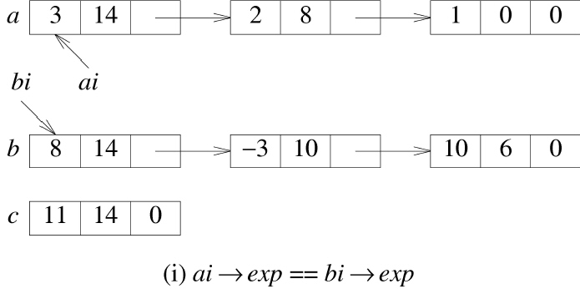
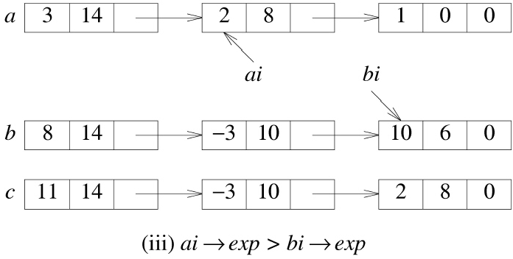
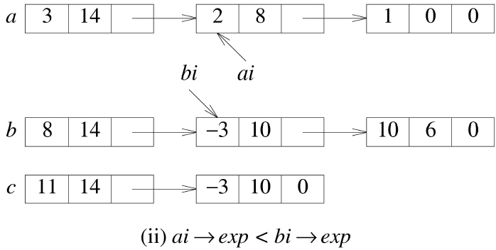
Adding Polynomials (2/3)
c=a+b

Slide 35
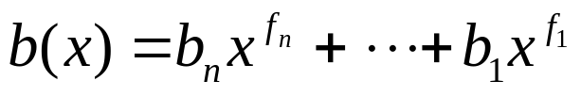
Adding Polynomials (3/3)
Analysis of operator+()
  ,
  Coefficient additions
    0 ≤ coefficient additions ≤ min{m,n}
  Exponent comparisons
    Bounded by m+n
  Inserting a term
    No more than m+n
O(m+n)

Slide 36
Circular List Representation of Polynomials
Circular list representation of a polynomial
  3x¹⁴+2x⁸+1
  The zero polynomial has to be handled as a special case
Introduce a header node
first
3
14
2
8
1
0
head
-
-
(a) Zero polynomial
head
-
-
3
14
2
8
1
0
(b) 3x + 2x + 1
14
8

Slide 37
4.8 Equivalence Classes (1/5)
For an arbitrary relation ≡
  (1) Reflexive: for any polygon c, x≡x
  (2) Symmetric: for polygons x and y, x≡y then y≡x
  (3)Transitive: for polygons x, y, and z, x≡y and y≡z then x≡z
Equivalence relation
  Over a set S, ≡ is symmetric, reflexive, and transitive.
Equivalence classes
  x≡y, then x and y are in the same equivalence
  ex)
  0≡4, 3≡1, 6≡10, 8≡9, 7≡4, 6≡8, 3≡5, 5≡11, 11≡0
  →{ 0, 2, 4, 7, 11}, {1, 3, 5}, {6, 8, 9, 10}

Slide 38
4.8 Equivalence Classes (2/5)
An algorithm for determining equivalence classes
  The equivalence pairs (i,j) are read and stored.
  Begin at 0 and find all pairs of the form (0,j). The values 0 and j are in the same class.
  Continue in this was till the entire equivalence class containing 0 has been found and output.
  Find an object not yet output.

Slide 39
4.8 Equivalence Classes (3/5)
First version of equivalence algorithm
  m: the number of input pairs
  n: the number of objects
  pairs[i][j] = true: (i,j) is an input pair.
  Very few of the array elements are used: waste of space.
  Θ(n²) time for initializing the array
void Equivalence()
{
Initialize;
while more pairs
{
input the next pair (i,j);
process this pair;
}
initialize for output;
for (each object not yet output)
output the equivalence class that contains this object;
}

Slide 40
4.8 Equivalence Classes (4/5)
A more detailed version of equivalence algorithm
  first[i]: a pointer to the first node in the chain for row i
    Random access to the ith row
  out[i]: tells whether or not object i is to be printed.
void Equivalence()
{
read n; //read in number of objects
initialize first[0:n-1] to 0 and out[0:n-1] to false;
while more pairs //input pairs
{
read the next pair (i,j);
put j on the chain first[i];
put i on the chain first[j];
}
for(i=0;i<n;i++)
if(!out[i]){
out[i] = true;
output the equivalence class that contains object i;
}
}

Slide 41
4.8 Equivalence Classes (5/5)
Lists after pairs have been input
  0≡4, 3≡1, 6≡10, 8≡9, 7≡4, 6≡8, 3≡5, 5≡11, 11≡0
[0]
[1]
[2]
[3]
[4]
[5]
[6]
[7]
[8]
[9]
[10]
[11]
first
data
11
3
11
5
7
3
8
4
6
8
6
0
link
0
0
0
0
0
0
data
4
1
0
10
9
2
link
0
0
0
0
0
0

Slide 42
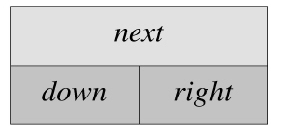
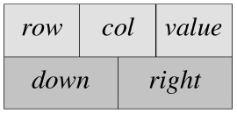
4.9 Sparse Matrices (1/2)
Sparse matrix representation
  A row list and a column list
  Each circular list has a header node.
  Header node
    down: link into a column list
    right: link into a row list
    next: link the header nodes
  Element node
    down: link to the next nonzero term in the same column
    right: link to the next nonzero term in the same row

Slide 43
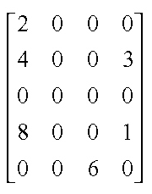
4.9 Sparse Matrices (2/2)
5*4 sparse matrix a
The number of needed nodes
  an n*m sparse matrix with r nonzero terms
  max{n,m}+ r + 1

Slide 44
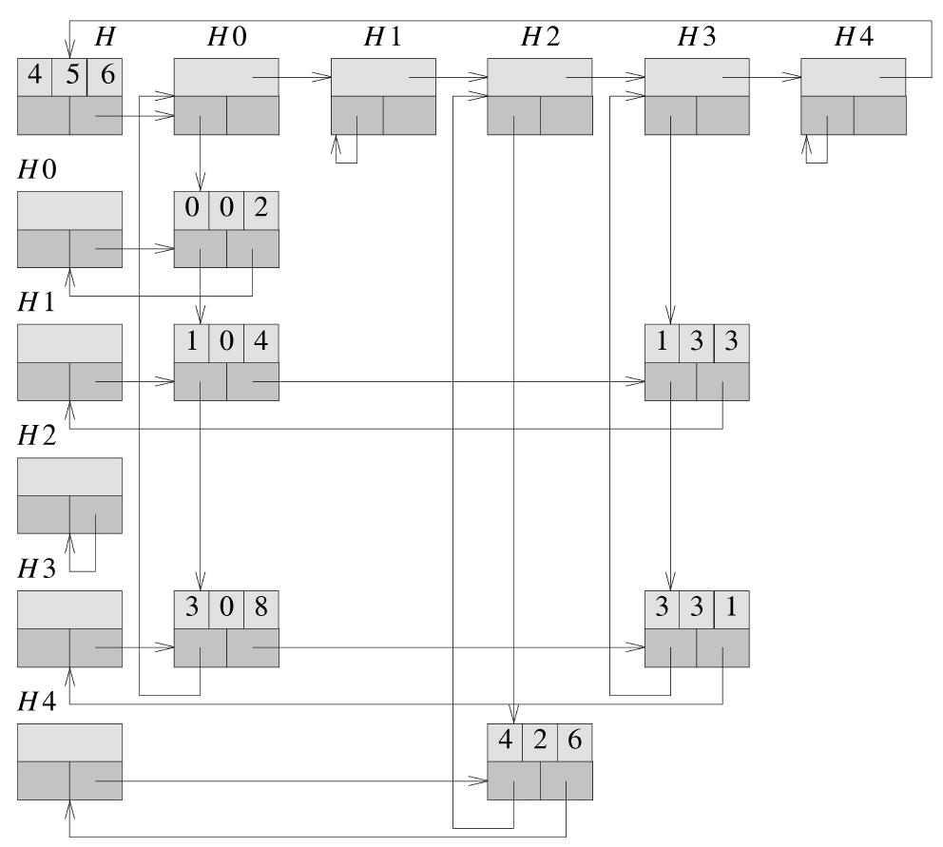
Linked representation of the sparse matrix (the head field is not shown)

Slide 45
Sparse Matrix Input
The first input line
  the respective numbers of rows, columns, and nonzero terms
Subsequent input lines
  Triples of the form (i,j,a_{ij})
  row, col, and value data members of the nonzero terms
  Ordered by rows and within rows by columns

Slide 46
Deleting a Sparse Matrix
A destructor using an available-space list
Matrix::~Matrix()
{//Return all nodes to the av list. This list is a chain linked via the right
//field. av is a static variable that points to the first node of the av list
if(~headnode) return ;//no nodes to delete
MatrixNode *x = headnode→right;
headnode→right = av; av= headnode; //return headnode
while(x!=headnode){//erase by rows
MatrixNode *y = x→right;
x→right = av;
av = y;
x=x→next;//next row
}
headnode =0;
}
Analysis of ~Matrix(): O(n+m) time

Slide 47
4.10 Doubly Linked Lists (1/3)
Doubly linked lists
  A node has left and right links
Header Node
Left
data
Right
-
Doubly linked circular list with header node
first
-
Empty doubly linked circular list with header node

Slide 48
4.10 Doubly Linked Lists (2/3)
Class definition of a doubly linked list
Deletion from a doubly linked circular list
class DblList;
class DblListNode {
friend class DblList;
private:
int data;
DblListNode *left, *right;
};
class DblList {
public:
// List manipulation operations
private:
DblListNode *first; // points to header node
};
void DblList::Delete(DblListNode *x)
{
if ( x == first ) throw "Deletion of header node not permitted“;
else {
x→left→right = x→right;
x→right→left = x→left;
delete x;
}
}
Before
After
first
first
-
-
x
x

Slide 49
4.10 Doubly Linked Lists (3/3)
Insertion into a doubly linked circular llist
void DblList::Insert(DblListNode *p, DblListNode *x)
{// insert node p to the right of node x
p→left = x; p→right = x→right;
x→right→left = p; x→right = p;
}
p
x

Slide 50
4.11 Generalized Lists (1/7)
Generalized lists
  A finite sequence of n≥0 elements, i.e., a₀ ,…, a_{n-1}
  a_{i}: either atom or list
  The elements a_{i} (0≤i≤n-1) that are not atoms are said to be the sublists
Representation
  A list A =(a₀ ,…, a_{n-1} )
  A: the name of the list
  n: list length
  All list names are represented by capital letters.
  Lowercase letters are used for atoms
  If n≥1, a₀ is the head of A.
  (a₁ ,…, a_{n-1} ) is the tail of A.

Slide 51
4.11 Generalized Lists (2/7)
Some examples
  A = (): the null, or empty, list; the length is zero.
  B = (a,(b,c)): a list of length two. The first element is the atom a; the second element is the linear list (b,c).
  C = (B,B,()): length is three.
  D = (a,D): a recursive list of length two. D corresponds to the infinite list (a,(a,(a,…).

Slide 52
4.11 Generalized Lists (3/7)
Representing polynomials in several variables
  P(x,y,z)=x¹⁰y³z² + 2x⁸y³z² + x⁴y⁴z + 6x³y⁴z + 2yz
  = ((x¹⁰ + 2x⁸)y³ + 3x⁸y² )z² + ((x⁴ +6x³)y⁴ + 2y)z
  =Cz²+Dz
  C(x,y) = Ey³ +Fy²
The type PolyNode
enum Triple { var, ptr, no };
class PolyNode
{
PolyNode *next; //link field
int exp;
Triple trio;
union {
char vble;
PolyNode *down; //link field
int coef;
};
};

Slide 53
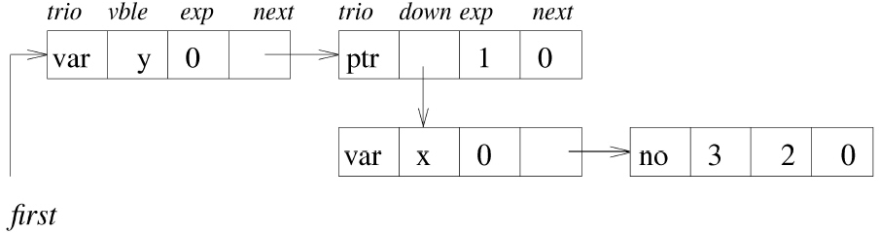
4.11 Generalized Lists (4/7)
Three types of nodes
  trio == var
    Header node for a list
  trio == ptr
    Coefficient is a list and is pointed by down.
  trio == no
    Coefficient is an integer and is stored in coef.
Representation of (3x²y)

Slide 54
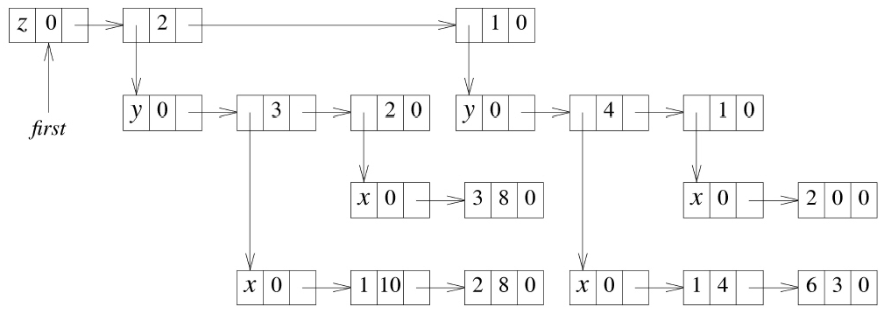
4.11 Generalized Lists (5/7)
((x¹⁰+2x⁸)y³+3x⁸y²)z²+((x⁴+6x³)y⁴+2y)z의 표현

Slide 55
4.11 Generalized Lists (6/7)
Node structure for the generalized list
tag=false/true
data/down
next
Data structure definition
template <class T> class GenList; //forward declaration
template <class T>
class GenListNode{
friend class GenList<T>;
private:
GenListNode<T> *next;
bool tag;
union{
T data;
GenListNode<T> *down;
};
};
template <class T>
class GenList{
public:
//list manipulation operations
private:
GenListNode<T> *first;
};

Slide 56
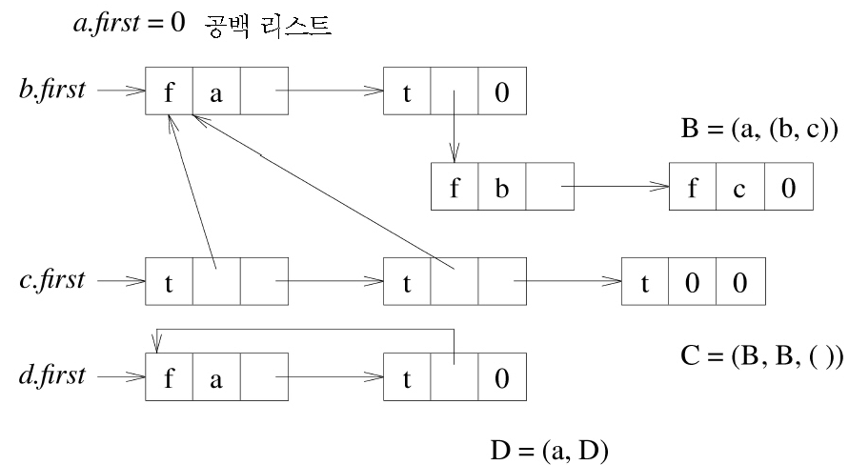
4.11 Generalized Lists (7/7)
data/down field
  If head(A) is an atom
    Holds an atom
  If head(A) is a list
    Holds a pointer to the list representation of head(A)
empty list

Slide 57
Recursive Algorithms for Lists (1/3)
Recursively defined objects → recursive algorithms
Recursive algorithms for C++ objects
  the recursive function itself (the workhorse)
  a second function that invokes the recursive function (the driver)
  Implementation
    Driver: public, workhorse: private
Copying a list
//Driver
void GenList<T>::Copy(const GenList<T>& l) const
{//Make a copy of l
first = Copy(l.first);
}
//Workhorse
GenListNode<T>* GenList<T>::Copy(GenListNode<T>* p)
{//Copy the nonrecursive list with no shared sublists pointed at by p
GenListNode<T> *q =0;
if(p){
q=new GenListNode<T>;
q→tag = p→tag;
if(p→tag)q→down = Copy(p→down);
else q→data = p→data;
q→next = Copy(p→next);
}
return q;
}

Slide 58
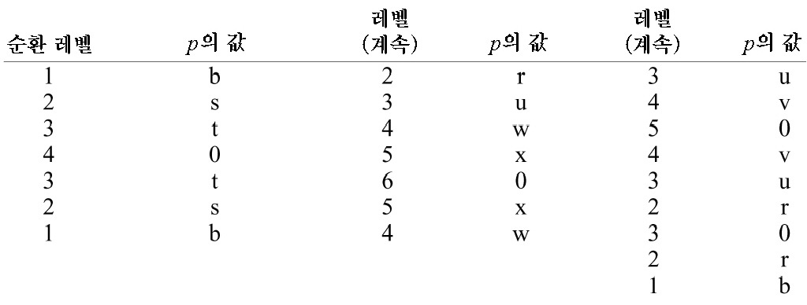
Recursive Algorithms for Lists (2/3)
Time complexity
  List A=((a,b),(c,d),e))
  Nodes with tag = false visited twice,
  Nodes with tag = true visited 3 times
  → No more than 3m executions if a list has a total of m nodes.
  O(m)
first
r
b
t
t
0
t
u
v
s
f
a
f
b
0
t
f
e
0
w
x
f
c
f
d
0
level of recursion
continuing level
continuing level
value of p
p
p

Slide 59
Recursive Algorithms for Lists (3/3)
List depth
0 if s is an atom
depth(s)=
1+ max(depth(x₁),…,depth(x_{n}) if s is the list (x₁,…,x_{n}), n≥1
// Driver
template <class T>
int GenList<T>::Depth()
{// Compute the depth of a non-recursive list
return Depth(first);
}
// Workhorse
template <class T>
int GenList<T>::Depth(GenListNode<T> *s)
{
if (!s) return 0; //empty list
GenListNode<T> *current = s;
int m = 0;
while (current) {
if (current→tag) m=max(m,Depth(current→down));
current = current→next;
}
return m+1;
}

Slide 60
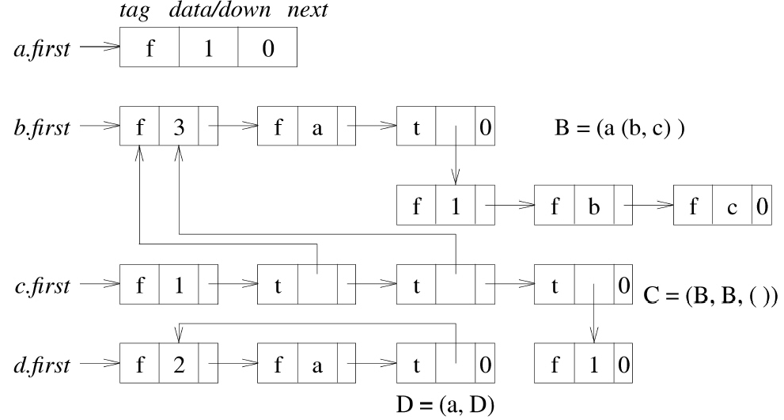
Reference Counts, Shared and Recursive Lists (1/4)
Specify shared subunits
  A sublist appearing within a list definition is named through th use of a list name preceding it.
List sharing could create problems when adding or deleting a node at the front
Using header nodes
  data/down: reference counts (the number of pointers to that list)

Slide 61
Reference Counts, Shared and Recursive Lists (2/4)
t.~GenList<T>()
  Decrement the reference counter of t.first by one
  Only when the ref counter becomes zero are the nodes of t deleted.
GenListNode<T> definition
template <class T>
class GenListNode<T>
{
friend class GenList<T>;
private:
GenListNode<T> *next;
int tag; // 0 for data, 1 for down, 2 for ref
union{
T data;
GenListNode<T> *down;
int ref;
};
};

Slide 62
Reference Counts, Shared and Recursive Lists (3/4)
Call to b.~GenList<T>(): b ← b - 2
Following call to c.~GenList<T>()
  The ref count of c → zero
  b.first→ref becomes 1 when the 2nd top-level node of c is processed
  b.first→ref becomes 0 when the 3rd top-level node of c is processed
  the top-level nodes of c are linked to the available-space list
Recursive lists: the ref count never becomes zero.
d.~GenList<T>(): d.first→ref become 1.

Slide 63
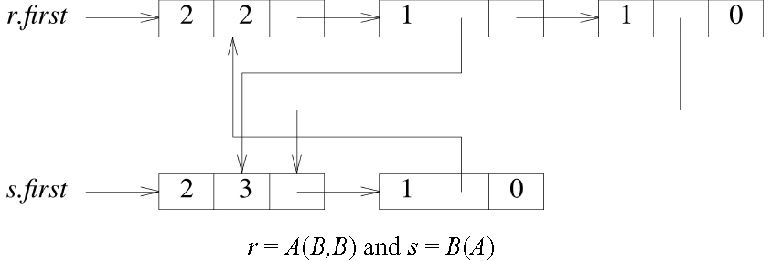
Reference Counts, Shared and Recursive Lists (4/4)
r.~GenList(), s.~GenList() then r.first→ref is 1,
s.first →ref is 2. no longer accessible, unable to free → garbage
  There is no simple way to determine when recursive lists may be physically deleted.

