Slide 1
Stacks and Queues
Chapter 3

Slide 2
Template Functions (1/2)
Reusable classes and functions
(1) Without template functions
  e.g., SelectionSort (Program 1.8, p. 27)
    int *a → float *a
    …
(2) Use templates (parameterized types)
  Save considerable amount of time and money for software development

Slide 3
Template Functions (2/2)
Template function SelectionSort
  Notice
    <, = and copy creator
    Automatically defined for int and float
    Should be defined for user-defined data types
  e.g., SelectionSort for Rectangle arrays
    operator < should be defined.
float farray[100];
int intarray[250];
...
// assume that the arrays are initialized at this point
SelectionSort(farray, 100);
SelectionSort(intarray, 250);
Program 3.2

Slide 4
Using Templates to Represent Container Classes (1/2)
(1) Container classes
  A class that represents a data structure containing a number of data objects; e.g., arrays and Bags
  Objects can be inserted to or deleted from the container class.
  Bag
    Can have multiple occurrences of the same element
    Insertion: the first available position in the array; if the array is full, its capacity is doubled.
    Deletion: the element in the middle position of the array; moving all the other elements to its right
    Pop: return the deleted item

Slide 5
Using Templates to Represent Container Classes (2/2)
(2) Implementation of Bag using templates
  Can store objects of any data types
  template <class T>
template <class T>
class Bag
{
public:
Bag (int bagCapacity = 10);
~Bag();
int Size() const;
bool IsEmpty() const;
T& Element() const;
void Push(const T&);
void Pop();
private:
T *array;
int capacity;
int top;
}
Instantiate the template class Bag to int and Rectangle
→ Bag<int> a;
→ Bag<Rectangle> r;
Definition of template class Bag

Slide 6
The Stack Abstract Data Type (1/5)
A special case of ordered list
A=a₀, a₁, …, a_{n-1}, n ≥ 0
Stacks
  An ordered list in which insertions and deletions are made at one end called the top
    S=(a₀,....,a_{n-1}):
    a₀ is the bottom element; a_{n-1} is the top element
    a_{i} is on top of element a_{i-1} (0<i<n).
  LIFO (Last-In-First-Out) list

Slide 7
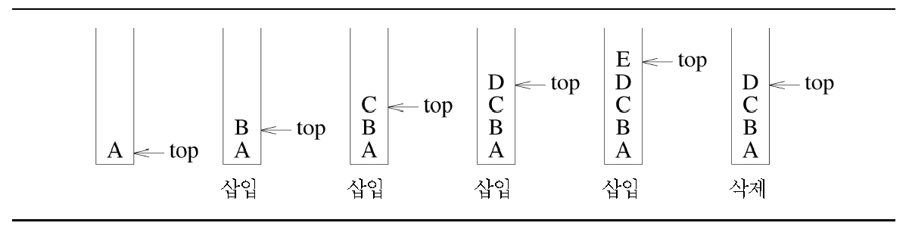
The Stack Abstract Data Type (2/5)
Inserting and deleting elements in a stack
add
add
add
add
pop

Slide 8
The Stack Abstract Data Type (3/5)
System stack
  Process function calls
  Create activation record or stack frame structure and place on the top of system stack
    Previous frame pointed
    Return address
    Local variables
    Arguments
  A recursive call requires no special strategy
    → A new stack frame for each recursive call
    → Can consume the entire available memory

Slide 9
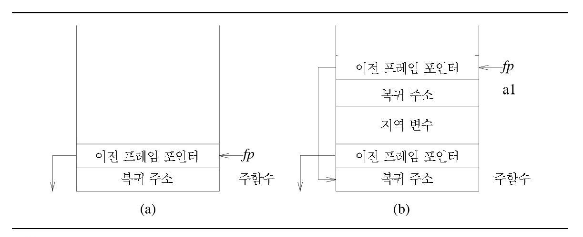
The Stack Abstract Data Type (4/5)
A main function invokes function a1
previous frame pointer
return address
local variables
previous frame pointer
previous frame pointer
return address
main
return address
main
System stack after function call

Slide 10
The Stack Abstract Data Type (5/5)
Stack ADT implementation
  Use an one-dimensional array stack[]
  the i-th element stored in stack[i-1]
  A variable, top, points to the top element of the stack
  (Initially: top = -1, an empty stack)
private:
T *stack; // array for stack elements
int top; // array position of top element
int capacity; // capacity of stack array
template <class T>
Stack<T>::Stack (int stackCapacity): capacity (stackCapacity)
{
if(capacity < 1) throw “Stack capacity must be > 0”;
stack = new T[capacity];
top = -1;
}

Slide 11
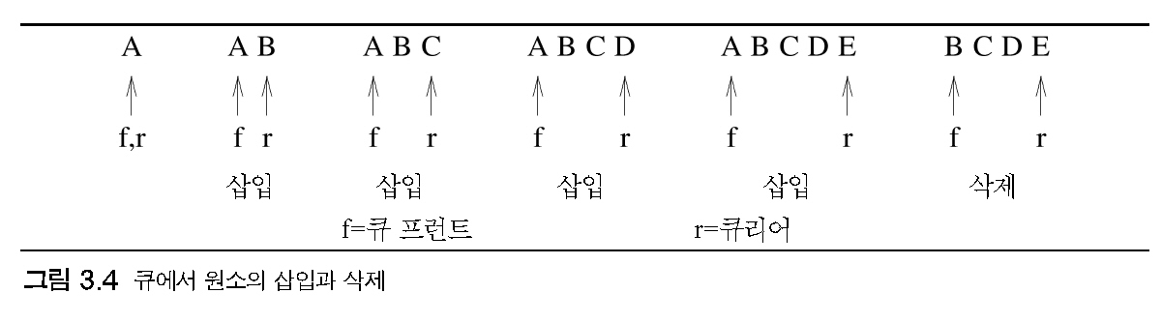
The Queue Abstract Data Type (1/10)
Queues
  An ordered list in which insertions and deletions take place at different ends
    The end at which new elements are added – rear
    The end from which old elements are deleted – front
  FIFO (First-In-First-Out) list
  Inserting and deleting elements in a queue

Slide 12
The Queue Abstract Data Type (2/10)
Implementation of queues using an one-dimensional array, queue[]
  The first element of the queue: queue[0]
rear
rear
rear
A
B
C
…
B
C
…
B
C
D
…
[0] [1] [2]
[0] [1]
[0] [1] [2]
- pop: deletes the element in queue[0]
→ The remaining elements should be shifted to the left.
→ If the queue has n elements, it takes Θ(n) time to pop an element.
- push: can be done in Θ(1) time exclusive of the time for array resizing

Slide 13
The Queue Abstract Data Type (3/10)
Implementation of queues
  (2) The first element in the queue: queue[front]
  - A variable front: keep track of the location of the front element
  - pop can be done in Θ(1) time.
  - Elements of queue: queue[front], …, queue[rear]
rear
rear
rear
front
front
front
A
B
C
…
B
C
…
B
C
D
…

Slide 14
The Queue Abstract Data Type (4/10)
Implementation of queues
(2) The first element in the queue: queue[front] (cont’d)
  - capacity: size of queue
Problematic when rear = capacity-1 and front > 0
    To shift all elements to the left end of the queue and create space at the right end
    – Takes time proportional to the size of the queue
    Circular queues
    – The worst-case add and delete times become Θ(1).
front
rear
front
rear
…
A
B
C
D
E
A
B
C
D
E
...
(a) Before shift
(b) After shift

Slide 15
The Queue Abstract Data Type (5/10)
Circular queues
  Variable front: points one position counterclockwise from the location of the front element in the queue
  Variable rear: points
rear
rear
rear
C
C
D
C
D
B
B
B
A
A
front
front
front
(a) Initial
(b) Addition
(c) Deletion

Slide 16
The Queue Abstract Data Type (6/10)
Circular Queues
  Each array position has a next and a previous position.
    Next to capacity – 1: 0
    The position that precedes 0: capacity - 1
  Move front and rear from current position to the next
→ if(rear == capacity-1) rear=0;
else rear++; // (rear++은 rear = (rear+1)%capacity)와 동등)
Private:
T* queue; // array for queue elements
int front, // one counterclockwise from front
rear, // array position of rear element
capacity; // capacity of queue array
template <class T>
Queue<T>::Queue (int queueCapacity): capacity (queueCapacity)
{
if(capacity < 1) throw “Queue capacity must be > 0”;
queue = new T[capacity];
front = rear = 0;
}

Slide 17
The Queue Abstract Data Type (7/10)
Member functions IsEmpty(), Front(), and Rear()
template <class T>
inline bool Queue<T>::IsEmpty() { return front == rear; }
Template <class T>
Inline T& Queue<T>::Front()
{
if(IsEmpty()) throw “Queue is empty. No front element”;
return queue[(front+1)%capacity];
}
Template <class T>
Inline T& Queue<T>::Rear()
{
if(IsEmpty()) throw “Queue is empty. No rear element”;
return queue[rear];
}
  Empty and full conditions for queue: front == rear
  Increase the capacity of a queue just before it becomes full

Slide 18
The Queue Abstract Data Type (8/10)
Implementation of push
  Use custom code to double the capacity of queue
queue
[0] [1] [2] [3] [4] [5] [6] [7]
C
D
C
D
E
F
G
A
B
B
E
front = 5, rear = 4
(b) Flattened view of circular full queue
A
F
G
[0] [1] [2] [3] [4] [5] [6] [7] [8] [9] [10][11][12][13][14][15]
front = 5
rear = 4
C
D
E
F
G
A
B
front = 5, rear = 4
(a) A full circular queue
(c) After array doubling
(by ChangeSize1D (Program 3.3)

Slide 19
The Queue Abstract Data Type (9/10)
Implementation of push (cont’d)
[0] [1] [2] [3] [4] [5] [6] [7] [8] [9] [10][11][12][13][14][15]
C
D
E
F
G
A
B
front = 13, rear = 4
(d) After shifting right segment
[0] [1] [2] [3] [4] [5] [6] [7] [8] [9] [10][11][12][13][14][15]
A
B
C
D
E
F
G
front = 15, rear = 6
(e) Alternative configuration
  (1) Create a new array newQueue of twice the capacity
  (2) Copy the second segment (i.e., the elements queue[front+1] through queue[capacity-1]) to positions in newQueue beginning at 0.
  (3) Copy the first segment (i.e., the elements queue[0] through queue[rear]) to positions in newQueue beginning at capacity-front-1

Slide 20
The Queue Abstract Data Type (10/10)
Pop
  Time complexity: O(1)
template <class T>
void Queue<T>::Pop()
{// Delete front element from queue
if(isEmpty()) throw “Queue is empty. Cannot delete.”;
front = (front+1)%capacity;
queue[front].~T(); // destructor for T
}
Deleting from a queue
lastOp variable
  One way to use all positions in the array queue
  Record the last operation performed on the queue
    Following each addition: set to “Push”
    Following each deletion: set to “Pop”
  When front == rear, we can determine according to the value of lastOp (“Push”: full, “Pop”: empty)
  Slow down the push and pop operations

Slide 21
Subtyping and Inheritance in C++ (1/4)
Inheritance: subtype relationships between abstract data types
  IS-A relationship
  e.g.,
    chair: subtype of furniture (IS-A)
    lion: subtype of mammal (IS-A)
    rectangle: subtype of polygon (IS-A)
The relationship between Bag and Stack
  Bag: a data structure into which elements can be inserted and from which elements can be deleted
  Stack: more specialized (last-in first-out)
  Stack is a subtype of Bag.

Slide 22
Subtyping and Inheritance in C++ (2/4)
Public inheritance in C++
: express IS-A relationship
The more general ADT
: Base class - Bag
The more specialized ADT
: Derived class - Stack
Virtual member function
  Declaration: base class
  Implementation: derived class
class Stack : public Bag
{
}

Slide 23
Subtyping and Inheritance in C++ (3/4)
Inheritance
  The derived class (Stack) inherits all the members (data and functions) of the base class (Bag).
    Only the non-private members of the base class are accessible.
  Inherited public and protected members have the same level of access.
  The inherited member functions have the same prototype.
    Reuse of the interface of a base class
    It is also possible to override the base class implementation.

Slide 24
Subtyping and Inheritance in C++ (4/4)
Queue ADT: a subtype of Bag
  More specialized: FIFO
  Queue: also can be expressed as a derived class of Bag
    The relationship between Queue and Bag is less similar than the relationship between Bag and Stack. → more operations should be redefined.

Slide 25
A Mazing Problem (1/5)
A maze is represented as a two-dimensional array maze[i][j] (1≤i≤m and 1≤j≤p)
1: blocked
0: non-blocked
entrance
maze[1][1]
0 1 0 0 0 1 1 0 0 0 1 1 1 1 1
1 0 0 0 1 1 0 1 1 1 0 0 1 1 1
0 1 1 0 0 0 0 1 1 1 1 0 0 1 1
1 1 0 1 1 1 1 0 1 1 0 1 1 0 0
1 1 0 1 0 0 1 0 1 1 1 1 1 1 1
0 0 1 1 0 1 1 1 0 1 0 0 1 0 1
0 0 1 1 0 1 1 1 0 1 0 0 1 0 1
0 1 1 1 1 0 0 1 1 1 1 1 1 1 1
1 1 0 0 0 1 1 0 1 1 0 0 0 0 0
0 0 1 1 1 1 1 0 0 0 1 1 1 1 0
0 1 0 0 1 1 1 1 1 0 1 1 1 1 0
exit
maze[m][p]
Can you find a path?

Slide 26
A Mazing Problem (2/5)
Current position x : maze[i][j]
NW
N
NE
[
i-1][j-1]
[
i-1][j]
[
i-1][j+1]
W
[
i][j-1]
X
[
i][j+1]
E
[
i] [j]
[
i+1][j-1]
[
i+1][j]
[
i+1][j+1]
SW
S
SE
Allowable moves
  If [i][j] is on a border; i=1 or m, or j=1 or p → only three neighbors exist.
    To avoid border conditions → surround the maze by a border of ones
    maza[m+2][p+2]

Slide 27
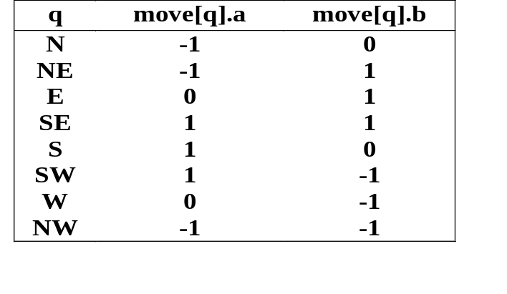
A Mazing Problem (3/5)
Predefine the possible directions to move in a table
struct offsets
{
int a, b;
};
enum directions {N, NE, E, SE, S, SW, W, NW};
offsets move[8];
Table of moves
[i][j] → [g][h]
→g = I + move[sw].a;
h = j + move[sw].b;
  Save the current position and the direction of the last move in a list

Slide 28
A Mazing Problem (4/5)
entrance
0 0 0 0 0 0 0 0 1
1 1 1 1 1 1 1 1 0
1 0 0 0 0 0 0 0 1
0 1 1 1 1 1 1 1 1
1 0 0 0 0 0 0 0 1
1 1 1 1 1 1 1 1 0
1 0 0 0 0 0 0 0 1
0 1 1 1 1 1 1 1 1
1 0 0 0 0 0 0 0 0
exit
A maze with a long path
  Using the three arrays maze, mark, and move
    Specify how to represent the list of triples (i, j, dir)
    Should be a stack since the most recently entered triple is remove first
  maze, mark, move assumed global to Path
  stack is defined as a stack of items
struct Items {
int x, y, dir;
};

Slide 29
A Mazing Problem (5/5)
Operator <<
  Overloaded for Stack and Items
  a friend to Stack
template <class T>
ostream& operator<<(ostream& os, Stack<T>& s)
{
os << "top = " << s.top << endl;
for (int i = 0; i <= s.top; i++)
os << i << ":" << s.stack[i] << endl;
return os;
}
ostream& operator<<(ostream& os, items& item)
{
return os << item.x << "," << item.y << ","
<< item.dir;
}
Overloading <<

Slide 30
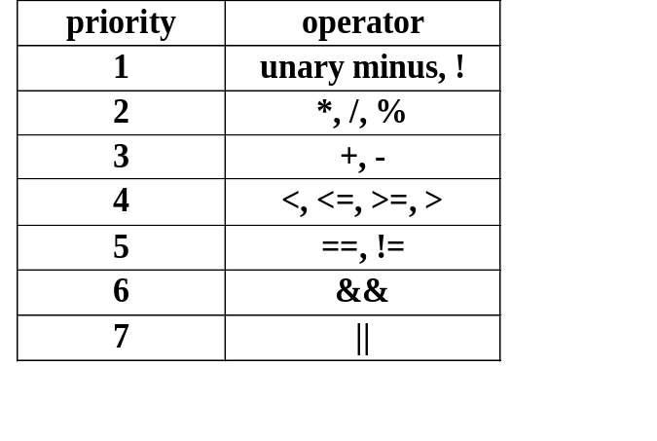
Evaluation of Expressions (1/2)
Expressions
  Operands, operators, and delimiters
  The first problem with understanding the meaning of an expression: in what order the operations are carried out
  A priority on each operator
Priority of operators in C++
e.g.,
X = A/B-C+D*E-A*C
X = (((A/B)-C)+(D*E))-(A*C)

Slide 31
Evaluation of Expressions (1/2)
Notations for expressions
  Infix:
  A * B / C
  Postfix:
  A B * C /
  Prefix:
  / * A B C

Slide 32
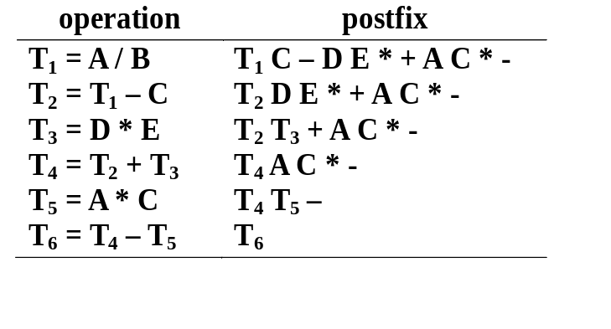
Postfix Notation
The virtues of postfix notation:
  No parentheses are needed.
  The priority of the operators is not relevant.
  May be evaluated by a left to right scan
e.g.,
  Infix notation: A/B-C+D*E-A*C
  Postfix notation: AB/C-DE*+AC*-

Slide 33
Infix to Postfix (1/3)
An algorithm for producing postfix from infix
  (1) Fully parenthesize the expression
  (2) Move all operators so that they replace their corresponding right parentheses
  (3) Delete all parentheses
  e.g., A/B-C+D*E-A*C.
  → ((((A/B)-C)+(D*E))-(A*C))
  → AB/C-DE*+AC*-
    Note: the order of operands is not changed.

Slide 34
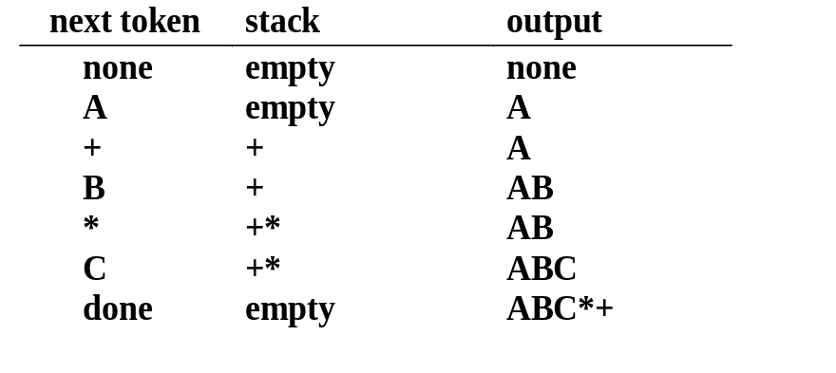
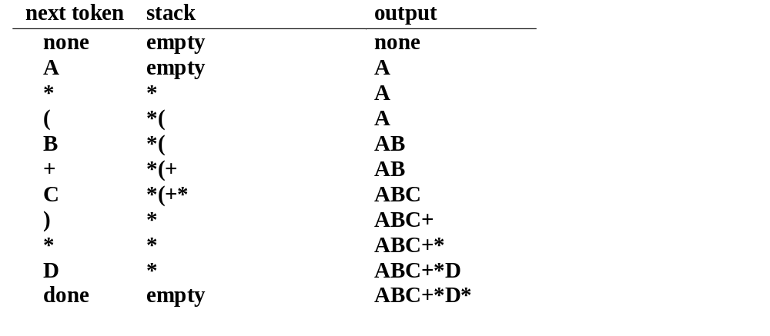
Infix to Postfix (2/3)
e.g., A+B*C → ABC*+
e.g., A*(B+C)*D → ABC+*D*

Slide 35
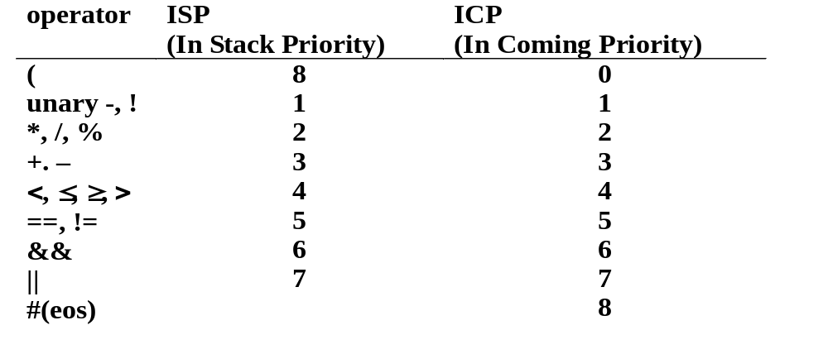
Infix to Postfix (3/3)
A priority-based scheme for stacking and unstacking operators
  The left parenthesis ‘(‘ complicates things.
    in the stack; low priority
    not in the stack; high priority
  Resolution: isp (in-stack precedence) and icp (incoming precedence)

