Slide 1
Trees

Slide 2
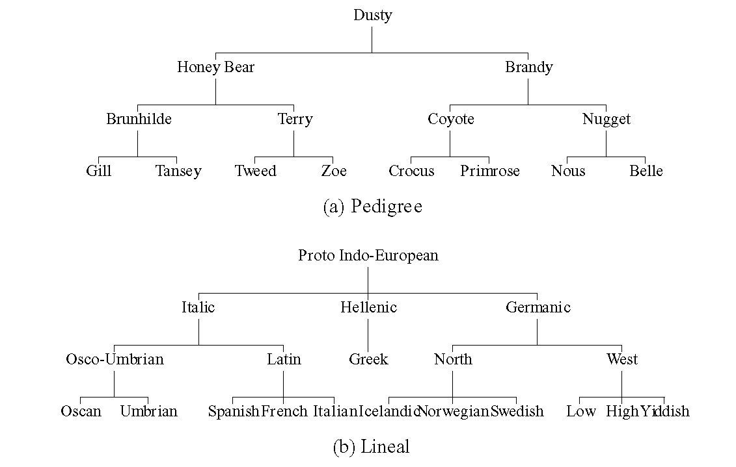
Tree Structures

Slide 3
Trees
Definition : a finite set of one or more nodes s.t.,
  ① A root node
  ② The remaining nodes are partitioned into n( ≥ 0) disjoint sets T₁, T₂, … , T_{n} (T_{i} : subtrees of the root)
  Node : item information + branches to other nodes
  Degree of a node : # of its subtrees
  Terminal (leaf) node : degree = 0
  Non-terminal : degree ≠ 0
  Children : roots of the subtrees of a node X (↔ parents)
  Siblings : children of the same parent
  Degree of a tree = max{degree of its nodes}
  Ancestors : all nodes along the path to the root
  Node level : root = level 1, children = level of the parent+1
  Height of trees (depth) = max{level of the nodes}

Slide 4
Tree Representation
Level
A
1
B
C
D
2
E
F
G
H
I
J
3
K
L
M
4

Slide 5
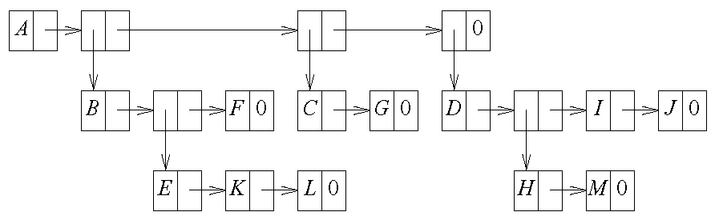
List Representation
Representation of trees based on the linked list
(A(B(E(K,L),F),C(G),D(H(M),I,J)))
A node structure for the tree with degree k
  Waste of the space
    k-ary tree : If the number of nodes is n, then n(k-1)+1 of nk child fields is 0.

Slide 6
Left Child-Right Sibling Representation
Node structure
Tree representation
data
left child
right sibling
A
B
C
D
E
F
G
H
I
J
K
L
M

Slide 7
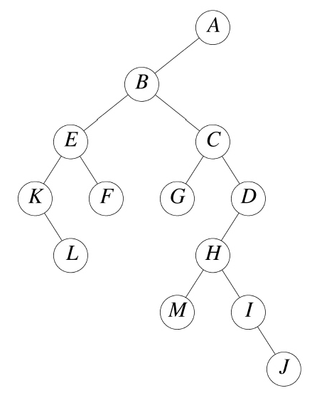
Representing as a Degree-Two Tree
Degree-2 representation
  Rotate right sibling pointers clockwise by 45 degrees.
  Right child of the root node is empty.
Binary trees
  Left child-right child trees

Slide 8
Tree Representations
A
A
A
B
B
B
Tree
Left child-right sibling
Binary
A
A
A
B
B
C
B
C
C
Tree
Left child-right sibling
Binary

Slide 9
Binary Trees (1/3)
Characteristics
  Each node has at most two branches.
  Distinction between the left and right subtrees
  May have zero node
Definition
  A finite set of nodes that either is empty or consists of a root node and two disjoint binary trees, i.e., the left and right subtrees.

Slide 10
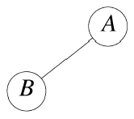
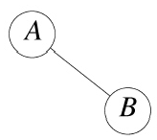
Binary Trees (2/3)
Distinction between a binary tree and a tree
  Empty binary trees exist.
  Order of the children
    Two different example binary trees

Slide 11
Binary Trees (3/3)
Skewed and complete binary trees
level
A
A
1
B
B
C
2
C
D
E
F
G
3
D
H
I
4
E
5

Slide 12
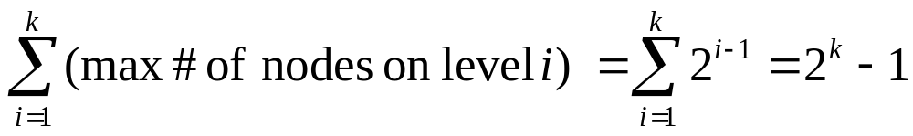
Properties of Binary Trees (1/4)
Maximum # of nodes
  The max # of nodes on level i : 2^{i-1} (i ≥ 1)
  The max # of nodes in a binary tree of depth k
  : 2^{k} – 1 (k ≥ 1)
  Proof of 1
    Induction base : the root is the only node on level i=1. Hence, max # of nodes on level 1 : 2¹⁻¹ = 2⁰ = 1.
    Induction hypothesis : assume that max # of nodes on level i-1 is 2^{i-2}.
    Induction Step : max # of nodes on level i-1 is 2^{i-2} by the induction hypothesis. Since the max degree is two, the max # of nodes on level i is 2^{i-1}. Q.E.D.
  Proof of 2

Slide 13
Properties of Binary Trees (2/4)
Relation btw # of leaf nodes and degree-2 nodes
  n₀ = n₂ +1
    n₀ : # of leaves
    n₂ : # of degree-2 nodes
  Proof
    n₁ : # of degree-1 nodes, n : # of total nodes, B : # of branches
    n = n₀ + n₁ + n₂
    Every node except the root has a branch leading into it.
    n = B + 1
    All branches stem from a node of degree one or two.
    B = n₁ + 2n₂
    ∴ n = B + 1 = n₁ + 2n₂ + 1
    n₀ = n₂ +1

Slide 14
Properties of Binary Trees (3/4)
Full binary trees
  Depth k, # of nodes 2^{k}-1 (k≥0)
  Numbering of the nodes 1, …, 2^{K}-1
1
2
3
4
5
7
7
8
9
10
11
12
13
14
15

Slide 15

Properties of Binary Trees (4/4)
Complete binary trees
  Depth k, # of nodes n
  The nodes correspond to the nodes numbered from 1 to n in the full binary tree of depth k.
  Height of a complete binary tree with n nodes
A
B
C
D
E
F
G
H
I

Slide 16

Binary Tree Representations (1/4)
Array representation
  One-dimensional array
  Lemma 5.4
    A complete binary tree having n nodes
    ① parent(i) : if i ≠ 1
    ② leftChild(i) : 2i if 2i ≤ n
    no left child if 2i > n
    ③ rightChild(i) : 2i+1 if 2i+1≤ n
    no right child if 2i+1 > n
  Complete binary tree : no wasted space
  Skewed tree : waste of the space
    In the worst case, a skewed tree with depth k requires 2^{k}-1 spaces.

Slide 17
Binary Tree Representations (2/4)
[0]
-
Skewed
Complete
[1]
A
[0]
-
[2]
B
[1]
A
[3]
-
[2]
B
A
A
[4]
C
[3]
C
B
[5]
-
[4]
D
B
C
[6]
-
[5]
E
C
[7]
-
D
E
F
G
[6]
F
[8]
D
[7]
G
D
[9]
-
H
I
[8]
H
.
.
.
.
.
.
[9]
I
E
[16]
E

Slide 18
Binary Tree Representations (3/4)
Linked representation
  Node representation
  Class definition
  Hard to find the parent
    parent field is attached.
data
left child
data
right child
LeftChild
RightChild
template <class T> class Tree;
template <class T>
class TreeNode{
friend class Tree<T>;
private:
T data;
TreeNode<T> *leftChild;
TreeNode<T> *rightChild;
};
template <class T>
class Tree {
public:
// operations
...
private:
TreeNode<T> *root;
};

Slide 19
Binary Tree Representations (4/4)
Linked representations
A
root
B
A
0
C
B
0
C
0
D
D
0
E
0
E
0
root
A
A
B
C
B
C
D
E
F
G
D
E
0
0
F
0
0
G
0
H
I
0
H
0
0
I
0

Slide 20
Binary Tree Traversal and Tree Iterators
Tree traversal
  Visiting each node in the tree exactly once
  Possible traversals : LVR, LRV, VLR, VRL, RVL, RLV
    L : moving left, V : visiting the node, R : moving right
  Traverse left before right (LR)
    LVR : inorder traversal
    VLR : preorder traversal
    LRV : postorder traversal
  Binary tree with arithmetic expression
+
*
E
*
D
/
C
A
B

Slide 21
Inorder Traversal
Call
currentNode
Action
Call
currentNode
Action
Driver
+
10
C
1
*
11
0
2
*
10
C
cout<<‘C’
3
/
12
0
4
A
1
*
cout<<‘*’
5
0
13
D
4
A
cout<<‘A’
14
0
6
0
13
D
cout<<‘D’
3
/
cout<<‘/’
15
0
7
B
Driver
+
cout<<‘+’
8
0
16
E
7
B
cout<<‘B’
17
0
9
0
16
E
cout<<‘E’
2
*
cout<<‘*’
18
0
Output : A/B*C*D+E

Slide 22
Level-Order Traversal
Using queues
Visit the root->left child->right child
+ * E * D / C A B
template <class T>
void Tree<T>::LevelOrder()
{//Traverse the binary tree in level order
Queue<TreeNode<T>*> q;
TreeNode<T> * currentNode = root;
while(currentNode){
Visit(currentNode);
if(currentNode->leftChild) q.Push(currentNode->leftChild);
if(currentNode->rightChild) q.Push(currentNode->rightChild);
if(q.IsEmpty()) return;
currentNode = q.Front();
q.Pop();
}
}

Slide 23
Traversal without a Stack
Add a parent field to each node
  Can trace the way back up to any root and down again
Threaded binary trees
  Two bits per node
  leftChild and rightChild fields to maintain the paths back to the root
  The stack of addresses is stored in the leaf nodes.

Slide 24
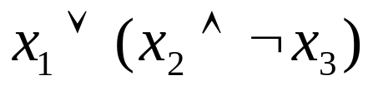
The Satisfiability Problem (1/4)
Variables x₁, x₂ , … , x_{n} and the operators ∧, ∨, ￢
  Values of the variables = {True, False}
Rules
  (1) a variable is an expression.
  (2) if x and y are expressions, then ￢x, x∧y, x∨y are expressions.
  (3) parentheses can be used. priority: ￢, ∧, ∨
Formulas of the propositional calculus
  Expressions based on the above rules

Slide 25
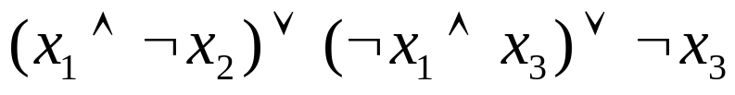
The Satisfiability Problem (2/4)
The satisfiability problem for the formulas
  If there is an assignment of values making the formula to be true.
∨
∨
¬
∧
∧
x₃
x₁
¬
¬
x₃
x₂
x₁

Slide 26
The Satisfiability Problem (3/4)
Take all possible combinations of values : O(g 2^{n})
  g : time to substitute values for the variables
  Traverse the tree in postorder; visit the node p after its subexpressions are evaluated
x₁ x₂ x₃ formular
T T T ?
T T F ?
T F T ?
T F F ?
F T T ?
F T F ?
F F T ?
F F F ?

Slide 27
The Satisfiability Problem (4/4)
Postorder computation
  Instantiate the template class Tree with T=pair<Operator, bool>; pair is the predefined C++ template structure with first and second.
  enum Operator { Not, And, Or, True, False};
for each of the 2^{n} possible truth value combinations for the n variables
{
replace the variables by their values in the current truth value combination;
evaluate the formula by traversing the tree it points to in postorder;
if(formula.Data().second()){cout << current combination; return;}
}
cout <<“no satisfiable combination”;

Slide 28
Threads (1/3)
Threaded representation of the binary tree with n nodes
  Total # of the links : 2n
  # of 0 links : n+1
root
A
B
C
D
0
E
0
0
F
0
0
G
0
0
H
0
0
I
0

Slide 29
Threads (2/3)
Threads
  Replace the 0-links by pointers to other nodes in the trees
  if p->rightChild == 0,
  p->rightChild = inorder successor of p
  if p->leftChild = 0,
  p->leftChild = inorder predecessor of p
root
A
B
C
D
E
F
G
H
I

Slide 30
Threads (3/3)
Empty threaded binary tree
  leftThread == false : leftChild ← pointer
  == true : leftChild ← thread
  rightThread == false : rightChild ← pointer
  == true : rightChild ← thread
Header node
  Leave no loose threads
LeftThread LeftChild data RightChild RightThread
TRUE
FALSE

Slide 31
Memory Representation of Threaded Trees
root
f
-
f
f
A
f
f
B
f
f
C
f
f
D
f
t
E
t
t
F
t
t
G
t
t
H
t
t
I
t
f = false; t = true

Slide 32
Inorder Traversal of a Threaded Binary Tree
Inorder traversal without stacks
Inorder successor
  x->rightThread == true : x->rightChild
  == false : following a path of left-child links till a node LeftThread==true is reached
Finding the inorder successor in a threaded binary tree
T* ThreadedInorderIterator::Next()
{//Return the inorder successor of currentNode in a threaded binary tree
ThreadedNode<T> *temp = currentNode->rightChild;
if(!currentNode->rightThread)
while(!temp->leftThread) temp = temp->leftChild;
currentNode = temp;
if(currentNode == root) return 0;
else return &currentNode->data;
}

Slide 33
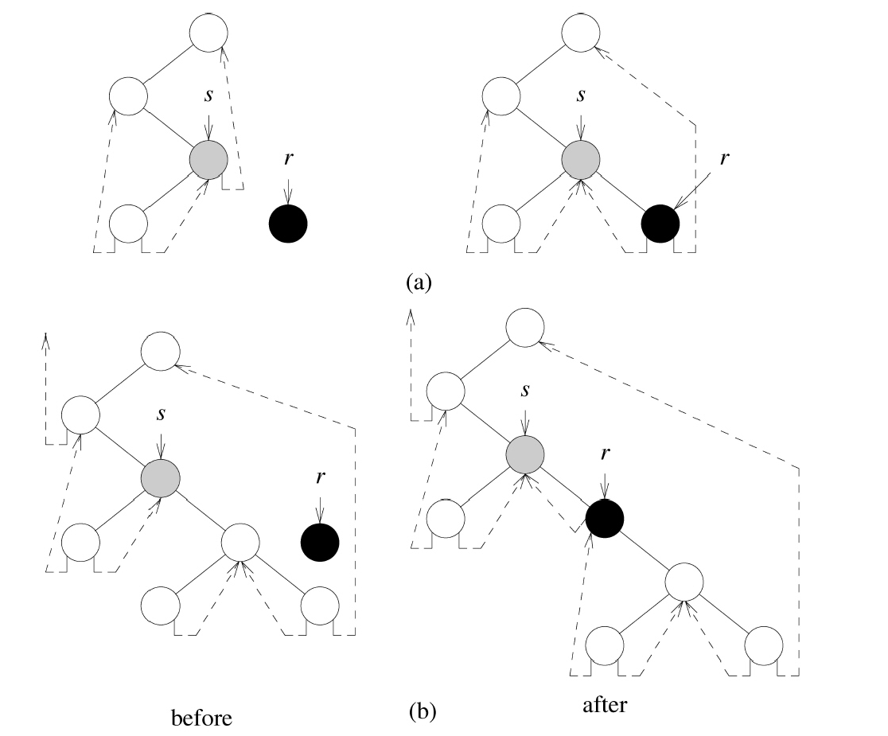
Node Insertion in a Threaded Binary Tree
r as a right child of s

Slide 34
Priority Queues (1/2)
Delete the one with highest (or lowest) priority
An element with arbitrary priority can be inserted.
Max priority queue
template <class T>
class MaxPQ{
public:
virtual ~MaxPQ(){}
//virtual destructor
virtual bool IsEmpty() const = 0;
//return true iff the priority queue is empty
virtual const T& Top() const =0;
//return reference to max element
virtual void Push(const T&) = 0;
//add an element to the priority queue
virtual void Pop() = 0;
//delete element with max priority
};

Slide 35
Priority Queues (2/2)
Representation methods
  Unordered linear lists
    IsEmpty() : O(1)
    Push() : O(1)
    Top() : Θ(n)
    Pop() : Θ(n)
  Max heaps
    IsEmpty() : O(1)
    Top() : O(1)
    Push() : O(log n)
    Pop() : O(log n)

Slide 36
Definition of a Max Heap
Max (min) tree : the key value in each node is no smaller (larger) than the key values in its children.
Max heap : complete binary max tree
Min heap : complete binary min tree
14
9
30
Max heaps
12
7
6
3
25
10
8
6
5
2
10
11
Min heaps
7
4
20
83
21
10
8
6
50

Slide 37
Insertion into a Max Heap
Ensure a max heap after the insertion
  Bubble up the new element as far as necessary
20
15
2
14
10
(a)
(b)
20
5
21
15
15
20
14
10
2
14
10
2
(c)
(d)

Slide 38
Deletion from a Max Heap
Deleting the root
  Remove the last element
  Trickle down
2
15
15
20
14
2
14
10
6
10
(a)
(b)
(c)

Slide 39
Binary Search Trees (1/2)
Dictionary
  collection of pairs <key, element>
template <class K, class E>
class Dictionary{
public:
virtual bool IsEmpty() const=0;
//return true iff the dictionary is empty
virtual pair<K,E>*Get(const K&) const = 0;
//return pointer to the pair with specified key; return 0 if no such pair
virtual void Insert(const pair<K,E>&)=0;
//insert the given pair; if key is a duplicate update associated element
virtual void Delete(const K&)=0;
//delete pair with specified key
};

Slide 40
Binary Search Trees (2/2)
Definition
  A binary tree. May be empty. If not empty,
  (1) The keys are distinct.
  (2) The keys in the left subtree are smaller than the key in the root.
  (3) The keys in the right subtree are larger than the key in the root.
  (4) The left and right subtrees are also binary search trees.
Binary trees
20
30
60
15
25
5
40
70
12
10
22
2
65
80
(a) X
(b) O
(c) O

Slide 41
Searching a Binary Search Tree
k = the key in the root : successful termination
k < the key in the root : left subtree search
k > the key in the root : right subtree search
template <class K, class E> //Driver
pair<K,E>* BST<K,E>::Get(const K& k)
{//search the binary tree (*this) for a pair with key k.
// if such a pair is found, return a pointer to this pair; otherwise, return 0.
return Get(root, k);
}
template <class K, class E> //Workhorse
pair<K,E>* BST<K,E>::Get(TreeNode <pair <K,E>>*p, const K& k)
{
if(!p) return 0;
if(k<p->data.first) return Get(p->leftChild,k);
if(k>p->data.first) return Get(p->rightChild,k);
return &p->data;
}

Slide 42
Searching a Binary Search Tree by Ranks
Rank
  Position in inorder traversal
  leftSize = # of elements in the left subtree + 1
Searching a binary tree by rank
template <class K, class E> //search by rank
pair<K,E>* BST<K,E>::RankGet(int r)
{//search the binary search tree for the rth smallest pair.
TreeNode<pair<K,E>>*currentNode = root;
while(currentNode)
if(r<currentNode->leftSize) currentNode = currentNode->leftChild;
else if (r> currentNode->leftSize)
{
r -= currentNode->leftSize;
currentNode = currentNode->rightChild;
}
else return &currentNode->data;
return 0;
}
leftSize key
3
30
2
5
1
40
1
2

Slide 43
Insertion into a Binary Search Tree
A search is carried out.
If successful, update the related element
If unsuccessful, the new pair is inserted around the last examined node
30
30
30
5
40
insert 80
5
40
insert 35
5
40
2
2
80
2
35
80

Slide 44
Deletion from a Binary Search Tree
Deletion of leaf nodes
  The left child field of its parent is set to 0. The node is disposed.
Deletion of non-leaf nodes having one child
  The single child takes place of the disposed node.
Deletion of non-leaf nodes having two children
  Replaced by either the largest element in the left subtree or the smallest one in the right subtree
  Proceed to delete the replacing element from the subtree from which it was taken
Time complexity : O(h)
30
5
delete 30
5
40
2
40
2
80
80

Slide 45
Joining and Splitting Binary Trees (1/2)
ThreeWayJoin(small, mid, big)
  Create a binary search tree consisting of the pairs initially in the binary search trees small, big, and mid
  Obtain a new node
    Data filed=mid
    Left-child pointer=small.root
    Right-child pointer=big.root
  O(1)
TwoWayJoin(small, big)
  Join the two binary search trees, small and big, to obtain a single binary search tree containing all the pairs originally in small and big
  If eigther small or big is empty
    The result is the other tree.
  When neither is empty
    Delete from small the pair mid with the largest key : small´
    Perform ThreeWayJoin(small´, mid, big)
  O(height(small))

Slide 46
Joining and Splitting Binary Trees (2/2)
Split(k, small, mid, big)
  Split *this into three parts
  small contains all pairs of *this that have key less than k.
  mid contains a pair with key k
  big contains all pairs of *this that have key larger than k.
  k = root->data.first
    small = left subtree of *this
    mid = the pair in the root
    big = right subtree of *this
  k < root->data.first
    big ⊇ root, right subtree
  k > root->data.first
    small ⊇ root, left subtree

Slide 47
Height of a Binary Search Tree
# of elements in a binary search tree : n
Worst case
  Height of the binary search tree = n
  Insert the keys [1,2,3,...,n] in this order
Average
  Height of the binary search tree = O(log n )
Balanced search trees
  Worst-case height = O(log n )
  Searches, inserts, and deletes in O(h)
  AVL, 2-3, 2-3-4, red-black, B, and B+ trees

Slide 48
Winner Trees (1/3)
Run
  k ordered sequences to be merged into a single ordered sequence
  Each run is in nondecreasing order of the key.
Winner trees
  A complete binary tree in which each node represents the smaller of its children
  Root : the smallest node
  Each Leaf : the first record in the corresponding run
  Represented using the sequential allocation scheme for binary trees resulting from Lemma 5.4

Slide 49
Winner Trees (2/3)
Winner tree for K=8
1
6
2
3
6
8
4
5
6
7
9
6
8
17
8
9
10
11
12
13
14
15
10
9
20
6
8
9
90
17
15
20
20
15
15
11
95
18
16
38
30
25
50
16
99
20
28
run 1 run 2 run 3 run 4 run 5 run 6 run 7 run 8

Slide 50
Winner Trees (3/3)
The restructured tree after one record output
  The tournament is played between sibling nodes and the result put in the parent node
1
8
2
3
9
8
4
5
6
7
9
15
8
17
8
9
10
11
12
13
14
15
10
9
20
15
8
9
90
17
15
20
20
25
15
11
95
18
16
38
30
28
50
16
99
20
run 1 run 2 run 3 run 4 run 5 run 6 run 7 run 8

Slide 51
Loser Trees (1/2)
Simplify the restructuring process
  Tournaments are played between sibling nodes along the path to the root.
  These sibling nodes are the losers of tournaments played earlier.
Loser trees
  Each nonleaf node has a pointer to the record that loses the tournament.
  An additional node, node 0, has been added to represent the overall winner.
  The tournaments are played via the parents.
  Sibling nodes are not accessed.

Slide 52
Loser Trees (2/2)
0
6
overall winner
6
1
8
6
8
2
3
9
17
9
6
8
17
4
5
6
7
10
20
9
90
8
9
10
11
12
13
14
15
10
9
20
6
8
9
90
17
Run 1 2 3 4 5 6 7 8

Slide 53
Forests
A Forest
  A set of n (≥0) disjoint trees
A
E
G
B
C
D
F
H
I

Slide 54
Transforming a Forest into a Binary Tree (1/2)
Transform each tree into the binary form
Link these binary trees through the rightChild field of the roots
Definition
  If T₁,T₂,…,T_{n} is a forest of trees, then the corresponding binary tree B(T₁,T₂,…,T_{n})
  is empty if n=0
  has equal to root (T₁)
  has left subtree equal to B(T₁₁,T₁₂,…,T_{1m})
    T₁₁,T₁₂,…,T_{1m} are the subtrees of T₁
  has right subtree B(T₂,…,T_{n})

Slide 55
Transforming a Forest into a Binary Tree (2/2)
Three-tree forest
A
E
G
B
C
D
F
H
I
Binary tree representation
A
B
E
C
F
G
D
H
I

Slide 56
Forest Traversal (1/2)
Forest preorder
  If F is empty, return.
  Visit the root of the first tree of F
  Traverse the subtrees of the first tree in forest preorder
  Traverse the remaining trees of F in forest preorder
Forest inorder
  If F is empty, return.
  Traverse the subtrees of the first tree in forest inorder
  Visit the root of the first tree
  Traverse the remaining trees in forest inorder

Slide 57
Forest Traversal (2/2)
Forest postorder
  If F is empty, return.
  Traverse the subtrees of the first tree of F in forest postorder
  Traverse the remaining trees of F in forest postorder
  Visit the root of the first tree of F
Level-order traversal of a forest
  Nodes are visited by level, beginning with the roots of each tree in the forest.
  Within each level, nodes are visited from left to right.

Slide 58
Representation of Disjoint Sets (1/2)
Representation of disjoint set using trees
  The elements of the sets: 0,1,2,...,n-1
  Assume that the sets are pairwise disjoint
    Every pair of the sets does not share any element.
  Possible tree representation of sets
0
4
2
6
7
8
1
9
3
5
S₁
S₂
S₃

Slide 59
Representation of Disjoint Sets (2/2)
Data representation for S₁, S₂, and S₃
Set
Name
Pointer
S₁
0
4
2
S₂
6
7
8
1
9
3
5
S₃
Array representation of S₁, S₂, and S₃
  The ith element : the tree node containing element i
  Element : the parent pointer of the corresponding tree node
  Parent of roots : -1
i
[0]
[1]
[2]
[3]
[4]
[5]
[6]
[7]
[8]
[9]
parent
-1
4
-1
2
-1
2
0
0
0
4

Slide 60
Disjoint Set Union
disjoint set union
  S_{i}∪S_{j} = {x|all elements x s.t. x is in S_{i} or S_{j}}
  Make one of the trees a subtree of the other
0
4
6
7
8
4
0
1
9
1
9
6
7
8
S₁ ∪ S₂
or
S₁ ∪ S₂

Slide 61

Analysis of SimpleUnion and SimpleFind
Degenerate trees
  n elements are contained in n sets, respectively.
    S_{i}={i} ( 0 ≤ i < n)
  Initial configuration : a forest with n nodes
  parent[i]= -1 (0 ≤i≤n)
  Union(0,1), Union(1,2),Union(2,3), ..., Union(n-2,n-1)
    n-1 unions are processed in O(n).
  Find(0), Find(1), ..., Find(n-1)
    The time required for an element at level i : O(i)
    n Find operations : O( ) = O(n²)
n-1
n-2
· · ·
0

Slide 62
Weighting Rule for Union (1/2)
Weighting rule for Union(i,j)
  If # of nodes in the tree with root i < # in the tree with root j
  : make j the parent of i
  otherwise
  : make i the parent of j
0
2
· · ·
n-1
0
3
· · ·
n-1
0
1
· · ·
n-1
1
1
2
initial
Union(0,1)
Union(0,2)
0
4
· · ·
n-1
0
· · ·
1
2
3
1
2
3
· · ·
n-1
Union(0,3)
Union(0,n-1)

Slide 63
Weighting Rule for Union (2/2)
A count field for recording the number of nodes
  Parent of root: –count
void sets::WeightedUnion(int i, int j)
// Union sets with roots i and j (i≠j) using the weighting rule
// parent[i] = -count[i] and parent[j] = -count[j]
{
int temp = parent[i] + parent [j];
if (parent[i] > parent[j]) { // i has fewer nodes
parent[i] = j;
parent[j] = temp;
}
else ( // j has fewer nodes (or i and j has the same number of nodes
parent[j] = i;
parent[i] = temp;
}
}

Slide 64

Analysis of WeightedUnion and WeightedFind
WeightedUnion : O(1)
WeightedFind (= SimpleFind) : O(log m)
  The height of a tree with m nodes created as a result of unions ≤
u-1 union + f find operations : O(u+f log u)
  # of node in the trees ≤ u

Slide 65
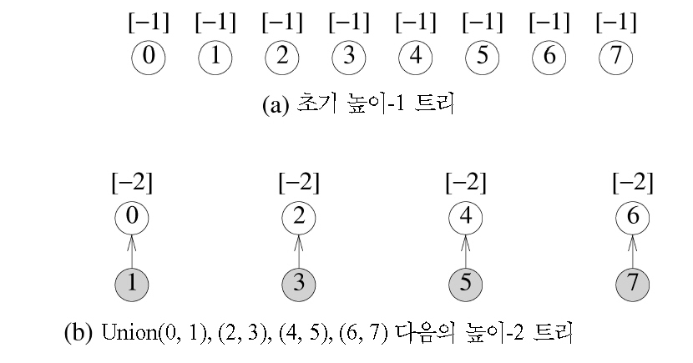
Trees Achieving Worst-Case Bound (1/2)
(a) Initial height-1 trees
(b) Height-2 trees following Union (0,1), (2,3), (4,5), and (6,7)

Slide 66
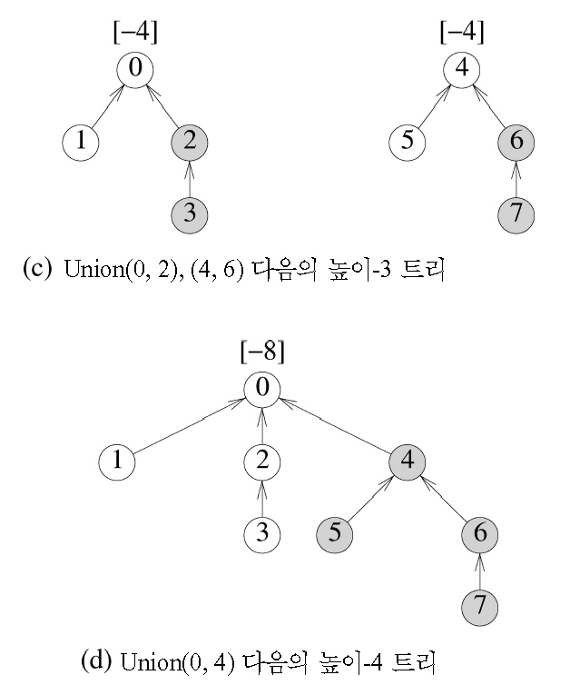
Trees Achieving Worst-Case Bound (2/2)
(c) Height-3 trees following Union (0,2) and (4,6)
(d) Height-4 tree following Union (0,4)

Slide 67
Find Algorithm Using the Collapsing Rule
Collapsing rule
  If j is a node on the path from i to its root and parent[i]≠root(i), then set parent[j] to root(i)
int Sets::CollapsingFind(int i)
{// Find the root of the tree containing element i
// Use the collapsing rule to collapse all nodes from i to the root
for (int r = i; parent[r] >= 0; r = parent[r]); // find root
while( i != r) { // collapse
int s = parent[i];
parent[i] = r;
i = s;
}
return r;
}

Slide 68
Application to Equivalence Classes (1/3)
Processing equivalence pairs
  Equivalence classes are regarded as sets.
  i≡j
    Determine the sets containing i and j
    If these are different, the two sets are replaced by their union.
    Otherwise, nothing to be done
  n polygons, m equivalence pairs
    Set up the initial n-tree forest : O(n)
    2m finds, at most min{n-1,m} unions
    : O(n+mα(2m, min{n-1,m}))

Slide 69
Application to Equivalence Classes (2/3)
[-1]
[-1]
[-1]
[-1]
[-1]
[-1]
[-1]
[-1]
[-1]
[-1]
[-1]
[-1]
0
1
2
3
4
5
6
7
8
9
10
11
(a) Initial trees
[-2]
[-2]
[-2]
[-1]
[-1]
[-1]
[-1]
[-1]
0
3
6
8
2
5
7
11
4
1
10
9
Height-2 trees following 0≡4, 3≡1, 6≡10, and 8≡9

Slide 70
Application to Equivalence Classes (3/3)
[-3]
[-4]
[-3]
[-2]
0
6
3
2
4
7
10
8
1
5
11
9
(c) Trees following 7≡4, 6≡8, 3≡5, and 2≡11
[-5]
[-4]
[-3]
0
6
3
4
7
2
10
8
1
5
11
9
(d) Trees following 11≡0

Slide 71
Counting Binary Trees
Distinct binary trees
  If n=2, # of distinct trees : 2
A
A
and
B
B
  If n=2, 5 distinct trees.

Slide 72
Stack Permutations (1/3)
Preorder seq. ABCDEFGHI, Inorder seq. BCAEDGHFI
  Preorder: A is the root of the tree
  Inorder: BC comprise the left subtree of A, EDGHFI the right subtree
  Preorder: B the next root
  Inorder: B has an empty left subtree, C as the right subtree
  Continuing in this way
A
B,C
D,E,F,G,H,I
A
B
D,E,F,G,H,I
C
A
B
D
C
E
F
G
I
H

Slide 73
Stack Permutations (2/3)
Preorder permutation
  The order in which the nodes are visited during a preorder traversal
Inorder permutation
  The order in which the nodes are visited during a inorder traversal
1
2
4
3
5
6
7
9
8

Slide 74
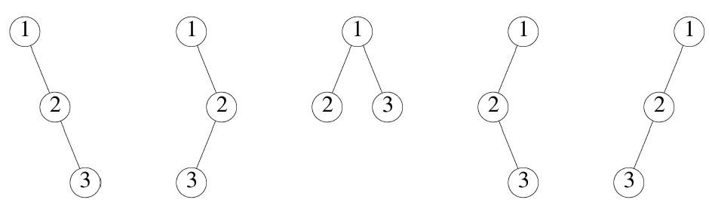
Stack Permutations (3/3)
Distinct binary trees define distinct inorder permutations
# of distinct binary trees with n nodes
= # of distinct inorder permutations from binary trees having the preorder permutation, 1, 2, …, n
= # of distinct permutations obtainable by passing the numbers 1 through n through a stack and deleting in all possible ways

Slide 75
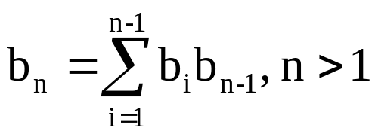
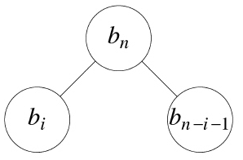
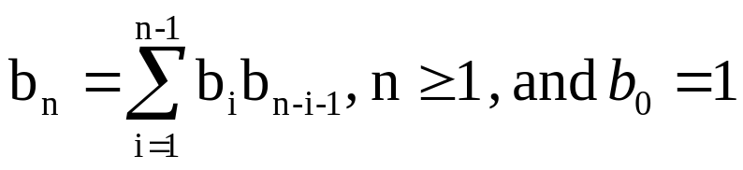
Matrix Multiplication
Product of n matrices
  M₁*M₂*M₃* ... *M_{n}
# of different ways to compute the product
  b₁=2, b₂=1, b₃=2, b₄=5
M_{ij} = M_{i}*M_{i+1}* ... *M_{j}
M_{1n} = M_{1i}*M_{i+1,n}
  # of distinct ways to obtain M_{1i} : b_{i}
  # of distinct ways to obtain M_{i+1,n} : b_{n-i}
b_{n} = a root and two subtrees with b_{i} and b_{n-i-1} nodes

Slide 76
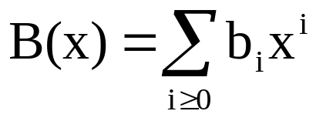
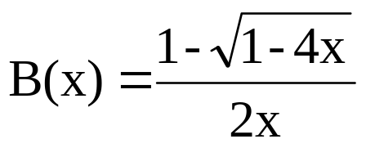
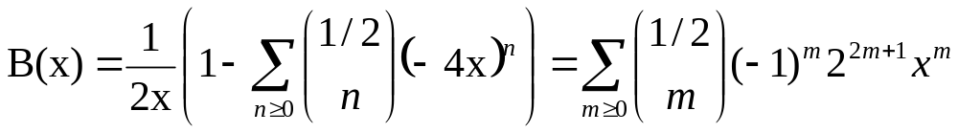
Number of Distinct Binary Trees (1/2)
The generating function for the number of binary trees
By the recurrence relation: xB²(x)=B(x)-1
Solve the quadratics with the fact that B(0)=b₀=1
Expand (1-4x)^{1/2} using the binomial theorem

Slide 77
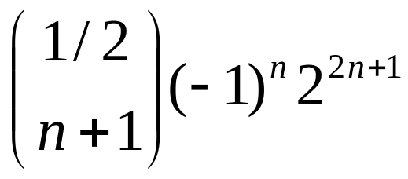
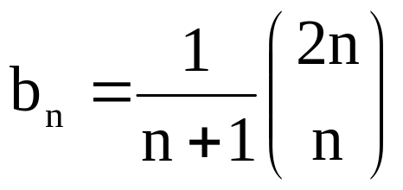
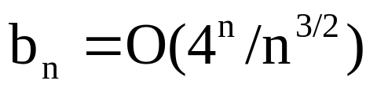
Number of Distinct Binary Trees (2/2)
b_{n} is as follows.

