Slide 1
Chapter 1:
Introduction to the Design and Specification of File Structure

Slide 2
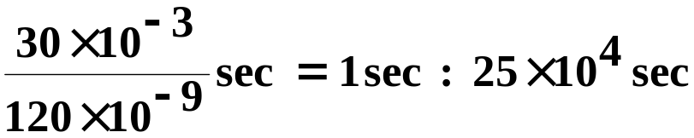
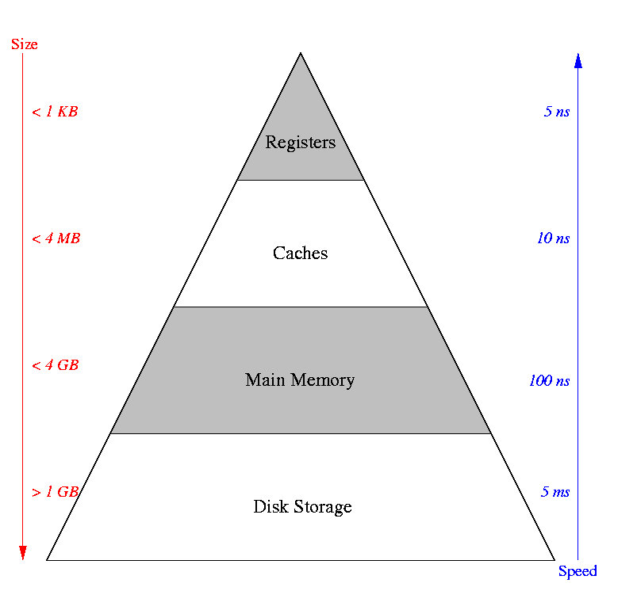
Why is File Structure Design Necessary?
Disks are very slow compared with RAM
How slow is a disk?
RAM : Disk = 120 nanosec : 30 milisec
= 1 sec :
= 1 sec : 2 days and 22 hours
However, disks provide enormous and
nonvolatile capacity at much less
cost than RAM
Dong-Joo Park

Slide 3
What is a Good File Structure Design?
What is a file?
  A set of same kind of records which are stored into secondary memory like hard disk, solid state disk, CD, tape, etc.
What is a file structure?
  A combination of representations for data in files and of operations for accessing the data
Goal of good file structure design
  Allowing us to get the information with as small cost as possible
  Main performance factor: number of disk accesses
Dong-Joo Park

Slide 4
A Short History of File Structure Design (1)
Sequential access
  Accessing records in order, looking at the first, then the next, and so on
  Most files were on tape in early work with files
struct {
  char name[20];
  char telephone[20];
  char address[60];
} phone_book;
Gildong Hong | +82-2-820-0914 | 1-1 Sangdo-dong, Dongjak-gu, Seoul 156-743, Korea
Paul B. Kantor | +1-732-932-1359 | New Brunswick, NJ 08901-1071, USA
Yasushi Ogawa | +81-45-477-1569 | 3-2-3, shin-yokohama, Kohoku-ku, Yokohama-shi 222, Japan
Hans-Peter Frei | +41-1-236-5714 | Ch-8021 Zurich, Bahnhofstrasse 45, Switzerland
Dong-Joo Park

Slide 5
A Short History of File Structure Design (2)
Simple index
  Storage devices like disk drives became available
  Keeping a list of keys and pointers in a smaller file
  Difficult to manage, especially for dynamic files
Index File
Data File
Gildong Hong | 1
Hans-Peter Frei | 301
Paul B. Kantor | 101
Yasushi Ogawa | 201
1 Gildong Hong | +82-2-820-0914 | 1-1 Sangdo- …...
101 Paul B. Kantor | +1-732-932-1359 | New Br …...
201 Yasushi Ogawa | +81-45-477-1569 | 3-2-3, s …...
301 Hans-Peter Frei | +41-1-236-5714 | Ch-8021 …...
Dong-Joo Park

Slide 6
A Short History of File Structure Design (3)
Binary tree : early 1960s
  binary trees can grow very unevenly as records are added and deleted
  ex) insert (A,1), (B,101), (C,201), (K,301), (L,401), (T,501), (Z,601)
A,1
B,101
C,201
K,301
L,401
T,501
Z,601
Dong-Joo Park

Slide 7
A Short History of File Structure Design (4)
AVL tree
  there is a limit on the amount of difference that is allowed between the heights of any two subtrees sharing a common root
x
x
x
x
Dong-Joo Park

Slide 8

A Short History of File Structure Design (5)
Balanced binary tree
  Given N keys, looks at levels of the tree
  ex) insert (A,1), (B,101), (C,201), (K,301), (L,401), (T,501), (Z,601)
K,301
B,101
T,501
A,1
C,201
L,401
Z,601
Dong-Joo Park

Slide 9
A Short History of File Structure Design (6)
B-tree
  A tree structure that provides fast access to data stored in files
  Unlike binary trees, in which the branching factor from a node of the tree is two, the descendents from a node of a B-tree can be a much larger number
B+ tree
  A variation on the B-tree structure that provides sequential access to the data as well as fast-indexed access
Hashing
  An access mechanism that transforms the search key into a storage address, thereby providing very fast access to stored data
Extendible hashing
  Hashing does not work well with dynamic files
  Dynamic hashing that could retrieve information with one or, at most, two disk accesses no matter how big the file becomes
Dong-Joo Park

Slide 10
C++ Language: Using Objects(1)
class Person {
private:
  char name[20];
  int age;
  char address[50];
public:
  Person(char *pname, int page, char *paddress);
  ~Person();
  char* getName();
  int getAge();
  char* getAddress();
  void setName(char *personname);
  void setAge(int personage);
  void setAddress(char *personaddress);
};
Dong-Joo Park

Slide 11
C++ Language: Using Objects(2)
class Student: public Person {
private:
  int year;
  char major[30];
public:
  Student(int syear, char *smajor);
  ~Student();
  char* getMajor();
  int getYear();
  void setMajor(char *smajor);
  void setYear(int syear);
};
Dong-Joo Park

