Slide 1
Chapter 2 :
Fundamental File Processing Operations

Slide 2
Physical Files and Logical Files (1)
Physical file
  A file that actually exists on secondary storage
  A file in file directory that is managed by OS
Logical file
  A file that is seen by the program
  Allowing the program to describe operations to be performed on file not knowing what physical file will be used
Dong-Joo Park

Slide 3
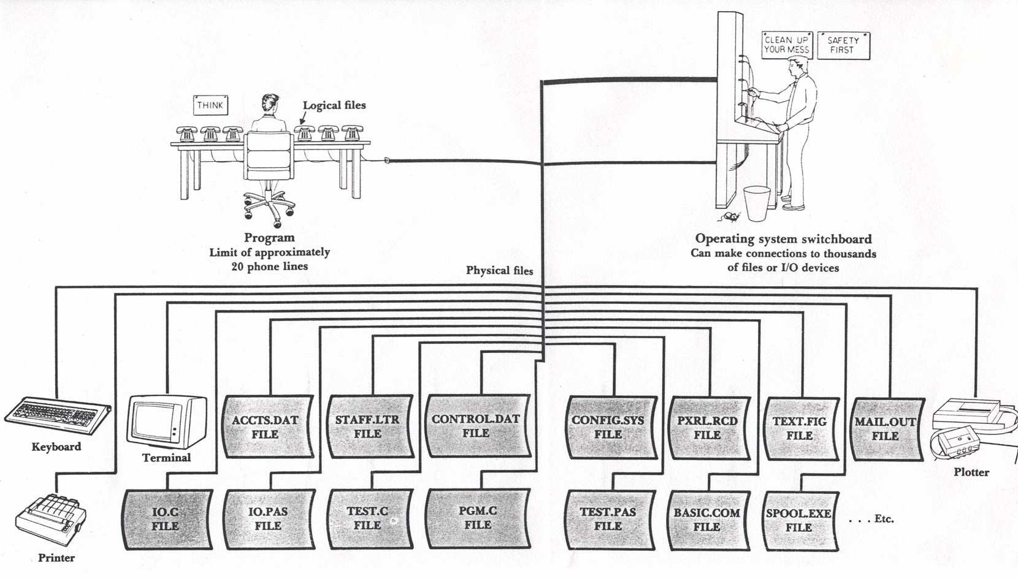
Physical Files and Logical Files (2)
Dong-Joo Park

Slide 4
Connections between Physical files and Logical files
Main frame era:
  by Job Control Language
Unix and DOS era:
  by the instructions within the program (O/S system calls or parts of programming languages)
  ex) select inp_file assign to “myfile.dat” (in COBOL)
    inp_file: logical file, myfile.dat: physical file
  ex) fd = open(“myfile.dat”, O_RDWR) (in C)
    fd: logical file, myfile.dat: physical file
Dong-Joo Park

Slide 5
System Calls vs. C Libraries for File Management
fd = open(filename, flags [, pmode])
fp = fopen(filename, type)
close (fd)
fclose(fp)
lseek(fd, offset, origin)
fseek(fp, offset, origin)
read (fd, buf, size)
fread(buf, num, len, fp)
write (fd, buf, size)
fwrite(buf, num, len, fp)
Dong-Joo Park

Slide 6
Opening files
Two options
  Open an existing file
  Create and open a file
ex) fd = open(filename, flags [, pmode]);
  fd: file descriptor (integer)
  filename: physical file name
  flags: O_APPEND, O_CREAT, O_EXCL, O_RDONLY, O_RDWR, O_TRUNC, O_WRONLY
  pmode(protection mode ): if O_CREAT is used, pmode is required
C streams (in stdio.h)
  file = fopen(filename, type);
Dong-Joo Park

Slide 7
Opening files: Example
pmode = 0751 = 111 101 001 in three-digit octal number
  [owner, group, others] x [read, write, execute]
Examples
  fd = open(fname, O_RDWR|O_CREAT, 0751)
  fd = open(fname, O_RDWR|O_CREAT|O_TRUC, 0751)
  fd = open(fname, O_RDWR|O_CREAT|O_EXCL, 0751)
Dong-Joo Park

Slide 8
Closing files
Closing a file
  Making the logical file name or file descriptor available for use with another file
  Ensuring that everything has been written to the file
  ex) close(fd); (fd: file descriptor)
Dong-Joo Park

Slide 9
Reading & Writing
Input or output operations
  Low-level system calls (Unix)
    read(source_file, destination_addr, size)
    write(destination_file, source_addr, size)
  C streams (in stdio.h)
    fread(), fget(), fwrite(), fput(), fscanf(), fprintf()
Dong-Joo Park

Slide 10
Seeking
Moving directly to a certain position in a file
lseek(source_file, offset, origin)
  source_file: the logical file name
  offset: number of bytes to move from some origin in the file
  origin: the value that specifies the starting position from which the offset is to be taken
in C
  pos = fseek(file, byte_offset, origin)
  origin: SEEK_SET, SEEK_CUR, SEEK_END
Dong-Joo Park

Slide 11
Example Program
#include <stdio.h>
#include <fcntl.h>
main()
{
char c;
int fd; /* file descriptor */
char filename[20];
printf (“Enter the name of the file: “);
gets (filename);
fd = open (filename, O_RDONLY);
lseek (fd, 501L, 0);
while (read(fd, &c, 1) != 0)
write (1, &c, 1);
close (fd);
} /* end of main */
Dong-Joo Park

